Slide 1

Exploratory Data Analysis on AMEO Dataset
By Satyaprakash Sahoo

Slide 2


About me
Hey there , I am Satyaprakash Sahoo currently pursuing my B .Tech from National Institute of Technology , Kurukshetra. I have a passion for turning data into actionable insights. As an enthusiastic Data Science aspirant I possess a solid foundation in manipulating data, visualizing it effectively and performing statistical analysis. I am eager to apply the knowledge gained from my studies to real world scenarios and contribute to decision making processes driven by data .I am proficient in Python (NumPy, Pandas, Scikit-learn), SQL, and more. My toolbox includes Jupyter Notebook, Google Cloud, GitHub, Tableau, Power BI, Matplotlib, and BeautifulSoup . From Exploratory Data Analysis (EDA) to Regression and Clustering, I bring a diverse skill set. My soft skills include effective communication, teamwork, attention to detail, and analytical thinking. Working collaboratively with teams to identify patterns and trends that lead to business success is something that truly excites me .I am enthusiastic, about utilizing my skills and continuous learning mindset to excel in the role of a data scientist.
Connect with me:
https://github.com/Satyaprakash23
linkedin.com/in/sahoosatyaprakash

Slide 3
Objective of the Project
The objective of the analysis is to explore and gain insights into the employment outcomes of engineering graduates using the AMEO dataset .Exploratory Data Analysis is to be done on the dataset provided and the relationships between the features of the data and the target variable Salary are investigated to find any observable patterns or trends in the data to arrive at various important conclusions.
Summary of Data
The dataset was released by Aspiring Minds from the Aspiring Mind Employment Outcome 2015 (AMEO). The study is primarily limited only to students with engineering disciplines. The dataset contains the employment outcomes of engineering graduates as dependent variables (Salary, Job Titles, and Job Locations) along with the standardized scores from three different areas – cognitive skills, technical skills and personality skills. The dataset also contains demographic features. The dataset contains around 40 independent variables and 4000 data points. The independent variables are both continuous and categorical in nature.

Slide 4
Data Cleaning & Manipulation
On performing some Pandas functions on the data related to description of data , it is observed that there is a lot of imbalance in the dataset:
The scales of college GPA are different.
There is some right skewness in salary distribution as there is difference between mean and median of salary.
Columns like ID, college ID, college Tier ,college City ID, College City Tier don't make any sense to measure them.
Lots of impurity in some columns i.e they contain (nan,-1) values.
Hence we drop the unnecessary columns to make our data analysis process better .The columns dropped are 'Unnamed: 0','ID','CollegeID','CollegeCityID’.

Slide 5
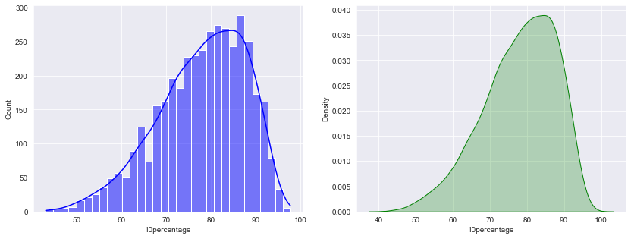
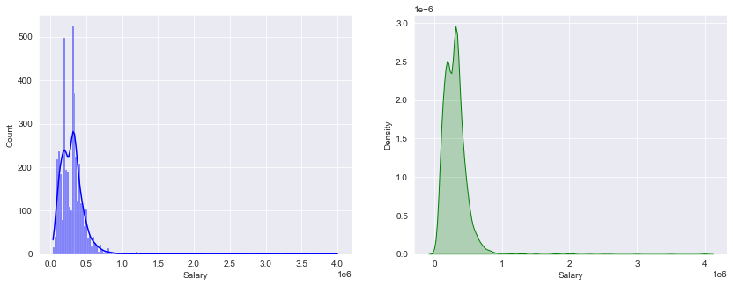
Exploratory Data Analysis
Univariate Analysis
1)Numerical Features:
Salary
Salary of employees is not normally distributed i.e there is a right skewness in salary as there are outliers in the data . The kurtosis is very high and mostly employees got there starting package of Rs 300000.
10th Percentage
Data is left skewed as some candidates didn't perform well in 10th standard which impacts average score of all candidates i.e reduces the average scores as seen above mean= 77.92% & Median= 79.15%. Most of the students score around 79% marks.

Slide 6
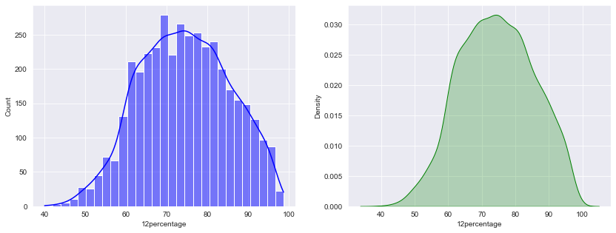
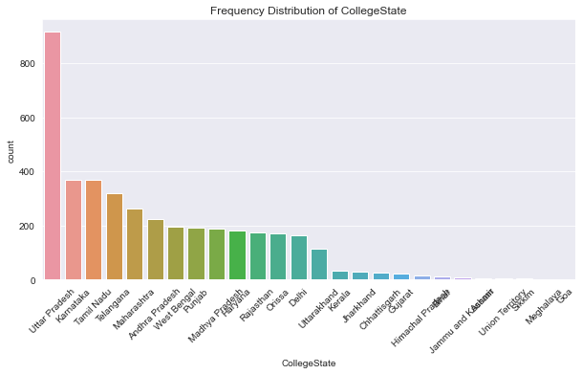
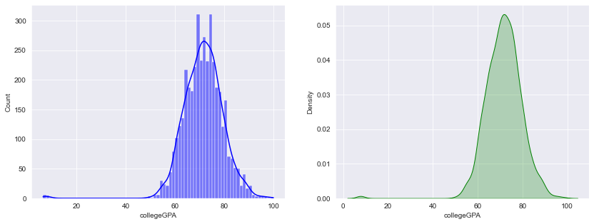
12th Percentage
Data is almost normally distributed.
College GPA
Distribution of college GPA is approximately normal and most of students scored 71.7% in college.
2)Categorical Features:
College State
The most number of people in the data set belong to the state of Uttar Pradesh which is justified as it is the state with the highest population in India.

Slide 7
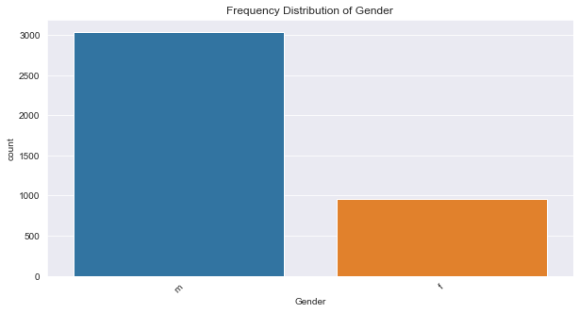
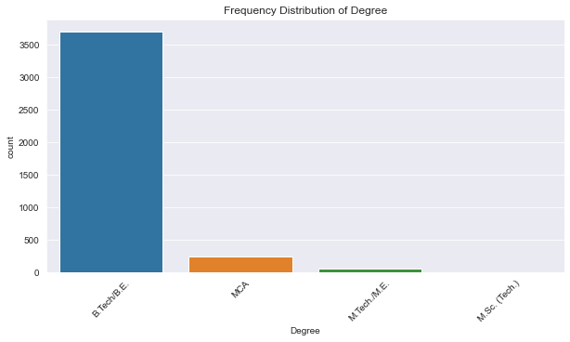
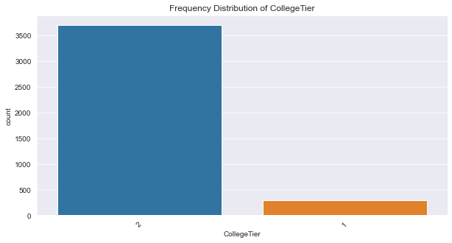
Gender
The number of males in the data is almost three times than women.
College Tier
Most people come from tier 2 colleges as compared to tier 1 colleges.
Degree
Most of the people in the data set are graduates whose highest academic qualification is a bachelor's degree.

Slide 8
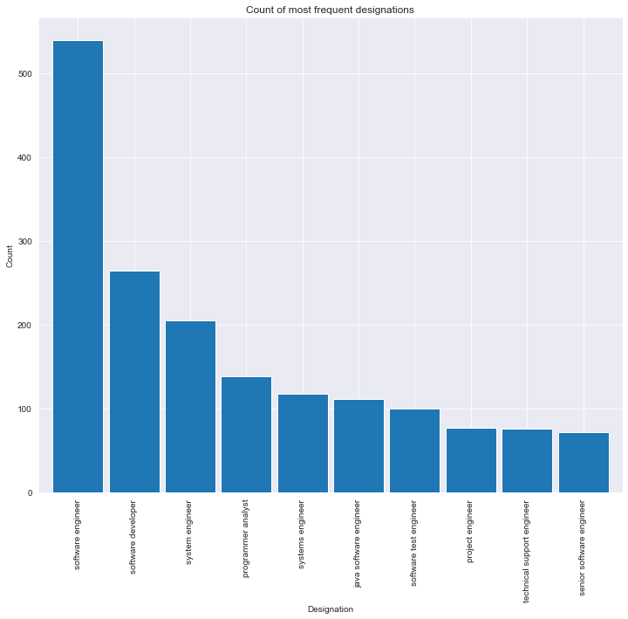
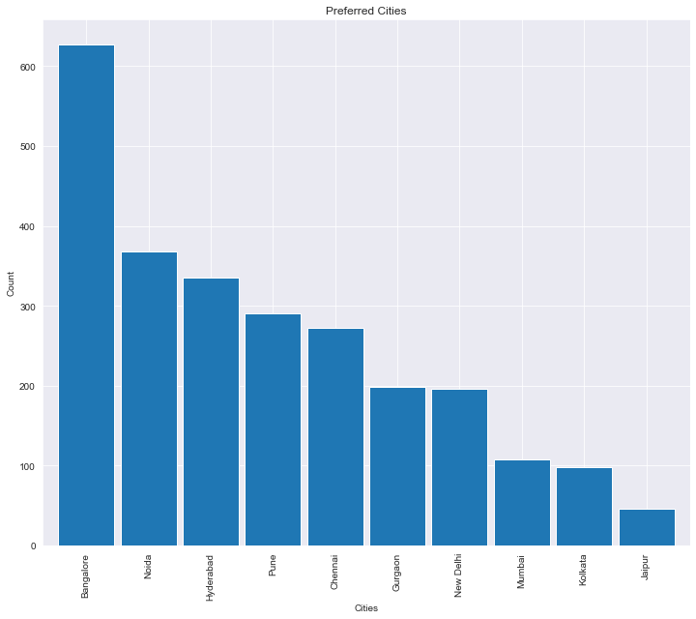
Designation
The software engineering domain is booming at the moment as most graduates prefer pursuing their career in the job roles in this particular domain.
Preferred Cities
Most jobs are offered in the cities of Bangalore followed by Noida and Hyderabad indicating the importance of location in the hiring process.

Slide 9
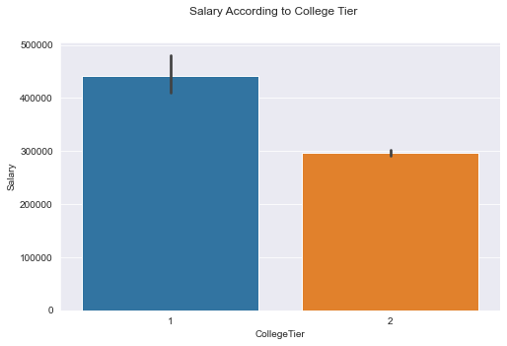
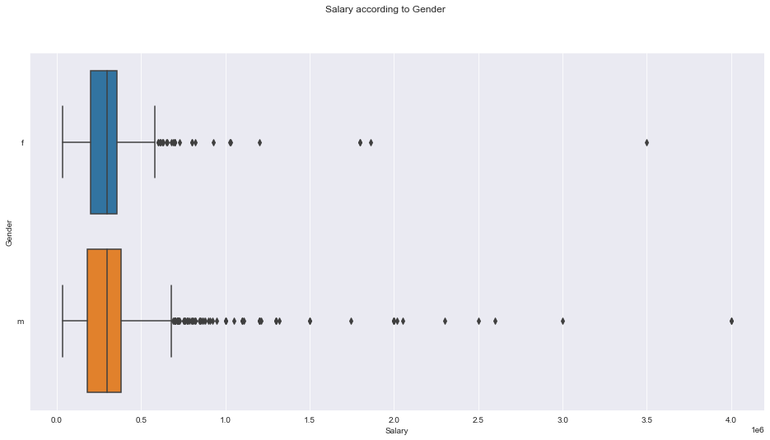
Bivariate Analysis
1)Categorical vs Numerical:
Gender vs Salary
Mean salary of males is slightly greater than females salary.
Median salary earned by both the genders are equal.
College Tier vs Salary
Students with an M.Tech/M.E. degree are paid the highest salaries.
Students graduating from a Tier 1 college are paid higher salaries than students from tier 2 colleges.

Slide 10
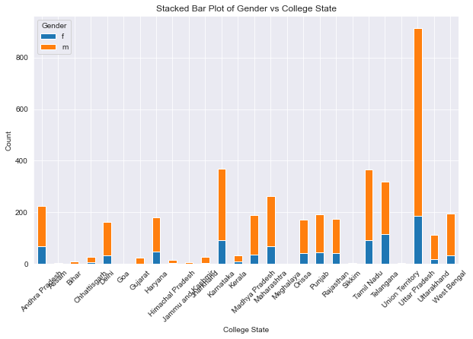
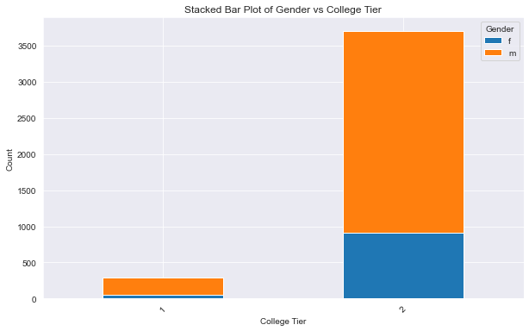
2)Categorical vs Categorical:
College Tier vs Gender
The ratio of male to female students is almost 3:1 in both tier 1 and tier 2 colleges.
College State vs Gender
In every state the number of male students is way higher than female students but in some states like Bihar ,Gujarat ,Haryana ,Jharkhand ,HP & J&K ,the proportion of female students is almost negligible.

Slide 11
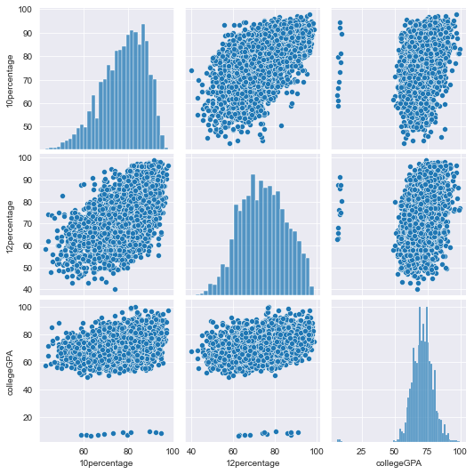
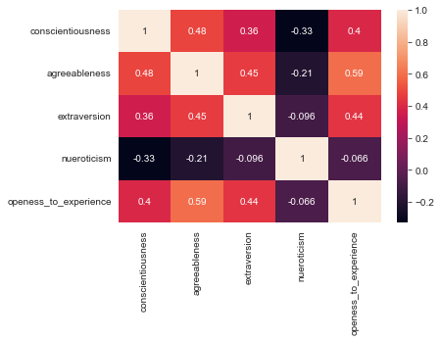
3)Numerical vs Numerical:
Relationships b/w Personality Scores
Trait Independence: Most traits appear to have little to no correlation with each other, indicating the independence of these personality dimensions.
Mild Correlations: Some traits show weak positive correlations, such as Agreeableness with Extraversion and Openness to Experience, hinting at a slight tendency for these traits to co-occur.
Skewed Traits: Openness to Experience and Neuroticism tend to skew towards lower scores.
Relationships b/w Academic Performance
There seems to be a positive correlation between '10percentage' and '12percentage', suggesting that students who perform well in 10th grade also tend to perform well in the 12th grade.
The correlation between '10percentage' and 'college GPA', as well as '12percentage' and 'college GPA', appears to be weaker. This indicates that high school performance does not necessarily predict college performance as strongly.

Slide 12
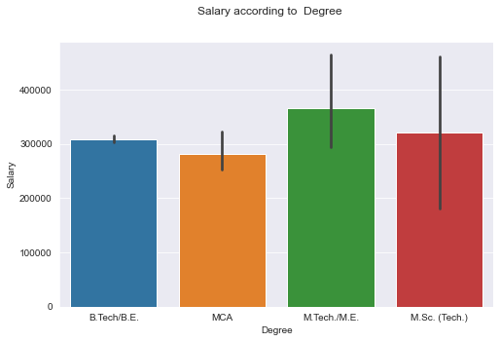
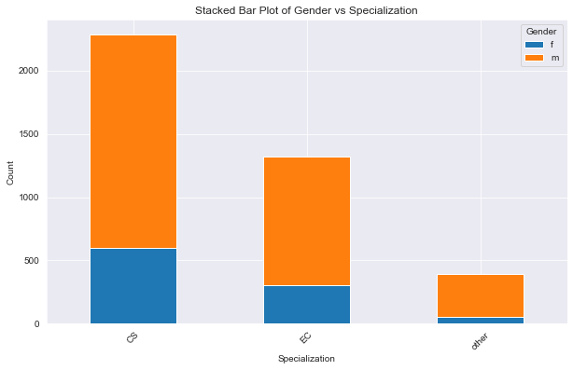
Key Business Questions
Does the preference of Specialization depend on the Gender?
The specialization vs gender plot also follows a similar trend that is the ratio of male to female students is 3:1 in each specialization.
Since the number of female to male students is almost proportionate ,its not really reasonable to say that the preference of specialization depends on gender.
2) Does degree awarded affect salaries of Candidates?
Yes, degree awarded does affect the salaries as students with an M.Tech/M.E. degree are paid the highest salaries which indicates that a Master’s degree bags more salary because of higher level of education than a Bachelor’s degree.

Slide 13
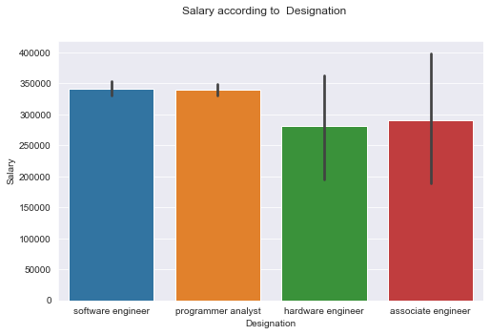
3)“After doing your Computer Science Engineering if you take up jobs as a Programming Analyst, Software Engineer, Hardware Engineer and Associate Engineer you can earn up to 2.5-3 lakhs as a fresh graduate.” Test this claim with the data given to you.
As we can see the mean of the overall salary of
the above four designations which meet the
specified criteria is 339790.4624277457 which is
greater than 3 lakhs.
The mean salaries of each designation
individually is also greater than 2.5 lakhs while
the designations of 'Software Engineer' and
'Programming Analyst’ earn even more than
3 lakhs comfortably.
Hence the claim made in this question is
absolutely justified.

Slide 14
Conclusion
After having done EDA on Aspiring Mind Employment Outcome 2015 (AMEO) dataset ,we have found some interesting insights with the help of univariate and bivariate analysis.
Only ~24% Female candidates pursued graduation.
The average salary across all entries is approximately ₹307,699.
The software engineering domain offers the most lucrative salaries out of all job roles.
Students from tier 1 colleges or with higher GPAs receive higher starting salaries.
The analysis shows the most popular job locations to be Bangalore followed by Noida.
There is a trend that people with higher proficiency in in-demand skills like Computer Programming or with certain domain knowledge bag higher salaries.

Slide 15

THANK YOU

