Slide 1

SEMINAR ON
Smart Farming using IoT, a solution for optimally
monitoring farming conditions
Presented By : Satya Narayan Padhy
Regd. No. : 2201287523
Instructed by : Prof.Sahasranshu Das
GITA Autonomous College,
Bhubaneswar

Slide 2
CONTENT
Introduction
Motivation
Research Strategy
Design
Working
Advantages
Disadvantages
Future Work
Conclusion
References

Slide 3
INTRODUCTION
IoT application in agriculture is must for feeding the global population of 9 billion by 2050.
Agriculture is a crucial sector to ensure food security with the increasing global population
IoT-based smart farming can solve many agriculture-based issues.
IoT in agriculture can improve crop yields and reduce waste.
Smart farming using IoT can optimize farming conditions and increase productivity

Slide 4
MOTIVATION
To provide a cost-effective and efficient solution for farmers to monitor
farming conditions.
To improve crop yields and reduce waste using IoT-based smart farming.
To optimize farming conditions and increase productivity.
To ensure food security with the increasing global population.
To provide real-time monitoring and control of farming conditions.

Slide 5
RESEARCH STRATEGY
Literature Review: Study existing research papers and articles on IoT-based smart farming.
Case Studies: Analyze successful implementations of IoT-based smart farming systems.
Surveys and Interviews: Conduct surveys and interviews with farmers to understand their
needs and challenges.
Experimental Research: Design and develop a prototype of an IoT-based smart farming system.
Data Analysis: Collect and analyze data from the prototype system to evaluate its effectiveness.

Slide 6
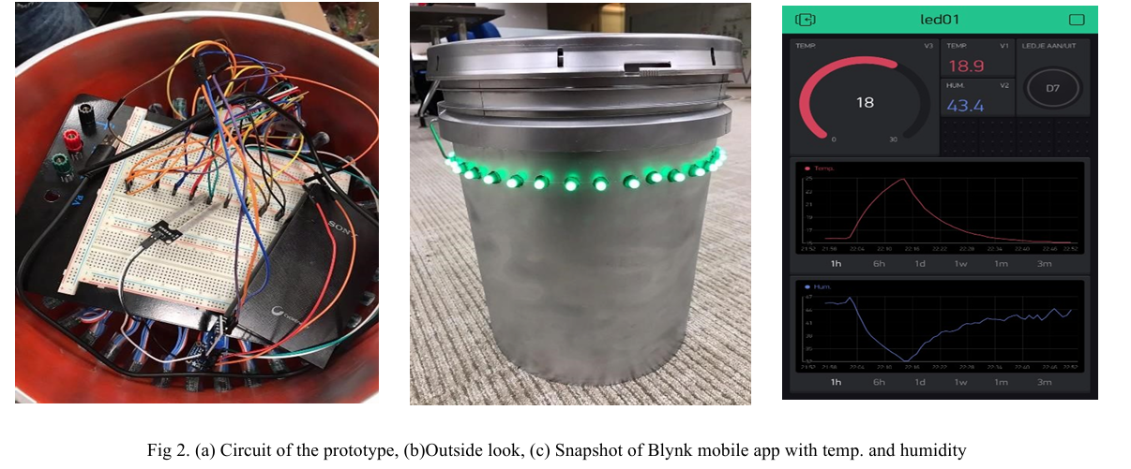
Design

Slide 7
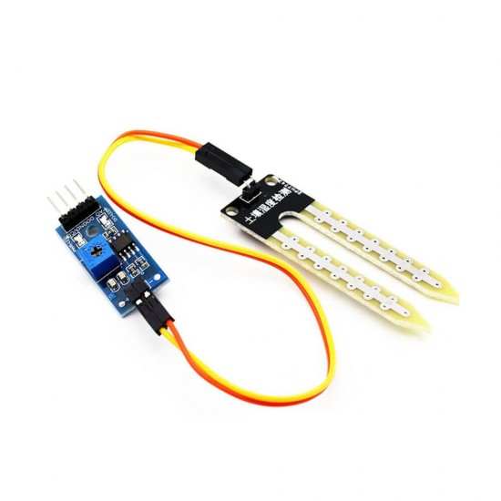
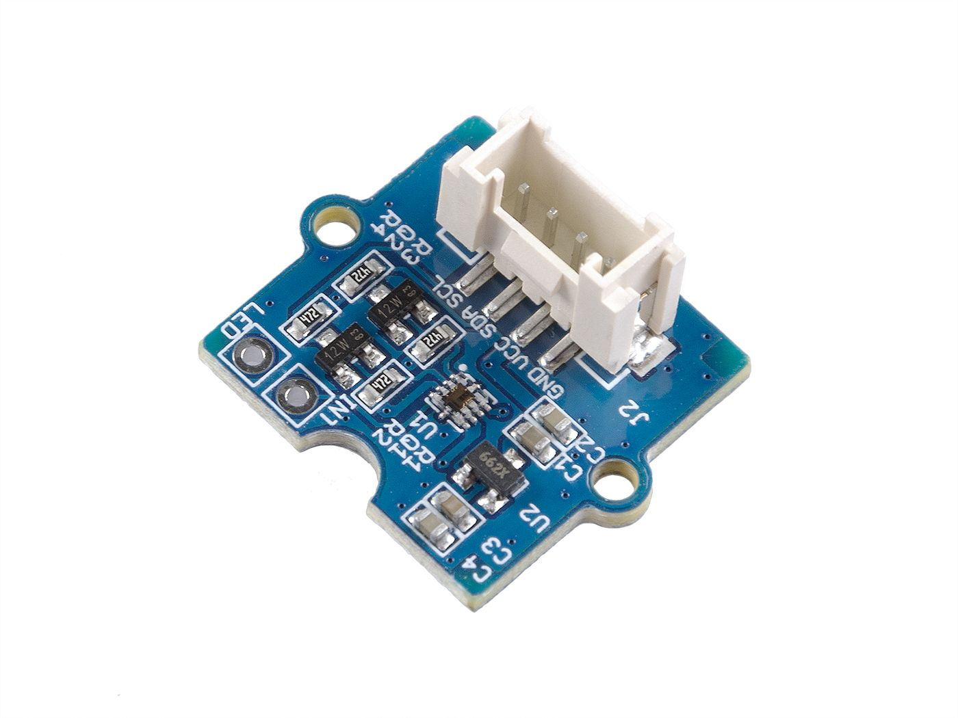
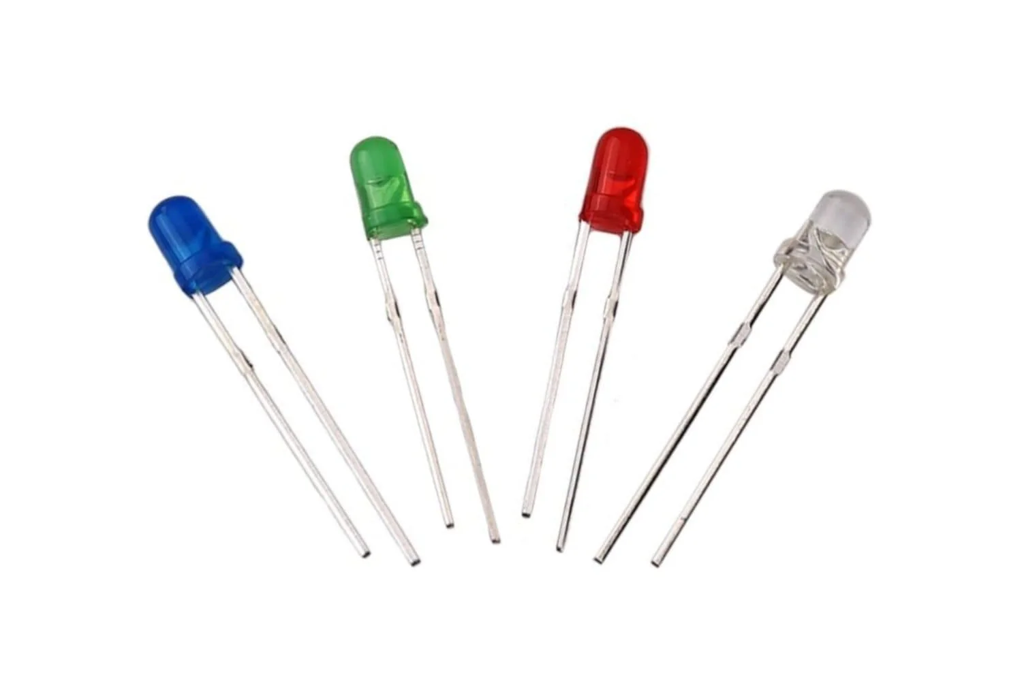
Components used in proposed product
Soil Moisture Sensor - Use: Tracks soil moisture levels. - Feature: Real-time monitoring and alerts for optimal watering.
Soil Moisture Sensor
SI1145 Sensor - Use: Measures light intensity for optimal plant growth.
Feature: Measures UV, IR, and visible light indices for comprehensive light analysis.
SI1145 Sensor
LEDs - Use: Provides visual alerts and status updates. - Feature: Low power consumption and long lifespan.
LEDs

Slide 8
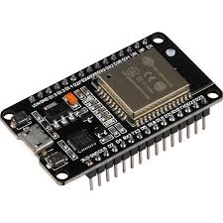
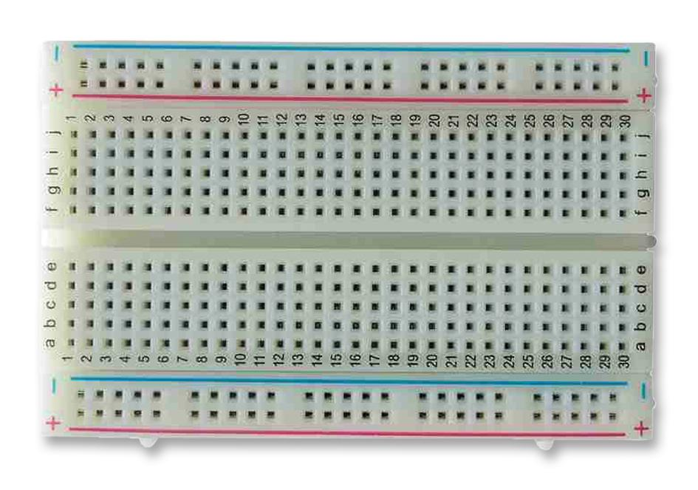
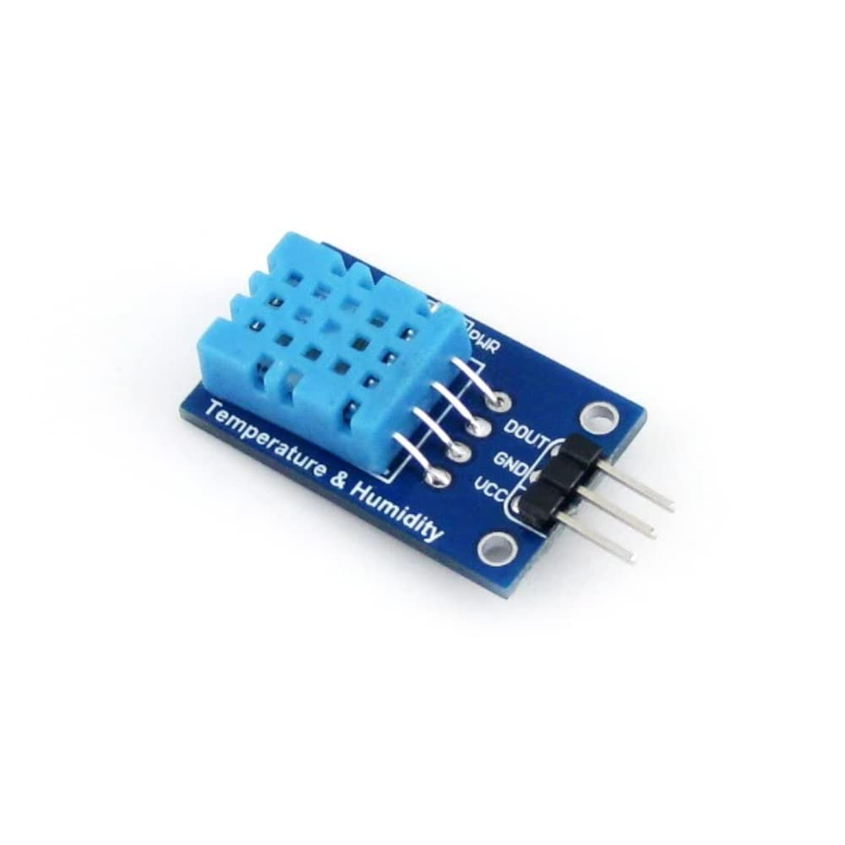
Components used in proposed product
ESP32s Node MCU - Use: Controls and connects the entire smart farming system.
Feature: Wi-Fi and Bluetooth connectivity for remote monitoring.
ESP32s Node MCU
Breadboard - Use: Holds and connects electronic components.
Feature: Reusable and flexible for prototyping and testing.
Breadboard
DHT11 Temperature and Humidity Sensor - Use: Monitors temperature and humidity.
Feature: High accuracy and reliability in measuring temperature and humidity.
DHT11 Temperature
and Humidity Sensor

Slide 9
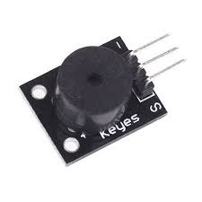
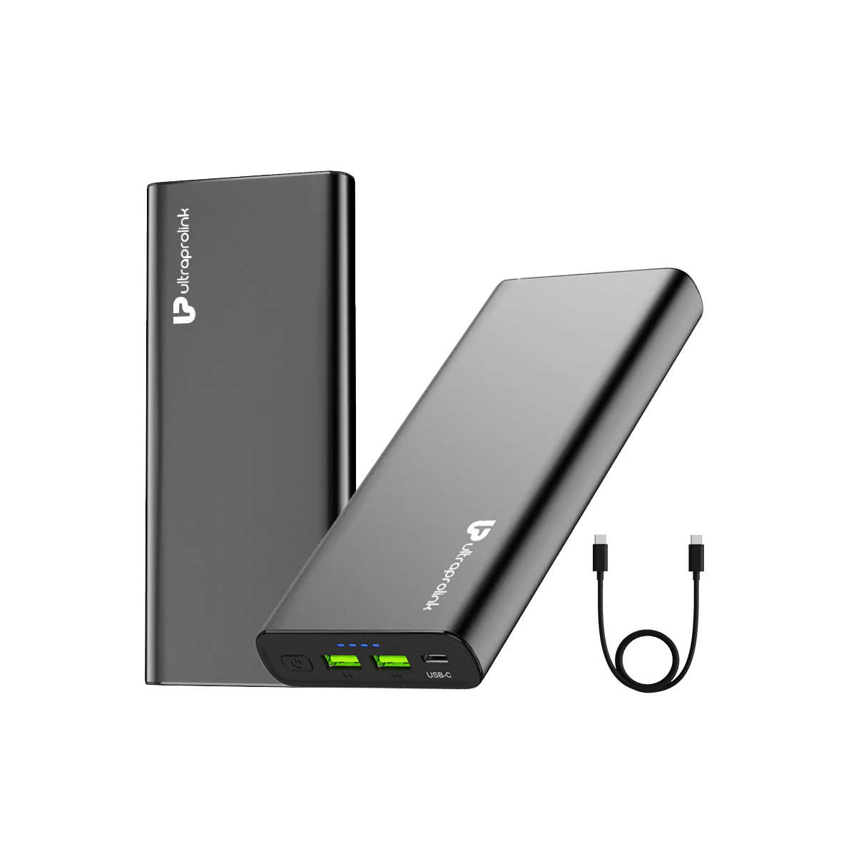
Components used in proposed product
KY-006 Passive Buzzer - Use: Generates audible alerts and notifications.
Feature: Adjustable volume and tone for customized alerts.
KY-006 Passive Buzzer
Power Supply (Power Bank) - Use: Powers the entire smart farming system.
Feature: Portable and rechargeable for convenient power management.
Power Supply (Power Bank)

Slide 10
WORKING
We used ESP32s node MCU, which is wireless and Wi-Fi enable.
2) Connected to the breadboard: ESP, DHT11, soil moisture sensor, buzzer, LEDs, and SI1145 sensor, using jumper wires.
3)ESP32 goes to sleep after every 18 minutes,
wakes up, takes the reading, upload it on the Blynk app cloud to feed the live data and goes to sleep mode again.
4) LEDs retain their state, providing visual alerts. Colors (red, blue, violet) and buzzer sounds (one, two) indicate different notifications.
5) In the prototype model, bucket is used.
Here the soil moisture sensor is fitted at the bottom and temperature humidity sensor,
Digital UV Index sensor and the buzzer are placed at the top by putting a whole in the cover.
6) We give power with the help of a 6000 mAh power bank,
so after uploading the code the system works on itself.

Slide 11
WORKING
The sleep mode also helps to save power to increase the life of the power bank. We are using ESP32, which has a power pin of 3.3V as well as 5V, here we connect sensors to 5V pin and the max operating voltage of the sensors are 5V. Now, for the power consumption calculation we need currents as well. Operating current for every component is as follows.
ESP32s node MCU (Active mode)- 40mA (CPU + electronics)
ESP32s node MCU (sleep mode)- 3.5 mA (sleep + electronics)
DHT11-1.5mA
Soil moisture- 5 mA
UV light/IR sensor- 2 mA
LED stipe (12V LEDs)- 1mA
Calculation of power consumption per hour for sleep mode, (2 minutes active, 18 minutes sleep mode) = 54/60*(3.5+1.5+5+2+1) + 6/60*(40+1.5+5+2+1) =54/60(13) + 1/10*(49.5) =16.65 mA per hour When we used 6000mAh power bank, So now capacity=6000 mAh Formulae, Capacity=Amp*hours(current*time) So, Hours= 6000/16.65 =360.36
Converting that to days, =360.36/24 =15 days approx. Calculation of power consumption per hour for active mode, =49.5 amps In days, =6000/49.5*24 =5 days Thus, by entering sleep mode life of the power bank gets extended by 10 days

Slide 12
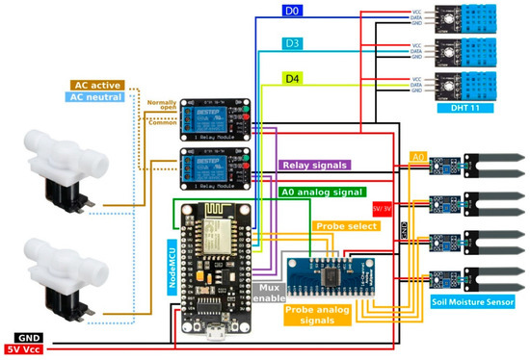
CONTROL ALGORITHM
Figure 2. A block diagram of the circuit.

Slide 13
Advantages
Disadvantages
Increased Efficiency
Improved Crop Management
Enhanced Decision-Making
Reduced Water and Energy Consumption
Increased Crop Quality
1.High Initial Investment
2.Technical Complexity
3.Data Security Concerns
4.Dependence on Internet Connectivity
5.Limited Scalability

Slide 14
Future Work
We developed a system with three notification mediums: LEDs, Blynk mobile app, and buzzer alerts. Future enhancements include:
Expanding the network with multiple prototypes connected via Bluetooth
Integrating artificial intelligence for autonomous decision-making
Implementing data mining algorithms for improved decision-making
Incorporating drone technology for 3D mapping and monitoring
Integrating with Soracon Lagoon dashboard for in-depth analysis

Slide 15
Conclusion
From our results and literature survey of other papers, we saw that the hardware and materials we used to develop our porotype allowed us to make an efficient and accurate, as well as cheap product for farmers. Which was economical and easily installable for farmers as well. Thus, we can conclude that this porotype will definitely help farmers in small farmland to effectively monitor their crops with the user-friendly app and other alert means.

Slide 16
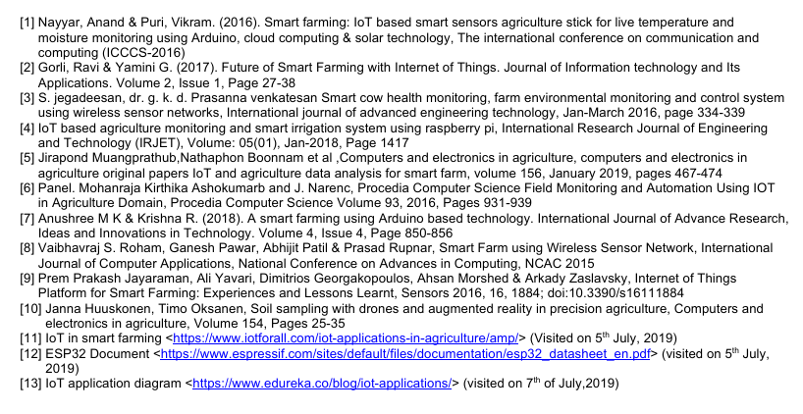
REFERENCES

Slide 17
