Slide 1

Sprocket Central Pty Ltd
Data analytics approach
[Division Name] - [Engagement Manager], [Senior Consultant], [Junior Consultant]

Slide 2
Agenda
Introduction
Data Exploration
Model Development
Interpretation

Slide 3
Introduction
Analytics for Sprocket Central
We have find different types of insights using the datasets provided by the company and we want to show some valuable insights.

Slide 4
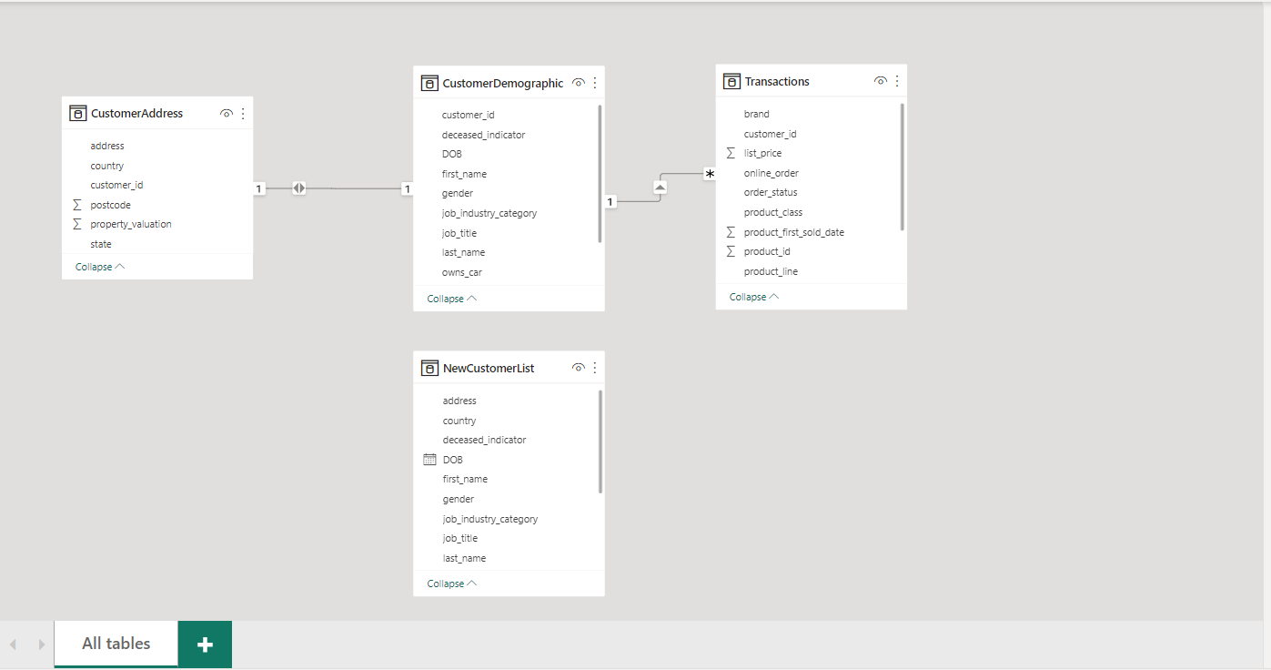
Data Exploration
For Data Exploration I have used Power Query Editor.
I have done some analysis and created some extra columns to obtain age insights .
Removed extra useless columns and created a copy of dataset.

Slide 5
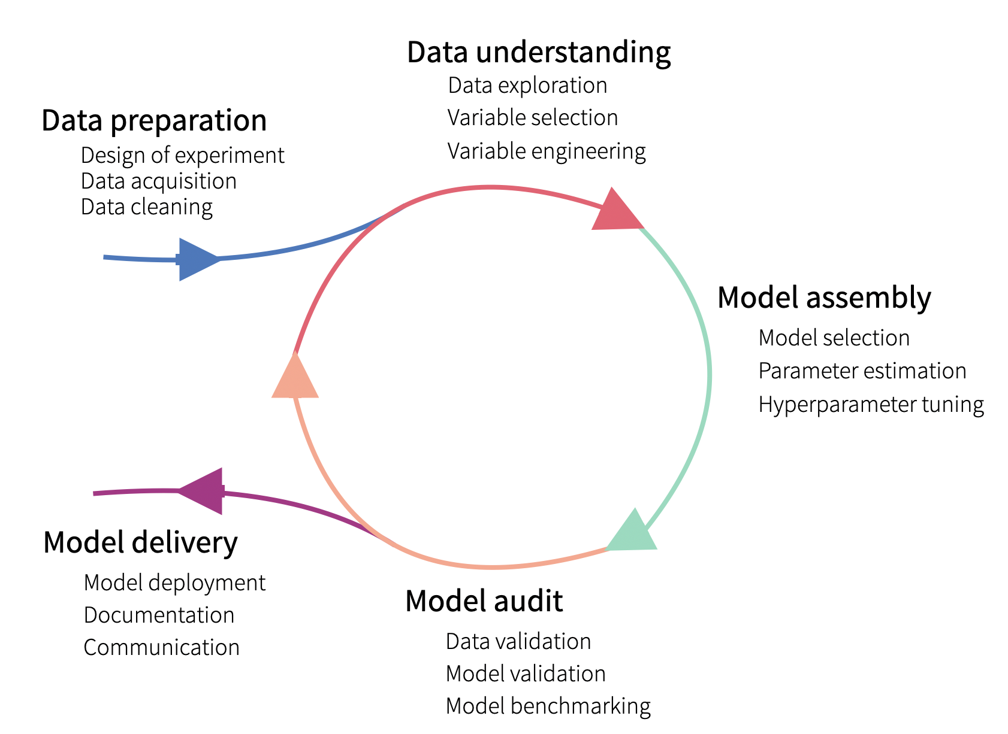
Model Development
This is the Model we will be working with

Slide 6
SATYARTH SRIVASTAVA

