Slide 1



IT_Spend_Report
View in Power BI
Last data refresh:
6/7/2024 12:13:51 AM UTC
Downloaded at:
6/7/2024 12:23:19 AM UTC

Slide 2
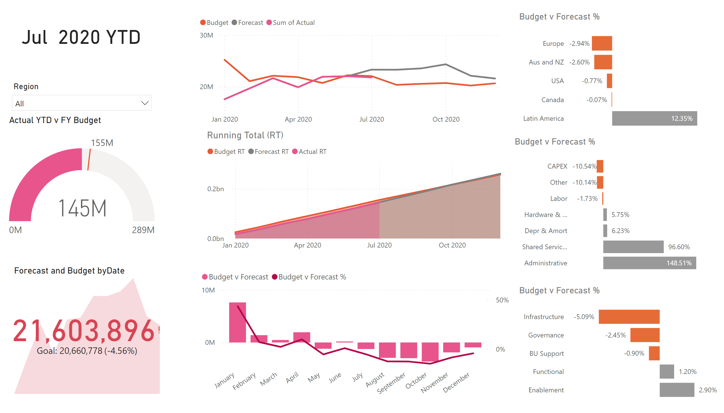
Headline
Notes:
Actual YTD v FY Budget
No alt text provided
Forecast and Budget byDate
No alt text provided
lineChart
No alt text provided
Running Total (RT)
No alt text provided
Running Total (RT)
No alt text provided
Budget v Forecast %
No alt text provided
Budget v Forecast %
No alt text provided
Budget v Forecast %
No alt text provided
slicer
No alt text provided
card
No alt text provided

Slide 3
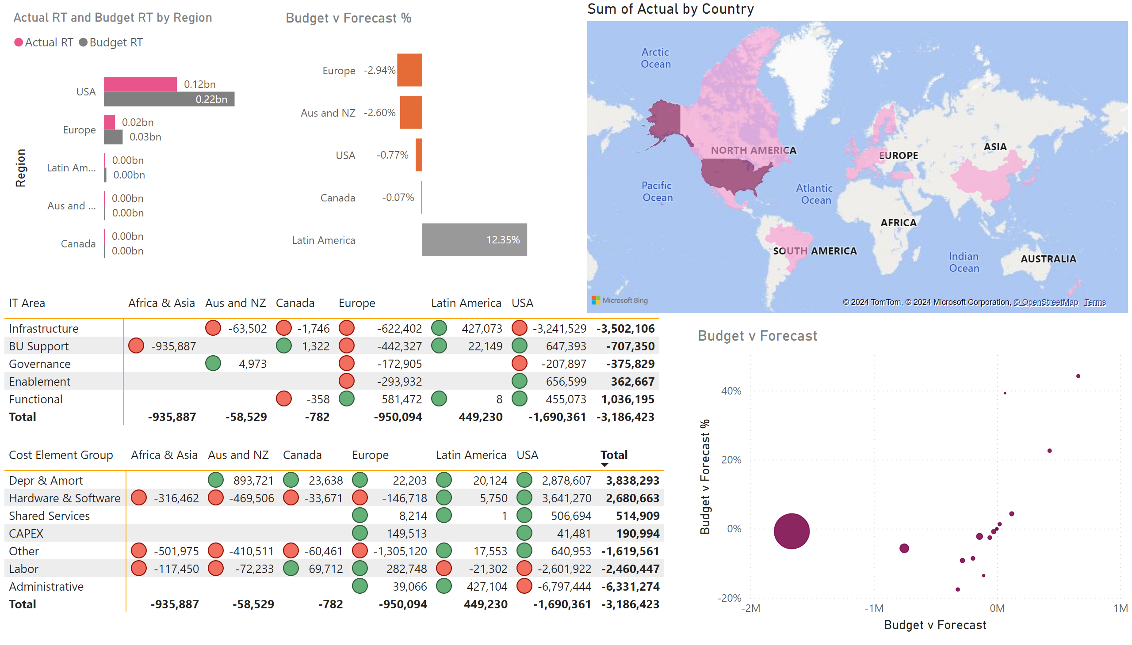
Regions
Notes:
clusteredBarChart
No alt text provided
Budget v Forecast %
No alt text provided
pivotTable
No alt text provided
pivotTable
No alt text provided
filledMap
No alt text provided
Budget v Forecast
No alt text provided

Slide 4
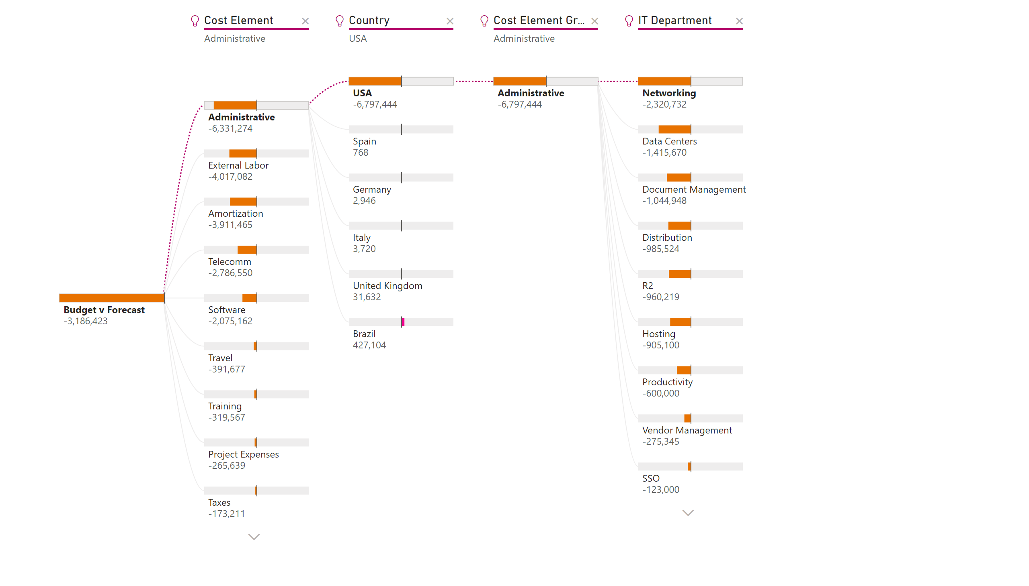
Decomposition
Notes:
decompositionTreeVisual
No alt text provided

