Slide 1
MENTOR-GUIDED INTERNSHIP PROJECT
Job Skill Extraction
Using NLP
Turning 5,000 unstructured job postings into a structured, searchable skill taxonomy — from rule-based matching to a fine-tuned transformer, evaluated end-to-end and shipped as a working app.
Satyam Singh
Data Analyst Intern
01

Slide 2
THE PROBLEM
Job skills live in free text, not in fields
Job postings describe required skills in unstructured paragraphs. Recruiters, job seekers, and workforce analysts all need those skills in structured form — but reading and tagging postings by hand doesn't scale, and it's inconsistent from one reviewer to the next.
RAW JOB DESCRIPTION
“We are looking for a Data Analyst with strong experience in Python, SQL, Power BI, AWS and PostgreSQL to support reporting and dashboards…”
!
Slow
Manually reading 5,000+ postings to tag skills is not feasible at scale.
WHAT WE ACTUALLY NEED
Inconsistent
Python
SQL
Power BI
AWS
!
Different reviewers extract different skills from the same text.
PostgreSQL
!
Unsearchable
Free text can't be filtered, counted, or trended without structure.
02

Slide 3
WHY IT MATTERS
One extraction engine, three audiences
R
J
A
Recruiters
Job Seekers
Workforce Analysts
Auto-tag postings with structured skills so listings become filterable and searchable instead of free text.
Compare a resume against a posting's extracted skills to see exactly where the gap is.
Aggregate extracted skills across thousands of postings to see which skills are rising in demand.
Same extraction pipeline, three downstream products: an application, an analytics dashboard, and a skills taxonomy.
03

Slide 4
THE DATA
5,000 real job postings, 23 fields
5,000
23
66+
2021–2023
Job postings
Columns
Unique job titles
Posting date range
Top job titles by posting count
Fields captured per posting
Role
job_title · role · job_description · responsibilities
Requirements
qualifications · experience · skills
Logistics
work_type · salary_range · location · country
Company
company · company_size · company_profile · benefits
Descriptions are templated: the same wording repeats across many postings for a given role.
04

Slide 5
PREPARATION
Cleaning before extraction
01
02
03
04
Missing & Duplicate Check
Schema Standardization
Date Parsing
Text Normalization
Audited every column for nulls; checked job_id for duplicate postings.
Column names normalized to lowercase snake_case for consistent access.
job_posting_date parsed to datetime; posting_year extracted for trend analysis.
Descriptions lowercased, punctuation and stopwords stripped for EDA and matching.
Why this mattered later
The dataset's heavy templating — identical description text reused across many postings — wasn't just a cleaning note. It turned out to be the root cause of a major modeling bug found later (Slide 12).
05

Slide 6
EXPLORATION
What the descriptions look like
24.3
186
1.6
avg. words / posting
avg. characters
avg. sentences
Most frequent words (post-cleaning)
Postings by year
06

Slide 7
SYSTEM DESIGN
End-to-end extraction pipeline
1
2
3
4
5
Clean Text
→
Rule-Based Match
→
ML / Transformer
→
Evaluate
→
Ship
Normalize & tokenize descriptions
Taxonomy regex + spaCy PhraseMatcher
Category classifier + fine-tuned NER
Precision / Recall / F1 vs. labeled sample
API + dashboard + app
Four extraction methods were built and compared head-to-head (Slides 8–11) before choosing what to ship.
07

Slide 8
METHOD 1 & 2
Rule-based skill matching
A custom skill taxonomy was built by hand and matched against every description two ways: exact-phrase regex, and a spaCy PhraseMatcher for a second, independent pass over the same vocabulary.
STRENGTHS
• Fast — millisecond inference, no GPU
• Fully explainable — exact synonym that matched
• No training data required
37
368
1,166
Skill categories
Canonical skills
Synonyms indexed
LIMITATIONS
Example match
• Only catches wording already in the taxonomy
• Misses paraphrased or novel phrasing
• Taxonomy must be maintained by hand
“...experience in Power BI and PostgreSQL...”
→ canonical_skill: "Power BI", category: "Business Intelligence"
→ canonical_skill: "PostgreSQL", category: "Database"
08

Slide 9
METHOD 3
TF-IDF + Logistic Regression classifier
A classifier was trained to predict skill category from description text using TF-IDF features.
BEFORE — 100% test accuracy
AFTER — group-aware split
Random train/test split let identical, templated description text land on both sides — the model memorized text→label pairs instead of learning.
GroupShuffleSplit keyed on the description text itself — every duplicate of a template now stays entirely in train or entirely in test.
Proof: tested on a genuinely novel sentence
Verification built into the notebook
“Python developer... Django, REST API” predicted: “UI/UX Design” (25% confidence)
A dedicated check confirms zero description templates appear in both train and test — leakage is provably closed, not just assumed fixed.
09

Slide 10
METHOD 4
From zero extraction to a fine-tuned NER model
1
2
3
Pretrained dslim/distilbert-NER
Weak Supervision
Fine-Tuned Model
General-purpose model — only knows PERSON / ORG / LOC / MISC. No SKILL entity type exists.
→
Taxonomy regex spans auto-generate BIO labels (B-SKILL / I-SKILL / O) — no manual annotation needed.
→
DistilBERT fine-tuned as a token classifier on the auto-labeled spans, with a real SKILL entity head.
0 skills extracted
Zero-cost training data
Real extraction capability
10

Slide 11
EVALUATION
Four methods, evaluated on the same labeled sample
Precision / Recall / F1 on a 100-row hand-labeled evaluation set, scored against canonical taxonomy skill names.
WINNER
spaCy
PhraseMatcher
F1 = 0.55, narrowly ahead of the Taxonomy matcher (0.53). Both dictionary methods beat both transformer variants.
Production choice: union (ensemble) of Taxonomy + spaCy — they don't fully overlap, so combining raises recall further.
11

Slide 12
DEBUGGING THE PIPELINE
Four bugs found and fixed along the way
1
Train/test leakage
Duplicate description templates split across train and test → fixed with GroupShuffleSplit.
2
Transformer had no SKILL class
Pretrained NER only knows PERSON/ORG/LOC/MISC → fixed via weak-supervision fine-tuning.
3
Mismatched evaluation samples
Day-14 and Day-15 samples were two different random draws merged incorrectly → 64% of rows had no ground truth → fixed by generating all predictions on one shared labeled sample.
4
Ground-truth vocabulary mismatch
Hand-written labels used different wording than the taxonomy's canonical names, deflating every method's score → fixed by relabeling against the real taxonomy vocabulary.
12

Slide 13
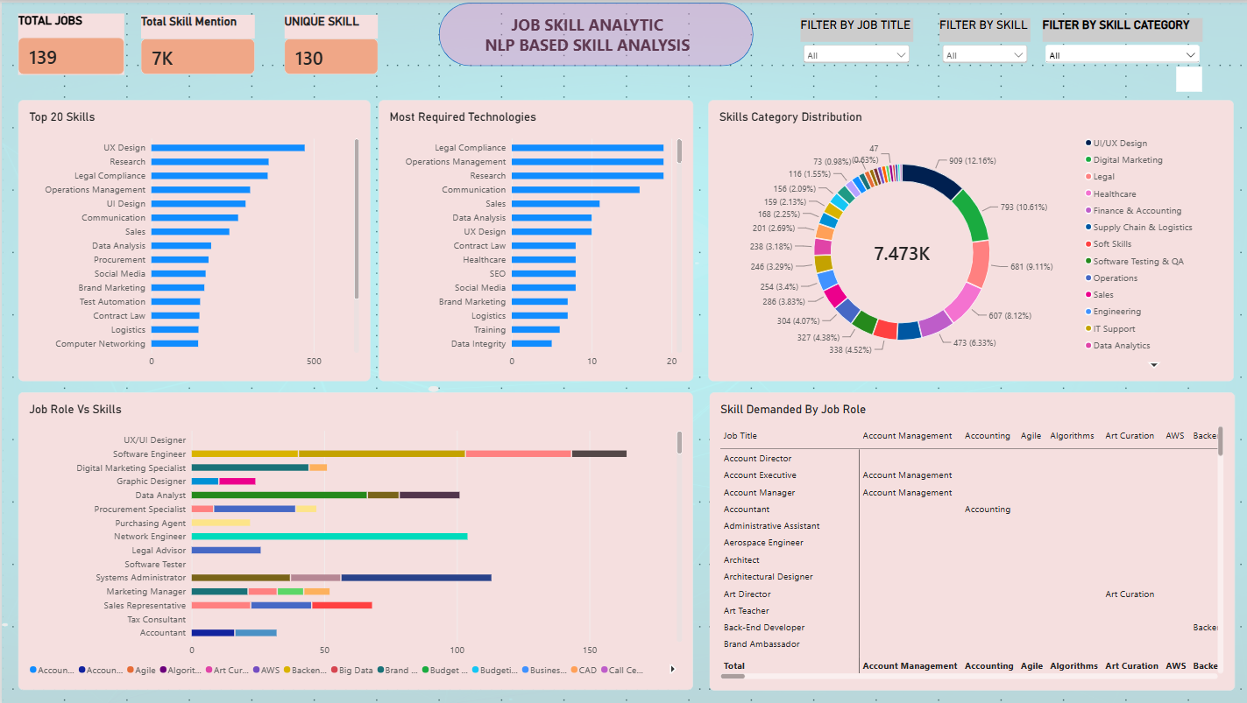
ANALYTICS
Power BI: Job_Skill_Analytics.pbix
Extracted skills exported as one row per (job, skill) pair and visualized as a business dashboard.
KPI Cards
Total Jobs
Unique Skills
Top Skill
Top Job Role
Top Skill Category
Most Required Technology
Charts
Top 20 Skills
Skill Demand by Job Role
Skill Category Distribution
Skill Trends
Bar chart ranked by mention count
Matrix: role × skill, filterable
Donut across taxonomy categories
Line chart by posting year
13

Slide 15
LIVE DEMO
From notebook to working web app
BACKEND — FastAPI
FRONTEND
• Loads the taxonomy once at startup, not per request
• Single endpoint: POST /extract-skills
• Runs Taxonomy + spaCy union — the winning ensemble
• Deployed independently (Render / Railway / Fly.io)
Paste a description → get categorized skill chips back
Looking for a Data Analyst with SQL, Excel and Power BI experience...
Data Analytics
SQL
Excel
Power BI
POST /extract-skills
{ "job_description": "..." }
→ { "skills": [{"canonical_skill": "SQL",
"category": "Database"}, ...] }
Found 3 skill(s).
Extract Skills
14

Slide 16
WRAP-UP
What this project delivered
4
0.55
1
1
Extraction methods built & compared
Best F1 (spaCy PhraseMatcher)
Working web app (FastAPI + frontend)
Power BI analytics dashboard
Beyond the numbers, the real work was diagnostic: every headline metric in this project — the 100% classifier accuracy, the zero-extraction transformer, the 1.8% evaluation accuracy — turned out to be a bug, not a result. Tracing each one back to its root cause, fixing the pipeline, and re-measuring honestly is what made the final comparison trustworthy.
Production recommendation: ship the Taxonomy + spaCy ensemble now; keep improving the fine-tuned transformer in parallel.
15

Slide 17
ROADMAP
Where this goes next
1
Widen taxonomy coverage
2
Train the transformer further
Recall is still ~45% — use Day-16 false negatives to add missing synonyms.
More epochs and more weakly-labeled spans; try a larger base model.
3
Resume-to-job matching
4
Harden the deployment
Extract skills from a resume and score the gap against a target posting.
Add auth, rate limiting, and monitoring before opening the API publicly.
5
Refine multi-label classification
6
Skill-trend forecasting
Predict all skill categories per posting, not just the dominant one.
Use posting_date to project rising and declining skill demand over time.
16

