Slide 1
ANALYSIS ON LEAF DATA FOR DECISION MAKING LEAF-THE FITNESS TRACKER OF BELLABEAT
BELLABEAT A USA BASED COMPANY
PRESENTED TO –
MR.VANDIT HEADAU
BY – SATYENDRA SINGH
DS5B-2132 -MSc II SEM

Slide 2

BELLABEAT-
Bellabeat is a successful small company, but they have the potential to become a larger player in the global smart device market. Urška Sršen, cofounder and Chief Creative Officer of Bellabeat, believes that analyzing smart device fitness data could help unlock new growth opportunities for the company.
PRODUCTS OF BELLABEAT
Leaf: A fitness Tracker
Time: Wellness Watch
Spring: Water Bottle –daily water intake

Slide 3
OBJECTIVE-
HOW CAN A WELLNESS TECHNOLOGY COMPANY(Bella-beat) PLAY IT SMART ?
AND MAKE DECISIONS TO ATTRACT ITS CUSTOMER
What are some trends in smart device usage?
How could these trends apply to Bellabeat customers?
How could these trends help influence Bellabeat marketing strategy?

Slide 4
LIBRARY USED -
library(ggplot2)
library(dplyr) #for pipeline and for printing table info like summary,row ,columns etc
install.packages("skimr")
library(skimr) # for generating summary of the dataset
library(tidyverse)
library(lubridate) #for date and time
library(stringr)

Slide 5
IMPORTING DATASET
daily_activity<-read_csv("D:/google cert/case_2/dailyActivity_merged.csv")
View(daily_activity)
daily_sleep<-read_csv("D:/google cert/case_2/sleepDay_merged.csv")
View(daily_sleep)
hourlyintensities<-read_csv("D:/google cert/case_2/hourlyIntensities_merged.csv")
View(hourlyintensities)
Metsperminute<-read_csv("D:/google cert/case_2/minuteMETsNarrow_merged.csv")
View(Metsperminute)
weightloginfo<-read_csv("D:/google cert/case_2/weightLogInfo_merged.csv")
View(weightlog)
#VIEW()-view function is used to show tables of the dataset

Slide 6
colnames(daily_activity) colnames(daily_sleep) colnames(hourlyintensities) colnames(metsperminute) colnames(weightlog)
#Getting summary of data
#Structure of datasets
str(daily_activity)
str(daily_sleep)
str(hourlyintensities)
str(Metsperminute)
str(weightloginfo)
#Removing Duplicates
daily_activity %>% distinct(Id) daily_sleep %>% distinct(Id) hourlyintensities %>% distinct(Id) Metsperminute %>% distinct(Id) weightloginfo %>% distinct(Id)

Slide 7
#Merging the distinct values and making the new data set
Daily_sleep <-daily_sleep %>% distinct(Id,SleepDay,.keep_all = TRUE)
str(Daily_sleep)
Weightloginfo<-weightloginfo %>% distinct(Id,.keep_all = TRUE)
str(Weightloginfo)
#Changing format of date time column using lubridate library
#Creating a copy of data set Daily_activity<-daily_activity str(Daily_activity
#changing format of data
Daily_activity$ActivityDate1<- as.Date(Daily_activity$ActivityDate,format="%m/%d/%Y")
str(Daily_activity)

Slide 8
#fetching weekdays
Daily_activity$DayName<weekdays(Daily_activity$ActivityDate1)
str(Daily_activity)
#Taking only required columns
Activitylog<-Daily_activity %>% select(Id,ActivityDate,DayName,TotalSteps,Calories,SedentaryM inutes) str(Activitylog) sleeplog<-Daily_sleep %>% select(Id,SleepDay,TotalTimeInBed,TotalMinutesAsleep) str(sleeplog) weightlog<-Weightloginfo %>% select(Id,BMI) str(weightlog)

Slide 9
#Merging data
MetPerMinutes1<- separate(Metsperminute,ActivityMinute,into=c("Date","Time"),sep=" ")
str(MetPerMinutes1)
MetLogs<-MetPerMinutes1 %>%
group_by(Id,Date) %>%
drop_na() %>% #dropping Null values
summarise(AvgMETsparday=mean(METs))
str(MetLogs)
#Renaming the columns
colnames(Activitylog)[colnames(Activitylog)=="ActivityDate"]<-"Date" colnames(sleeplog)[colnames(sleeplog)=="SleepDay"]<-"Date1" sleeplog$Date<-strtrim(sleeplog$Date1,9) sleeplog$Date1<-NULL str(sleeplog) str(Activitylog)

Slide 10
#Merging of required columns
mergedata1<- merge(Activitylog,sleeplog,by=c('Id',"Date"))
str(mergedata1)
mergedata2<- merge(mergedata1,MetLogs,by=c("Id","Date"))
str(mergedata2)
#changing units and values in variables
#changing minutes to hour
mergedata2$Sedentaryhrs<-mergedata2$SedentaryMinutes/60 mergedata2$SedentaryMinutes<-NULL mergedata2$TotalsleepHrs<-mergedata2$TotalMinutesAsleep/60 mergedata2$TotalMinutesAsleep<-NULL mergedata2$TotalTimeInBedHrs<-mergedata2$TotalTimeInBed/60 mergedata2$TotalTimeInBed<-NULL str(mergedata2)
#merge weights
mergeWt<-merge(mergedata2,weightlog,by="Id")
str(mergeWt)

Slide 11
#Extracting the required info from a string
hourlyintensities hourlyintensities$Time<-substr(hourlyintensities$ActivityHour,start = 11,stop = 21) hourlyintensities$Date<-substr(hourlyintensities$ActivityHour,1,9) hourlyintensities$Date1<-as.Date(hourlyintensities$Date,format = ("%m/%d/%Y")) hourlyintensities$DayName<-weekdays(hourlyintensities$Date1) str(hourlyintensities)

Slide 12
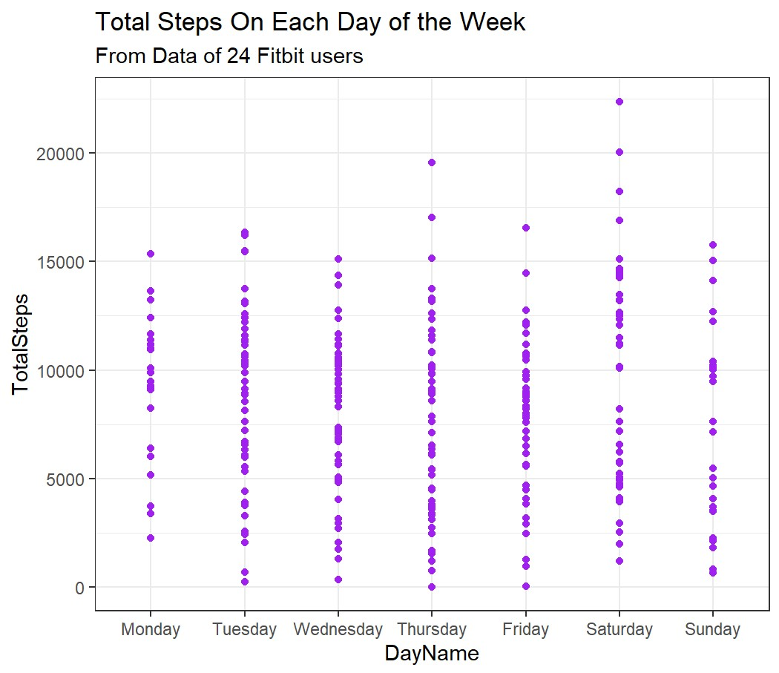
VIZUALISATION:
VIZ.1:Total Steps on each day of the week
ggplot(mergedata2)+
geom_point(mapping=aes(x=DayName,y=TotalSteps),color="Purple")+
scale_x_discrete(limits=c("Monday","Tuesday","Wednesday","Thursday","Friday","Saturday","Sunday"))+
labs(title = "Total Steps On Each Day of the Week",
subtitle = "From Data of 24 Fitbit users")

Slide 13
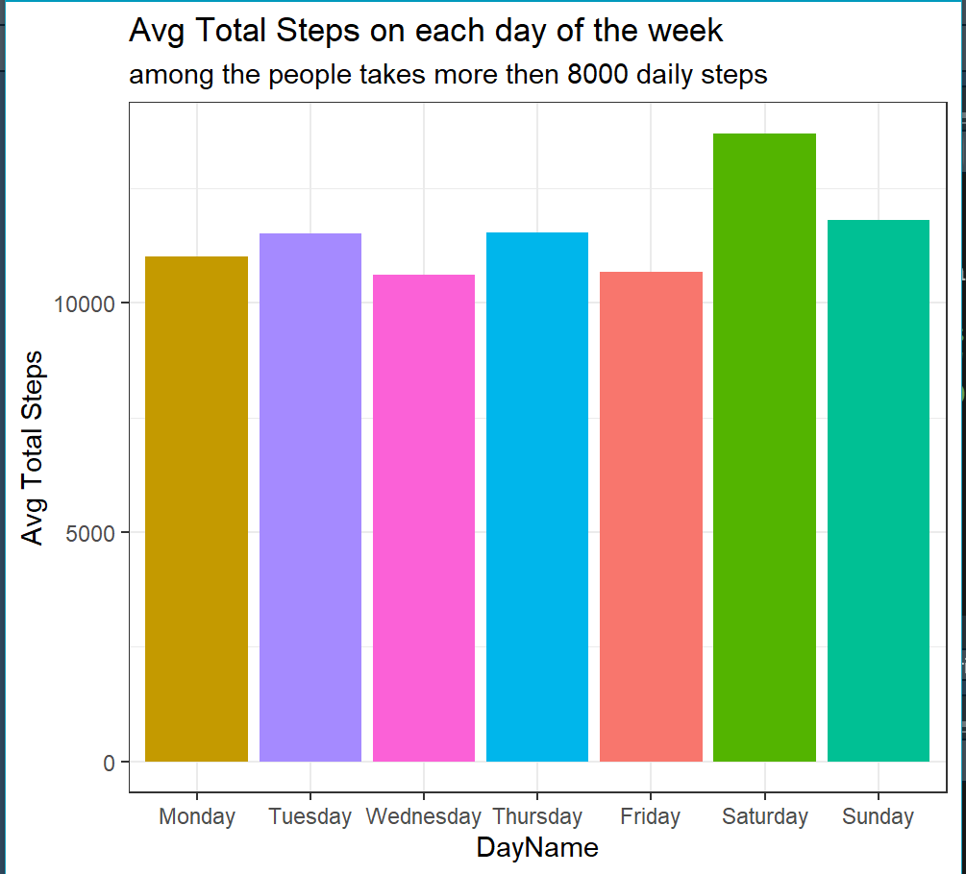
VIZ.2: Weekly steps taking pattern in a group of people who takes more than 8000 daily steps.
mergedata2 %>%
filter(TotalSteps>8000) %>% ggplot(mapping=aes(x=DayName,y=TotalSteps,fill=DayName))+ geom_bar(stat="summary",fun="mean")+ scale_x_discrete(limits=c("Monday","Tuesday","Wednesday","Thursday","Friday","Saturday","Sunday"))+
labs(title="Avg Total Steps on each day of the week",
subtitle = "among the people takes more then 8000 daily steps", y="Avg Total Steps")+
theme(legend.position="none")

Slide 14
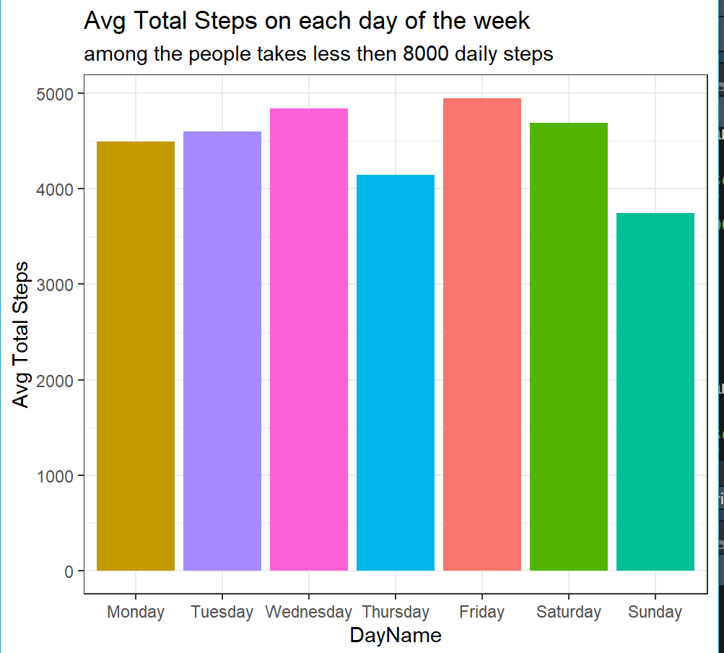
VIZ.3: Steps pattern among those who takes less than 8000 daily steps.
theme_set(theme_bw())
mergedata2%>%
filter(TotalSteps<8000) %>% ggplot(mapping=aes(x=DayName,y=TotalSteps,fill=DayName))+ geom_bar(stat="summary",fun="mean")+ scale_x_discrete(limits=c("Monday","Tuesday","Wednesday","Thursday","Friday","Saturday","Sunday"))+
labs(title="Avg Total Steps on each day of the week",
subtitle = "among the people takes less then 8000 daily steps",
y="Avg Total Steps")+
theme(legend.position="none")

Slide 15
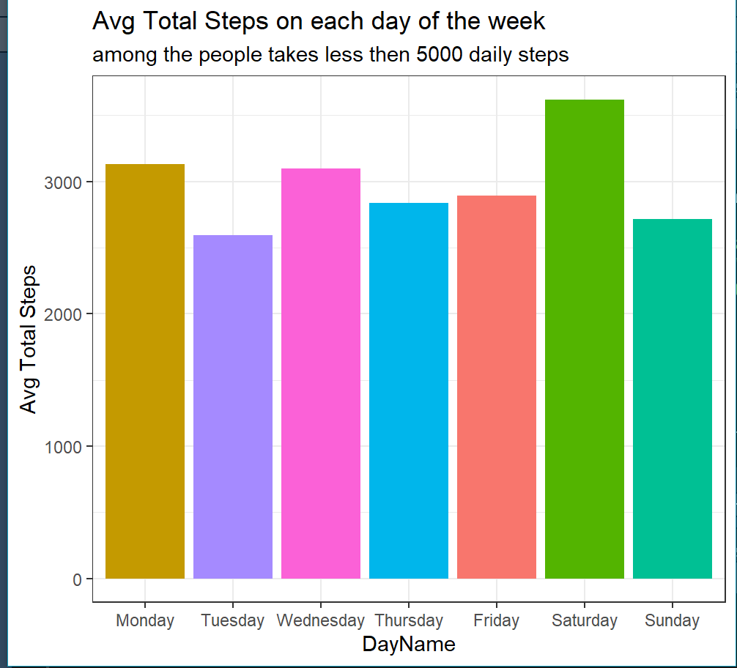
VIZ.4: Steps pattern among those who takes less than 5000 daily steps.
mergedata2%>%
filter(TotalSteps<5000) %>% ggplot(mapping=aes(x=DayName,y=TotalSteps,fill=DayName))+ geom_bar(stat="summary",fun="mean")+ scale_x_discrete(limits=c("Monday","Tuesday","Wednesday","Thursday","Friday","Saturday","Sunday"))+
labs(title="Avg Total Steps on each day of the week",
subtitle = "among the people takes less then 5000 daily steps",
y="Avg Total Steps")+
theme(legend.position="none")

Slide 16
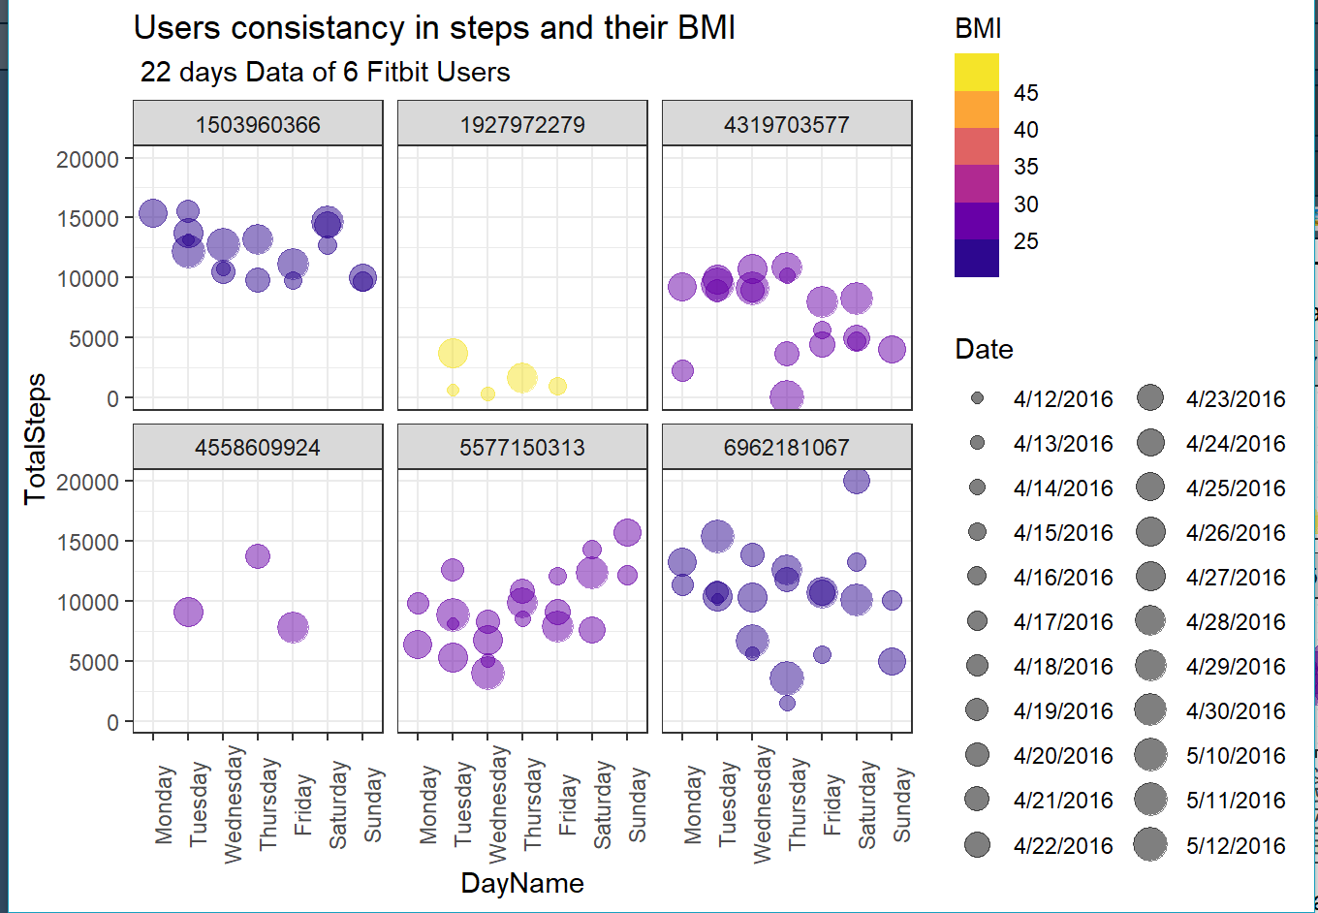
VIZ.5: Users consistency in steps and their BMI with 22 days Data of 6 Fitbit Users.
mergeWt %>%
ggplot(aes(DayName,TotalSteps,color=BMI,size=Date))+
geom_point(alpha=0.5)+
scale_x_discrete(limits = c("Monday" , "Tuesday", "Wednesday", "Thursday" , "Friday" , "Saturday" , "Sunday"))+
facet_wrap(~Id)+
scale_color_viridis_b(option = "C")+
theme(axis.text.x = element_text(angle = 90))+
labs(title = "Users consistancy in steps and their BMI",
subtitle = " 22 days Data of 6 Fitbit Users")

Slide 17
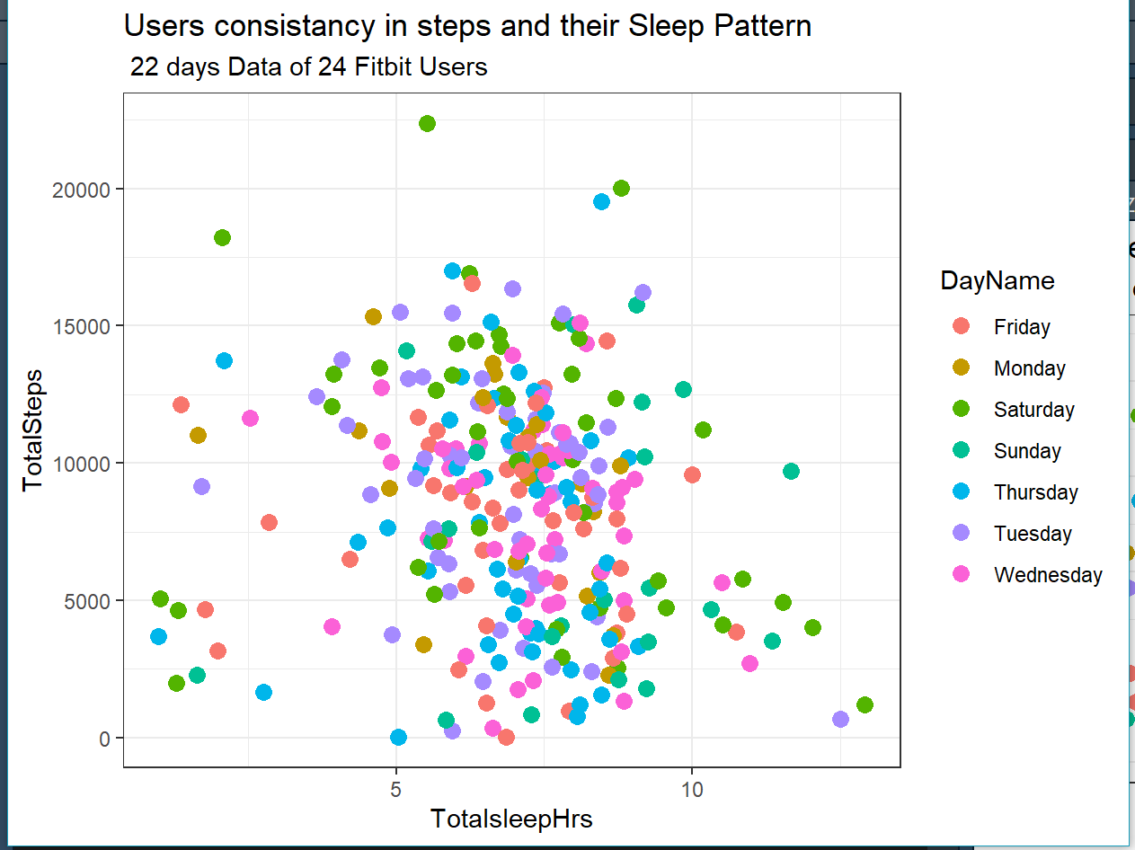
VIZ.6: Users consistency in steps and their Sleep Pattern.
ggplot(data=mergedata2) +
geom_point(mapping = aes(x=TotalsleepHrs,y=TotalSteps, color=DayName),size=3) +
labs(title = "Users consistancy in steps and their Sleep Pattern",
subtitle = " 22 days Data of 24 Fitbit Users")

Slide 18
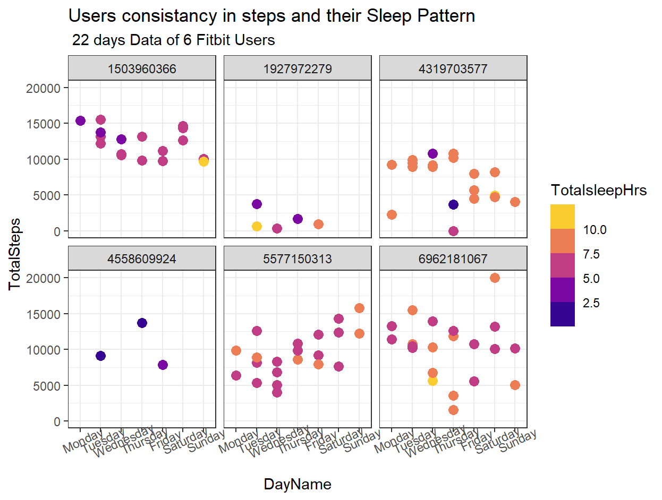
VIZ.7: 6 Users consistency in steps and their Sleep Pattern in 22 days time period.
mergeWt %>%
ggplot(aes(DayName,TotalSteps,color=TotalsleepHrs))+geom_point(size=3)+
scale_x_discrete(limits = c("Monday" , "Tuesday", "Wednesday","Thursday" , "Friday" , "Saturday" , "Sunday"))+
facet_wrap(~Id)+
scale_color_viridis_b(option = "C")+
theme(axis.text.x = element_text(angle = 25))+
labs(title = "Users consistancy in steps and their Sleep Pattern",
subtitle = " 22 days Data of 6 Fitbit Users")

Slide 19
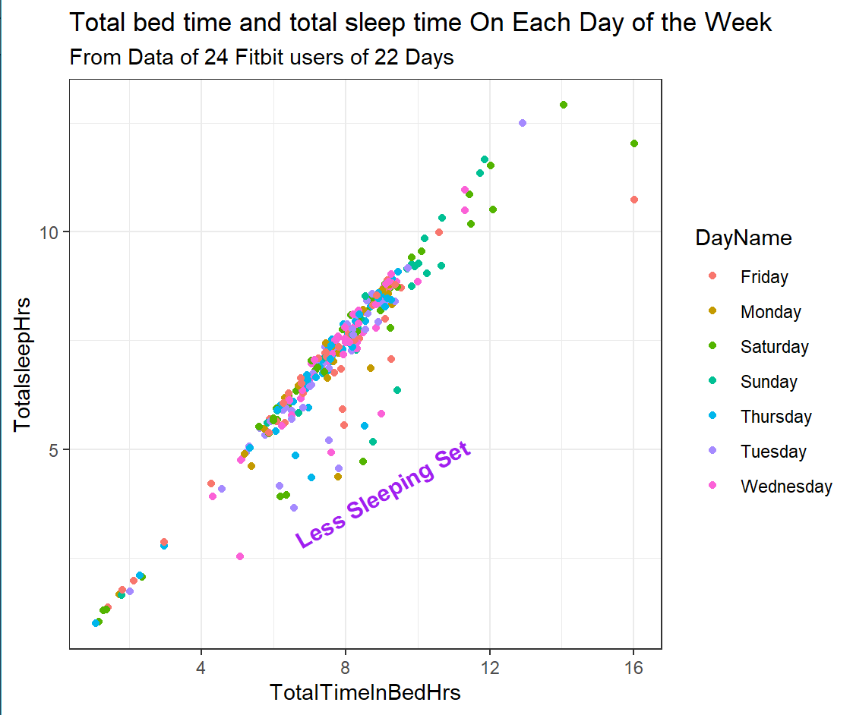
VIZ.8: Total bed time and total sleep time.
ggplot(data=mergedata2) +
geom_jitter(mapping = aes(x=TotalTimeInBedHrs,y=TotalsleepHrs,color=DayName)) +
labs(title = "Total bed time and total sleep time On Each Day of the Week",
subtitle = "From Data of 24 Fitbit users of 22 Days")+
annotate("text",x=9,y=4,label=
"Less Sleeping Set",color="purple",
fontface="bold",angle=30,size=4)

Slide 20
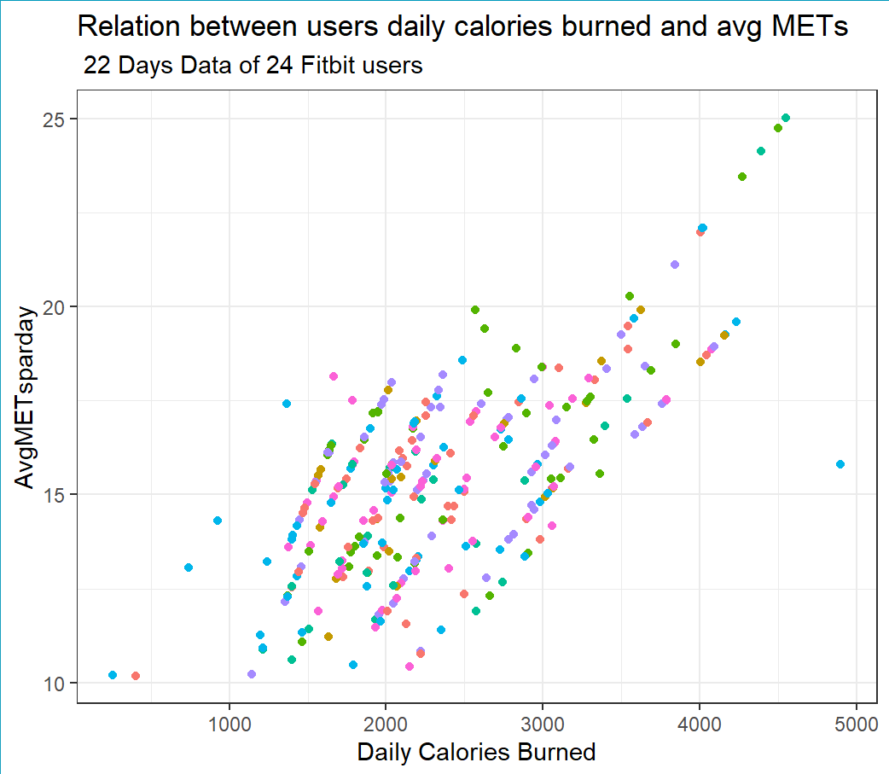
VIZ.9: Relation between users daily calories burned and avg METs.
Your Fitbit estimates METs by calculating your physical activity and heart rate.
ggplot(data=mergedata2) +
geom_point(mapping = aes(x=Calories,y=AvgMETsparday,
color=DayName)) +
theme(legend.position = "none") +
labs(title = "Relation between users daily calories burned and avg METs",
subtitle = " 22 Days Data of 24 Fitbit users ",x="Daily Calories Burned")

Slide 21
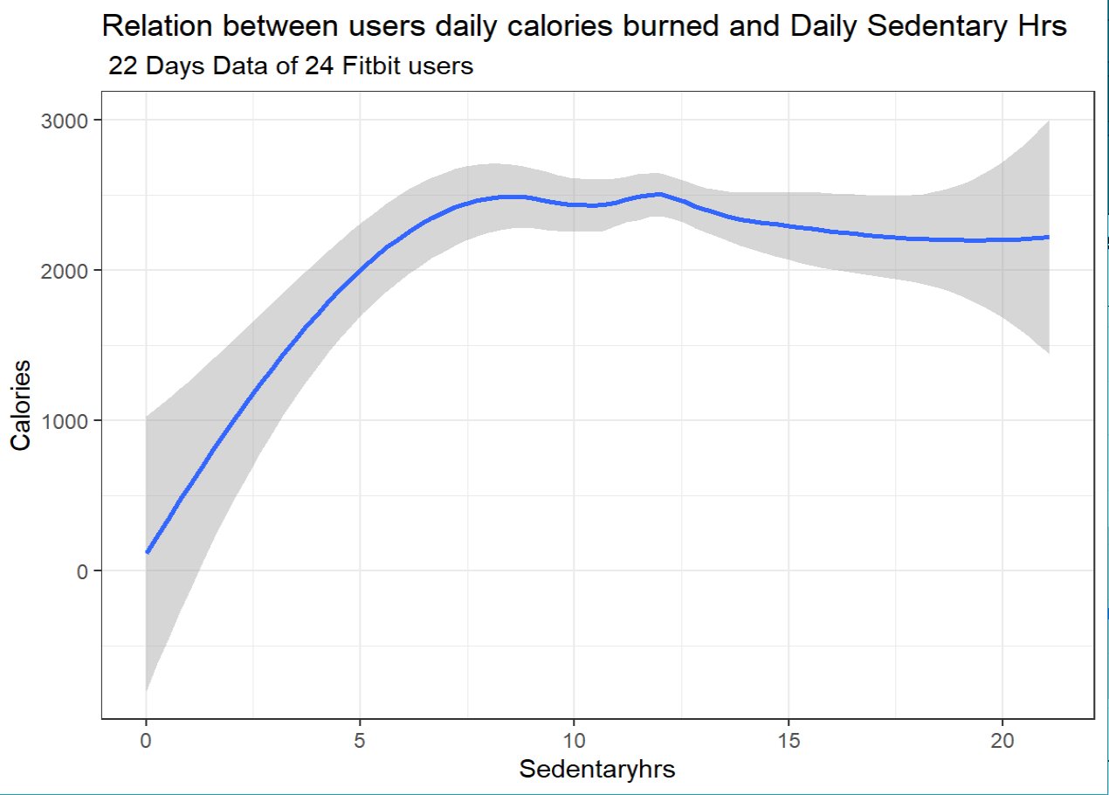
VIZ.10: Relation between users daily calories burned and Daily Sedentary Hrs.
SEDENTARYHRS-SITTING HOURS
ggplot(data=mergedata2) +
geom_smooth(mapping = aes(x=Sedentaryhrs ,y=Calories)) +
labs(title = "Relation between users daily calories burned and Daily Sedentary Hrs", subtitle = " 22 Days Data of 24 Fitbit users ")

Slide 22
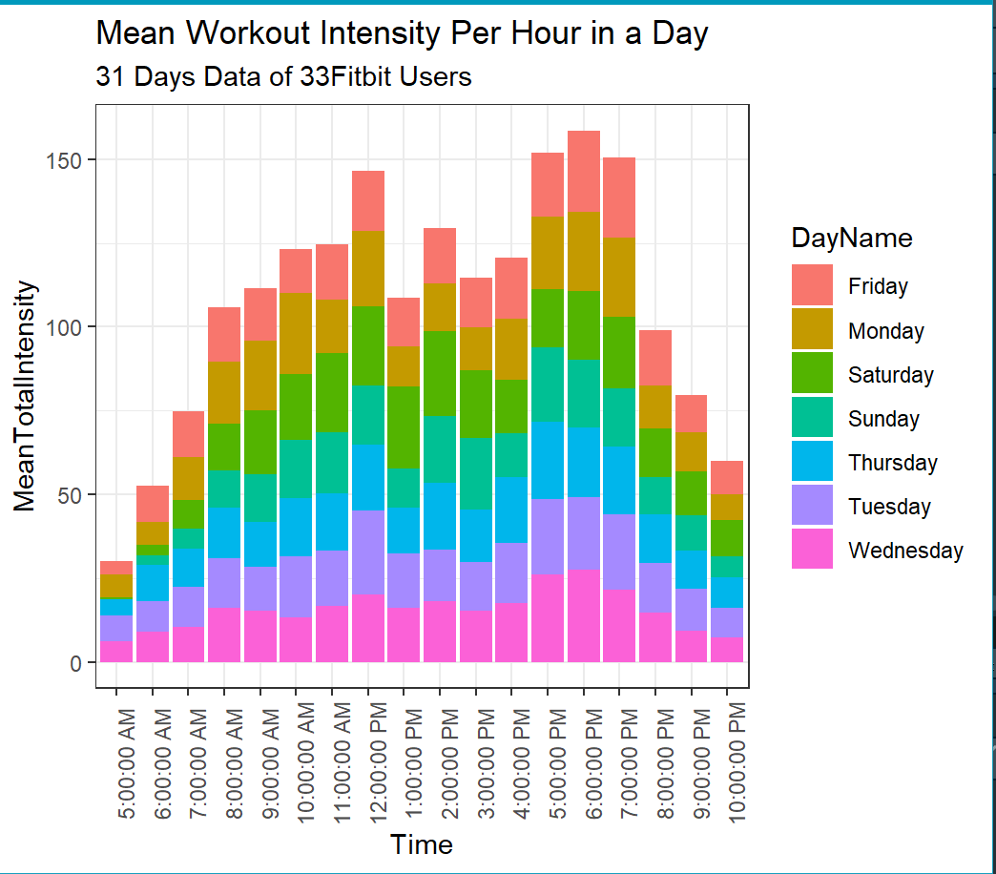
VIZ.11: Mean Workout Intensity Per Hour in a Day with 31 Days Data of 33 Fitbit Users.
ggplot(data=hourlyintensities,
aes(x=Time,y=TotalIntensity,fill=DayName))+geom_bar(stat="summary“
,fun="mean") +
theme(axis.text.x = element_text
(angle = 90))+
scale_x_discrete(limits = c("5:00:00 AM","6:00:00 AM","7:00:00 AM“, "8:00:00 AM","9:00:00 AM", "10:00:00 AM","11:00:00 AM","12:00:00 PM","1:00:00 PM","2:00:00 PM", "3:00:00 PM","4:00:00 PM”,"5:00:00 PM", "6:00:00 PM","7:00:00 PM",
"8:00:00 PM","9:00:00 PM","10:00:00 PM" )) +
labs(title = "Mean Workout Intensity Per Hour in a Day",y="MeanTotalIntensity",
subtitle="31 Days Data of 33Fitbit Users")

Slide 23
RECOMMENDATIONS:
Target existing Fitness tracker users who takes less than 5000 daily steps, advertise Bellabeat's wellness coaching specially on Saturdays.
Target existing Fitness tracker users who takes less than 8000 daily steps and give frequent reminders to maintain their daily steps. Motivate them for better goals so that they can achieve fitness badges and more benefits from the app.
Target existing Fitness tracker users who takes more than 10000 daily steps and appreciate them with weekly fitness badges, half/yearly coupons, encourage for social media engagement.
Target existing fitness tracker users with high BMI levels and recommend small 5 days a week work out plans, remind them monthly weight check.
Targeted Days for late evening social media Marketing and consumer social media engagement are Saturday, Sunday, Monday, Tuesday.
Most advised media marketing (TV, Radio) times Mon-Sat are 12pm and 5-7 pm, as data shows the peak workout time falls in the above mentioned time. So there is high chance that people might be watching or listening TV/Radio/Podcast etc while their active work out sessions.

Slide 24
THANK YOU

