Slide 1





REAL TIME BERTH CONFIRMATION SYSTEM
Name: SATYENDRA SINGH
Theme: IOT

Slide 2
introduction
SYMBICON 2022
This idea is completely based on the real life observation which we all have been through . It is related to our railway management ,specifically berth allocation management using IOT and based on that I named it
“REAL TIME BERTH CONFIRMATION SYSTEM”.
Motive behind this idea is to reduced the workload of the
Train Ticket Examiner (TTE)of Indian Railways whose work is completely offline based in this era of Online .

Slide 3
Problem statement
SYMBICON 2022
We have seen in our daily life while travelling from train that the Ticket collectors has to go to every seat every coach for verification of seats so that it can manage the records of occupied and unoccupied seats in that particular coach which is very time consuming process . TTE is completely dependent on the charts sheets available to him /her for verification which is regularly updated after a span of time .

Slide 4
objective
SYMBICON 2022
The main objective behind this idea and observation is to mitigate the workload for TTE by automating the verification process (not completely) , involving the passengers who are travelling.

Slide 5
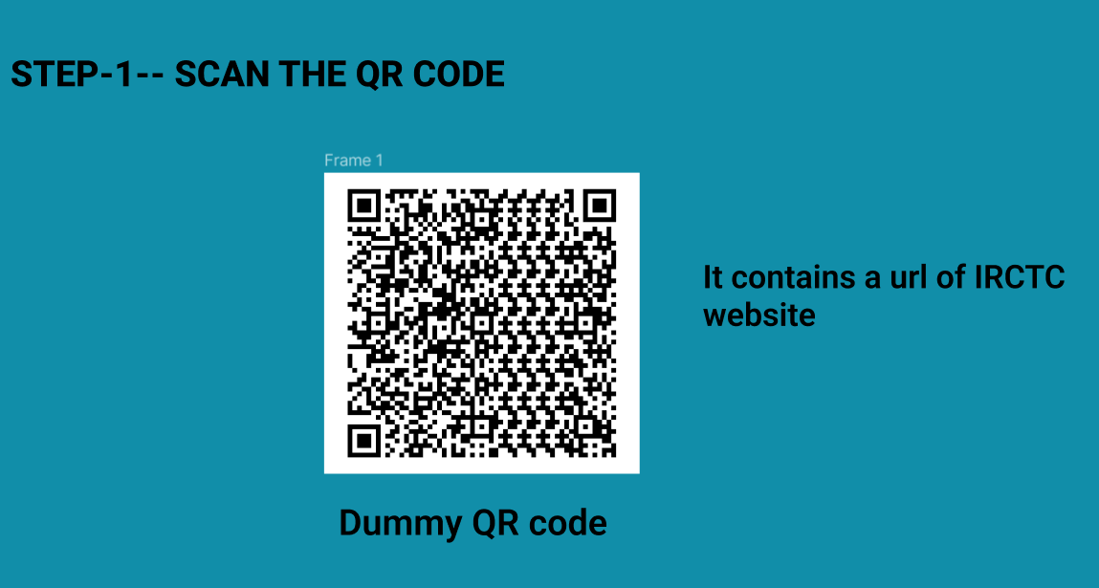
implementation
SYMBICON 2022
Implementation is divided into some steps that are following :-
Providing the link to the passenger
Through text message
Through QR code (in tickets)

Slide 6
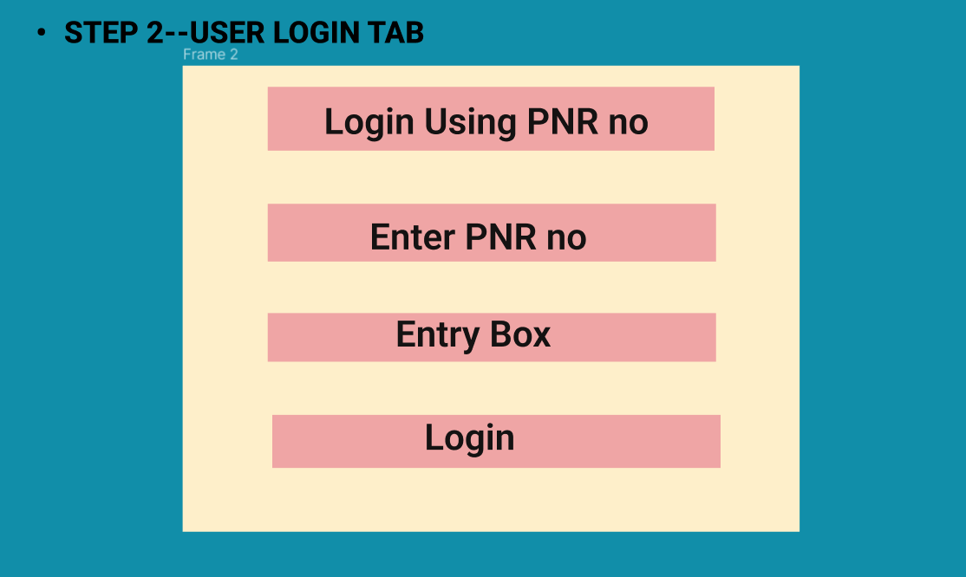

Slide 7
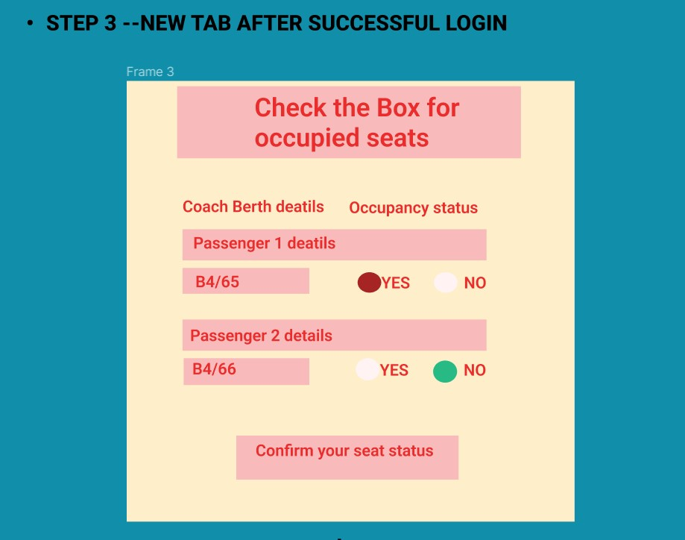

Slide 8
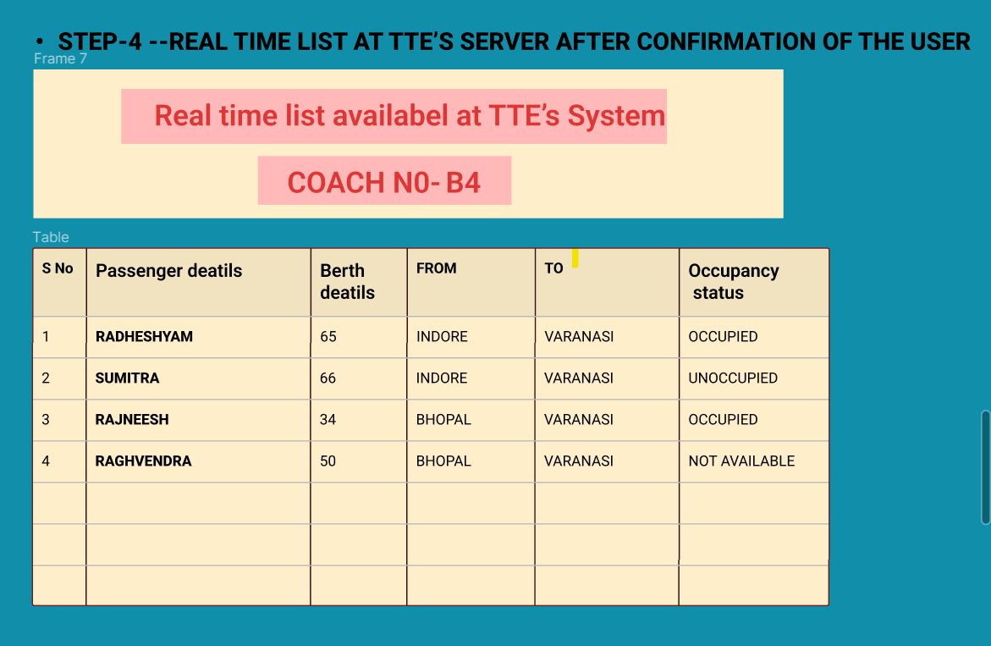

Slide 9
results
SYMBICON 2022
1- TTE and the administrator has now idea of which seat is occupied or not occupied . 2- With this they can allot seats to WL / RAC passengers. 3- TTE has to only concern about the seats whose status in Not available and has verify selected seats for their occupancy status 4- Carrying of updated chart is resolved with just one device and real time monitoring of seats in at TTE’s hand

Slide 10
conclusion
SYMBICON 2022
In this idea can not completely replace the TTE’s work because at the a person is needed to re verify and check personally, but it can mitigates his work by limiting his no verification that he has to do in every coach of 20-30 coach long train .

