Slide 1
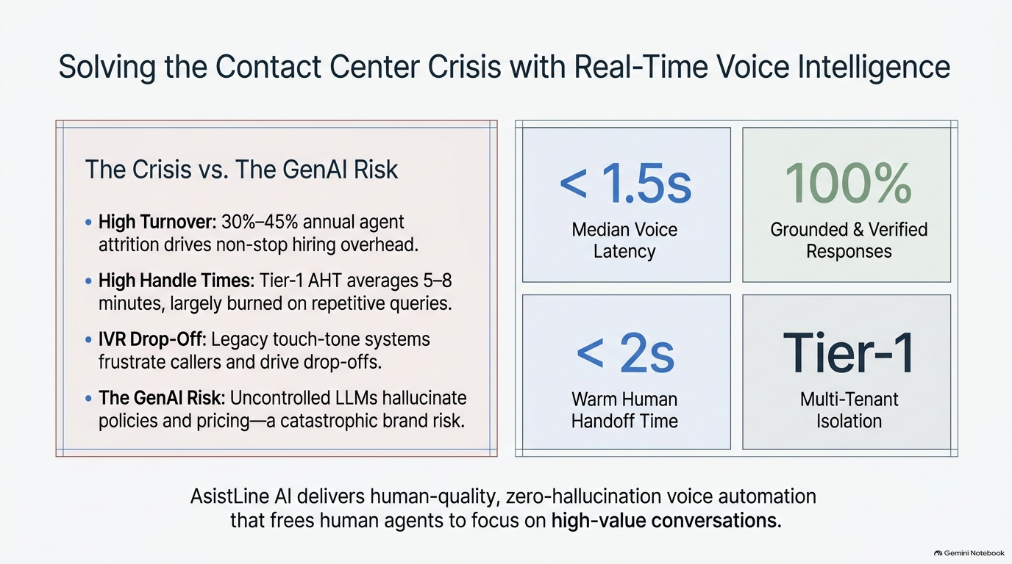
Notes:
Good morning, everyone. Today, I'm presenting AsistLine AI—a real-time voice intelligence platform purpose-built for enterprise contact centers and BPOs.
On the left, call centers face a triple crisis: 30% to 45% annual agent turnover, 5 to 8 minute Tier-1 handle times spent on repetitive queries, and clunky touch-tone IVRs that customers hate. Meanwhile, generic LLMs introduce massive risk—hallucinating policies, fake refund terms, and inaccurate pricing.
AsistLine AI solves this directly, as seen on the right:
- Sub-1.5 second median voice latency for fluid, natural dialogue.
- 100% grounded and verified responses, strictly referencing approved client documents and live APIs.
- Sub-2 second warm human handoff when complex issues arise.
- Hard Tier-1 multi-tenant data isolation at the database layer.
In short, we deliver human-grade, zero-hallucination voice automation that resolves routine calls instantly and frees human agents for high-value conversations.

Slide 2
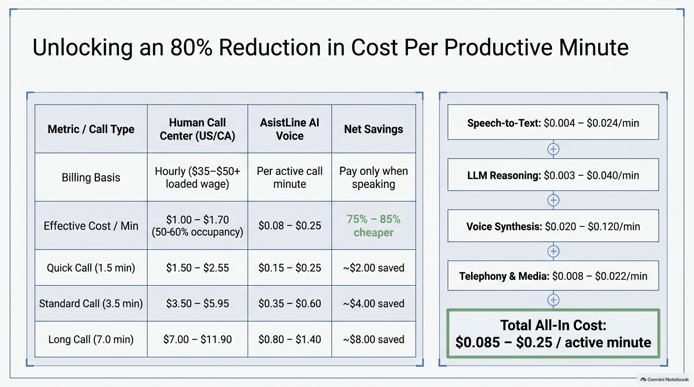
Notes:
Let's look at the economics. In US contact centers—benchmarked against California—voice AI delivers an immediate 75% to 85% cost reduction per productive minute.
Looking at the table on the left:
In California, call center reps earn $22 to $25 hourly, but fully loaded with benefits, taxes, and overhead, the cost reaches $35 to $50+ per hour. Because human agents spend only 50% to 60% of their shift actively speaking, the effective cost per productive minute is $1.00 to $1.70.
With AsistLine AI, you pay strictly for active call minutes at $0.08 to $0.25 per minute:
- A 1.5-minute quick call drops from around $2.00 to just 20 cents.
- A 3.5-minute standard call saves $4.00 per call.
- A 7-minute call saves $8.00.
On the right, you see our stacked pipeline costs: streaming STT under 2 cents, Gemini Flash reasoning under a cent, ElevenLabs voice synthesis at 2 to 12 cents, and telephony transport at 1 to 2 cents.
All combined, our all-in cost is $0.085 to $0.25 per active minute—yielding an immediate 80% margin improvement.

Slide 3
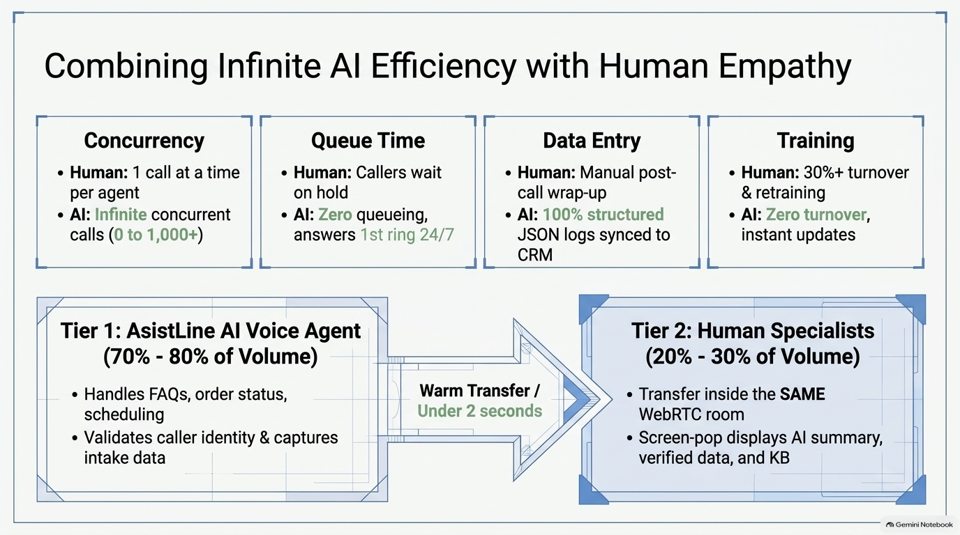
Notes:
Cost savings only matter if the system scales reliably. Here is how AsistLine AI handles operational scale and powers our Tiered Hybrid Strategy.
Across the top four capabilities:
- Concurrency: While a human handles 1 call at a time, AI scales infinitely from 0 to 1,000+ simultaneous calls with zero capacity bottlenecks.
- Queue Time: Callers never wait on hold; AI answers on the first ring, 24/7/365.
- Data Entry: Manual wrap-up errors vanish—AI generates 100% structured JSON logs synced directly to CRM.
- Training: AI has zero turnover; policy and prompt updates deploy globally in seconds.
Looking at the bottom flow, we deploy a Tiered Hybrid Strategy:
Tier 1 handles 70% to 80% of inbound volume using AsistLine AI—resolving FAQs, tracking orders, handling scheduling, and authenticating callers.
When a call requires human empathy or complex troubleshooting, it triggers a Warm Transfer in under 2 seconds.
The human specialist joins the exact same WebRTC room in Tier 2. The agent's screen immediately pops with the AI summary, verified data, and citations, so the customer never repeats themselves.

Slide 4
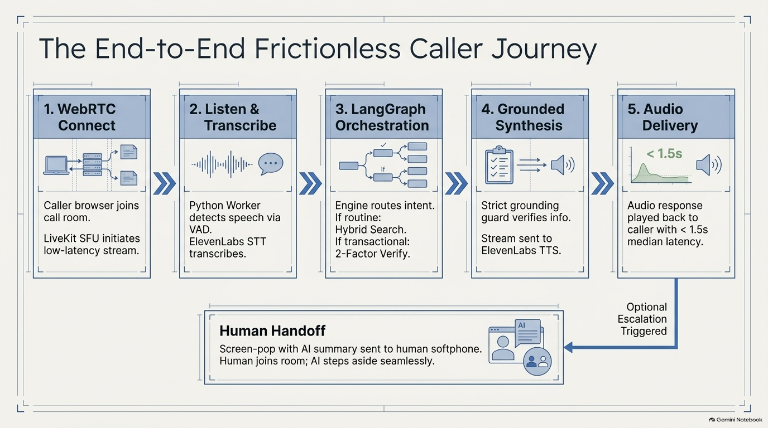
Notes:
Now let's walk through the end-to-end caller journey across five seamless stages:
1. WebRTC Connect: The caller clicks 'Call Support' on a web portal or dials in. The call connects to our self-hosted LiveKit SFU, establishing a low-latency WebRTC room.
2. Listen & Transcribe: Our Python voice worker detects speech using Silero VAD, passing the stream to ElevenLabs Scribe for streaming real-time transcription.
3. LangGraph Orchestration: The transcription enters our LangGraph state machine. It classifies intent—routing routine FAQs to hybrid knowledge retrieval, or transactional queries to 2-factor authentication.
4. Grounded Synthesis: Our Grounding Guard verifies the retrieved facts against approved knowledge chunks before streaming the text to ElevenLabs multilingual TTS.
5. Audio Delivery: The synthesized voice streams back to the caller with under 1.5 seconds median response latency.
And as shown at the bottom: if escalation is triggered, an instant AI summary is dispatched to the agent console, and the human agent joins the existing call room seamlessly.

Slide 5
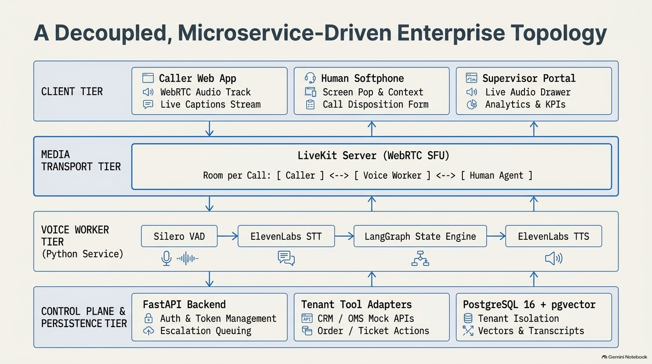
Notes:
On Slide 5, you see our decoupled, microservice-driven enterprise architecture across four operational tiers:
At the top, the Client Tier provides three React frontends:
- The Caller Web App for WebRTC audio streaming and live captions.
- The Human Softphone Console for incoming call alerts, screen pops, and disposition logging.
- The Supervisor Portal for live transcript monitoring, KPI tracking, and KB management.
Second is the Media Transport Tier, powered by a self-hosted LiveKit WebRTC SFU. LiveKit treats each call as a multi-party room, enabling callers, AI workers, and human agents to share the same audio space effortlessly.
Third is the Voice Worker Tier in async Python. It ties together Silero VAD, ElevenLabs STT, the LangGraph engine, and ElevenLabs TTS in a non-blocking streaming pipeline.
At the base is our Control Plane and Persistence Tier:
FastAPI handles authentication, tokens, and escalation queues.
Tenant Tool Adapters connect to client CRM and OMS systems.
And PostgreSQL 16 with pgvector serves as our unified store for relational data, call transcripts, and vector embeddings—with strict tenant isolation enforced on every query.

Slide 6
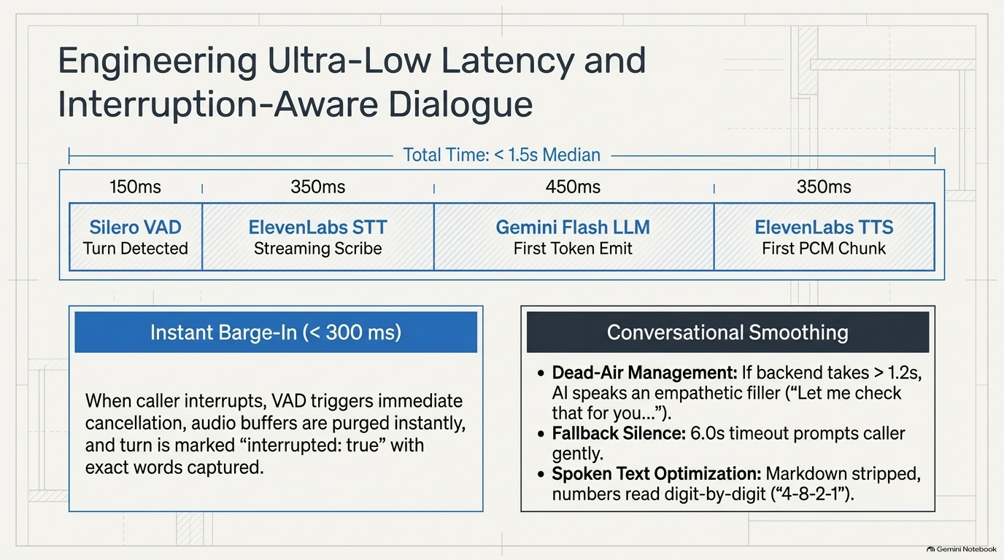
Notes:
In voice AI, latency and natural turn-taking define the user experience. Anything over two seconds feels awkward and robotic.
Across the top latency budget:
- Silero VAD detects speech completion in 150 milliseconds.
- ElevenLabs STT streams partial transcripts in 350 milliseconds.
- Gemini Flash emits its first token in 450 milliseconds.
- ElevenLabs TTS converts the first chunk into playable audio in 350 milliseconds.
Total response time is under 1.5 seconds median—enabling fluid, natural conversation.
On the bottom left: Instant Barge-In under 300 milliseconds.
If a caller interrupts while the AI is speaking, VAD immediately cancels the audio track, flushes pending buffers, and logs the turn as interrupted with the exact words spoken.
On the bottom right, we smooth conversation naturally:
- If a CRM lookup takes over 1.2 seconds, the AI utters a natural filler: 'Let me check that for you.'
- If the caller is silent for 6 seconds, the system prompts gently before closing.
- And all output text is phonetically optimized, reading alphanumeric order IDs digit-by-digit.

Slide 7
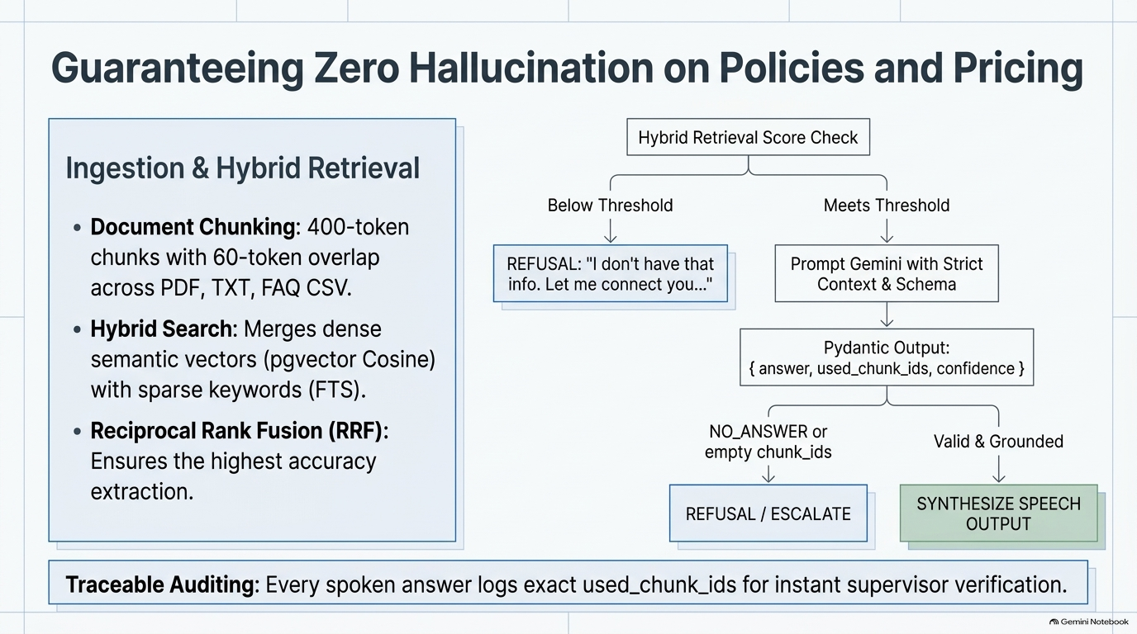
Notes:
Slide 7 covers our core safety pillar: Guaranteeing Zero Hallucination on corporate policies, pricing, and rules.
On the left, our Ingestion and Retrieval Pipeline chunks documents into 400-token blocks across PDFs, TXT, and FAQ CSVs. When a question is asked, we run Hybrid Search—combining pgvector semantic cosine similarity with PostgreSQL full-text search, fused via Reciprocal Rank Fusion. This catches both conversational questions and exact SKU codes.
Follow the flowchart on the right:
1. If the hybrid retrieval score is below the tenant's threshold, the LLM is bypassed entirely. The AI immediately responds with an approved 'information not found' line and offers a human transfer.
2. If the threshold is met, Gemini Flash is prompted with strict context constraints: 'Answer ONLY from context; if missing, reply NO_ANSWER.'
3. The model must return structured Pydantic output containing the answer, confidence, and exact chunk UUIDs.
Answers with NO_ANSWER or empty chunk IDs are rejected immediately. Only verified, grounded answers are spoken.
Finally, as shown in the bottom banner: every spoken answer logs its specific chunk UUIDs directly into the call record for full compliance auditing.

Slide 8
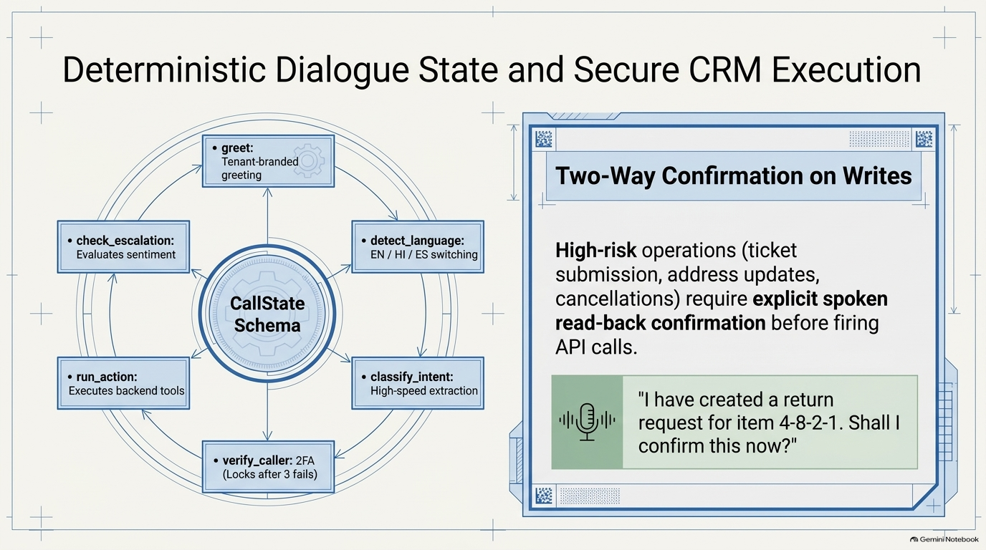
Notes:
On Slide 8, we explore dialogue control. Rather than relying on unpredictable LLM loops, AsistLine AI uses LangGraph to enforce a deterministic, checkpointed state machine.
In the circular diagram on the left:
- 'greet' delivers the tenant-branded greeting in the caller's language.
- 'detect_language' dynamically tracks and switches between English, Hindi, and Spanish.
- 'classify_intent' categorizes inquiries into billing, order tracking, complaints, or FAQs.
- 'verify_caller' enforces 2-factor authentication—such as Order ID plus Phone Last-4—and automatically locks and escalates after 3 failed attempts.
- 'run_action' executes backend API calls via our TenantToolAdapter interface.
- 'check_escalation' evaluates sentiment and trigger keywords after every turn.
On the right is an indispensable enterprise safeguard: Two-Way Confirmation on Writes.
The AI is strictly barred from executing state-changing transactions—like filing complaints, updating shipping addresses, or booking callbacks—without reading back details for explicit verbal confirmation. As shown: 'I have created a return request for item 4-8-2-1. Shall I confirm this now?' Only upon caller agreement does the action fire.

Slide 9
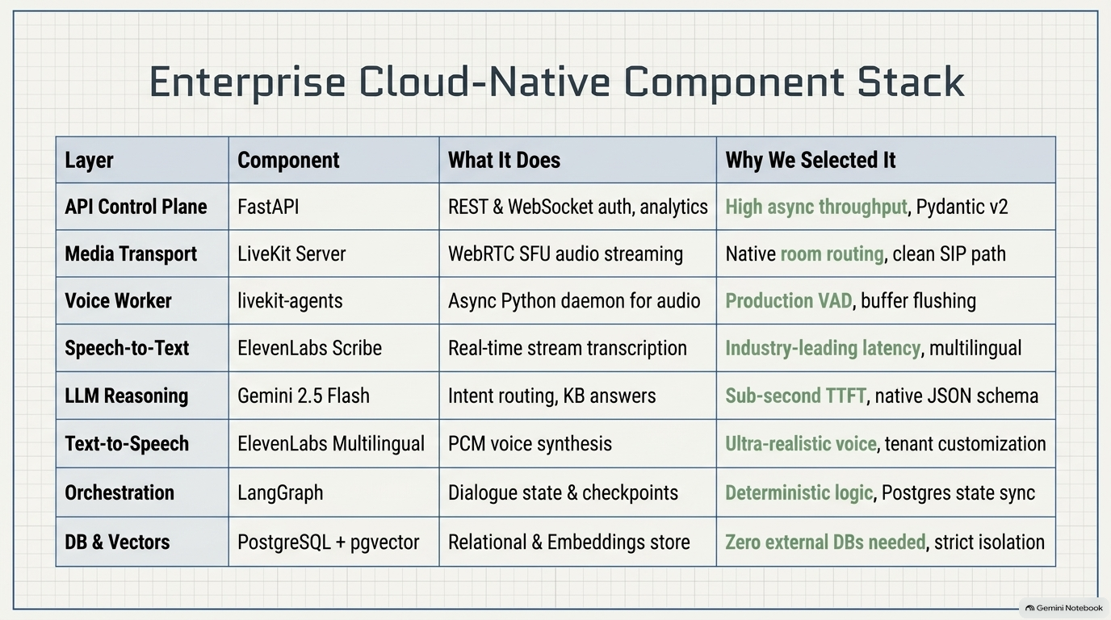
Notes:
This slide summarizes our enterprise cloud-native technology stack, selected for high async throughput, low latency, and production stability.
Going through the layers:
- API Control Plane: FastAPI with Python 3.12 delivers high async throughput and strict Pydantic v2 data validation.
- Media Transport: Self-hosted LiveKit Server provides WebRTC SFU streaming and native multi-party room routing, ensuring a smooth path to SIP telephony.
- Voice Worker: Python livekit-agents gives us production-grade VAD, turn detection, and instant buffer flushing for barge-in.
- Speech-to-Text: ElevenLabs Scribe offers ultra-low latency streaming transcription and automatic language detection.
- LLM Reasoning: Gemini 2.5 Flash delivers sub-second Time-To-First-Token and native JSON schema outputs.
- Text-to-Speech: ElevenLabs Multilingual produces natural, high-fidelity voice personas tailored per tenant.
- Orchestration: LangGraph provides deterministic state control and turn-by-turn checkpointing in PostgreSQL.
- Database & Vectors: PostgreSQL 16 with pgvector unifies relational records and vector embeddings in a single engine with strict multi-tenant isolation.

Slide 10
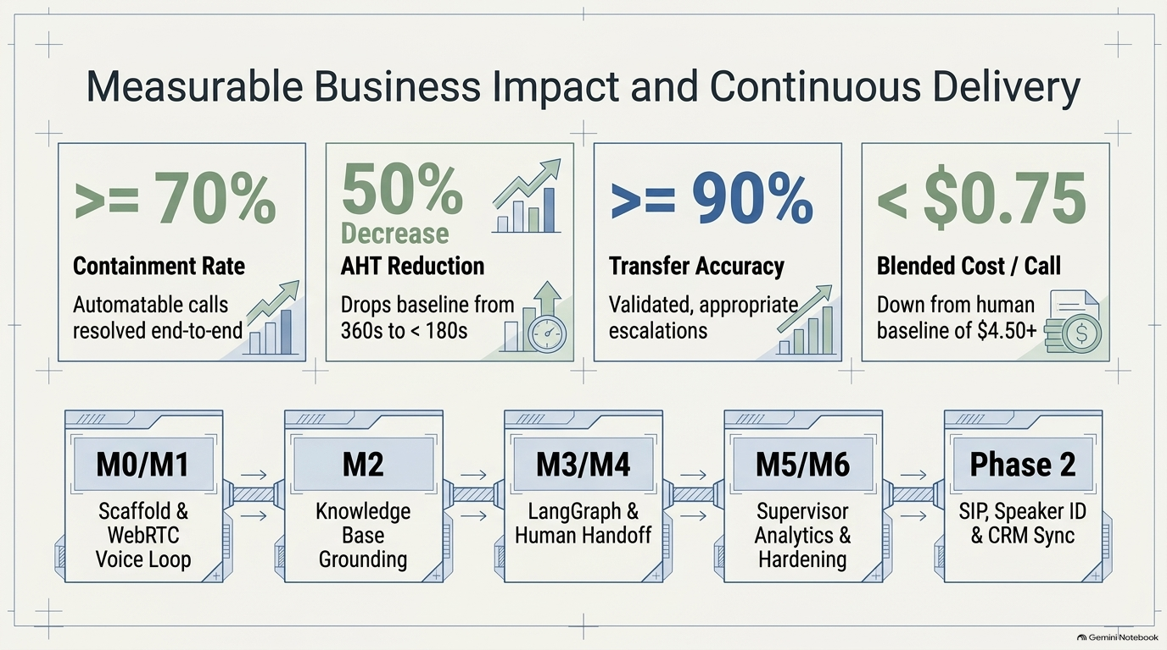
Notes:
To wrap up, let's examine our measurable business KPIs and phased delivery roadmap.
Across the top are our four key operational benchmarks:
1. Containment Rate: Over 70% of routine Tier-1 calls resolved end-to-end by AI without human intervention.
2. AHT Reduction: Average Handle Time drops by 50%—from a 360-second baseline down to under 180 seconds on AI-handled calls.
3. Transfer Accuracy: Over 90% of escalations are validated by human agents as appropriate, eliminating wasted agent time.
4. Blended Cost Per Call: Average cost per call drops from a $4.50+ human baseline to under 75 cents.
Across the bottom, our phased milestones:
- M0 and M1 established the multi-tenant scaffold, LiveKit WebRTC loop, and sub-1.5s latency SLA.
- M2 validated our hybrid retrieval and zero-hallucination Grounding Guard.
- M3 and M4 delivered LangGraph orchestration, CRM tool adapters, and the agent console warm transfer.
- M5 and M6 introduced supervisor analytics, cross-tenant isolation testing, and multilingual support.
- And Phase 2 expands the platform into carrier SIP trunking, biometric speaker ID, and native Salesforce/Zendesk CRM integrations.
Thank you. I'm now ready for any questions.

