Slide 1
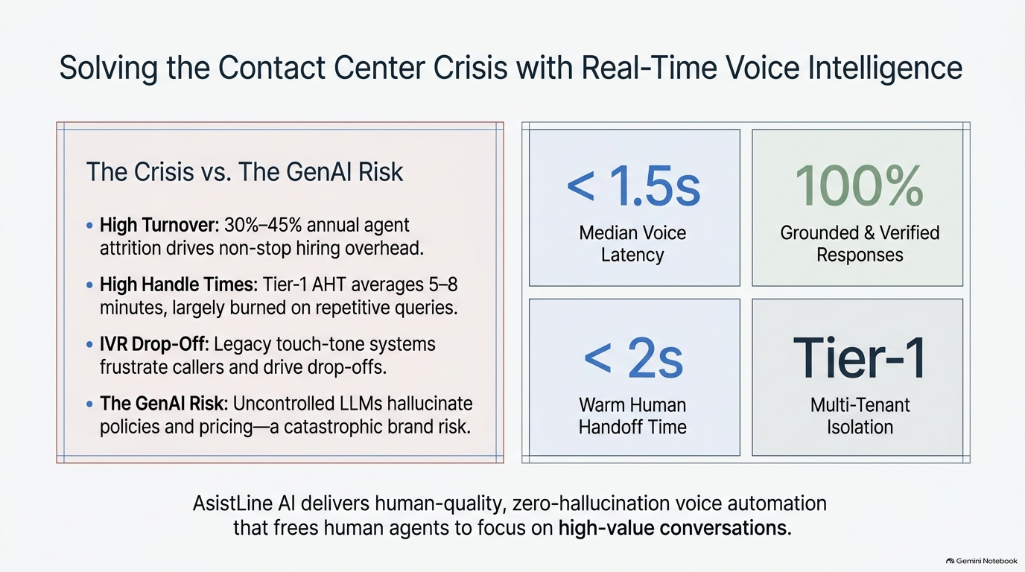

Solving the Contact Center Crisis with Real-Time Voice Intelligence
ia]
The Crisis vs. The GenAl Risk
<1.5s
100%
High Turnover: 30%-45% annual agent
Median Voice
Grounded & Verified
attrition drives non-stop hiring overhead.
Latency
Responses
e High Handle Times: Tier-1 AHT averages 5-8
minutes, largely burned on repetitive queries.
IVR Drop-Off: Legacy touch-tone systems
<2S
Tier-1
frustrate callers and drive drop-offs.
The GenAl Risk: Uncontrolled LLMs hallucinate
Warm Human
Multi-Tenant
policies and pricing—a catastrophic brand risk.
Handoff Time
Isolation
AsistLine Al delivers human-quality, zero-hallucination voice automation
that frees human agents to focus on high-value conversations.
Notebook

Slide 2
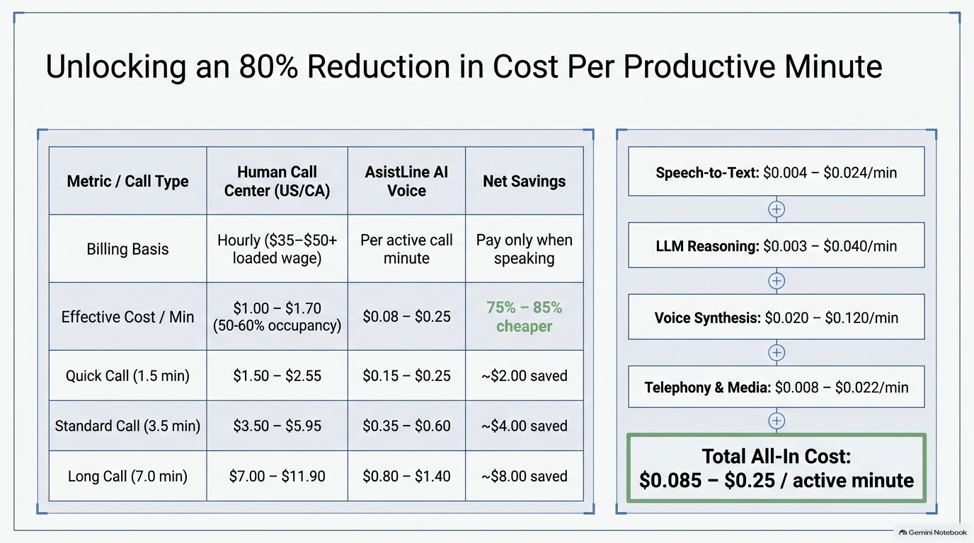
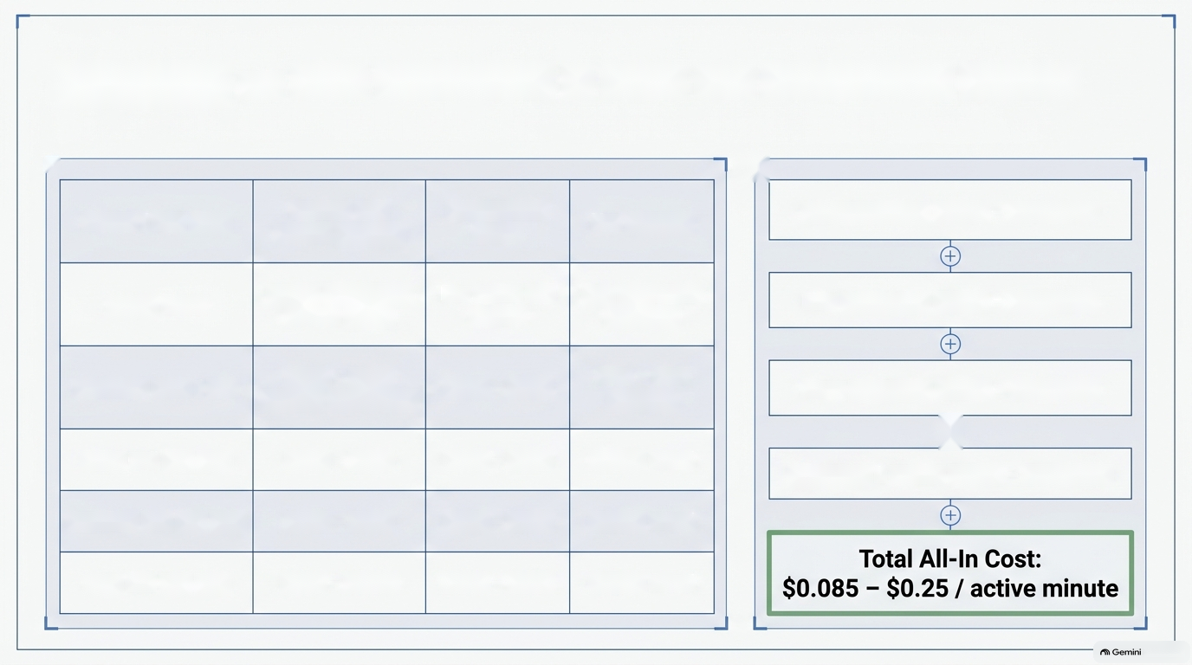
Unlocking an 80% Reduction in Cost Per Productive Minute
r
GG
Metric / Call Type
Human Call
AsistLine Al
Net Savings
Speech-to-Text: $0.004 — $0.024/min
Center (US/CA)
Voice
Billing Basis
Hourly ($35-$50+
Per active call
Pay only when
LLM Reasoning: $0.003 - $0.040/min
loaded wage)
minute
speaking
Effective Cost / Min
$1.00 - $1.70
$0.08 - $0.25
75% — 85%
Voice Synthesis: $0.020 - $0.120/min
(50-60% occupancy)
cheaper
©
Quick Call (1.5 min)
$1.50 - $2.55
$0.15 - $0.25
~$2.00 saved
Telephony & Media: $0.008 - $0.022/min
Standard Call (3.5 min)
$3.50 - $5.95
$0.35 - $0.60
~$4.00 saved
Long Call (7.0 min)
$7.00 - $11.90
$0.80 - $1.40
~$8.00 saved
Notebook

Slide 3
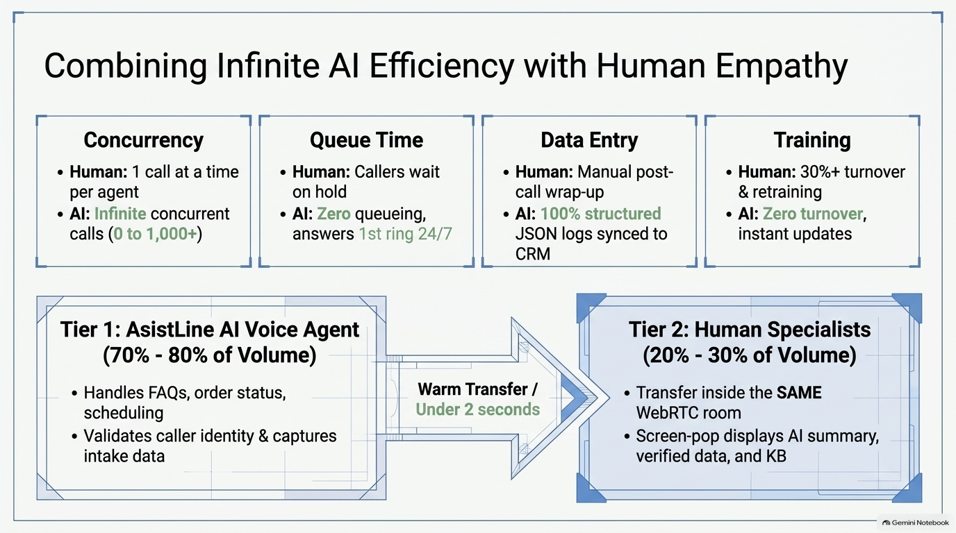
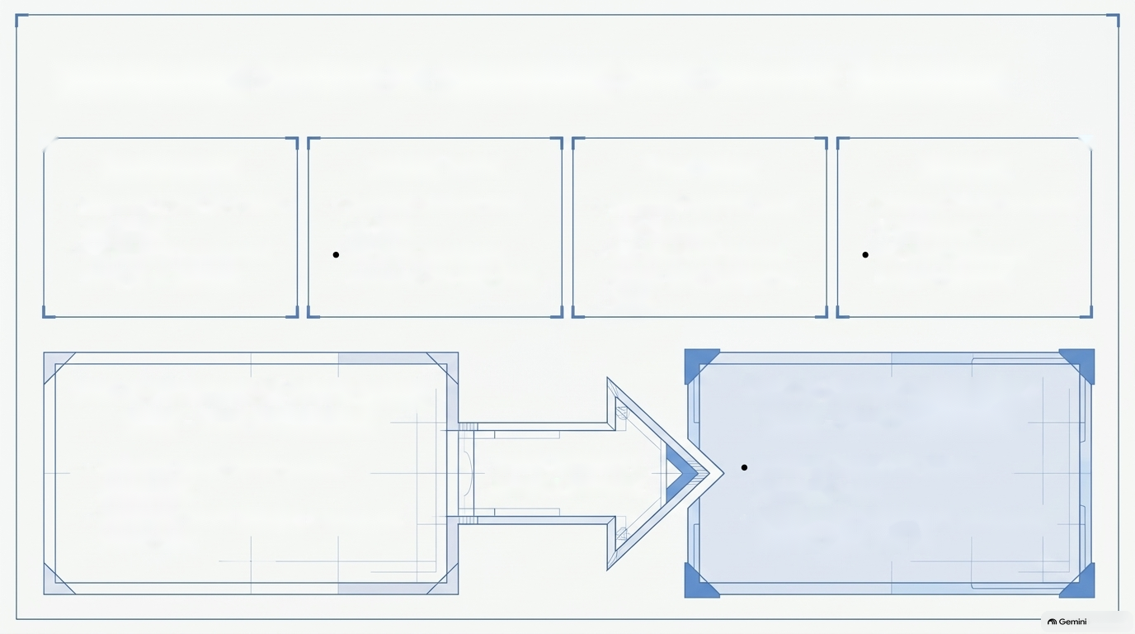
Combining Infinite Al Efficiency with Human Empathy
r
4
Concurrency
Queue Time
Data Entry
Training
¢ Human: 1 call at a time
¢ Human: Callers wait
¢ Human: Manual post-
¢ Human: 30%+ turnover
per agent
on hold
call wrap-up
& retraining
¢ Al: Infinite concurrent
Al: Zero queueing,
¢ Al: 100% structured
Al: Zero turnover,
calls (0 to 1,000+)
answers 1st ring 24/7
JSON logs synced to
instant updates
CRM
Tier 1: AsistLine Al Voice Agent
Tier 2: Human Specialists
(70% - 80% of Volume)
(20% - 30% of Volume)
« Handles FAQs, order status,
Warm Transfer /
Transfer inside the SAME
scheduling
Under 2 seconds
WebRTC room
+ Validates caller identity & captures
¢ Screen-pop displays Al summary,
intake data
verified data, and KB
Notebook

Slide 4
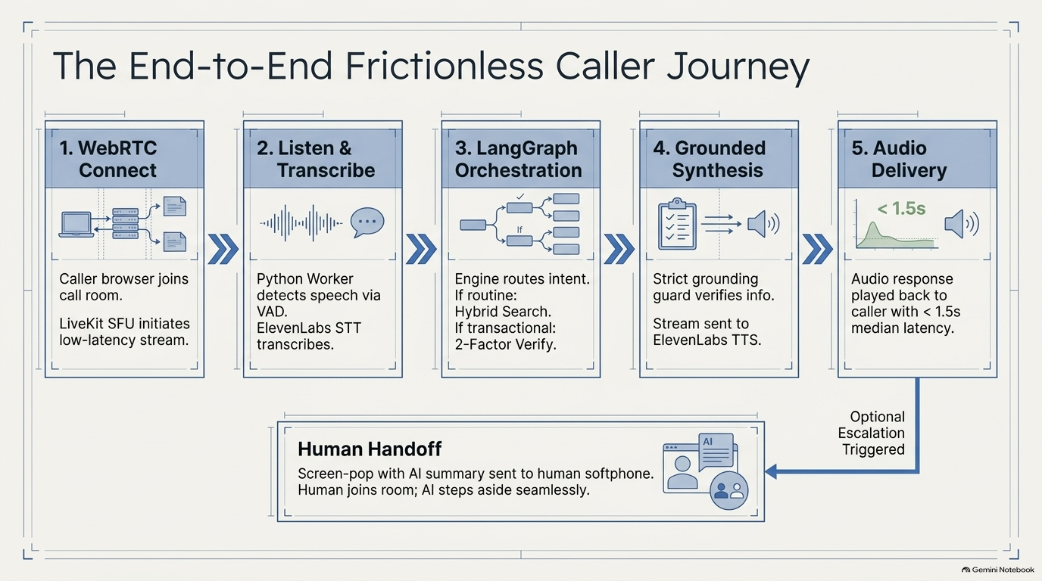
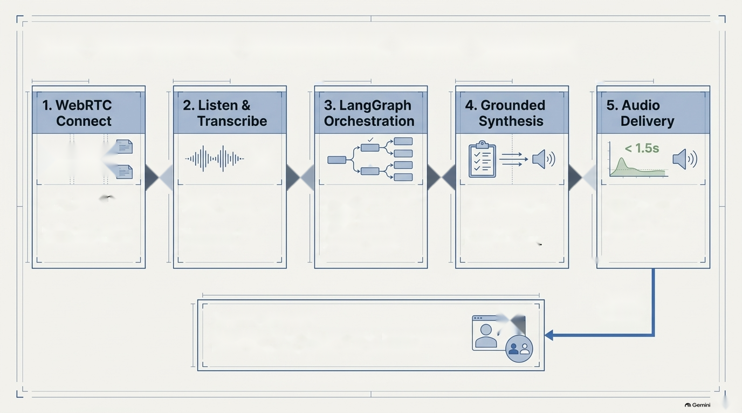
al
The End-to-End Frictionless Caller Journey
=
=
Be
e
»
»
if
»
»
Caller browser joins
Python Worker
Engine routes intent.
Strict grounding
Audio response
call room.
detects speech via
If routine:
guard verifies info.
played back to
VAD.
Hybrid Search.
caller with < 1.5s
LiveKit SFU initiates
ElevenLabs STT
If transactional:
Stream sent to
median latency.
low-latency stream.
transcribes.
2-Factor Verify.
ElevenLabs TTS.
L
AL
Optional
=
Escalation
Human Handoff
Triggered
Screen-pop with Al summary sent to human softphone.
Human joins room; Al steps aside seamlessly.
Notebook

Slide 5
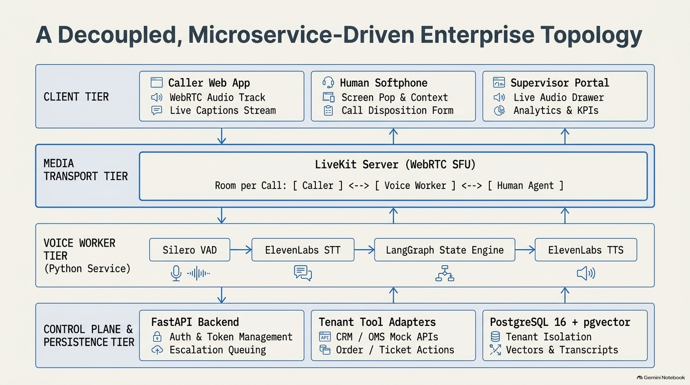
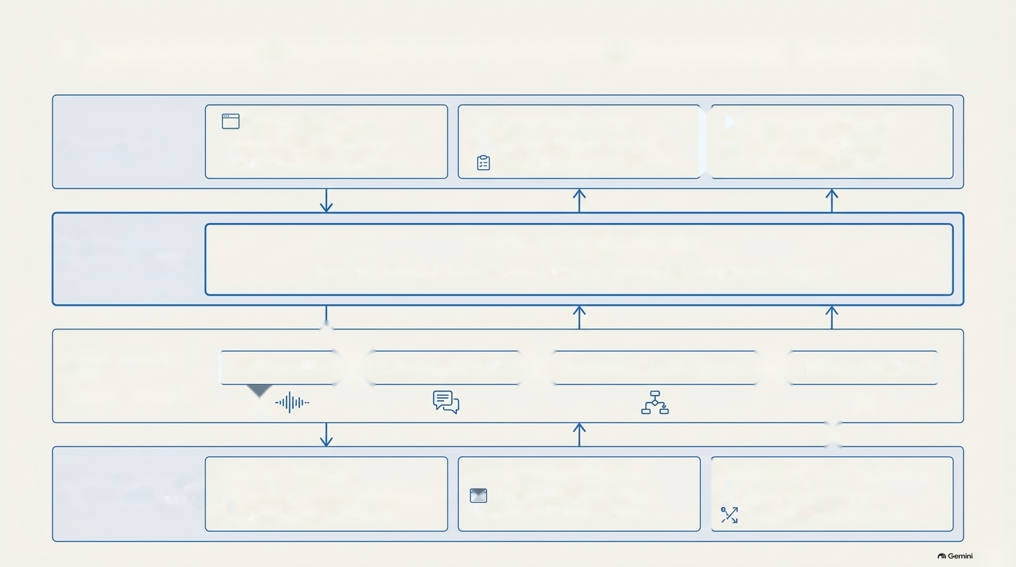
A Decoupled, Microservice-Driven Enterprise Topology
Caller Web App
6 Human Softphone
|
fa] Supervisor Portal
CLIENT TIER
<)) WebRTC Audio Track
EG Screen Pop & Context
<)) Live Audio Drawer
© Live Captions Stream
Call Disposition Form
G Analytics & KPIs
MEDIA
LiveKit Server (WebRTC SFU)
TRANSPORT TIER
Room per Call: [ Caller ] <--> [ Voice Worker ] <--> [ Human Agent ]
awe
VOICE WORKER
| Silero VAD [> ElevenLabs STT = LangGraph State Engine = ElevenLabs TTS |
TIER
(Python Service)
10)
cP)
48
FastAPI Backend
Tenant Tool Adapters
|
PostgreSQL 16 + pgvector
CONTROL PLANE &
@ Auth & Token Management
mr) CRM / OMS Mock APIs
& Tenant Isolation
PERSISTENCE TIER
& Order / Ticket Actions
@® Escalation Queuing
Vectors & Transcripts
Notebook

Slide 6
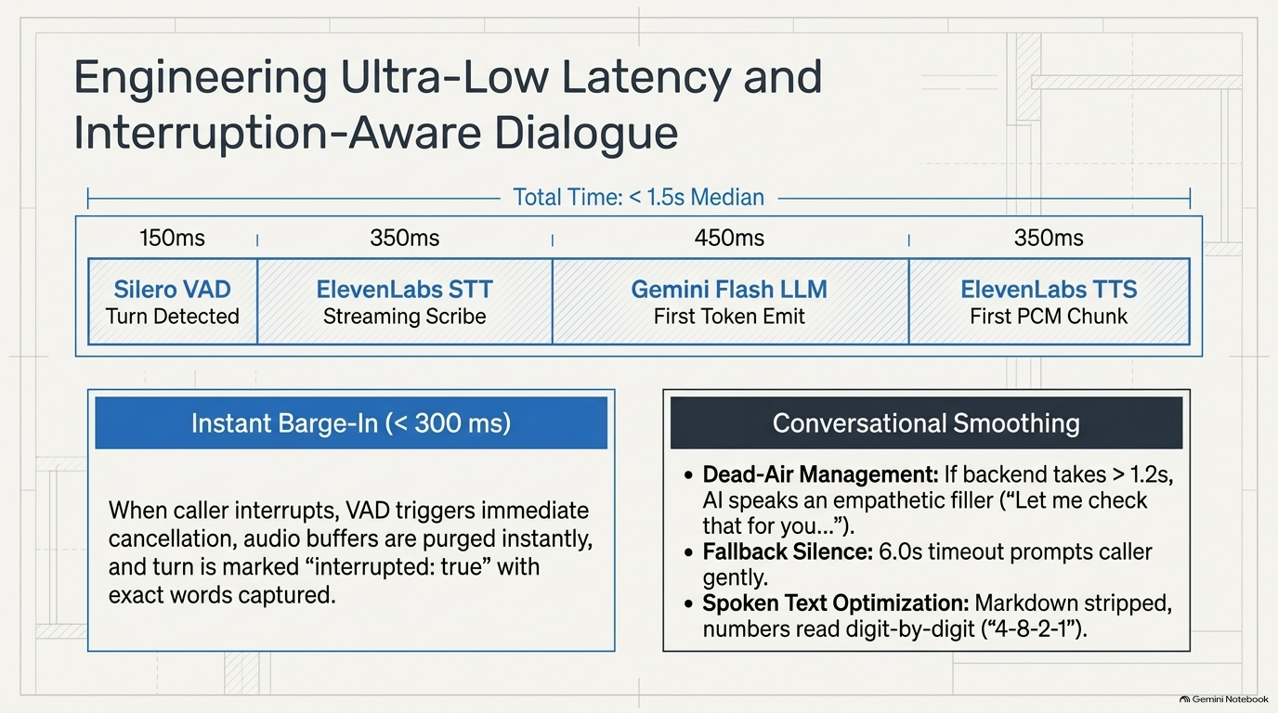
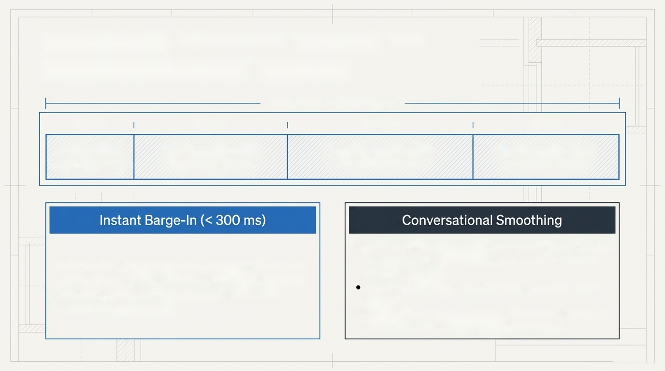
Engineering Ultra-Low Latency and
Interruption-Aware Dialogue
Total Time: < 1.5s Median
150ms
350ms
450ms
350ms
Silero VAD
ElevenLabs STT
Gemini Flash LLM
ElevenLabs TTS
Turn Detected
Streaming Scribe
First Token Emit
First PCM Chunk
¢ Dead-Air Management: If backend takes > 1.2s,
When caller interrupts, VAD triggers immediate
Al speaks an empathetic filler (“Let me check
cancellation, audio buffers are purged instantly,
that for you...”).
Fallback Silence: 6.0s timeout prompts caller
and turn is marked “interrupted: true” with
gently.
exact words captured.
¢ Spoken Text Optimization: Markdown stripped,
numbers read digit-by-digit (“4-8-2-1").
(Gemini Notebook

Slide 7
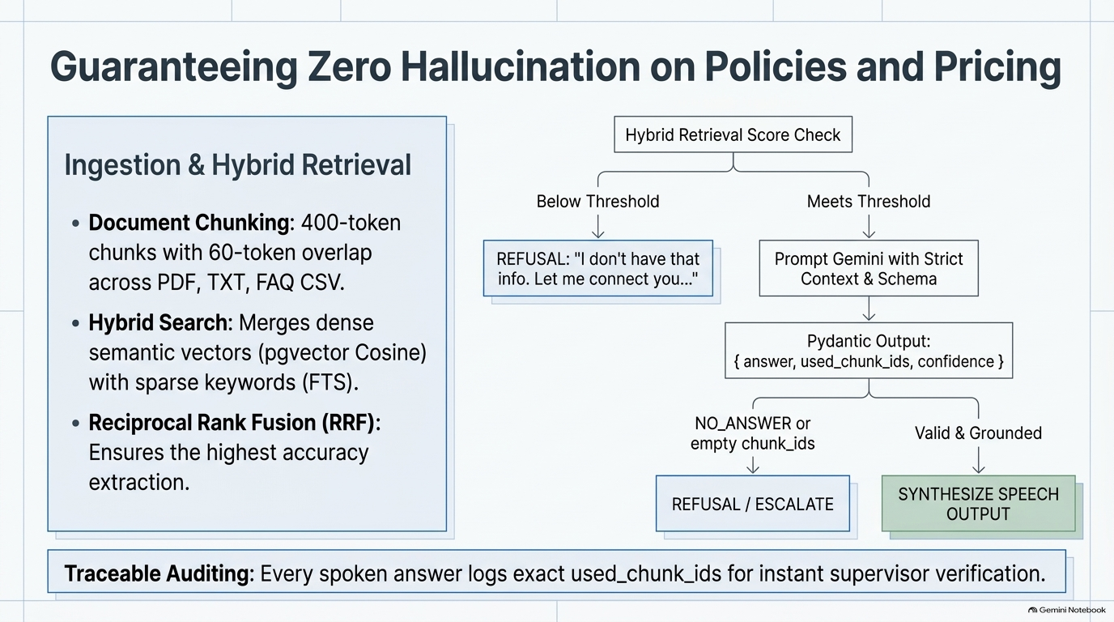
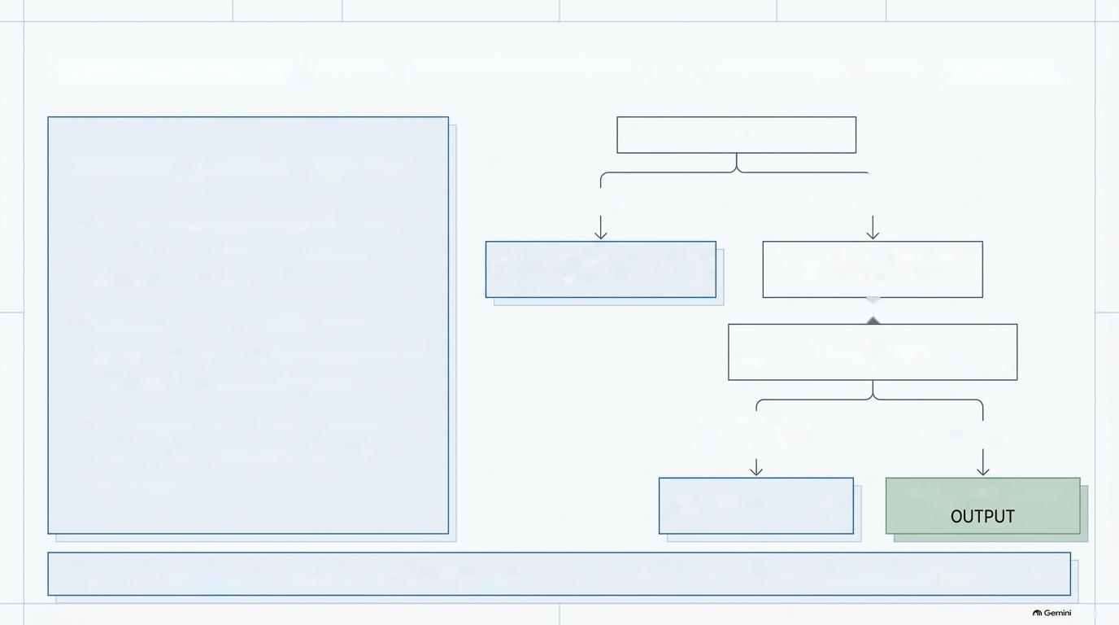
Guaranteeing Zero Hallucination on Policies and Pricing
Hybrid Retrieval Score Check
Ingestion & Hybrid Retrieval
}
Below Threshold
Meets Threshold
¢ Document Chunking: 400-token
chunks with 60-token overlap
REFUSAL: "| don't have that
Prompt Gemini with Strict
across PDF, TXT, FAQ CSV.
info. Let me connect you..."
Context & Schema
i}
¢ Hybrid Search: Merges dense
semantic vectors (pgvector Cosine)
Pydantic Output:
{ answer, used_chunk_ids, confidence }
with sparse keywords (FTS).
¢ Reciprocal Rank Fusion (RRF):
NO_ANSWER or
empty chunk_ids
Valid & Grounded
Ensures the highest accuracy
extraction.
REFUSAL / ESCALATE
SYNTHESIZE SPEECH
Traceable Auditing: Every spoken answer logs exact used_chunk_ids for instant supervisor verification.
Notebook

Slide 8
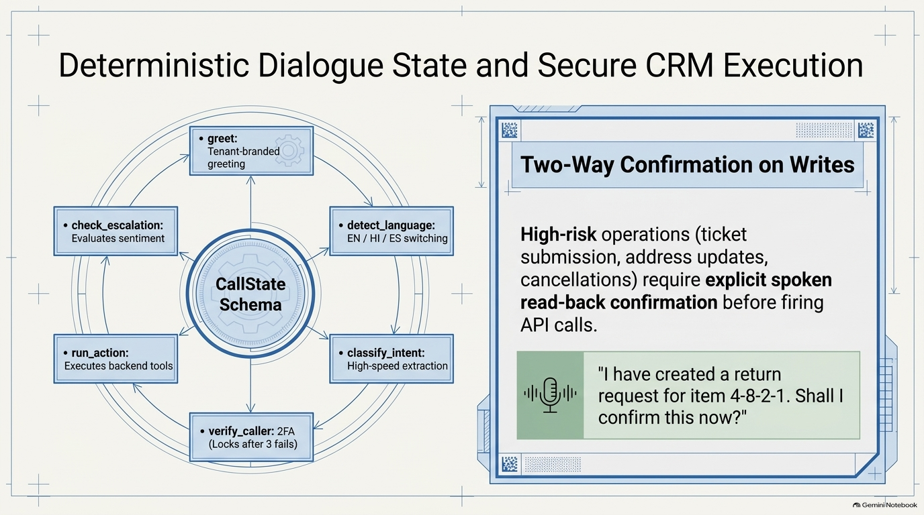
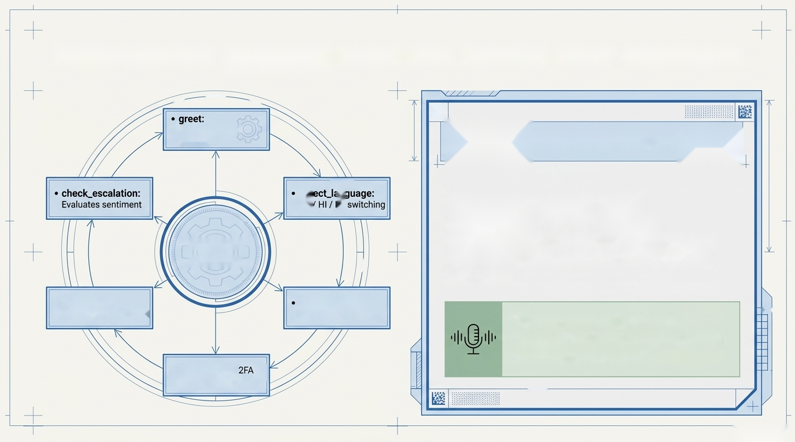
Deterministic Dialogue State and Secure CRM Execution
=
=
=
ke
Tenant-branded
Two-Way Confirmation on Writes
greeting
—-
EN eS
High-risk operations (ticket
submission, address updates,
CallState
cancellations) require explicit spoken
Schema
|
read-back confirmation before firing
API calls.
* run_action:
classify_intent:
Executes backend tools
High-speed extraction
"| have created a return
|
request for item 4-8-2-1. Shall |
confirm this now?"
* verify_caller: |
(Locks after 3 fails)
—
(Gemini Notebook

Slide 9
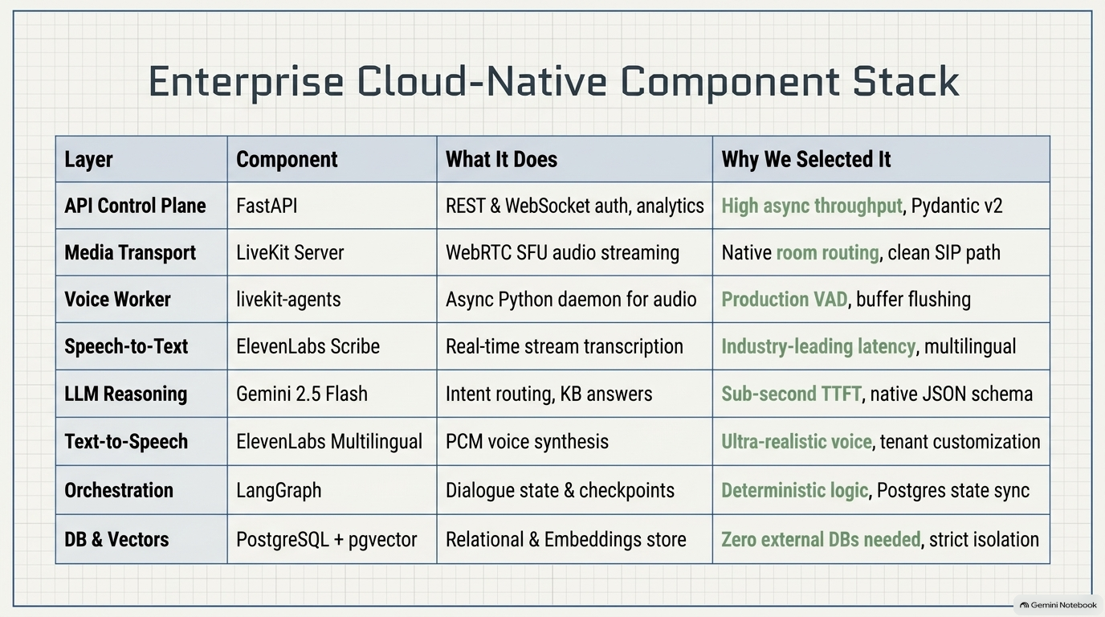

Enterprise Cloud-Native Component Stack
Layer
Component
What It Does
Why We Selected It
API Control Plane
FastAPI
REST & WebSocket auth, analytics
High async throughput, Pydantic v2
Media Transport
LiveKit Server
WebRTC SFU audio streaming
Native room routing, clean SIP path
Voice Worker
livekit-agents
Async Python daemon for audio
Production VAD, buffer flushing
Speech-to-Text
ElevenLabs Scribe
Real-time stream transcription
Industry-leading latency, multilingual
LLM Reasoning
Gemini 2.5 Flash
Intent routing, KB answers
Sub-second TTFT, native JSON schema
Text-to-Speech
ElevenLabs Multilingual
PCM voice synthesis
Ultra-realistic voice, tenant customization
Orchestration
LangGraph
Dialogue state & checkpoints
Deterministic logic, Postgres state sync
DB & Vectors
PostgreSQL + pgvector
Relational & Embeddings store
Zero external DBs needed, strict isolation
Notebook

Slide 10
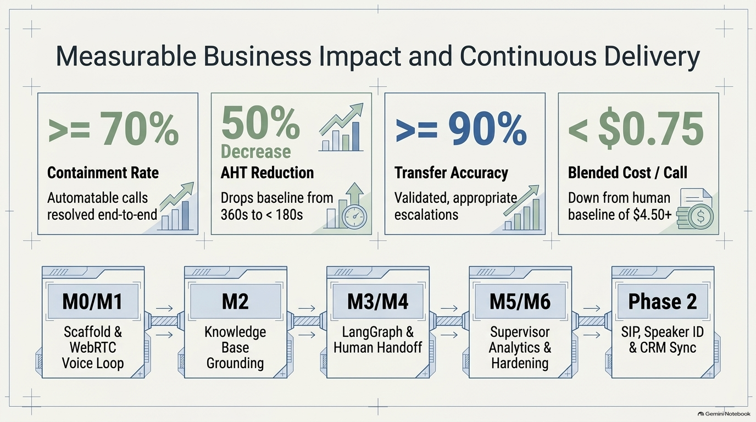
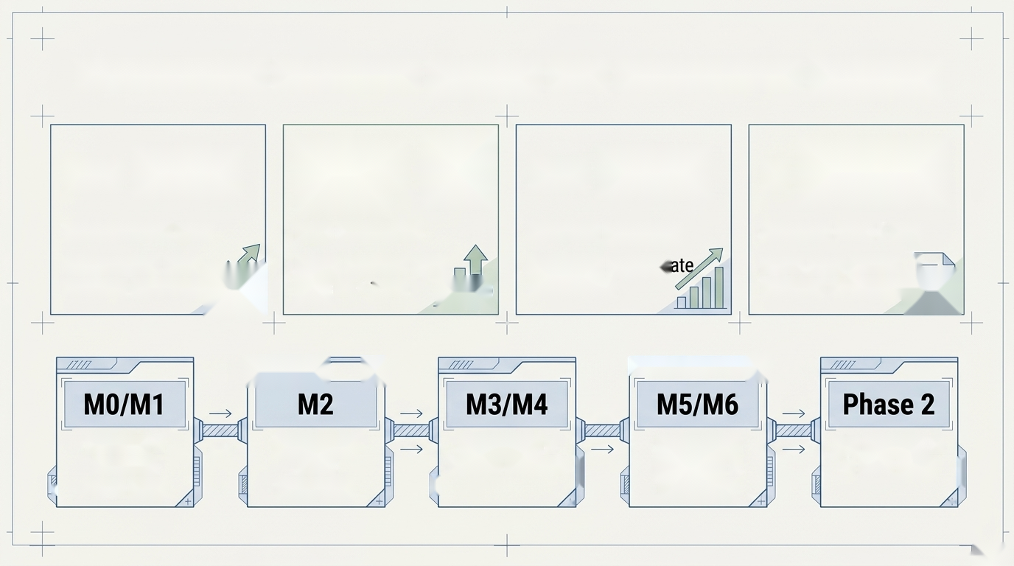
Measurable Business Impact and Continuous Delivery
90%
él
>= 90%
< $0.75
>= 70%
Decrease
Containment Rate
AHT Reduction
Transfer Accuracy
Blended Cost / Call
Automatable calls
Drops baseline from
Validated, appropri
Down from human |
resolved end-to-end All|
360s to < 180s He |
baseline of $4.50+ &G)
escalations
—_ |
ey |
=
Scaffold &
_—
Knowledge
LangGraph &
Supervisor
SIP, Speaker ID
WebRTC
Base
4 Human Handoff E
Analytics &
& CRM Sync E
4
Voice Loop
Grounding
Hardening
4
A
Gemini Notebook

