Slide 1

AIR BNB CASE STUDY
Submitted by:
Sudhanshu Raj
Jagdeeshan
Riya Chetwani

Slide 2

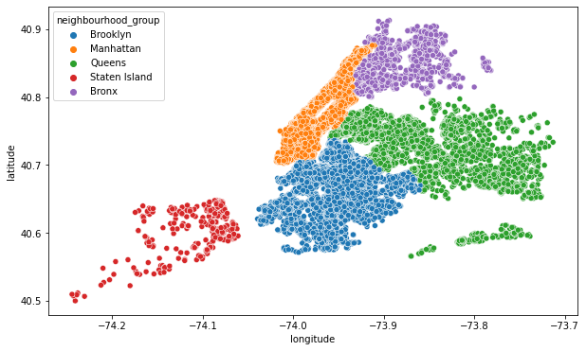
As we can see Manhattan has the highest number of properties listed (44.17%), followed by Brooklyn (41.02%) which is evident in the orange and blue cluster shown in the map.

Slide 3
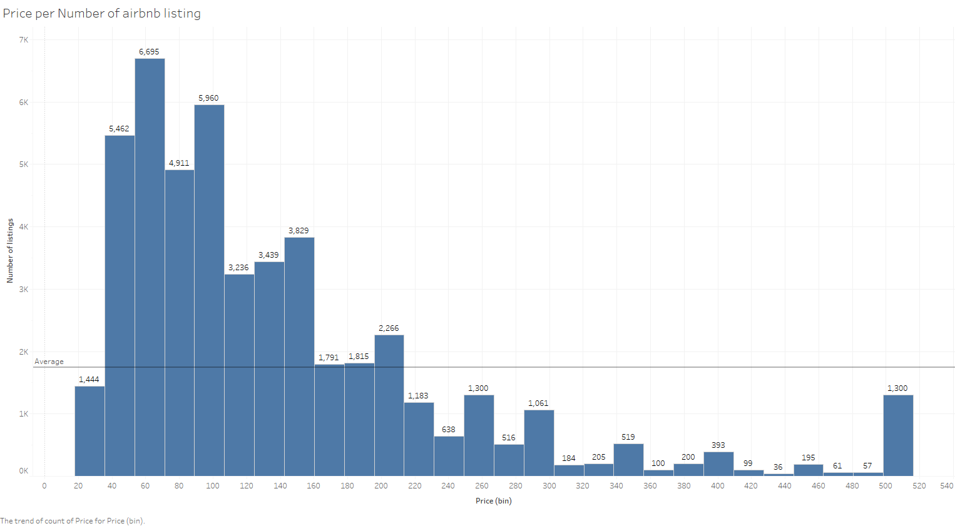
The most preferred price category was $ 30 to $150 as majority of the listings were priced in that range.

Slide 4
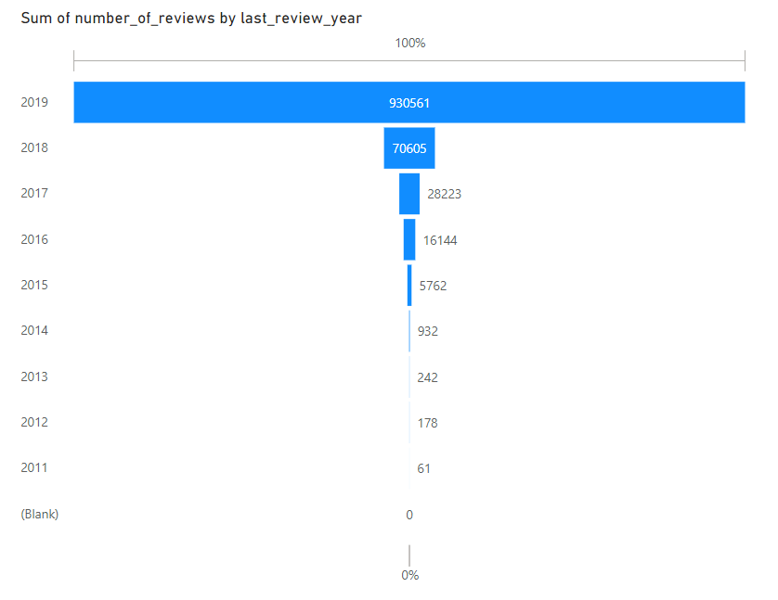
The listed properties received a huge number of reviews in year 2019 as compared to the previous years.
So this indicates the increasing trend of people going out on vacation an thereby increase in company’s revenue.
So the company should be more inclined on being ready for much more increase in the number of customer and be ready to sever them better in order to gain a good business in future.

Slide 5
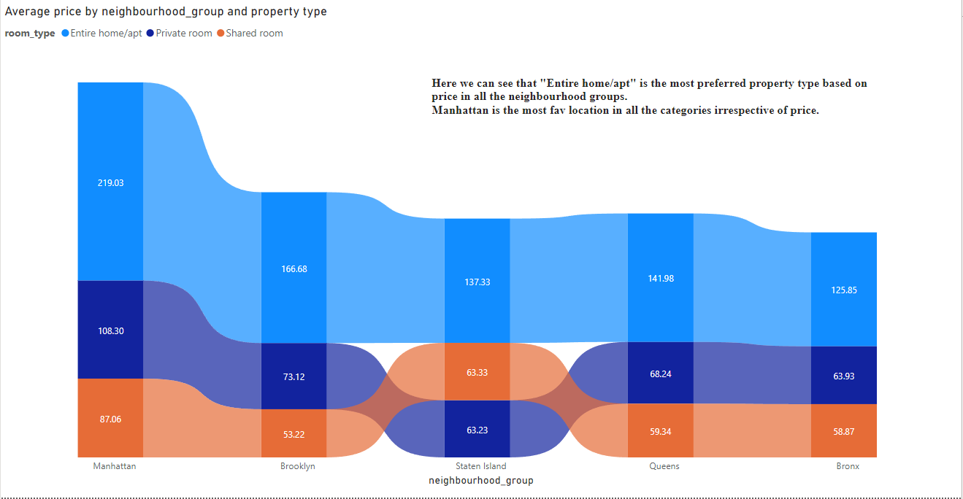
Manhattan has the highest avg price of $175.37 followed by Brooklyn with $117.21. Bronx has the lowest avg pricing at $85.21.

Slide 6
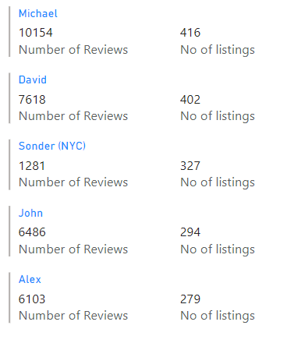
As shown these were the top 5 hosts with most number of reviews and also most number of properties listed on the platform

Slide 7
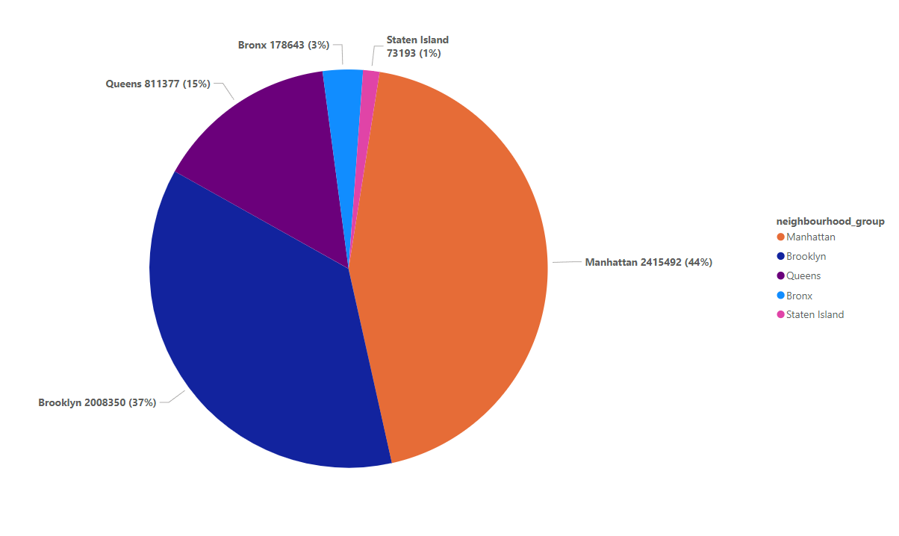
This pie chart shows the availability of the property throughout the year.
Manhattan has the highest availability with being available for 44% of the total days.
Staten Island was least available with only 1% availability.

Slide 8
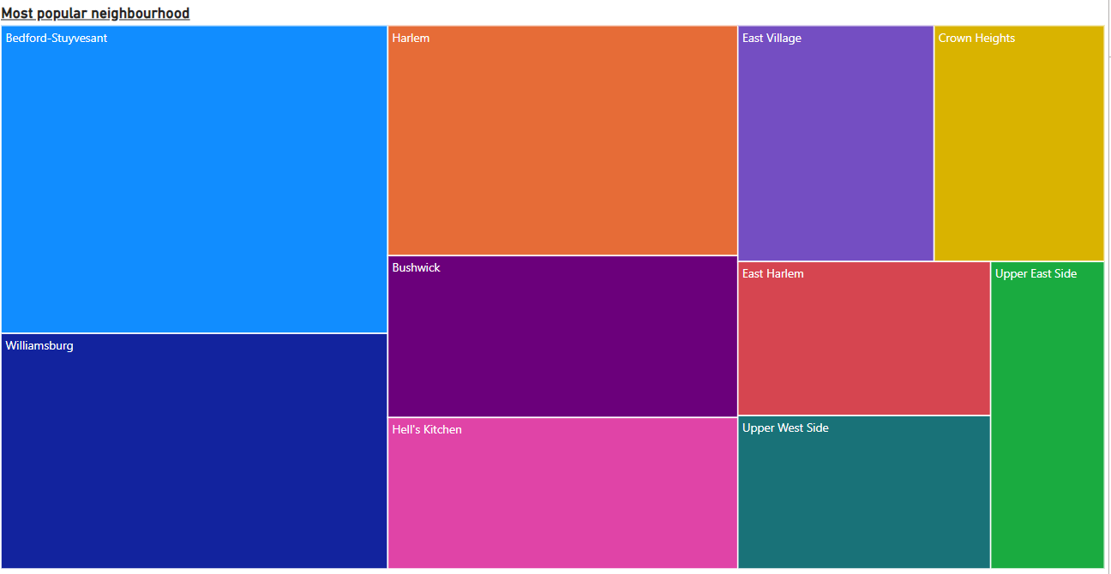
Bedford-Stuyvesant is the most friendly neighborhood with the highest number of reviews followed by Williamsburg and Harlem.
If company wants to expand its business it can prefer these neighborhood, and also focus in strengthening/maintaining the existing properties to aim for more good returns from these localities.

Slide 9
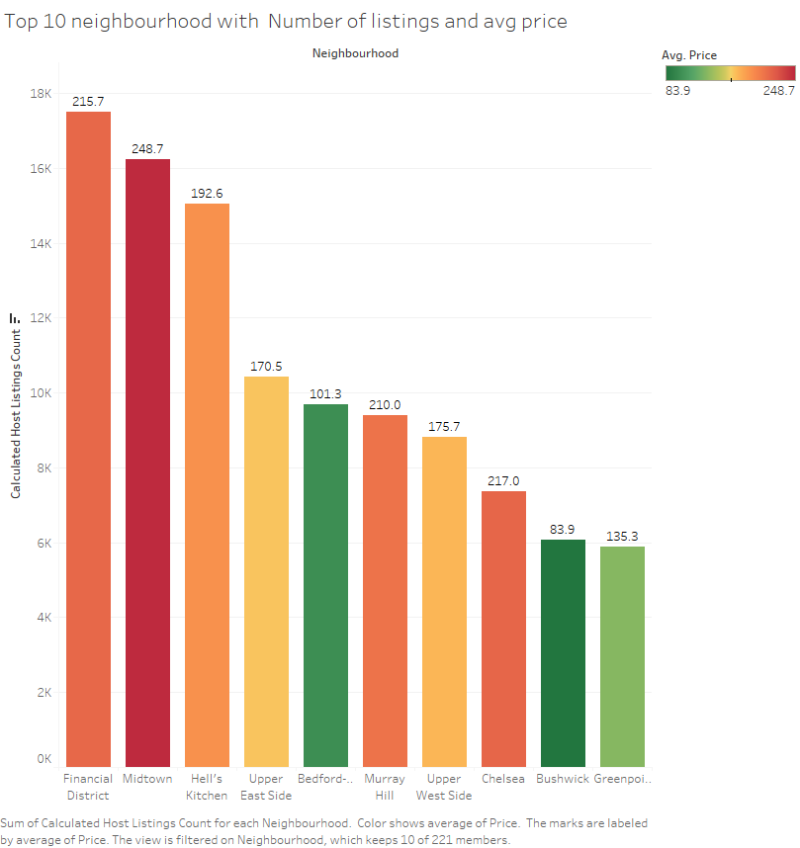
These are the top 10 neighborhood WRT the total number of properties present there and also the avg price in that neighborhood.
Midtown has the highest avg price whereas Bushwick is the lowest.
Financial district has the highest number of listings
Based on the company’s requirement we can consider the localities, if the company is looking to expand then Financial District should not be the choice as it is already very crowded an might cause troubles in future. Greenpoint can be a choice for expansion but it does not has good reviews and also the avg price is also high. Based on our earlier visualization Bedford-Stuyvesant will be a good choice for expansion as it has all the favorable stats, number of reviews is also high, avg price is also decent at $101.3 and also it is not very much crowded

Slide 10
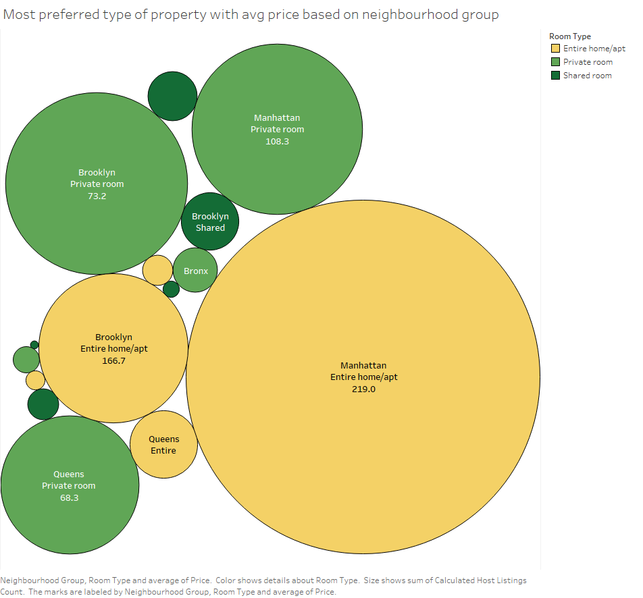
“Entire home/apt” followed by ‘Private Room’ is the most preferred property type and also Manhattan is the popular location.
However in Brooklyn Private rooms are the first preference for the customers.
“Shared Rooms” category is not much popular among the customers in any locations.
So in order to increase revenue, if the company expands then it should focus more on “Entire Home/Apt” and “Private Room” category.

