Slide 1

CREDIT EDA ASSIGNMENT By SUDHANSHU Raj

Slide 2
PROBLEM STATEMENT
This assignment aims to identify the patterns that indicate if a client has difficulty in loan repayment which can be used to take actions such as refusing the loan, reducing the amount of loan, lending cash loans etc. This will ensure that loan is not rejected for the consumers capable of repaying timely.
By this analysis company can understand the driving factors behind loan default, i.e. the variables which are strong indicators of default. The company can utilize this knowledge for its success and risk assessment.

Slide 3
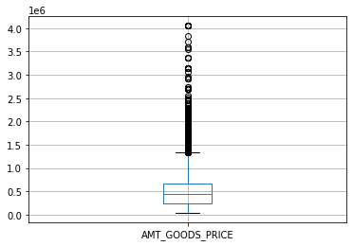
Initial steps I performed before starting the analysis.
I searched for columns having missing values more than 40 % and then removed those columns as part of Data cleaning.
Then there were some columns that still had missing values but they had very less percent of missing values, so instead of removing I imputed them with mode and median of respective cols. E.g. :
By this graph we see that there are outliers present, so it is good to take median for imputing the missing values.
3. Then I looked for errors in the data, data types, xna, negative values, and rectified those errors.
4. Finally I created bins of the columns where it was possible to create like Days of birth.

Slide 4
CHECKING FOR OUTLIERS

Slide 5
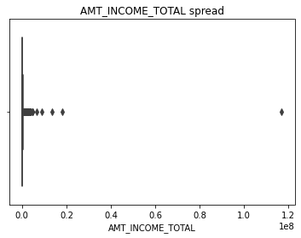
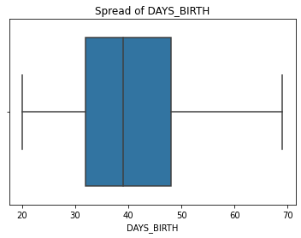
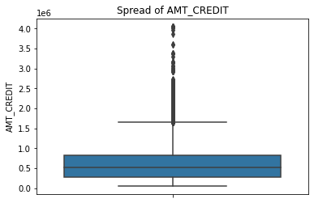
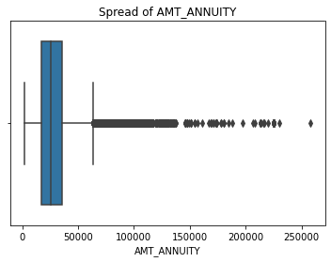
Used BOX-PLOT to check for Outliers.

Slide 6
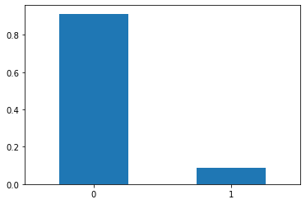
IMBALANCE RATIO
The graph shows the imbalance between the two values of the variable TARGET.

Slide 7
UNIVARIATE ANALYSIS OF COLUMNS

Slide 8
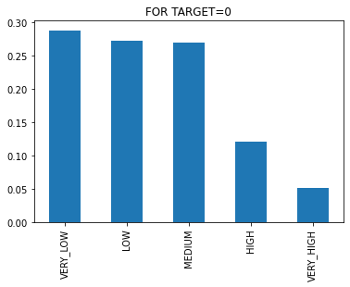
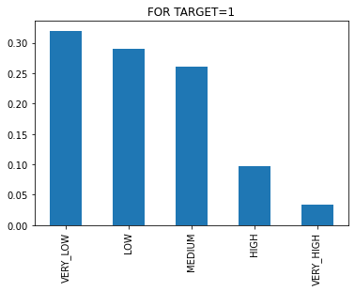
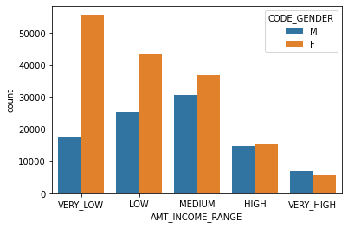
AMT_INCOME_RANGE
1. From the above plot we see that for both target 1 and target 0 the Very_low category is the highest and very high is lowest. We can say that people with higher income take less loans and also are the least defaulters when compared to people with very low income for both the target categories.
2. Also Females have a higher credit that males in almost all income ranges.

Slide 9
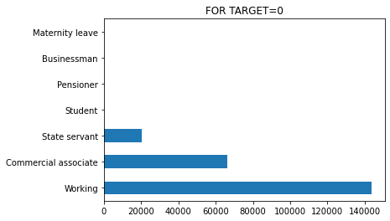
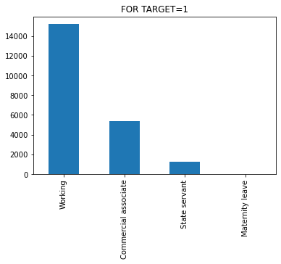
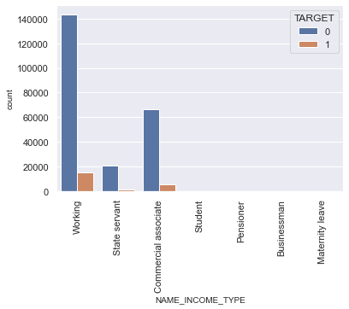
AMT_INCOME_TYPE
1. From the above we see that for Target=0 the first 3 categories have higher credits than others.
2. Also Majority of the defaulters are from Working category for Target 1
3. 'student’, 'pensioner’ and 'Businessman' don't do any late payments as these categories are not shown in the target=1 graph.
4. ‘Working’ category has the highest count credit count, amongst all category.

Slide 10
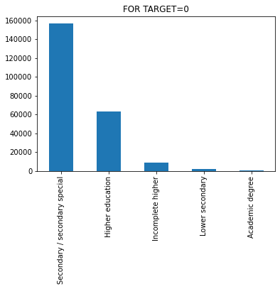
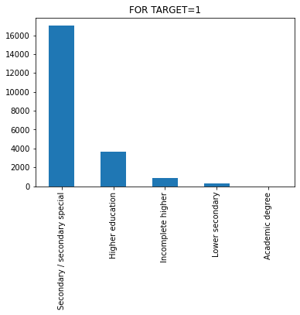
NAME_EDUCATION_TYPE
Here we see that there is no such major difference in loan application based on education type, as the highest point and lowest point is nearly same, and also the other values are also nearly same for both Target 0 & 1

Slide 11
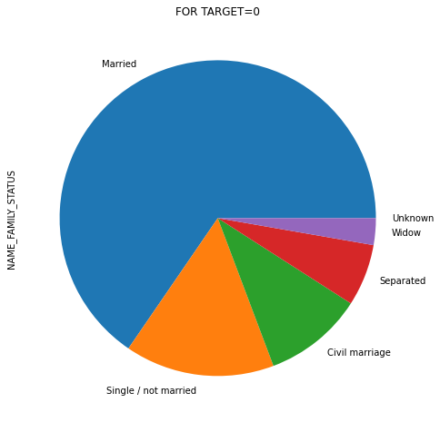
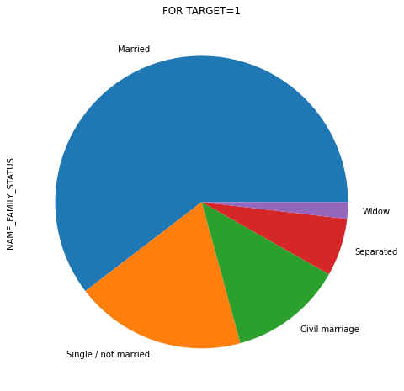
NAME_FAMILY_STATUS
1. At first glance we see that there is no such major difference b/w the two. But for Target=0 there are few unknown values also, but not in Target=1.
2. Also Married people are taking more loans and also are the highest defaulters amongst the others.

Slide 12
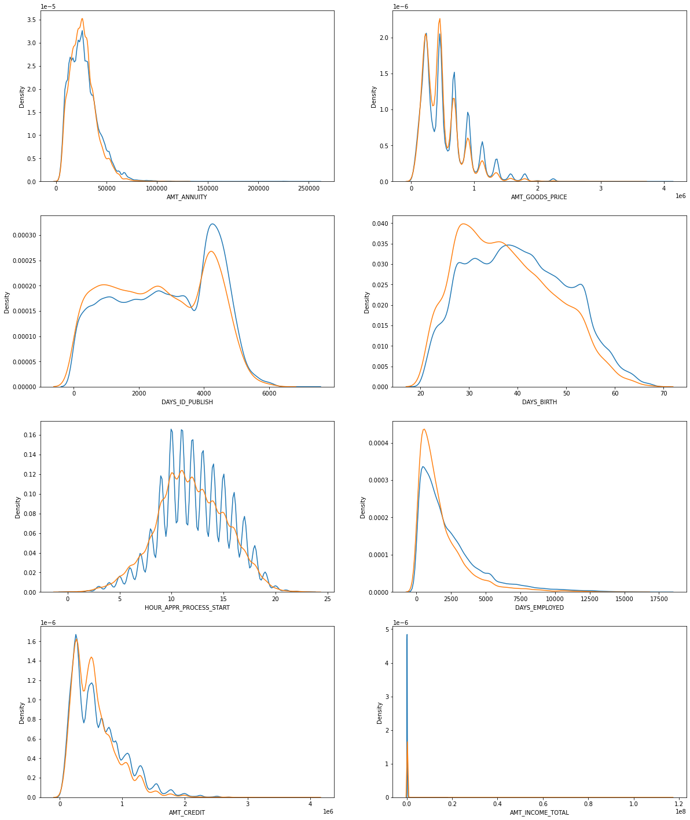
Continuous Numerical Columns
From the above graphs we can say that:
1. More loans are taken for less quantity of goods but at a higher price.
2. People with higher Credit tend to have less Annuity.
3. People employed for less time take more loans.
4. People aged 25-40 take more loans.
5. People with less annuity have higher number of loans.
6. Between 10-15 (i.e. 10 AM- 3PM) most of the applications are processed.

Slide 13
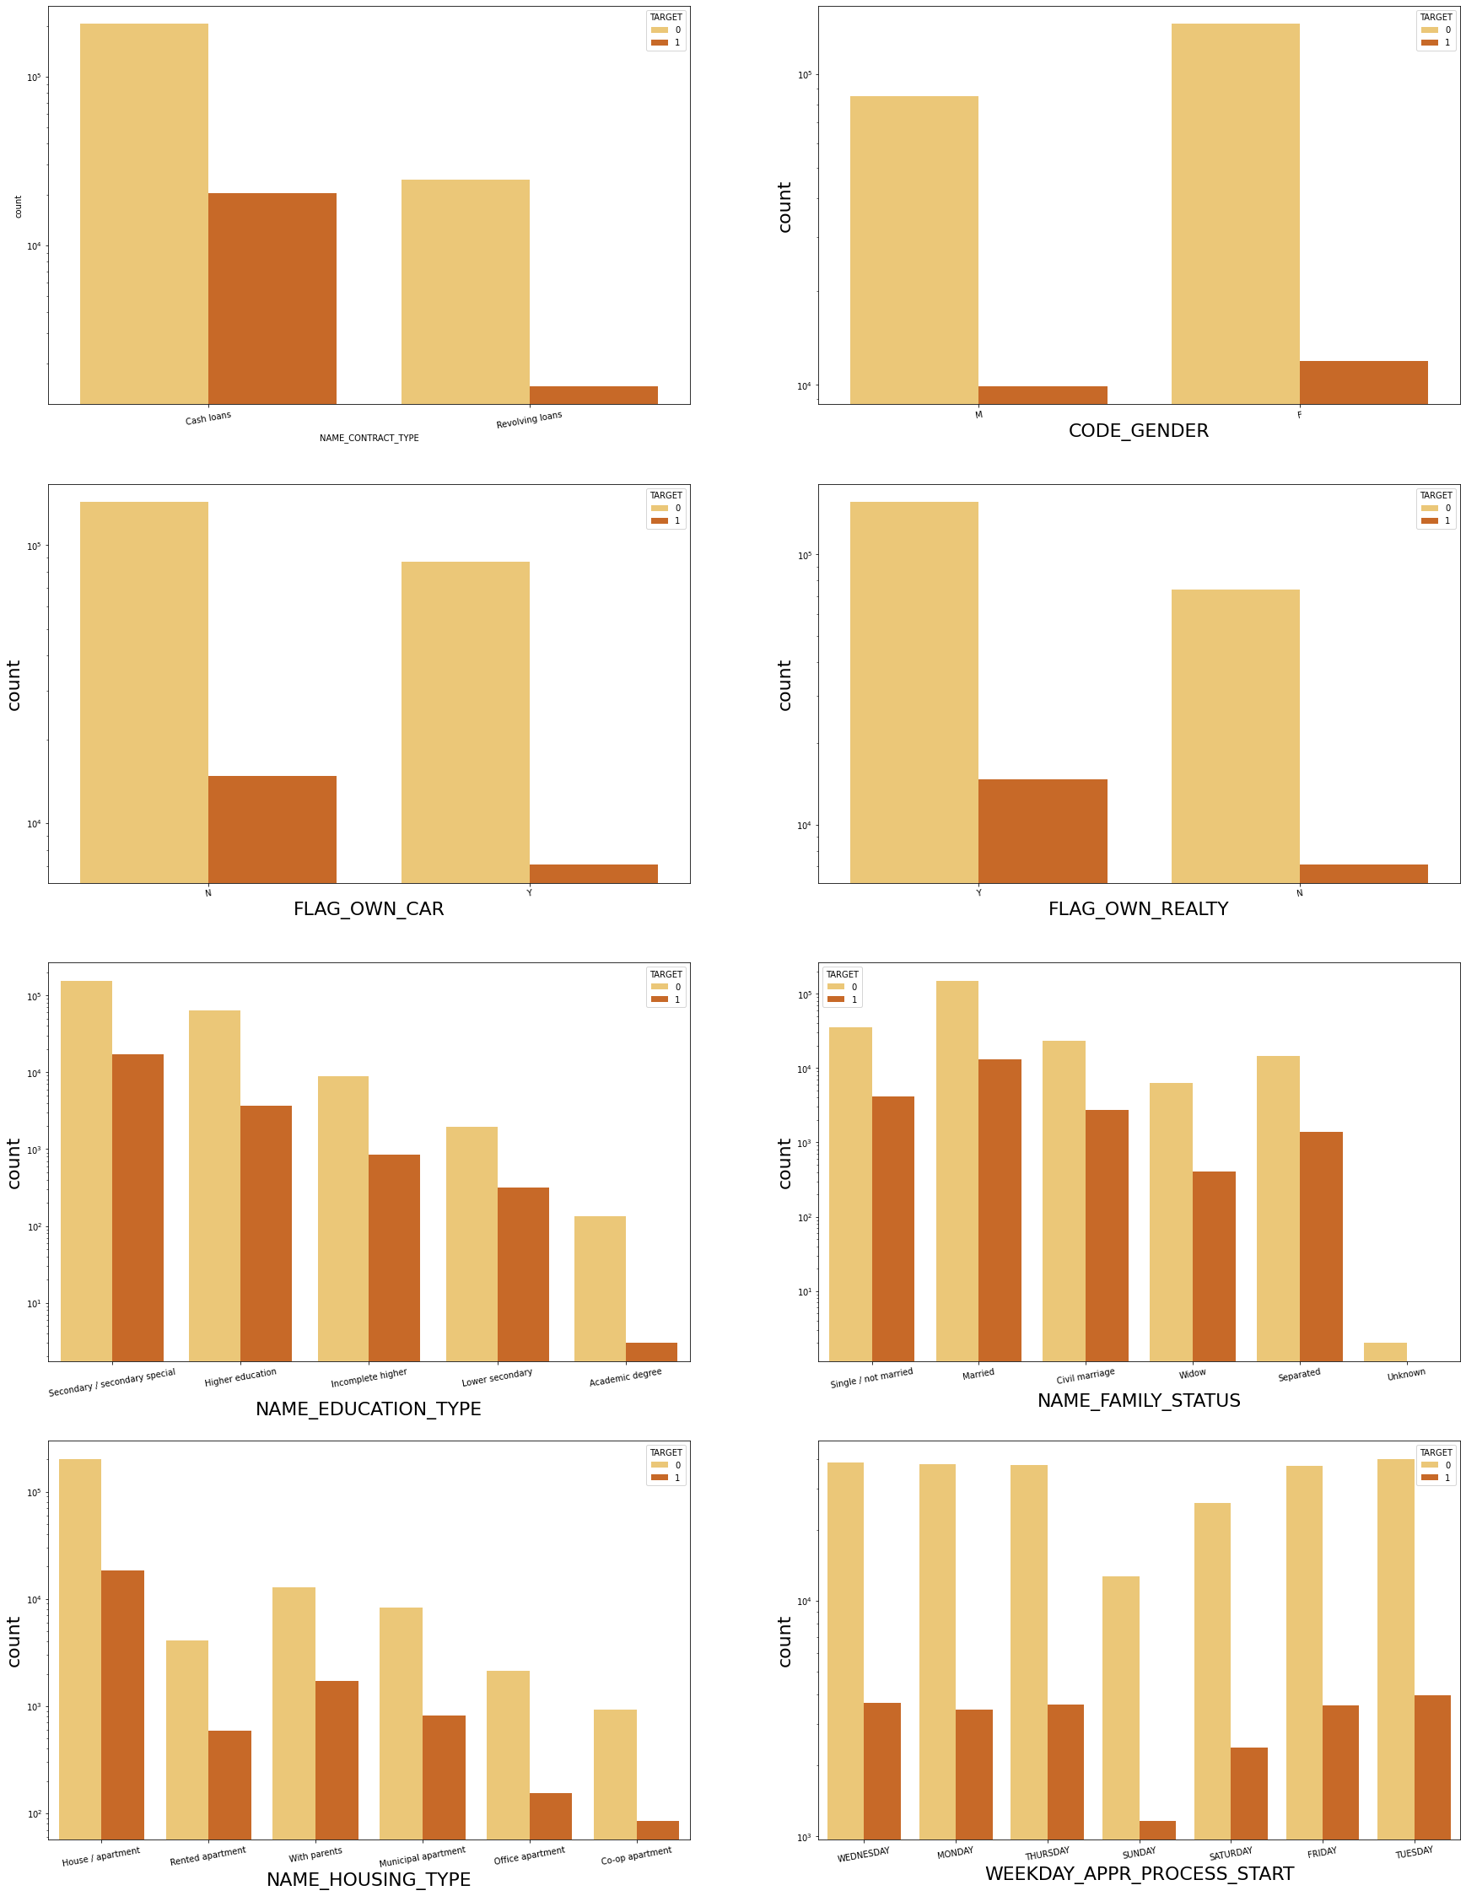
Continuous Categorical Columns
From the above graphs we see that:
1. People taking cash loans more than revolving loans, and also are more likely to default.
2. As a total Females take more loans.
3. People who do not have car take more loans.
3. as compared to people without cars, people with cars also have a pretty good numbers for defaulting.
4. Loan application are less on Saturday and Sunday. hence the defaulting chances are also at par with the other days.
5. Married people take more loans and also lead the defaulter section.

Slide 14
BI-VARIATE ANALYSIS OF COLUMNS

Slide 15
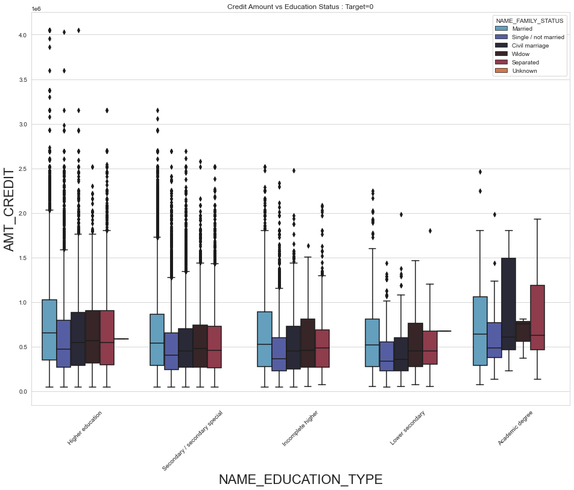
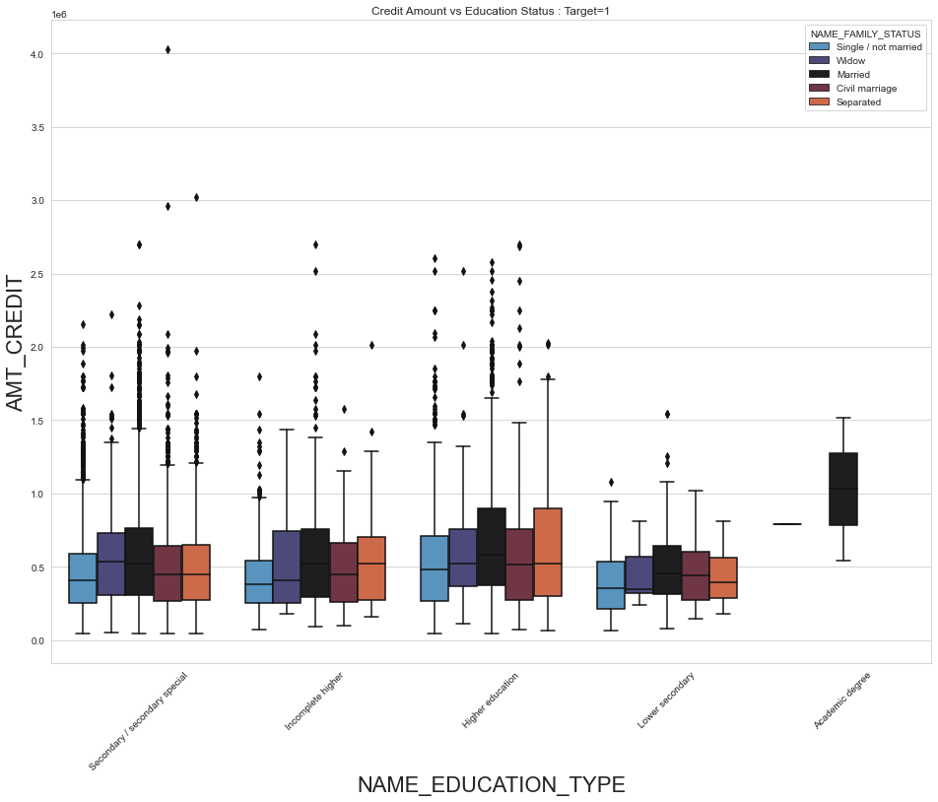
AMT_CREDIT vs NAME_EDUCATION_TYPE

Slide 16
From the graphs in previous slide we can say that :
1. For target=0 Education type "higher education" have the most outliers for married, 'single' and 'civil marriage' categories.
2. For target=0 Married people and separated people with Academic degree have high credit.
3. For target=0 "Civil Marriage" has most values in third quantile.
4. For target=1 "Secondary/secondary special" has the most outliers for 'civil marriage'
5. For target=1 "Married" of Academic degree has no outliers
Over all the graph of both the variable are same, and secondary and higher education type have the most number of outliers.

Slide 17
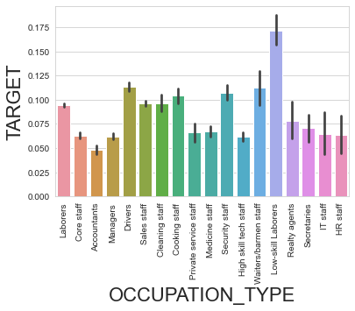
OCCUPATION_TYPE vs TARGET as whole
From this graph we see that :
1. Low-Skill laborers category have high defaulting rate.
2. Accountants have the lowest defaulting rate.

Slide 18
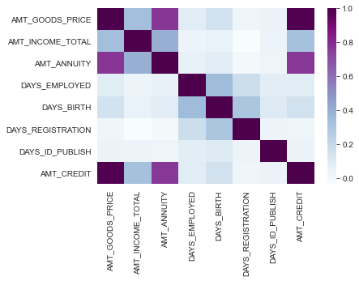
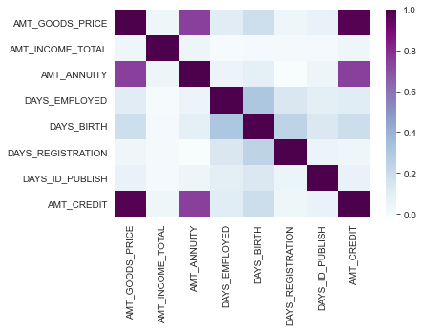
CORRELATION HEATMAP of TARGET VARIABLES
Target=0
Target=1
By these plots we see that Credit amount and Goods Price are highly co-related.
Also there is some deviation in co-relation between Total income VS Credit amount, total income vs goods price.

Slide 19
CHECKING FROM PREVIOUS DATA

Slide 20
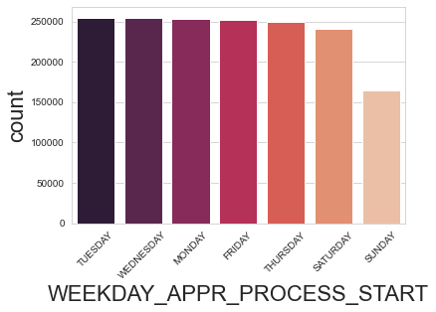
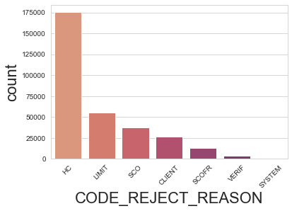
UNIVARIATE ANALYSIS
From this graph we can see that the number of applications decline over the week and by weekend it is the lowest.
We see from the graph that HC is the major reason due to which applications got rejected.

Slide 21
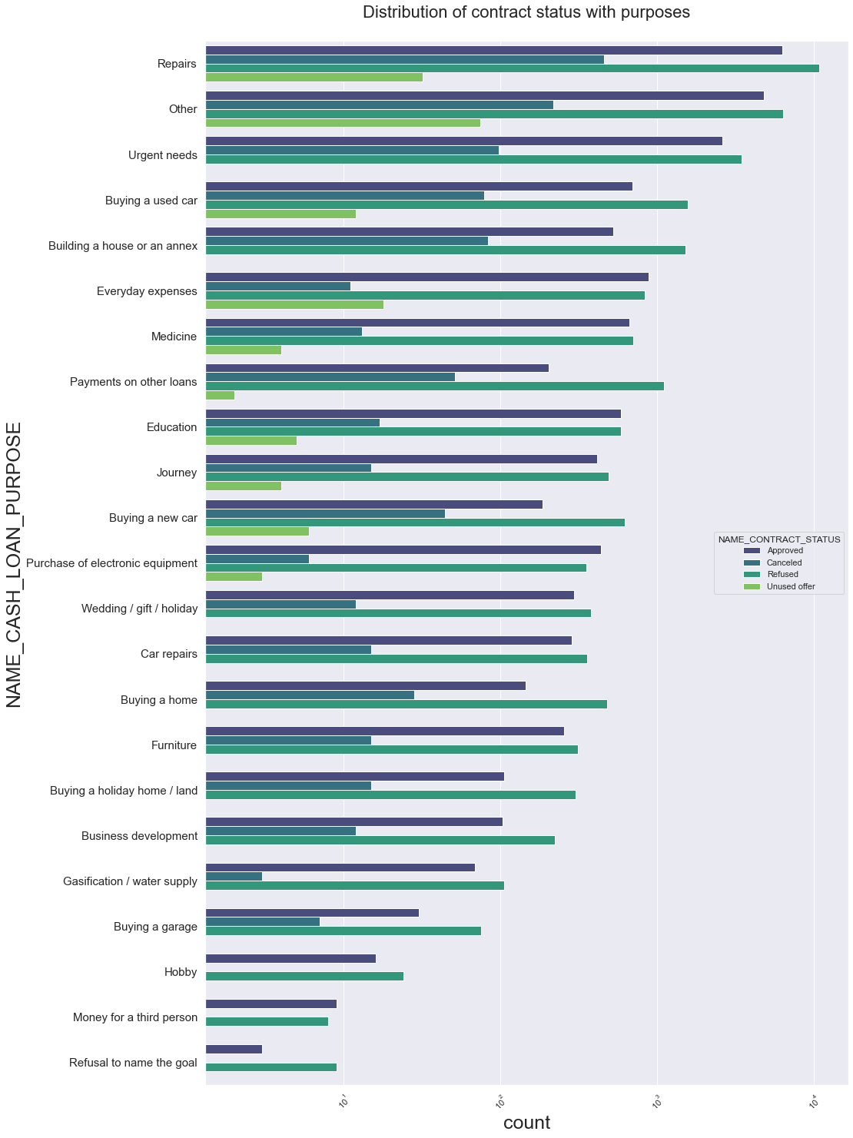
BIVARIATE ANALYSIS
Analysis on NAME_CASH_LOAN_PURPOSE and NAME_CONTRACT_STATUS
Points to be concluded from above plot:
"Other" purpose has highest number of Unused offers.
For purpose 'Repairs the maximum number of loans were Refused.
Equal amount of loans were approved as well as rejected for "Education" purpose.
Paying other loans and buying a new car both have higher rejection than approves.

Slide 22
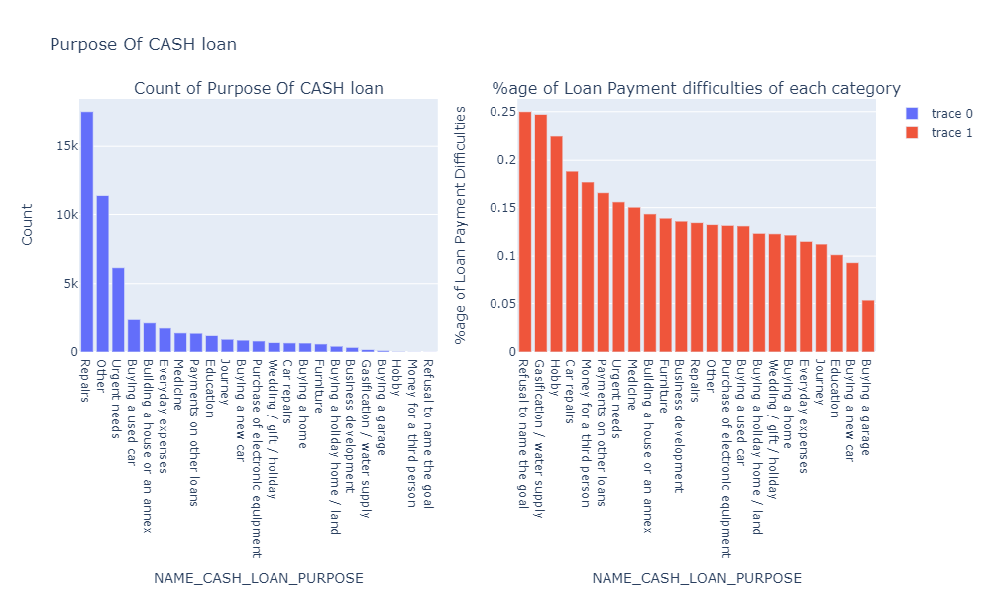
NAME_CASH_LOAN_PURPOSE vs Loan payment difficulty
1. We can see here that Maximum Cash loans were given for "Repair" purpose.
2. "Refusal to name the goal" has the most difficulty in loan payment.

Slide 23
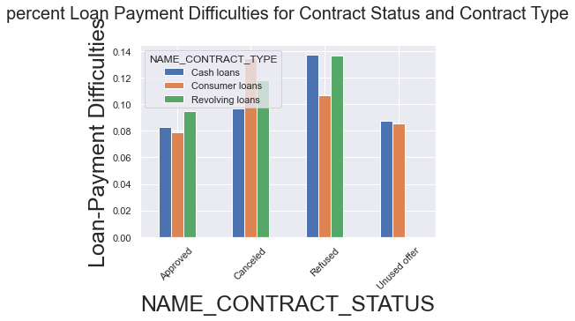
CONTRACT STATUS vs CONTRACT TYPE
Points to be concluded from above plot:
1. Revolving loans with Refused previous application have more loan payment difficulties in current application.
2. Also Cash loans with Refused previous application also have high loan payment difficulties in current application.
3. All types of approved loans have significantly low loan payment difficulties as compared to others.

Slide 24
INSIGHTS & CONCLUSIONS
1. Application Data
The count of 'Maternity Leave' in 'NAME_INCOME_TYPE' is very less and it also has maximum payment difficulties- around 40%. Hence, client with income type as 'Maternity leave' are the major factors for Loan Defaulters.
The count of 'Low skilled Laborers' in 'OCCUPATION_TYPE' is very less, where in it has max payment difficulties - appx. 17%. Hence, client with occupation type as 'Low skilled Laborers' can be considered as major factors for Loan Defaulters.
The count of 'Lower Secondary' in 'NAME_EDUCATION_TYPE' is comparatively very less and it also has maximum % of payment difficulties- around 11%. Hence, client with education type as 'Lower Secondary' are the reasons for Loan Defaulters.

Slide 25
2. Previous Application Data
The count of 'Refusal to name the goal' in 'Cash loan purpose' is comparatively very less and it also has maximum percentage of payment difficulties- around 23%. Hence, client who ‘Refused to name the goal’ for cash loan in previous application are considered the driving factors for Loan Defaulters.
The count of 'Refused' in 'Contract Status' is less and also it has maximum % of payment difficulties- around 12%. Hence, again client with contract status as 'Refused' in previous application are the driving factors for Loan Defaulters.
It can be seen from the plot that Clients with 'Revolving loans' and with 'Refused' previous application have more payment difficulties in current application. So clients with 'Revolving Loans' and 'Refused' previous application are driving factors for Loan Defaulters
As a total the bank should not give any loans to people shown as possible defaulters and if need to give loan they should improve their repayment by a certain criteria.
THANK YOU

