Slide 1
Contents
Mean-variance portfolio -> optimization problem
Security margin -> stocks multipliers data (P/E), (P/B)
Diversification measures, e.g., effective number of constituents
Dirichlet process it’s proposed to sample stocks based on the multipliers -> you want to oversample stocks with low multipliers and evaluate the portfolio performance
We explore stocks contained in the cap weighted index SPI or SP500. Best if it is SPI.
How can we evaluate the performance of the portfolio? I would use returns over a study period, and the sharpe ratio (volatility-reward)

Slide 2


Portfolio optimization with security margin and diversification

Slide 3
Goals 1. How can we extend the mean-variance portfolio… 1.1 …using diversification 1.2 …using security margin 1.3 …consider value investing principles 2. Limit the drawdown of the portfolio

Slide 4
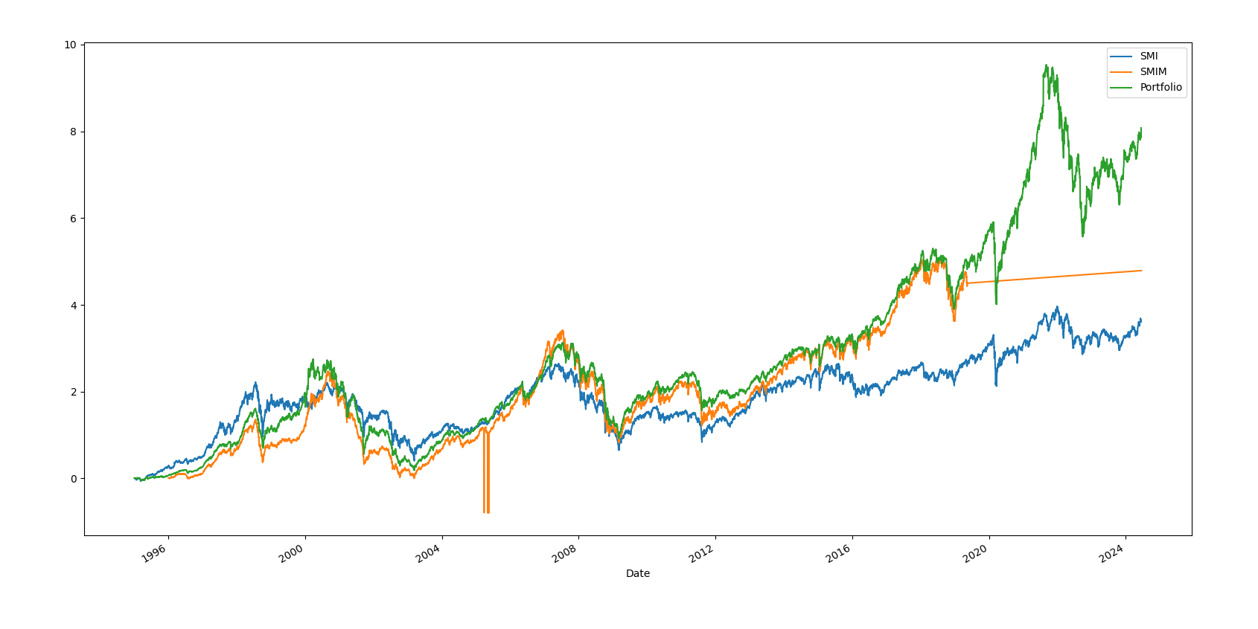
Dataset Preparation | Mean-Variance portfolio | Diversification | Simulation
Dataset from Eodhd APIs:
30 years of historical
Delisted stock included
Benchmark SMIM:
30 largest mid-cap stocks
Delisted stock included
6.37% - 15 years return
14.31% - 15 years volatility
Prof. Dr. Beat Muster
Funktion des Präsentierenden
TT. Monat JJJJ, Ort
STRENG VERTRAULICH

Slide 5
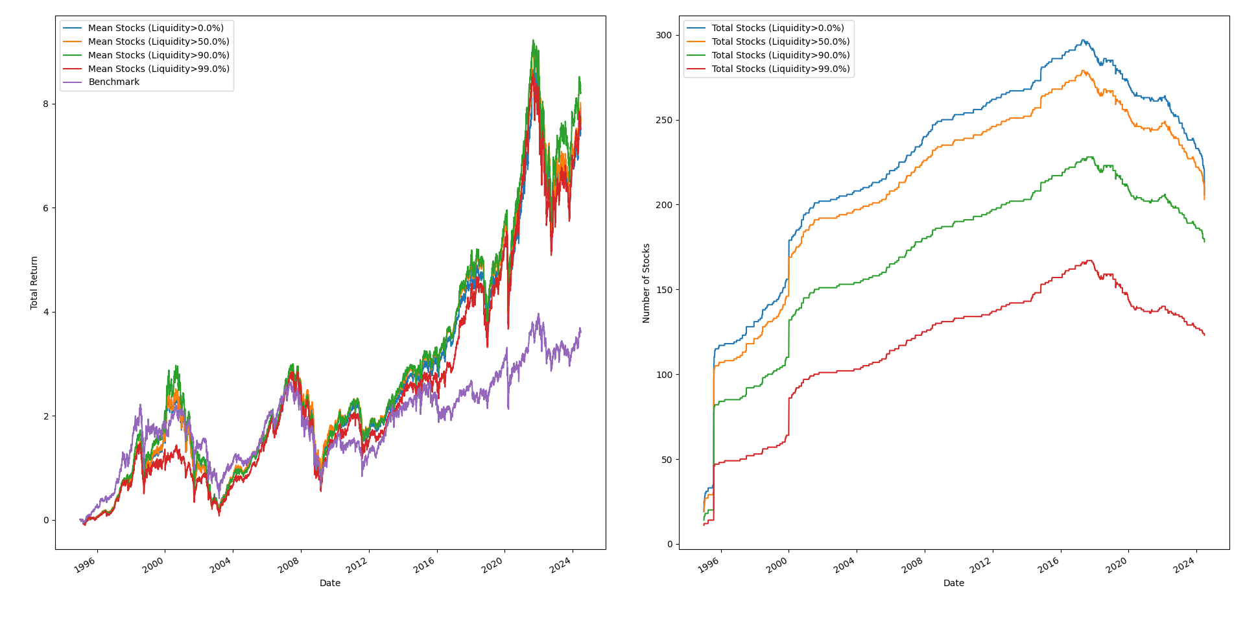
Dataset Preparation | Mean-Variance portfolio | Diversification | Simulation
Prof. Dr. Beat Muster
Funktion des Präsentierenden
TT. Monat JJJJ, Ort
STRENG VERTRAULICH

Slide 6
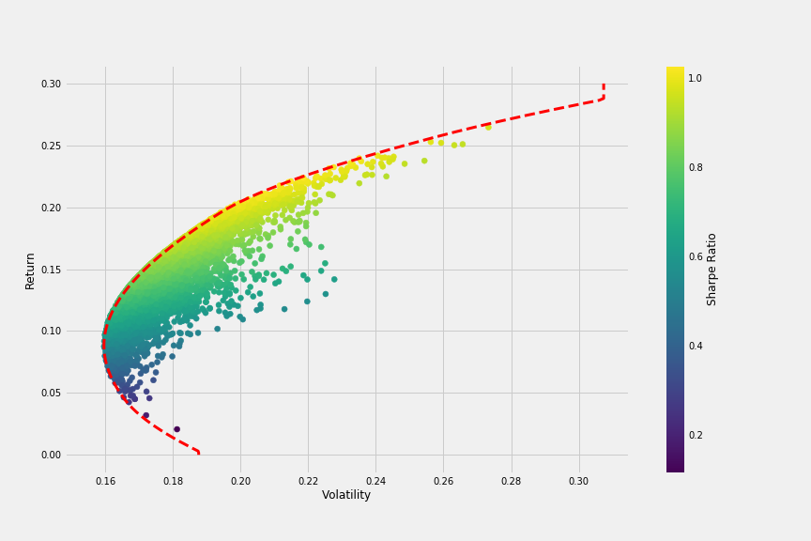
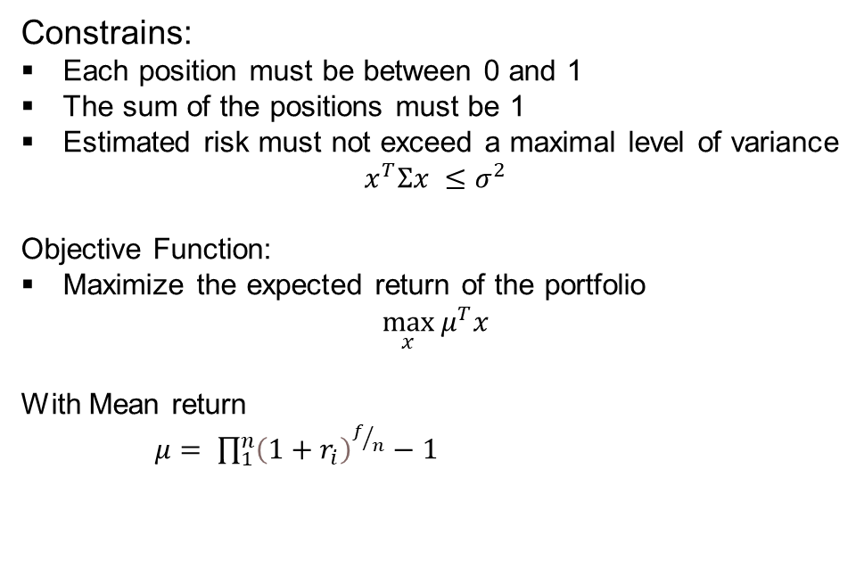
Dataset Preparation | Mean-Variance portfolio | Diversification | Simulation
Standard mean-variance portfolio selection model - Balance risk and expected returns
Constrains:
Each position must be between 0 and 1
The sum of the positions must be 1
Estimated risk must not exceed a maximal level of variance
$$x^{T}Σx ≤σ^{2}$$
Objective Function:
Maximize the expected return of the portfolio
$$\max_{x}{μ^{T}x}$$
With Mean return
$μ= \prod_{1}^{n}{{\left(1+r_{i}\right)}^{f/n}−1}$

Slide 7
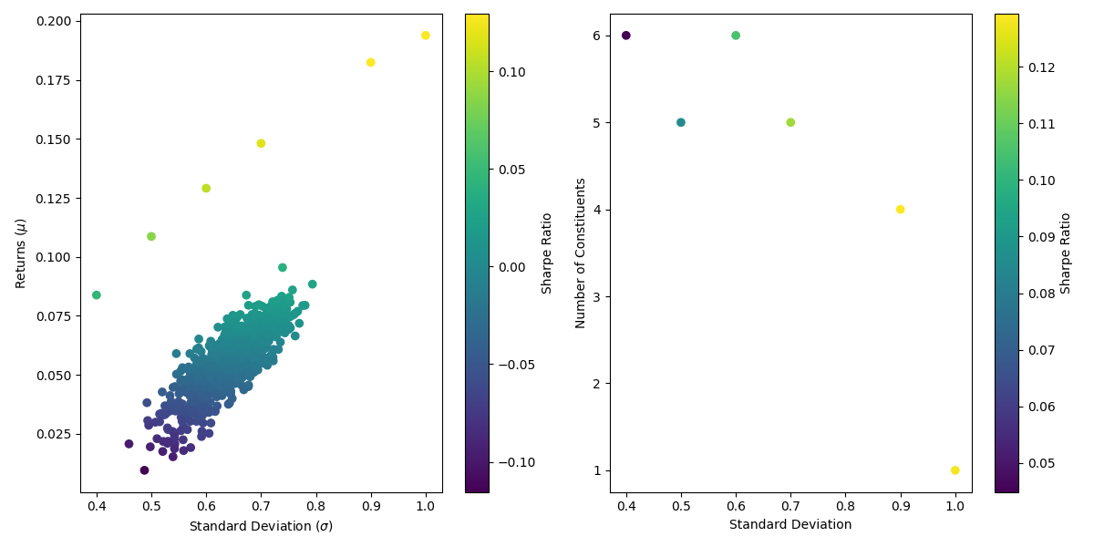
Dataset Preparation | Mean-Variance portfolio | Diversification | Simulation

Slide 8
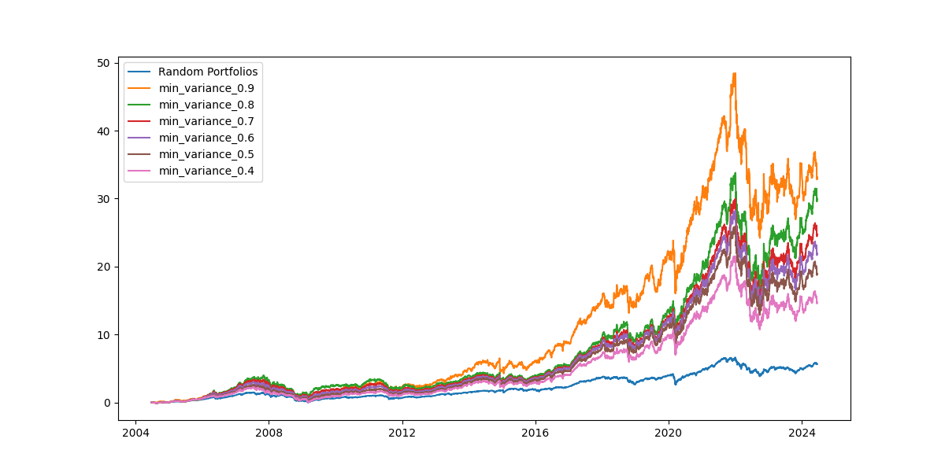
Dataset Preparation | Mean-Variance portfolio | Diversification | Simulation

Slide 9
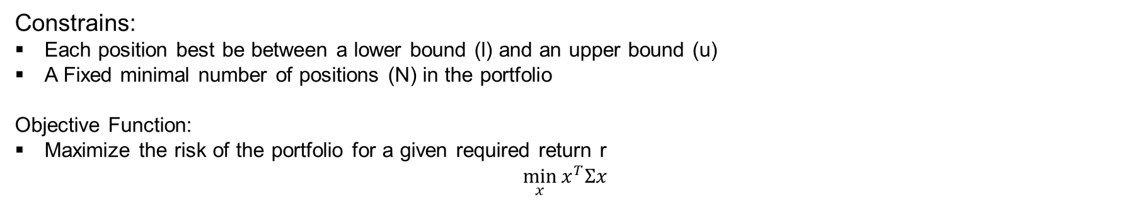
Dataset Preparation | Mean-Variance portfolio | Diversification | Simulation
Enforcing diversification
Constrains:
Each position best be between a lower bound (l) and an upper bound (u)
A Fixed minimal number of positions (N) in the portfolio
Objective Function:
Maximize the risk of the portfolio for a given required return r
$$\min_{x}{x^{T}Σx}$$
Prof. Dr. Beat Muster
Funktion des Präsentierenden
TT. Monat JJJJ, Ort
STRENG VERTRAULICH

Slide 10
Dataset Preparation | Mean-Variance portfolio | Diversification | Simulation
Enforcing diversification
Constrains:
Each position best be between a lower bound (l) and an upper bound (u)
A Fixed minimal number of positions (N) in the portfolio
Objective Function:
Maximize the risk of the portfolio for a given required return r
$$\min_{x}{x^{T}Σx}$$
Prof. Dr. Beat Muster
Funktion des Präsentierenden
TT. Monat JJJJ, Ort
STRENG VERTRAULICH

Slide 11
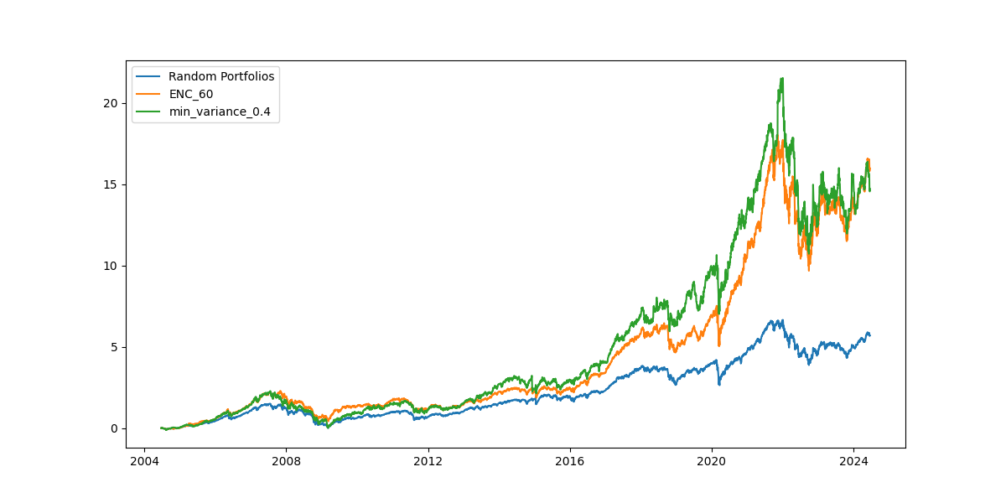
Mean-Variance portfolio | Security Margin | Diversification | Simulation
Prof. Dr. Beat Muster
Funktion des Präsentierenden
TT. Monat JJJJ, Ort
STRENG VERTRAULICH

Slide 12
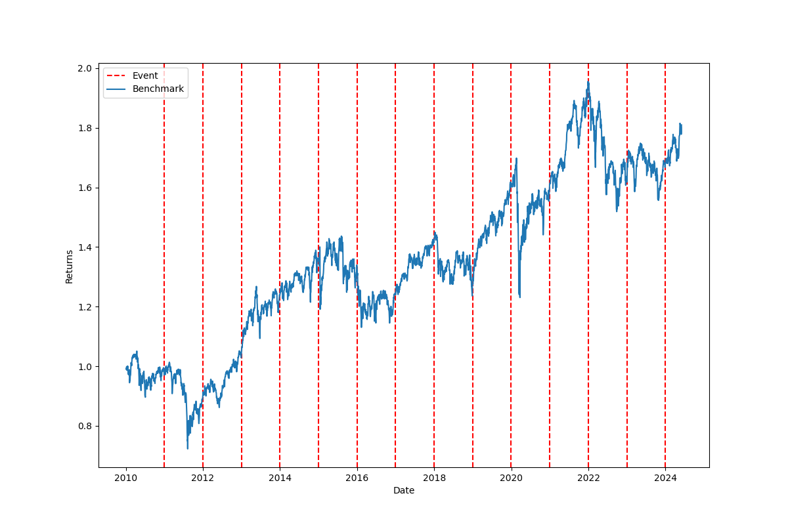
Mean-Variance portfolio | Security Margin | Diversification | Simulation
Goal:
Test the out of sample performance
Multiple years
With regular investment event
Currently broken

