Slide 1
Contents
Mean-variance portfolio -> optimization problem
Security margin -> stocks multipliers data (P/E), (P/B)
Diversification measures, e.g., effective number of constituents
Dirichlet process it’s proposed to sample stocks based on the multipliers -> you want to oversample stocks with low multipliers and evaluate the portfolio performance
We explore stocks contained in the cap weighted index SPI or SP500. Best if it is SPI.
How can we evaluate the performance of the portfolio? I would use returns over a study period, and the sharpe ratio (volatility-reward)

Slide 2

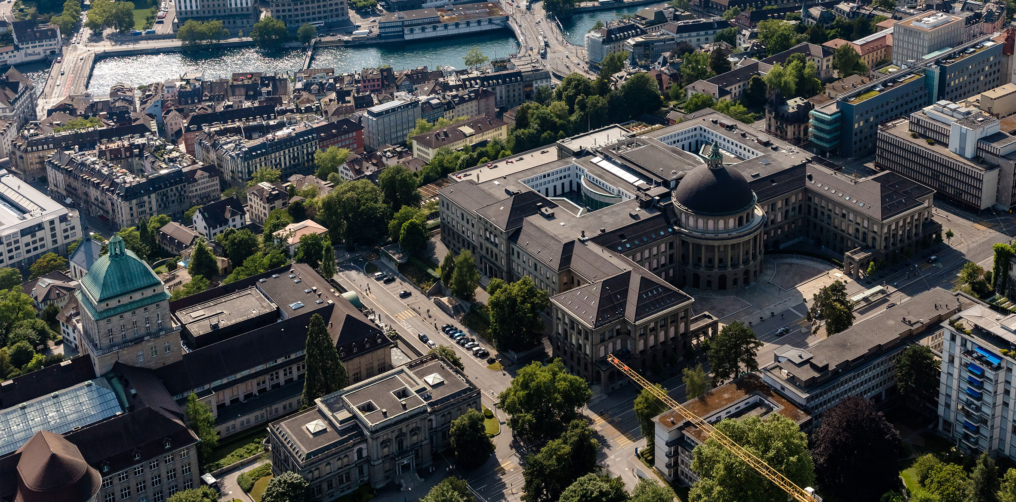
Hier steht der Titel der Präsentation
Prof. Dr. Beat Muster
Funktion des Präsentierenden
TT. Monat JJJJ, Ort
STRENG VERTRAULICH

Slide 3
Goals

Slide 4
How can we extend the mean-variance portfolio to consider value investing principles? – security margin and diversification
Limit the drawdown of the portfolio

Slide 5
Mean-Variance portfolio | Security Margin | Diversification | Performace
Prof. Dr. Beat Muster
Funktion des Präsentierenden
TT. Monat JJJJ, Ort
STRENG VERTRAULICH

Slide 6

The efficient frontier - Mean-Variance portfolio
Mean variance: mathematical framework used to construct the efficient frontier
Form the basis of Modern portfolio theory
x is the weights
μ is the vector of expected returns.
Σ is the return covariance matrix.
The condition implied that the sum of weights is 100%
Set of optimal portfolios that gives the highest expected return for a given level of risk (risk-return tradeoff)
They maximize the return for a given risk
https://gurobi-optimization-gurobi-optimods.readthedocs-hosted.com/en/latest/mods/portfolio.html

Slide 7
Weights => Very quick (max 45 seconds) => Explain the input of the frontier
+ SMI (https://www.marketscreener.com/quote/index/SMI-7508/components/)
How the weights of the SMI are distributes
+ Example

Slide 8
Expected return => Very quick (max 45 seconds) => Explain the input of the frontier
+ Daily data (yahoo finance), normalization
+ Return plots (formula), cumulative returns + SMI average (good for comparison later)

Slide 9
Covariance matrix => Very quick (max 45 seconds) => Explain the input of the frontier
+ Provide a measure of strength of correlation between two variable or a bigger set of variables
+ Image
+ Analisis with the biggest correlation and the lower correlation assets

Slide 10

Sharpe ratio => Very quick (max 45 seconds) => Explain the valuation of the frontier
Used to evaluate the risk-adjusted return of an instement
Less than 1: Bad
1 – 1.99: Adequate/good
2 – 2.99: Very good
Greater than 3: Excellent
https://corporatefinanceinstitute.com/resources/career-map/sell-side/risk-management/sharpe-ratio-definition-formula/
Efficient frontier have higher sharpe ratio, offer best return for the level of risk.
Portfolio with higher sharpe ratio called Optimal portfolio
Point on the efficient frontier line where the ratio is higher
What is the risk free rate and what is the value in the case of Switzerland

Slide 11
Frontier
Example with 2 assets, then 3 assets

Slide 12
Frontier
Results on the SMI, plot with the red for where the SMI stays, and the best on the vertical and horizontal plus the best the Sharpe ratio

Slide 13
Mean-Variance portfolio | Security Margin | Diversification | Performace
Prof. Dr. Beat Muster
Funktion des Präsentierenden
TT. Monat JJJJ, Ort
STRENG VERTRAULICH

Slide 14
Security margin – (vs) Value investing
stocks multipliers data
-
Used to compare the company performance
Value investing uses a lot more parameters
Security margin is a subset of value investing

Slide 15
Ratios
(P/E)
(P/B)
(P/S)
Debot to Equity Ratio

Slide 16
Yield
Dividend yield
Earnings Yield

Slide 17
Returns
Return on Equity (ROE)
Return on Assets (ROA)

Slide 18
Mean-Variance portfolio | Security Margin | Diversification | Performace
Prof. Dr. Beat Muster
Funktion des Präsentierenden
TT. Monat JJJJ, Ort
STRENG VERTRAULICH

Slide 19
Diversification
effective number of constituents

Slide 20
Mean-Variance portfolio | Security Margin | Diversification | Performace
Prof. Dr. Beat Muster
Funktion des Präsentierenden
TT. Monat JJJJ, Ort
STRENG VERTRAULICH

Slide 21
Dirichlet process it’s proposed to sample stocks based on the multipliers -> you want to oversample stocks with low multipliers and evaluate the portfolio performance

