Slide 1
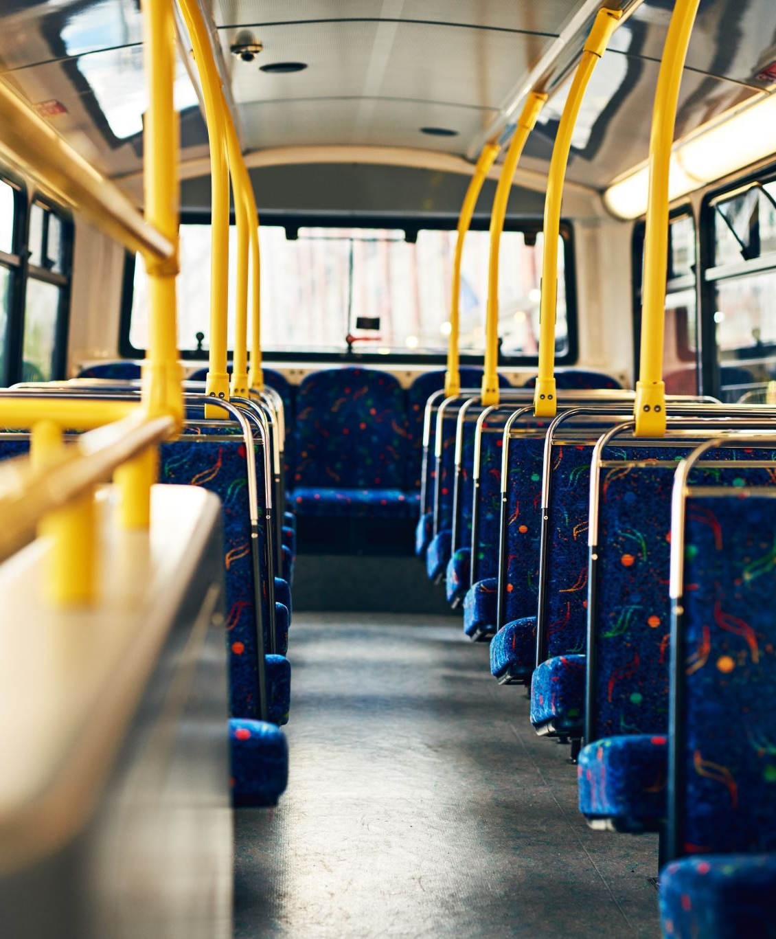
BUS RESERVATION SYSTEM
Presented by-
SAUBHAGYA CHAUDHARI(2100290110146)
SAURABH KASHYAP(2100290110147)
SHIKHAR YADAV(2100290110153)
https://github.com/Saubhagya717312/BusReservationSystem.git

Slide 2
INTRODUCTION
Bus Reservation System is software that handles the entire booking data of the Bus. It is fully based on the concept of reserving bus tickets for various destinations.
The system uses bus information, which includes the bus number, seat number, and the passenger's name, to book a seat on the bus. Under the passenger's name, the specific bus seat number is booked.
This will eventually help you organize the reserved passenger to safely depart after reservation.

Slide 3
TOOLS USED
Language used: C++
Coding Tool used: Visual Studio Code
Concepts used: Arrays

Slide 4
MODULES
Can Add Bus Information
Reserve Passenger Seat
View Available Bus Seat
View Total Passenger Reserved

Slide 5
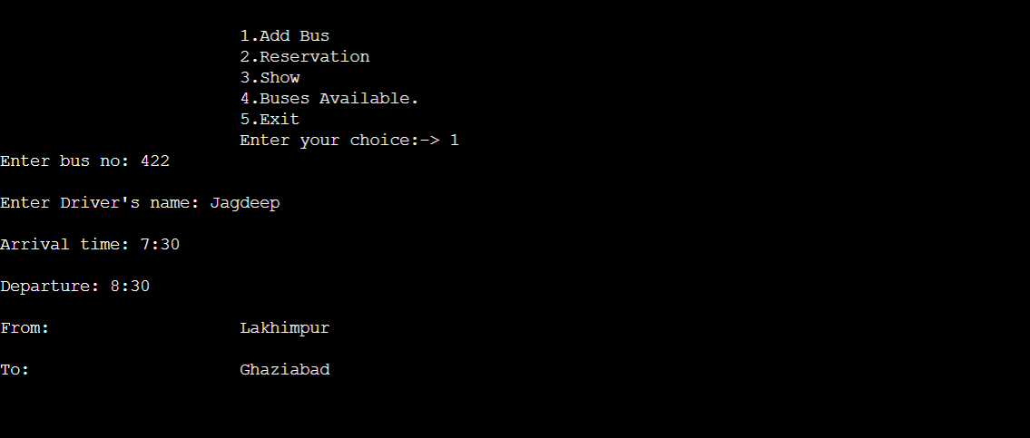
SAMPLE OUTPUT
addBus():

Slide 6
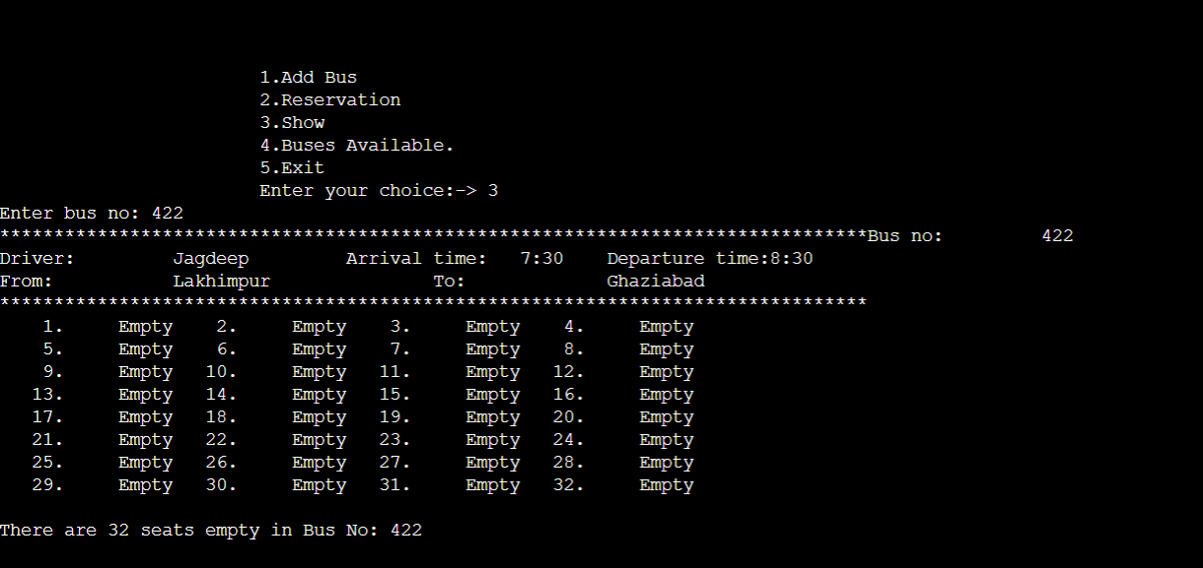
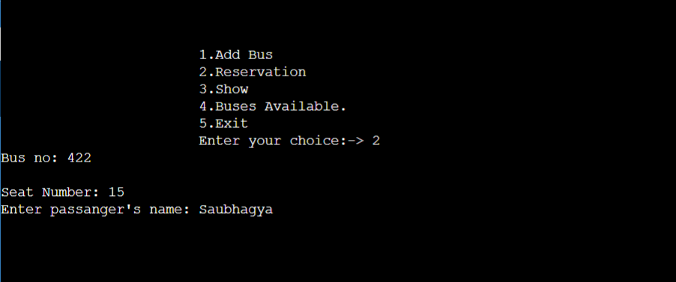
SAMPLE OUTPUT
show():
reserve():

Slide 7
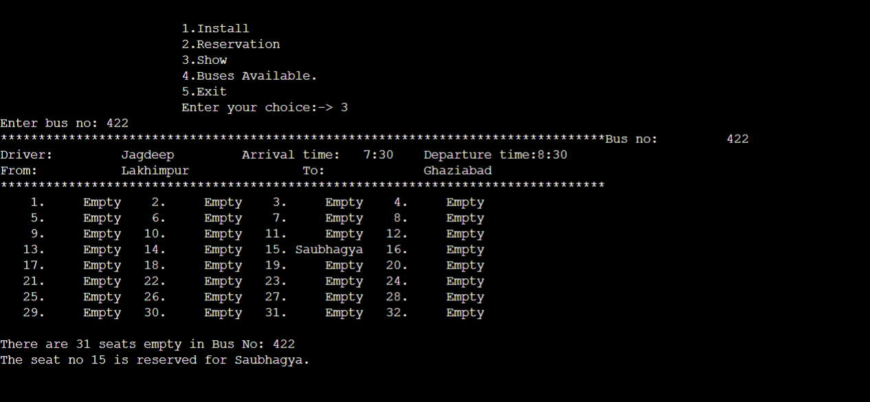
SAMPLE OUTPUT
show():

Slide 8
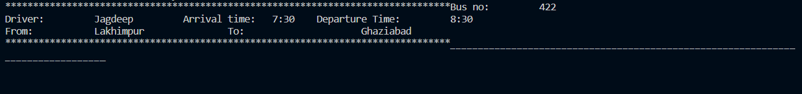
SAMPLE OUTPUT
avail():

Slide 9
THANK YOU

