Slide 1
TASK SCHEDULER
DAA LAB (PBL PROJECT)
Presented by-
Saubhagya Chaudhari(2100290110146)
Saurabh Kashyap(2100290110147)

Slide 2
PROBLEM STATEMENT
A task scheduler is a system that manages and executes tasks based on their priority levels. In this context, a task refers to a unit of work that needs to be executed, and each task is associated with a priority value. The priority queue and min-heap are data structures that help efficiently organize and retrieve tasks based on their priorities.
Priority Queue with Min-Heap: The priority queue is implemented using a min-heap data structure. A min-heap is a binary tree where the value of each node is less than or equal to the values of its children, ensuring that the smallest element (highest priority in this context) is at the root of the heap.

Slide 3
ALGORITHM
Heapify is an algorithm used to create or maintain the heap property of a binary heap data structure. The heap property ensures that the value of each node is less than or equal to the values of its children, creating a specific order that is useful for priority queue implementations.
Two main operations:
1. HeapifyUp
2. HeapifyDown
HeapifyUp :
HeapifyUp is used when a new element is inserted into the heap, typically at the end, and we
need to ensure that the heap property is maintained.

Slide 4
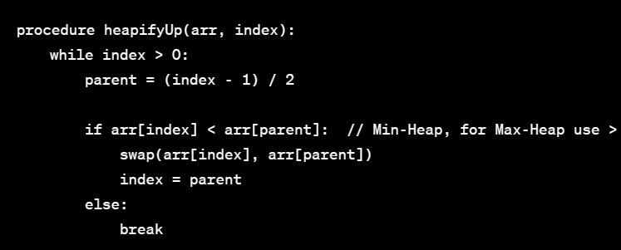
ALGORITHM
Algorithm for HeapifyUp:

Slide 5
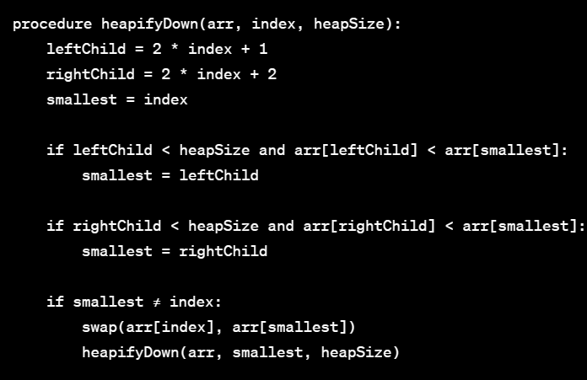
ALGORITHM
HeapifyDown:
HeapifyDown is used when an element is removed or replaced from the root of the heap, and we need to ensure that the heap property is maintained.
Algorithm for HeapifyDown:

Slide 6
Analysis of algorithm
1. HeapifyUp:
Time Complexity:
The worst-case time complexity of HeapifyUp is O(log n), where n is the number of elements in the heap.
In the worst case, the height of the heap is log n, and each swap in the while loop takes constant time.
Space Complexity:
The space complexity is O(1) as the algorithm only requires a constant amount of extra space for temporary variables.

Slide 7
Analysis of algorithm
2. HeapifyDown:
Time Complexity:
The worst-case time complexity of HeapifyDown is O(log n), where n is the number of elements in the heap.
Similar to HeapifyUp, the worst-case time complexity is determined by the height of the heap.
Space Complexity:
The space complexity is O(1) as the algorithm only requires a constant amount of extra space for temporary variables.

Slide 8

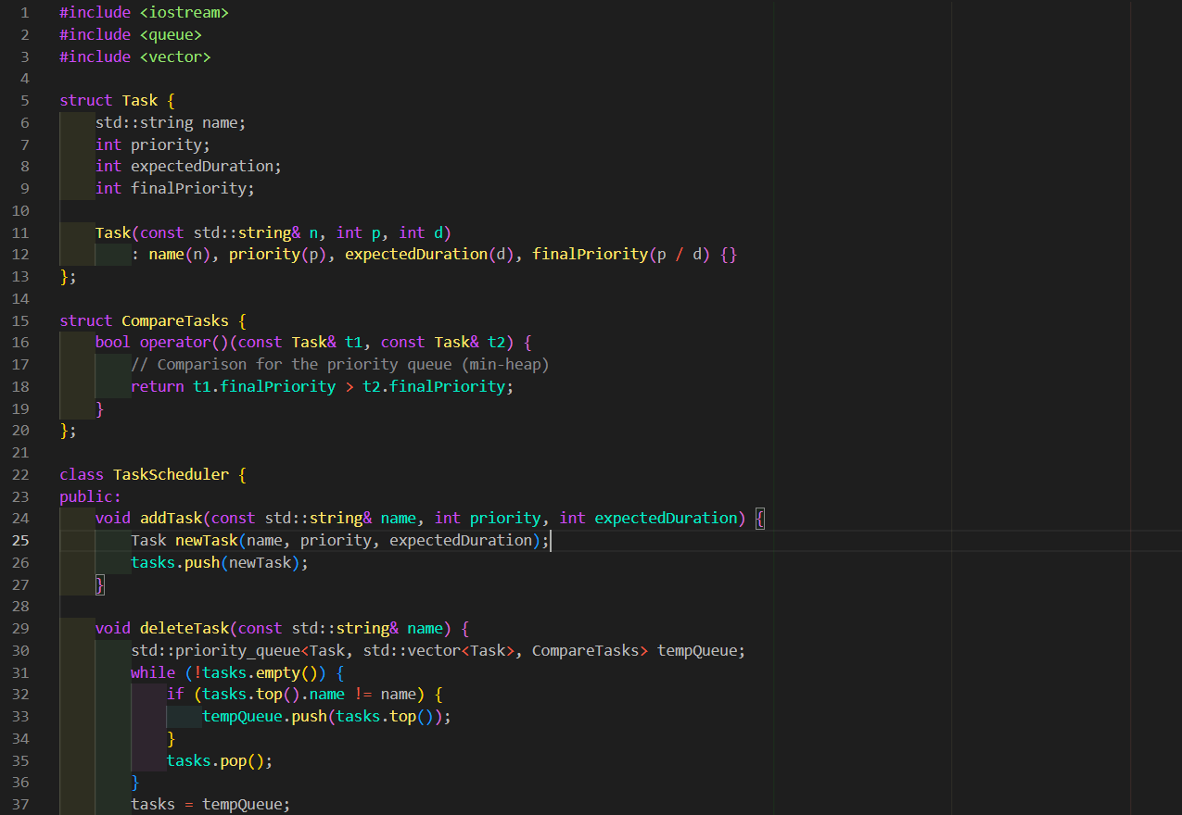
IMPLEMENTATION

Slide 9
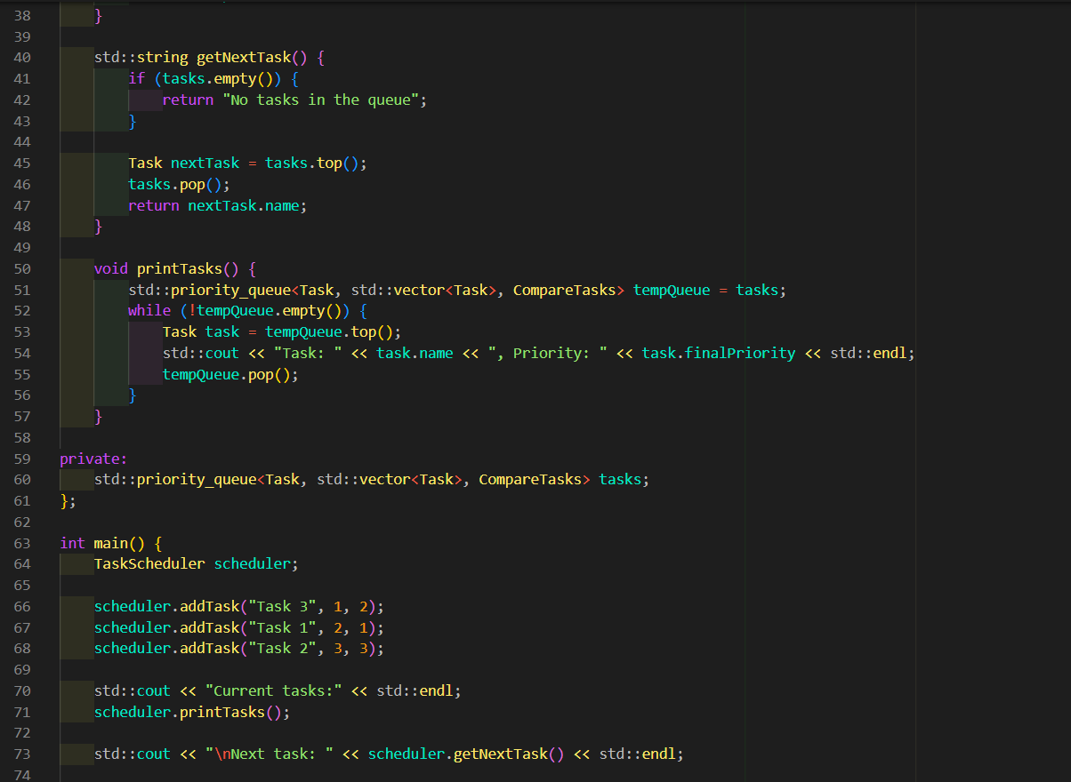
implementation

Slide 10
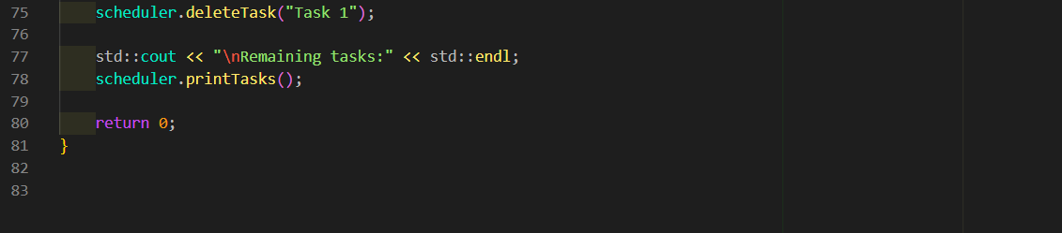
IMPLEMENTATION

Slide 11
Conclusion
A task scheduler using a priority queue and a min-heap data structure is a powerful and efficient mechanism for managing and executing tasks based on their priority levels. The use of a priority queue with a min-heap ensures that the highest priority tasks are readily accessible, allowing for quick retrieval and execution.
Efficient Task Retrieval:
The min-heap data structure ensures that the task with the highest priority is always at the root of the heap, allowing for constant-time retrieval.
Dynamic Priority Management:
The scheduler can easily handle dynamic changes in task priorities. Tasks can be dequeued, their priorities updated, and then re-enqueued, ensuring flexibility in task scheduling.
Priority-Based Execution:
Tasks are executed based on their priority levels, allowing the scheduler to focus on high-priority tasks first. This is crucial in scenarios where tasks have varying levels of urgency or importance.

Slide 12
THANK YOU

