Slide 1

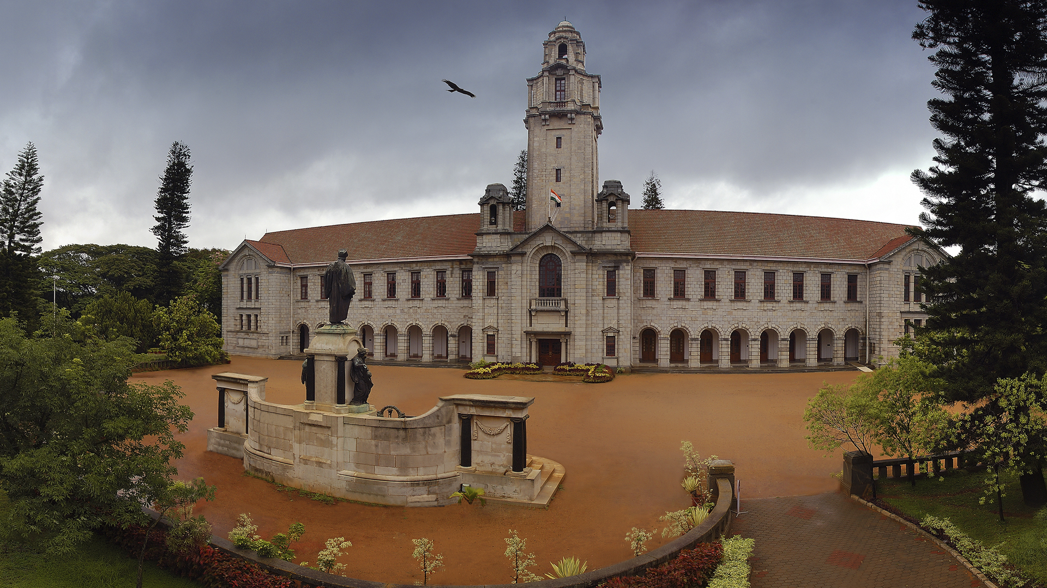

NPTEL Joy of Computing in Python TA Session-1 1-8-23
Saubhik Som,
saubhiksom@iisc.ac.in
Integrated PhD student,
Indian Institute of Science,
Bangalore

Slide 2
TA session 1
Which of the following is/are control commands in Scratch?
repeat
repeat until
forever
forever until
Which option in scratch is used to wait between the commands:
Event
Sensing
Control
Operators
___________ command is used to make the sprite walk by certain steps.
Hide
Delete
Move
Walk
The command used to make the sprite disappear from the animation stage is _____________.
Show
Hide
Delete
move
What is the extension of a scratch file?
py
Se
Sb
sc

Slide 3
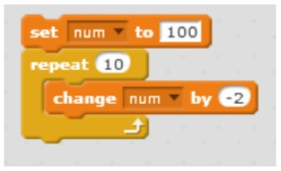
TA session 1
Predict the output of the following:
0
100
20
None of the above
10*(-2)=-20
100-20=80
Which of the following is a facility provided by scratch to use sound effects?
A sound library is provided
Sound can be recorded using a microphone
We can use sound file
None of the above
All of the above are correct (except 4).

Slide 4
TA session 1
In addition to an option of using the inbuilt sprite library in scratch, what are the other ways to use a sprite?
We can paint a custom sprite
We can use the camera to take pictures
We can upload an image from our computer
All of the above
__________ scratch constructs are used to keep doing a set of instructions infinitely?
ever
forever
never
None of the above
Which of the following commands would make the sprite move backward?
Move 10 steps
Move -10 steps
Both 1 and 2
Neither 1 and 2

