Slide 1
Examining ez diffusion parameters for two experimental conditions
Saucedo Saucedo
Notes:
In this presentation I will be examining EZ diffusion parameters for Response accuracy and Response time

Slide 2
Capturing decision confidence through response trajectories and willingness to gamble
O’hara et al. (2017)
Notes:
The paper from which the dataset in this project originates.

Slide 3
Dataset – o’hara 2017
The goals of this experiment were to 1) show whether characteristics of hand movements could be used as objective measurement of decision confidence and 2) study the relationship between certainty and confidence.
In total there were 27 participants and 16 unique items
Random Dot Kinematogram (RDK)
Display containing a dense pattern of random black and white dots that moves in one direction during subsequent frames. (See figure below)
Notes:
Participants report direction of this movement according to coherence level
Participants required to view RDK and report dominant direction via mouse movements
Directly afterwards participants were asked to select number of points willing to wager that the answer chosen was correct
Coherence was manipulated
“Decision confidence” = subjective sense of certainty
Motion coherence (the probability of any particular dot being displaced in the
stimulus direction)
ouse trajectory information was not predictive of post-decision
certainty but was strongly related to decision accuracy.
Result of the experiment: mouse trajectories were not indicative of confidence but were related to accuarcy

Slide 4
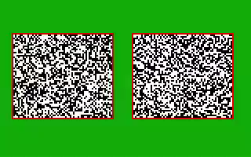
Random Dot Kinematogram Display

Slide 5
About EZ diffusion model
Based on the Ratcliff Diffusion Model (1978)
Published by Wagenmakers, et al. in 2007
EZ diffusion model forgoes between–trial variability in accumulation rate, starting point, and non-decision time
It does not require a parameter fitting routine
Notes:
speed–accuracy trade-off
sequential accumulator models.
Ratcliff Diffusion model assumes that an observer accumulates evidence for responses until a threshold level of evidence for one of the responses is reached
tarting
point z is assumed to be equidistant from the response
boundaries, so that z=a/2.

Slide 6
Exploratory Data Analysis
Notes:
Let's look at the dataset more closely.

Slide 7
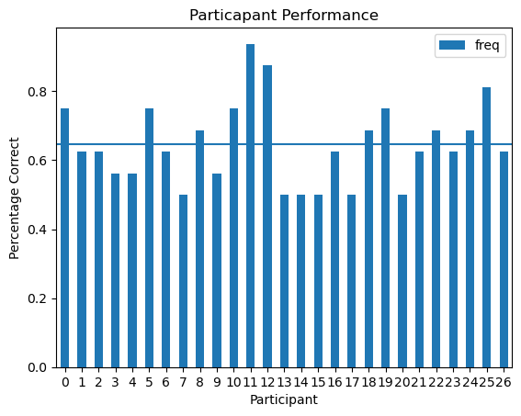
Participant Performance – Response Accuracy
Mean: 0.645
Best score: 0.9375
6/27 scored 50%
Notes:
This figure shows the overall score of each individual based on the number items they answered correctly. Participants demonstrated a mean accuracy score of 64.5%. The highest scoring individual, circled in green, scored a 93.7% followed by the second highest score of 87.5%. Finally, six participants tied for lowest rate of accuracy, each receiving a score of 50%. Taken together, these statistics may suggest that the tasks presented in this experiment required a moderate to high level of effort.

Slide 8
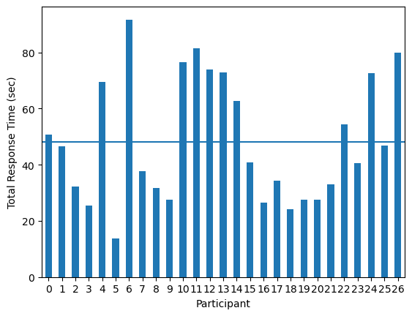
Participant performance – Response time
Mean: 48.25 sec
Fastest: 13.86 sec
Slowest: 91.70 sec
Notes:
This figure shows the total amount of time (seconds) that each participant took to complete all tasks. Participants demonstrated a mean response time of 48.25 seconds. The red circle indicates the participant with the largest amount of time taken with 91.7 seconds. On the other hand, the fastest participant, circled in green, only took 13.86 seconds. Notably, the participant who completed teh still scored above average rate of response accuracy.

Slide 9
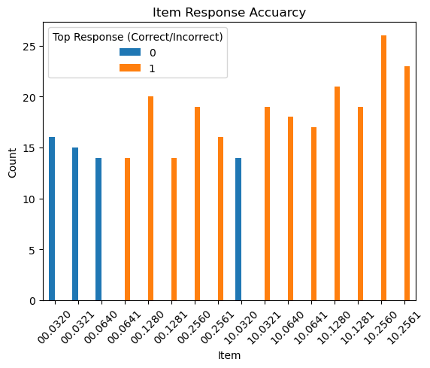
Item performance – Response Accuracy
Easiest item: “10.2560”
Hardest Item: “00.0320”
Notes:
3x as many easy than hard itmes suggest this was an easy experiment.
Kinematograms are based on low level movement not visual acuity
Easiest item was highest coherence no training
Hardest item was lowest coherence no training

Slide 10
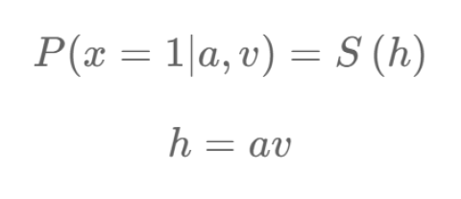
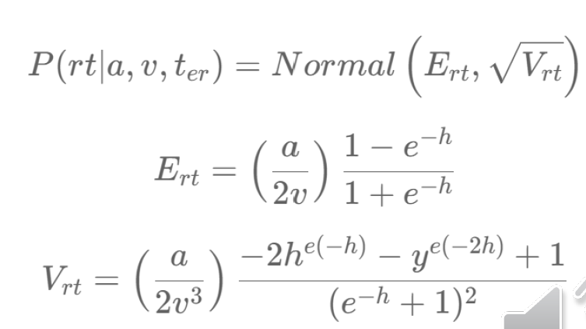
The Ez diffusion model
Priors
Response Accuracy
Response Time
Boundary
a = ln(0,1), shape=(I,1)
Drift
v = ln(0,1), shape = (I,1)
Non-Decision Time
t_er = ln(0,1), shape =(I,1)
Notes:
Goal to be at 5 mins at this mark

Slide 11
Parameter Estimation method: No-u-turn sampler
1
An extension of Hamiltonian Monte Carlo algorithm
2
Unlike HMC, NUTS doesn’t require user to set a specific number of steps
3
NUTS performs as efficiently as standard HMC method
Notes:
HMS is itself an instance of Metropolis Hastings

Slide 12
Present study
I used the accuracy dataset to identify which items were hard or easy with hard items being classified as being responded to incorrectly by more than half of the participants (14/27). The rest were classified as easy.
Easy data set consisted of 12 items and hard consisted of 4 items

Slide 13
Results

Slide 14
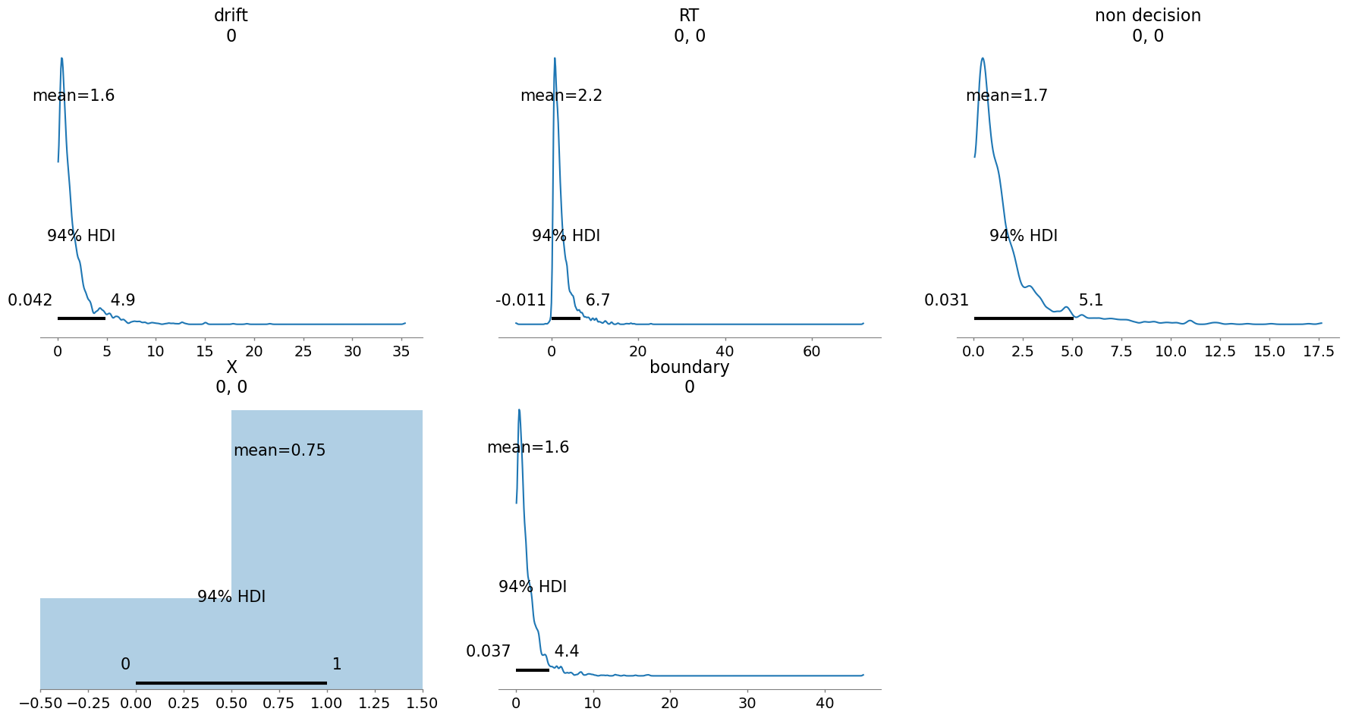
Prior Distributions of Model
Notes:
Discuss range of values supported by your model
•Discuss whether your priors are weak, strong or un-informative
•Discuss an implication of prior choice.
•Discuss why the pattern flipped in case of response accuracy.

Slide 15
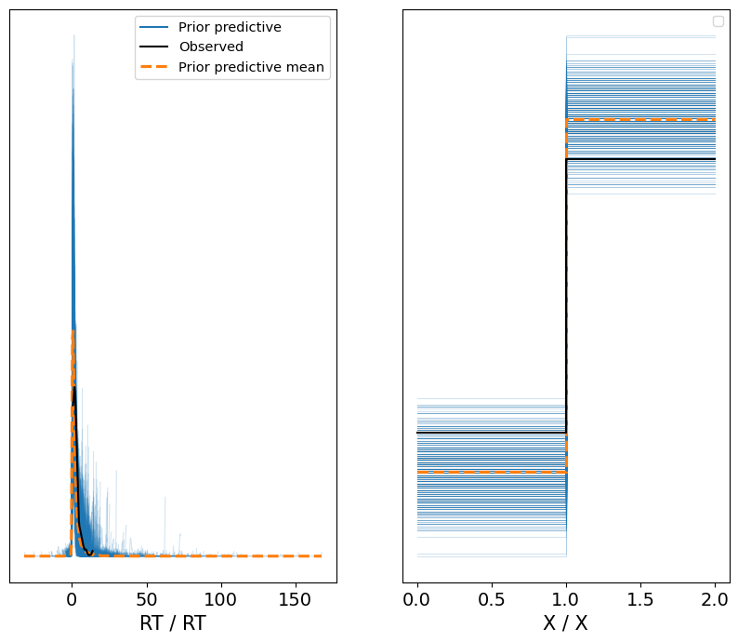
Prior predictive check - easy

Slide 16
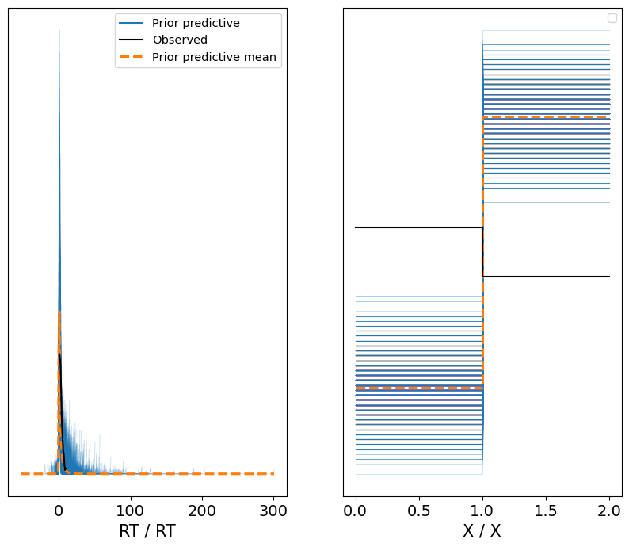
Prior predictive check - hard

Slide 17
Posterior
Notes:
Goal to be at 10 min mark by this slide

Slide 18
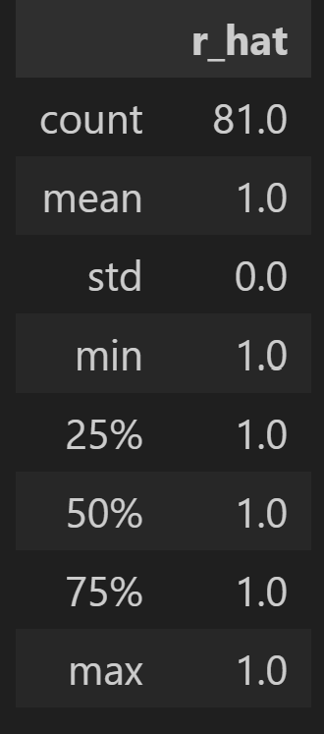
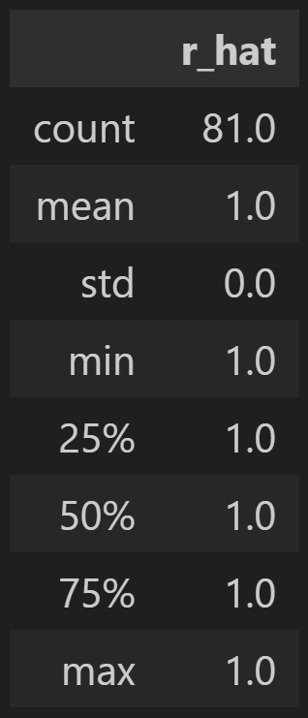
Model fit - R
Hard
Easy
Notes:
Discuss whether all your parameters converged
•Mention the range of each of the parameter estimates
•Mention whether the parameter estimates are able to represent the observed data

Slide 19
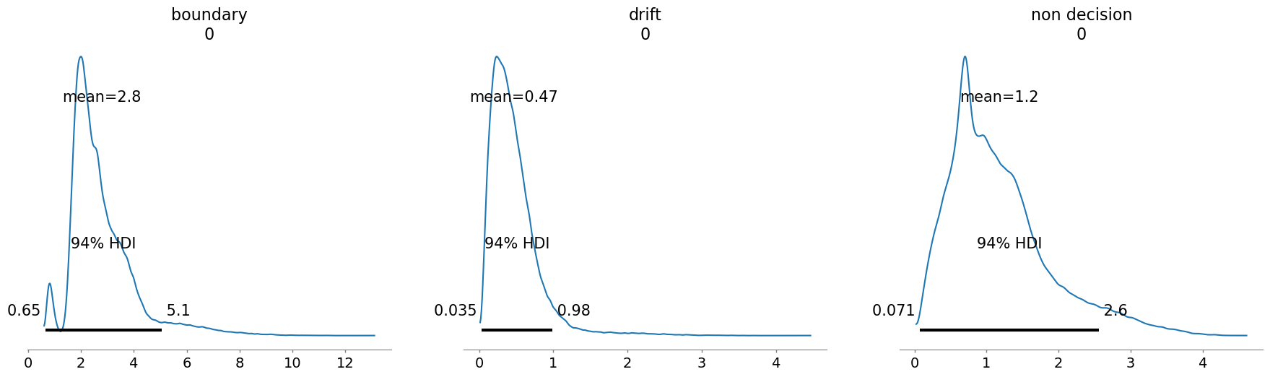
Posterior Distribution - Easy

Slide 20
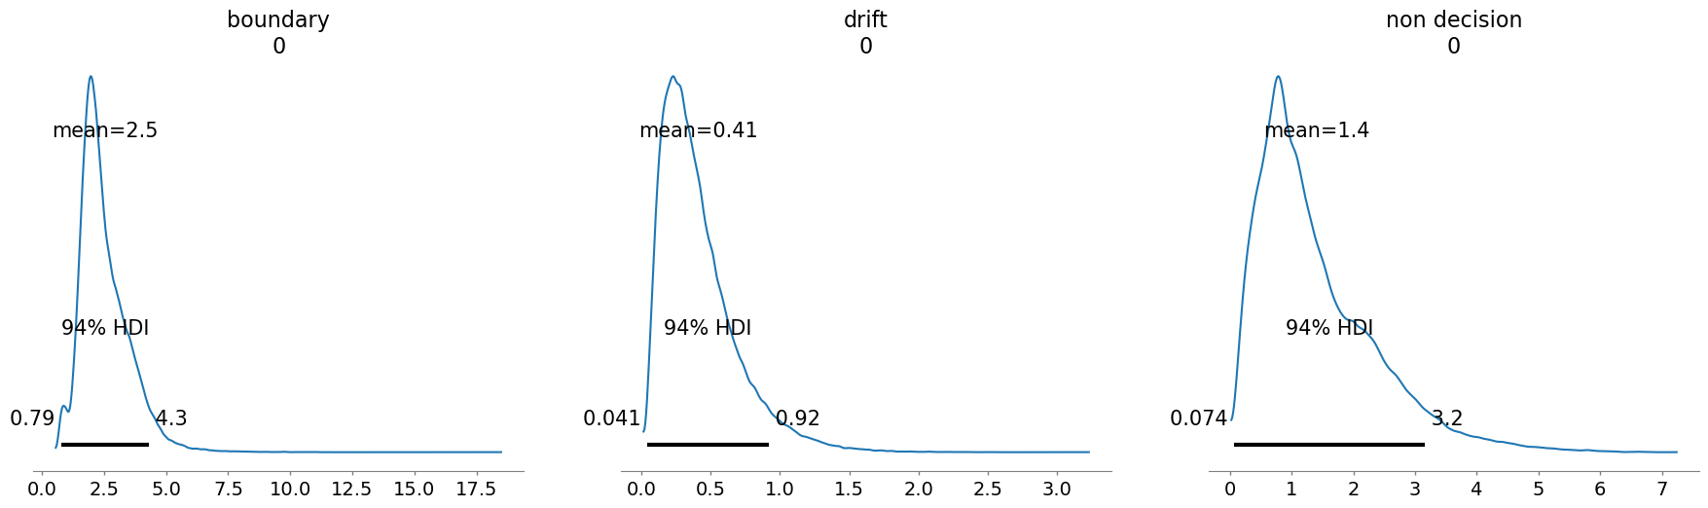
Posterior distribution - hard

Slide 21
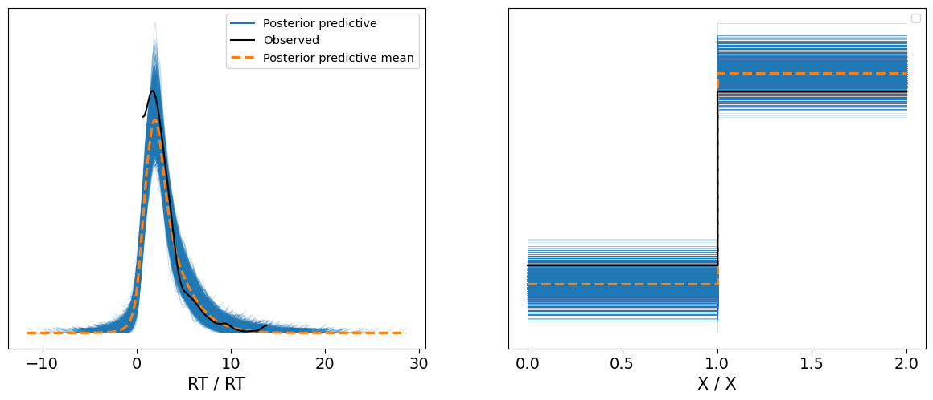
Posterior predictive check - easy

Slide 22
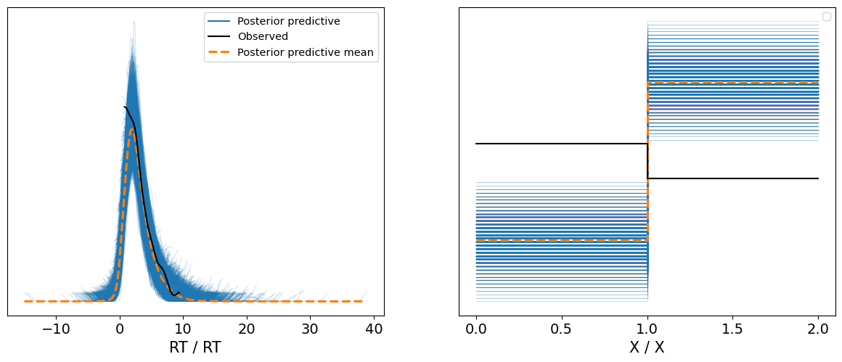
Posterior predictive check - hard

Slide 23
Examine ez – diffusion parameters

Slide 24
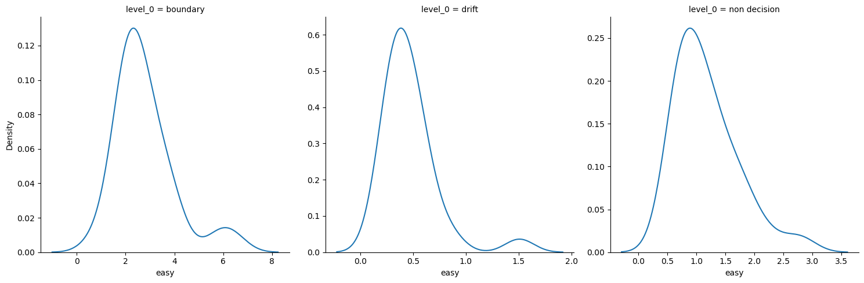
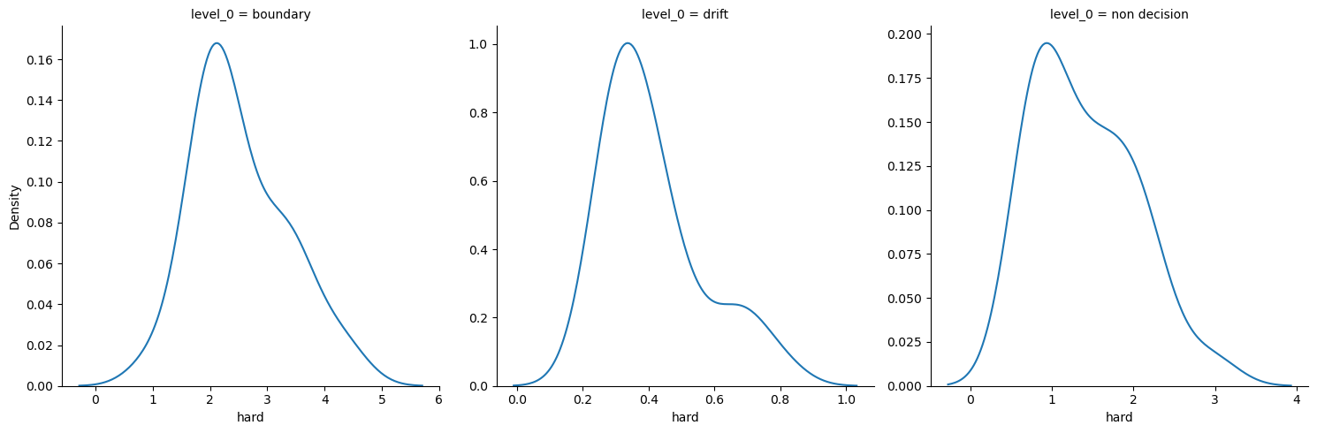
EZ-Diffusion Parameter Estimates
easy
hard

Slide 25
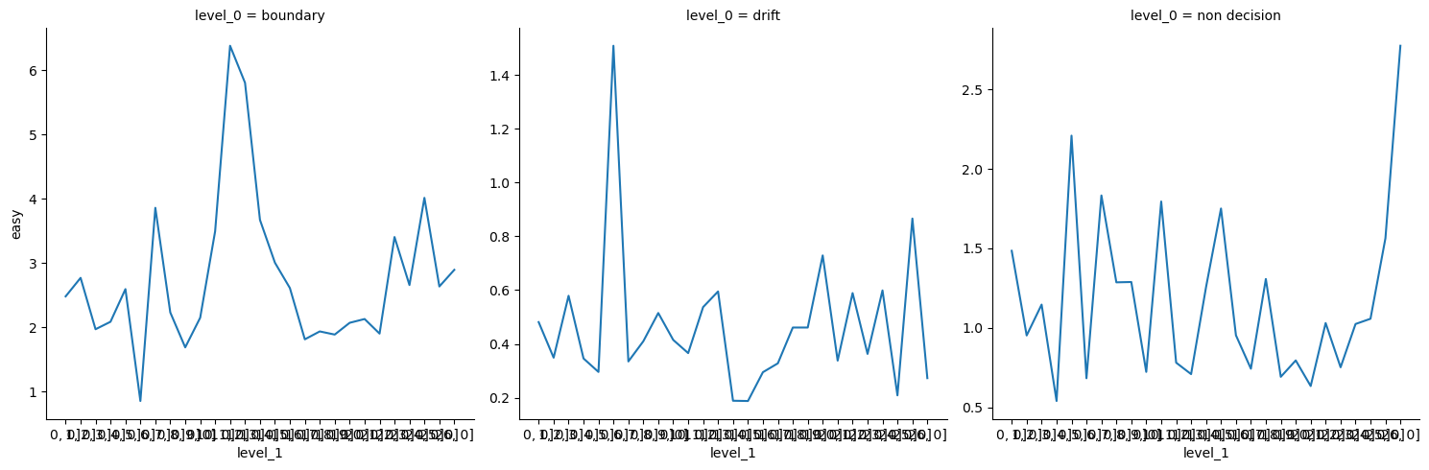
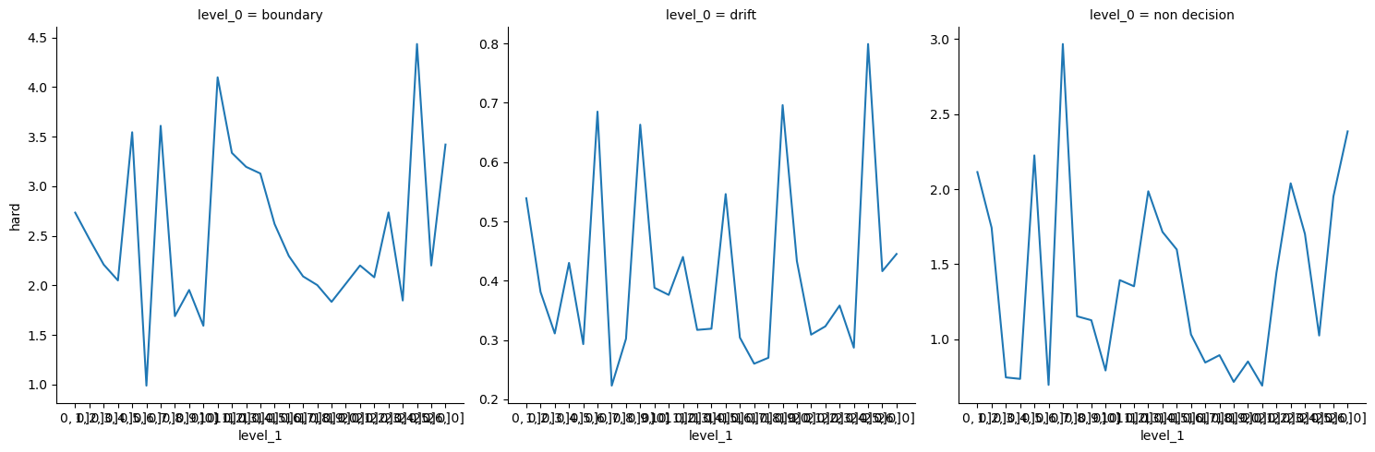
EZ-Diffusion Parameter Estimates
easy
hard

Slide 26
THANK YOU
Saucedo Saucedo
S/O to the instructors of this course!

