Slide 1
Un-cleaning / Creating Raw data
TASK B
Ahmad Saud Azmi - 1108047

Slide 2
Data Source
The data set is downloaded from: https://www.kaggle.com/datasets/dgomonov/new-york-city-airbnb-open-data
The data set describes the listing activity and metrics in NYC for 2019. It includes information about hosts, geographical availability, reviews, and rating. It has 16 columns that provide data about host id, host name, latitude and longitude, reviews, room type, availability of 365 days, etc.

Slide 3
Quality Dimensions
The following quality dimensions were kept in mind:
Validity
Consistency
Conformity
Completeness
Uniqueness
Accuracy

Slide 4
Quality Dimensions
Completeness:
To make the data incomplete the Staten Island neighbourhood group was filtered.
Some of the columns, such as latitude, number of reviews, and number of reviews per month, have been left blank.
Consistency:
To make data inconsistent selected rows by filtering the neighbourhood group Queens.
In some rows, the unique column id is replaced with duplicate values.
Instead of DD-MM-YYYY, the date format was changed to MM-DD-YYYY.

Slide 5
Quality Dimensions
Accuracy:
To make data inaccurate selected rows by filtering the neighbourhood group Bronx.
Replaced Lat, long with wrong co-ordinates.
Replaced neighbourhood “Queen” spelling with “Qeens”
Validity:
To make data invalid selected rows by filtering the neighbourhood group Manhattan for neighbourhood Lower East Side
Replaced price with negative value
To make data invalid selected rows by filtering the neighbourhood group Bronx.
Replaced Minimum Nights with negative values
Replaced availability_365 columns by add few values (total number of days in a year more than 365)

Slide 6
Quality Dimensions
Uniqueness:
To make data not unique selected rows by filtering the neighbourhood group Queens.
Unique column id is replaced with duplicate values in all the rows.
Conformity:
To remove conformity selected rows by filtering the neighbourhood group Queens.
Replaced the date with MM-DD-YYYY instead of DD-MM-YYYY.

Slide 7
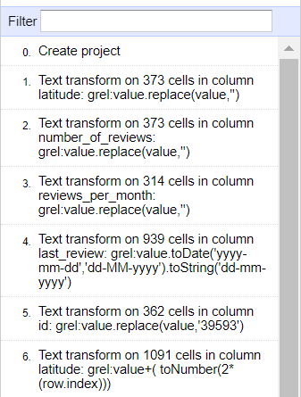
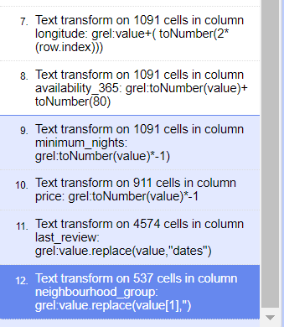
Recipe/ Steps
File:

Slide 8
Calculations
48895 rows excluding header were present in the document
Around 26 % of entire dataset i.e., 12713 records /data were either removed or applied variations into it. 1-1.5 % extra to involve margin of error.
As per the steps performed ,we have used neighbourhood group column as a text facet for various locations and performed the majority steps.
The total number of records that has been cleanup is close to 12777 hence the dataset is made 25% Raw/Unclean based on the mentioned dimensions

