Slide 1
DATA MANAGEMENT - 1 PROJECT
DATA PROFILING Using Talend Open Studio for Data Quality & Data Cleaning Using Open Refine
Ahmad Saud Azmi - 1108047

Slide 2
Data Source
The data set is downloaded from: https://www.kaggle.com/datasets/dgomonov/new-york-city-airbnb-open-data
The data set describes the listing activity and metrics in NYC for 2019. It includes information about hosts, geographical availability, reviews, and rating. It has 16 columns that provide data about host id, host name, latitude and longitude, reviews, room type, availability of 365 days, etc.

Slide 3

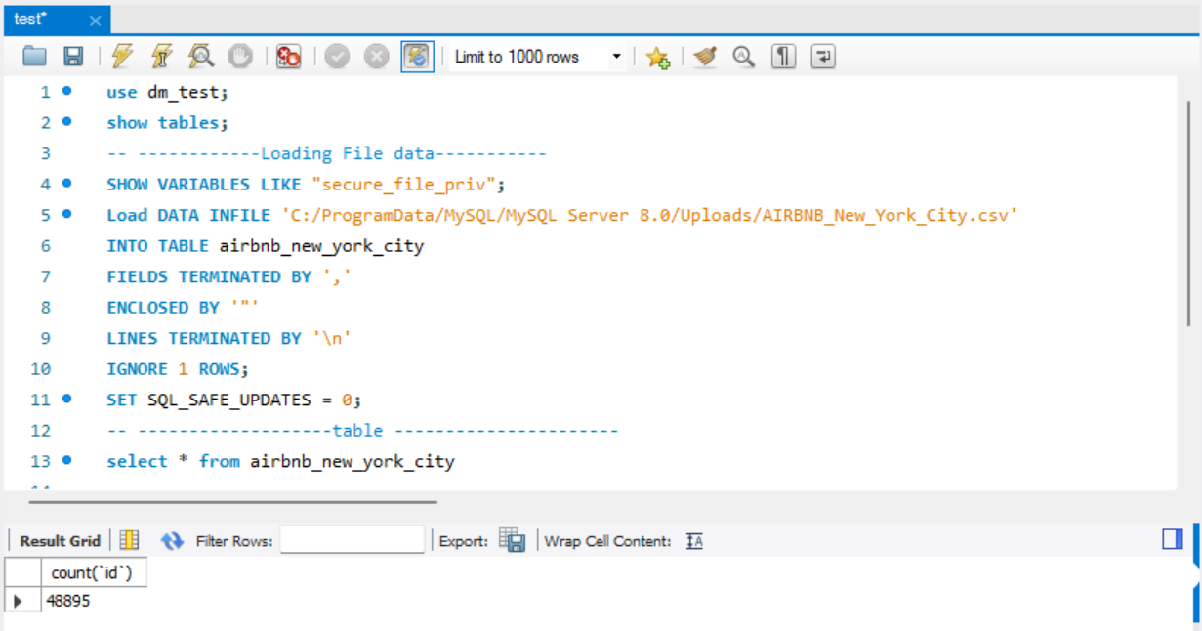
Data Loading
Loaded the data into SQL workbench using code :

Slide 4
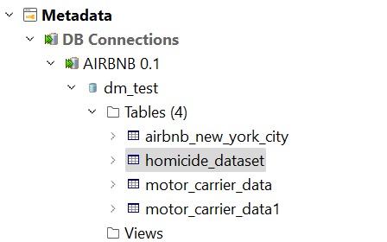
Data Profiling using Talend Data prep
The Dataset was loaded into Talend using DB connection (MySQL) using localhost server.

Slide 5
USER STORY
As a Blogger, I want to know which host has more listing on the Airbnb platform, so that I can compare the reviews based on number of listings.
As a Guest, I want to browse the area so that I can discover type of room which are most reviewed in a particular area.
As a Guest, I want to see past reviews of the listing, and other listings by the same hosts, so that I can assess the quality of the host and the quality of the space.
As a Guest, I want to browse listings so that I can discover unique places to stay that aren't hotel rooms.
As an Analyst, I want to see the changes in the number of reviews for all listings over the months for a particular year.
As an Analyst, I want to see the area where maximum listings exists.
As a Guest I want to average prices of each Airbnb location broken down by the individual neighborhoods.

Slide 6
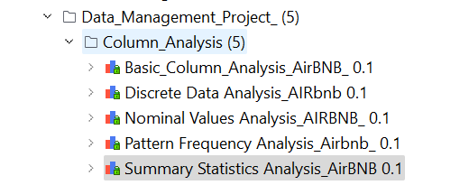
DATA PROFILING: ANALYSIS
The following Column Analysis
were done on the dataset:
Basic Column Analysis
Discrete Data Analysis
Nominal Value Analysis
Pattern Analysis
Summary Analysis

Slide 7
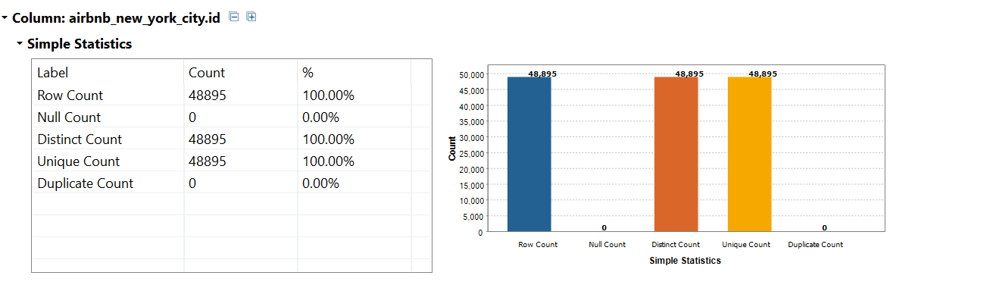
Basic Column Analysis
Performed Basic Column Analysis on all the columns using simple statistics to identify the row count, null count, duplicate count etc.
Data quality that can be identified using this analysis Completeness and Uniqueness.

Slide 8
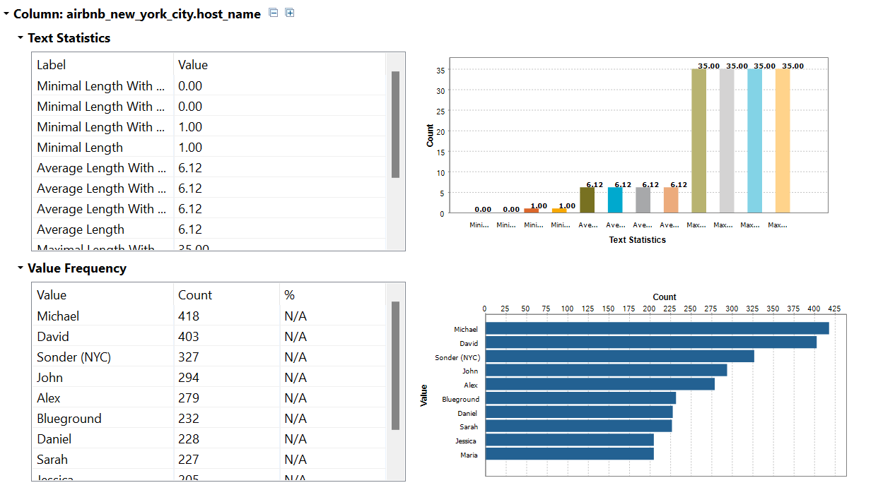
Nominal Value Analysis
This is done only on the columns with Nominal data type. It gives the text statistics and Value frequency of the data in a particular column.
Data quality that can be identified using this analysis Validity and Uniqueness.

Slide 9
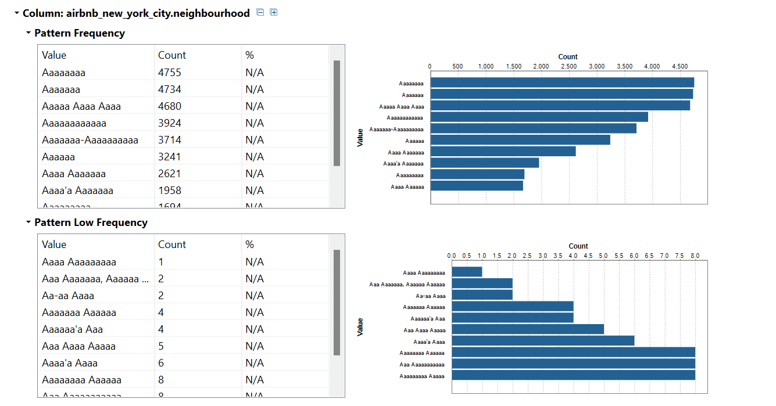
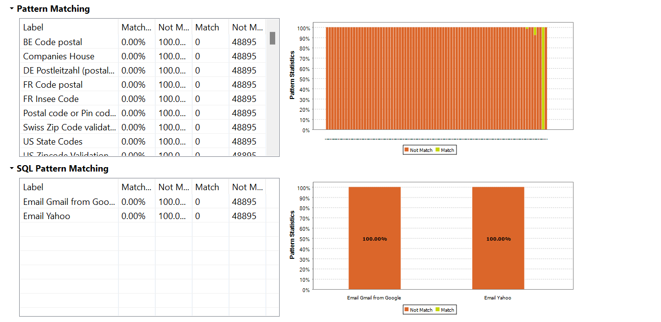
Pattern Frequency Analysis
In pattern analysis, the pattern frequency of the data in columns are identified, and then we can also set regex/business rules according to the pattern.
Data quality that can be identified using this analysis Validity and Consistency.

Slide 10
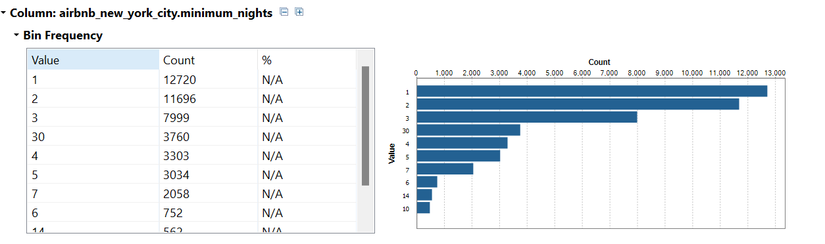
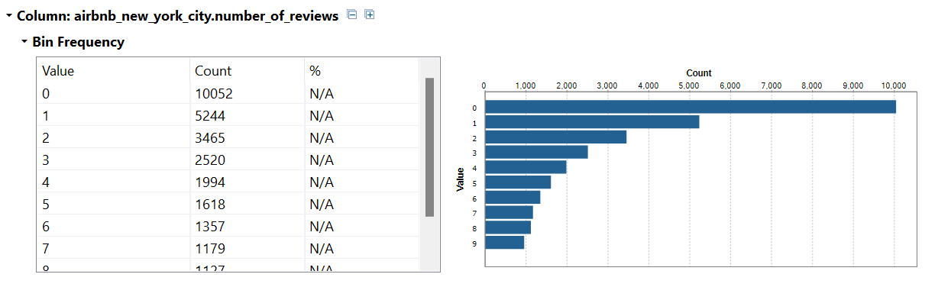
DISCRETE DATA ANALYSIS
Discrete data analysis provides analysis of NUMERICAL data
It gives the Bin frequency, helping us to find out the group of data present in the column
It is useful in identifying the user stories easily.

Slide 11
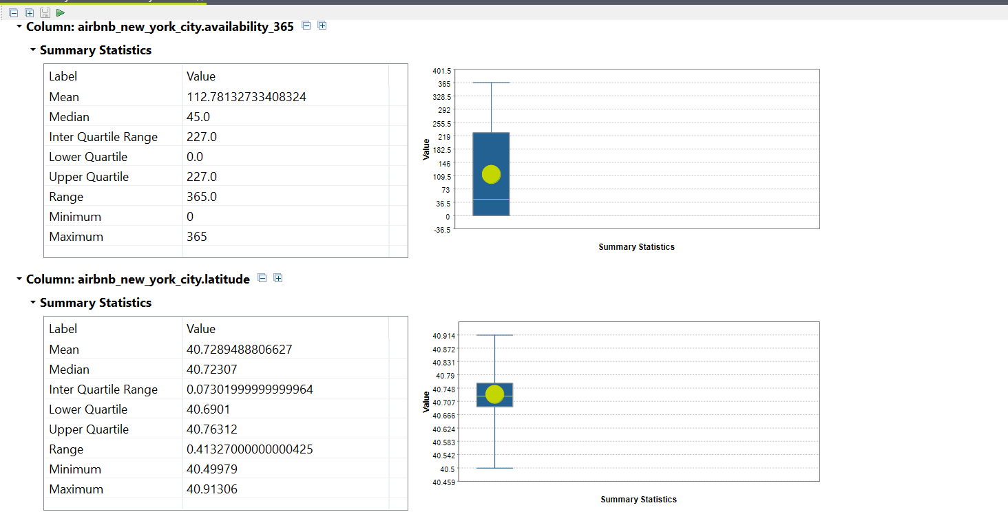
SUMMARY ANALYSIS
Discrete data analysis provides analysis of numerical data
It gives the range, the inter quartile range and the mean and median values
It is useful in identifying the outliers.

Slide 12
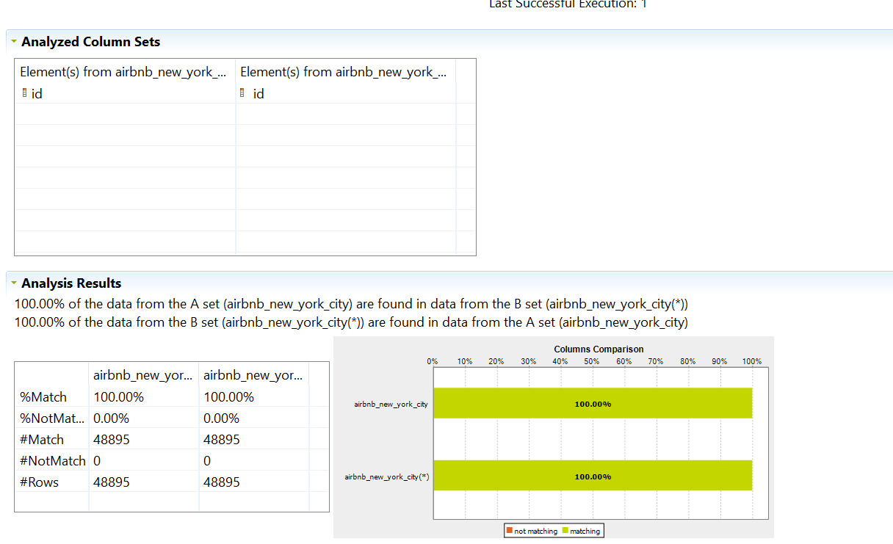
CROSS-TABLE ANALYSIS: REDUNDANCY ANALYSIS
In this analysis the two tables are to be compared to find out the primary key and foreign key based on functional dependency.

Slide 13
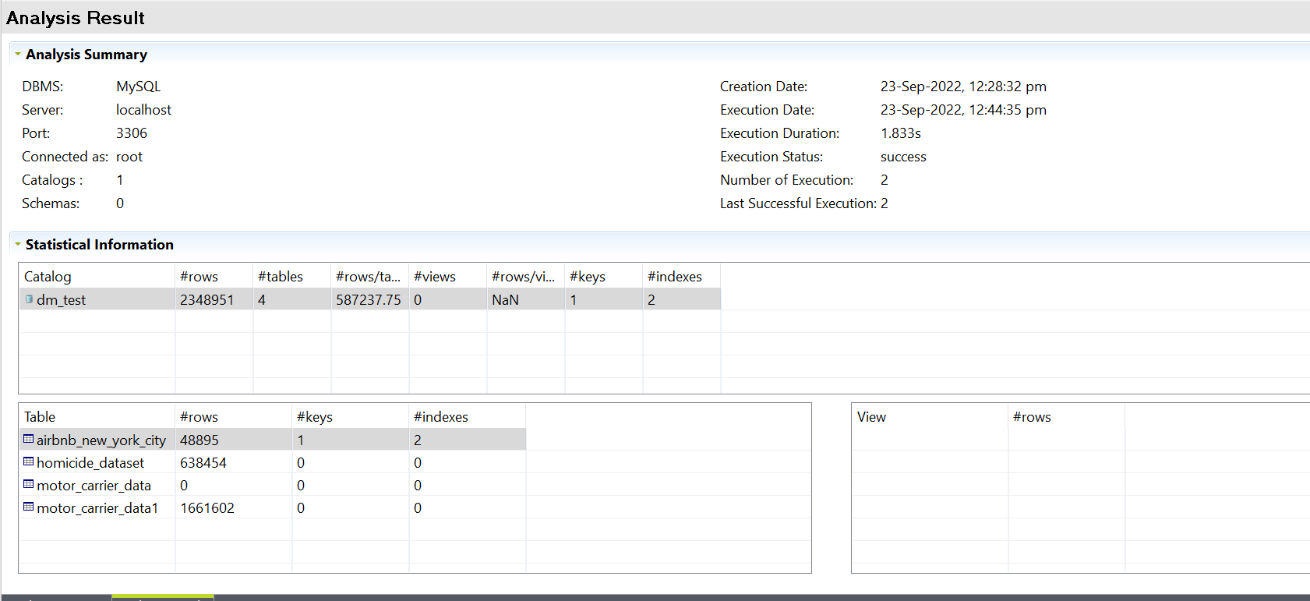
STRUCTURAL ANALYSIS: CONNECTION ANALYSIS:
Analyses the MySQL Database structure with number of rows, tables, keys, indexes etc.

Slide 14
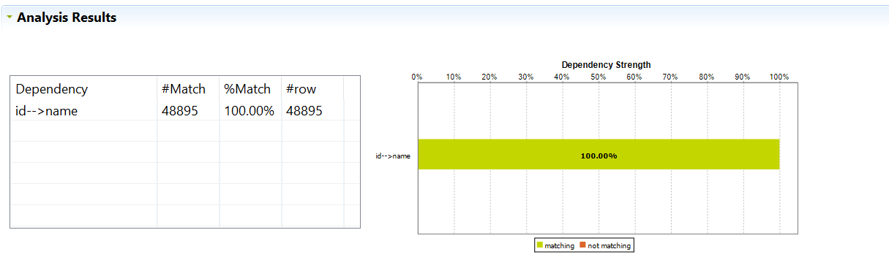
FUNCTIONAL DEPENDENCY ANALYSIS
In this Analysis we find that column is the Primary key by having functional dependency with maximum columns having greater number of match %. In this, column “Id” has 100% match with other columns(here we have checked for name column)

Slide 15
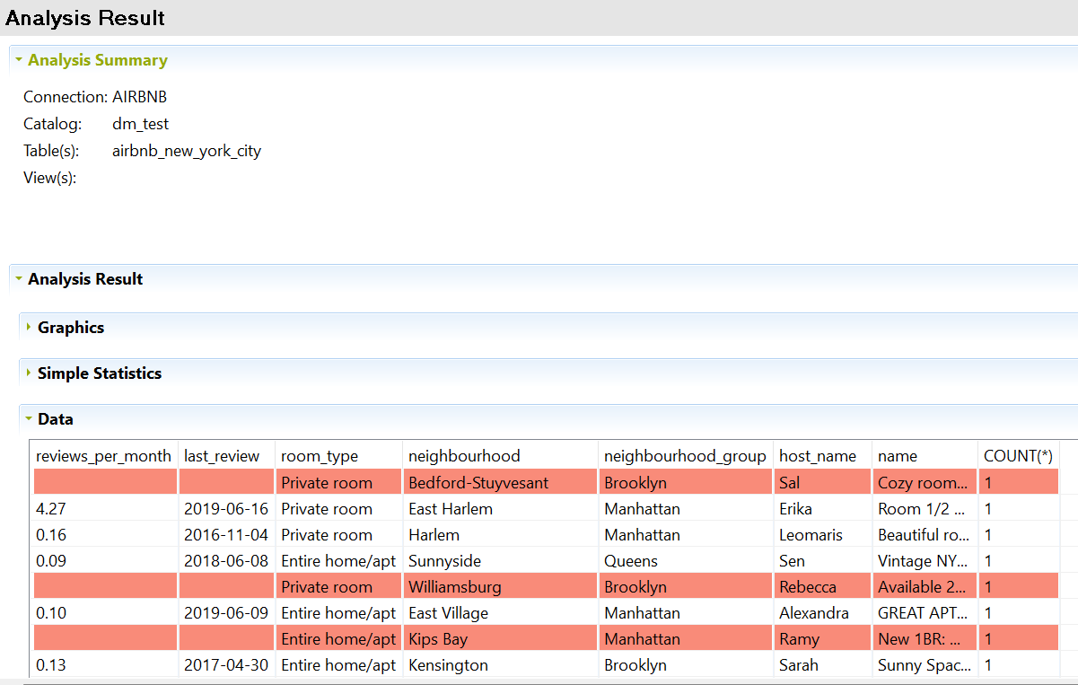
CORRELATIONAL ANALYSIS: NOMINAL ANALYSIS
This analysis works with only nominal values and shows the relations between pairs of data.
No conclusion as count is 1

Slide 16
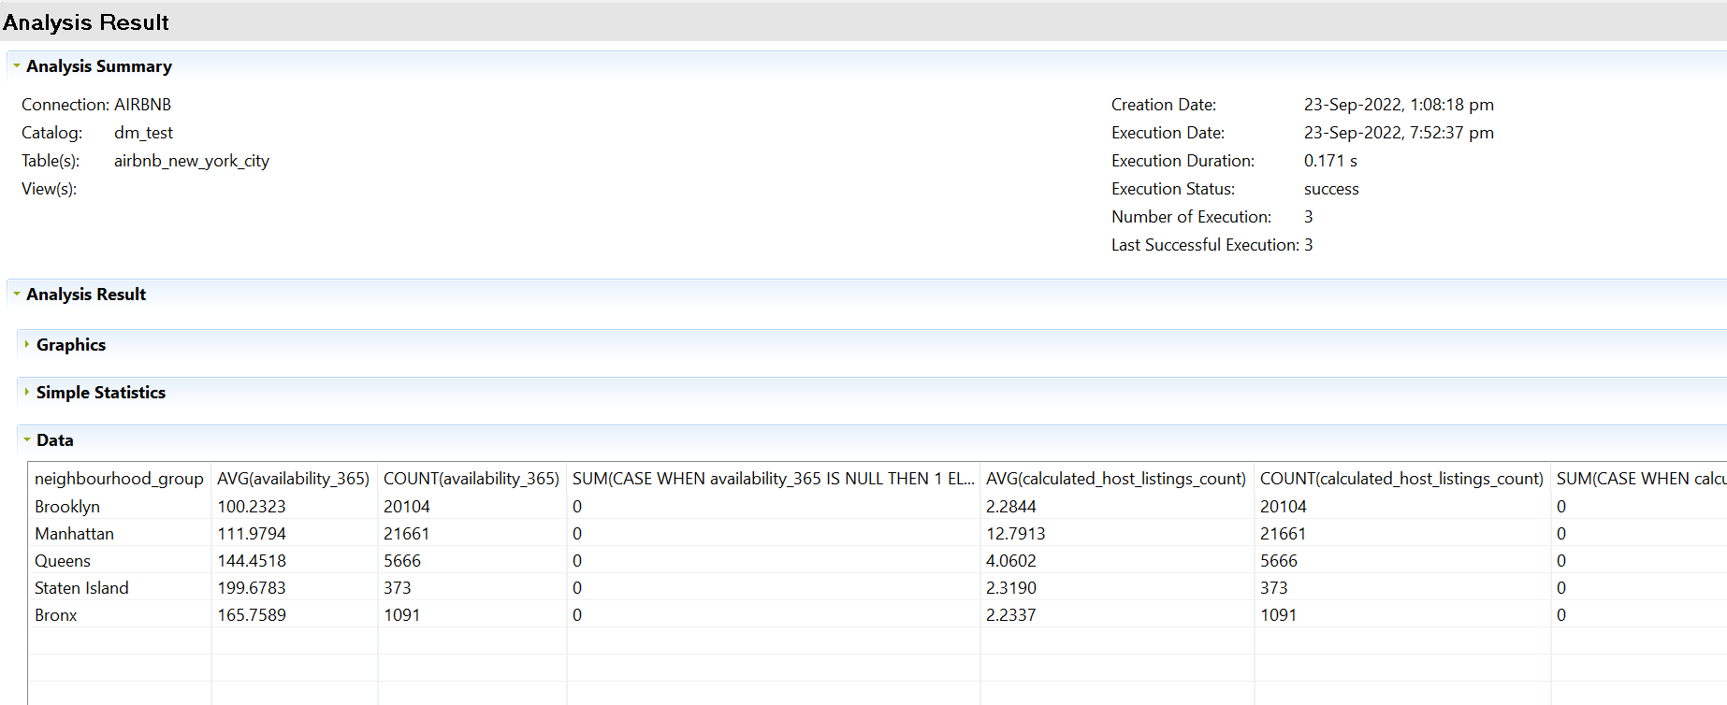
NUMERICAL CORRELATIONAL ANALYSIS
This analysis works with both Provide NOMINAL and NUMERICAL.
It is useful for user stories identification.

Slide 17
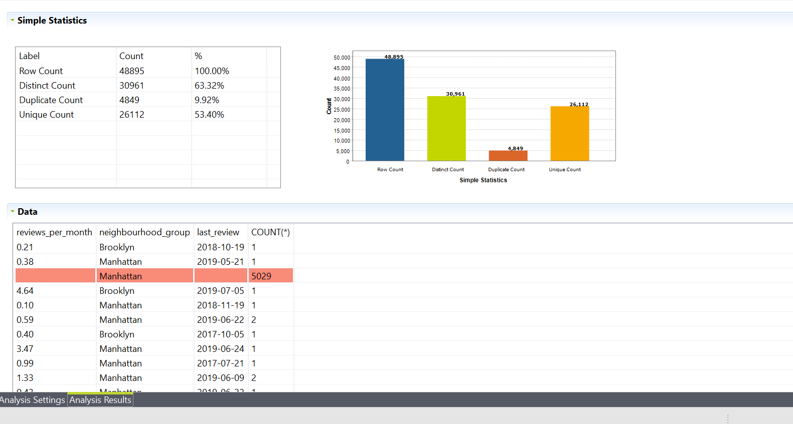
TIME CORRELATIONAL ANALYSIS
It also includes Nominal column, hence can analyze user story. “As a Guest, I want to browse the area so that I can discover type of room which are most reviewed in a particular area “ user story can be analyzed from this.

Slide 18
Quality Dimensions
Column_name | Primary Key | Completeness | Consistency | Validity | Conformity | Accuracy | Uniqueness
id | Primary Key (Functional Depedency) | X | Yes | X | X | X | Yes
name | NA | Yes | X | X | Yes | Yes | NA
host_id | NA | X | Yes | Yes | X | X | NA
host_name | NA | Yes | Yes | X | X | Yes | NA
neighbourhood_group | NA | X | Yes | Yes | Yes | Yes | NA
neighbourhood | NA | X | Yes | Yes | Yes | X | NA
latitude | NA | X | X | X | X | X | NA
longitude | NA | X | X | X | X | X | NA
room_type | NA | X | X | X | X | X | NA
price | NA | X | Yes | X | X | Yes | NA
minimum_nights | NA | X | Yes | X | X | X | NA
number_of_reviews | NA | X | Yes | X | X | X | NA
last_review | NA | Yes | X | X | X | X | NA
reviews_per_month | NA | Yes | X | X | X | Yes | NA
calculated_host_listings_count | NA | X | Yes | X | X | X | NA
availability_365 | NA | X | Yes | Yes | X | Yes | NA

Slide 19
Data Cleaning
Using OpenRefine

Slide 20
Recipe/ Steps
Text Transformation - to Titlecase, replace characters on “name” column (By Nominal Value Analysis - Consistency)
Text Transformation – fix names with by removing special characters on “name” column (By Nominal Value Analysis –, Conformity)
Text Transformation - remove decimal on “price” column (by Discrete data Analysis - Consistency, Accuracy)
Text Transformation - fix spelling of Queens in “neighbourhood_group” column(by Nominal Value Analysis - Accuracy)
Text Transformation - updated the rows from ‘New York’ to ‘Manhattan’ in “neighbourhood_group” column(by Nominal Value Analysis - Accuracy, conformity, Validity)
Text Transformation - updated blank cells with “NA” in column “last_review”(by Basic Column Analysis - Completeness)
Text Transformation - to Titlecase, replace characters on “host_name” column (By Nominal Value Analysis - Consistency)
Text Transformation - replaced null value with 0 and rounded the value unto 2 decimal point in “reviews_per_month” column (by pattern frequency analysis - completeness, consistency, accuracy)
Edit column - added new column based on this column, added column by fetching URL on column “longitude” and “latitude”(Basic column Analysis - completeness, conformity )

Slide 21
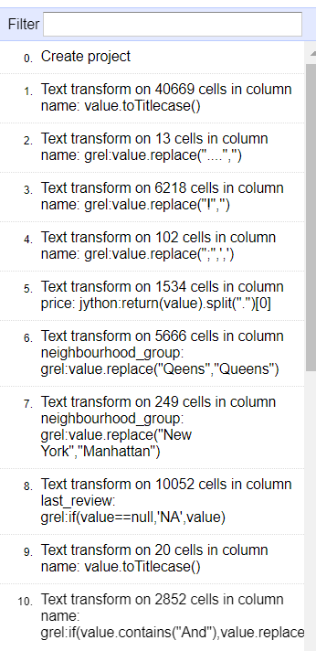
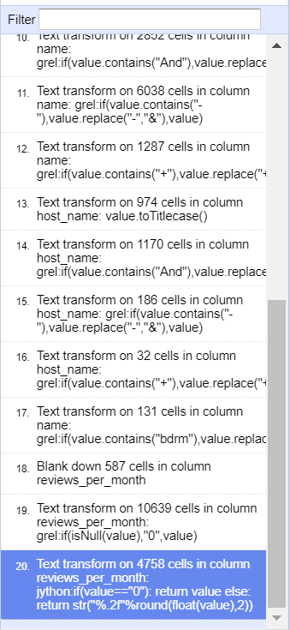
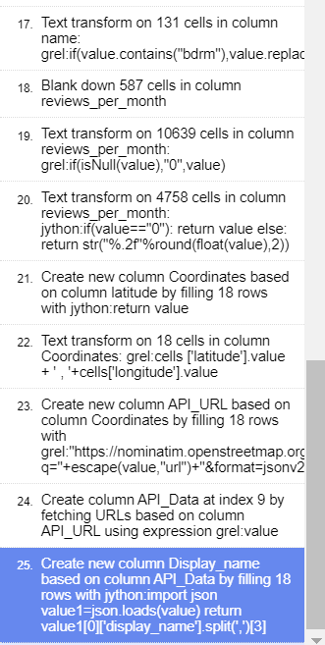
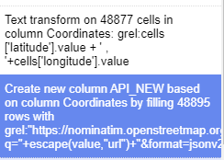
Recipe/ Steps

Slide 22
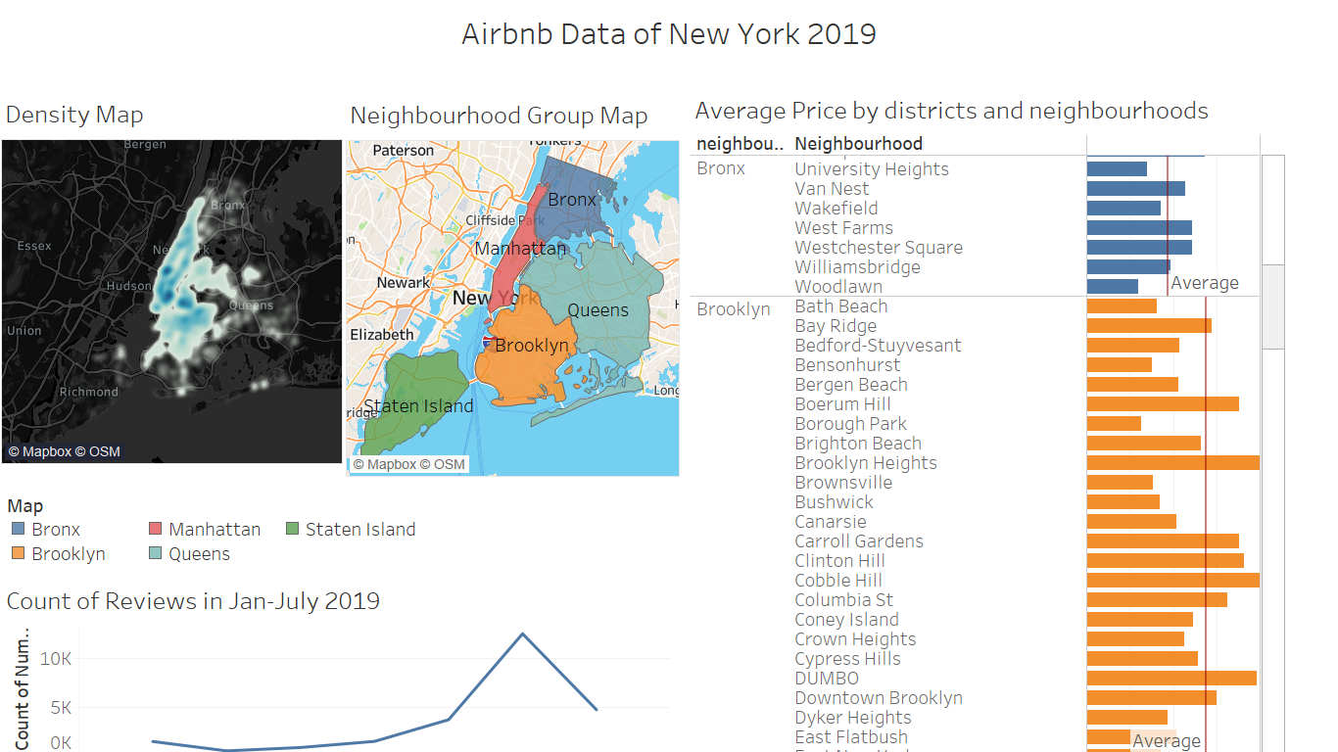
Dashboard

Slide 23
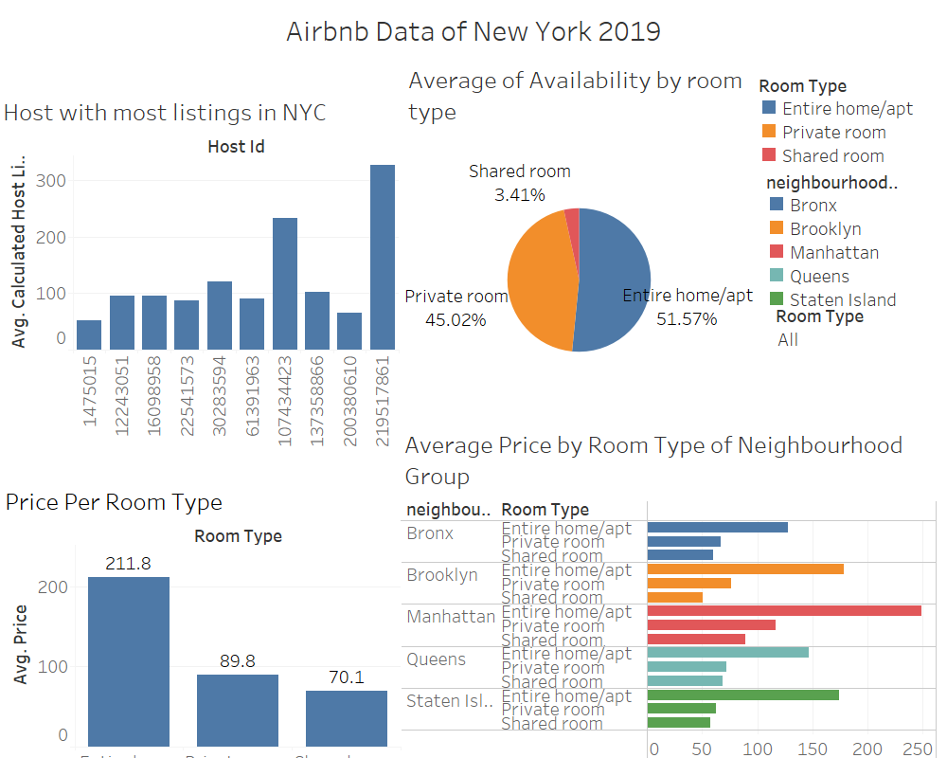
Dashboard

Slide 24
Questions?

Slide 25
Thank You

