Slide 1
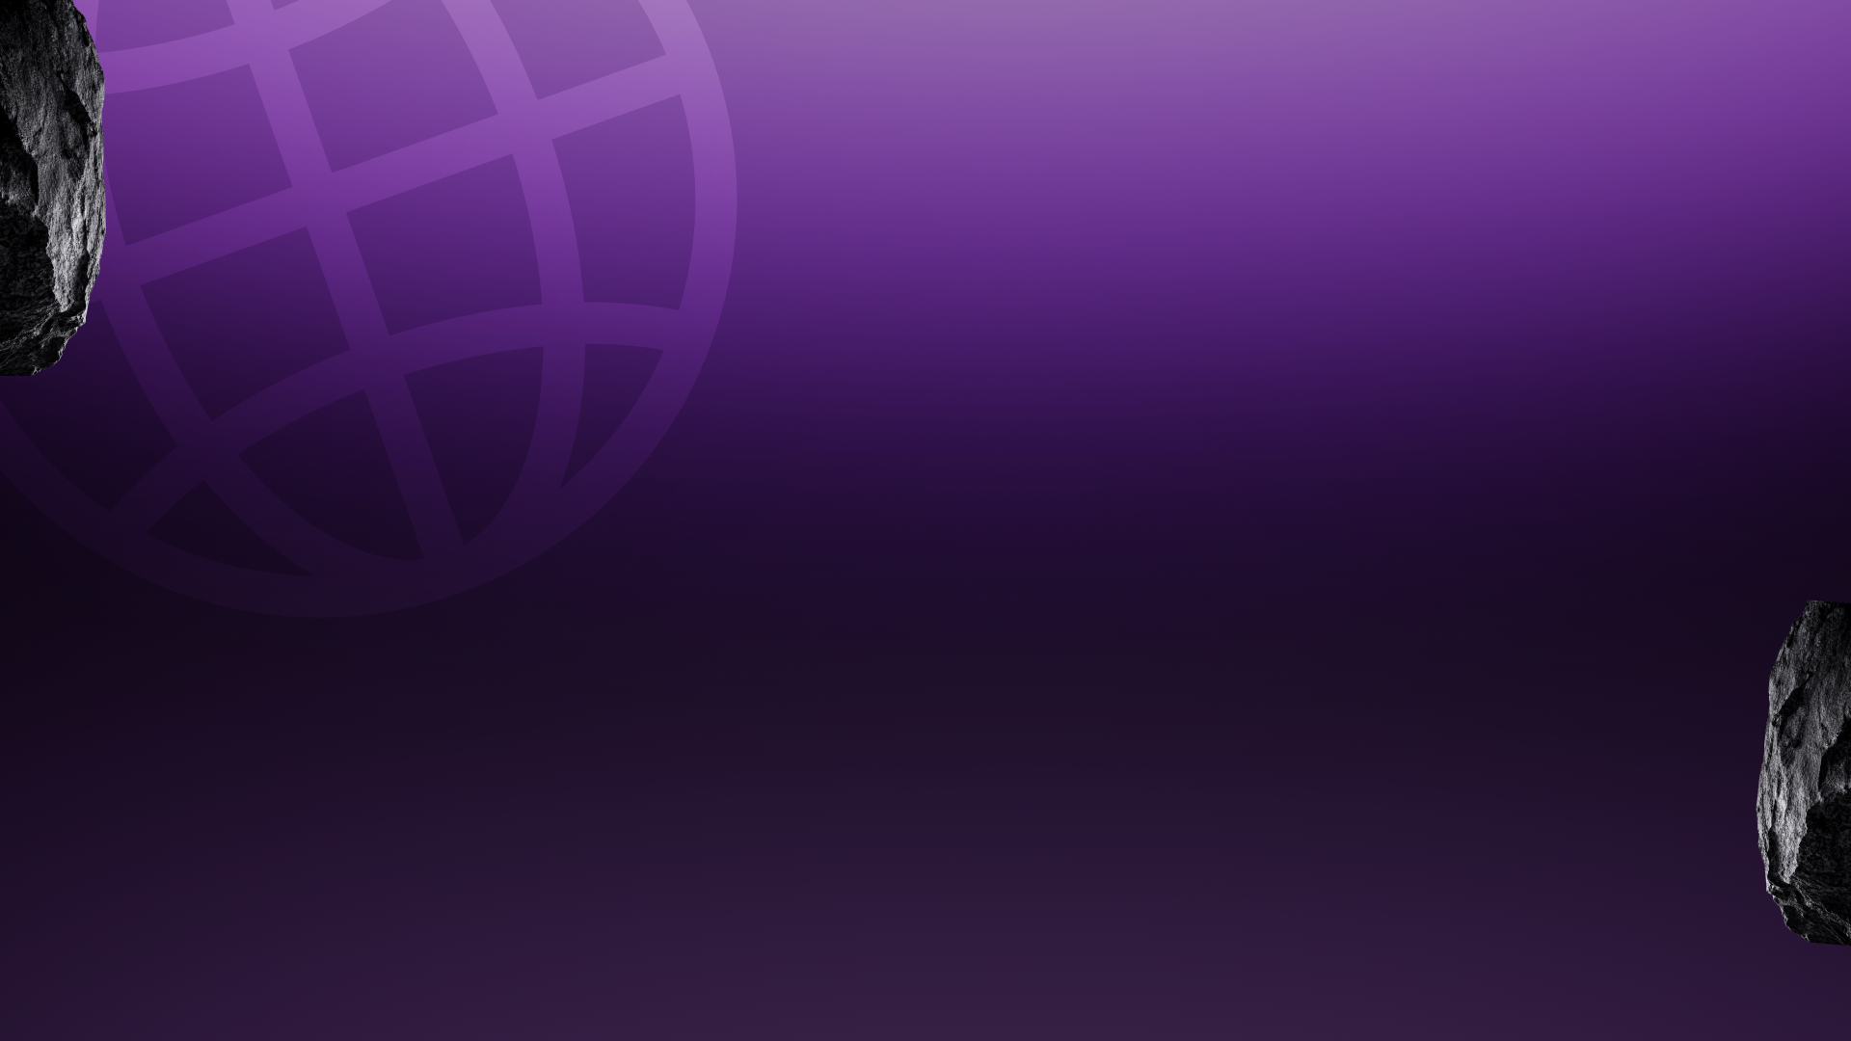


Dhaal (ढाल) — the pre-payment scam shield for every Indian
Team Name: [Your Team Name]
Team ID: [Registration ID]
Problem Statement Selected: Consumer Protection Against Payment Scams (Fintech PS #7)
Theme: Fintech

Slide 2

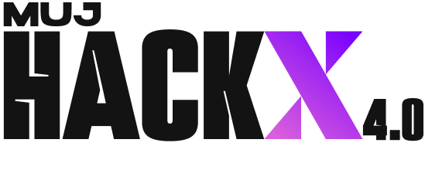

IDEA / SOLUTION TITLE
पैसे भेजने से पहले — एक जाँच। One check before you pay: paste it, photo it, or SPEAK it.
जाँच · Check
Verdict + every weighted signal, in the user's language (हिं/EN toggle) — and spoken aloud. Never "safe", only "no known risk".
परिवार की ढाल · Guardian
An elderly user's risky payment pings family for a 10-second Allow/Block. Every check visible; dignity intact — risk, never transactions.
धोखों का नक्शा · Intel
Report → human verify → everyone's live blocklist. A scam burned in Jaipur today can't work in Jodhpur tomorrow.
पहला घंटा · Recover
1930 call script + cybercrime.gov.in complaint + bank letter — auto-drafted in Hindi, in the golden hour that gets money back.
The verdict is computed by rules — the AI explains it, and can never change it. LIVE: dhaal-delta.vercel.app — check your own inbox in Q&A.

Slide 3
TECHNICAL APPROACH
Next.js PWA (Vercel) · FastAPI on Vercel Python · MongoDB Atlas · Claude claude-sonnet-5 · Sarvam AI (Saarika ASR + Bulbul TTS) · jsQR on-device
INPUT
text · URL · UPI · QR (on-device) · voice ASR
SIGNAL ENGINE
deterministic verdict — collect-vs-pay · lookalike domains · 10 scam-script families · coercion · bait-VPA · blocklist | ≥60 खतरा · ≥30 सावधान
EXPLAIN & SPEAK
Claude narrates from signals — zero verdict weight · Bulbul speaks the warning
MongoDB Atlas
durable community intel — human-verified blocklist
Reliability engineering
Retry-once + deterministic fallback on every external call (dead Wi-Fi degrades prose, never protection; mocked responses say mocked:true) · 49 automated checks green · measured live: verdict in ms, p50 5.4s with explanation, Hindi ASR 0.6s.

Slide 4
USER EXPERIENCE & DESIGN
A public-safety poster, not a SaaS dashboard
Hand-built "suraksha poster" identity — ink + saffron hazard language, Anek Devanagari display type, a rubber-stamp community count on the verdict card.
Built for the next billion users
Hindi-first with a global हिं/EN toggle that holds across every page and every output — including the spoken warning · voice in AND out for low-literacy users · QR photos decoded on-device (the image never leaves the phone) · entry-level phones, weak networks.
Dignity by design
Guardian mode shares the risk summary only — never transactions. Risky checks ask for a decision; clean ones appear as quiet notes. Honest language everywhere.
Danger screams. Safety whispers.

Slide 5
FEASIBILITY AND VIABILITY
Not a concept — deployed, tested and durable tonight.
49
AUTOMATED CHECKS GREEN
5.4s
P50 CHECK, LIVE PROD
450+
VERIFIED REPORTS IN ATLAS
₹0
INFRA — FREE TIERS
Live now
dhaal-delta.vercel.app (app) · dhaal-api.vercel.app (API) · guardian pairing, community flywheel and the full voice loop verified end-to-end on stage hardware.
Risks & mitigations
API outage → deterministic fallbacks, demo survives · false positives → delivery-vs-request context rules, tested on real bank OTP/debit SMS (score 0) · blocklist poisoning → human verification before any indicator goes live · scale → stateless serverless + Atlas, TTS caching.

Slide 6
IMPACT AND BENEFITS
₹22,495 crore lost to cyber fraud in 2025 — and the victim pressed PAY themselves.
24.51B UPI txns/month (NPCI Aug '26) · 28.1 lakh complaints in 2025 (I4C) · ₹805 crore UPI fraud in FY26 (Parliament) — bank controls cannot stop payments the victim authorises.
1 REPORT
10 seconds
HUMAN VERIFY
no rumour poisoning
BLOCKLIST LIVE
durable · Atlas
EVERYONE SHIELDED
every phone, instantly
↻ herd immunity for fraud — the shield compounds with every user
Who benefits
Every Indian with a phone (free forever) · the elderly — the most-targeted group (guardian mode) · banks & UPI apps (fewer reimbursements) · cyber cells (structured early reports — fast 1930 reporting has already saved ₹7,130+ crore).

Slide 7
BUSINESS MODEL & SUSTAINABILITY
Citizens: free forever. Institutions pay.
Protection this fundamental must not be paywalled — and by construction the marginal cost per check is a fraction of a paisa (deterministic verdict; one short narration).
Revenue — from those who bear today's fraud cost
Risk-API + verified-blocklist licensing to banks, fintechs and UPI apps (they reimburse this fraud today; prevention is cheaper) · pre-payment check SDK inside UPI apps — the check runs before the PAY button renders · deployment partnerships: state cyber cells & the CSC network.
Sustainability & moat
The community blocklist compounds with every user — a network effect no new entrant starts with · Roadmap: one-tap 1930/I4C hand-off · 10+ Indic languages via the same Sarvam pipeline (one parameter) · auto-verify thresholds for moderation at scale.

Slide 8
RESEARCH AND REFERENCES
Data sources (verified 11 Sep 2026)
NPCI monthly UPI statistics — 24.51B transactions / ₹29.82 lakh crore, Aug 2026 · I4C (MHA): ₹22,495 crore lost, 28.1 lakh complaints, 2025; 32.4M calls to 1930 · Ministry of Finance, Rajya Sabha reply: ₹805 crore UPI fraud, 10.64 lakh incidents, FY26 (to Nov) · PIB/MHA: ₹7,130+ crore saved via CFCFRMS (1930) early reporting · RBI guidelines on unauthorised-transaction liability.
Domain research
Scam-script corpus from I4C advisories & documented fraud patterns: digital arrest, KYC-expiry, collect-request refund bait, OLX/army advance, job-task & loan-fee scams, electricity disconnection, victim-voiced coercion · upi:// deep-link collect-vs-pay semantics · NPCI PSP handle registry for VPA verification.
Build
Live app: dhaal-delta.vercel.app · API: dhaal-api.vercel.app · Repo: github.com/SaudSatopay/MUJ-HACKX (49 automated checks, full contracts & docs) · Sponsor tech in production: Sarvam AI (Saarika ASR + Bulbul TTS), MongoDB Atlas.

