Slide 1

DhanDrishti धन-दृष्टि
Cash-flow foresight & early-warning intelligence
for rural micro enterprises
AI-Driven Cash Flow Prediction & Risk Flagging System for Rural Micro Enterprises
NABARD HACKATHON · GLOBAL FINTECH FEST 2026 · ROUND 1
Working prototype included — every number in this deck is measured output.
Notes:
DhanDrishti = 'wealth-sight'. One line: we give rural lenders and field officers three months of cash-flow foresight per micro enterprise, with explanations in Hindi. Working prototype exists.

Slide 2
THE PROBLEM
Bharat's micro enterprises are credit-invisible
14%
₹25L Cr+
Too late
of India's 6.3 crore MSMEs
have formal credit access
MSME financing gap —
worst in rural districts
lenders learn of stress only
after an EMI is missed
Deloitte, 2025
≈ rural 32% vs urban 20%
no forward-looking tooling
Kirana stores, dairy units, tailors, agri-input dealers, food processors, handloom weavers — cash-heavy, seasonal, no audited books, thin bureau files. Field officers cover hundreds of accounts with no early-warning system: by the time stress is visible, the intervention window has closed.
DhanDrishti · NABARD Hackathon @ GFF 2026
2
Notes:
Anchor the size of the problem, then the operational failure: detection happens at default, not before.

Slide 3



THE OPENING
The signal now exists — nobody has stitched it together
UPI
→ digital revenue rhythm, counterparty mix
≈ 21.7 billion transactions a month — rural merchants included
Account Aggregator
→ bank-statement cash flows, on tap
₹1.67 lakh crore disbursed on AA rails in FY25, with user consent
Open public data
→ the context that drives rural cash cycles
Agmarknet mandi prices · eNAM · IMD rainfall · crop calendars
The gap: these signals have never been fused into enterprise-level cash-flow foresight for rural Bharat. That is exactly what DhanDrishti does.
DhanDrishti · NABARD Hackathon @ GFF 2026
3
Notes:
DPI rails make the data legally and technically reachable — consent-first. Our contribution is the fusion + foresight layer.

Slide 4




THE PRODUCT
Four outputs, one loop: foresee → flag → explain → act
Probabilistic forecast
Risk score + flags
12-week net cash-flow bands (P10/P50/P90), conformally calibrated — honest uncertainty, not a point guess.
Calibrated 0–100 score with discrete early warnings: liquidity crunch ahead, EMI stress, buyer concentration, seasonal dip…
Bilingual reason codes
Recommended action
Every alert explained in English + Hindi from SHAP attributions: “Revenue is down ~58% vs the same season last year.”
One concrete intervention per flag: pre-approve working capital, restructure EMI post-harvest, diversify buyers.
Surfaces: offline-capable dashboard (EN/हिंदी) · scoring API for bank LOS/LMS · SMS/WhatsApp nudges (roadmap)
DhanDrishti · NABARD Hackathon @ GFF 2026
4
Notes:
The loop matters: prediction alone doesn't change outcomes; explained, actionable prediction does.

Slide 5
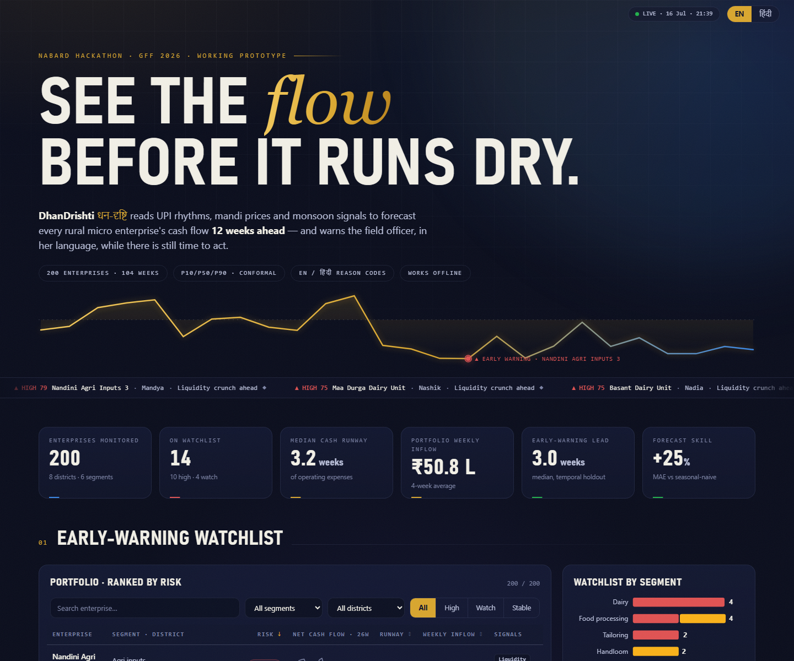
LIVE PROTOTYPE
The command deck — running, offline, bilingual
LIVE ALERT TICKER
Every HIGH/WATCH enterprise scrolls past with its top flag — click any alert to drill straight in.
RISK-RANKED WATCHLIST
200 enterprises, calibrated 0–100 scores, sparklines and signal chips; search, filter, sort in place.
BILINGUAL & OFFLINE
EN/हिंदी toggle on every reason and action; zero external assets — the demo runs with the internet off.
Deep-link any enterprise for the jury: localhost:8765/#ENT0178
DhanDrishti · NABARD Hackathon @ GFF 2026
5
Notes:
Everything on this slide is the running product, not a mockup. The hero pulse line is the top-risk enterprise's actual cash-flow history drawing itself.

Slide 6
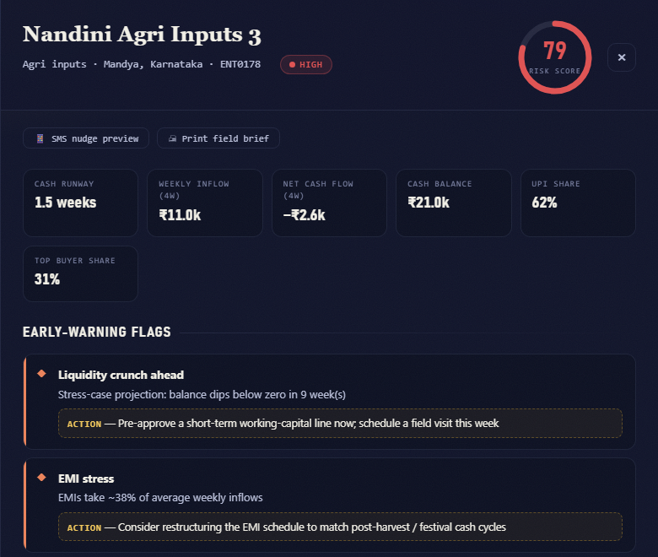
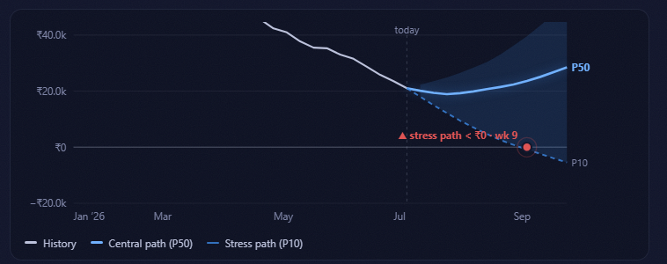
LIVE PROTOTYPE — THE DRILL-DOWN
Nine weeks of warning before the balance hits zero
Risk 79/100 — flagged today. The stress path crosses ₹0 in week 9. The field officer sees two flags, four plain-language reasons, and one concrete action: pre-approve a working-capital line now — in Hindi if she prefers. A missed EMI would have surfaced this ~2 months later.
DhanDrishti · NABARD Hackathon @ GFF 2026
6
Notes:
Walk the eye: risk dial, flags with suggested actions, then the stress chart — the pulsing red dot is the projected ₹0 crossing in week 9.

Slide 7


UNDER THE HOOD
Boring where it should be, clever where it counts
Feature store
28 weekly signals per enterprise: cash-flow trend & volatility, runway, UPI share drift, buyer concentration, EMI burden, mandi & rainfall context, festival calendar.
Quantile forecaster
Gradient-boosted P10/P50/P90, direct multi-horizon (12 wk), conformalized on a temporal holdout — the 80% band actually covers 80%.
Early-warning classifier
Predicts distress within 8 weeks. Domain monotonicity constraints (risk ↑ as runway ↓, EMI ↑, volatility ↑) + Platt calibration = smooth, defensible probabilities.
Explainability layer
TreeSHAP → curated bilingual reason codes. Transparent rules overlay generates flags; a noisy-OR blend guarantees the score and flags never contradict.
CPU-only (LightGBM) · retrains weekly in minutes · runs on-prem at an RRB data centre
DhanDrishti · NABARD Hackathon @ GFF 2026
7
Notes:
Judges' trust: no exotic infra. Monotone constraints + calibration + conformal = the rigor story. Roadmap: temporal fusion transformers once history deepens.

Slide 8
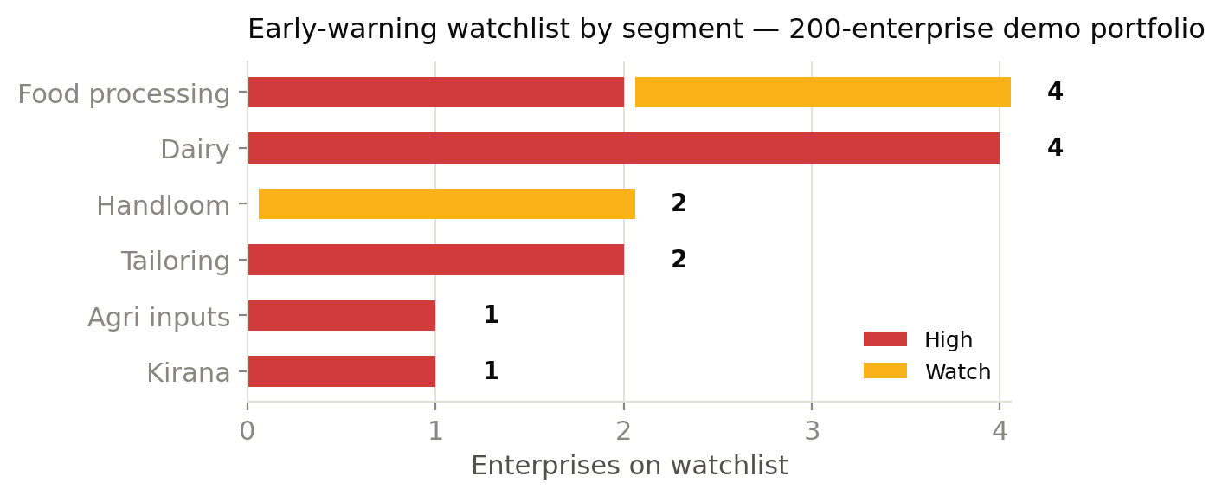
MEASURED, NOT PROMISED
Prototype results on a 200-enterprise simulated panel
−25%
80%
0.83
3 wks
forecast MAE vs
seasonal-naive baseline
band coverage after
conformal calibration
early-warning AUC
(13× precision lift)
median warning lead
before distress
Every top-10 alert on the demo panel corresponds to a genuine engineered distress ramp. Data is synthetic-but-realistic: harvest & festival seasonality, monsoon shocks, UPI adoption drift, household draws, and ground-truth distress episodes — so accuracy is measurable, honestly.
DhanDrishti · NABARD Hackathon @ GFF 2026
8
Notes:
Temporal holdout = last 16 weeks unseen in training. Simulated panel is the honest Round-1 posture; AA sandbox integration is the Round-2 plan.

Slide 9



DATA STRATEGY
Consent-first and DPI-native by design
Account Aggregator
bank/UPI statements — inflow rhythm, balances, counterparties (consented pull)
UPI / QR payments
daily revenue proxy, customer count, ticket size
SHG / JLG ledgers · Udyam
group repayment history, enterprise vintage & segment
Agmarknet · eNAM · IMD
mandi prices, rainfall, crop calendar — the rural context layer
No Aadhaar numbers · no location tracking · no scraping. Pseudonymous features, logged consent artefacts, DPDP-aligned. Cold start via segment seasonality priors.
DhanDrishti · NABARD Hackathon @ GFF 2026
9
Notes:
Consent-first isn't compliance theater — AA is the reason this is deployable by public institutions without a proprietary data moat.

Slide 10


BUILT FOR THE FIELD
If a BC sakhi can't use it, it doesn't count
Works where the network doesn't
Speaks the field officer's language
Runs on what banks already have
Offline-capable PWA, zero external assets, SMS fallback on the roadmap. Demo runs with the internet switched off.
Every reason and action in English + Hindi (extensible to Marathi, Telugu, Bangla…). Not a score — a sentence someone can act on.
CPU-only models, one server per district pilot, on-prem deployable at an RRB — no cloud dependency, no GPUs.
SAMPLE ALERT — AS THE FIELD OFFICER SEES IT
▲ Liquidity crunch ahead — stress-case balance dips below zero in 9 weeks. → Pre-approve a short-term working-capital line; schedule a field visit this week.
▲ नकदी संकट की आशंका — तनाव-परिदृश्य में 9 सप्ताह में शेष राशि शून्य से नीचे जा सकती है। → अभी अल्पकालिक कार्यशील-पूंजी सीमा स्वीकृत करें; इसी सप्ताह क्षेत्र भ्रमण तय करें।
DhanDrishti · NABARD Hackathon @ GFF 2026
10
Notes:
The Hindi line is generated by the system (templated reason codes), not marketing copy — it's in the live demo.

Slide 11



IMPACT
One rail, three winners
Lenders (RRBs, DCCBs, MFIs)
Rural entrepreneurs
NABARD & policy
Weeks of early warning → intervene before slippage, cut micro-book NPAs
Explainable, auditable basis for cash-flow-based lending
Portfolio heatmaps by district & segment
A bankable, consent-based cash-flow record — the on-ramp from moneylenders to formal credit
Vernacular nudges to plan for lean seasons
Credit priced on evidence, not absence of it
District-level early-warning view across the rural portfolio
Evidence base for scheme design & timing
A reusable public-good scoring rail for the SHG/RRB ecosystem
DhanDrishti · NABARD Hackathon @ GFF 2026
11
Notes:
Framing: not another fintech credit score — an early-warning public rail aligned with NABARD's institutional mandate.

Slide 12
ROADMAP
From working prototype to district pilot
NOW · DONE
JUL–AUG 2026
POST-GFF
THEN
1
2
3
4
Working prototype
Round 2 build
District pilot
Scale via NABARD
Full pipeline: data → models → bilingual dashboard. Measured: −25% MAE, AUC 0.83, 3-wk lead.
AA-sandbox integration demo, SMS nudge prototype, hardening, demo video + deployment guide.
One RRB/DCCB partner, 500–1,000 consented enterprises. Measure lead time, intervention uptake, repayment outcomes vs control.
State roll-out through the RRB/SHG ecosystem, OCEN-integrated scoring API, more languages.
DhanDrishti · NABARD Hackathon @ GFF 2026
12
Notes:
Pilot success metric is not model AUC — it's intervention uptake and repayment outcomes vs control branches.

Slide 13
Seeing cash-flow stress
before it strikes.
DhanDrishti · cash-flow foresight & early warning for rural micro enterprises
Team «name» — «members & roles» · «email» · «phone»
Prototype: runs offline on a laptop · synthetic data only · no real enterprise or personal data
Notes:
Close with the pilot ask: one district, one RRB partner, 500 consented enterprises.

