Slide 1
Python For Data Analytics

Slide 2
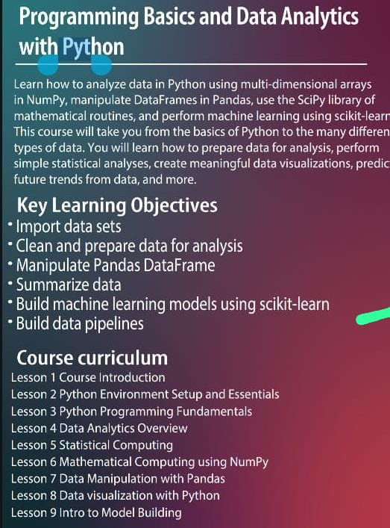
Syllabus of Python for Data Anaylytics

Slide 3
3)Python Fundamentals Syllabus
Python variable and datatypes
Python print and input function
Python operators and its types
Python decision making statement if ,if-else, nesting if-else ,ladder if-else
Python looping statement for, while and nesting loop
Python list, tuple, set, dictionary collection and its method
Python Array and python function and python recursion function
Python lambda function
Python filter and map
python Type casting
Python String and its method

Slide 4
Python Introduction
Python is a widely used general purpose, dynamic, interpreted, high level programming language developed by Guido van Rossum in 1991at the national Research institute of Mathematics and Computer Science Netherlands
It supports Object Oriented programming approach to develop applications. It is simple and easy to learn and provides lots of high-level data structures.
Python is easy to learn yet powerful and versatile(to be capable of doing many different things or being used for many different purposes) scripting language, which makes it attractive for Application Development.
Python's syntax and dynamic typing with its interpreted nature make it an ideal language for scripting and rapid application development.
Python supports multiple programming pattern, including object-oriented, imperative, and functional or procedural programming styles.

Slide 5
History Of Python
In February 1991, Guido Van Rossum published the code (labeled version 0.9.0) to alt. sources.
In 1994, Python 1.0 was released with new features like lambda, map, filter, and reduce.
Python 2.0 added new features such as list comprehensions, garbage collection systems.
On December 3, 2008, Python 3.0 (also called "Py3K") was released. It was designed to rectify the fundamental flow of the language.
ABC programming language is said to be the predecessor of Python language, which was capable of Exception Handling and interfacing with the Amoeba Operating System.

Slide 6
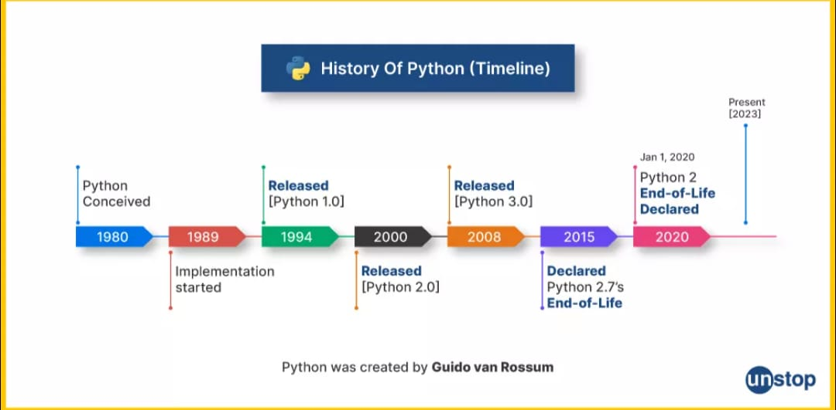

Slide 7
Why the Name Python?
There is a fact behind choosing the name Python. Guido van Rossum was reading the script of a popular BBC comedy series "Monty Python's Flying Circus".
It was late on-air 1970s.
Van Rossum wanted to select a name which unique, sort, and little-bit mysterious.
So he decided to select naming Python after the "Monty Python's Flying Circus" for their newly created programming language.
The comedy series was creative and well random.
It talks about everything. Thus it is slow and unpredictable, which made it very interesting.
Python is also versatile and widely used in every technical field, such as Machine Learning, Artificial Intelligence, Data Analytics, Web Development, Mobile Application, Desktop Application, Scientific Calculation, etc.

Slide 8
Features of Python
Simple and Easy To Learn
Python is easy to learn as compared to other programming languages. Its syntax is straightforward and much the same as the English language. There is no use of the semicolon or curly-bracket, the indentation defines the code block.
Expressive Language
Python can perform complex tasks using a few lines of code. A simple example, the hello world program you simply type print("Hello World"). It will take only one line to execute, while Java or C takes multiple lines.
Interpreted language
Python is an interpreted language; it means the Python program is executed one line at a time. The advantage of being interpreted language, it makes debugging easy and portable.
Cross platform Language
Python can run equally on different platforms such as Windows, Linux, UNIX, and Macintosh. So, we can say that Python is a portable language. It enables programmers to develop the software for several competing platforms by writing a program only once.

Slide 9
Free and Open Source
Python is freely available for everyone. It is freely available on its official website www.python.org. It has a large community across the world that is dedicatedly working towards make new python modules and functions. Anyone can contribute to the Python community. The open-source means, "Anyone can download its source code without paying any penny."
Object Oriented Programming Language
Python supports object-oriented language and concepts of classes and objects come into existence. It supports inheritance, polymorphism, and encapsulation, etc. The object-oriented procedure helps to programmer to write reusable code and develop applications in less code.
Large Standard Library
It provides a vast range of libraries for the various fields such as machine learning, web developer, and also for the scripting. There are various machine learning libraries, such as Tensor flow, Pandas, Numpy, Keras, and Pytorch, etc. Django, flask, pyramids are the popular framework for Python web development.
Gui Programming Supports
Graphical User Interface is used for the developing Desktop application. PyQT5, Tkinter, Kivy are the libraries which are used for developing the web application.

Slide 10
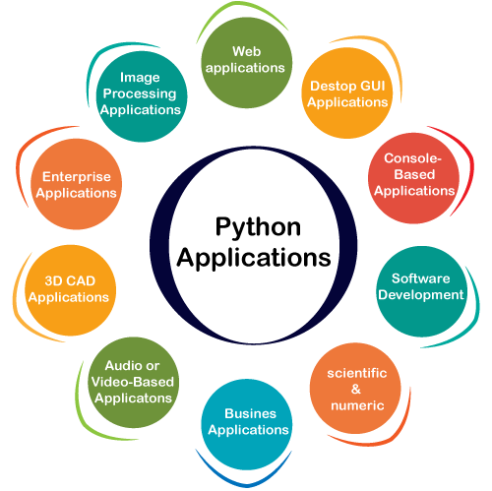
Python Applications

Slide 11
Web applications :www.youtube.com , www.Linkedin.com
Desktop Gui Application :- Notepad, word, Pycharm
Console application : only character based application
Software Development : ERP Application, Billing application
Audio And Video Based Application: Cliphamp, iMovie, DanVinci Resolve.
Business Application : flipkart, amazon
Image Processing Application: X-rays and MRI Scanner.
Scientific application: Brainly, Rstudio, Zotero,Wikipedia
Cad Application : Cad /Com Application
Enterprise application :SAP/HANA Net Suite, HubSpot,Salesforce

Slide 12
Careers With Python

Slide 13
Installation of Python
There are many interpreters available freely to run Python scripts like IDLE (Integrated Development Environment) which is installed when you install the python software from
Link For Download Python in Your Pc/laptop: http://python.org/downloads/
Steps to be followed and remembered:
Step 1: Select Version of Python to Install.
Step 2: Download Python Executable Installer.
Step 3: Run Executable Installer.
Step 4: Verify Python Was Installed On Windows.
  Open the command prompt and run the following command:
python --version

Slide 14
Execution Process of Python
Python Code Execution:
Python’s traditional runtime execution model: Source code you type is translated to byte code, which is then run by the Python Virtual Machine (PVM). Your code is automatically compiled, but then it is interpreted.
            Source Byte Runtime
            Code Code
            What is Source Code
            Source Code is Code which is written by the programmer in human readable form with proper programming language.
            What is Byte Code
            ByteCode is the intermediate code generated by the Python compiler . Bytecode is run by interpreter pvm instead of the original machine (Computer processor). This code is platform-independent
m.py
m.pyc
PVM

Slide 15
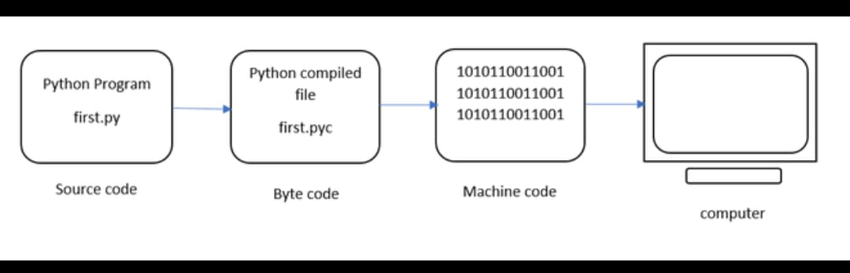
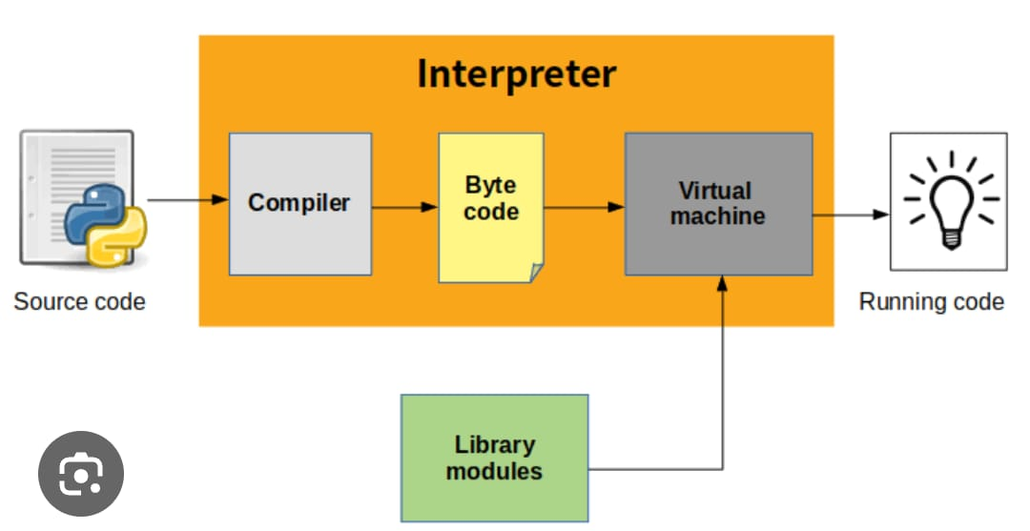
Execution Process of Python

Slide 16
Difference between compiler and interpreter
S.No | Interpreter | Compiler
1 | It interprets line by line and executes | Whole program at a time
2 | It gives the result line by line | It gives whole output at a time
3 | If any error occurs interpreter stops Hence it shows only one error | It checks all statements in the program and shows all the errors in the program.
4 | It will not generate executable file | If no errors in the program, then it generates executable file
5 | It always executes only source code | It executes exe file
6 | all scripting languages | all programming language
7 | Eg: HTML, PERL, Java Script, Python, Shell | Eg; C, C++ ,java and .Net C#
8 | Interpreter based languages don’t have exe file concept | Every program converts into exe file
9 | Open Source, it can be modified any time | It is not an open source , it is exe based , it’s code can not be modified

Slide 17
Automatic Compilation in Python
Python is an interpreted language, but it also goes through a compilation step automatically
Your .py file (source code) is first compiled into bytecode.
The bytecode is a lower-level, platform-independent representation of your code.
This bytecode is then sent to the Python interpreter (Python Virtual Machine - PVM), which executes it line by line.
Why Is It Automatic?
Python hides the compilation step from the user to simplify the development process.
Unlike languages like C or Java (where you explicitly compile), Python handles it in the background.
This improves developer productivity and allows for quicker testing and iteration.
When you run a Python script, it may create a .pyc file inside the __pycache__ folder.
This is the compiled bytecode version of your script, used to speed up future runs.

Slide 18
Install or download Jupyter Notebook
>pip --version
Using PIP with Python is one of the best method to install Jupyter Notebook in your Windows Operating System
Step 1: Check for any Exisiting Update
Use the following command to update pip (to verify if pip is updated):
python -m pip install --upgrade pip
Step 2: Install Jupyter Notebook
After updating the pip version, type the following command to install Jupyter:
python -m pip install jupyter
Step 3: Launching Jupyter
Use the following command to launch Jupyter using:
jupyter notebook

Slide 19
Jupyter Notebook
Interactive Environment: Jupyter Notebook provides an interactive web-based environment where you can write and run code, visualize data, and document your work all in one place.
Supports Multiple Languages: Although primarily used for Python, Jupyter also supports many other programming languages via kernels (e.g., R, Julia, Scala).
Code and Text in One Document: You can combine executable code, rich text (using Markdown), equations (using LaTeX), and visualizations in a single document.
Open Source: Jupyter Notebook is open-source and freely available, making it accessible to anyone.
Widely Used in Data Science: It's a popular tool among data scientists and researchers for data analysis, machine learning, and statistical modeling.

Slide 20
Jupyter Notebook
Cell-Based Execution: Notebooks are made up of cells that can be executed independently, allowing easy debugging and iterative development.
Integration with Other Tools: Can be run on local machines or cloud platforms like Google Colab, Binder, or JupyterHub for collaborative work.
Extensions and Customization: Jupyter supports a wide variety of extensions and themes that enhance functionality (e.g., spell checker, table of contents, code folding).

Slide 21
Python print() function
The print() function in Python is a built-in function used to display output on the screen (console).
It sends the specified message, variable, or expression result to the standard output (usually the terminal).
Syntax of print() function --
print(object1, object2, ..., sep=' ', end='\n')
Parameter | Description
object(s) | The values you want to print. Can be strings, numbers, variables, etc.
sep | (Optional) Separator between objects. Default is a space ' '.
end | (Optional) What to print at the end. Default is newline \n.

Slide 22
Python print() function
print("Hello, World!")
print("Name:", "Alice", "Age:", 25) //Printing multiple items:
print("2025", "07", "02", sep="-") # Output: 2025-07-02
print("Hello", end=" ")
print("World!") # Output: Hello World!

Slide 23
Python Variables and There Rules
A variable in Python is a named location in memory used to store data that can be changed during program execution.
It acts as a label for a value, allowing you to reference and manipulate the value throughout your code.
Rules of Declaring Variables in Python
  Variable names must start with a letter (A–Z or a–z) or an underscore (_)
Example: name, _value
  Cannot start with a number
    ❌ Invalid: 1name ✅ Valid: name1
  Can include letters, numbers, and underscores
    Example: user_name1, temp_123
  Cannot use special characters like @, #, $, %, etc.
  ❌ Cannot use Python reserved keywords (e.g., if, for, while, class, def)
  Case-sensitive
    name and Name are two different variables.
  No need to declare type explicitly
    Python is dynamically typed, so the type is inferred from the value.
python
a = 5 # int b = "Hi" # str

Slide 24
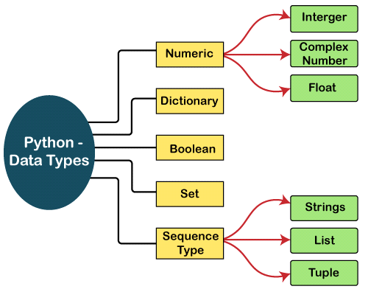
Python Datatypes

Slide 25
Python Datatypes complex_number = real_part + imaginary_part * j j represents the imaginary unit (just like i in mathematics).
Python uses j instead of i for complex numbers.
Feature | int (Integer) | float (Floating Point) | complex (Complex Number) | str (String)
Definition | Whole numbers | Numbers with decimals | Numbers with real & imag parts | Sequence of characters
Example Values | 5, -10, 0, 999 | 3.14, -0.5, 2.0 | 2+3j, -1-1j, 5j | "hello", 'Python'
Decimal Support | No | Yes | Yes (real and imaginary) | Not numeric
Imaginary Part | Not supported | Not supported | Yes (with j) | Not applicable
Type Name | int | float | complex | str
Conversion Example | int(3.9) → 3 | float(5) → 5.0 | complex(2, 3) → 2+3j | str(100) → "100"
Supports Math Ops | Yes | Yes | Yes | (only string operations)
Use Case | Counting, indexing | Measurements, averages | Scientific/engineering | Text processing

Slide 26
Python Keywords
Python keywords are unique words reserved with defined meanings and functions that we can only apply for those functions. You'll never need to import any keyword into your program because they're permanently present. There Are 35+ Keywords in Python
False | await | else | import | pass
None | break | except | in | raise
True | class | finally | is | return
and | continue | for | lambda | try
as | def | from | nonlocal | while
assert | del | global | not | with
async | elif | if | or | yield

Slide 27
Python Input() function
input() is a built-in function used to take input from the user via the keyboard.
It returns the input as a string, regardless of what the user types.
name = input("Enter your name: ")
age=int(input("Enter your age: "))
print(name) # Always a string
input() is different from raw_input() in Python 2. In Python 3, only input() exists and behaves like raw_input() did.

Slide 28
Python Indentation
Indentation in Python refers to the spaces or tabs added at the beginning of a line to indicate a block of code.
Unlike many other programming languages that use curly braces {} to group code blocks, Python uses indentation as a core part of its syntax.
✅ Indentation defines code blocks
In Python, blocks of code for functions, loops, conditionals, and classes are defined by indentation — not by braces. if x > 0: print("Positive number")
❌ Improper indentation causes errors
If indentation is missing or inconsistent, Python raises an IndentationError or misinterprets the code logic.
if x > 0: print("Error!") # Incorrect indentation
✅ Standard indentation is 4 spaces
Python's official style guide (PEP 8) recommends using 4 spaces per indentation level for consistency and readability.
🚫 Do not mix tabs and spaces
Mixing tabs and spaces in the same file or block can cause errors and unexpected behavior. Always use only spaces.
✅ Essential for readability and logic
Proper indentation makes Python code clean, structured, and easy to understand. It's both a stylistic and functional requirement.

Slide 29
Python Operators
The operator is a symbol that performs a certain operation between two operands, according to one definition. In a particular programming language, operators serve as the foundation upon which logic is constructed in a programme. The different operators that Python offers are listed here.
Arithmetic operators
Comparison operators/Relational Operators
Assignment Operators
Logical Operators
Membership Operators

Slide 30
Arithmetic operators
Arithmetic operations between two operands are carried out using arithmetic operators. It includes the exponent (**) operator as well as the + (addition), - (subtraction), * (multiplication), / (divide), % (reminder), and // (floor division) operators.
These operators are used to perform basic mathematical operations such as addition, subtraction, multiplication, division, and modulus.
Operator | Description | Example | Use (Result)
+ | Addition | 5 + 3 | Adds values (Result: 8)
- | Subtraction | 5 - 3 | Subtracts values (2)
* | Multiplication | 5 * 3 | Multiplies values (15)
/ | Division | 6 / 3 | Divides values (2.0)
// | Floor Division | 7 // 2 | Division, removes decimal (3)
% | Modulus | 7 % 2 | Remainder of division (1)
** | Exponentiation | 2 ** 3 | Raises to power (8)

Slide 31
Comparison operators/Relational Operators
Comparison operators compare the values of the two operands and return a true or false Boolean value in accordance. The following table lists the comparison operators.
Also known as relational operators, these are used to compare two values and return a Boolean result (True or False) based on the comparison.
Operator | Description | Example | Use (Result)
== | Equal to | 5 == 5 | True if equal (True)
!= | Not equal | 5 != 3 | True if not equal (True)
> | Greater than | 5 > 3 | True if left > right (True)
< | Less than | 3 < 5 | True if left < right (True)
>= | Greater than or equal | 5 >= 5 | True if left ≥ right (True)
<= | Less than or equal | 3 <= 5 | True if left ≤ right (True)

Slide 32
Assignment Operators
The right expression's value is assigned to the left operand using the assignment operators. The following table provides a description of the assignment operators.
These are used to assign values to variables and can also perform operations while assigning (e.g., +=, -=).
Operator | Description | Example | Use (Final value of x)
= | Assign | x = 5 | Assigns value 5 to x
+= | Add and assign | x += 2 | x = x + 2
-= | Subtract and assign | x -= 2 | x = x - 2
*= | Multiply and assign | x *= 2 | x = x * 2
/= | Divide and assign | x /= 2 | x = x / 2
//= | Floor divide and assign | x //= 2 | x = x // 2
%= | Modulus and assign | x %= 2 | x = x % 2
**= | Exponent and assign | x **= 2 | x = x ** 2

Slide 33
Python Logical Operators
These are used to combine multiple conditional statements and return a Boolean value depending on the logic (e.g., AND, OR, NOT).
Operator | Description | Example | Use (Result)
And | Logical AND | True and False | True if both are true (False)
or | Logical OR | True or False | True if one is true (True)
not | Logical NOT | not True | Reverses condition (False)

Slide 34
Python MemberShip Operators
These test whether a value or variable is found within a sequence such as a list, tuple, or string.
Operator | Description | Example | Use (Result)
in | Present in sequence | 'a' in 'apple' | True if found (True)
not in | Not in sequence | 'x' not in 'apple' | True if not found (True)

Slide 35
Python Decision Making Statements
Python decision-making statements allow the program to execute certain blocks of code based on specific conditions. These statements evaluate expressions and control the flow of execution depending on whether a condition is True or False.
Python decision-making statements are control flow constructs that allow a program to make choices and execute different blocks of code based on one or more conditions. These statements evaluate logical or relational expressions, and depending on whether the condition is true or false, specific parts of the code are executed or skipped. This enables the program to react dynamically to different inputs or states during execution, making it capable of handling real-world decision processes.
Key Keywords: Python uses if, elif, and else for decision-making.
Boolean Logic: Conditions are evaluated as Boolean expressions (True or False).
Indentation Matters: Python uses indentation (typically 4 spaces) to define the block of code under each condition.
Nested Conditions: You can nest if statements inside one another for complex logic.
Short-Circuit Evaluation: Logical operators like and and or stop evaluating as soon as the result is determined.

Slide 36
Python Decision Making Statements
Statement Type | Definition | Use | Syntax | Example Code
if Statement | Executes a block of code only if the condition is true. | Use when you want to check one condition. | if condition: # Code Block | x = 10 if x > 5: print("x is greater than 5“)
if-else Statement | Executes one block if condition is true, another if false. | Use when you have two choices or outcomes. | if condition: # true Block else:# false Block | x = 3 if x > 5: print("x is greater than 5") else: print("x is 5 or less")
if-elif-else Statement | Checks multiple conditions. First true one runs; else runs if none are true. | Use when checking three or more conditions. | if condition1: # block1 elif condition2: # block2 else: # block3 | x = 0 if x > 0: print("Positive") elif x == 0: print("Zero") else: print("Negative")
Nested if-else Statement | One if or else contains another if-else inside. | Use when decisions depend on another condition. | if condition1: if condition2: block else: # block else: # block | x = 15 if x > 10: if x < 20: print("x is between 10 and 20") else: print("x is 20 or more") else: print("x is 10 or less")

Slide 37
Assignment On Decision Making Statement
Check Even or Odd Number
Write a Python program that takes a number as input and checks whether it is even or odd using an if statement.
Find the Largest of Two Numbers
Write a program to accept two numbers from the user and use an if-else statement to print the largest number.
Check Eligibility to Vote
Write a program that asks the user to enter their age and uses if-else to determine if they are eligible to vote (age ≥ 18).
Grade Calculation Based on Marks
Write a program that takes marks (0 to 100) as input and uses if-elif-else to print the grade:
  A: 90–100
  B: 75–89
  C: 60–74
  D: 40–59
  F: below 40
Check if a Number is Positive, Negative, or Zero
Write a Python program that checks whether a given number is positive, negative, or zero using if-elif-else.

Slide 38
Check if a Character is a Vowel or Consonant
Write a program to input a character and check whether it is a vowel or consonant using if-else.
Find the Largest Among Three Numbers
Write a Python program that takes three numbers as input and uses if-elif-else to find and print the largest number.
Check Divisibility by 3 and 5
Write a program that checks whether a number is divisible by both 3 and 5 using a single if statement with logical operators.
Nested if-else: Age and Gender Check
Write a program that checks if a person is eligible for a job:
  Age must be above 18
  If age > 18, then check gender:
    If male → eligible
    If female → not eligible
    Use nested if-else statements.
Electricity Bill Calculator (Simple Slab System)
Write a program to input the number of electricity units consumed and calculate the bill using the following rules:
Up to 100 units: ₹5/unit
101–200 units: ₹7/unit
More than 200 units: ₹10/unit
Use if-elif-else to solve.

Slide 39
Python Looping Statements
A looping statement allows you to execute a block of code repeatedly based on a condition.
Looping statements are used to execute a block of code repeatedly until a specific condition is met.
Python supports two main types of loops: for loops and while loops.
The for loop is commonly used to iterate over sequences such as lists, strings, and ranges.
The while loop continues to execute as long as the given condition remains True.
Loop control statements like break, continue, and pass are used to modify the flow of loops.
Python provides two main types of loops:
for loop
while loop

Slide 40
range() Function in Python?
The range() function in Python is used to generate a sequence of numbers. It's commonly used in loops, especially for loops, to specify how many times the loop should run or what values to iterate over.
Syntax of range(1,20)
python
range(start, stop, step)
Parameter | Description | Optional/Required
start | Starting number of the sequence | Optional (default is 0)
stop | End of the sequence (not included) | Required
step | Difference between each number (default 1) | Optional
for i in range(5):
print(i)
for i in range(2, 6):
print(i)
for i in range(1, 10, 2):
print(i)
for i in range(10, 0, -2):
print(i)
Common Uses Of Range Function
range() helps generate sequences of numbers for looping.
It can be customized sing start, stop, and step.
It's efficient and commonly used in for loops.

Slide 41
Python For Loop and While loop
Feature | for Loop | while Loop
Definition | Used to iterate over a sequence (like list, tuple, string, or range). | Repeats a block of code as long as a condition is True.
Syntax | for variable in sequence: # code block | while condition: # code block
Control Type | Definite loop (number of iterations is known or defined). | Indefinite loop (number of iterations is not known in advance).
Use Case | When you want to loop through items in a collection or range. | When you want to loop until a condition changes (e.g., user input, counter).
Example | for i in range(5): print(i) | i = 0 while i < 5: print(i) i += 1
Common Uses | Iterating over: ✅ Lists ✅ Strings ✅ Ranges | Repeating actions: ✅ User input ✅ Wait loops ✅ Condition checks
Termination | Stops when sequence ends. | Stops when the condition becomes False.
Loop Control | Works well with break, continue, and else. | Same as for, supports break, continue, and else.

Slide 42
Assginments on Python For loop And While loop
Write a program that uses a for loop to print the reverse of a string entered by the user.
Use a while loop to reverse a number entered by the user.
Write a program to print the squares of numbers from 1 to 10 using a for loop.
Write a program that prints numbers from 1 to 10 using a while loop.
Use a for loop to calculate and print the factorial of a given number.
Write a program that uses a while loop to check whether a number is a palindrome.
Use a while loop to calculate the sum of digits of a number entered by the user.
Use a for loop to print only the even numbers between 1 and 50.
Create a program using a while loop to count how many times the digit 5 appears in a given number.
Use a while loop to print numbers from 50 down to 1.

Slide 43
Assginments on Python For loop And While loop
Write a program that prints numbers from 1 to 20 using a for loop.
Use a for loop to count and print how many numbers between 1 and 100 are divisible by 3.
Write a program that uses a while loop to print all even numbers from 1 to 100.
Use a while loop to display the first 10 terms of the Fibonacci sequence.
Use a for loop to print all characters of a string one by one.
Write a program that calculates the sum of the first 10 natural numbers using a for loop.
Write a program that uses a for loop to print the multiplication table of a number entered by the user.
Use a while loop to accept numbers from the user until they enter 0, then print the total count of numbers entered.
Use a for loop to print all numbers from 100 to 1 in reverse order.
Write a program that uses a while loop to find the smallest number whose square is greater than 200.

