Slide 1
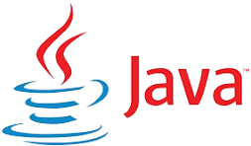



Java Full Stack Development – Demo Session
Viren| UV Tech

Slide 2

What is Full Stack Development?
- Frontend + Backend + Database + Tools
- A Full Stack Developer can build end-to-end applications
- Example: E-commerce application (UI, APIs, Database)

Slide 3
Java History
1991 – Initiated by James Gosling and team at Sun Microsystems (Project Oak).
1995 – Officially released as Java, designed for Write Once, Run Anywhere (WORA).
1990s – Quickly became popular for web applets and enterprise software.
2006 – Java was made open source under the GNU General Public License (GPL).
2009 – Sun Microsystems acquired by Oracle Corporation (Java’s new steward).
Present – Java remains one of the most widely used programming languages for web, enterprise, mobile (Android), and cloud applications.

Slide 4
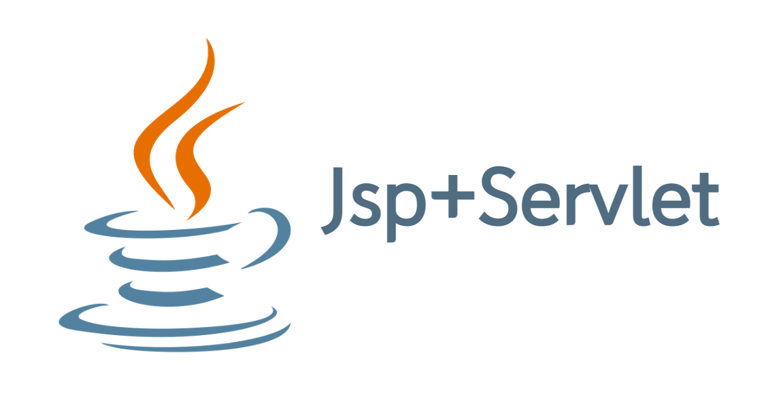

Course Roadmap / Syllabus Overview
- Core Java
- Advanced Java
- Frameworks (Spring, Hibernate, Spring Boot)
- SQL & Database
- Microservices
- Frontend (HTML, CSS, JavaScript, React)
- Tools (Postman, Git, Maven)

Slide 5
Core Java (Basics to OOPs)
- Java Basics: Data types, Loops, Arrays, Methods & Objects,
- OOPs concepts: Encapsulation, Inheritance, Polymorphism, Abstraction
- Exception Handling
- Collections Framework
- Multithreading

Slide 6
Advanced Java
- Servlets & JSP
- JDBC (Database Connectivity)
- MVC Architecture
- REST API Basics

Slide 7
Frameworks
- Spring Core (IoC, DI)
- Spring Boot (Rapid development, Embedded server)
- Hibernate/JPA (ORM, Database mapping)
- Spring Security (Basics)

Slide 8
SQL & Database
- RDBMS basics (Tables, Joins, Indexing)
- CRUD operations
- Stored procedures, Views, Transactions

Slide 9
Microservices
- Monolith vs Microservices
- REST APIs with Spring Boot
- Communication (REST, Feign, Eureka)
- Deployment basics (Docker/Kubernetes)

Slide 10
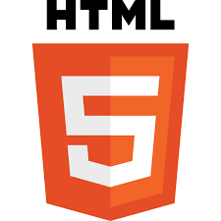


Frontend Technologies
- HTML5 – Structure
- CSS3 – Styling, Responsive design
- JavaScript (ES6, DOM manipulation)
- React – Components, Props, State, Hooks
Connectivity with backend

Slide 11


Tools
- Postman – API Testing
- Git & GitHub – Version control
- Maven – Build tools

Slide 12
Real-World Project
Example Project: E-Commerce App
- Frontend: React
- Backend: Spring Boot + Microservices
- Database: MySQL
- API Testing: Postman

Slide 13
Learning Outcomes
- Build full-stack applications
- REST API design and integration
- Hands-on with real-time tools
- Deployment-ready projects
- Ready for jobs and interview

Slide 14
Q&A / Thank You
Contact: samarthuvtech@gmail.com
Let's Build Together!
Thanks…

