Slide 1
CS
CityShield Platform
Simulating and Defending Smart City Cyberattacks
University of Ha'il | College of Computer Science and Engineering
Department of Information Security | Graduation Project II (ISEC471)
Supervisor: Dr. Ali Alferaidi
Sami Obaid Alsulaymi (202208147)
Thamer Muteb Alshammari (202100655)
Khaled Abdulaziz Alshammari (202102650)
Bati Meshal Albata (202206452)
Abdulwahab Saad Alfayez (202102873)
1 / 15

Slide 2
Introduction
Smart Cities & Cybersecurity
What Are Smart Cities?
Why Cybersecurity Matters
▸ Urban environments powered by digital infrastructure
▸ IoT devices controlling traffic, energy, water, and public safety
▸ Connected systems generating massive real-time data
▸ Critical services rely on continuous digital operations
▸ 75% increase in smart city IoT deployments (2023-2025)
▸ Cyberattacks on cities can disrupt essential services
▸ IoT devices expand the attack surface dramatically
▸ Single vulnerability can cascade across interconnected systems
▸ Real-world testing on production systems is too risky
▸ Defenders need safe environments to train and practice
2 / 15

Slide 3
Problem Statement
Key Cybersecurity Challenges in Smart Cities
Expanding IoT Attack Surface
No Safe Testing Environment
Detection & Response Gaps
▸ Thousands of connected devices per city zone
▸ Many devices lack built-in security controls
▸ Heterogeneous protocols increase complexity
▸ Testing attacks on live infrastructure is dangerous
▸ Limited cyber ranges for smart city domains
▸ Academic institutions lack hands-on training tools
▸ Difficulty evaluating detection mechanisms before deployment
▸ Manual incident response is too slow for real-time attacks
▸ No standardized way to measure MTTD/MTTR for city systems
3 / 15

Slide 4
Project Objectives
Planned Objectives
Objectives Achieved So Far
▸ Develop modular microservices representing smart city domains
✓ Modular Microservices
3 simulators + 6 backend services deployed via Docker Compose
▸ Build a realistic smart city simulation environment
✓ Smart City Simulation
Traffic, IoT sensors, and network emulator generating live events
▸ Simulate realistic cyber-attack scenarios (MITRE ATT&CK aligned)
✓ Attack Scenarios
21+ built-in scenarios including 10 OWASP + Cyber Range attacks
▸ Deploy SIEM detection rules and anomaly detection
✓ Detection Engine
25 YAML rules aligned to MITRE ATT&CK, real-time alert pipeline
▸ Implement automated response playbooks (Ansible)
✓ Automated Response
Ansible playbooks for block_ip, isolate_service, revoke_token
▸ Provide interactive dashboards and 3D visualization
✓ Dashboard & 3D City
Interactive 3D smart city with 6 zones, live attack visualization
4 / 15

Slide 5
System Architecture
Containerized Microservices on Docker Compose
UI Layer
React 18 + TypeScript + Three.js 3D City
▼
Backend API
FastAPI + JWT Auth + RBAC + WebSocket
▼
Data Store
OpenSearch 2.11 (9 indices) + Filebeat
▼
Detection & Response
Rule Engine (25 rules) + Response Manager (Ansible)
▼
Simulation Layer
Traffic Sim + IoT Sim + Network Emulator
Cyber/IoT Range
Metasploitable + Kali Attacker + IoT Target (isolated nets)
5 / 15

Slide 6
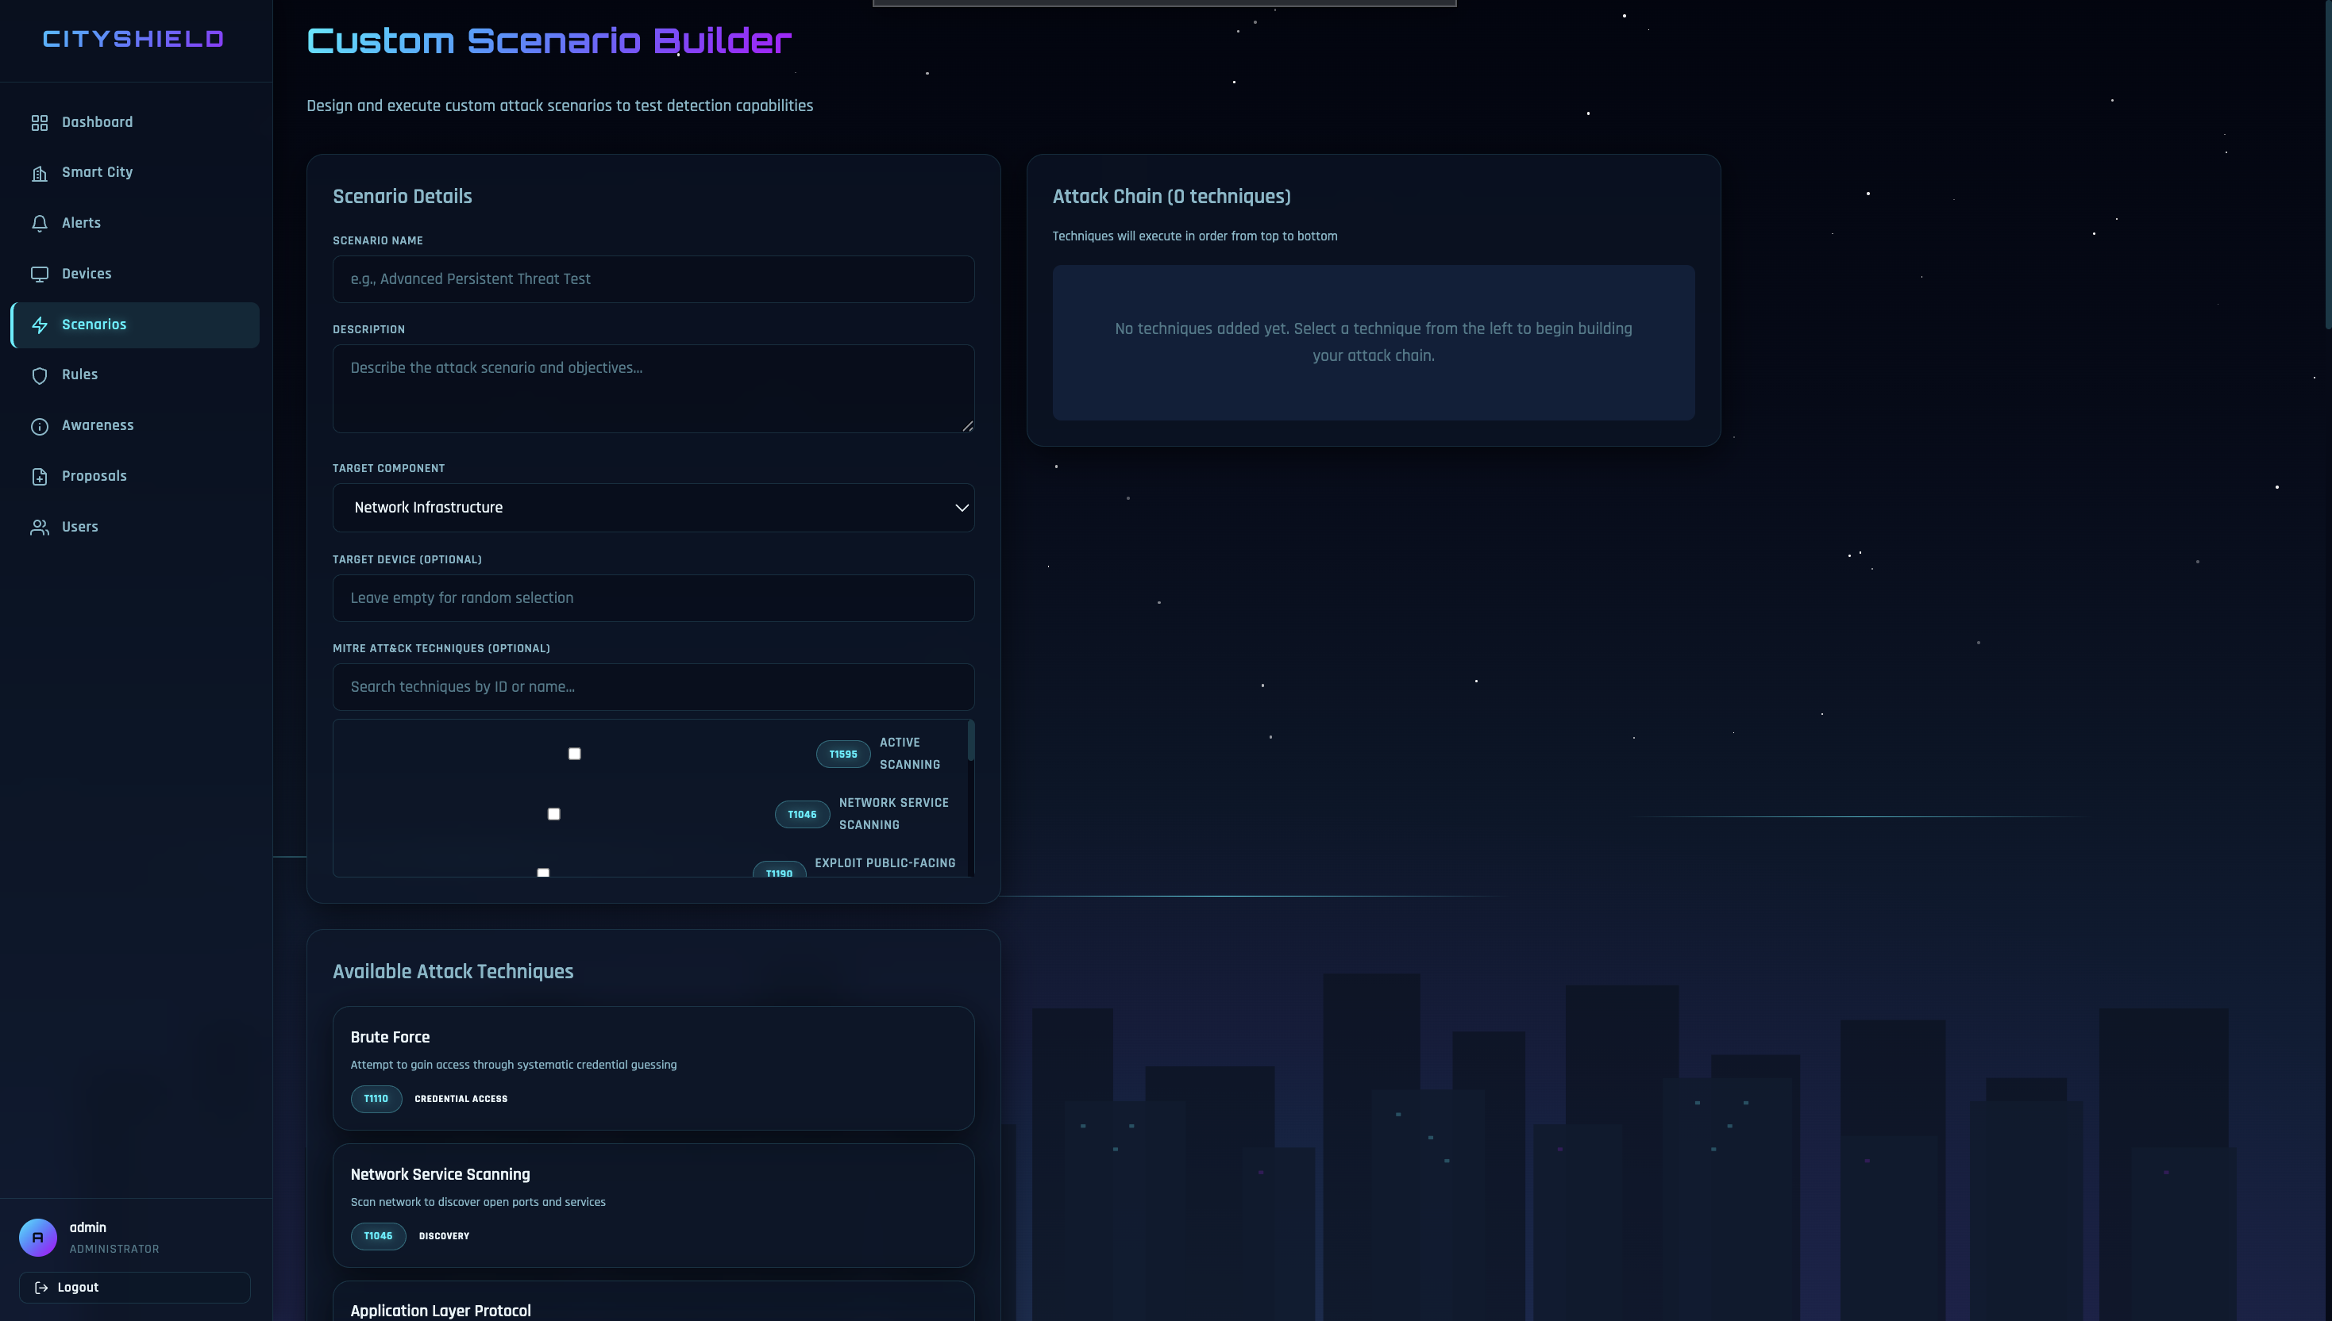
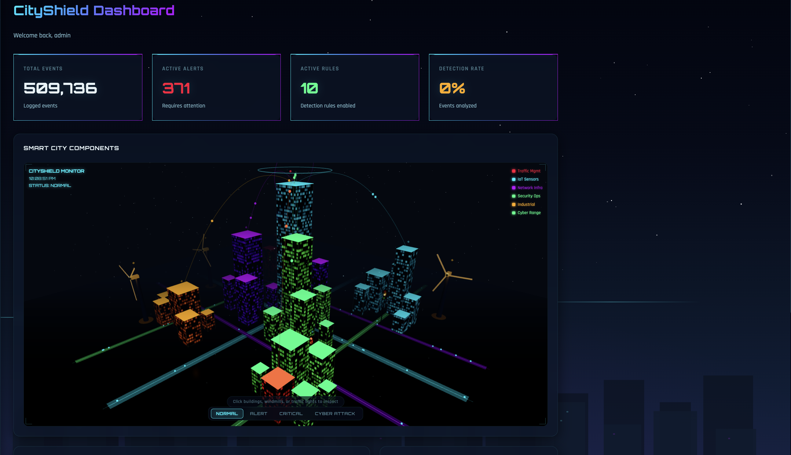
Platform Features
Scenario Builder & Smart City Simulation
Scenario Builder
Smart City Simulation
▸ 21+ built-in attack scenarios with 4-stage execution
▸ 10 OWASP Top 10 aligned scenarios (A01-A10:2021)
▸ Custom Scenario Builder with MITRE technique selection
▸ Real-time stage progression with live UI feedback
▸ Attack Proposal workflow (Researcher → Admin approval)
▸ Traffic Simulator — signal events, incidents
▸ IoT Simulator — sensor readings, anomalies, firmware events
▸ Network Emulator — connections, DNS, firewall, scans
▸ Each runs as independent FastAPI microservice
▸ Events written to OpenSearch in real-time + JSONL backup
6 / 15

Slide 7
Platform Features
Logging Pipeline & Detection Engine
Centralized Logging Pipeline
Detection Engine
▸ Simulators generate JSON events → OpenSearch indices
▸ Filebeat ships JSONL logs as secondary pipeline
▸ 3 log indices: logs-traffic, logs-iot, logs-network
▸ OpenSearch Dashboards for ad-hoc log exploration
▸ Real-time indexing with structured event schemas
▸ 25 YAML detection rules aligned to MITRE ATT&CK
▸ Covers 25 techniques across multiple tactics
▸ Severity levels: Low, Medium, High, Critical
▸ Configurable query windows and thresholds
▸ Optional AbuseIPDB threat intelligence enrichment
Example Detection Rules:
T1046 Network Port Scan │ High T1110 Brute Force Authentication │ High T1498 DDoS Attack │ Critical T1041 Data Exfiltration │ Critical T1486 Ransomware │ Critical
Simulators → JSONL + OpenSearch → Filebeat → logs-* → Detection Engine
7 / 15

Slide 8
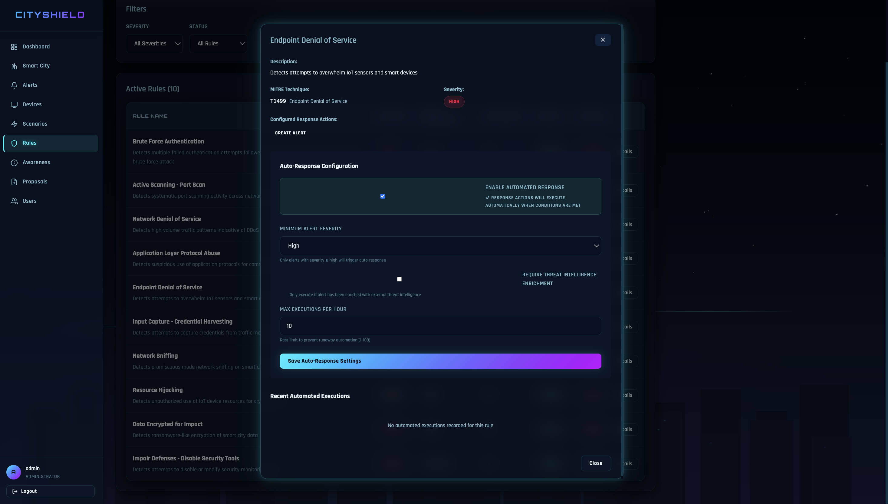
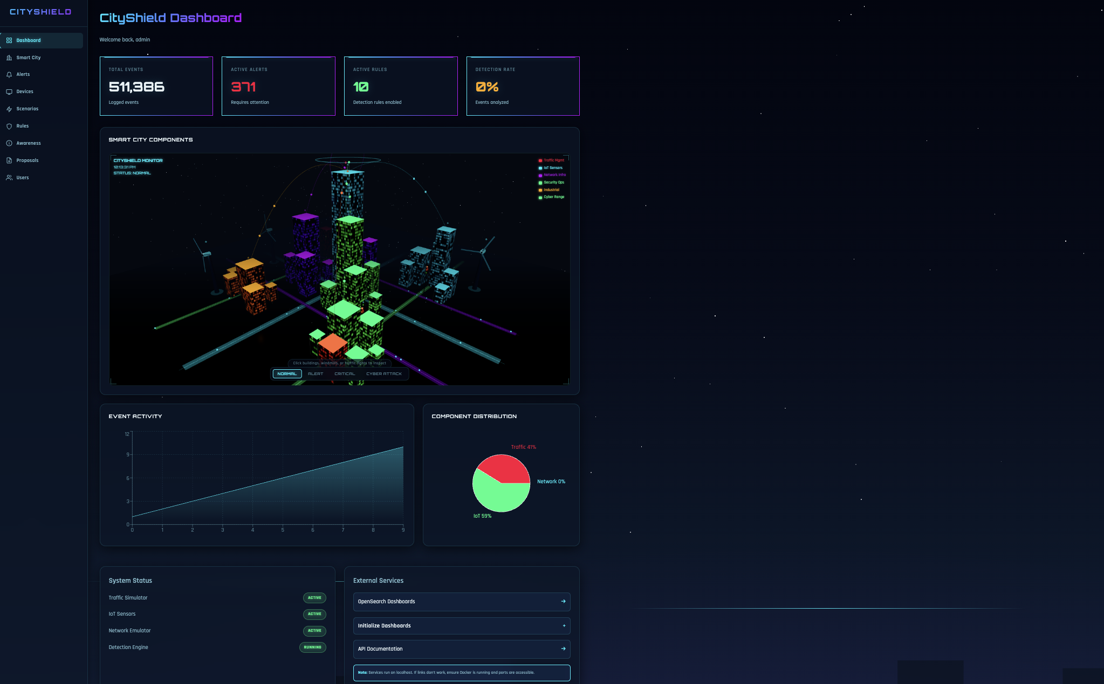
Platform Features
Automated Response & Security Dashboard
Automated Response System
Security Dashboard
▸ Response Manager polls alerts for auto-response triggers
▸ Executes Ansible playbooks for containment actions
▸ 3 response actions: block_ip, isolate_service, revoke_token
▸ Configurable per-rule: severity threshold, rate limits
▸ Full audit trail in action-audit-log index
▸ Manual execution also available for Analysts
▸ Real-time overview with event counts and alert stats
▸ Interactive 3D smart city with 25 assets across 6 zones
▸ Live attack visualization with building flash effects
▸ Alert investigation with Analysis, Actions, and Events tabs
▸ Device Management with power control (Admin)
▸ WebSocket + REST polling for real-time updates
8 / 15

Slide 9
User Roles & Access Control
Role-Based Access Control (RBAC)
A
S
R
Administrator
Security Analyst
Researcher
▸ Manage system infrastructure and configuration
▸ Create and manage user accounts
▸ Approve/reject attack proposals
▸ Toggle device power on/off
▸ Full access to all platform features
▸ Monitor alerts and investigate incidents
▸ Execute manual response actions
▸ View logs and detection rule results
▸ Update alert status and investigation notes
▸ Access action audit history
▸ Create and run attack scenarios
▸ Submit attack proposals for approval
▸ Configure detection rules and auto-response
▸ Access Research Lab (personal container)
▸ Build custom scenarios with MITRE techniques
9 / 15

Slide 10
Attack Scenario Flow
End-to-End Example: DDoS Against Traffic Control
1
2
3
4
5
6
7
Launch
▶
Simulate
▶
Collect
▶
Detect
▶
Alert
▶
Investigate
▶
Respond
Researcher selects and runs attack scenario
Simulators generate malicious traffic events
Events indexed in OpenSearch logs-*
Detection engine matches MITRE ATT&CK rules
Alert generated with severity and technique
Analyst reviews alert and related events
Response action executed (auto or manual)
Result: Full attack lifecycle captured, analyzed, and responded to within the platform
3D city shows live attack progress | Alerts generated in real-time | Full audit trail preserved
10 / 15

Slide 11
Current Progress
Implementation Status
✓ Platform Environment
15 Docker containers deployed via Docker Compose with 3 isolated networks
✓ Web Dashboard
Full React UI with 3D city, alerts, scenarios, devices, and admin panels
✓ Smart City Simulation
3 simulators generating continuous traffic, IoT, and network events
✓ Cyber Range
Isolated Metasploitable + Kali attacker environment with packet capture
✓ Logging Pipeline
Filebeat + OpenSearch with 9 indices, structured event schemas
✓ IoT Range
Isolated IoT sensor hub target reachable from Research Lab
✓ Detection Engine
25 YAML rules covering MITRE ATT&CK techniques, real-time alert generation
✓ RBAC & Authentication
JWT-based auth with 3 roles (Administrator, Analyst, Researcher)
✓ Automated Response
Ansible playbooks with configurable auto-response per rule
✓ Attack Scenarios
21+ scenarios including 10 OWASP + custom builder with MITRE selection
11 / 15

Slide 12
Live Demonstration
Platform Screenshots
Now we will see the in the site
12 / 15

Slide 13

Implementation Roadmap
NOW
6-Month Project Timeline
Progress: Month 3 of 6 · 50% Complete
✅ COMPLETED
🔄 IN PROGRESS
⏳ UPCOMING
Phase 1
Phase 2
Phase 3
Month 1 – 3
Month 4 – 5
Month 6
Planning & Core Engine
Analysis & Platform Build
Design, Testing & Delivery
✅ Requirements gathering & system design
✅ IDS/IPS core setup with Snort/Suricata
✅ AI model training on N-BaIoT & UNSW-NB15
✅ 50-device IoT test lab simulation built
🔄 System analysis & use-case modelling
🔄 React.js SOC dashboard development
🔄 SOAR automated response playbooks
⏳ Threat intelligence feed integration
⏳ Full system architecture & DB design
⏳ Integration testing across all sectors
⏳ Performance benchmarking & QA
⏳ Final report & project presentation
14 / 16
14 / 16

Slide 14
Evaluation Metrics
Measuring Platform Performance
MTTD
MTTR
Detection Accuracy
Resource Util.
Mean Time to Detect
Mean Time to Respond
True Positive Rate
System Performance
Target: < 20 min
Target: < 10 min
Target: > 90%
Monitored
Time from attack initiation to detection
Time from detection to response execution
Ratio of true positives to total detections
CPU, memory, network under different workloads
13 / 15

Slide 15
Future Work
Planned Improvements & Enhancements
More Attack Techniques
Enhanced Threat Intelligence
Advanced Detection Models
Platform Enhancements
▸ Expand MITRE ATT&CK technique coverage
▸ Add multi-stage chained attack scenarios
▸ Real exploit execution in cyber range
▸ Integrate additional threat feeds beyond AbuseIPDB
▸ IOC correlation and enrichment pipeline
▸ Automated reputation scoring for alerts
▸ ML-based anomaly detection for behavioral analysis
▸ Statistical baseline modeling per asset
▸ Reduce false positives with contextual analysis
▸ Cloud-native deployment (Kubernetes)
▸ Multi-user training modules and scoring
▸ Dataset export for academic research
14 / 15

Slide 16
Conclusion
▸ CityShield is a fully functional smart city cyber range for cybersecurity training and research
▸ Simulates realistic attack scenarios across traffic, IoT, and network domains
▸ 25 detection rules aligned to MITRE ATT&CK with automated Ansible response playbooks
▸ Interactive 3D city visualization with real-time attack feedback and alert pipeline
▸ Role-based access control supporting Administrator, Analyst, and Researcher workflows
▸ Evaluation metrics (MTTD, MTTR, detection accuracy) ensure measurable performance
Thank You
Questions & Discussion
15 / 15

