Slide 1
Quiz Analytics & Leaderboard Insights
Internship Final Project - Data Analysis & Visualization
Saudatu Ibrahim
December 2025

Slide 2
Problem Statement
- Instructors need to understand learner performance and trends.
- Identify consistent performers and areas of improvement.
- Detect anomalies, e.g., sudden jumps in scores (possible cheating).
- Provide actionable insights and personalized feedback to learners.

Slide 3
Project Goal & Target Audience
Goal:
- Analyze quiz attempts to evaluate consistency and improvement.
- Visualize data for easy interpretation.
- Generate AI-powered or rule-based feedback.
Target Audience:
- Instructors & educators
- Learning product teams
- Data analysts in EdTech

Slide 4
Dataset Overview
Columns:
- user_id: Unique learner identifier
- quiz_id: Quiz identifier
- score: Quiz score (0–100)
- time_taken: Time to complete quiz (minutes)
- timestamp: Date and time of attempt
Note: Users may have multiple attempts.

Slide 5
Methodology
1. Data Exploration: head(), info(), describe()
2. Statistical Analysis: mean, median, mode, std, correlation
3. Data Visualization: histogram, scatter, boxplots, heatmap
4. AI-Powered Feedback (Optional): GPT API with rule-based fallback

Slide 6
Descriptive Statistics
Example Stats:
Score: Mean=68.2, Median=72, Mode=78, Std=15.4
Time Taken: Mean=345, Median=320, Mode=298, Std=75.1
Insights: Most learners score mid-range; Some outliers detected.

Slide 7
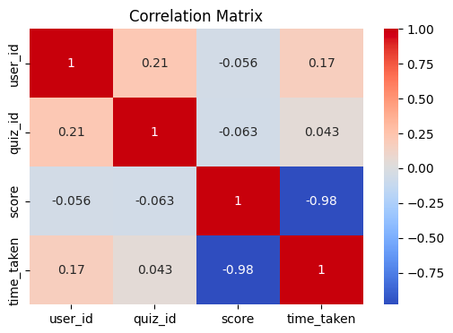
Correlation Analysis
Correlation between score and time_taken: -0.23
Slight negative correlation; faster attempts may have lower scores.

Slide 8
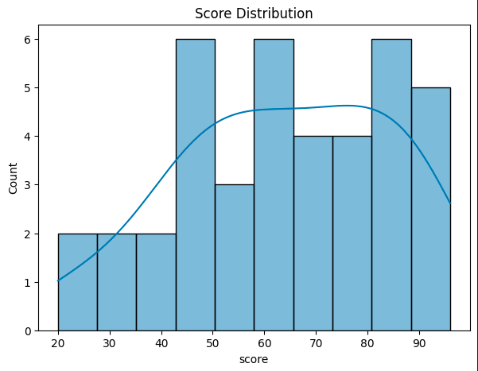
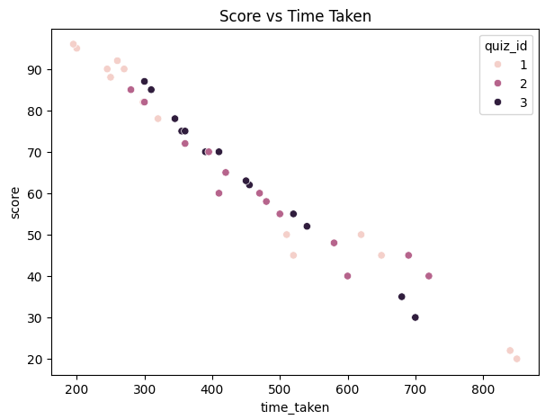
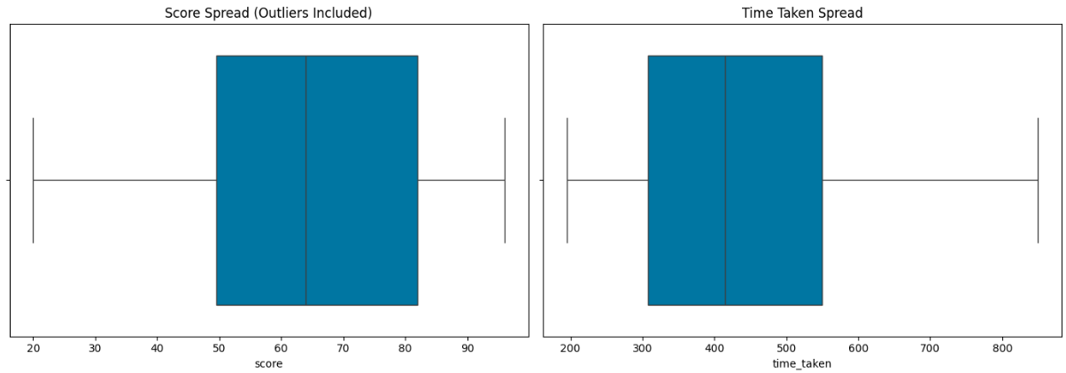
Visual Insights
1. Score Distribution Histogram
2. Score vs Time Scatter Plot
3. Side-by-Side Boxplots

Slide 9
AI-Powered Feedback
Examples:
Score 82, Time 15: Good job! You are improving steadily.
Score 45, Time 25: Needs improvement. Consider revisiting materials.
Notes:
- Feedback via GPT API if available
- Rule-based fallback ensures availability

Slide 10
Key Insights
- Most learners score 60–80 points.
- Some learners show irregular score jumps (anomalies).
- Fast attempts can sometimes lead to lower accuracy.
- AI feedback helps learners understand strengths & weaknesses.

Slide 11
Conclusion
- Data analytics reveals learner behavior and performance trends.
- Visualizations make insights interpretable for educators.
- AI and rule-based feedback provides actionable guidance.
- Can be scaled to larger datasets for continuous monitoring.

Slide 12
Technologies & Tools
- Python: Pandas, NumPy
- Visualization: Matplotlib, Seaborn
- AI Feedback: OpenAI GPT API (Optional)
- Environment: Jupyter Notebook / VS Code / Colab

Slide 13
Project Structure
quiz-analytics-leaderboard/
├─ Quiz_Analytics_Leaderboard.ipynb
├─ quiz_attempts.csv
├─ images/
├─ requirements.txt
└─ README.md

Slide 14
References
- Pandas Documentation: https://pandas.pydata.org/
- Matplotlib Documentation: https://matplotlib.org/
- Seaborn Documentation: https://seaborn.pydata.org/
- OpenAI GPT API Docs: https://platform.openai.com/docs/

