Slide 1
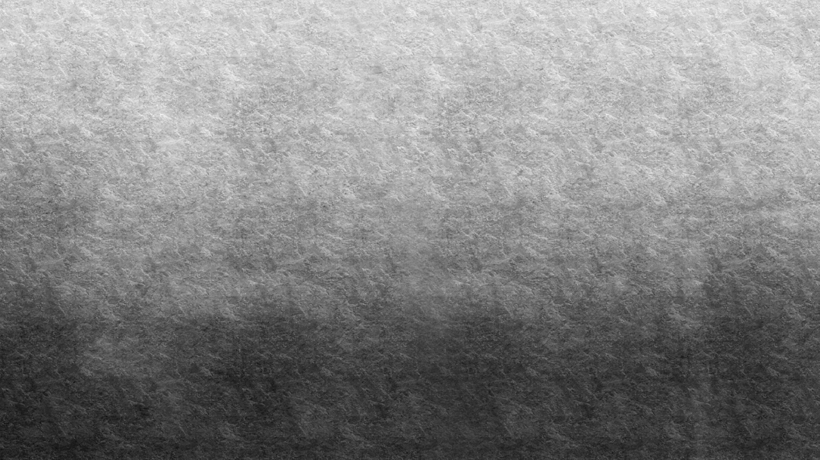


Perfect Fitness Club Advertisement Video
CU5008NI Digital Media Project – 10 % Presentation
Student: Saugat Pradhan | ID: 22068811

Slide 2
INTRODUCTION
This project was entirely about creating a television commercial for the gym “Perfect Fitness Club” where the main motive of it was to motivate people and as well as make people aware about the healthy lifestyle and choices while leads to better life ahead.

Slide 3
Objectives
Showcasing the atmosphere and ambience of the Perfect Fitness Club.
Highlighting the teamwork and motivation present within the gym premise with the help of footages.
Encouraging people to start their fitness journey and as well as making them relate to the advertisement

Slide 4
Research Areas
A deep dive into getting insights regarding the on-going gym trends and about the audience preference were studied.
Various fitness commercials were observed carefully and studied upon to gain some ideas about what makes an advertisement immersive.
Ideas about the art of storytelling was achieved along side the experiences on how visuals can be improved.

Slide 5
Technologies used
Adobe Premiere Pro – Video Editing
Adobe After Effects – Animation
Adobe Photoshop & Illustrator – Graphics
Google Forms & Excel – Survey
Samsung Galaxy S24 Camera
HP Victus Laptop
Tripod for stable shots

Slide 6
Pre-production
Concept was created alongside the storyboard.
Script was created according to the shooting plans.
Logo design was made for the Perfect Fitness Club.

Slide 7
Production Process
Videos were recorded inside the gym which showed the entire gym ambience and as well as people working out together.
Transition between the scenes were set precisely with respect to the music selected for the commercial.
Camera angles were fiddled out to achieve a cinematic visuals of the gym.

Slide 8
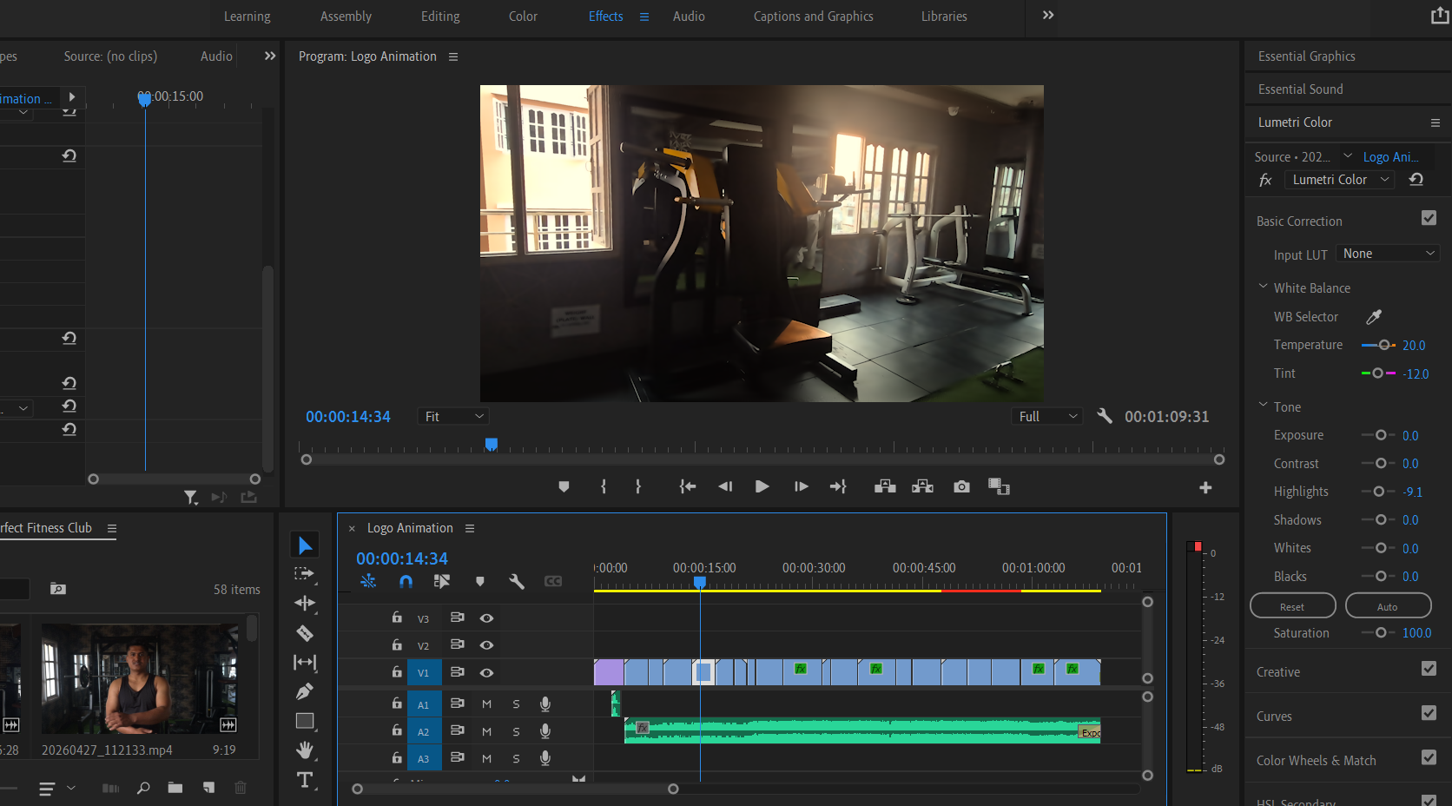

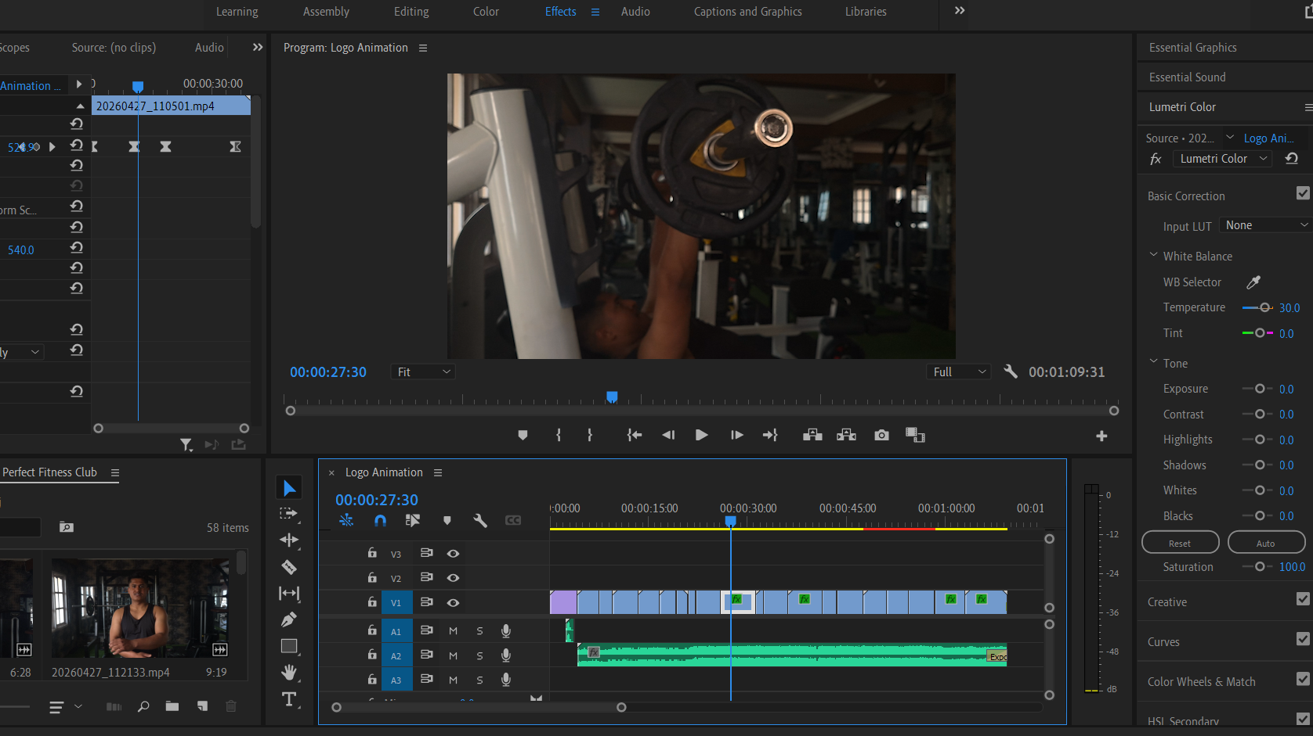
Editing & Post-production
Every footage were imported into premiere pro for modulating the lighting and as well as colors altogether for better visuals.
Various effects like De-noise, sharpen & unsharp mask, lighting (direction), lumetri color were used for the overall editing process.
For the audio exponential fade was used so that the music fades out smoothly.

Slide 9
Logo Animation
Logo animation was carried out in Adobe After Effects.
The techniques of 3D motion graphics were used for the proper animation of the light rays and the logo which appears .
Keyframes were added for the positioning of the camera , opacity and as well as the lightings.

Slide 10
User Testing & findings
From the survey carried out majority of the audience gave a positive feedbacks about how the visuals and as well as the intensity of the workout complimented one another.
Proper selection of song was also mentioned who showed that precise selection of the music can vastly improve the overall commercials
People seemed inspired and motivated to sign up for the gym from the glimpse of the workout sessions.

Slide 11
Thank you
I would like to show my utmost respect and gratitude towards my internal supervisor Mr. Bijay Shrestha and external supervisor Ms. Aarsha Maharjan for providing me immense support through the project and for being patience with me throughout the entire learning progress.

