Slide 1
Luxury Housing Market Analysis – Bangalore
Bangalore’s luxury housing market is analyzed using Python, SQL, and Power BI to understand pricing, buyer behavior, and micro-market demand.
The project converts raw data into meaningful insights for developers and investors.

Slide 2
Domain Overview
Luxury real estate market focuses on high-end residential properties.
It involves analysis of buyer behavior, pricing, and geographic demand.
Market intelligence helps developers optimize strategy and sales.

Slide 3
Project Introduction
This project analyzes luxury housing data for Bangalore.
It provides insights using Python, SQL, and Power BI.

Slide 4
Project Objective
To clean, transform, and analyze sales data for decision-making.
To identify market trends, buyer patterns, and developer performance.

Slide 5
ELT Approach
Raw data was extracted from CSV, loaded into Python for transformation,
and loaded into MySQL for validation and downstream analytics.

Slide 6
Data Migration
Cleaned data was transferred from processing layer into SQL tables.
SQL enabled structured querying and validation before Power BI consumption.

Slide 7
Exploratory Data Analysis (EDA)
EDA revealed pricing ranges, buyer types, conversion rates, and micro-market trends.
It also highlighted data gaps, outliers, and variable relationships.

Slide 8
Feature Engineering
Derived booking conversion rates, total ticket value, and aggregated KPIs.
These features improved downstream analytics and insights.

Slide 9
Statistical Techniques
IQR method was used for outlier treatment as it preserves distribution without removal.
Median imputation was chosen due to skewness in pricing and unit sizes.

Slide 10
Conclusion
Bangalore's luxury market shows strong demand across micro-markets with balanced buyer segments.
Developers differ by pricing, amenities, and sales channels, influencing booking outcomes.

Slide 11
Business Suggestions
Enhance amenities and connectivity to boost conversion.
Optimize sales channels by micro-market buyer behavior insights.

Slide 12
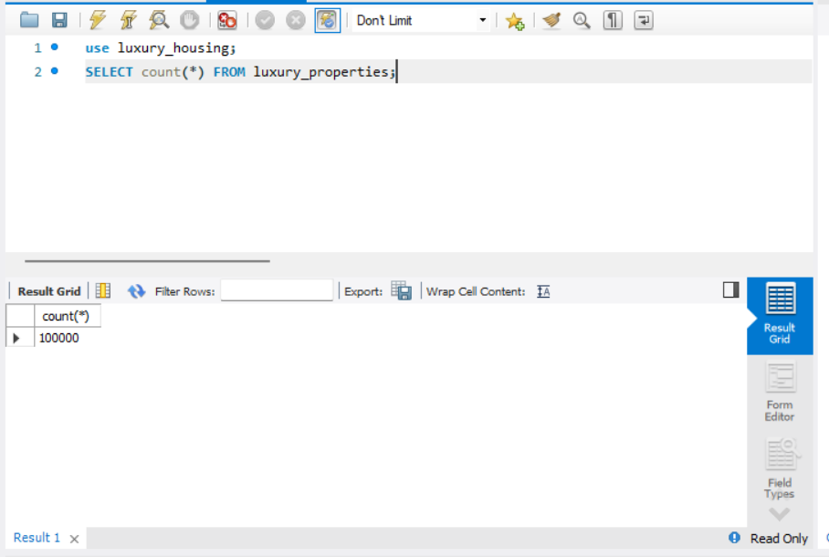
Row Count Validation
Validates number of records loaded into SQL.

Slide 13
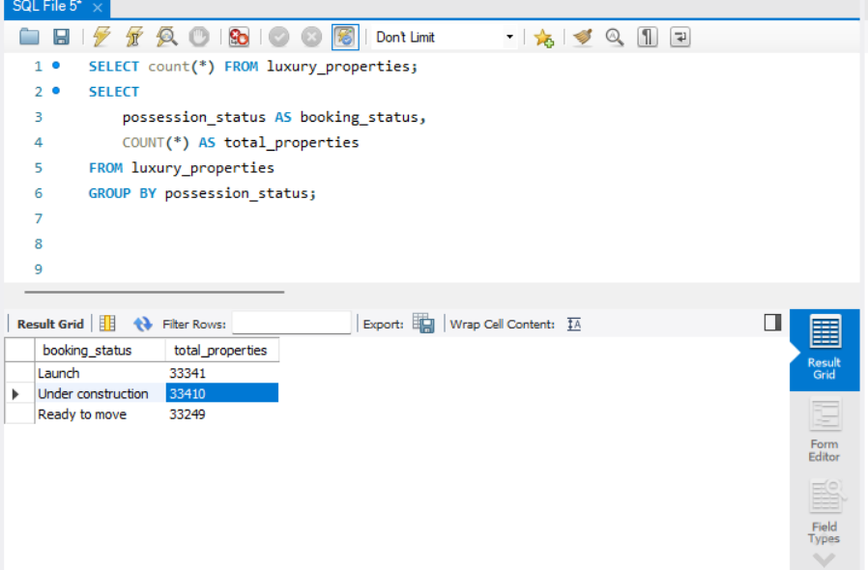
Booking Status Distribution
Checks distribution of possession/booking status.

Slide 14
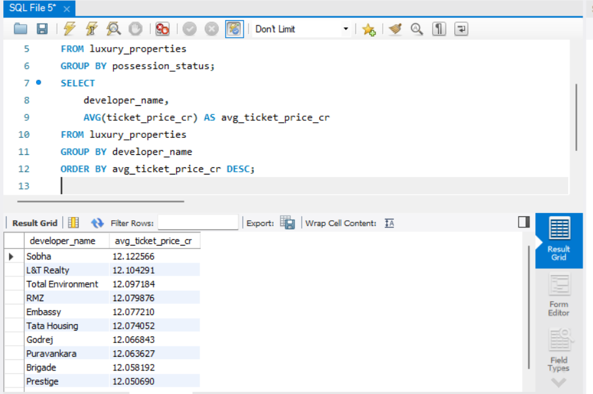
Avg Ticket Price per Builder
Validates pricing performance across developers.

Slide 15
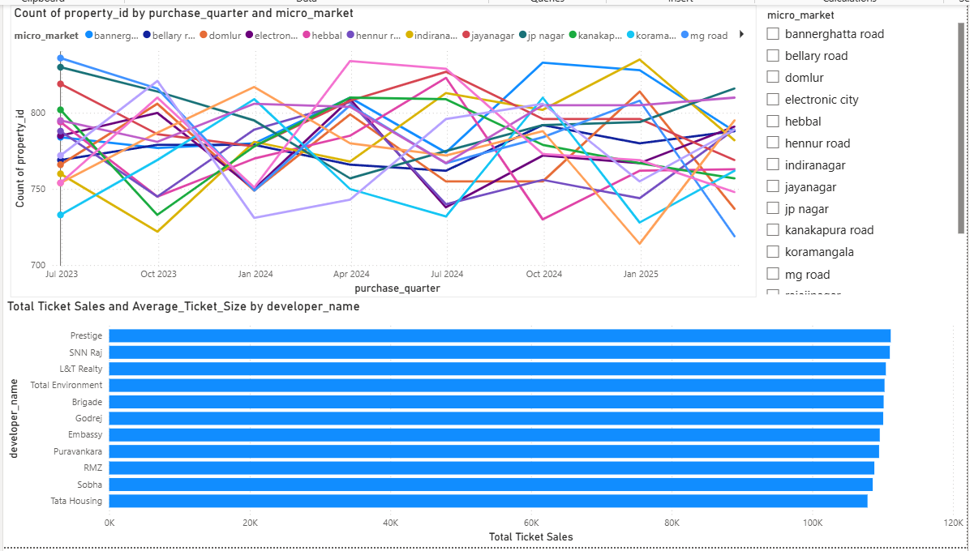
Market Trends & Builder Performance
Insight:
Whitefield and Sarjapur show sustained demand while top builders capture higher
ticket values.

Slide 16
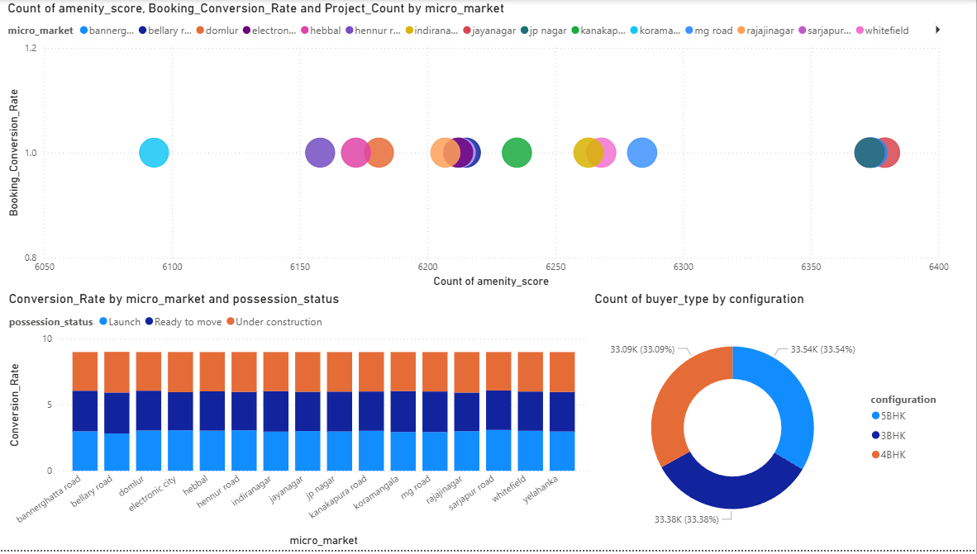
Amenities, Conversion & Configuration
Insight:
Amenities positively influence booking conversion; 3BHK units remain most preferred.

Slide 17
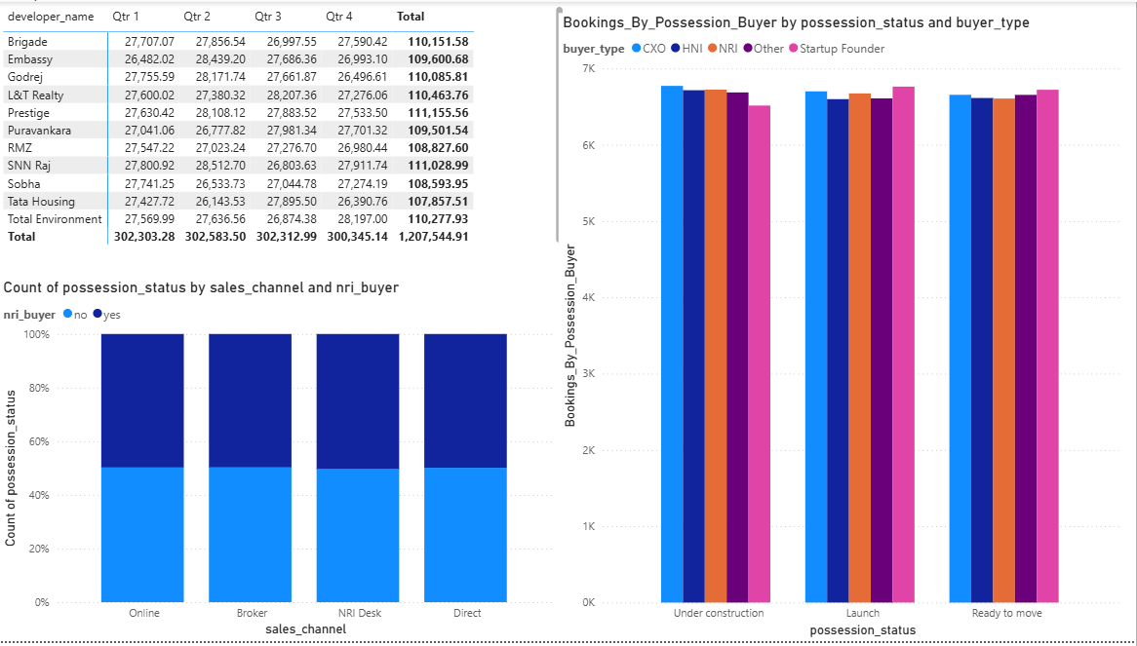
Sales Channel, Quarterly & Possession
Insight:
Direct sales outperform brokers; quarterly trends show spikes during Q3-Q4.

Slide 18
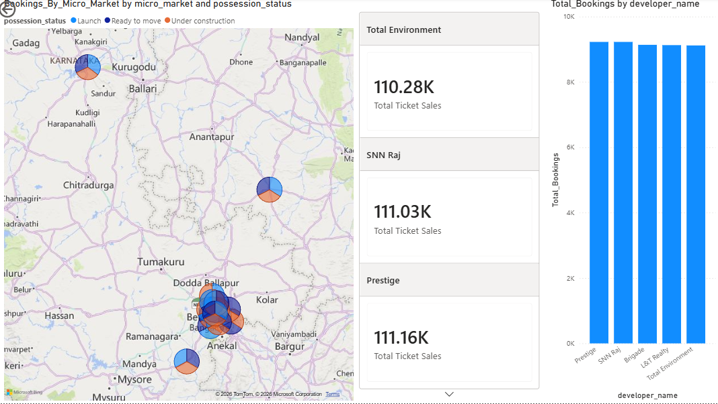
Geographical Insights & Top Performers
Insight:
Eastern Bangalore dominates luxury segment; top 5 builders contribute majority of revenue.

Slide 19
Thank You

