Slide 1
Data Analysis
A Look at FIFA Players and Attributes
Sau Kha

Slide 2
Dataset
European Soccer Database (from Kaggle.com)
https://www.kaggle.com/hugomathien/soccer/data
+25,000 matches
+10,000 players
11 European Countries with their lead championship
Seasons 2008 to 2016
Players and Teams' attributes* sourced from EA Sports' FIFA video game series

Slide 3
Python – SQLite3 & Pandas
Create connection object
conn = sqlite3.connect ('database.sqlite’)
Define SQL
sql ="""SELECT * FROM sqlite_master WHERE type='table';"""
Pandas command; get data into a DataFrame
df = pd.read_sql(sql, conn)

Slide 4
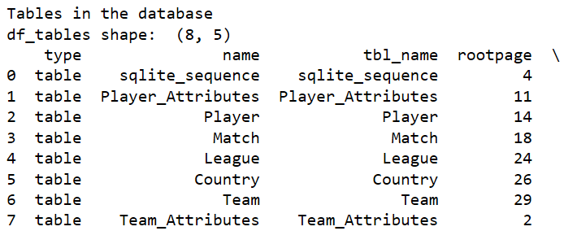
Data Exploration: All Tables
df_tables = pd.read_sql ("""SELECT * FROM sqlite_master WHERE type='table';""", conn)

Slide 5
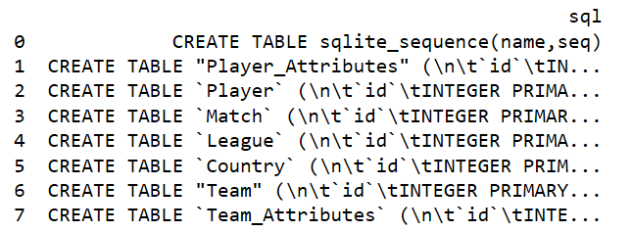
Data Exploration: All Tables

Slide 6
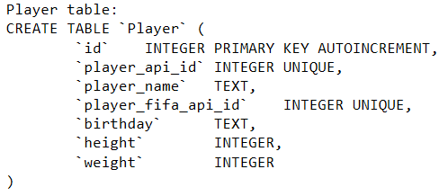
Data Exploration: Player Table

Slide 7
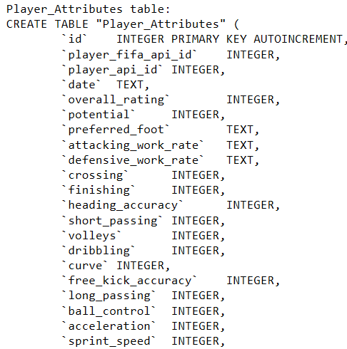
Data Exploration: Player Attributes Table

Slide 8
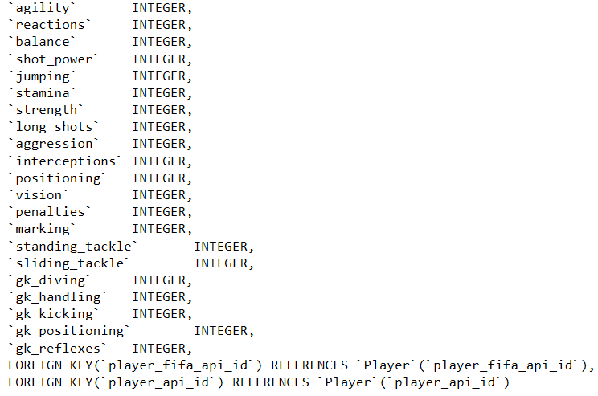
Data Exploration: Player Attributes Table

Slide 9
Data Cleaning
df_all_col.replace(r'\s+', np.nan, regex=True, inplace = True)
#drop row with any NA entry df_all_col.dropna(axis=0, how='any', inplace=True)
df_all_col.sort_values('player_name',axis=0, inplace=True)
df_all_col.drop_duplicates(inplace=True)
df_all_col.to_csv('df_all_col.csv’)
Before: 183929 rows, 57 columns
After: 10898 rows, 57 columns
38 columns with numeric attributes for principal component analysis

Slide 10
Research Questions
Which player’s attribute contributes most to player’s overall rating
What attributes set players apart

Slide 11
Intended Audience
Soccer fans
FIFA Video Players

Slide 12
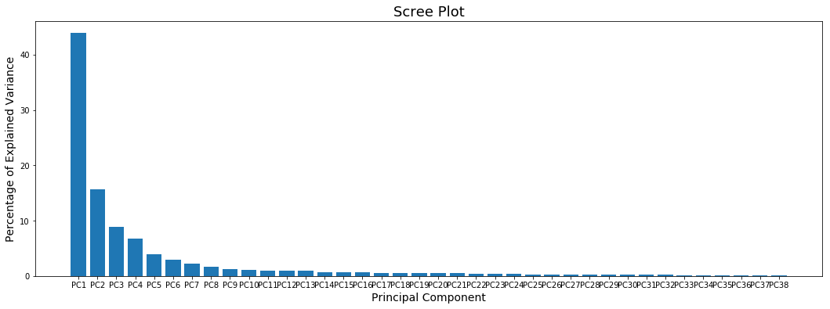
Principal Component Analysis (PCA)

Slide 13
PCA 1 Loading Scores
Player Attributes | Loading Scores | Player Attributes | Loading Scores | Player Attributes | Loading Scores
ball_control | 0.233895 | gk_positioning | 0.193662 | gk_kicking | 0.121982
dribbling | 0.226609 | volleys | 0.193077 | reactions | 0.105162
short_passing | 0.220168 | finishing | 0.191773 | aggression | 0.087644
crossing | 0.213529 | acceleration | 0.185480 | overall_rating | 0.083033
curve | 0.211442 | penalties | 0.183370 | potential | 0.080174
long_shots | 0.211257 | sprint_speed | 0.182038 | interceptions | 0.071469
positioning | 0.204851 | long_passing | 0.177636 | standing_tackle | 0.065230
shot_power | 0.199655 | agility | 0.168734 | sliding_tackle | 0.059237
vision | 0.197614 | stamina | 0.158548 | marking | 0.052163
gk_diving | 0.196600 | balance | 0.153811 | strength | 0.028138
free_kick_accuracy | 0.196366 | height | 0.134852 | age | 0.005573
gk_reflexes | 0.195234 | heading_accuracy | 0.132158 | jumping | 0.001561
gk_handling | 0.195011 | weight | 0.125473
Notes:
The list of loading scores for player’s attributes in PC1 dimension does not show that any attribute plays a significant part in the variations among players.

Slide 14
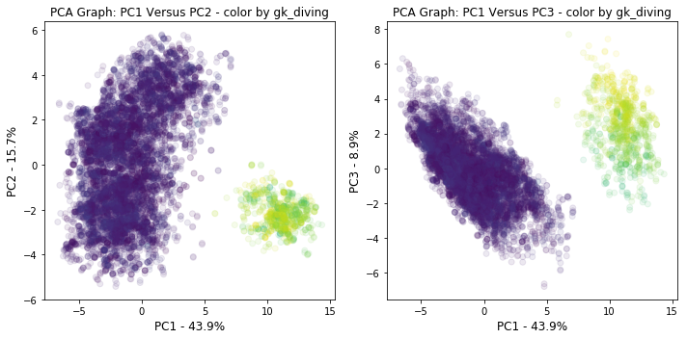
PC1 Vs PC2 PC1 Vs PC3 color by gk_diving

Slide 15
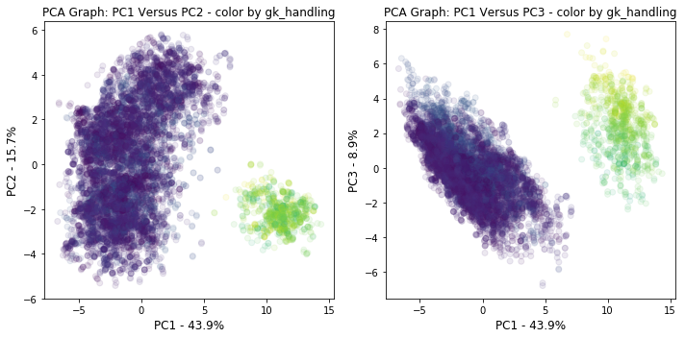
PC1 Vs PC2 PC1 Vs PC3 color by gk_handling

Slide 16
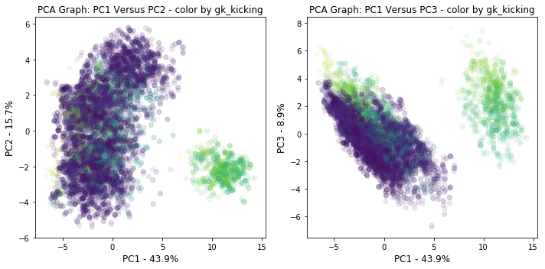
PC1 Vs PC2 PC1 Vs PC3 color by gk_kicking

Slide 17
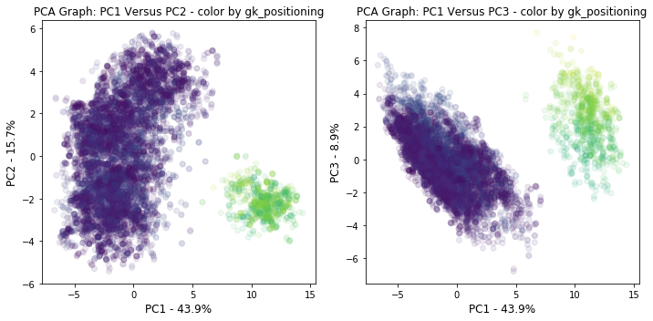
PC1 Vs PC2 PC1 Vs PC3 color by gk_positioning

Slide 18
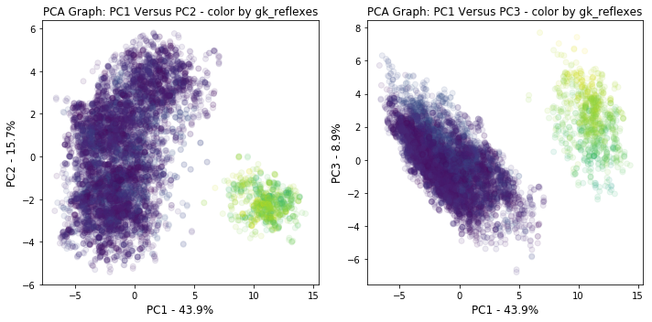
PC1 Vs PC2 PC1 Vs PC3 color by gk_reflexes

Slide 19
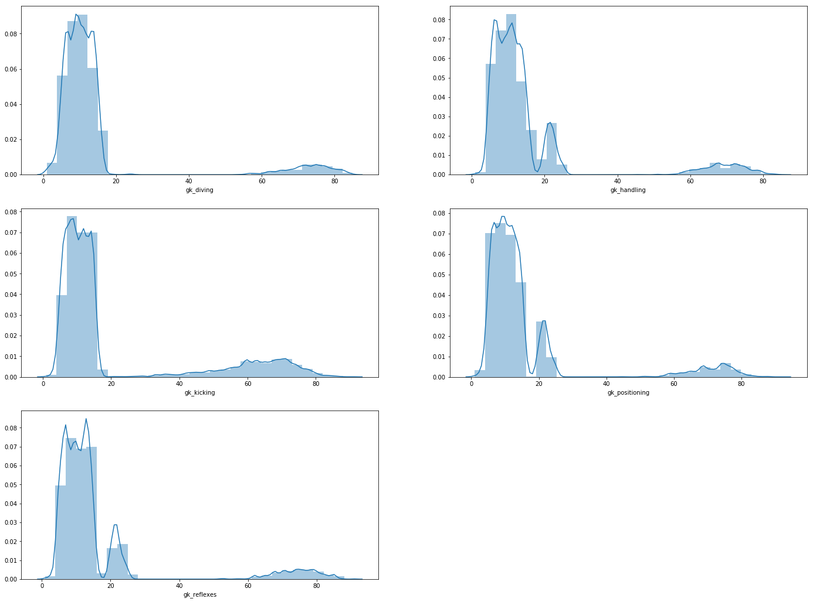
Distribution Plots (goalkeepers – subgroup on the right )

Slide 20
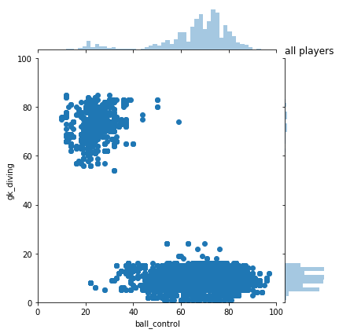
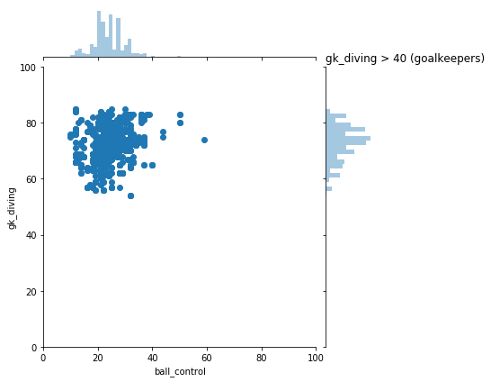
Ball Control Vs gk_Diving
Goalkeepers: gk_diving attributes > 40; much higher than the rest players

Slide 21
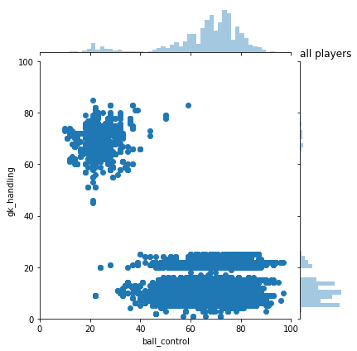

Ball Control Vs gk_Handling
Goalkeepers: gk_diving attributes > 40; much higher than the rest players

Slide 22
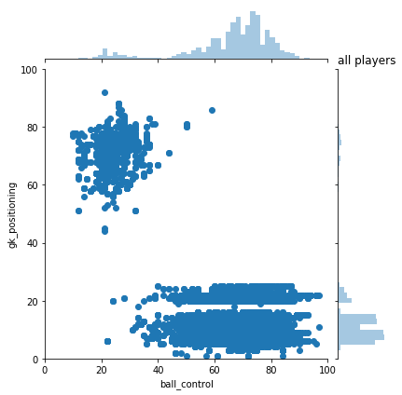

Ball Control Vs gk_Positioning
Goalkeepers: gk_diving attributes > 40; much higher than the rest players

Slide 23
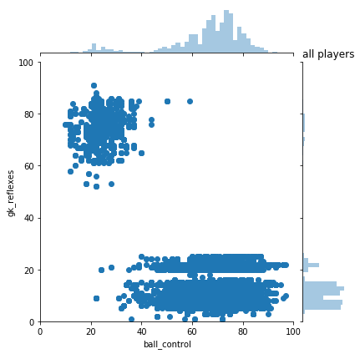
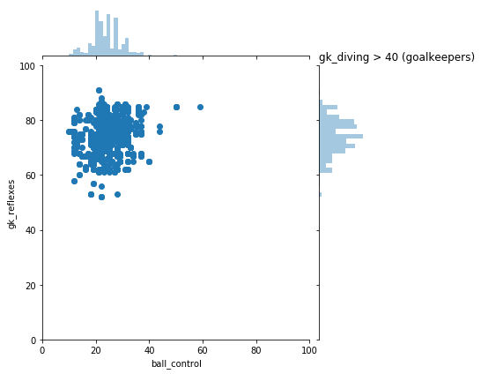
Ball Control Vs gk_Reflexes
Goalkeepers: gk_diving attributes > 40; much higher than the rest players

Slide 24
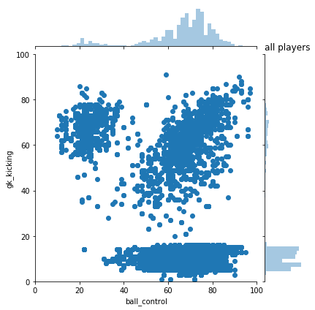

Ball Control Vs gk_Kicking
gk_kicking attribute has a moderate +ve linear correlation with ball control attribute
Goalkeepers
gk_kicking attribute further separates the bigger subgroup into two smaller subgroups

Slide 25
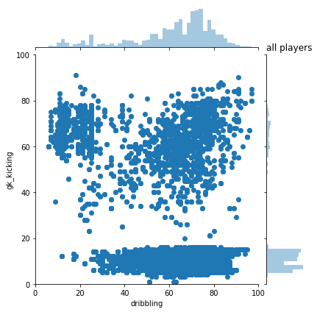
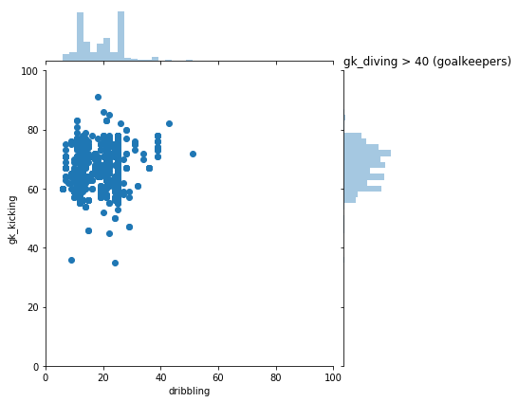
Dribbling Vs gk_Kicking
gk_kicking attribute has a moderate +ve linear correlation with ball control attribute
Goalkeepers
gk_kicking attribute further separates the bigger subgroup into two smaller subgroups

Slide 26
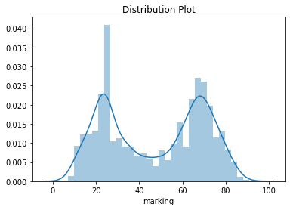
Bimodal Distribution Marking

Slide 27
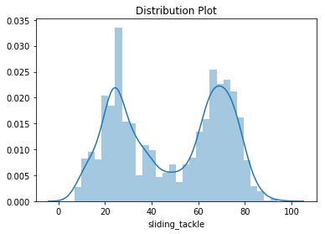
Bimodal Distribution Sliding Tackle

Slide 28
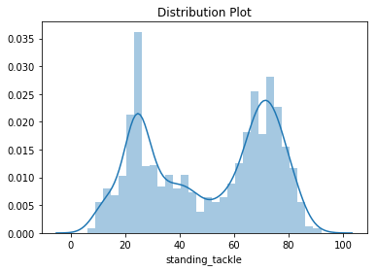
Bimodal Distribution Standing Tackle

Slide 29
Attribute Categories
Total Attack | Total Skill | Total Movement | Total Power | Total Mentality | Total Defending | Total Goalkeeping
Crossing | Dribbling | Acceleration | Shot Power | Aggression | Marking | gk_Diving
Finishing | Curve | Sprint Speed | Jumping | Interceptions | Standing Tackle | gk_Handling
Heading Accuracy | Free Kicking Accuracy | Agility | Stamina | Positioning | Sliding Tackle | gk_Kicking
Short Passing | Long Passing | Reactions | Strength | Vision |  | gk_Positioning
Volleys | Ball Control | Balance | Long Shots | Penalties |  | gk_Refelexes

Slide 30
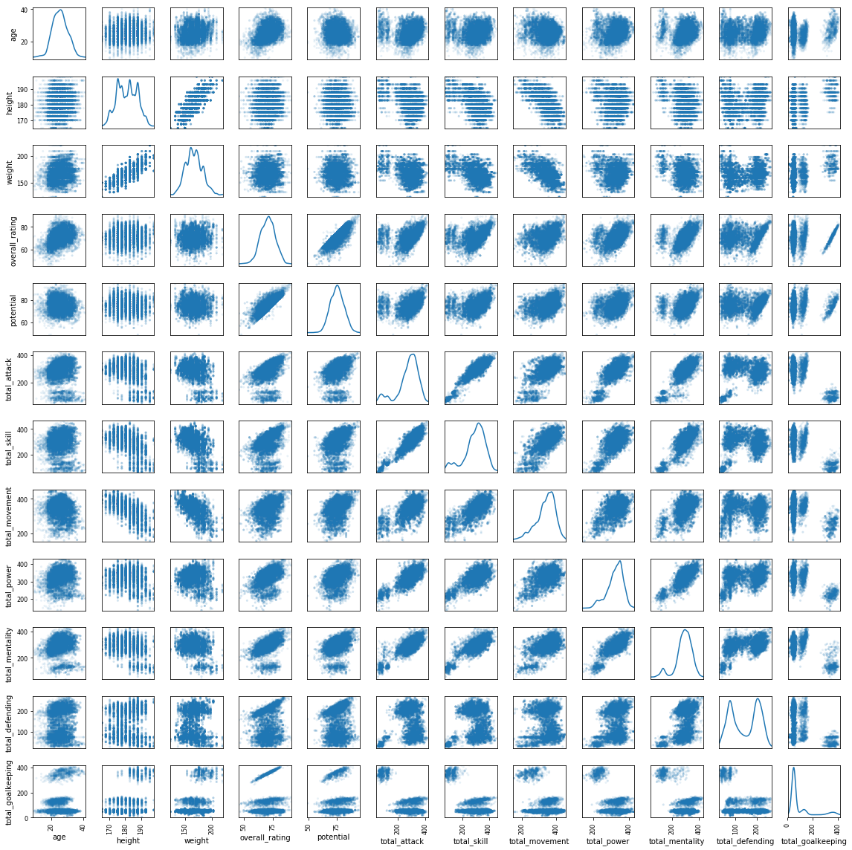
Scatter Plot Matrix
Overall Rating
Strong + ve Linear Correlation Between Overall Rating and
Total Goalkeeping Attribute
Only In the Goalkeeper Subgroup
Total Defending
Total Goalkeeping
2 subgroups per Total Defending
1 large and 1 small subgroup per Total Goalkeeping

Slide 31
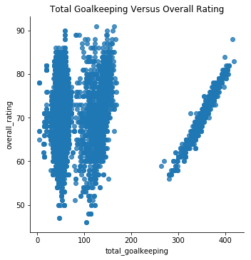
Goalkeeper Subgroup Coeff. Overall Rating & Total Goalkeeping
Correlation Coefficient = 0.978269

Slide 32
Conclusion 1
 | overall_rating |  | overall_rating |  | overall_rating
age | 0.3826 | long_passing | 0.4300 | interceptions | 0.2373
height | 0.0259 | ball_control | 0.3726 | positioning | 0.2782
weight | 0.0351 | acceleration | 0.2137 | vision | 0.3992
overall_rating | 1.0000 | sprint_speed | 0.2184 | penalties | 0.3373
potential | 0.7840 | agility | 0.2211 | marking | 0.1106
crossing | 0.2911 | reactions | 0.7248 | standing_tackle | 0.1456
finishing | 0.2694 | balance | 0.1094 | sliding_tackle | 0.1159
heading_accuracy | 0.2403 | shot_power | 0.3703 | gk_diving | 0.0501
short_passing | 0.4161 | jumping | 0.2112 | gk_handling | 0.0373
volleys | 0.2908 | stamina | 0.2487 | gk_kicking | 0.0795
dribbling | 0.2991 | strength | 0.2404 | gk_positioning | 0.0361
curve | 0.2987 | long_shots | 0.3267 | gk_reflexes | 0.0437
free_kick_accuracy | 0.3048 | aggression | 0.2615
Strong Positive Linear Correlation Between
Overall Rating & Reactions: Coeff = 0.7248
Overall Rating & Potential: Coeff = 0.7840
Potential as another rating of the players
Strong correlation explained by rating on similar set of attributes

Slide 33
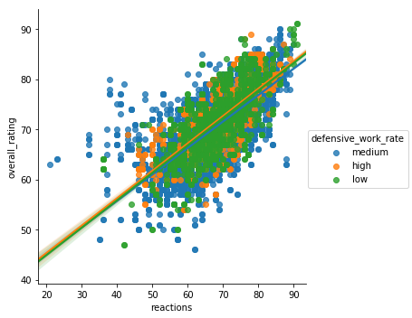
Overall Rating Versus Reaction Attribute
Strong Positive Linear Correlation: 0.7248

Slide 34
Conclusion 2
Defending & Goalkeeping Attributes set players into subgroups
Total Defending Attributes: Marking, Standing tackle, Sliding tackle
Total Goalkeeping Attributes: gk_Diving, gk_Handling, gk_Kicking, gk_Positioning, gk_Reflexes

Slide 35
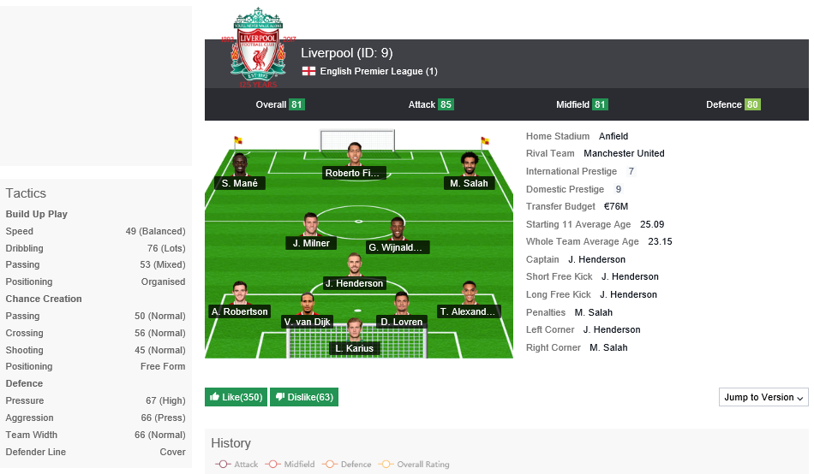
Limitation
Team formation information: https://sofifa.com/

Slide 36
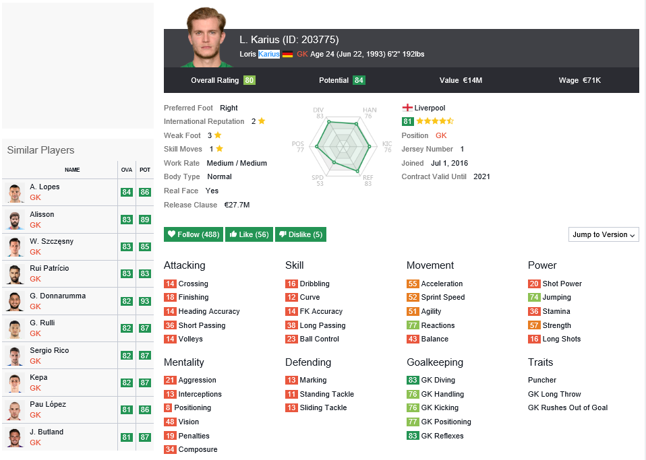
Limitation
Player Position: https://sofifa.com/

