Slide 1
Pure Foundations
Saul Youssef
Boston University
April, 2023

Slide 2
A data is a finite sequence of codas.
A coda is a pair of data.
We will use a small natural algebra of data:
A B denotes the concatenation of data A with data B.
A : B denotes the data consisting of a single coda made from A and B.
( ) - the empty sequence of codas.
(:) - the data consisting of one coda made from the pair () and ().
(:) (:) ((:):(:)) - a sequence of three codas.
This is pure data. It is data “made of nothing.”

Slide 3
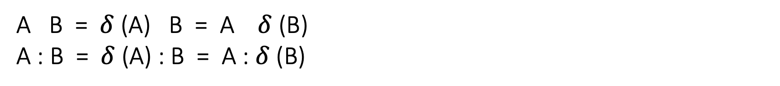
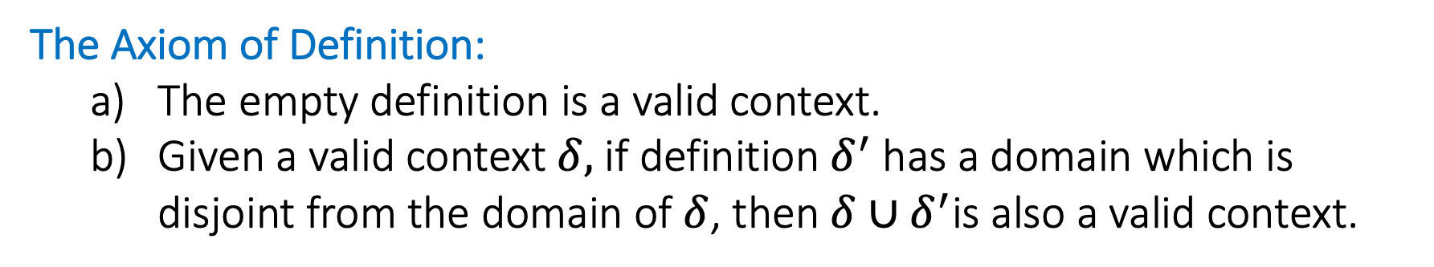
A definition is a partial function from coda to data.
A valid context is a definition that has been accepted as valid.
Given a context $δ,$equality of data is defined by
A B = $δ$ (A) B = A $δ$ (B)
A : B = $δ$ (A) : B = A : $δ$ (B)
The Axiom of Definition:
The empty definition is a valid context.
Given a valid context $δ,$ if definition$δ^{′}$ has a domain which is disjoint from the domain of $δ$, then $δ∪δ^{′}$is also a valid context.
That’s it. There is only one axiom.

Slide 4
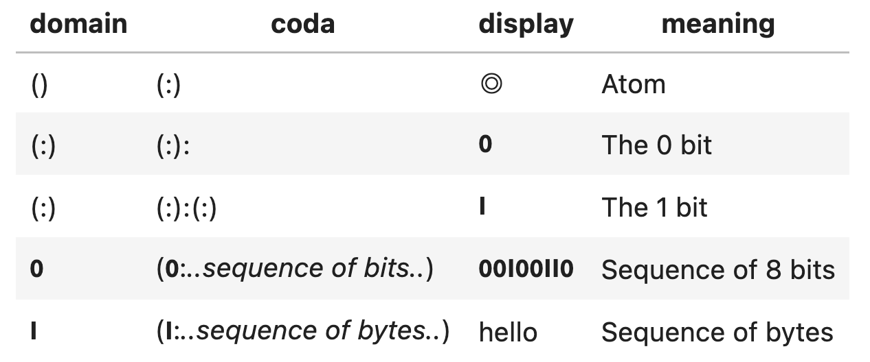
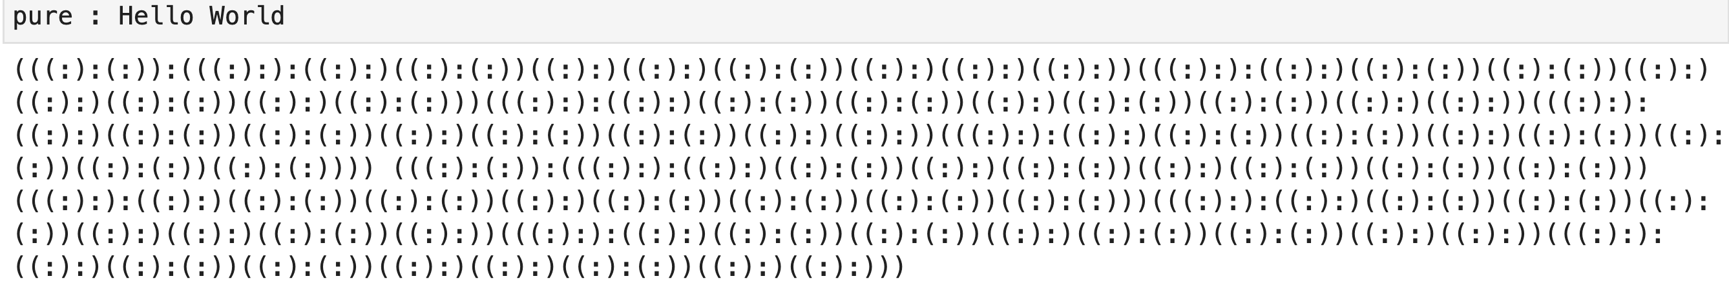
The 0 and 1 bit, bit sequences, byte sequences, functions, variables, categories, morphisms, types, theorems, language expressions,… are represented by pure data.

Slide 5
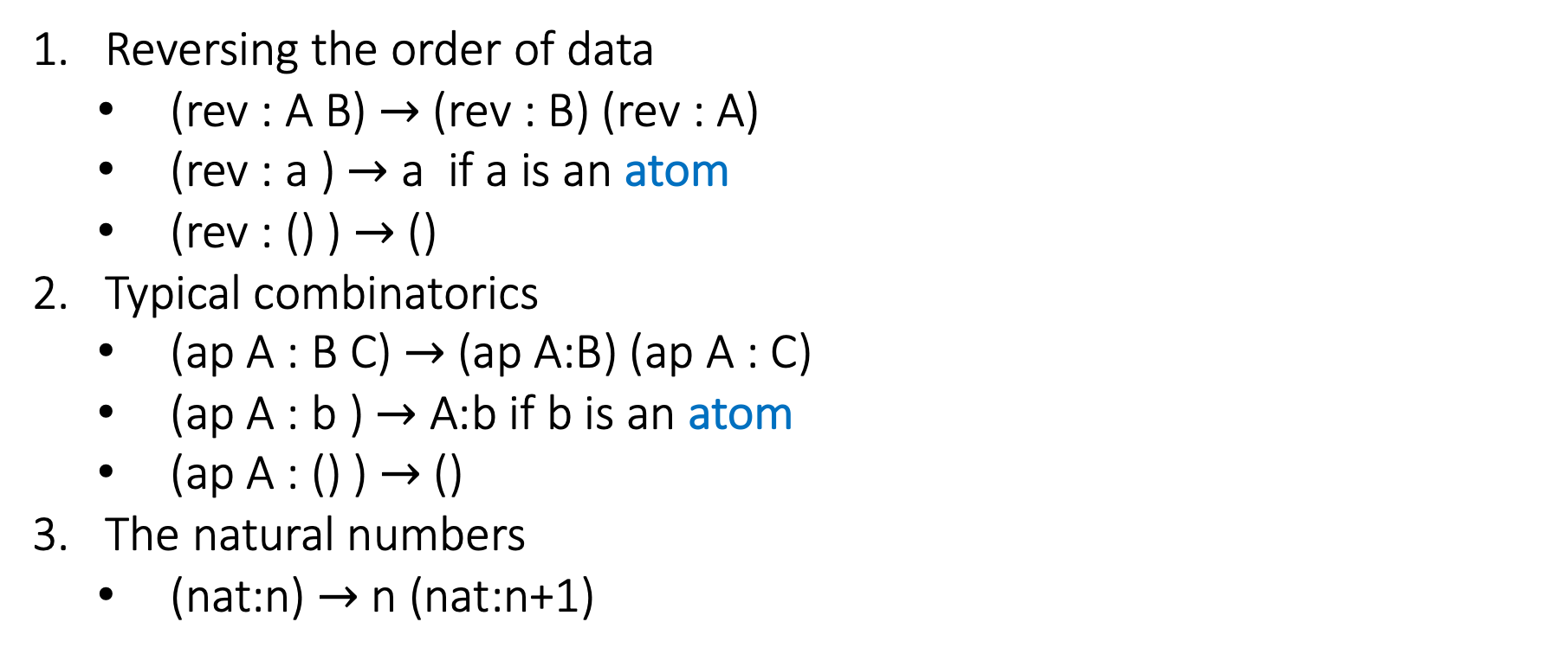
Typical definitions with disjoint domains:
Reversing the order of data
(rev : A B) $→$ (rev : B) (rev : A)
(rev : a ) $→$ a if a is an atom
(rev : () ) $→$ ()
Typical combinatorics
(ap A : B C) $→$ (ap A:B) (ap A : C)
(ap A : b ) $→$ A:b if b is an atom
(ap A : () ) $→$ ()
The natural numbers
(nat:n) $→$ n (nat:n+1)
Data A is an atom if the length of A is 1 and if $δ$(A) = A.

Slide 6
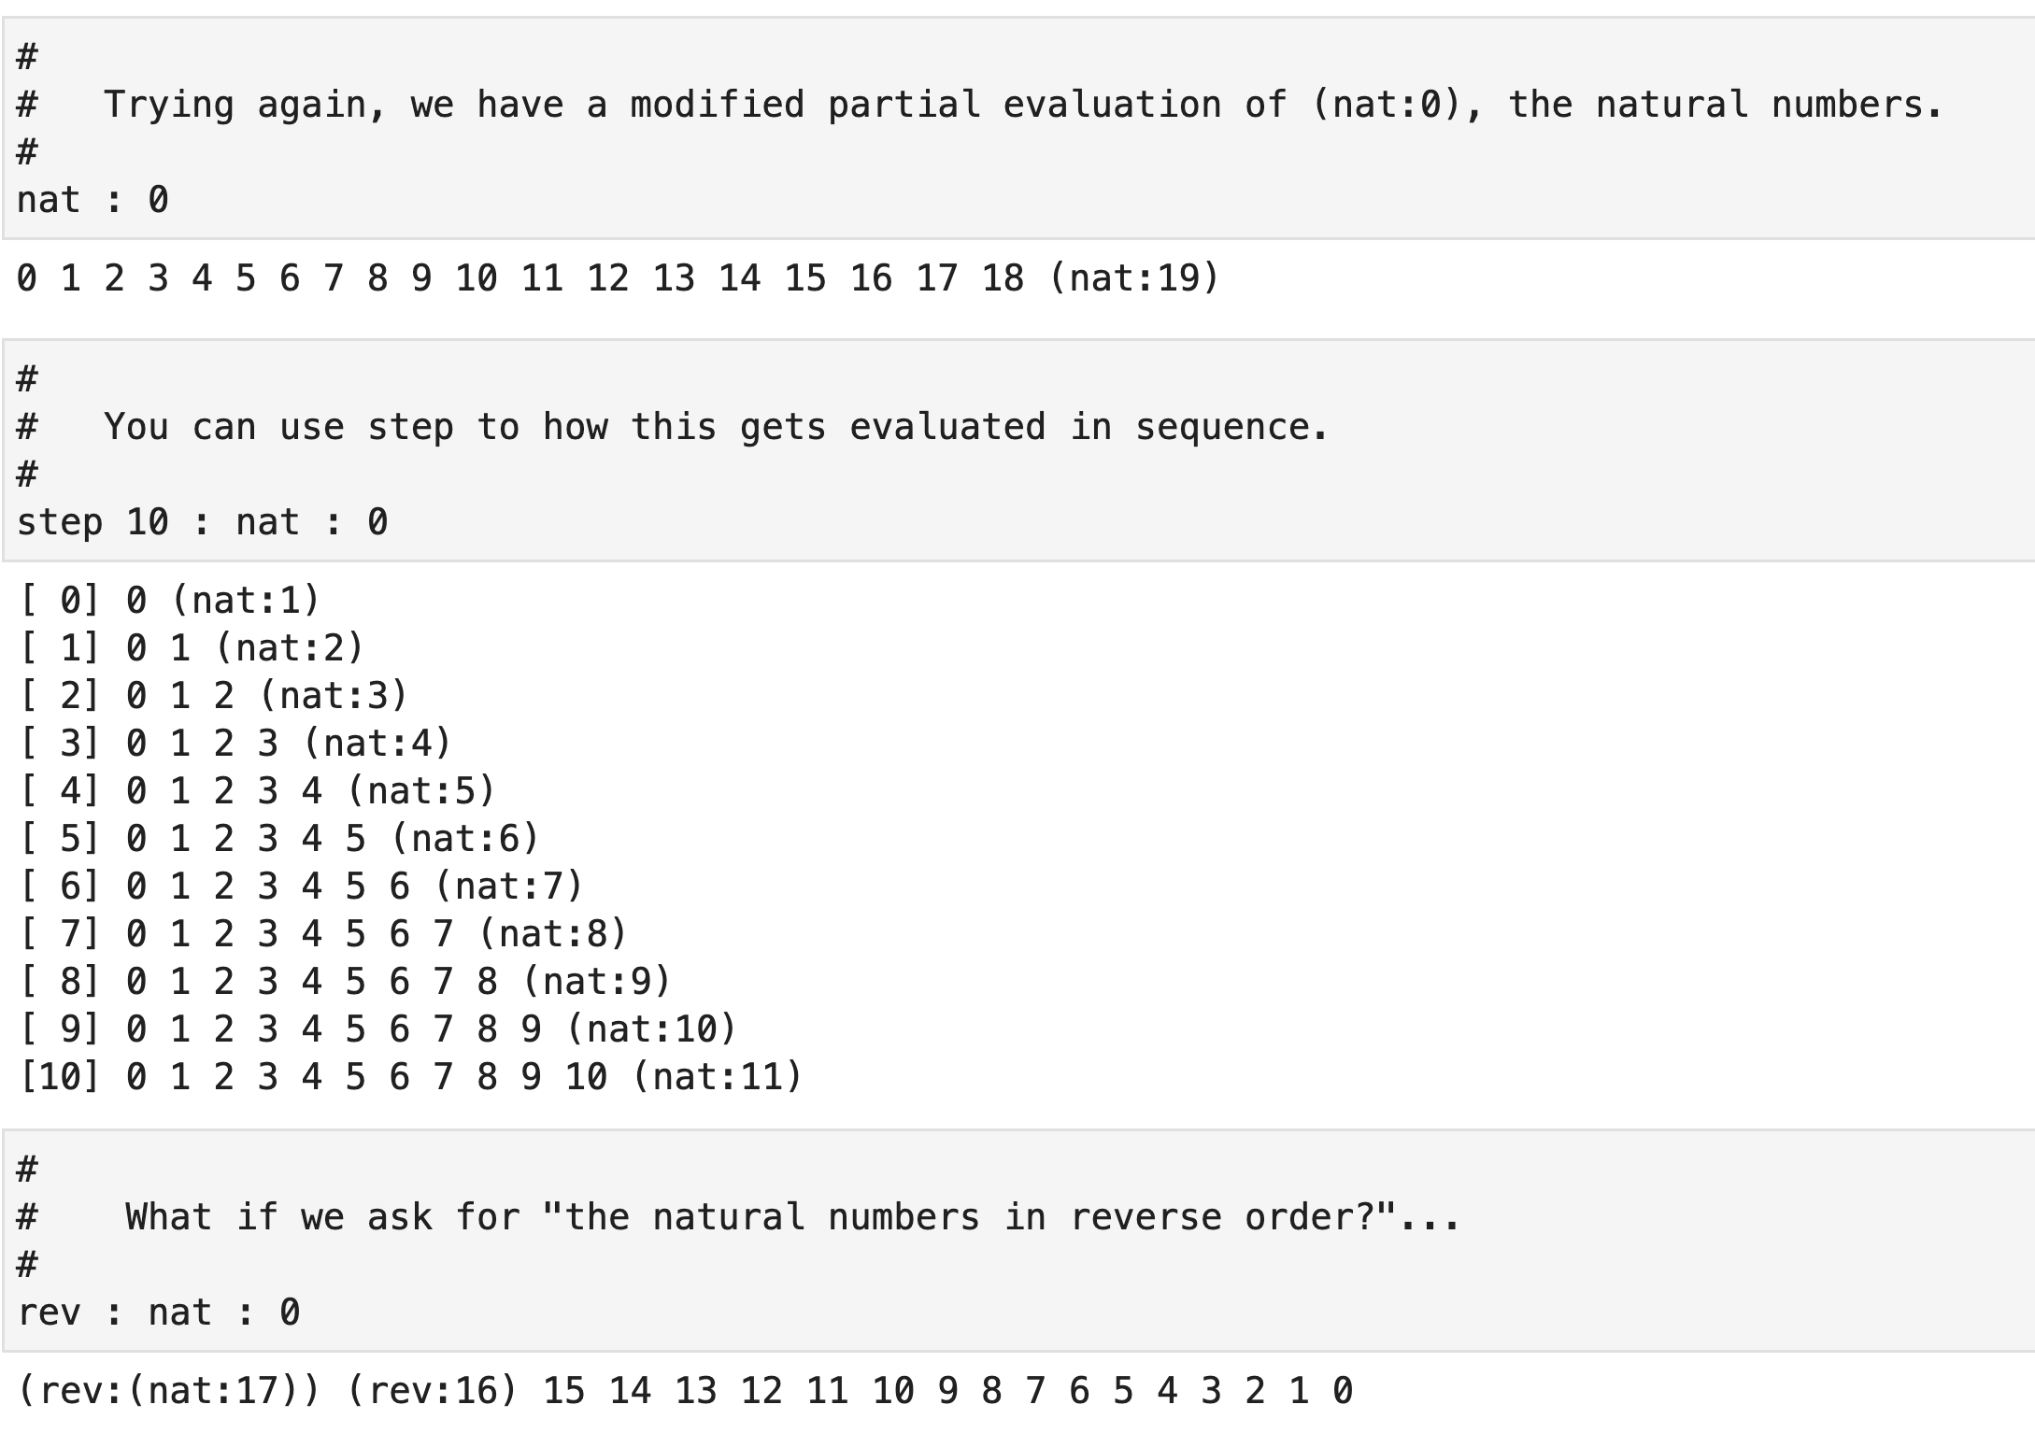
Data is always a finite sequence
Infinite quantities are still represented correctly.

Slide 7
Within coda, all items of mathematics or computing are merely different kinds of data as we have defined. This means, roughly speaking, that any mathematical question will be of the form
Is data A equal to data B?
Since the answer to this question A=B is also data, the answer to this question should be deducible from the concrete data (= A : B) suggesting that “logic” should be the coarsest classification of data in general.
Data A is true if A is equal to the empty data.
Data A is false if A as a sequence contains an atom.
Data A is undecided otherwise.

Slide 8
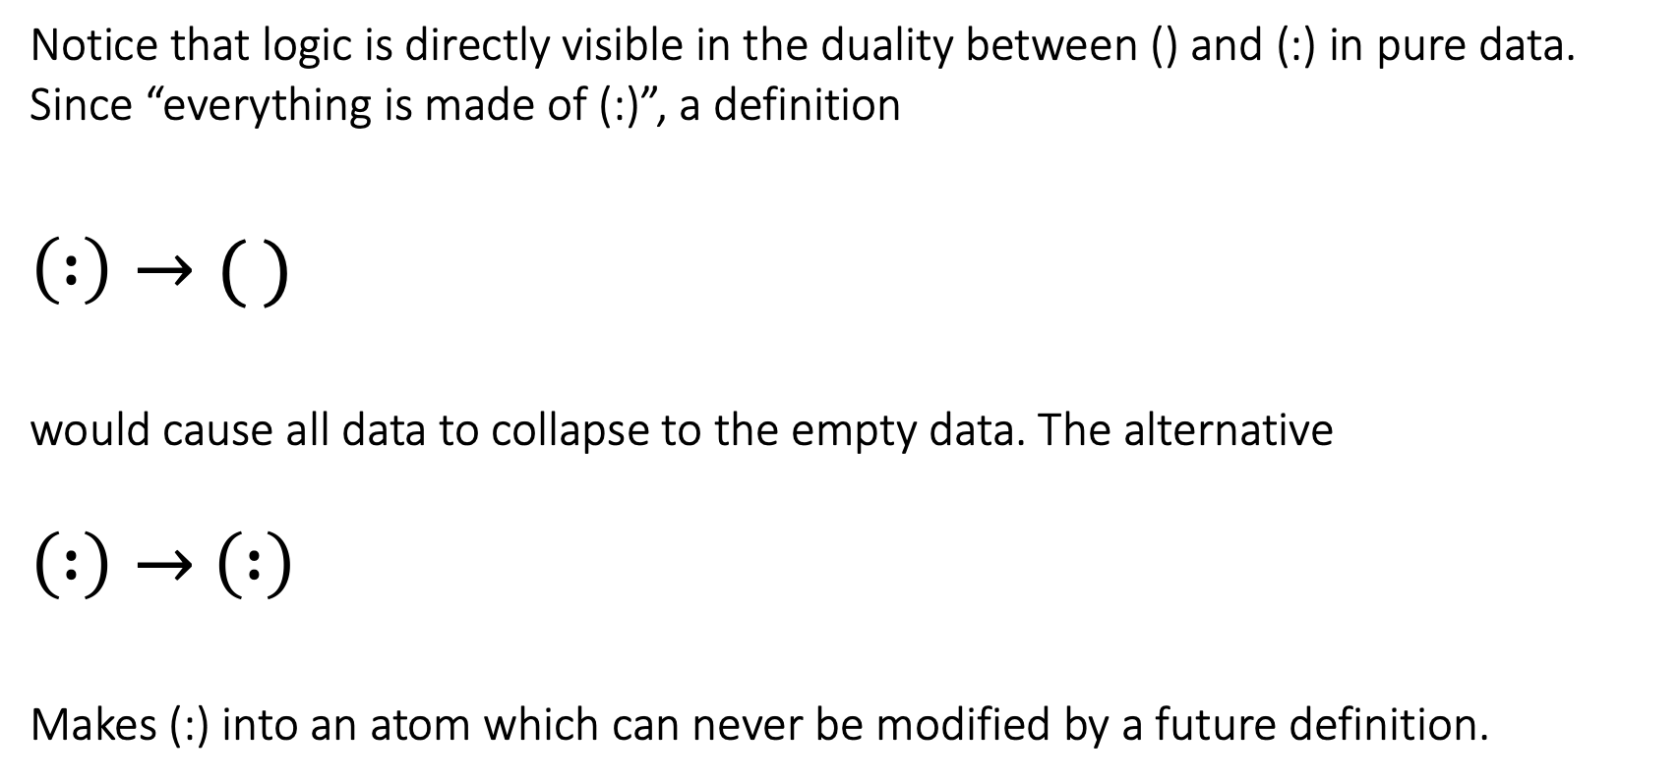
Notice that logic is directly visible in the duality between () and (:) in pure data. Since “everything is made of (:)”, a definition
$$\left( :\right)→( )$$
would cause all data to collapse to the empty data. The alternative
$\left( :\right)→$ $\left( :\right)$
Makes (:) into an atom which can never be modified by a future definition.

Slide 9
Since any added definitions must avoid the domain of any existing definition, being an atom is permanent.
True data is “always true” independent of future definitions.
False data is “always false” independent of future definitions.
Undecided data may become true or false with future definitions
Undecided data like (foo:bar) or (?:X) are “variables” in the sense that they may receive values in future definitions. If data A=B is undecided, the undecided value presumably provides insight into why A is not equal to B. It may, for instance, inspire a new definition.
Some undecided data remains undecided no matter what future definitions are chosen. Such data are called undecidable. This is the Godel phenomenon, which we will see later.

Slide 10
Empty => True
Undecided
Undecidable
Neither true nor false
Atomic => False
sum n : X? Y? = sum n : Y? X?

Slide 11
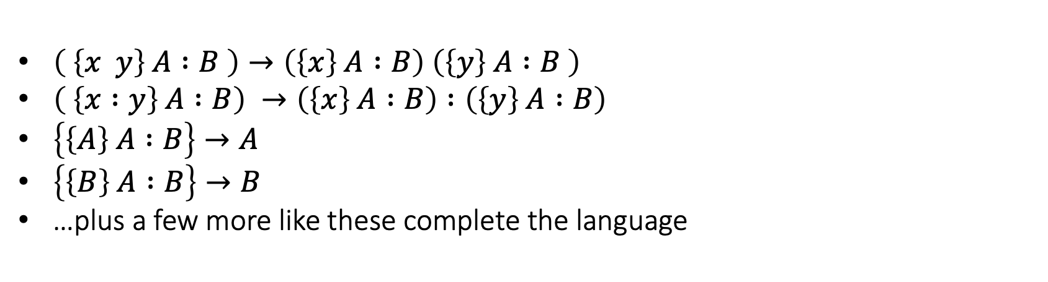
Language
As with predicate calculus with ZFC and dependent type theory, coda has a language which specifies data valued expressions. Unlike ZFC and dependent type theory, however, the whole language is merely one more definition just as we have defined it. It is a partial function from coda to data acting on codas of the form ( {…some sequence of bytes…} A : B ) where A and B can be any data.
$\left( \left\{x y\right\} A :B \right)→\left(\left\{x\right\} A :B\right) \left(\left\{y\right\} A :B \right)$
$\left( \left\{x :y\right\} A :B\right) →\left(\left\{x\right\} A :B\right) :\left(\left\{y\right\} A :B\right)$
$\left\{\left\{A\right\} A :B\right\}→A$
$\left\{\left\{B\right\} A :B\right\}→B$
…plus a few more like these complete the language
There are several points to notice…

Slide 12
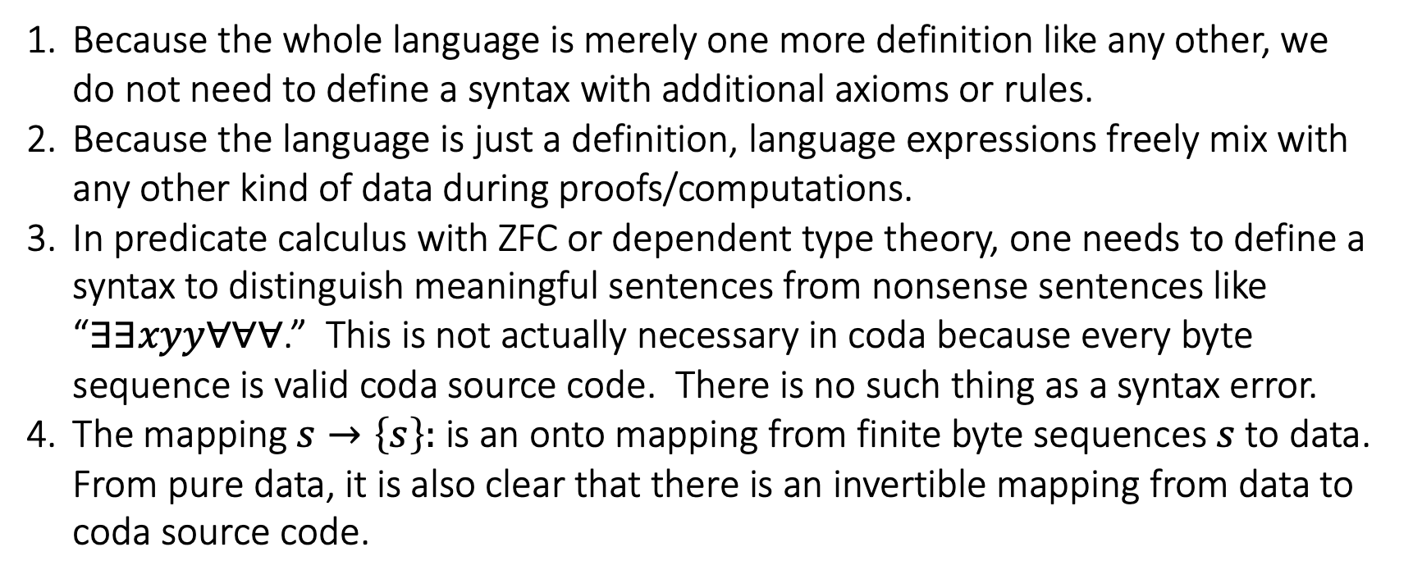
Notice…
Because the whole language is merely one more definition like any other, we do not need to define a syntax with additional axioms or rules.
Because the language is just a definition, language expressions freely mix with any other kind of data during proofs/computations.
In predicate calculus with ZFC or dependent type theory, one needs to define a syntax to distinguish meaningful sentences from nonsense sentences like “$∃∃xyy∀∀∀$.” This is not actually necessary in coda because every byte sequence is valid coda source code. There is no such thing as a syntax error.
The mapping $s→\left\{s\right\}:$ is an onto mapping from finite byte sequences $s$ to data. From pure data, it is also clear that there is an invertible mapping from data to coda source code.

Slide 13
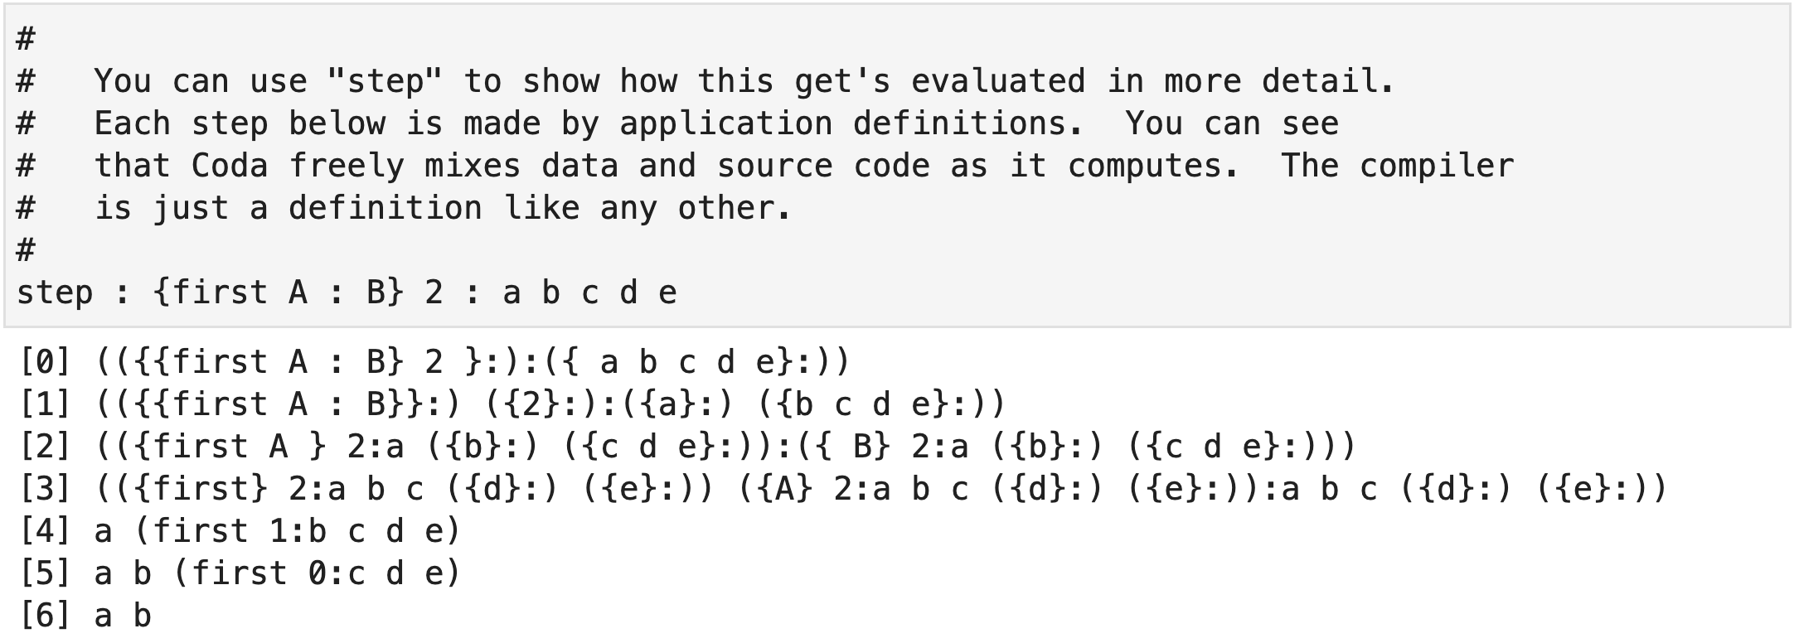
Language expressions mix freely with any other data

Slide 14
Proof and Computation
Any sequence A=D₁=D₂=…=D_{n}=B constitutes a proof that data A is equal to data B.
A
B
“Computation of A” just means proving that A=B where B is suitably “flattened” for terminal output
B
A
Since these steps only apply definitions, every computation is a proof and every proof is a computation.

Slide 15
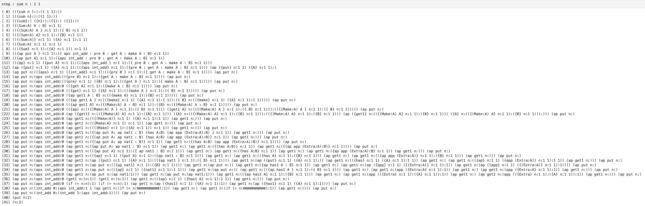
Echoing Russell & Whitehead, here is the complete proof that 1 + 1 = 2
This is actually proving a bit more. It is a proof that the coda ({sum n: 1 1}) is equal to the data (n:2).

Slide 16
Notice…
Since each of the steps is the application of one definition, each computation is a valid proof and each proof is a computation.
This is different than the situation in dependent type theory with the Curry-Howard correspondence.
Since any definition can be applied at any point in the data, there is no unique way to “execute” data. There are different strategies for different purposes.
Although the the number of steps in the previous page may be unbounded, each step is the application of a definition, so each individual step cannot loop, by definition.

Slide 17
Spaces
The most natural way to identify a particular part of the enormous space of all pure data is to fix some data A and consider the data equal to
A : X
for any data X. To make the space “A” closed under sequences, we require
A : (A:X) (A:Y) = A : X Y
Any distributive data F can be thought of as a function from data X to data F:X. Suppose that we want F applied to data in A, F : (A:X) to end up in space “B”. We can do that by requiring
F : A : X = B : F : X
For all data X.

Slide 18

One ”space” of natural numbers: (n:0), (n:1), (n:2),…
Another: (m:0), (m:1), …
Familiar mathematical structure is nicest in equivalent sequential form, e.g.
sum n : 1 2 3 4 …rather than…. 1 + 2 + 3 + 4 with a binary operator
sort n : 4 3 99 1 …rather than…. Sorting with a binary operator
$$≤$$
make n
sum n
sort n
prod n
term n
Each of these is a “space”, each identifying the same collection of data: (n:0), (n:1), … but representing different mathematical structure.

Slide 19
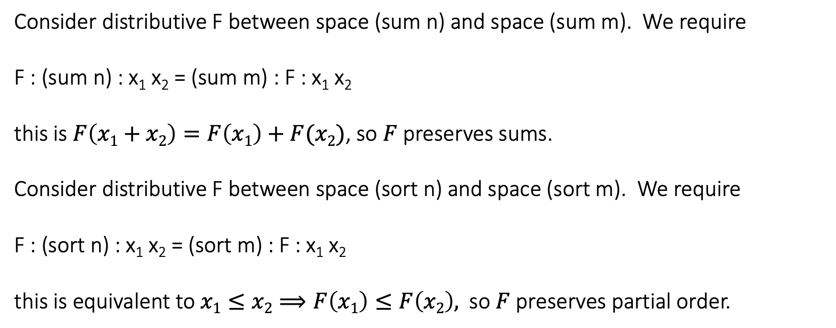
make n
sum n
sort n
prod n
term n
Each of these is a “space”, each identifying the same collection of data: (n:0), (n:1), … but representing different mathematical structure.
Consider distributive F between space (sum n) and space (sum m). We require
F : (sum n) : x₁ x₂ = (sum m) : F : x₁ x₂
this is $F\left(x1+x2\right)=F\left(x1\right)+F(x2)$, so $F$preserves sums.
Consider distributive F between space (sort n) and space (sort m). We require
F : (sort n) : x₁ x₂ = (sort m) : F : x₁ x₂
this is equivalent to $x1≤x2⟹F\left(x1\right)≤F\left(x2\right),$ so $F$preserves partial order.

Slide 20
Spaces are Categories
…but not exactly. The difference is very interesting…
Spaces have no dependence on sets or set theory.
Unlike in set theory, any data F, G, H can be composed as X -> F:G:H:X whether domains match with codomains or not.
The categorical properties of morphisms is determined by the category. This is not true in standard category theory where, for instance, you can have a category of vector spaces with ordinary, non-linear maps.
A distributive morphism F : X is a sequence preserving function on the atoms of X. It is the coda version of an ordinary function.
A space with distributive morphisms is a type.
Both types and categories naturally appear in coda.
Types are distributive spaces

Slide 21
X?....variable
Natural:n
def Group : { (Type : B)
(Associative : prod B)
(Identity prod B : (id:B))
(Inverse prod B : (inv:B))
}
skip N? : prime : nat : 0…there are an infinite number of primes.
sum n : X? Y? = sum n : Y? X?...addition of natural numbers is commutative.
C : X? Y? = C : (C:X?) (C:Y?)
M*C = C*M
let this_is_true? : not : this_is_true?

Slide 22
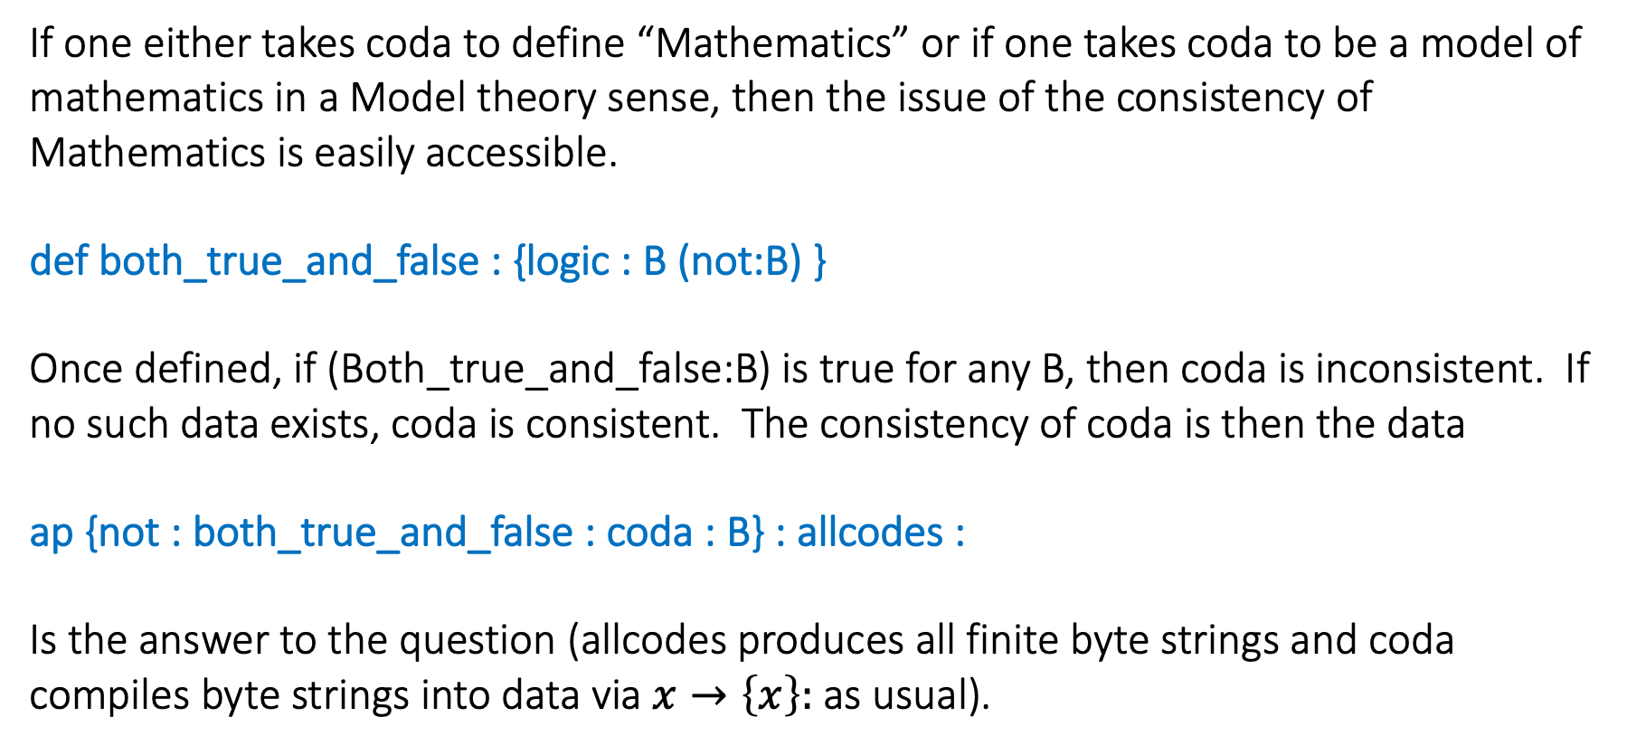
Is Mathematics Consistent?
If one either takes coda to define “Mathematics” or if one takes coda to be a model of mathematics in a Model theory sense, then the issue of the consistency of Mathematics is easily accessible.
def both_true_and_false : {logic : B (not:B) }
Once defined, if (Both_true_and_false:B) is true for any B, then coda is inconsistent. If no such data exists, coda is consistent. The consistency of coda is then the data
ap {not : both_true_and_false : coda : B} : allcodes :
Is the answer to the question (allcodes produces all finite byte strings and coda compiles byte strings into data via $x→\left\{x\right\}:$as usual).

Slide 23
ap {not: Both_true_and_false : coda : B} : allcodes :
If data A is equal to data B, then A and B have the same number of atoms. Thus atomic data cannot be equal to empty data and, therefore, no data can be both true and false. This means that each application of
{not : Both_true_and_false : coda : B}
is empty.
2.
Since “allcodes” will eventually produce the string
”ap {not: Both_true_and_false : coda : B} : allcodes :”
and so the expression above will recursively never finish.

Slide 24
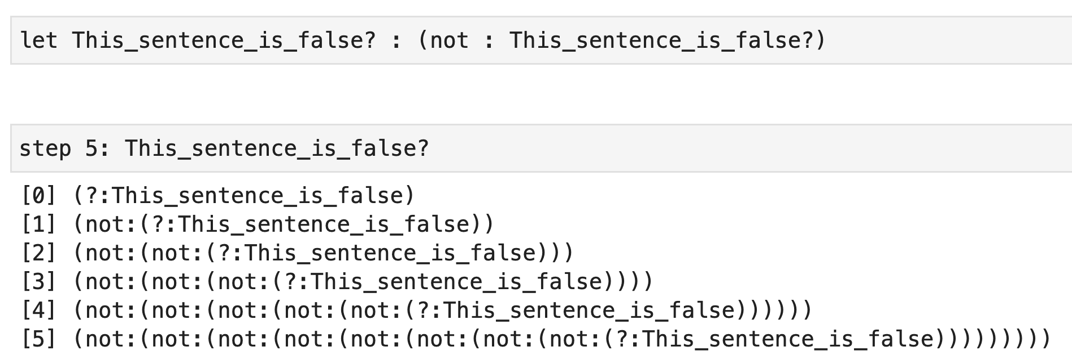
Data can be undecidable

Slide 25
Mathematical Machine Learning

