Slide 1
Pure Data Foundations of Mathematics
Saul Youssef
Boston University
April, 2023

Slide 2
types
ee
egg
Aldor
With Margo Seltzer and David Parkes
By Stephen Watt & collaborators
coda classic
coda

Slide 3
types
ee
egg
Aldor
With Margo Seltzer and David Parkes
By Stephen Watt & collaborators
coda classic
Formal system which can be a foundation of mathematics in general, analogous to ZFC or HOTT.
A computing system where all computations are proofs and vice versa.
Analogue of categories and types appears naturally.
Applications are mathematical exploration, proof assistance, “mathematical machine learning.”
This is Model theory-like in the sense that we can address issues like the consistency of Mathematics.
coda

Slide 4
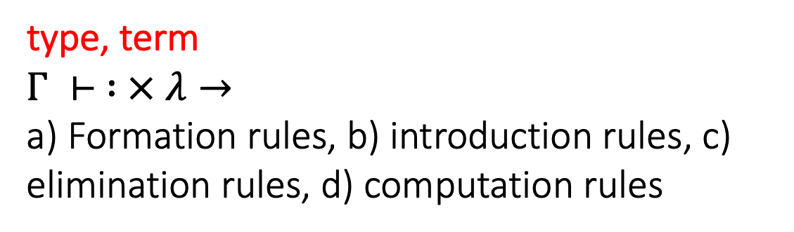
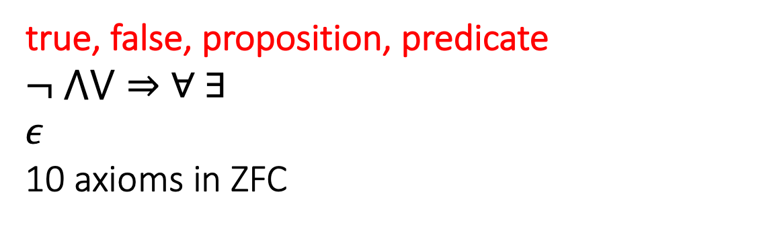
Mathematics is defined by formal systems
Predicate logic with Zermelo-Fraenkel Set Theory
true, false, proposition, predicate
$$¬ ⋀⋁⇒∀ ∃$$
$$ε$$
10 axioms in ZFC
Any system of reasoning must have terms which are understood before the first definition.
type, term
$$Γ ⊢ : × λ→$$
a) Formation rules, b) introduction rules, c) elimination rules, d) computation rules
Dependent type theories: Martin-Lof, CIC, HOTT,…

Slide 5
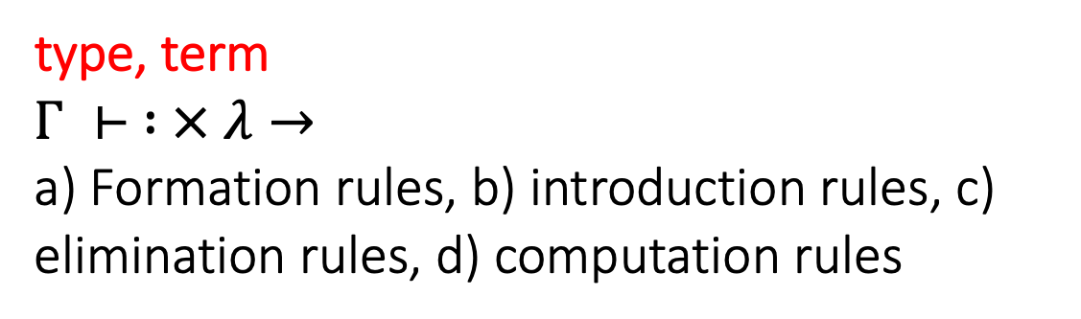
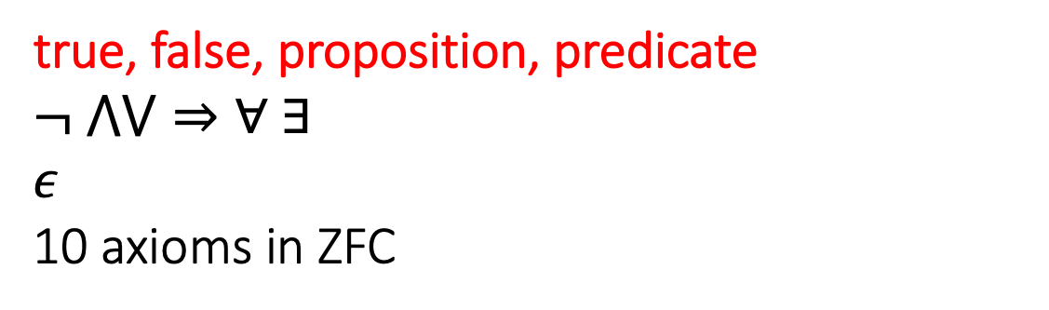
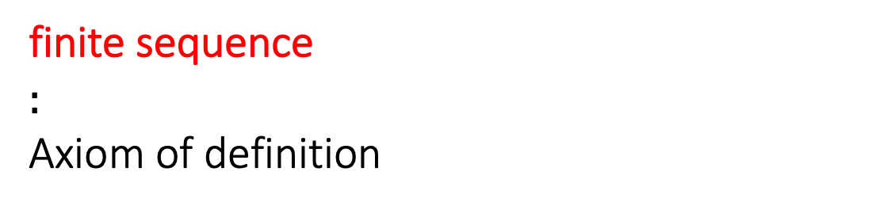
Predicate logic with Zermelo-Fraenkel Set Theory
true, false, proposition, predicate
$$¬ ⋀⋁⇒∀ ∃$$
$$ε$$
10 axioms in ZFC
Any system of reasoning must have terms which are understood before the first definition.
type, term
$$Γ ⊢ : × λ→$$
a) Formation rules, b) introduction rules, c) elimination rules, d) computation rules
Dependent type theories: Martin-Lof, CIC, HOTT,…
finite sequence
$$:$$
Axiom of definition
coda

Slide 6
A data is a finite sequence of codas.
A coda is a pair of data.
We will use a small natural algebra of data:
A B denotes the concatenation of data A with data B.
A : B denotes the data consisting of a single coda made from A and B.
( ) - the empty sequence of codas.
(:) - the data consisting of one coda made from the pair () and ().
(:) (:) ((:):(:)) - a sequence of three codas.
This is pure data. Pure data is “finite sequences of nothing.”

Slide 7
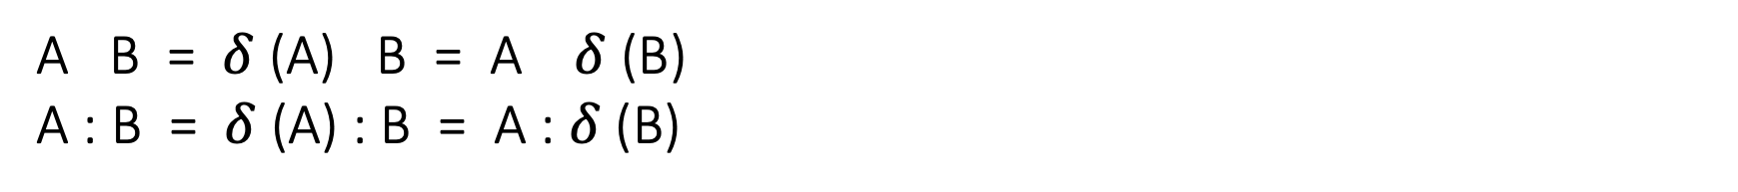
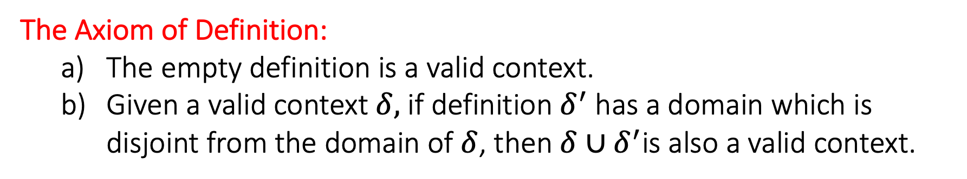
A definition is a partial function from coda to data.
A valid context is a definition that has been accepted as valid.
Given a context $δ,$equality of data is defined by
These are the “deduction rules” in the sense of a formal system.
A B = $δ$ (A) B = A $δ$ (B)
A : B = $δ$ (A) : B = A : $δ$ (B)
The Axiom of Definition:
The empty definition is a valid context.
Given a valid context $δ,$ if definition$δ^{′}$ has a domain which is disjoint from the domain of $δ$, then $δ∪δ^{′}$is also a valid context.
There is only one axiom.

Slide 8
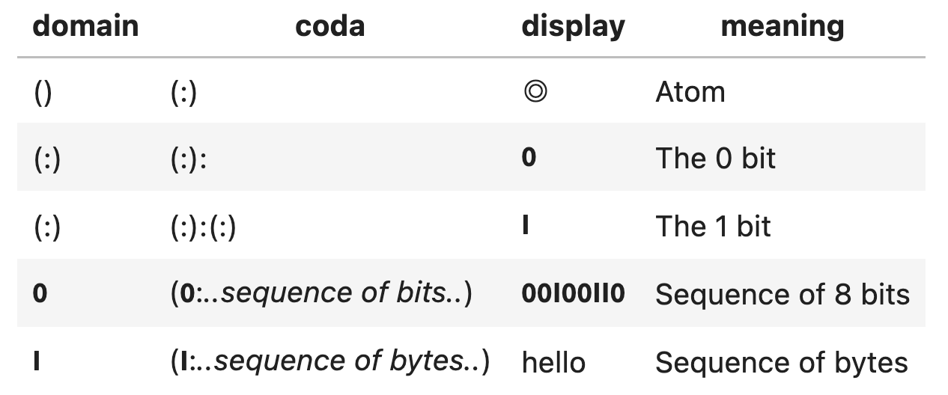
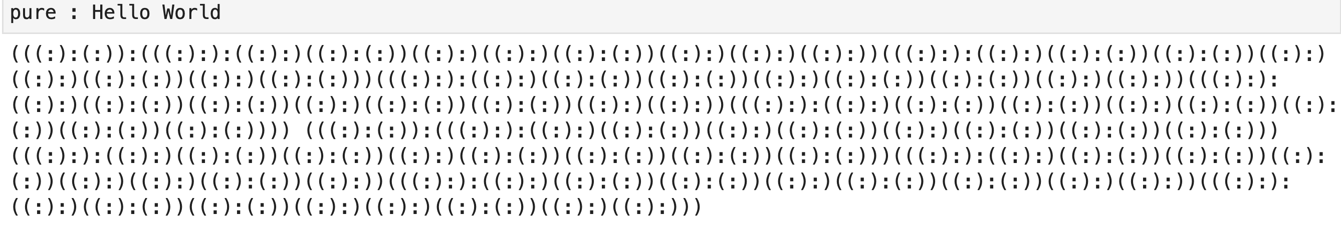
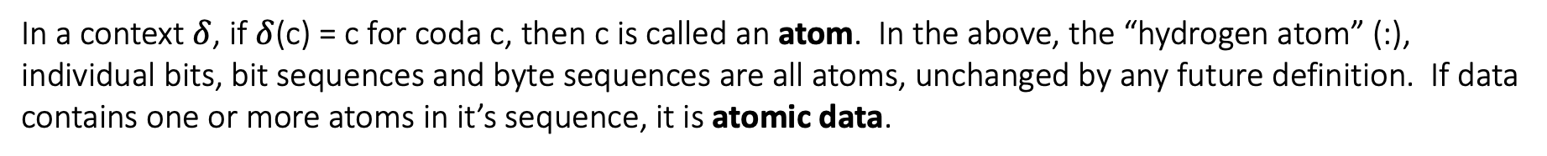
The 0 and 1 bit, bit sequences, byte sequences, functions, variables, categories, morphisms, types, theorems, language expressions,… are represented by pure data.
In a context $δ$, if $δ$(c) = c for coda c, then c is called an atom. In the above, the “hydrogen atom” (:), individual bits, bit sequences and byte sequences are all atoms, unchanged by any future definition. If data contains one or more atoms in it’s sequence, it is atomic data.

Slide 9
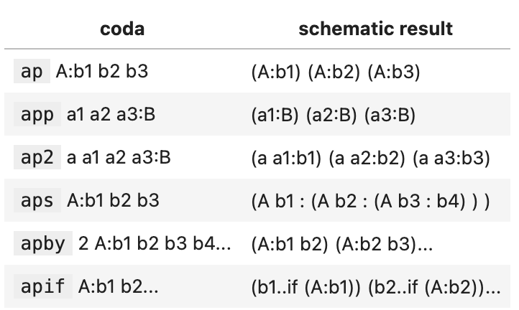

Typical definitions:
Doing nothing to “input”
(pass A:B) -> B
Null data for any A,B
(null A : B) -> ()
Reversing the order of data
(rev : A B) $→$ (rev : B) (rev : A)
(rev : a ) $→$ a if a is an atom
(rev : () ) $→$ ()
Typical combinatorics
(ap A : B C) $→$ (ap A:B) (ap A : C)
(ap A : b ) $→$ A:b if b is an atom
(ap A : () ) $→$ ()
The natural numbers
(nat : n) $→$ n (nat: n+1)

Slide 10
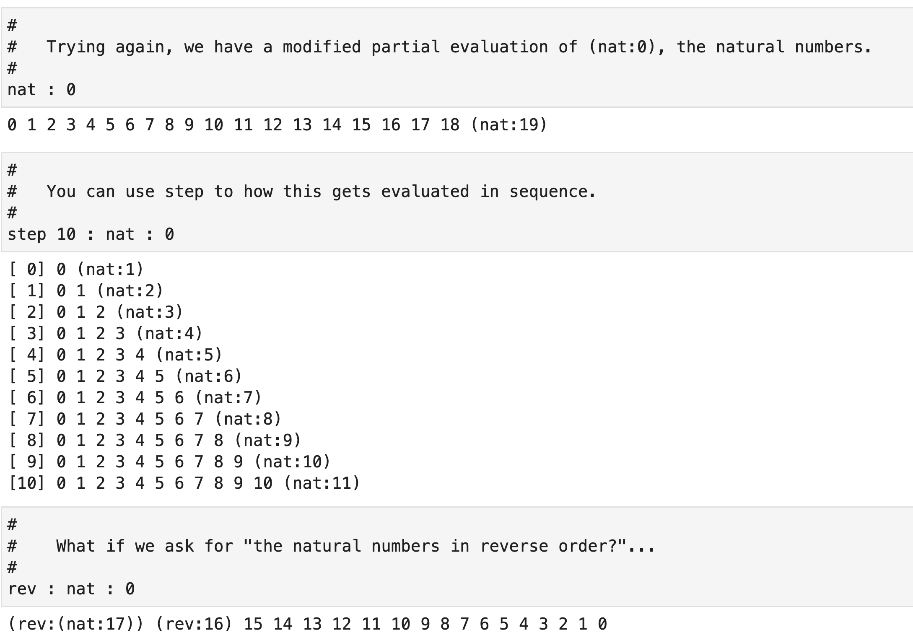
Data is always a finite sequence
..but this is not a meaningful limitation

Slide 11
Logic
Within coda, all items of mathematics or computing are merely different kinds of data as we have defined. This means, roughly speaking, that any mathematical question will be of the form
Is data A equal to data B?
Since the answer to this question A=B is also data, the answer to this question should be deducible from the concrete data (= A : B) suggesting that “logic” should be the coarsest classification of data in general.
Data is true if it is empty.
Data is false if it is atomic.
Data is undecided otherwise.

Slide 12
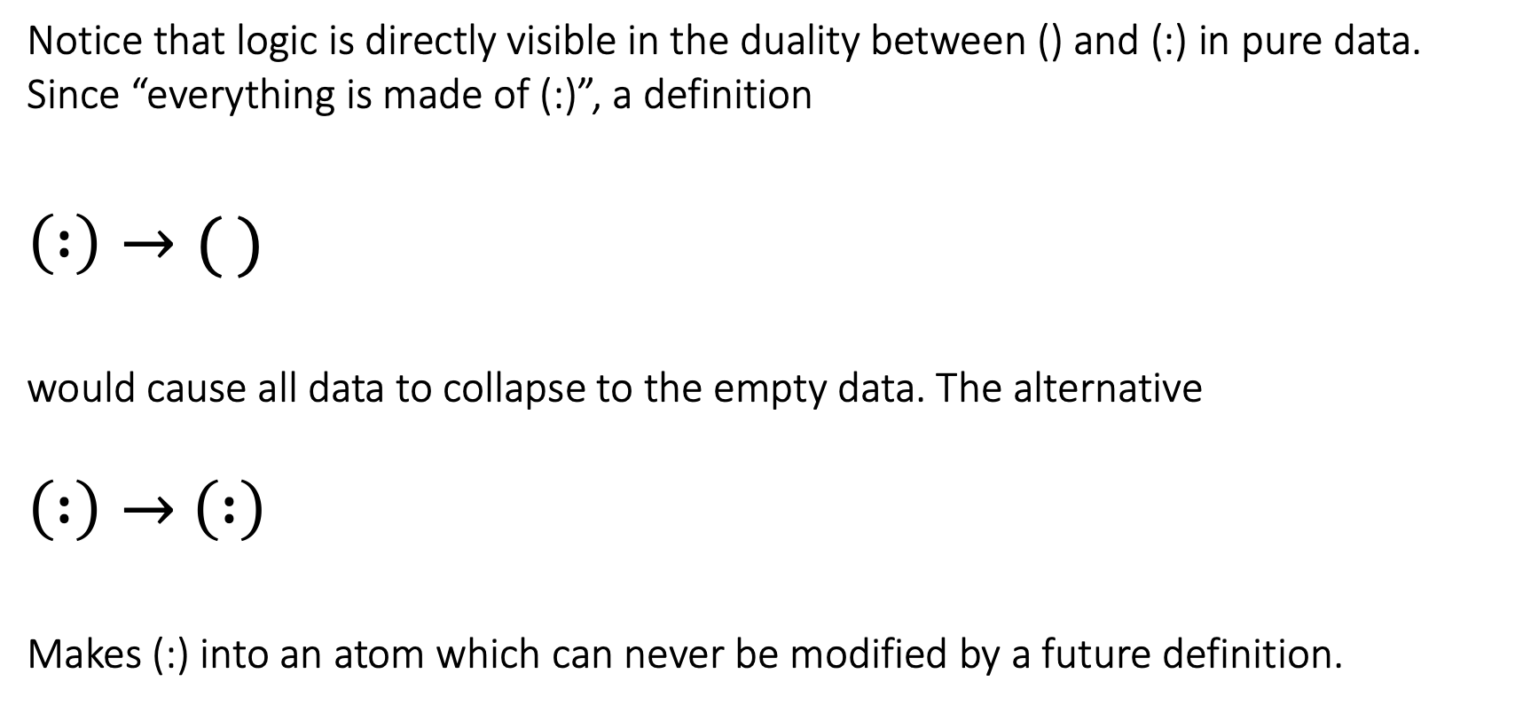
Notice that logic is directly visible in the duality between () and (:) in pure data. Since “everything is made of (:)”, a definition
$$\left( :\right)→( )$$
would cause all data to collapse to the empty data. The alternative
$\left( :\right)→$ $\left( :\right)$
Makes (:) into an atom which can never be modified by a future definition.

Slide 13
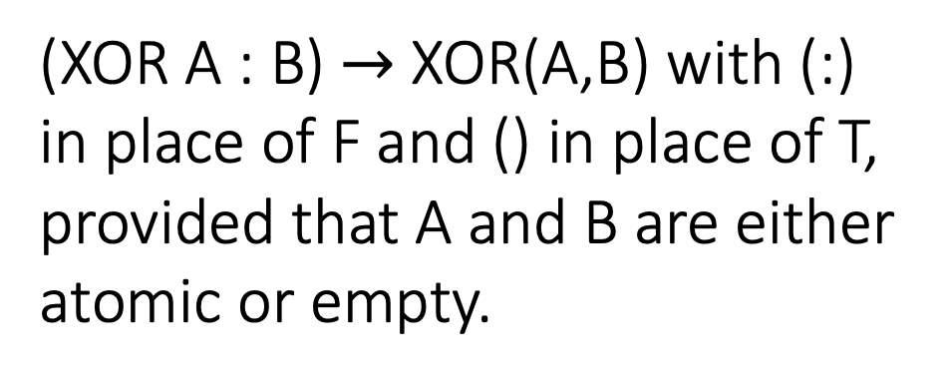
This is not as unfamiliar as it might appear. Any of the usual binary Boolean operators has a corresponding definition in coda. Each of the 16 usual binary Boolean operations has a corresponding definition in Coda:
A | B | XOR(A,B)
T | T | F
T | F | T
F | T | T
F | F | F
(XOR A : B) $→$ XOR(A,B) with (:) in place of F and () in place of T, provided that A and B are either atomic or empty.

Slide 14
Since any added definitions must avoid the domain of any existing definition, being an atom is permanent.
True data is “always true” independent of future definitions.
False data is “always false” independent of future definitions.
Undecided data may become true or false with future definitions
Undecided data like (foo:bar) or (?:X) are “variables” in the sense that they may receive values in future definitions. If data A=B is undecided, the undecided value presumably provides insight into why A is not equal to B. It may, for instance, inspire a new definition.
Some undecided data remains undecided no matter what future definitions are chosen. Such data are called undecidable. This is the Godel phenomenon, which we will see later.

Slide 15
Empty => True
Undecided
Undecidable
Neither true nor false
Atomic => False
Values, variables, functions, propositions, theorems, definitions, “spaces”, “morphisms”… live in the space of pure data

Slide 16
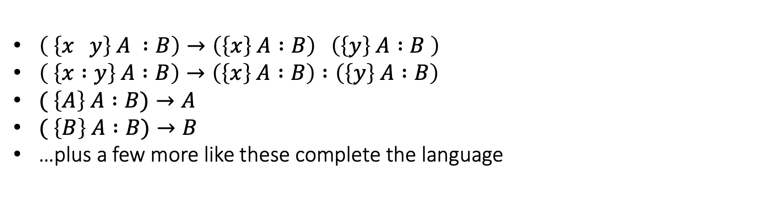
Language
As with predicate calculus with ZFC and dependent type theory, coda has a language which specifies data valued expressions. Unlike ZFC and dependent type theory, however, the whole language is merely one more definition just as we have defined it. It is a partial function from coda to data acting on codas of the form ( {…some sequence of bytes…} A : B ) where A and B can be any data.
$\left( \left\{x y\right\} A :B\right)→\left(\left\{x\right\} A :B\right) \left(\left\{y\right\} A :B \right)$
$\left( \left\{x :y\right\} A :B\right)→\left(\left\{x\right\} A :B\right) :\left(\left\{y\right\} A :B\right)$
$( \left\{A\right\} A :B)→A$
$( \left\{B\right\} A :B)→B$
…plus a few more like these complete the language
There are several points to notice…

Slide 17
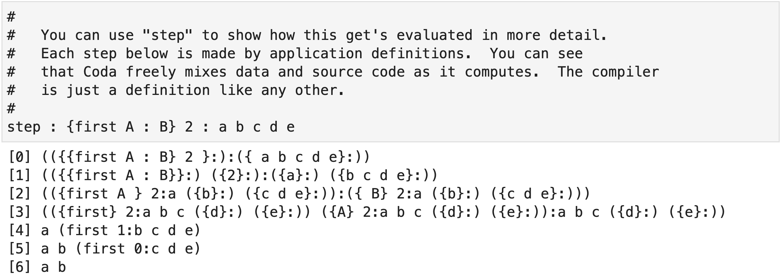
Language expressions mix freely with any other data

Slide 18

Note…
Because the whole language is merely one more definition like any other, we do not need to define a syntax with additional axioms or rules.
In predicate logic with ZFC or dependent type theory, one needs to define a syntax to distinguish meaningful sentences from nonsense sentences like “$∃∃xyy∀∀∀$.” This is not actually necessary in coda because every byte sequence is valid coda source code. There is no such thing as a syntax error.
The mapping $s→\left\{s\right\}:$ is an onto mapping from finite byte sequences $s$ to data. From pure data, it is also clear that there is an invertible mapping from data to coda source code.

Slide 19
Proof and Computation
Any sequence A=D₁=D₂=…=D_{n}=B constitutes a proof that data A is equal to data B.
A
B
“Computation of A” just means proving that A=B where B is suitably “flattened” for terminal output
B
A
Since these steps only apply definitions, every computation is a proof and every proof is a computation.

Slide 20
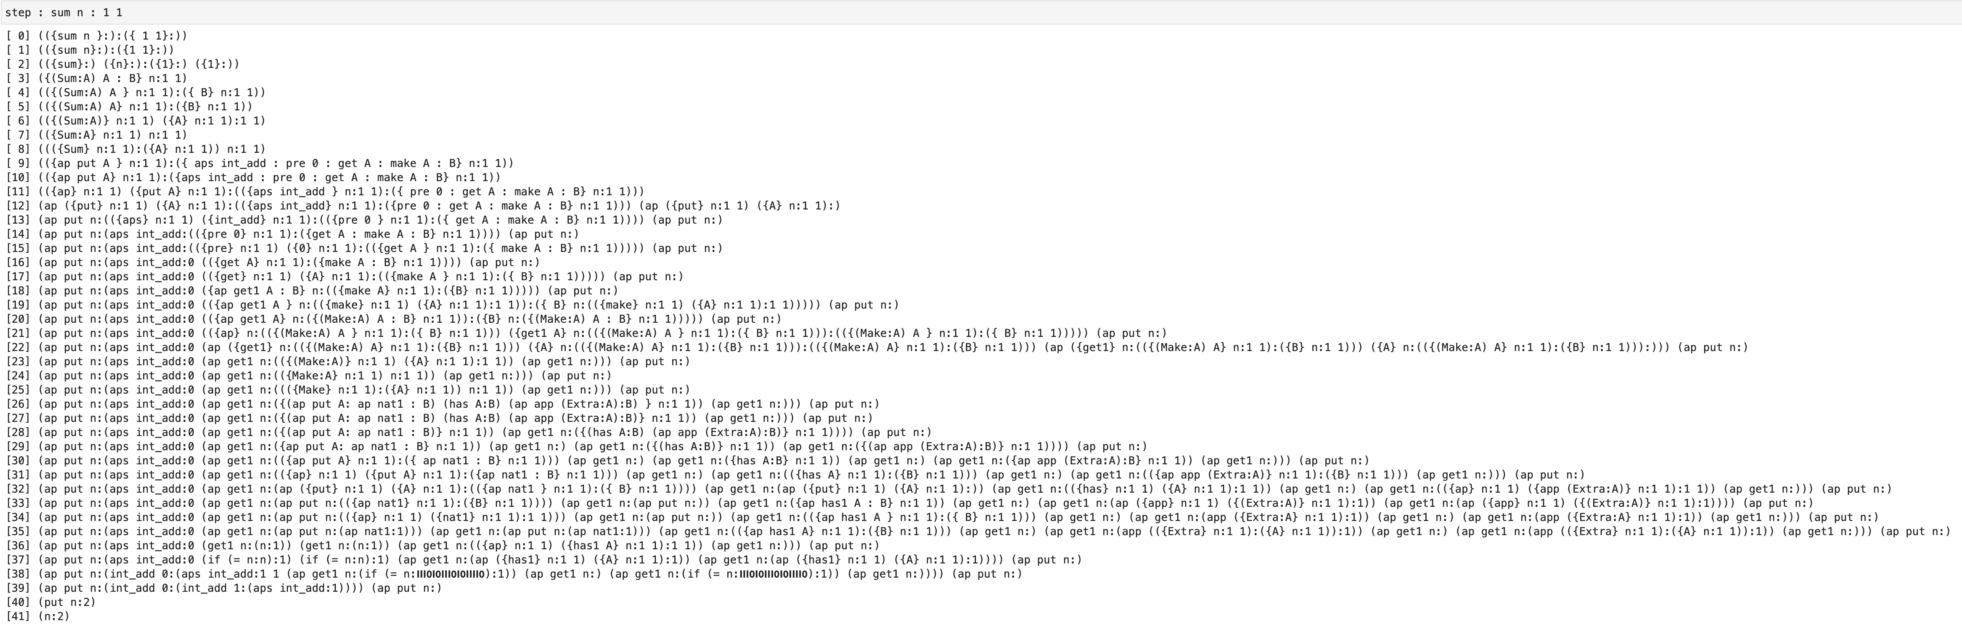
Echoing Russell & Whitehead, here is the complete proof that 1 + 1 = 2
This is actually proving a bit more. It is a proof that the data ({sum n: 1 1} :) is equal to the data (n:2).

Slide 21
Note…
Since each step is the application of definition, each computation is a valid proof and each proof is a computation.
This is different than the situation in dependent type theory with the Curry-Howard correspondence.
Since any definition can be applied at any point in the data, there is no unique way to “execute” data. There are different strategies for different purposes.
Although the the number of steps in the previous page may be unbounded, each step is the application of a definition, so each individual step cannot loop.

Slide 22
Spaces
The most natural way to identify a particular part of the enormous space of all pure data is to fix some data A and consider the data equal to
A : X
for any data X. To make the space “A” closed under sequences, we require
A : (A:X) (A:Y) = A : X Y
For any data X and Y. Any distributive data F can be thought of as a function from data X to data F:X. Suppose that we want F applied to data in A, F : (A:X) to end up in space “B”. We can do that by requiring
F : A : X = B : F : X
For all data X. If so, we say that F is a morphism from space A to space B.

Slide 23
One ”space” of natural numbers: (n:0), (n:1), (n:2),…
Another: (m:0), (m:1), …
Familiar mathematical structure is nicest in equivalent sequential form, e.g.
sum n : 1 2 3 4 …rather than…. 1 + 2 + 3 + 4 with a binary operator
sort n : 4 3 99 1 …rather than…. Sorting with a binary operator
type n
sum n
sort n
prod n
term n
Each of these is a “space”, each identifying the same collection of data: (n:0), (n:1), … but representing different mathematical structure.

Slide 24
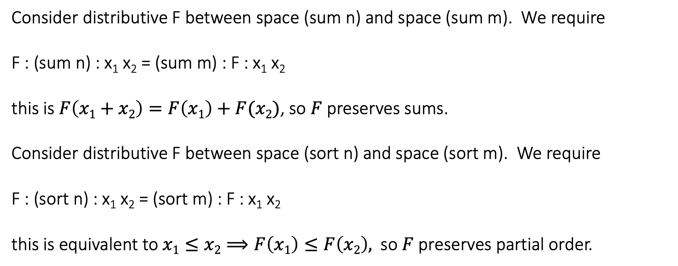
type n
sum n
sort n
prod n
term n
Each of these is a “space”, each identifying the same collection of data: (n:0), (n:1), … but representing different mathematical structure.
Consider distributive F between space (sum n) and space (sum m). We require
F : (sum n) : x₁ x₂ = (sum m) : F : x₁ x₂
this is $F\left(x1+x2\right)=F\left(x1\right)+F(x2)$, so $F$preserves sums.
Consider distributive F between space (sort n) and space (sort m). We require
F : (sort n) : x₁ x₂ = (sort m) : F : x₁ x₂
this is equivalent to $x1≤x2⟹F\left(x1\right)≤F\left(x2\right),$ so $F$preserves partial order.

Slide 25
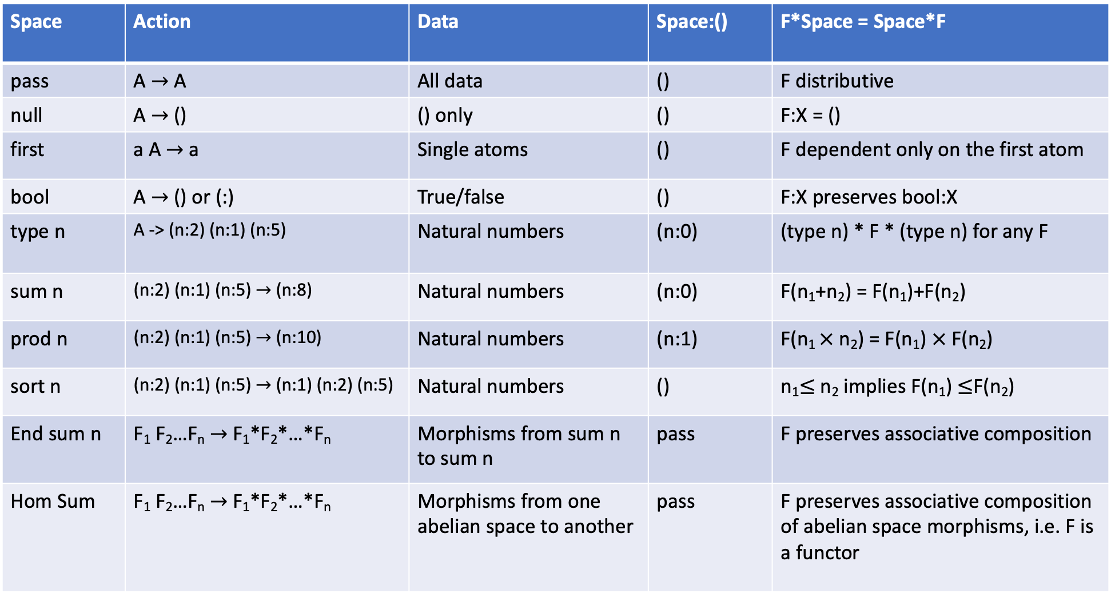
Space | Action | Data | Space:() | F*Space = Space*F
pass | A $→$ A | All data | () | F distributive
null | A $→$ () | () only | () | F:X = ()
first | a A $→$ a | Single atoms | () | F dependent only on the first atom
bool | A $→$ () or (:) | True/false | () | F:X preserves bool:X
type n | A -> (n:2) (n:1) (n:5) | Natural numbers | (n:0) | (type n) * F * (type n) for any F
sum n | (n:2) (n:1) (n:5) $→$ (n:8) | Natural numbers | (n:0) | F(n₁+n₂) = F(n₁)+F(n₂)
prod n | (n:2) (n:1) (n:5) $→$ (n:10) | Natural numbers | (n:1) | F(n₁ $×$ n₂) = F(n₁) $×$ F(n₂)
sort n | (n:2) (n:1) (n:5) $→$ (n:1) (n:2) (n:5) | Natural numbers | () | n₁$≤$ n₂ implies F(n₁) $≤$F(n₂)
End sum n | F₁ F₂…F_{n} $→$ F₁*F₂*…*F_{n} | Morphisms from sum n to sum n | pass | F preserves associative composition
Hom Sum | F₁ F₂…F_{n} $→$ F₁*F₂*…*F_{n} | Morphisms from one abelian space to another | pass | F preserves associative composition of abelian space morphisms, i.e. F is a functor

Slide 26
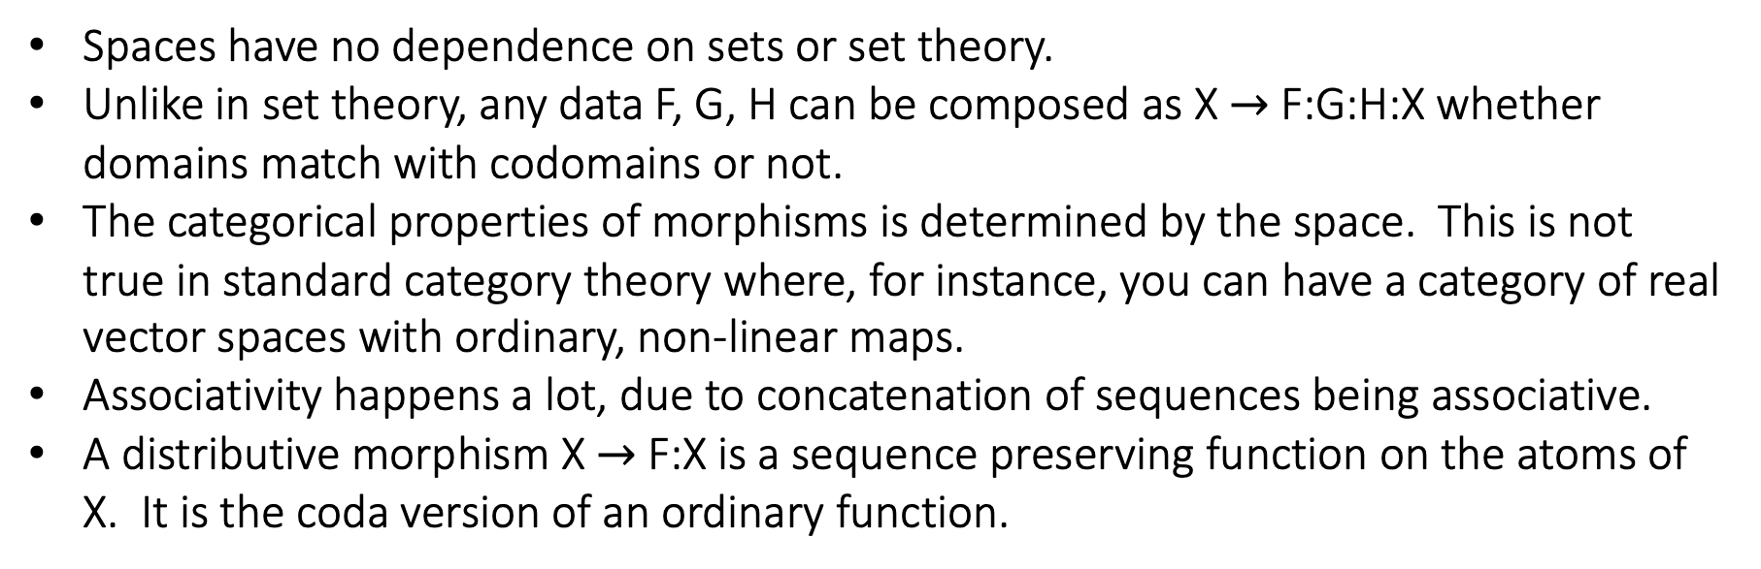
Compare “spaces” with categories in category theory
Spaces have no dependence on sets or set theory.
Unlike in set theory, any data F, G, H can be composed as X $→$ F:G:H:X whether domains match with codomains or not.
The categorical properties of morphisms is determined by the space. This is not true in standard category theory where, for instance, you can have a category of real vector spaces with ordinary, non-linear maps.
Associativity happens a lot, due to concatenation of sequences being associative.
A distributive morphism X $→$ F:X is a sequence preserving function on the atoms of X. It is the coda version of an ordinary function.

Slide 27
There is an abstract theory of Spaces
Data is a space if
A : (A:X) (A:Y) = A : X Y
A space is idempotent if
A : A : X = A : X
A space is abelian if
A : X Y = A : Y X
A distributive space is a type
A : X Y = (A:X) (A:Y)
A morphism from space A to space B is distributive data F where
F : A : X = B : F : X
A space A has an antispace B if
A : (A:X) (B:X) = A:
A : (B:X) (A:X) = A:
A pure group is a space with an antispace.
Lemma: A pure group G is a group. Let set {(G:X)}, group multiplication (G:X) x (G:Y) $→$ G:(G:X) (G:Y). Then (G:) is the identity and (G⁻¹:X) is the inverse of (G:X) where if G⁻¹ is the promised antispace of G.

Slide 28
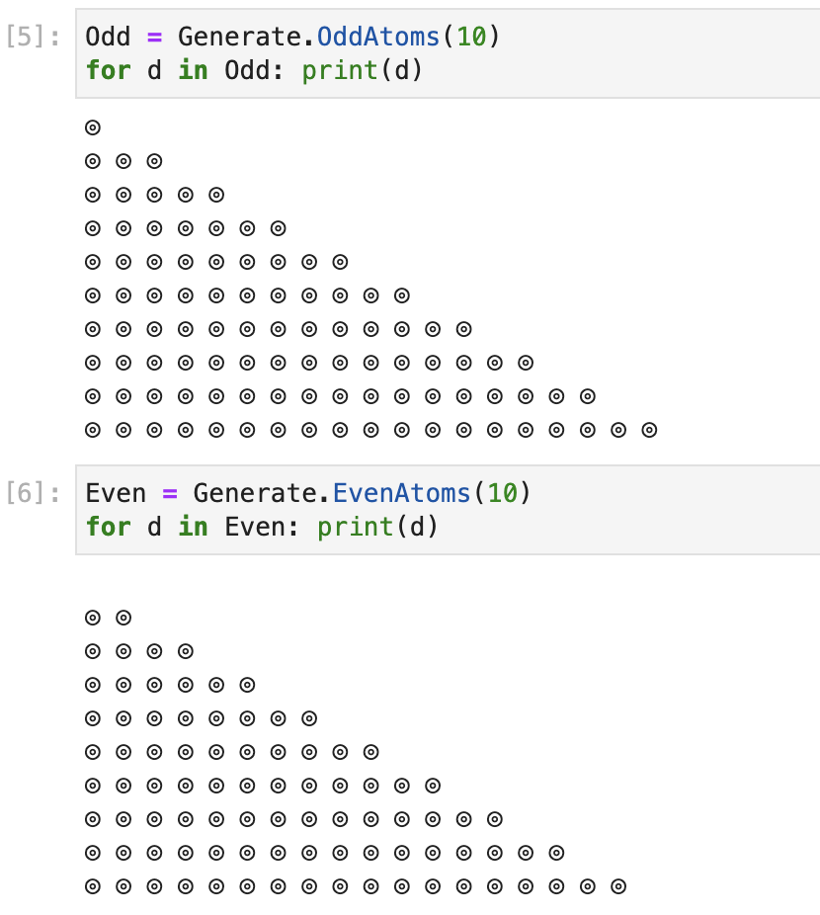
First steps in “Mathematical Machine Learning”
How can we distinguish some kind of mathematical objects…
…from some other kind of mathematical objects?

Slide 29
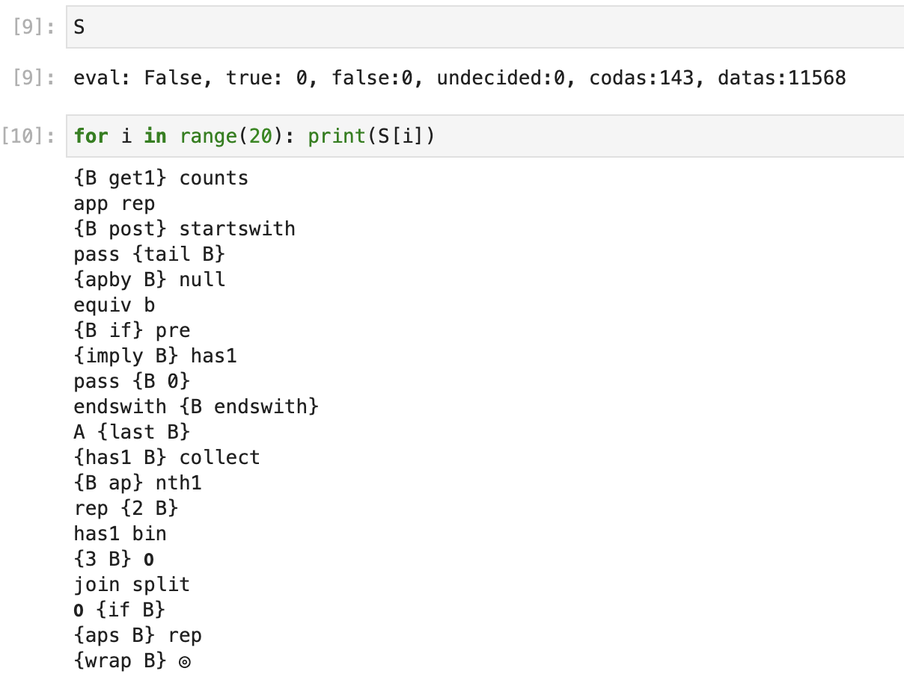
Search for a “classifying space” A…
…such that A:X distinguishes even sequences of (:) from odd sequences of (:).

Slide 30
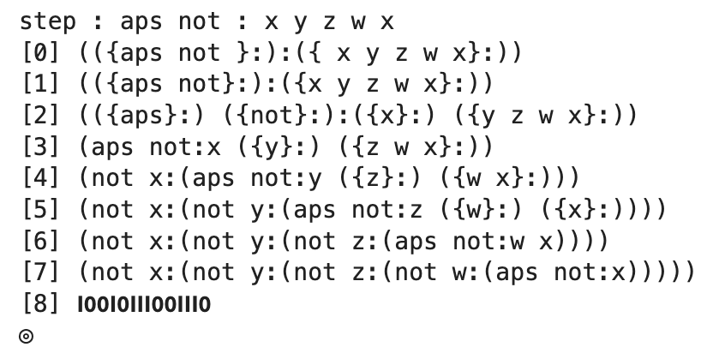
Three of these data successfully distinguish the two samples. One of these is…
aps not
Combinatorial operator that turns binary operations like (+ A : B) to a sequential sum like a+b+c+d…
Logical negation operation. not:X is atomic if X is empty and not:X is empty if X is atomic.

Slide 31
Conclusions which hopefully generalize…
The solution is clever. aps not combines a combinatorial operator with a logical operator in a way that I did not think of beforehand.
The solution generalizes. The solution distinguishes the atomic parity of any data, not just sequences of (:).
A slightly modification: bool * aps not is a space, so we are “getting a mathematical structure for free.”
The morphisms of the category bool * aps not are interesting. They are functions which preserve the atomic parity of data.

Slide 32
But does this contradict Godel?
We are claiming that empty data is “true” and atomic data is “false.”
Since atoms cannot be changed by a definition, no data can be both true and false.
If coda and mathematics are supposed to be the same thing, this appears to prove that mathematics is consistent.
But this contradicts Godel, who showed that an axiomatic system at least as strong as Peano arithmetic cannot prove it’s own consistency.
?

Slide 33
To see the answer, express “coda is consistent” in coda…
let CONSISTENT :
ap { XOR (coda:B) : (not:coda:B) } : allByteSequences:
Then the answer is…
CONSISTENT?

Slide 34
To see the answer, express “coda is consistent” in coda…
let CONSISTENT :
ap { XOR (coda:B) : (not:coda:B) } : allByteSequences:
Then the answer is…
CONSISTENT?
() () () () () () … (…undecided…)
If you accept Coda as “mathematics”, then mathematics is consistent in this sense.

Slide 35
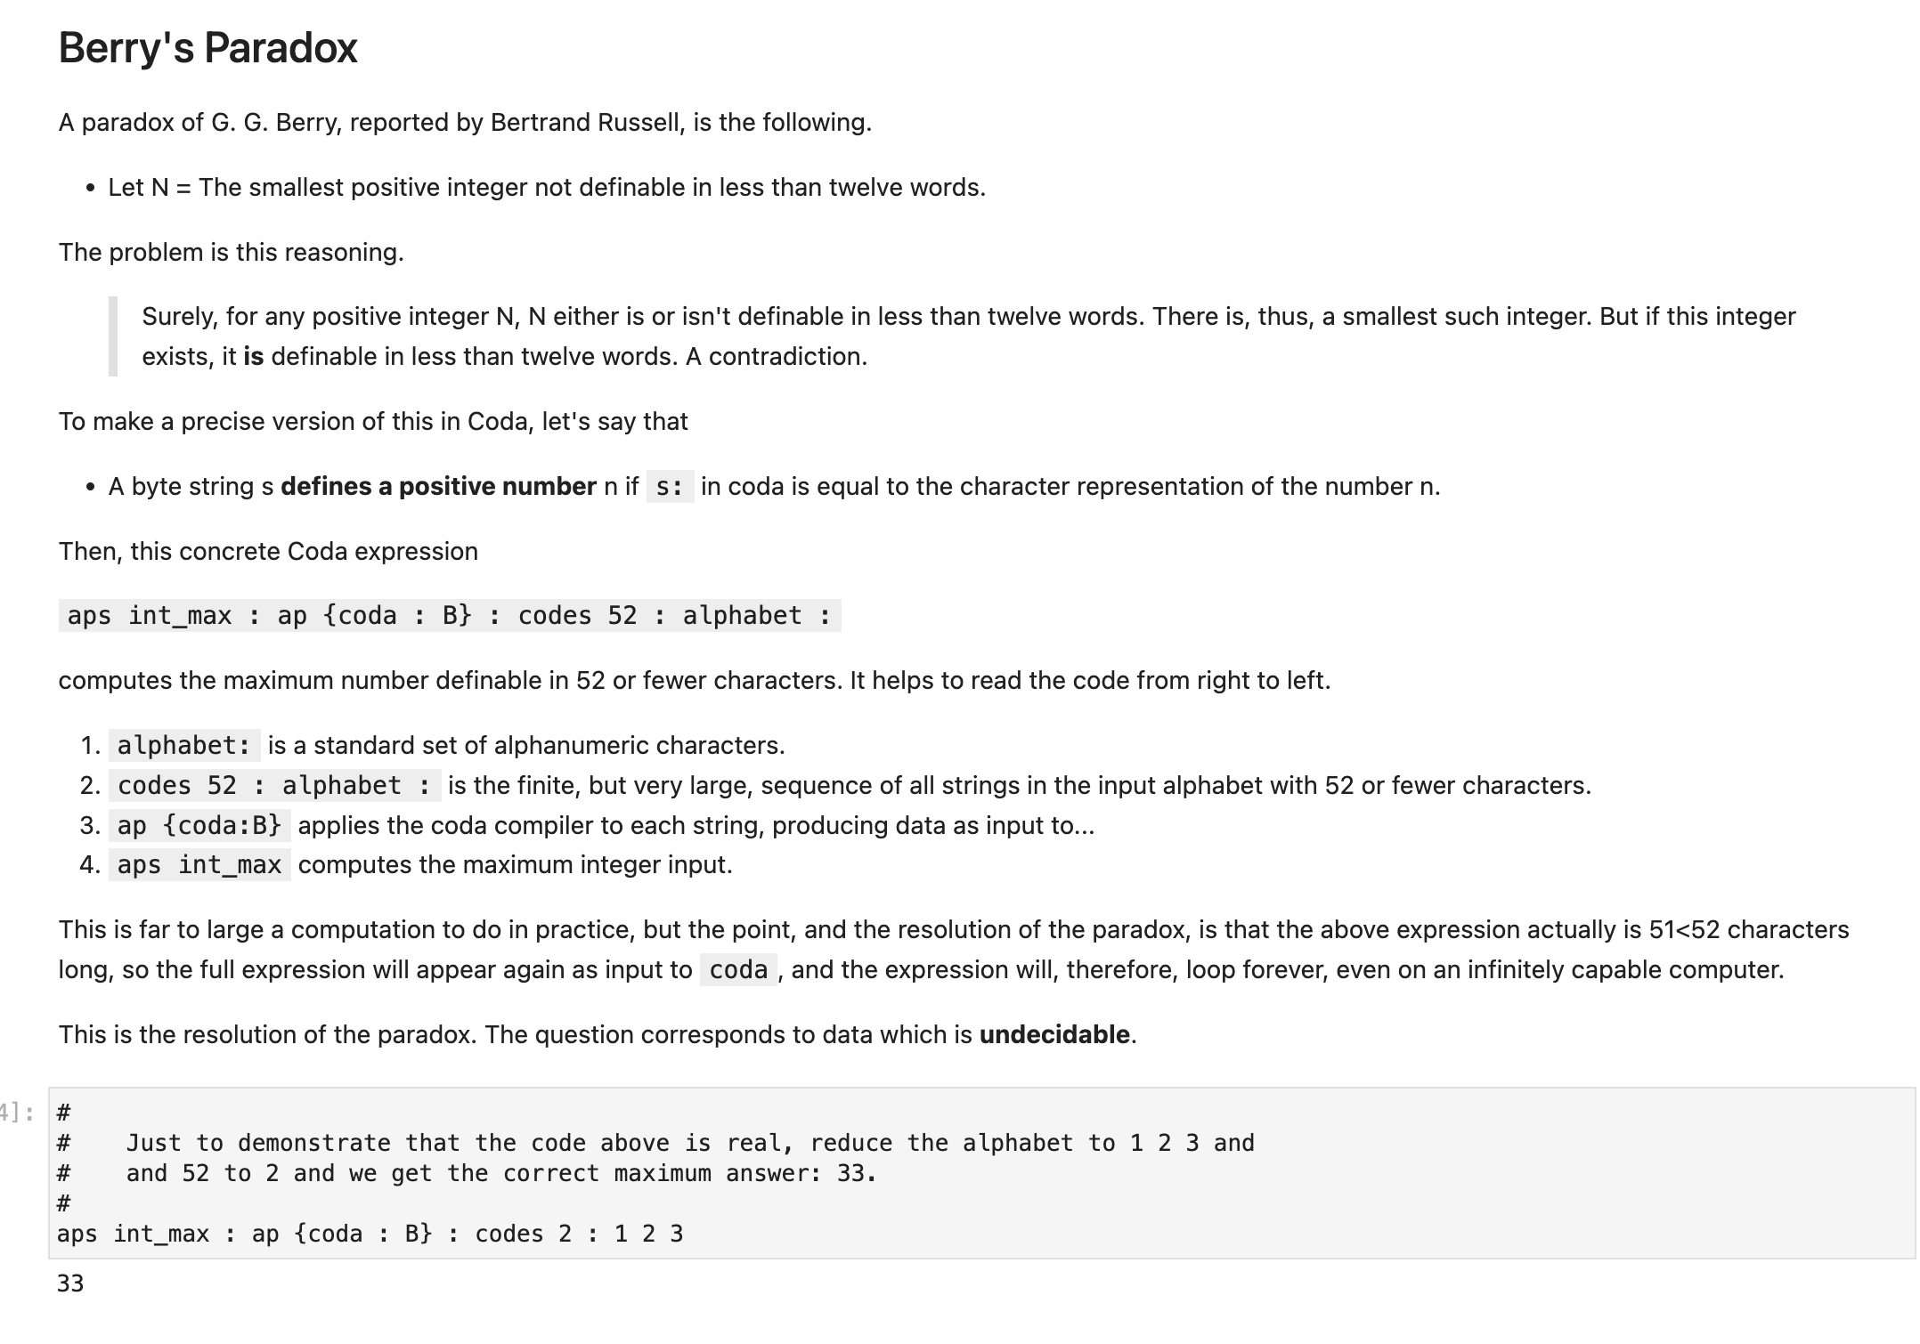

Slide 36
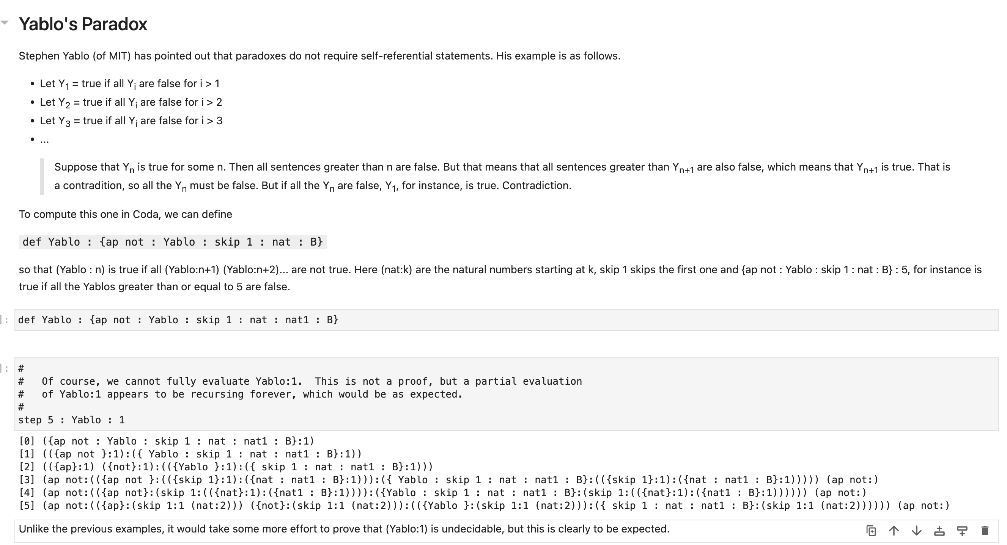

Slide 37
Summary
Axiomatic formal system aimed at mathematics in general.
Pure data with natural algebra A B, A:B
Definitions added to a “context”
Only one axiom: The Axiom of Definition
Mathematical objects are different types of pure data
Context determines equality which determines mathematical meaning
Internal Logic
True/false/undecided ⬄ empty/atomic/neither data
Internal language
Language is a definition like any other
Language expressions freely mix during “evaluation”
Proof and computation
All proofs are computations. All computations are proofs.
Abstract spaces
Analogues of types in type theory and categories in category theory naturally appear as “spaces”.
There appears to be an interesting abstract theory of spaces.
First tries at “Mathematical machine learning” yields interesting results.
Global issues
Mathematics is “consistent” in a specific described sense.
Direct computation of “paradoxes” gains confidence in logic.

Slide 41
Typical Mathematical Questions
skip n? : prime : nat : 0
sum n : X? Y? = sum n : Y? X?
Coda is consistent
def Space : { B : X? Y? = B : (B:X?) (B:Y?) }
def Group : { (Space:B) (Antispace A : B) }

Slide 42
Recall Godel’s 2d incompleteness argument.
Assume:
…a Godel sentence G exists that says of itself that G is not provable in PA.
…that PA is consistent, meaning that PA proved sentences are platonically true.
Reasoning outside of PA in human Platonic logic…
Suppose that G is false.
Then G is provable in PA.
But then G is false, since it says that it’s not provable. =><=
Therefore, G is true.
Thus, G is platonically true, but G is not provable within PA.

Slide 43
Recall Godel’s 2d incompleteness argument…
We have a Godel sentence G? that says of itself that G? is not provable in coda.
We assume that coda is consistent, meaning that a proved sentence in coda is actually true.
Reasoning outside of PA in human Platonic logic…
Suppose that G? is false.
Then G? is provable in coda.
But then G? is false, since it says that it’s not provable. =><=
Therefore, G? is true.
Thus, we G? is true and G? is not provable within coda.

Slide 44
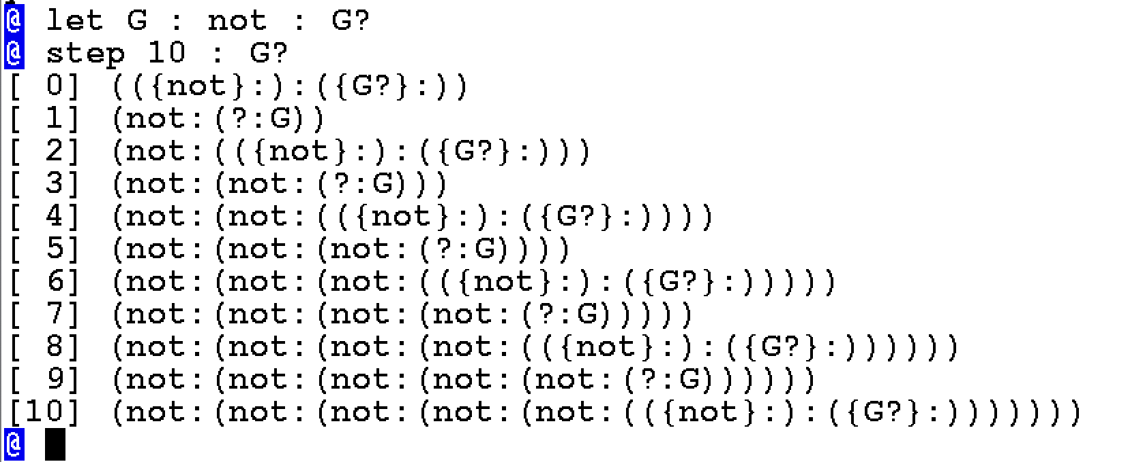
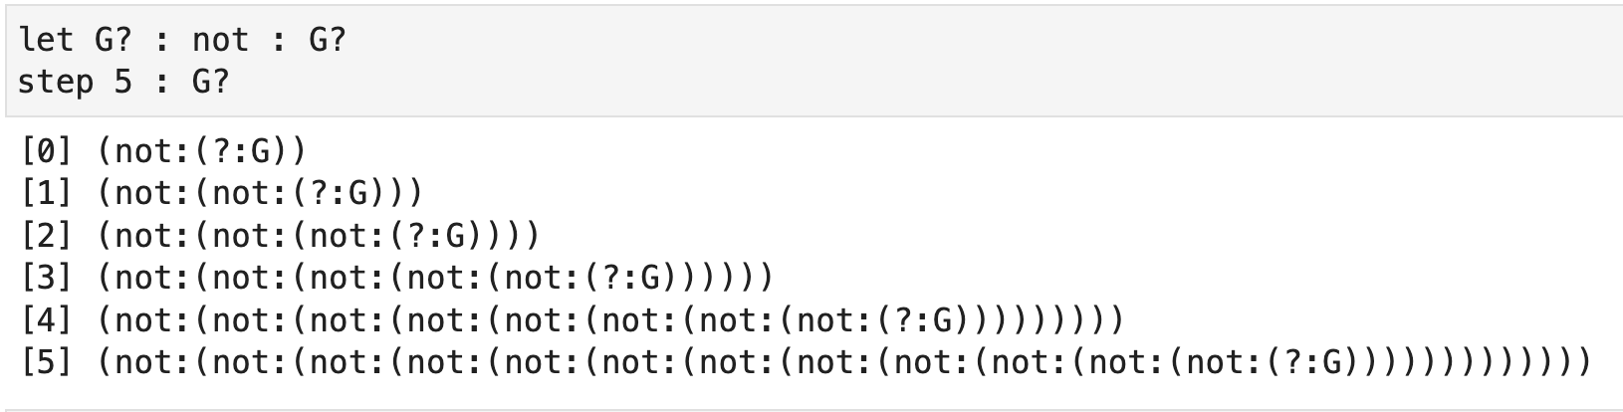
In coda, data G? is provable if and only if it is true in the sense of being equal to empty data. This means that
let G : not : G?
G? is true if it is not provable.
This is clearly undecidable data in the coda sense.

