Slide 1
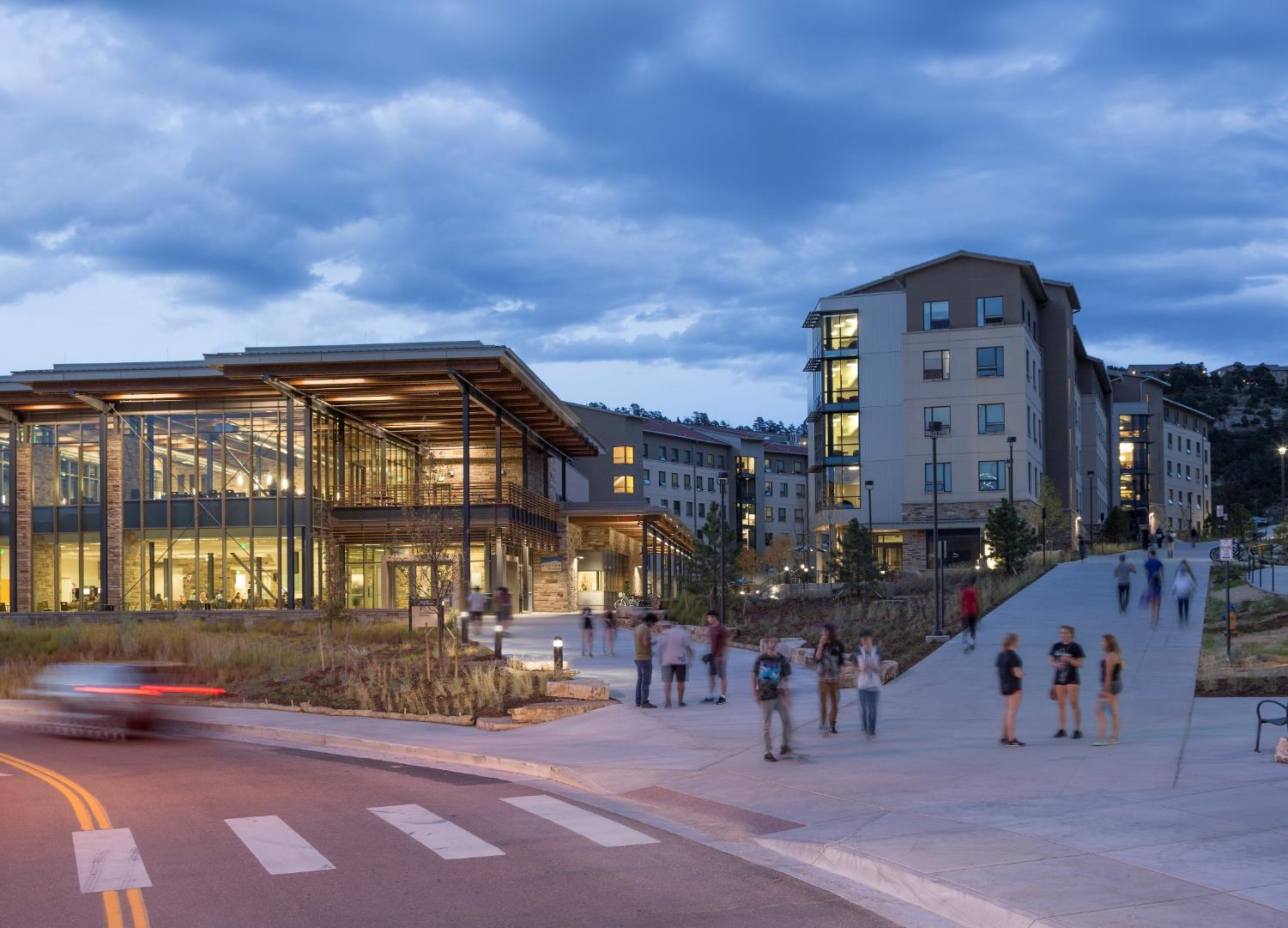

RocKIE Presentation

Slide 2
Contents
Background
Preprocessing
Processing
Two-Dimensional Analysis
Three-Dimensional Analysis
Results
Areas for Improvement

Slide 3
Background
Riprap Specification
Manual Measurement
Wipfrag

Slide 4

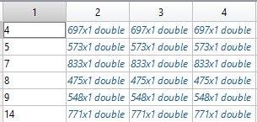
Preprocessing- Data Conversion
Excel Raw Point Cloud
MATLAB Cell Structure

Slide 5
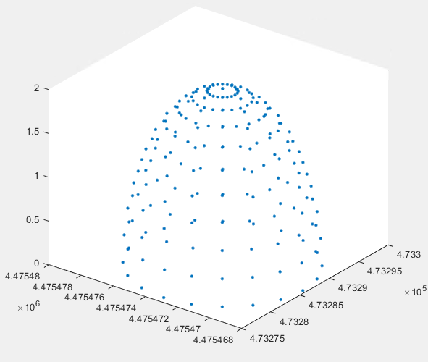
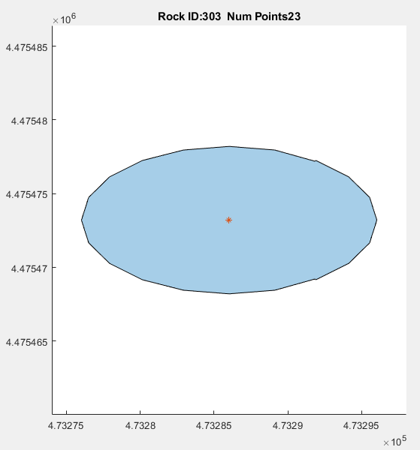
Processing- Two Dimensional Analysis
Load the data and delineate the Plan-view boundary.
Create the Polyshape and calculate the centroid

Slide 6
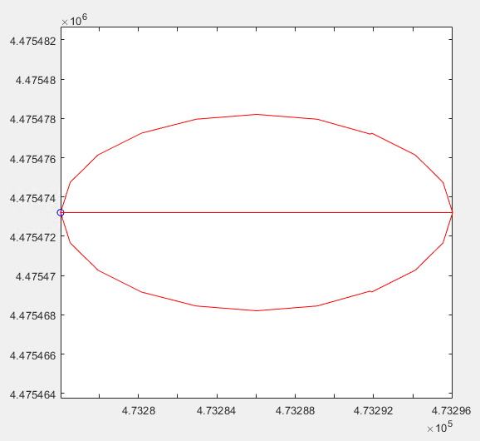
Processing- Two Dimensional Analysis
Calculate Primary Axis and Rotate the Boundary

Slide 7
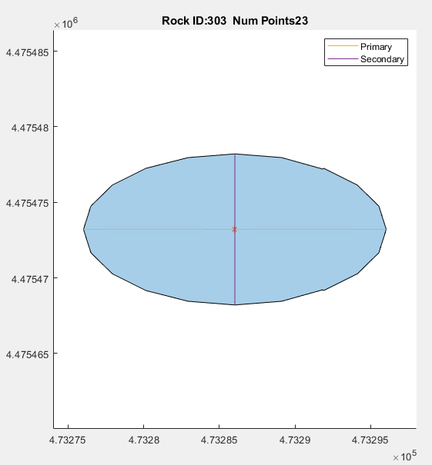
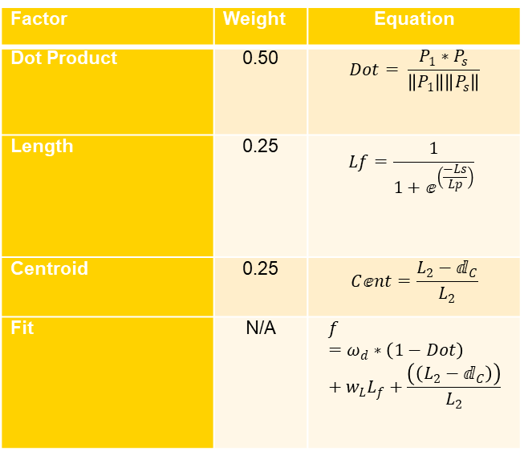
Processing- Two Dimensional Analysis
Factor | Weight | Equation
Dot Product | 0.50 | $$Dot= \frac{P_{1}∗P_{s}}{\left\|P_{1}\right\|\left\|P_{s}\right\|}$$
Length | 0.25 | $$Lf=\frac{1}{1+ⅇ^{\left(\frac{−Ls}{Lp}\right)}}$$
Centroid | 0.25 | $$Cⅇnt=\frac{L_{2}−ⅆ_{C}}{L_{2}}$$
Fit | N/A | $$f=ω_{d}∗\left(1−Dot\right)+w_{L}L_{f}+\frac{\left(\left(L_{2}−ⅆ_{C}\right)\right)}{L_{2}}$$
The secondary axis is found by the best fit line
The algorithm searches for the two points that are the longest, most perpendicular to the primary axis and closest to the centroid.

Slide 8
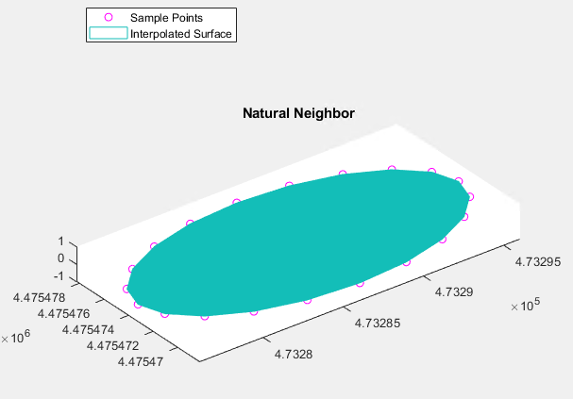
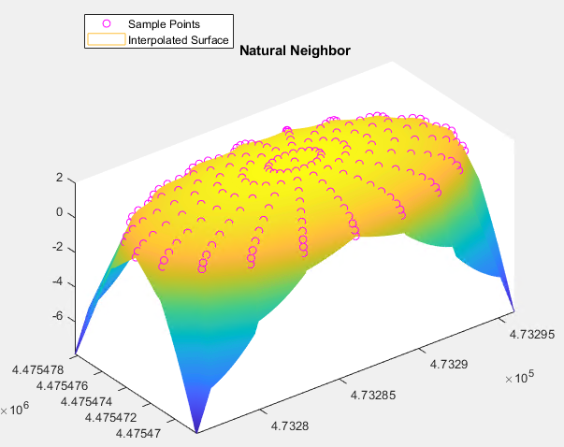
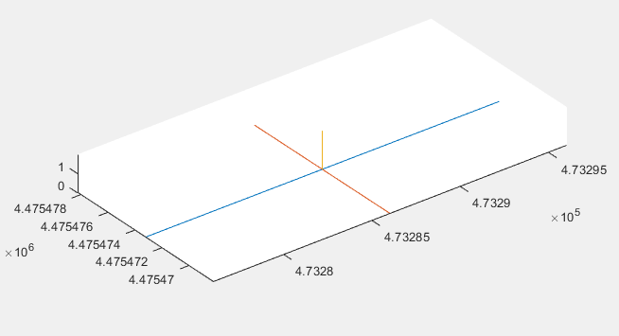
Processing- Three Dimensional Analysis
Bottom Surface
Top Surface
Principle Axis
Top and Bottom surfaces are intercepted and gridded. Vertical Axis surveyed from Surfaces

Slide 9
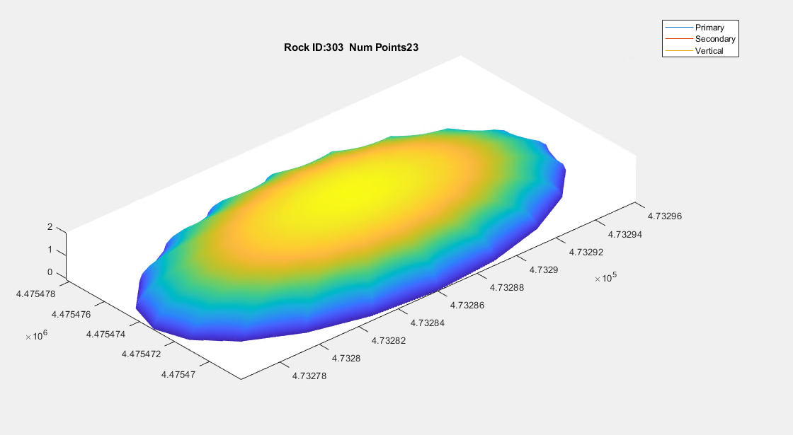
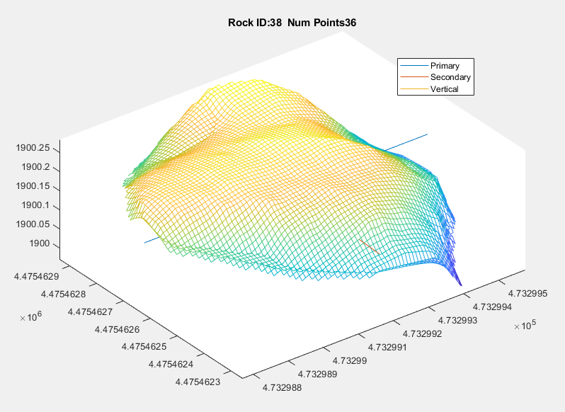
Results
Half Ellipsoid
Rock 38

Slide 10
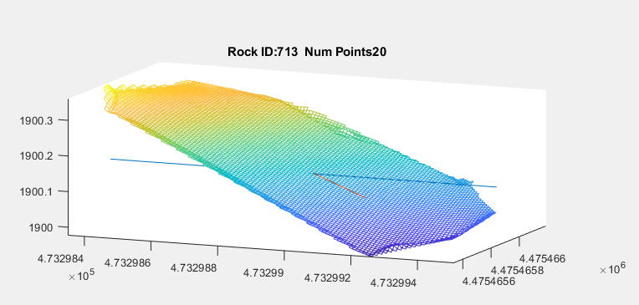
Areas for Improvement
Even when a stone has a point cloud density higher than 200 points, rocks may appear flat
Gives insight to the general Length: Width ratio

Slide 11
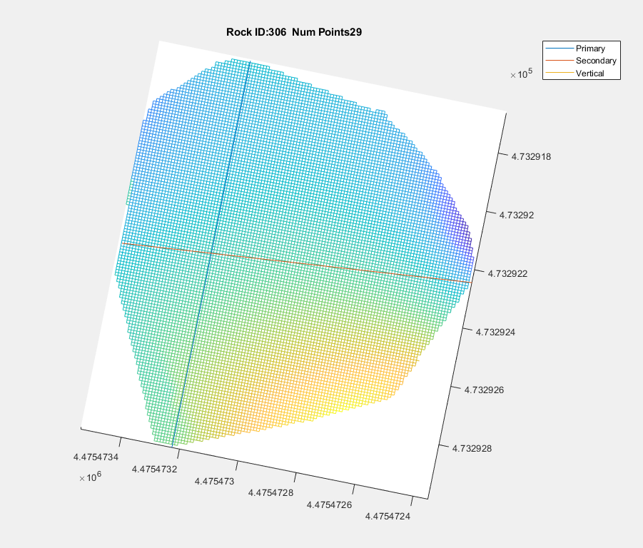
Areas for Improvement
Bottom view of Rock 306
Algorithm works as expected

Slide 12
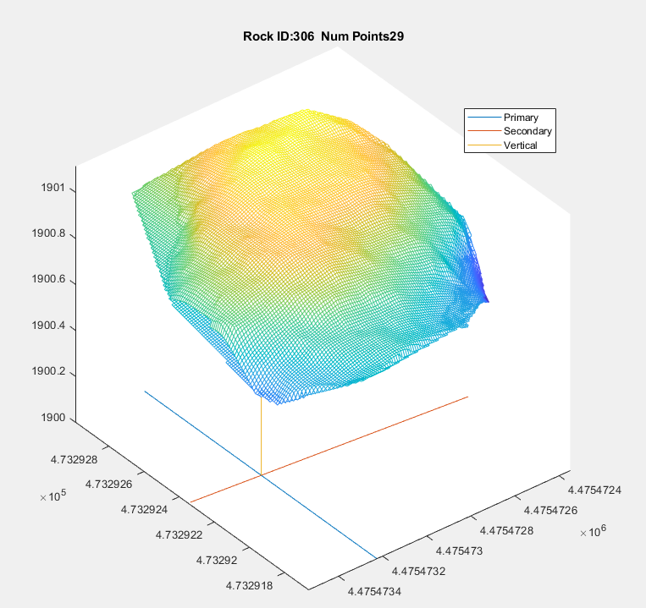
Areas for Improvement
Top view of Rock 306
Primary Axis crosses null void data

Slide 13
Conclusion
The RocKIE algorithm is a powerful analysis tool for Riprap gradation that can significantly improve the workflow of specification validation
Efforts need to be made to increase point cloud densities
Major improvement that is required to be made to this process is the segmentation

Slide 14
Thank You

