Slide 1
Seasonal Forecasting of Summertime Precipitation in the Midwest US
Dr. Saul Ramirez

Slide 2
OUTLINE
Introduction
Data Overview
EDA
Modeling Strategy
Baseline Model
Neural Network
Caveats
Future Directions

Slide 3
Introduction: Overview of the Challenge
Goal:
Forecast summertime (June, July, and August) precipitation in the Midwest using machine learning and AI techniques
Importance:
Accurate precipitation forecasting is crucial for the Midwest, especially during the summer months, as this period is vital for agricultural productivity
Notes:
Goal: The primary objective of this project is to forecast summertime (June, July, and August) precipitation in the Midwest using machine learning and AI techniques. The challenge involves leveraging provided spatio-temporal data, including atmospheric and oceanic variables, to improve the accuracy of precipitation forecasts.
Importance: Accurate precipitation forecasting is crucial for the Midwest, especially during the summer months, as this period is vital for agricultural productivity. The region's agriculture heavily depends on reliable water availability, and precipitation variability can significantly impact crop yields, irrigation planning, and water resource management.
Motivation for ML/AI Approach: Traditional forecasting methods, while useful, may struggle to capture complex, non-linear relationships between atmospheric patterns and precipitation. By applying ML/AI models, there is an opportunity to enhance prediction accuracy by learning from historical data and uncovering hidden patterns within the provided predictor fields.

Slide 4
Data: Data Sources and Variables
Variables | Description | Relation to Precipitation
Total Precipitation (tp) | Amount of liquid water over time. | Target variable for seasonal analysis.
Tropospheric Thickness (thickness) | Pressure difference between atmospheric levels. | Indicates moisture and weather system presence.
Precipitable Water (pr_wtr) | Total moisture in the atmosphere. | More moisture available for precipitation.
Atmospheric Lifted Index (lftx4) | Measure of atmospheric stability. | Negative values suggest potential for thunderstorms.
Upper Troposphere Velocity Potential (chi) | Divergence of upper-level winds. | Indicates storm development areas.
Total Cloud Cover (tcdc) | Fraction of sky covered by clouds. | More clouds increase likelihood of precipitation.
2m Specific Humidity (shum) | Water vapor mass at 2 meters high. | Higher humidity indicates potential for rain.
Ocean Niño Index (oni) | Sea surface temperature anomalies. | Influences precipitation trends via climatic patterns.
Preprocessing
Total Precipitation was up-sampled
0.25 -> 2.5 degrees
Sea surface temperature (SST) and Ocean Potential Temperature (pottemp) were replace with Ocean Nino Index (ONI)
Notes:
ONI: https://origin.cpc.ncep.noaa.gov/products/analysis_monitoring/ensostuff/ONI_v5.php

Slide 5
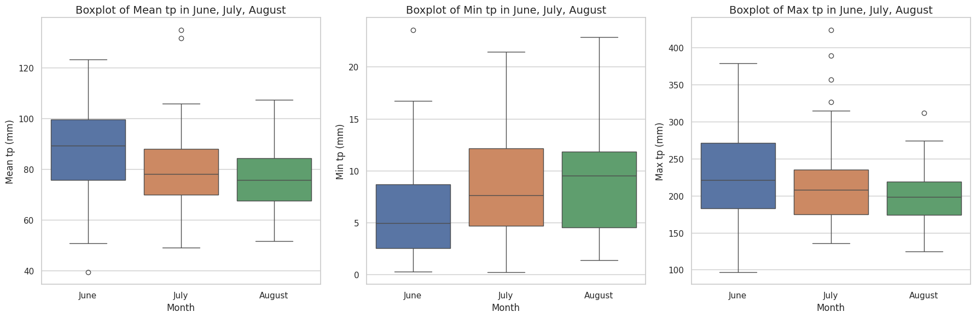
EDA: Spatial and Temporal Patterns
Notes:
The first analysis I’d like to share is the mean, min, and max distributions for each cell in our region
We see that the mean precipitation is fairly consistent during the summer months, with a little more variance in June
However, when the area is dry, it can be very dry, with almost no precipitation at all
However on the on the Max side, the area get’s hit with extreme events that are up to 5x the mean

Slide 6
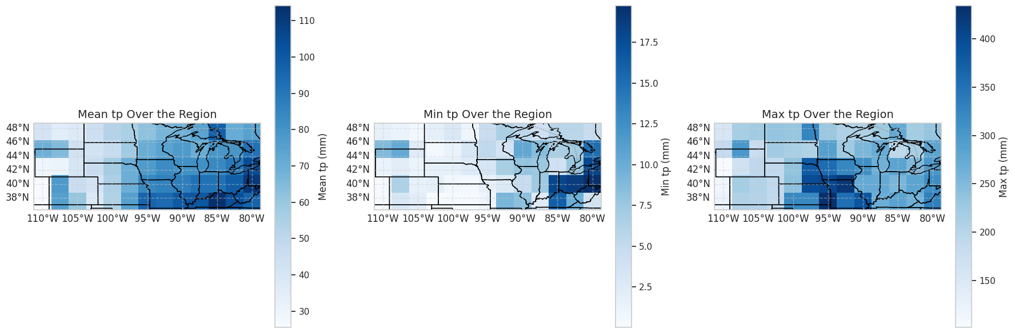
EDA: Spatial and Temporal Patterns
Notes:
The next thing I wanted to investigate was where were these patterns prevalent
I performed a similar analysis, but focused on the spatial aspect of the data
Generally states like Kentucky, and Pennsylvania are wetter than other places in the region
The great plains states are more likely to experience severe drought
And the last thing I’d like to point out is that the area along the Mississippi near Missouri, Nebraska and Iowa have experienced some fairly extreme events recently.

Slide 7
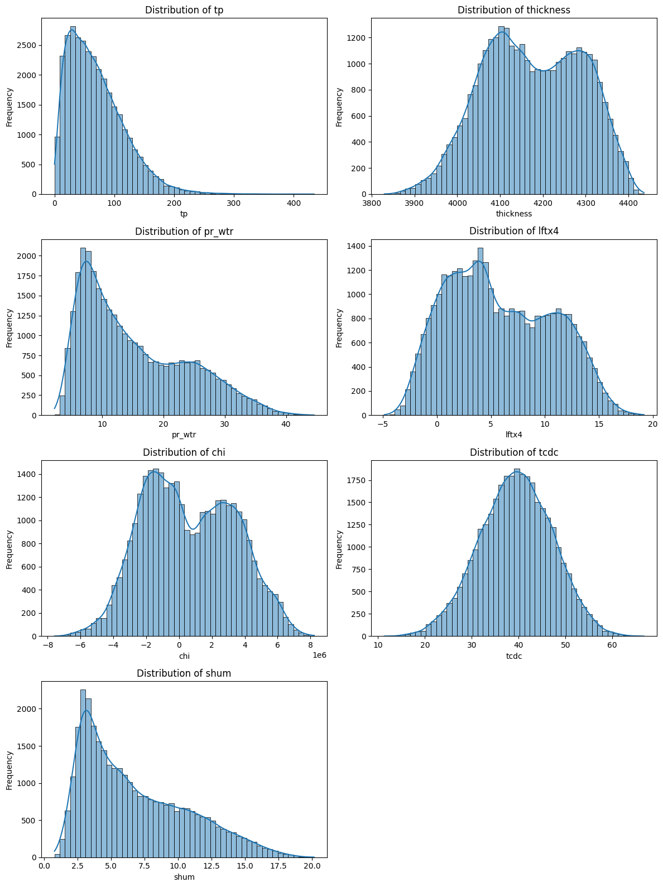
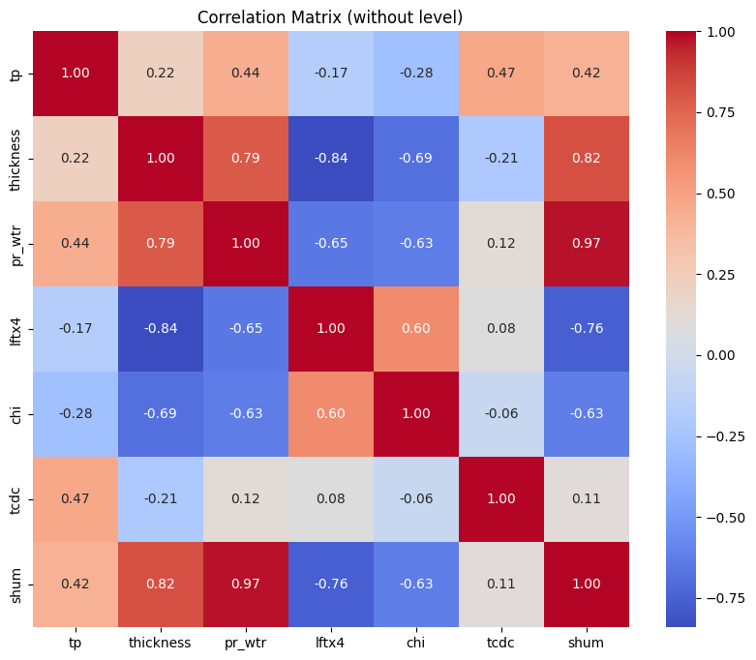
EDA: Exploratory Data Analysis

Slide 8
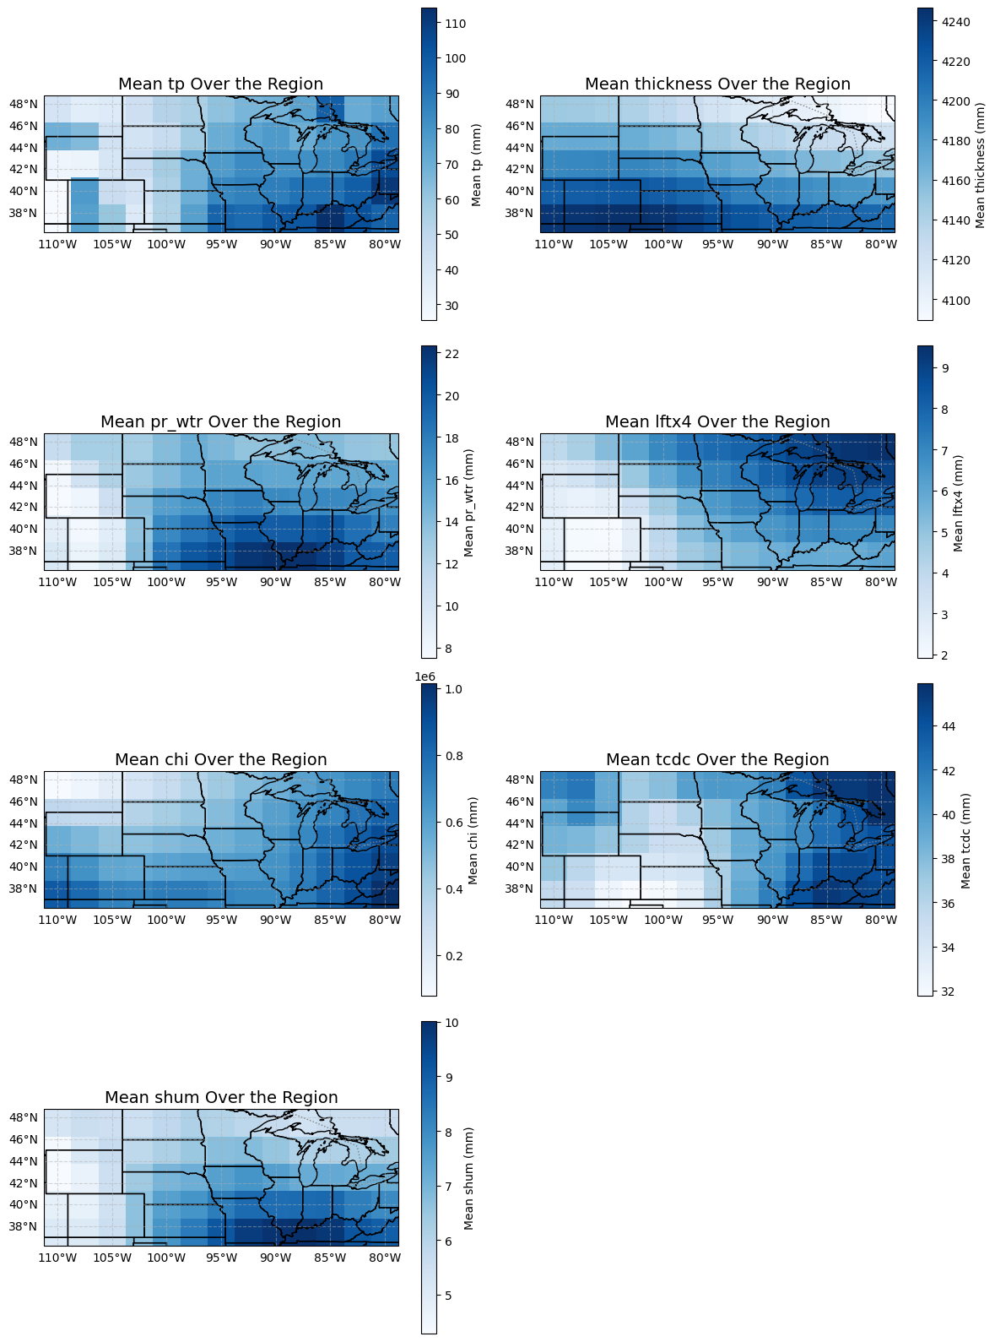
EDA: Spatial and Temporal Patterns
Notes:
I performed a mean spatial analysis on precipitation and it’s relationship to the other variables.
We see a clear correlation between precipitation and precipitable water (pr_wtr) as well as specific humidity (shum) as well as total cloud cover (tcdc) but that one didn’t fit in this slide
An issue I foresee is accounting for teleconnections and properly modeling the environmental phenomena that links separated locations
* tp: Total precipitation
* sst: Sea surface temperature
* thickness: Tropospheric thickness between 850 and 500 hPa
* pottemp: 45m ocean potential temperature
* pr_wtr: Precipitable water
* lftx4: Atmospheric lifted index
* chi: upper troposphere velocity potential
* tcdc: total cloud cover
* shum: 2m specific humidity

Slide 9
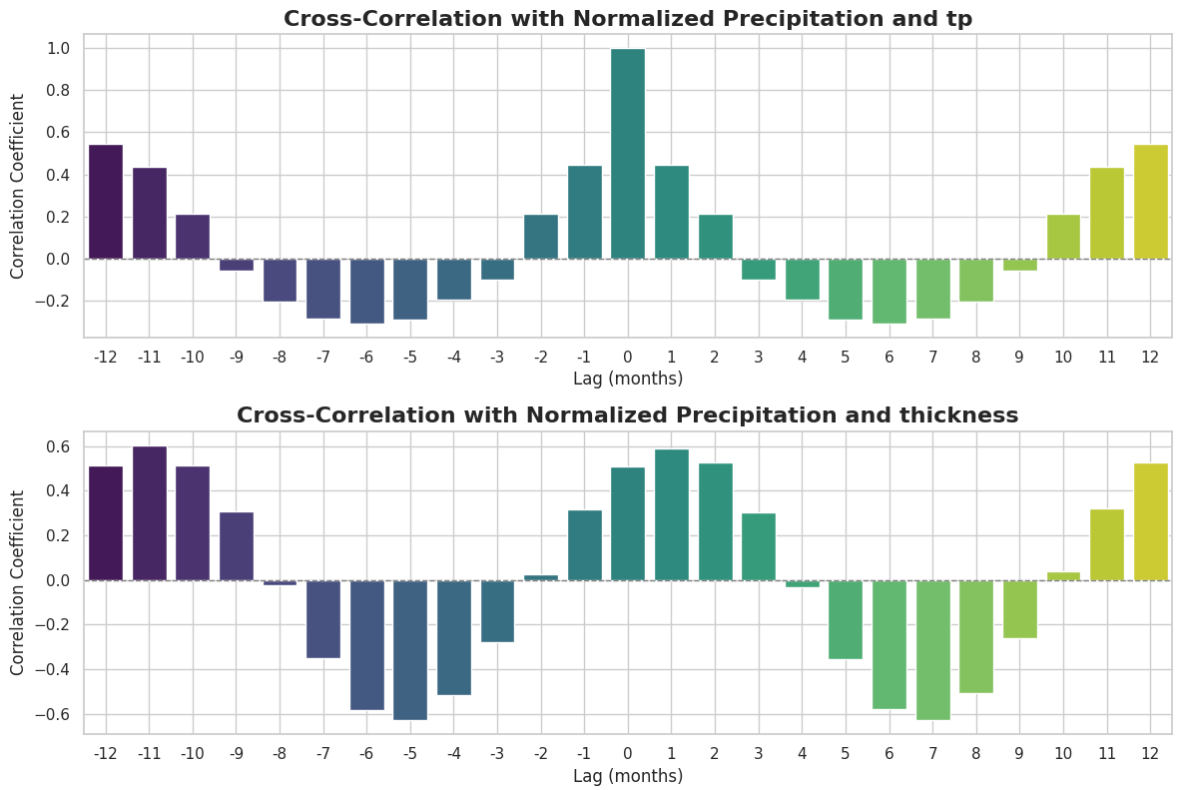
EDA: Cross Correlation
Notes:
I also wanted to begin thinking of features that I could engineer to help with my model.
I used a simple Cross correlation to compare the different average signals
In this case we see that precipitation is highly correlated at a yearly basis
And we also see that Tropospheric thickness is highly correlated at 11 months before
Temperature and Moisture Availability: Warmer temperatures can increase the tropospheric thickness and promote moisture evaporation, leading to greater potential for precipitation, especially during convective weather events like thunderstorms.
Atmospheric Instability: In regions where the tropospheric thickness is high, there may be greater atmospheric instability, which can enhance the likelihood of convective precipitation. The lifted index (LI), for example, is an indicator of atmospheric instability, and regions with higher thickness may show lower LI values, indicating more instability.

Slide 10
Modeling: Forecasting Strategy
Forecasting Method: Gridded Field vs. Regional Average
Gridded Field Forecasting:
This approach allows for capturing spatial variability
Provides more detailed information
Lead Times Consideration
3-month Lead Time:
Most of the crops in the Midwest grow within 3 months
Gives plenty of time to adjust growth season
Monthly Forecasting Strategy
Separate Monthly Forecasting:
Captures the unique patterns associated with each month
Notes:
Forecasting Method: Gridded Field vs. Regional Average
Gridded Field Forecasting: I chose to forecast precipitation as a gridded field across the Midwest rather than averaging it over the region. This approach allows for capturing spatial variability in precipitation patterns, which can be crucial for understanding localized weather events. A gridded field also provides more detailed information, as clients are only interested within small sections of the region.
Monthly Forecasting Strategy
Separate Monthly Forecasting: I chose to forecast each summer month (June, July, and August) separately. By treating each month individually, the model can better account for month-specific dynamics and trends.
Lead Times Consideration
Multiple Lead Times: I decided to model precipitation with a 3-month lead time. The reason for this number is that most crops grow within 3-months. And this can provide enough time to adjust and execute plans.
Sweet corn: 60-100 days Green beans: 50-60 days Cucumbers: 50-70 days Summer squash: 40-60 days Radishes: 20-30 days Lettuce: 30-60 days Spinach: 40-45 days Beets: 50-70 days Carrots: 60-80 days Peas: 60-70 days

Slide 11
Modeling: Baseline Model
Chronological Data Split:
Implemented a 90-10 train-test split based on time.
Training Data Analysis:
Filtered training dataset to include only summer months before the cutoff date.
Calculated mean monthly precipitation from the training set.
Analyzed residuals through:
Mean Squared Error (MSE):
Root Mean Squared Error (RMSE):
Mean Error (ME):
Visualized distribution of residuals using histograms.
Test MSE: 1560.12
Notes:
I made a baseline model that was just the arithmetic mean of the summer months within a set time period
My data was split chronologically to avoid temporal leakage at a percentage of 90-10. This last 10 percent is what the other model will be evaluated on as well
Test Mean Squared Error: 1560.1229
Test Root Mean Squared Error: 39.49839
Test Mean Error: -7.5630803

Slide 12
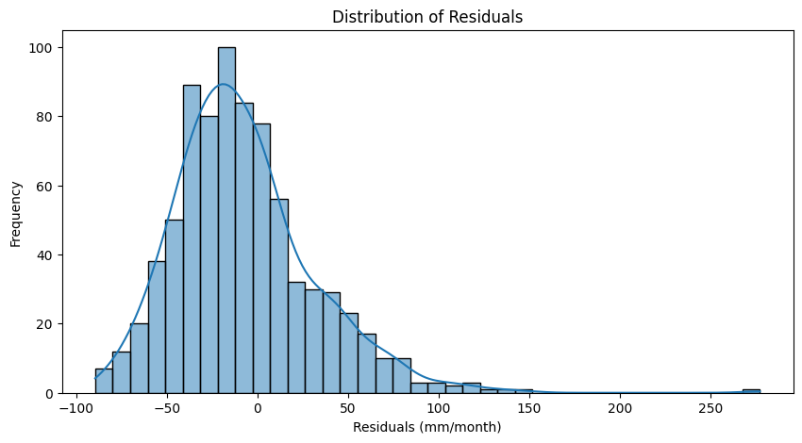
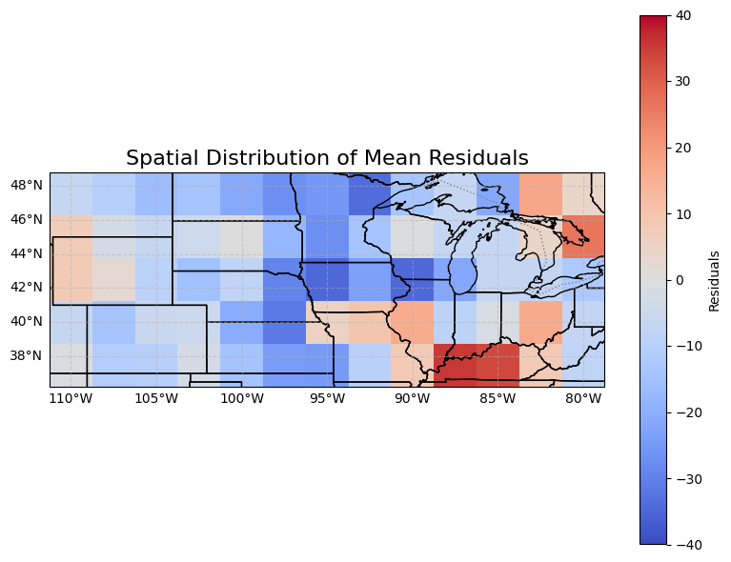
Evaluation: Baseline Results
Notes:
Res = (y-y_hat) negative is bias high, positive is bias low
We have quite a few extreme events skewing our distributions, such as Missouri, and Kentucky
Test Mean Squared Error: 1560.1229
Test Root Mean Squared Error: 39.49839
Test Mean Error: -7.5630803

Slide 13
Modeling: Neural Network
Data Loading and Preparation
Loaded climate and ocean data (precipitation, atmospheric thickness, lifted index, etc.).
Engineered features using time-shifted variables based on cross correlation analysis
Merged datasets and transformed spatial-temporal data (latitude, longitude, time) with sine/cosine encodings.
Data Splitting and Scaling
Chronologically split data into training (80%), validation (10%), and test (10%) sets.
Filtered test/validation sets to summer months only (June-August).
Standardized features and target variables for uniform scaling.
Neural Network Training
Built a custom PyTorch model with fully connected layers, batch normalization, and dropout.
Employed early stopping, learning rate scheduling (cosine annealing), and smooth L1 loss.
Trained using AdamW optimizer, tracking training and validation losses across epochs.
Evaluation and Visualization
Evaluated model performance using MSE and residual plots.
Inverse-scaled predictions and analyzed residuals spatially and temporally.
Visualized mean residuals on a 2D grid and plotted time series trends.
Notes:
I also built a neural network, but it was a little more complicated
Data Loading and Preparation: Loaded climate and ocean data, including variables like precipitation, atmospheric thickness, and lifted index, which are known to influence precipitation patterns. Time-shifted features were engineered to incorporate temporal dependencies, allowing the model to learn from past conditions. Spatial-temporal data was transformed using sine/cosine encoding for latitude, longitude, and time to capture cyclic patterns.
Data Splitting and Scaling: The dataset was split chronologically, with 80% for training, 10% for validation, and 10% for testing, ensuring data from different time periods was used for each phase. The test and validation sets were filtered to focus exclusively on the summer months (June-August), aligning with the project's objective of forecasting summertime precipitation. Standardization was applied to the features and target variables to facilitate consistent model training and improve convergence.
Neural Network Training: A custom PyTorch model was developed, featuring fully connected layers, batch normalization, and dropout to prevent overfitting. Techniques such as early stopping, learning rate scheduling with cosine annealing, and smooth L1 loss were employed to optimize training. The AdamW optimizer was used to track training and validation losses over epochs, helping ensure robust model performance.
Evaluation and Visualization: Model performance was assessed using mean squared error (MSE) to measure prediction accuracy. Residuals were analyzed spatially and temporally to identify areas where the model struggled. Predictions were inverse-scaled to the original units, and residual plots were created to visualize errors on a 2D grid. Additionally, time series trends were plotted to gain insights into model behavior across different periods.

Slide 14
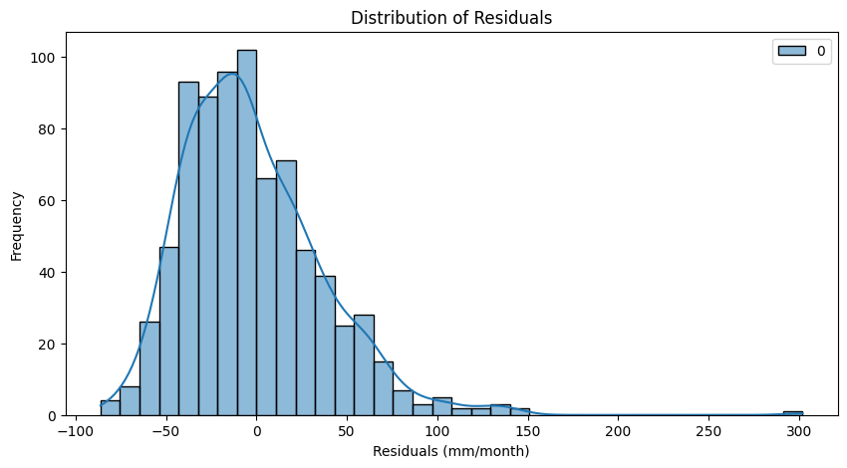
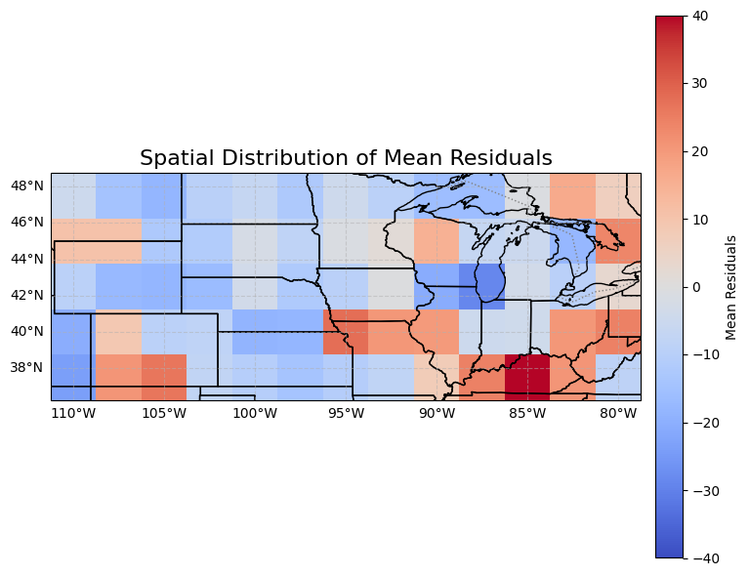
Evaluation: Neural Network Results
Notes:
Test Mean Squared Error: 1525.4384
Test Root Mean Squared Error: 39.05686
Test Mean Error: -2.2175937

Slide 15
Evaluation: Base vs ML
Notes:
Test Mean Squared Error: 1525.4384
Test Root Mean Squared Error: 39.05686
Test Mean Error: -2.2175937

Slide 16
Evaluation: Base vs ML
Notes:
Test Mean Squared Error: 1525.4384
Test Root Mean Squared Error: 39.05686
Test Mean Error: -2.2175937

Slide 17
Caveats
1. Measurements are Independent - Assumes each measurement is unrelated, potentially overlooking spatial and temporal correlations.
2. Lack of Teleconnections - Ignores the influence of remote climate patterns (e.g., GPLLJ, NAO, AO, ect) on local weather.
3. Lack of Physical Process Consideration - Does not account for underlying physical mechanisms driving climate change.
4. Extreme Events - Struggles to accurately predict rare, high-impact events (e.g., floods, droughts).
5. Underfitting Temporal Correlation - Fails to capture seasonal patterns, leading to suboptimal predictions.
*Implications: How can we better integrate physical processes into our machine learning approaches?*
Notes:
Data is spatially autocorrelated
teleconnections are natural patterns that link weather phenomena across large distances on Earth
Great Plains Low-Level Jet (GPLLJ):
While not a traditional teleconnection, the GPLLJ is an important feature in the Midwest's climate, particularly during the warm season. It can transport moisture from the Gulf of Mexico into the Midwest, influencing rainfall patterns.
North Atlantic Oscillation (NAO):
The NAO refers to the fluctuation in atmospheric pressure between the Icelandic low and the Azores high. Its phases can affect winter weather patterns in the Midwest, influencing temperatures and precipitation.
Arctic Oscillation (AO):
The AO describes pressure patterns in the Arctic region. Positive phases can lead to milder winters in the Midwest, while negative phases may bring colder air and increased chances of extreme winter weather.

Slide 18
Future Directions
Data
30-year Mean
Drought Index (PDSI)
Evapotranspiration
Elevation
Models
Individual cell modeling
CNN-LSTM
ViT/Multimodal Transformer
Notes:
Chirps infraed
Physical model output

Slide 19
Questions?

