Slide 1

Saúl A. Fernández Dávalos
Job Interview Presentation | Data Science Lead

Slide 2
Professional Profile & Core Competencies
01
Introduction
02
General assumptions
03
Data Analysis
04
Modeling
05
Production roadmap

Slide 3
01
Introduction

Slide 4
Introduction
PURPOSE
METHODOLOGY
ASSUMPTIONS
Risk estimation
• Define relevant risk KPI´s to use for risk underwriting.
• Create a base model for Auto policies underwriting.
• Creation of a deployment plan.
Analysis, Modeling & Deployment
• Interpretability and maintainability took precedence over maximum performance.
• For graphs, clearness of presentation was preferred to aesthetics.
• Preference was given to testing diverse models over parameter tuning
In general
• We will suppose that the propensity of a given policy to generate claims is independent from the average severity of its claims.
• Policies will be treated as independent observations and the only time dependance for each one is given by the “prior_” fields.*
• Missing values will be treated as true missing in the models which don´t allow for native null handling

Slide 5
02
Data Analysis

Slide 6
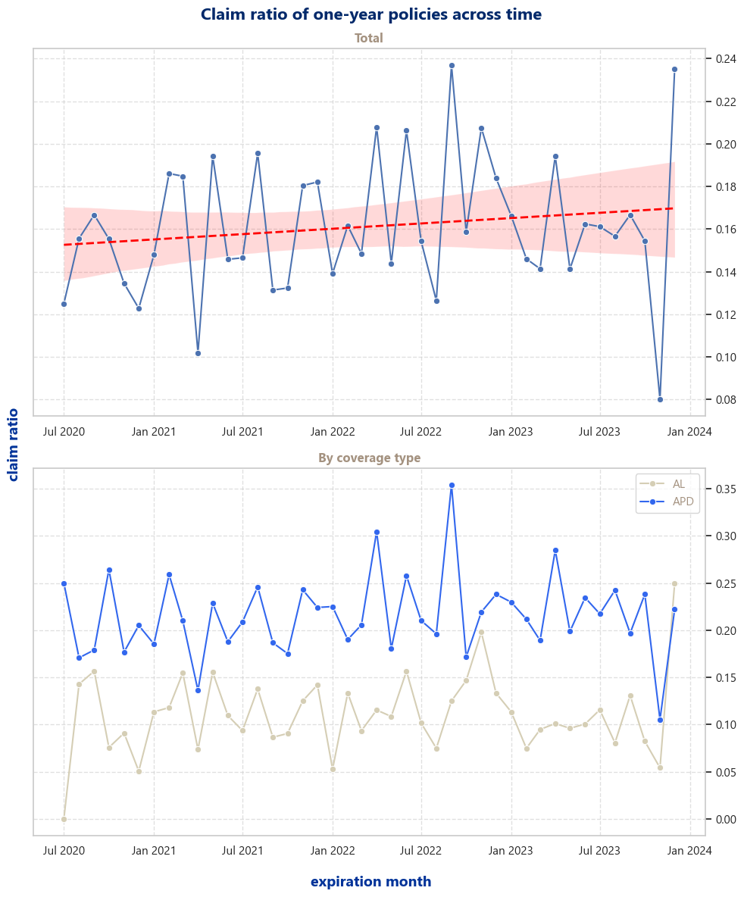
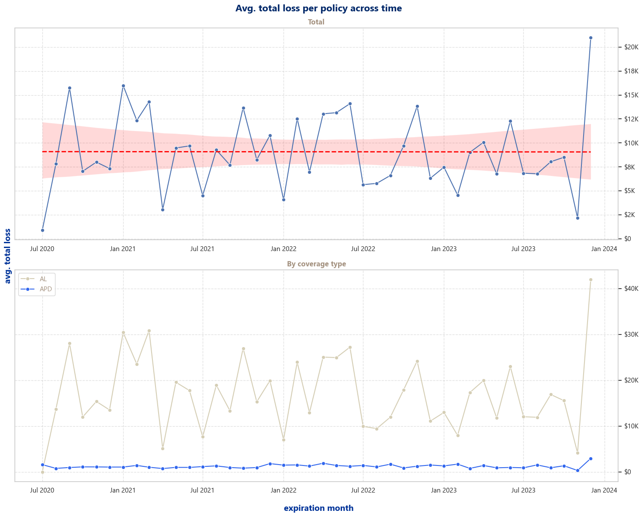
Data Analysis – General findings
Stability of claim raitios & avg. loss
• The distribution of claim ratios seems to have a slight upward trend.
• Variance increase at the extremes seems to be caused by a difference in the number of observations.
• The distribution of the avg loss seems stable.
• We can observe a consistent discrepancy between coverage types

Slide 7
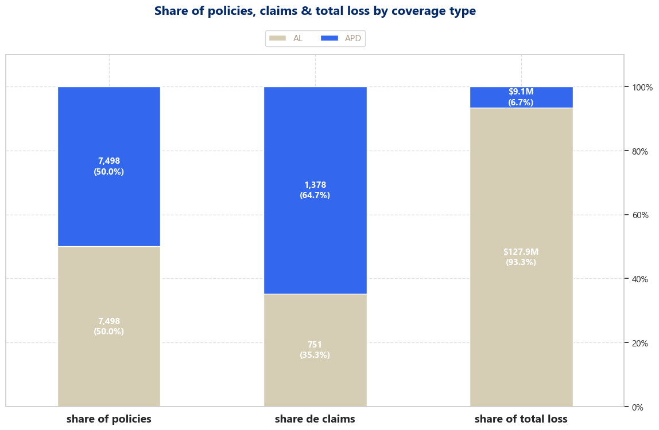
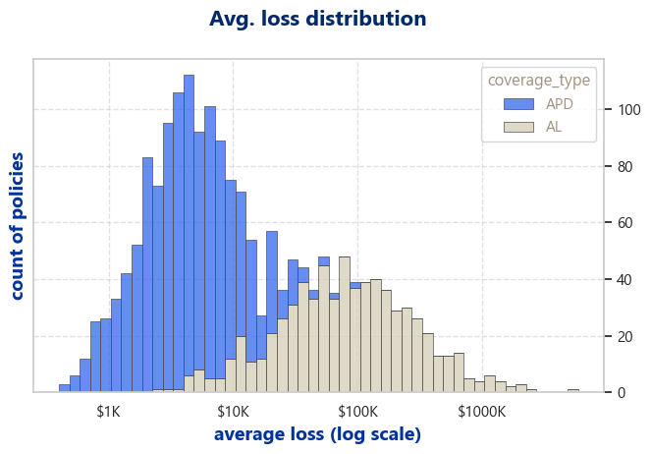
Data Analysis – General findings
Massive discrepancies in behaviors by coverage type
• Policies are evenly distributed yet; AL has only 35% of the claims but brings 93% of the losses.
• This can be seen in the differences in avg loss distribution.

Slide 8
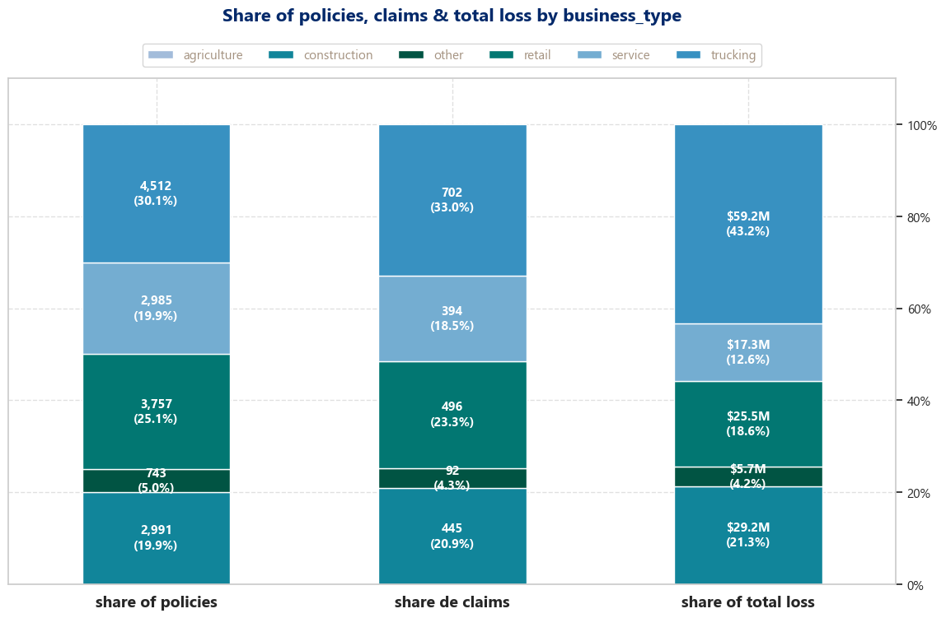
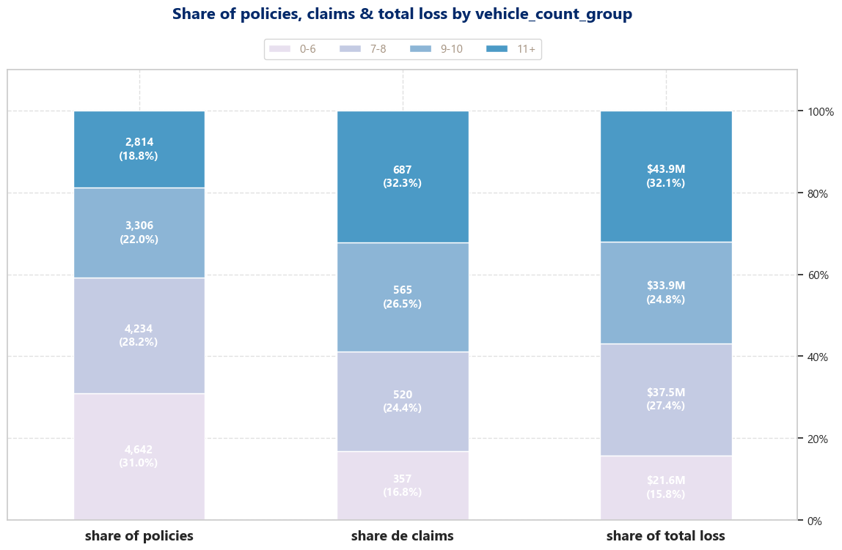
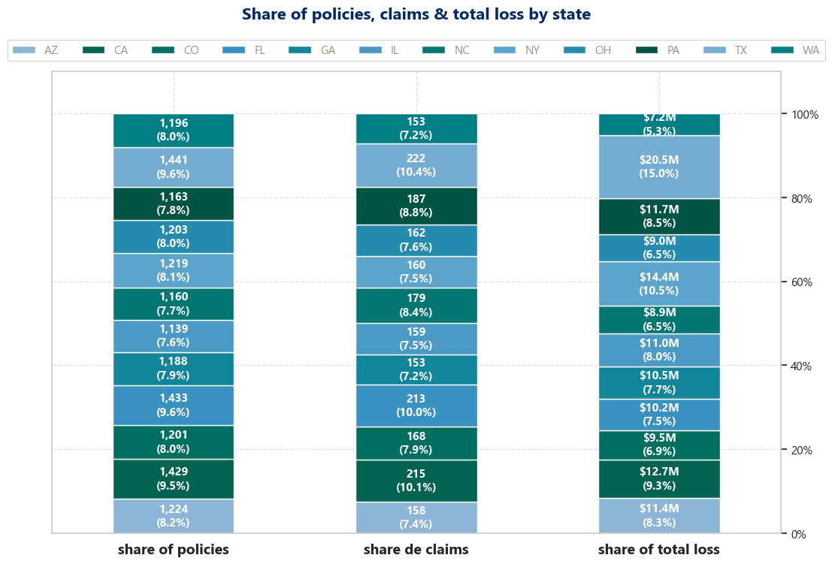
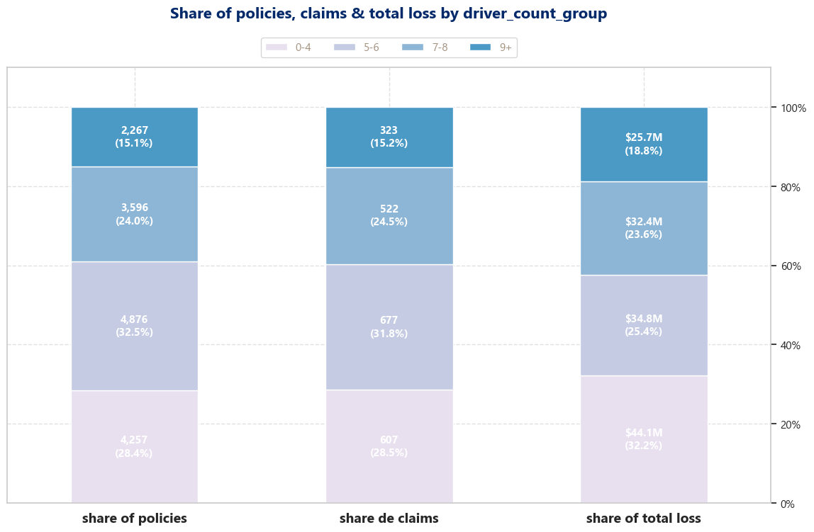
Data Analysis – General findings
Discrepancies are much less evident elsewhere
• No otherr feature exhibits such extreme behavior.
Other observations
• Business “size” indicators do seem to have a noticeable effect in both claims and loss.

Slide 9
Data Analysis – Metrics relevant for model selection
Metrics tested
• Lineal correlation between features
• VIF
• Box-Tidewell test for continuous variables (for logistic regression)
• Poisson test (for number of claims)
• Mutual Information
Results
• Correlation matrix doesn’t show any significant signals.
• VIF is between expected ranges for all features except the temporal ones.
• Box-Tidewell fails for driver avg. age but it´s somewhat close
• The number of claims does appear to be Poisson distributed
• MI is low in general

Slide 10
03
Modeling

Slide 11


Modeling – Initial evaluation
Old Model
Review of the initial draft
The initial draft had three kind of problems that needed to be solved at baseline
• Code quality: poor or confusing naming’s , using the wrong object, no consideration for next steps.
• Core misunderstandings about ml: No consideration for target leakage, filling values or doing encodings just because, no previous analysis in sight.
• Poor understanding of the use case: Naive view on risk, it is only considering the probability of at least an event happening which doesn’t help us to understand nor frequency nor severity
New Model

Slide 12
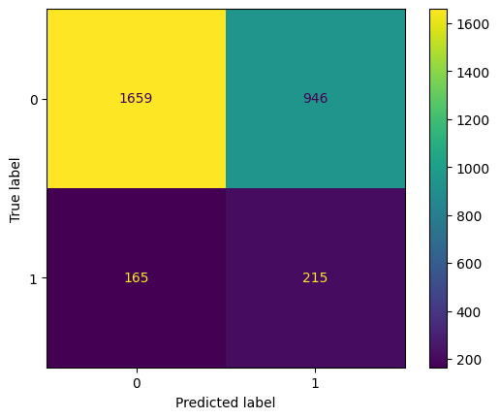
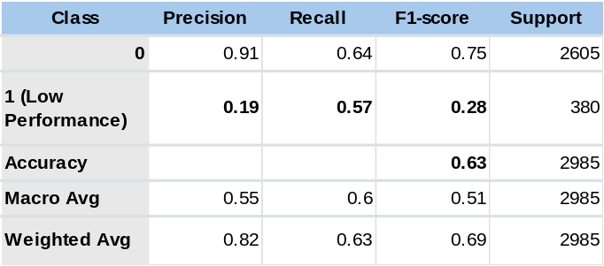
Modeling – 1) Probability of at least one claim
Confusion matrix
Overview
Given the results of the data analysis logistic regression did seem to be a good approach, I also tried SVC and cat boost
Results
Model performance overall was poor; the best fairing was logistic regression which results are showed here, over all we prefer to classify a no-claim policy as claim
Key Metrics

Slide 13
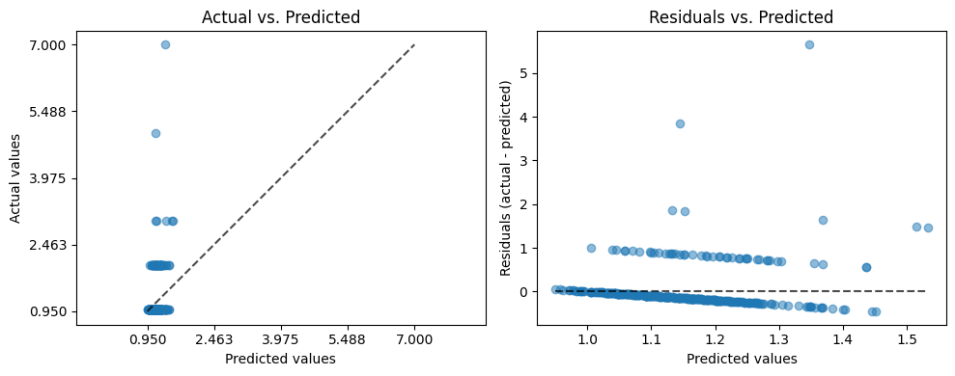
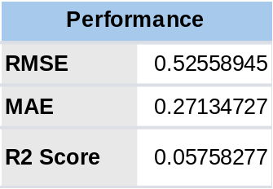
Modeling – 2) Expected Claims
Actual vs Predicted
Overview
Given the results of the data analysis, the distribution strongly resembles a Poisson distribution, so we tried Poisson Regression first, we also tried cat boost to contrast
Results
Model performance overall was poor; the best fairing was Poisson Regression which results are showed here
Key Metrics

Slide 14
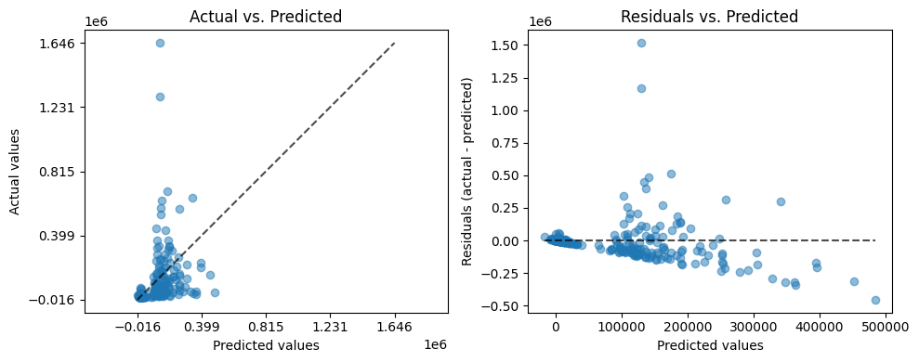
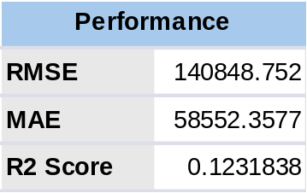
Modeling – 1) Probability of at least one claim
Confusion matrix
Overview
Given the distribution of the avg. losses and this problem being less restricted we only used cat-boost
Key Metrics

Slide 15
04
Production roadmap

Slide 16
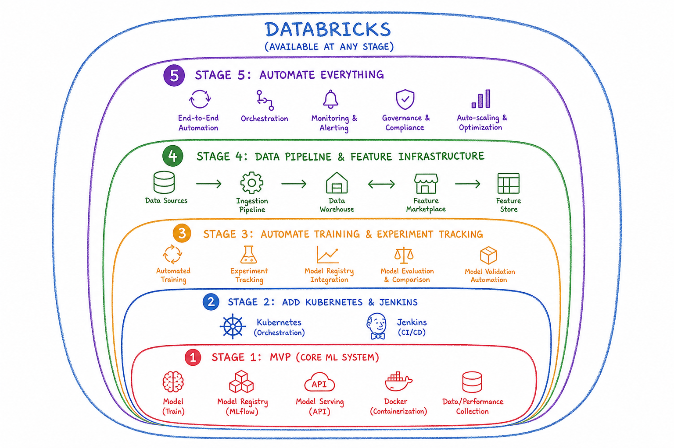
Production roadmap
Current state
• Currently we would be at stage 1 (MVP) minus the monitoring, which is heavily dependent of the production deployment
• All stages are subject to business requirements of course, this is not a strict order

