Slide 1

By QuGamers
Saúl Yael Puente Ruiz
Ana Belén Jaime Cepeda

Slide 2
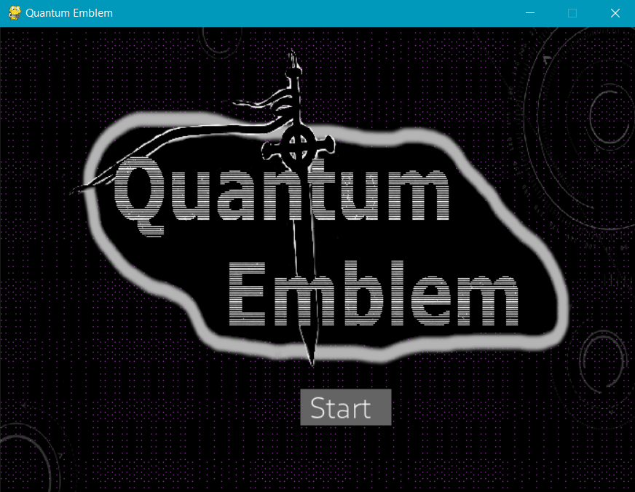
OUR project
“Quantum Emblem” is a quantum strategy game inspired in the famous game “Fire Emblem”. We modified the game's mechanics in order to take advantage of the quantum phenomena.

Slide 3







Using qubits to control units
$$|0⟩$$
$$|1⟩$$
1 Soldier
1 Qubit
q0
X
q1
H
X
q2
Y
X
q3
X
H
q4
Z
1 Army
1 Circuit

Slide 4







Soldier’s states
sss
$$\frac{1}{\sqrt{2}}(|0⟩+|1⟩)$$
$$|0⟩$$
H
$$|0⟩$$
$$|0⟩$$
In this game we use qubits to define the soldier’s states (positions in the board), and quantum gates to modify those states.
$$|1⟩$$
$$|1⟩$$

Slide 5
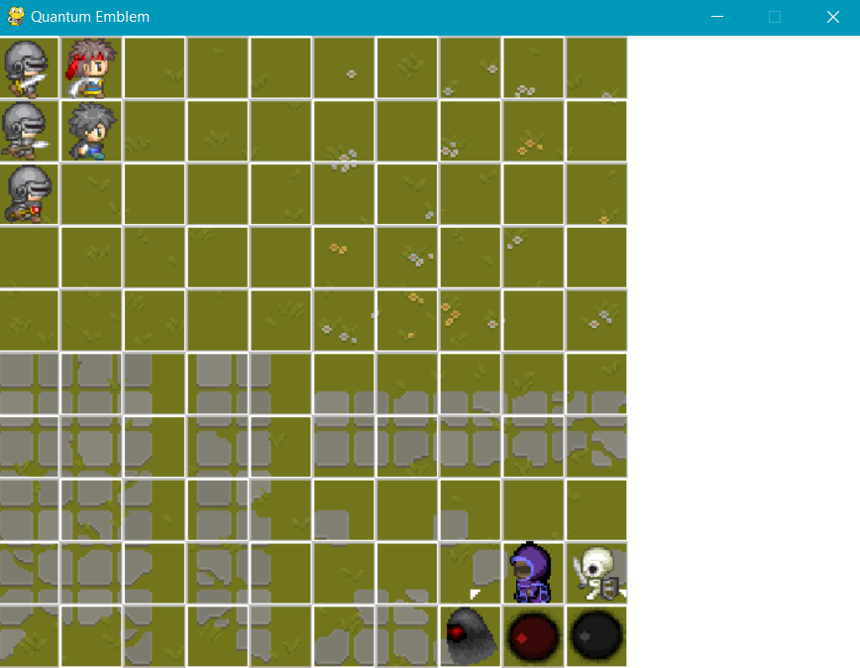
The game
Player’s 1 army
This is a two players game, in which each player controls an army consisting of five soldiers.
Player’s 2 army

Slide 6
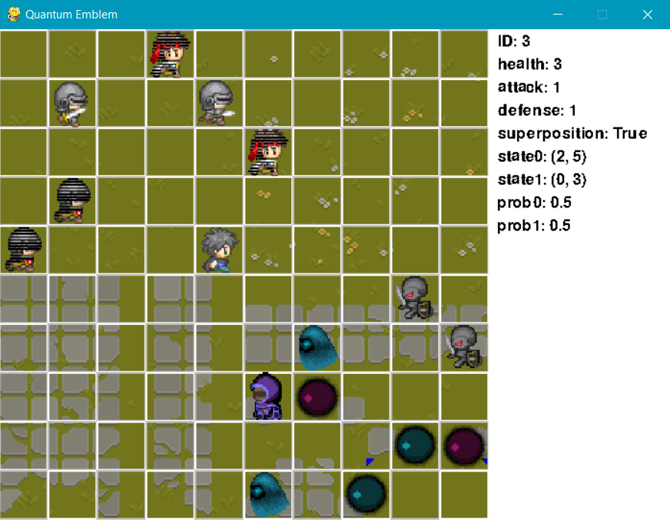

Soldier’s status
The soldier’s status is shown at the right when you click in a square containing a unit.
Here you can find the soldier’s states and the probability of being in each position.
It also says if the soldier is in superposition (the second state doesn’t matter if the unit isn’t in superposition).

Slide 7
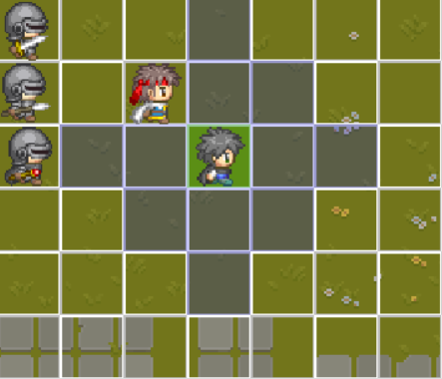
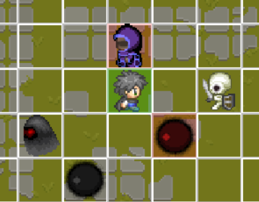
Moves and attacks
The possible movements appear in blue.
The possible attacks appear in red.
You can skip the moves and attacks.
You can also skip the move and then attack.
You win when you defeat all your enemies.

Slide 8
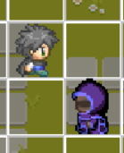
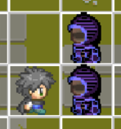
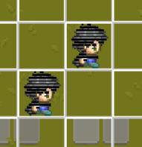
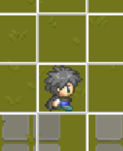
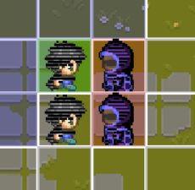

Collapsing qubits
Attacker
Victim
You can collapse a qubit by pressing the key “M” and choosing a soldier in superposition.
The qubits automatically collapse when attacking. Both the attacker and the victim. The victim only collapses and gets hurt if the soldiers collapse to the indicated states

Slide 9
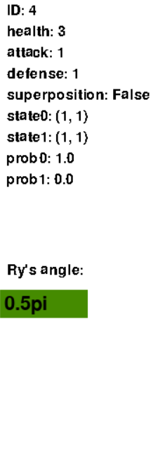
Applying quantum logic gates
You can add gates to your quantum circuit by pressing the keys ‘H’ (Hadamard gate), ‘X’ (pauli-X gate), ‘Y’ (pauli-Y gate), ‘Z’ (pauli-Z gate), and ‘R’ (rotation over y-axis) or collapse a superposition state by pressing key “M”.
Use this box to introduce an angle (radians).
Examples:
8
10.3
0.5pi
0.33pi

Slide 10
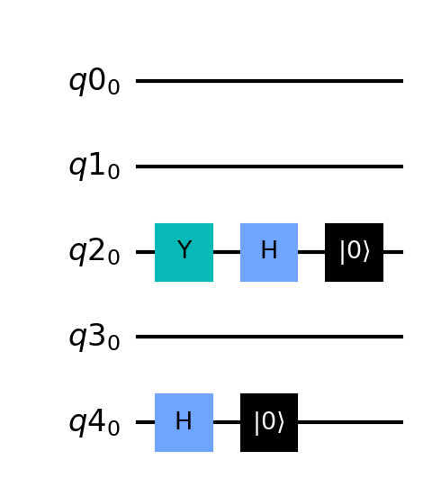
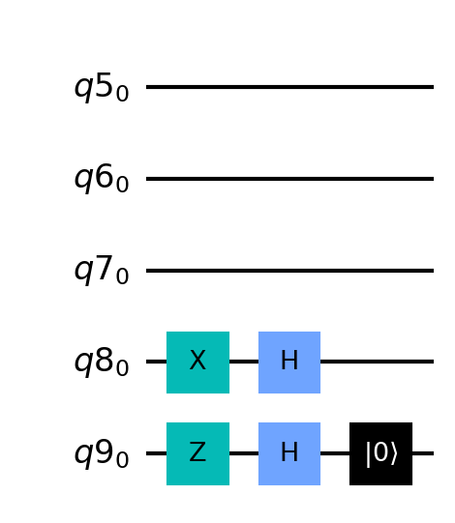
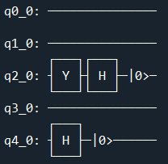
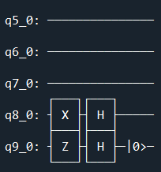
the quantum circuit
By pressing the key ‘D’ you can save an image of the quantum circuit or just see it printed in the console.

Slide 11


Utility of the game
$$|0⟩$$
Teaches about simple quantum logic gates and superposition.
Tests math skills
It’s fun!
$$|1⟩$$

Slide 12
what’s next?
Fix bugs
Improve the attack system
Add more gates
Implement an AI
Improve UI
Add more scenes, game modes, and options to choose your units
The game is slow to start sometimes, let’s fix it

