Slide 1


GIT & GITHUB

Slide 2
GIT / GITHUB
Version Control System
Most widely used modern version control system in the world today
Tracking file changes
Easy to Use
Command line tools
Terminal / Command Prompt / Powershell / Git Bash
GUI
GitHub / BitBucket
Manage Projects
More Efficiently/ Faster
Multiple Contributors
A/B Testing
Local
Hosted on PC
Not reliant on an internet Connection
Store commits until network connection restored

Slide 3

Revision Control System
tool to manager your source code history

Slide 4


Hosting Service
Place to Manage git repositories

Slide 5
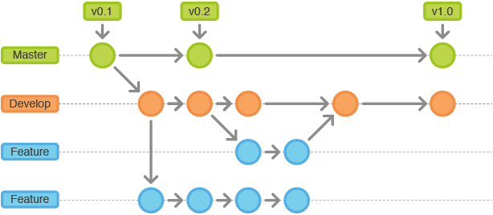

Version Control System

Slide 6
Lets Git into it!

Slide 7
Q & A

