Slide 1

Stock market price shocks and monetary policy within the US economic cycle: an empirical analysis with the VAR model
Academic year
2019/2020
Graduand
Saulo Cotturone
Supervisor
Prof.ssa Francesca Parpinel

Slide 2
PURPOSES
Analysing, through the estimation of a vector autoregressive
(VAR) model:
The effects of stock market price and monetary policy shocks on the US economic cycle
How the FED reacts to a shock in the financial market and how the financial market and the US economy react to a monetary policy shock
Saulo Cotturone | Dissertation Defense
Ca’ Foscari University, 13/11/2020

Slide 3
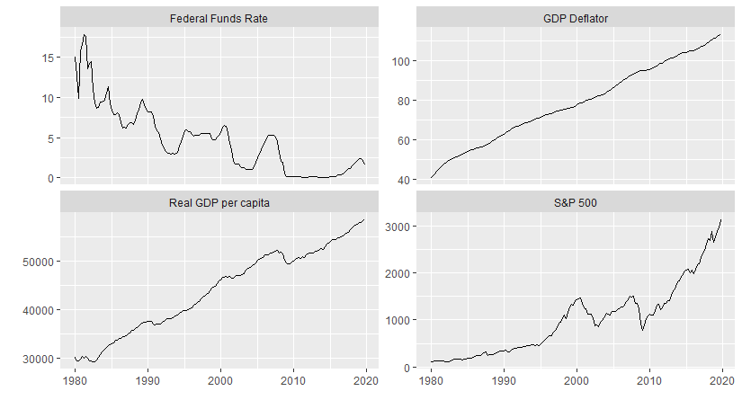
THE VARIABLES
The time series variables,
after applying the ACF,
partial-ACF and the augmented Dickey-Fuller tests, appear to be
non-stationary.
ACF and ADF tests
Saulo Cotturone | Dissertation Defense
Ca’ Foscari University, 13/11/2020

Slide 4
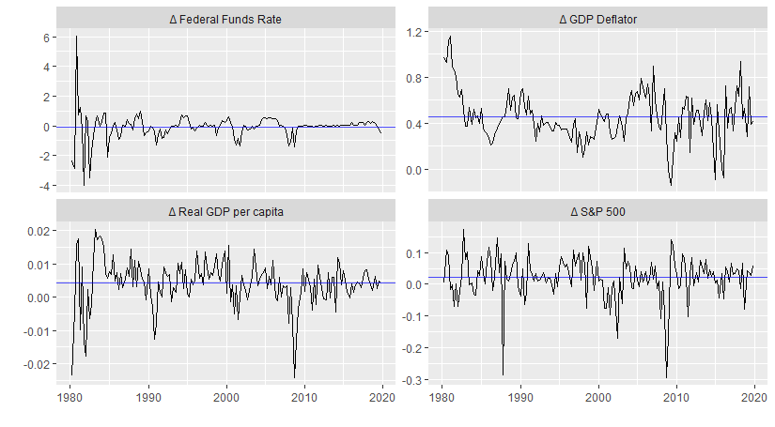
THE TRANFORMED VARIABLES
The transformed time series represent the variables obtained once applied the log-transformation, respectively to Real GDP per capita and S&P 500, and the first difference to all the variables.
The time series appear to be stationary.
ACF and ADF tests
Saulo Cotturone | Dissertation Defense
Ca’ Foscari University, 13/11/2020

Slide 5
MODEL ESTIMATION METHODOLOGY
Time series conversion
VAR model order selection
VAR model estimation
Model adequacy tests
Saulo Cotturone | Dissertation Defense
Ca’ Foscari University, 13/11/2020

Slide 6
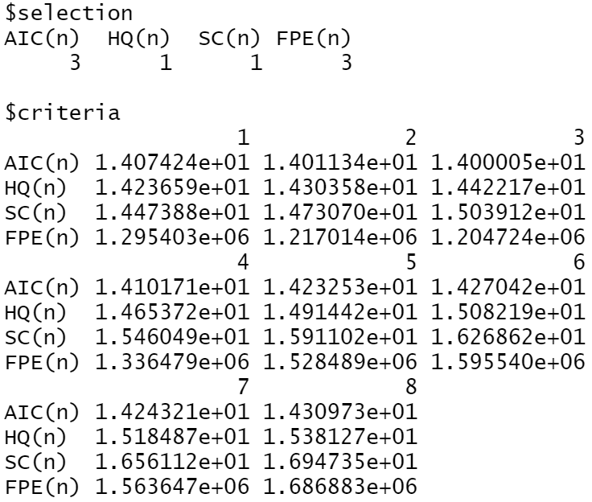
VAR MODEL ORDER SELECTION
The information criteria output I referred to, are:
Akaike information criterion (AIC)
Bayesian/Schwarz information criterion
Saulo Cotturone | Dissertation Defense
Ca’ Foscari University, 13/11/2020

Slide 7
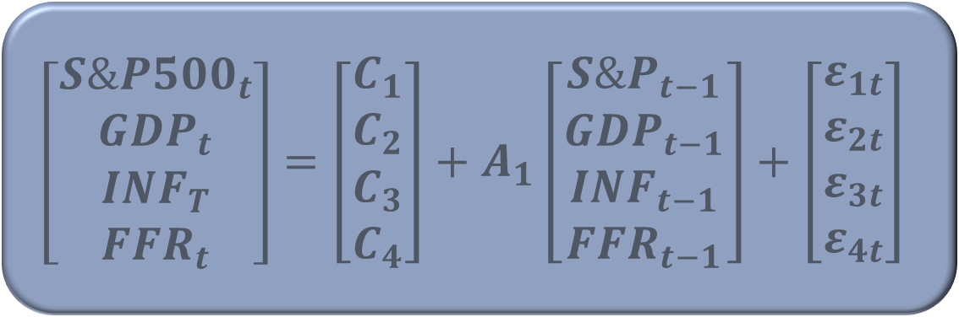
VAR (1) MODEL ESTIMATION
VAR (1) model estimated by utilising OLS per equation
$$\left[\begin{aligned}{S\&P500}_{t} \\ {GDP}_{t} \\ {INF}_{T} \\ {FFR}_{t}\end{aligned}\right]=\left[\begin{aligned}C_{1} \\ C_{2} \\ C_{3} \\ C_{4}\end{aligned}\right]+A_{1}\left[\begin{aligned}{S\&P}_{t−1} \\ {GDP}_{t−1} \\ {INF}_{t−1} \\ {FFR}_{t−1}\end{aligned}\right]+\left[\begin{aligned}ε_{1t} \\ ε_{2t} \\ ε_{3t} \\ ε_{4t}\end{aligned}\right]$$
Saulo Cotturone | Dissertation Defense
Ca’ Foscari University, 13/11/2020

Slide 8
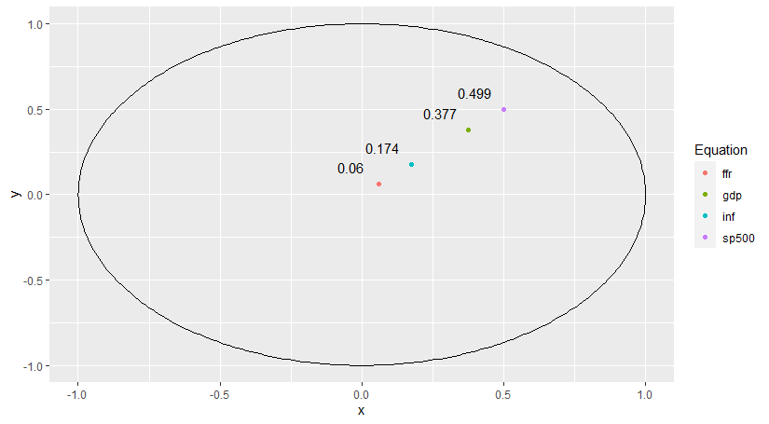
MODEL ADEQUACY TESTS
Stable process assessment
Serial correlation Test
Conditional heteroskedasticity Test
Structural stability Test
Saulo Cotturone | Dissertation Defense
Ca’ Foscari University, 13/11/2020

Slide 9
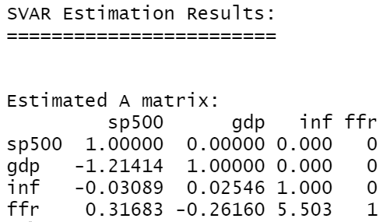
STRUCTURAL VAR IDENTIFICATION
The structural form is obtained through the Cholesky decomposition, which imposes a recursive ordering of the identified shocks.
Saulo Cotturone | Dissertation Defense
Ca’ Foscari University, 13/11/2020

Slide 10
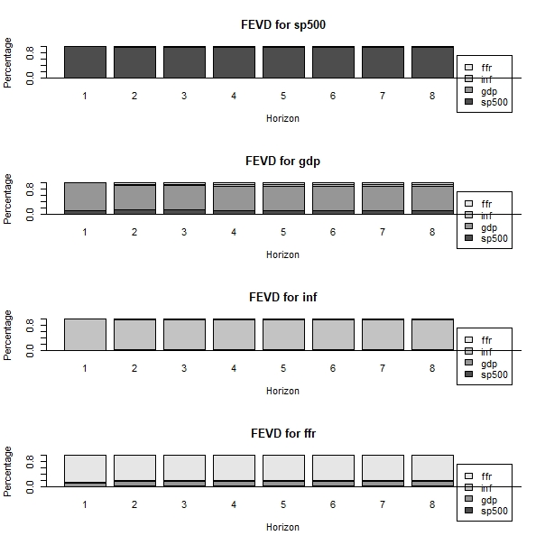
FORECAST ERROR VARIANCE DECOMPOSITION
The FEVD investigates how
much of the forecast error variance of each of the variables can be explained by exogenous shocks to the other variables.
Saulo Cotturone | Dissertation Defense
Ca’ Foscari University, 13/11/2020

Slide 11
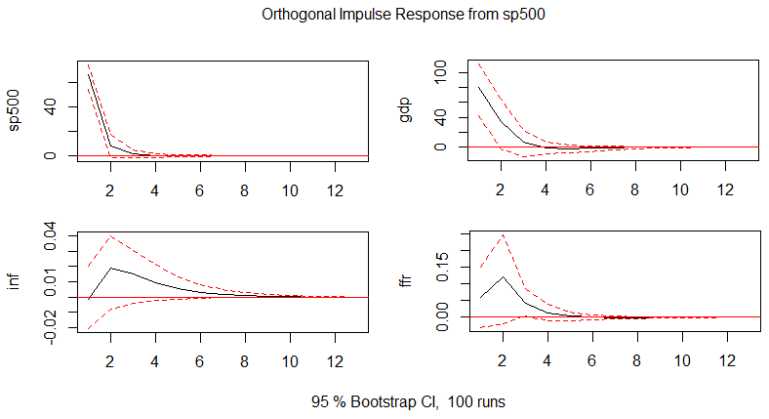
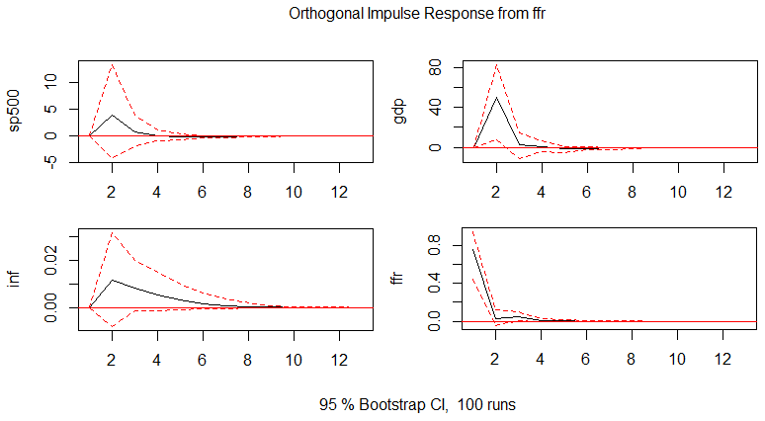
IMPULSE RESPONSE FUNCTIONS
Remaining IRF
Saulo Cotturone | Dissertation Defense
Ca’ Foscari University, 13/11/2020

Slide 12
THANK YOU
Saulo Cotturone | Dissertation Defense
Ca’ Foscari University, 13/11/2020

Slide 13
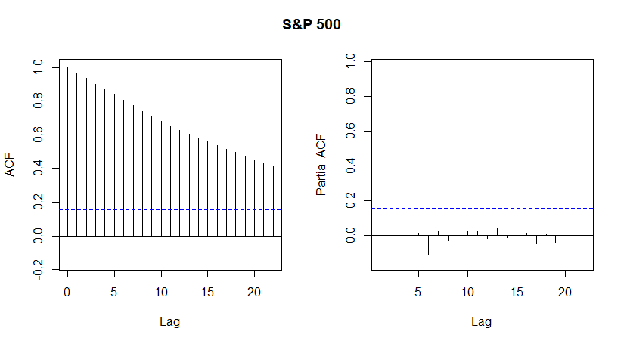
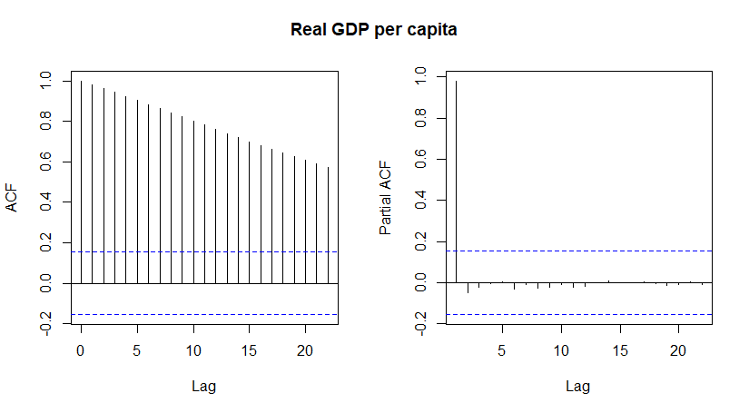
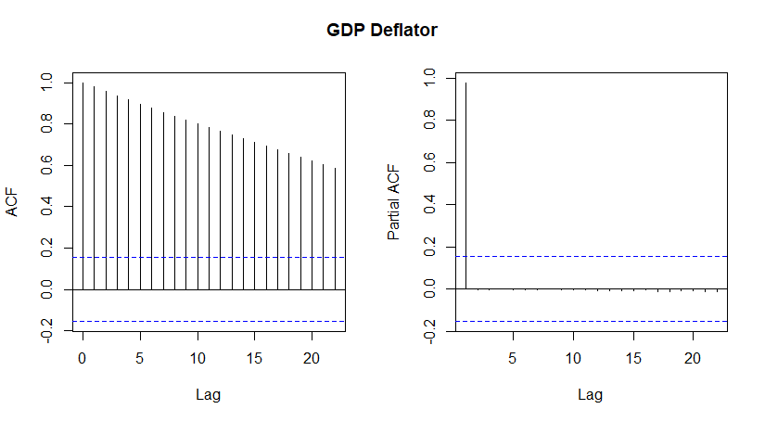
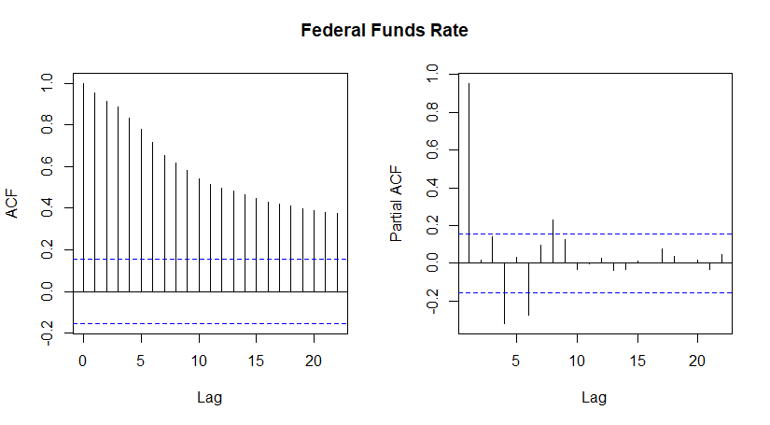
APPENDIX
ACF and partial-ACF non-stationary time series
Saulo Cotturone | Dissertation Defense
Ca’ Foscari University, 13/11/2020

Slide 14
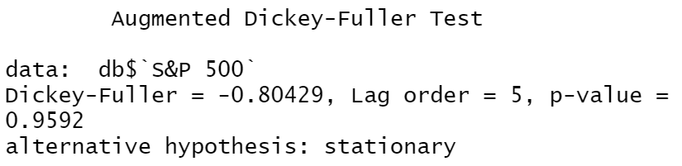
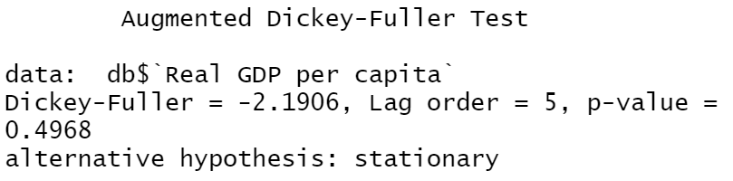
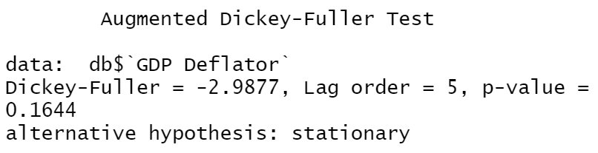
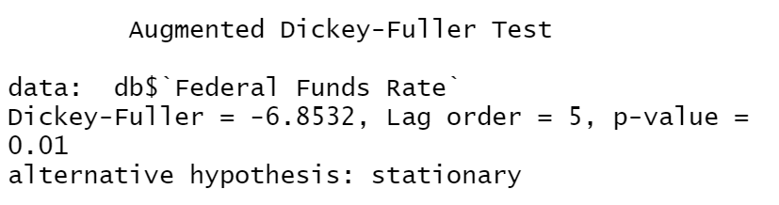
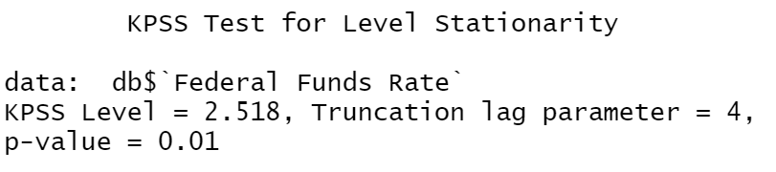
Augmented Dickey-Fuller test non-stationary time series
Saulo Cotturone | Dissertation Defense
Ca’ Foscari University, 13/11/2020

Slide 15
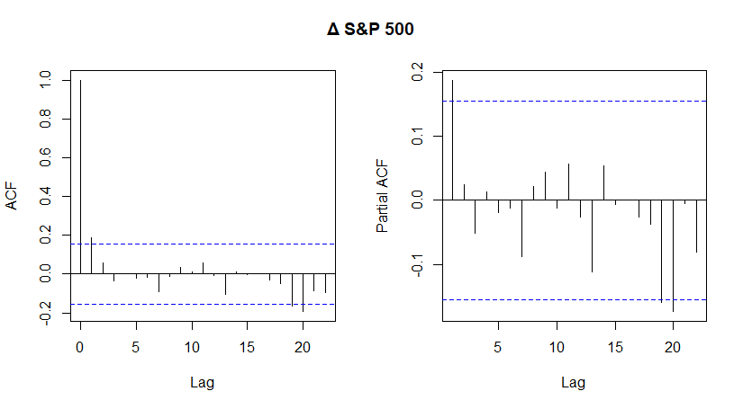
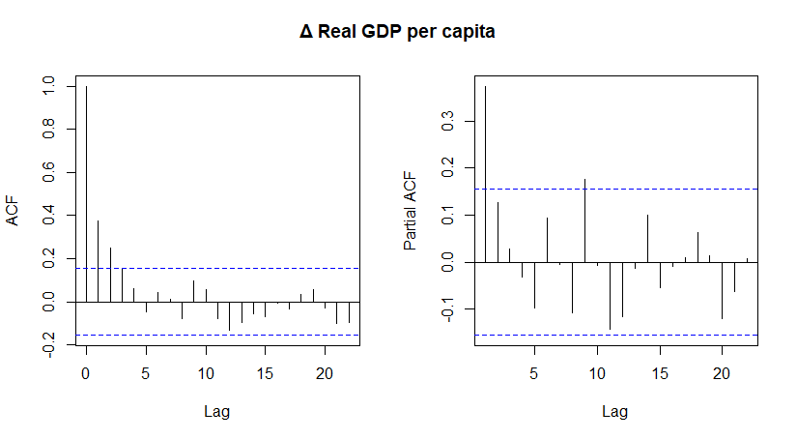
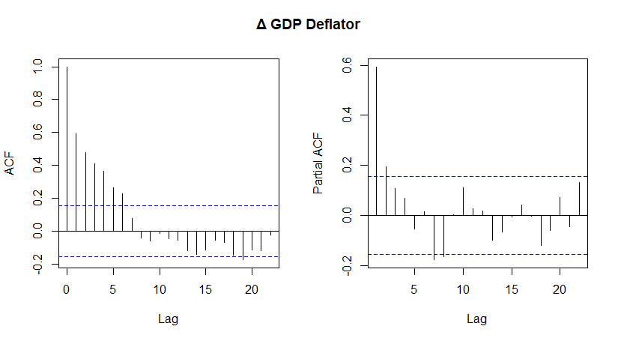
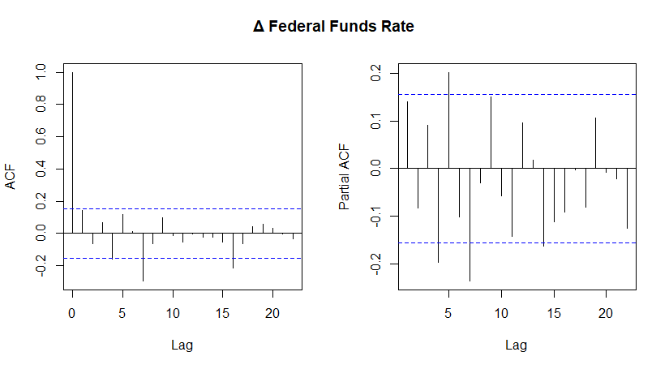
ACF and partial-ACF transformed time series
Saulo Cotturone | Dissertation Defense
Ca’ Foscari University, 13/11/2020

Slide 16
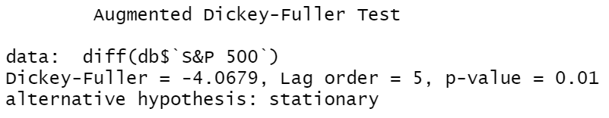
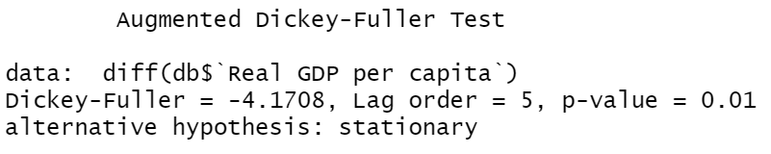
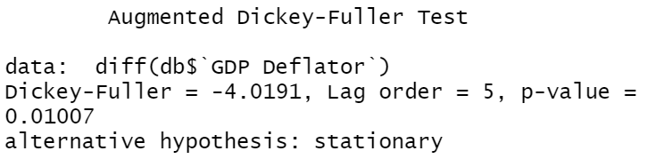
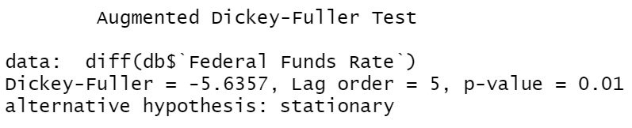
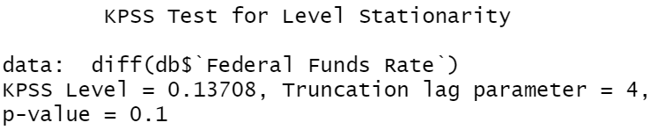
Augmented Dickey-Fuller test transformed time series
Saulo Cotturone | Dissertation Defense
Ca’ Foscari University, 13/11/2020

Slide 17
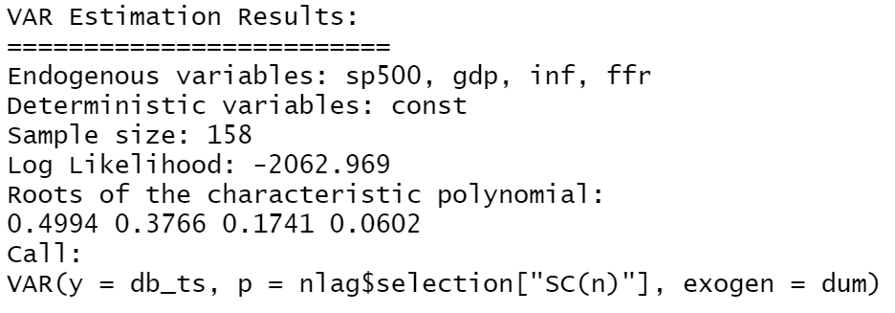
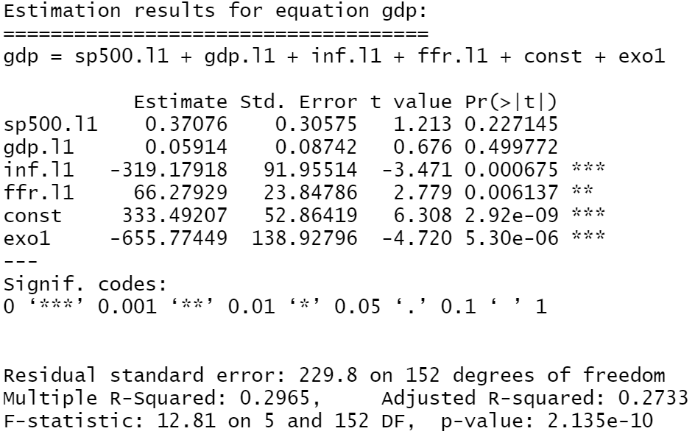
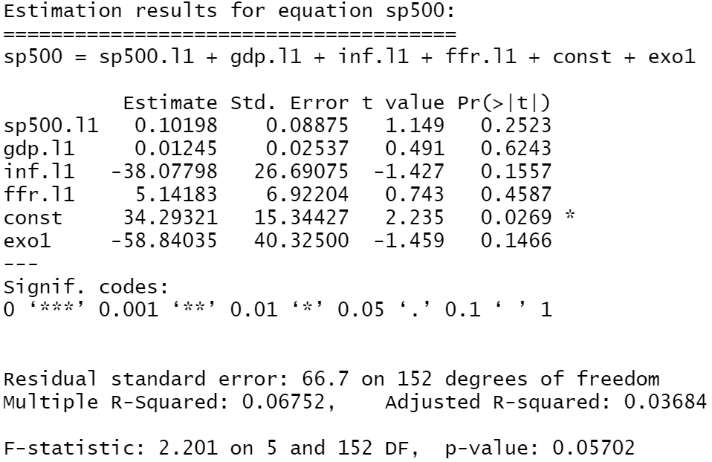
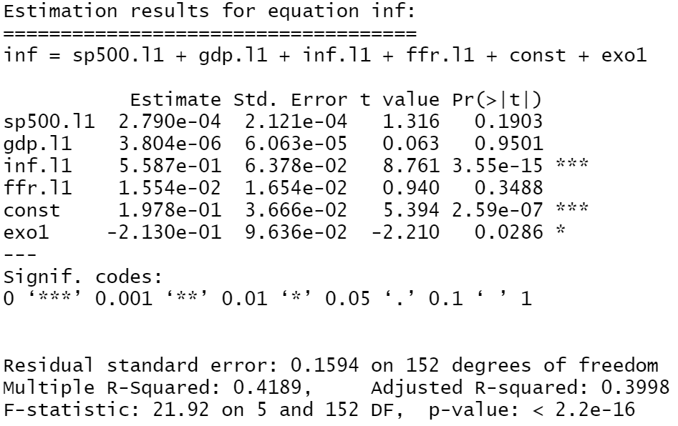
VAR (1) output
Saulo Cotturone | Dissertation Defense
Ca’ Foscari University, 13/11/2020

Slide 18
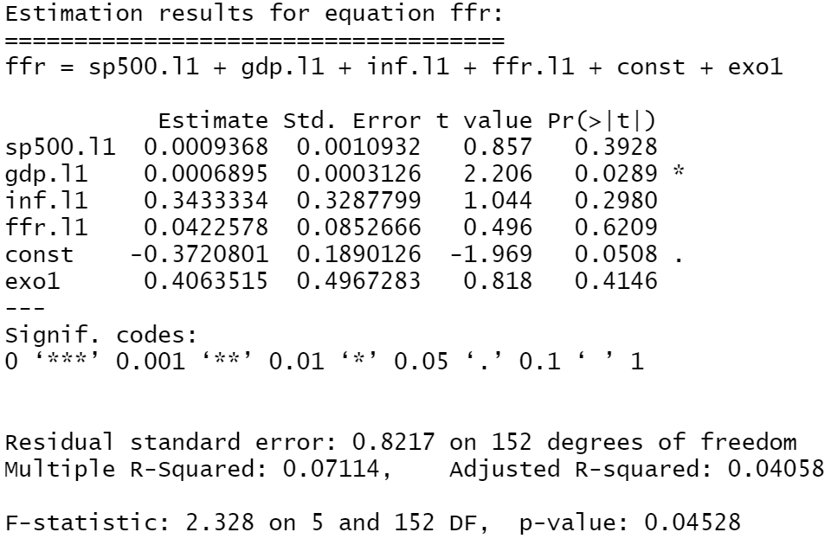
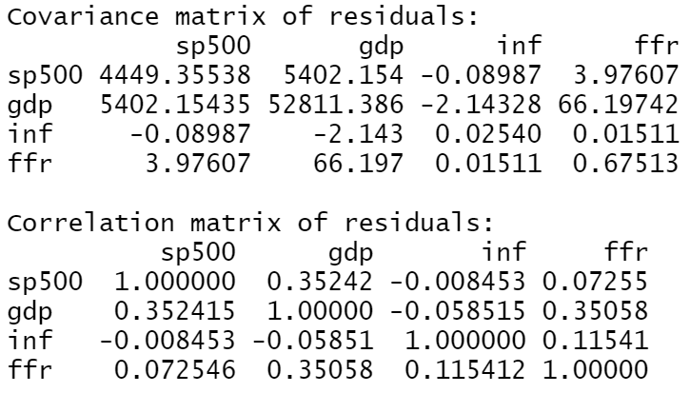
Saulo Cotturone | Dissertation Defense
Ca’ Foscari University, 13/11/2020

Slide 19
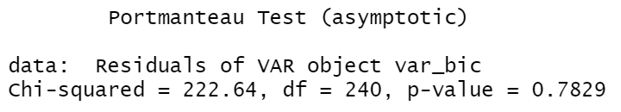
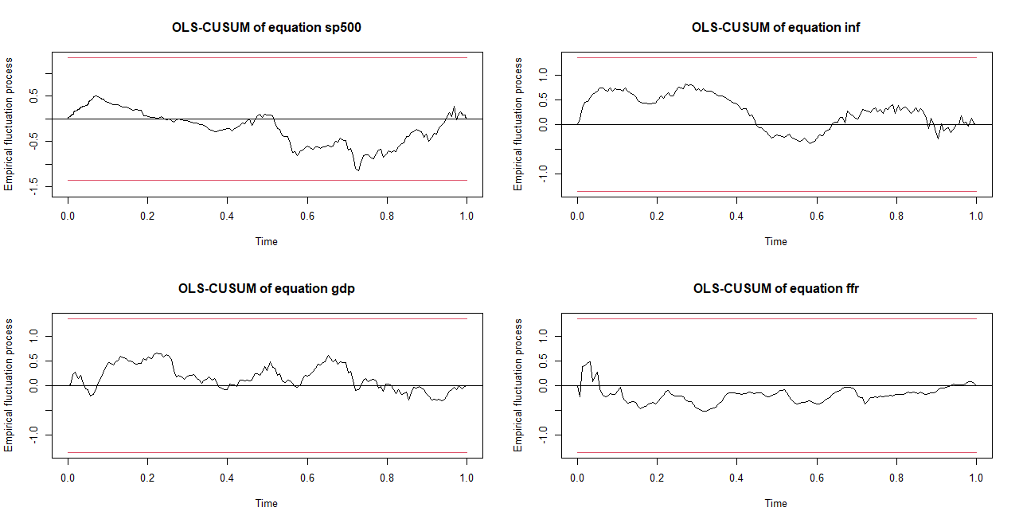
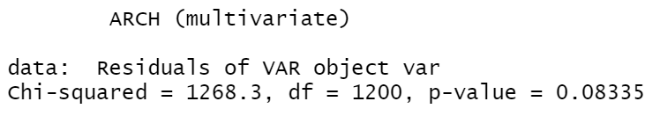
Model adequacy tests
Saulo Cotturone | Dissertation Defense
Ca’ Foscari University, 13/11/2020

Slide 20
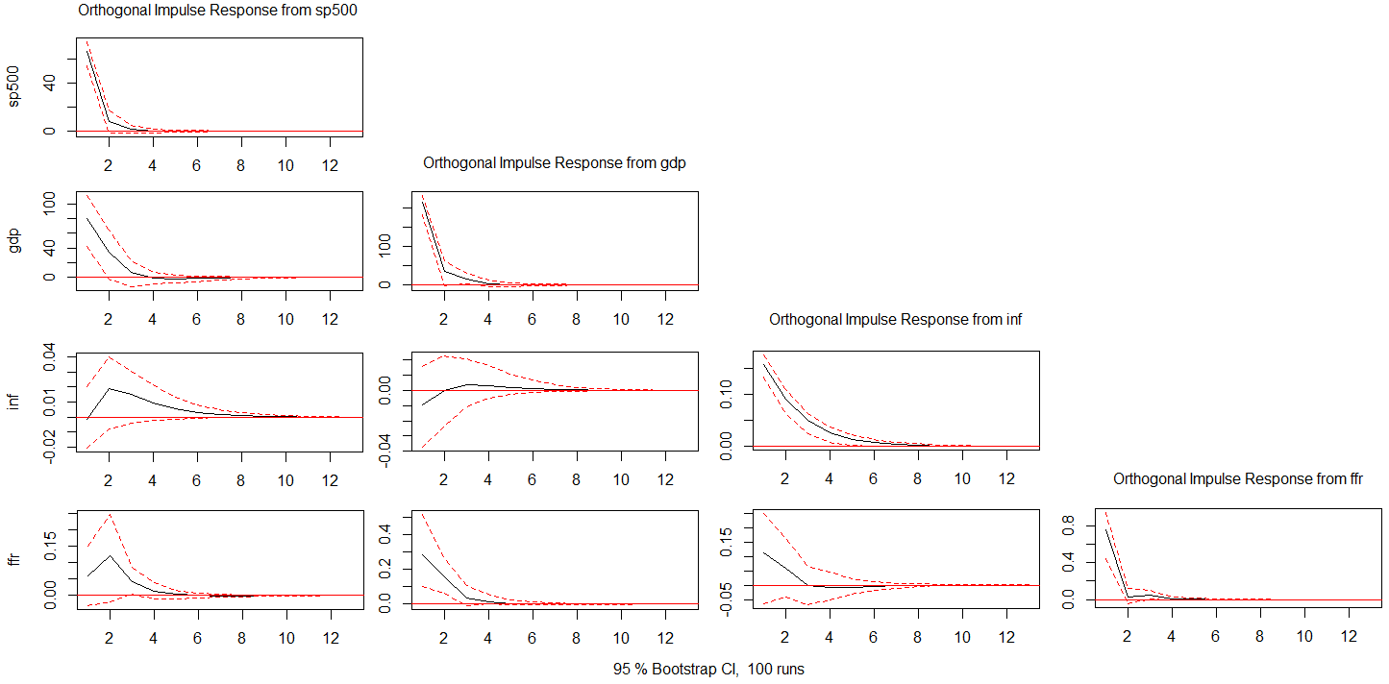
IRF (lower triangular matrix)
Saulo Cotturone | Dissertation Defense
Ca’ Foscari University, 13/11/2020

