Slide 1
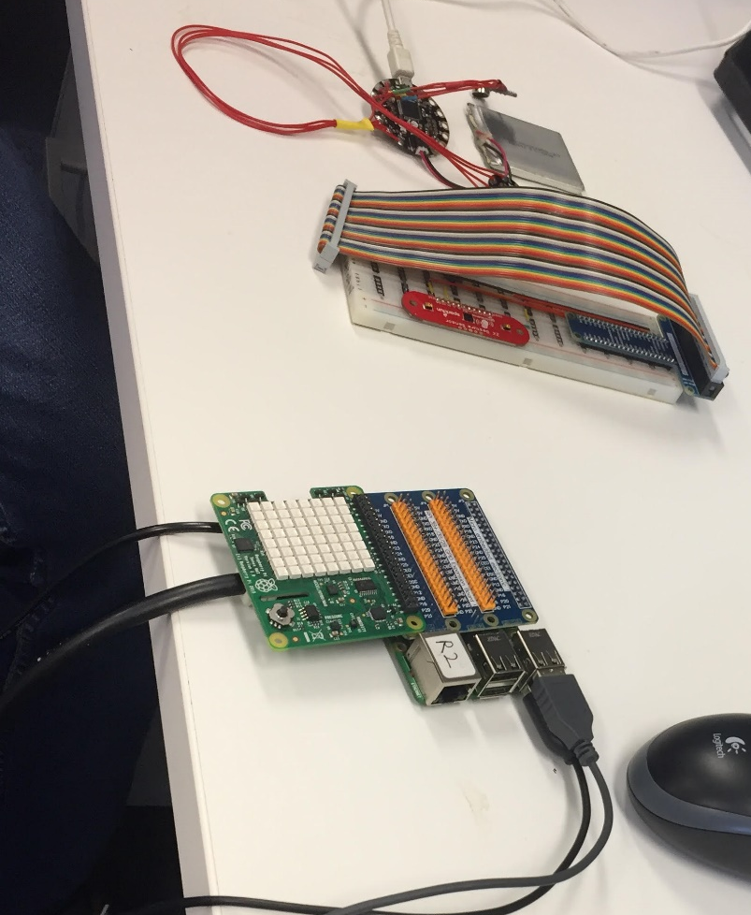
Haptic vibration actuator
Arm microcontroller
(Arduino flora)
Battery for Arm microcontroller
Arm position sensor (ZX near visible light detector)
LED matrix display (sense HAT)
Main information processor (raspberry pi 2B+)

Slide 2
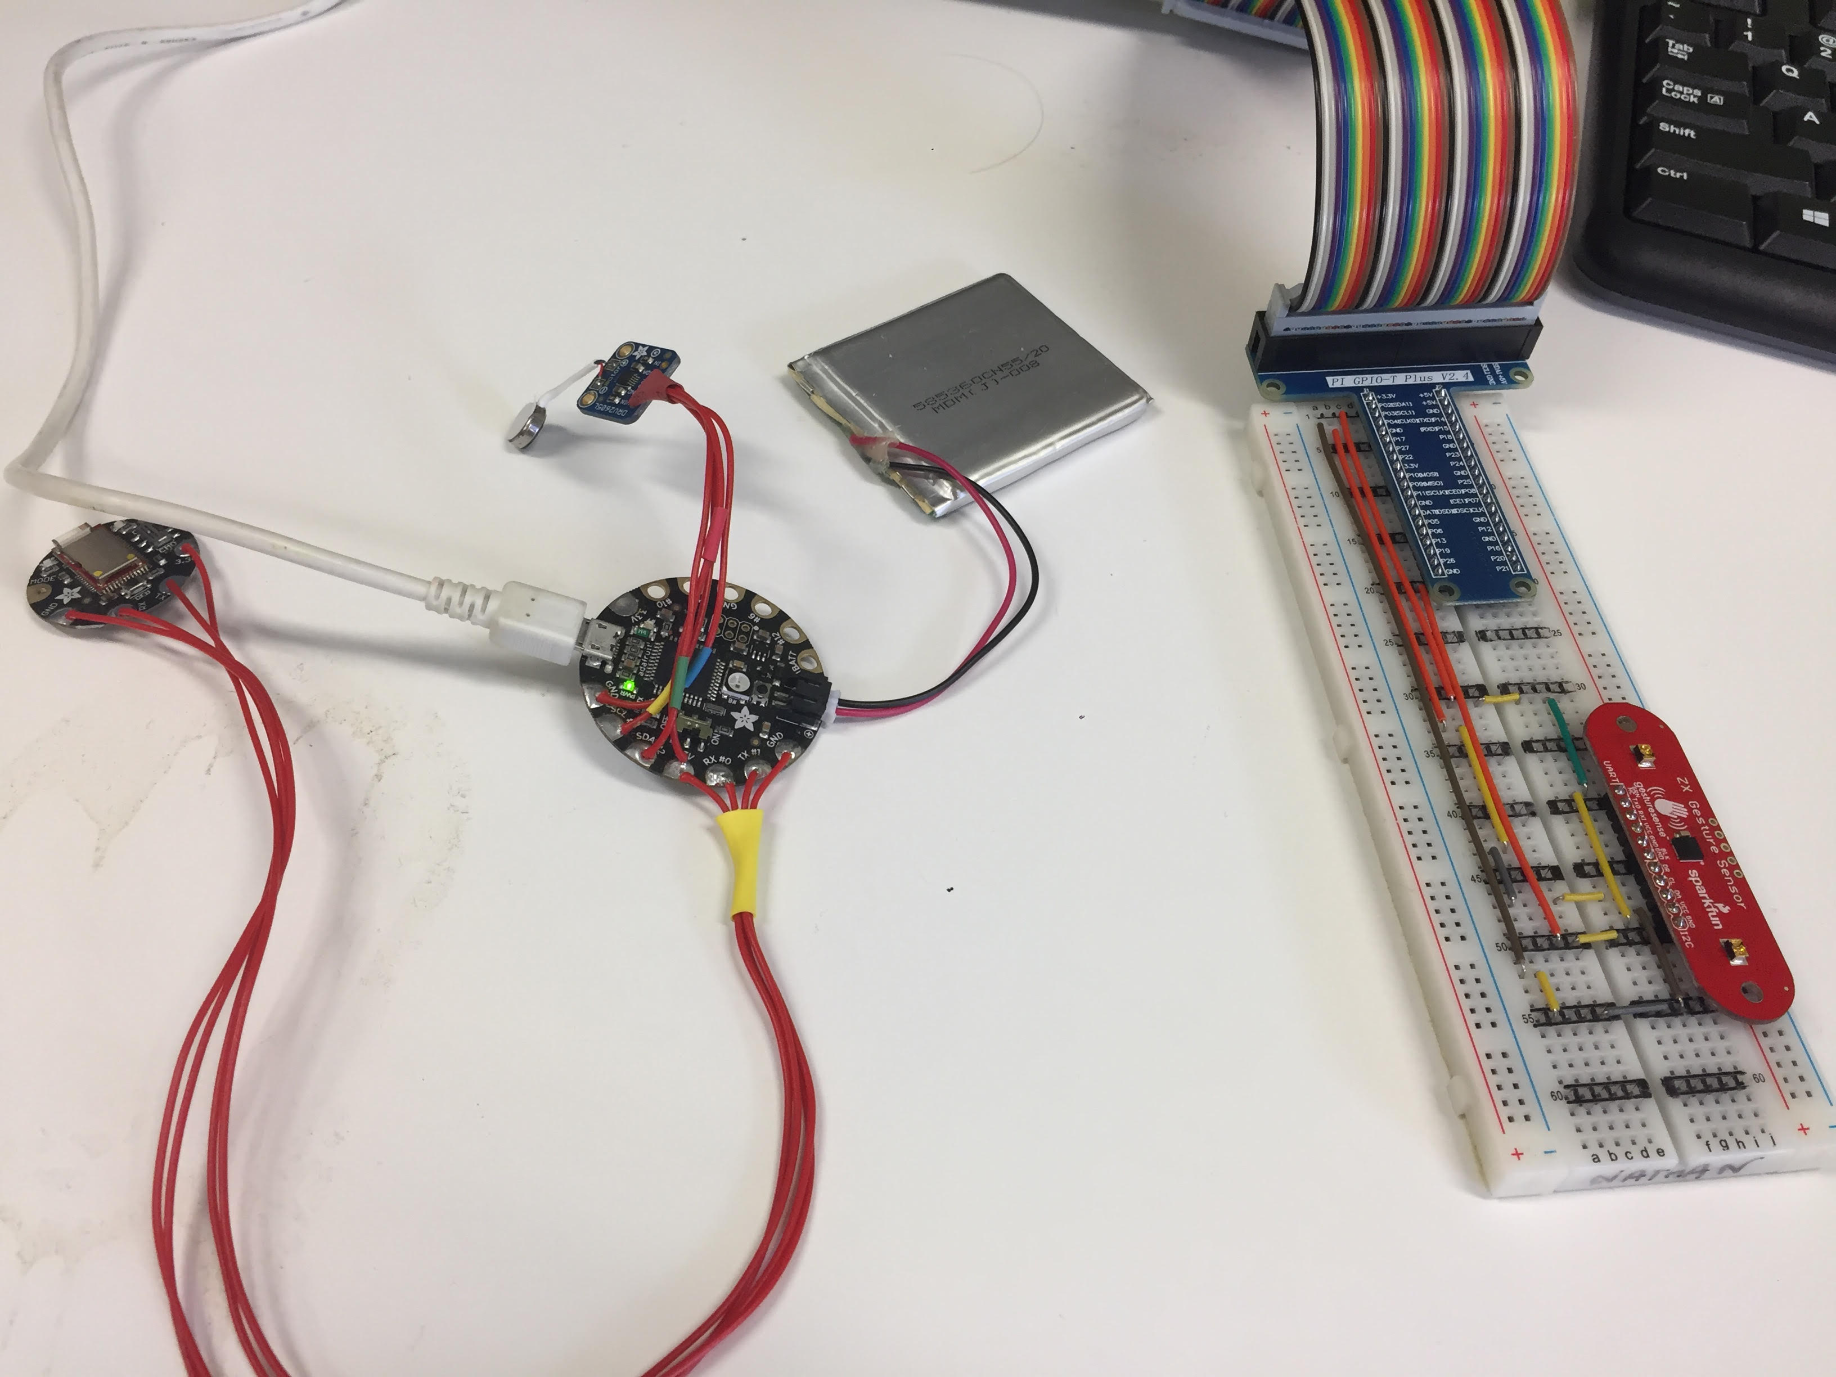
Haptic vibration actuator
Haptic vibration actuator Speed controller
Battery for Arm microcontroller
Bluetooth module for commination between arm microcontroller and main information processor
Arm microcontroller
(Arduino flora)
Arm position sensor (ZX near visible light detector)

Slide 3
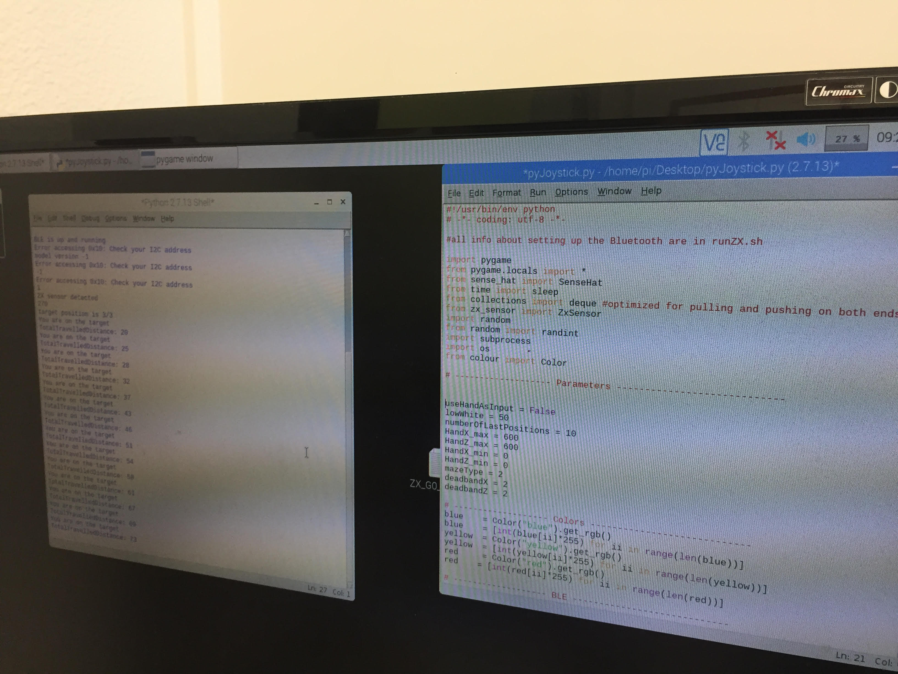
Output of the running application
Script of the application

Slide 4
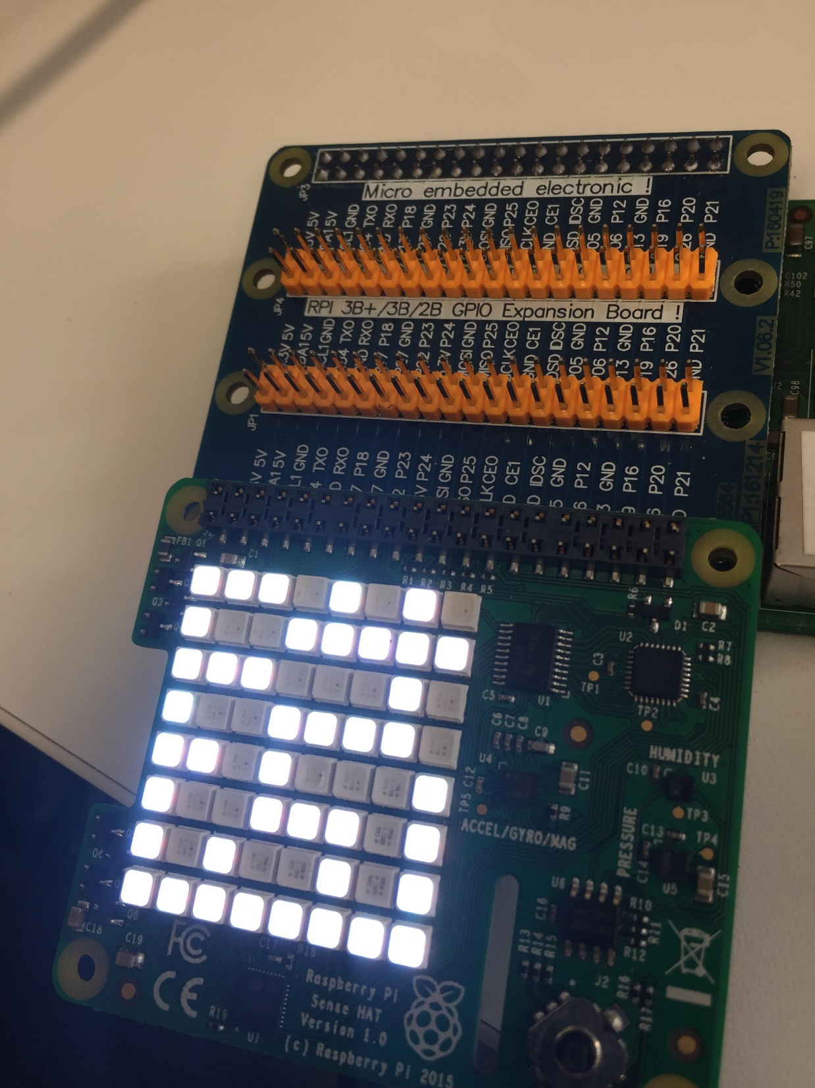
Maze type 1 is running

Slide 5
