Slide 1
RESTAURANT RECOMMENDER SYSTEM (For Delhi)

Slide 2
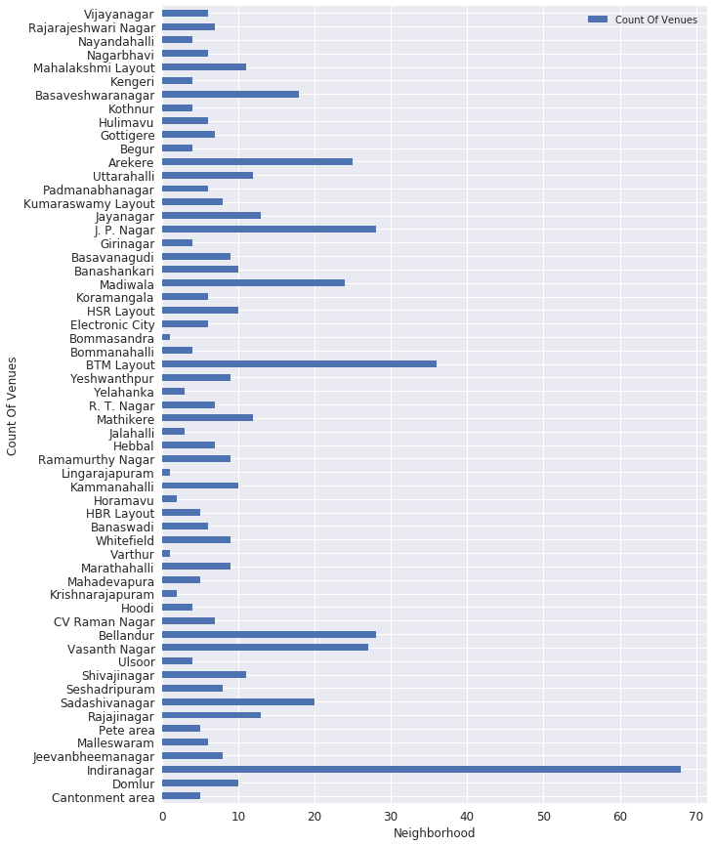
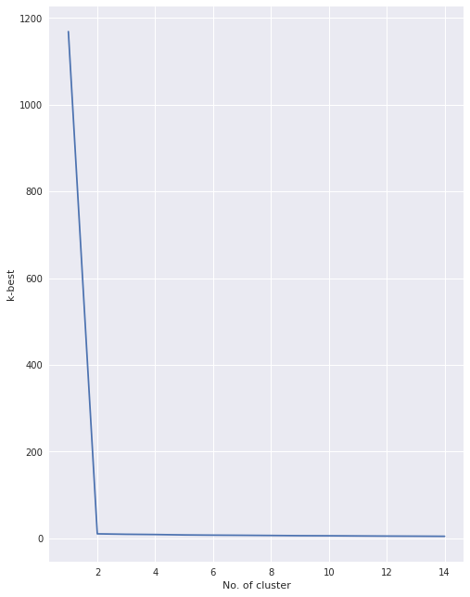
Methodology & Analysis:

Slide 3

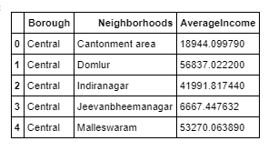
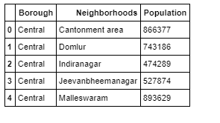

Datasets

Slide 4
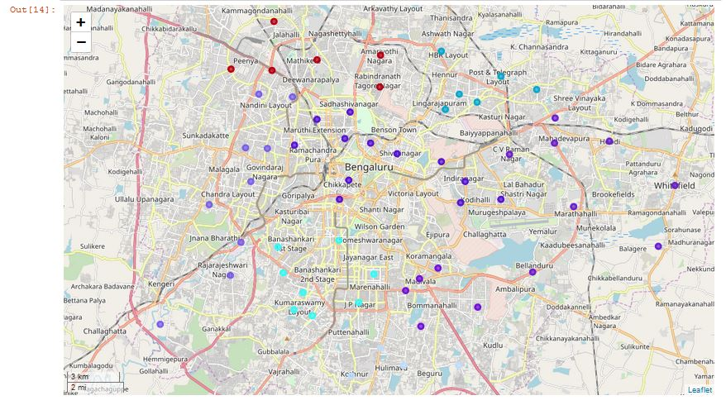
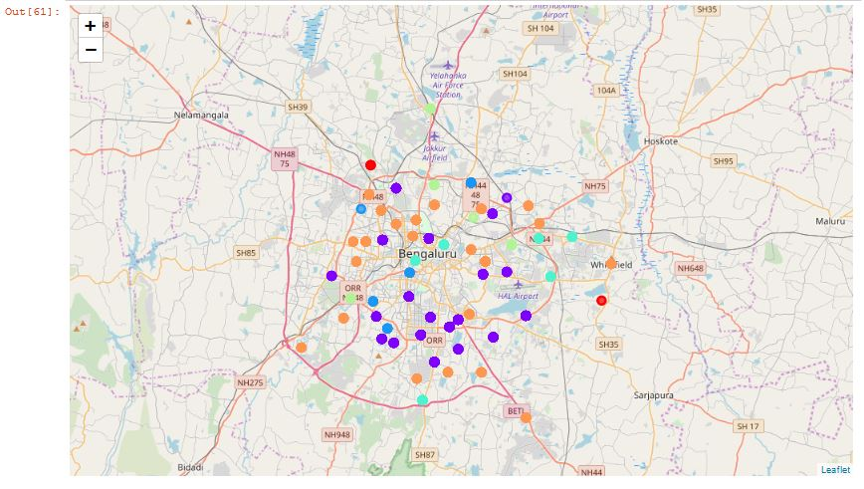
Clustering:

Slide 5

Results and conclusion

Slide 6
THANK YOU

