Slide 1
PeopleGrove ML/AI Project
By Saumaan Momin (sauman.1099@gmail.com)

Slide 2
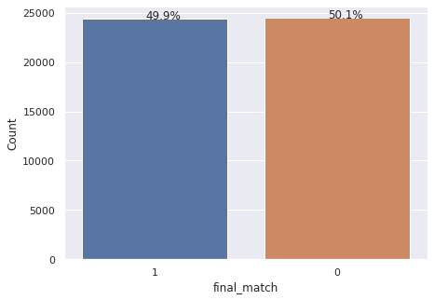
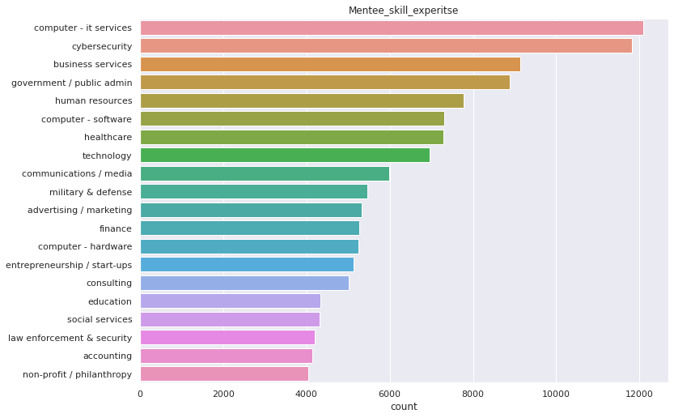
EDA
From Countplot we can see that, Given dataset is balanced. So we will use Accuracy as our evaluation matrix
mentee_major has 1800 missing values,mentor_major has 1200 missing values, mentee_help_topics has 16000 missing values, etc.,
Top 3 skill selected by mentees in college are: 1) Business administration 2) Computer networks and cybersecurity 3) Psychology
Top 3 skill selected by mentors in college are: 1) Business administration 2) Computer networks and cybersecurity 3) Information system management
Top 3 topics in which mentees are seeking help: 1) Career planning 2) Career / industry trends 3) General networking
Top 3 topics in which mentors are willing to help: 1) Leadership skills 2) Career / industry trends 3) Management
Top 3 domain in which mentee are looking to build expertise: 1) computer - it services 2) Cybersecurity 3) Business services
Top 3 domain in which mentors has expertise: 1) computer - it services 2) government / public admin 3) Business services

Slide 3
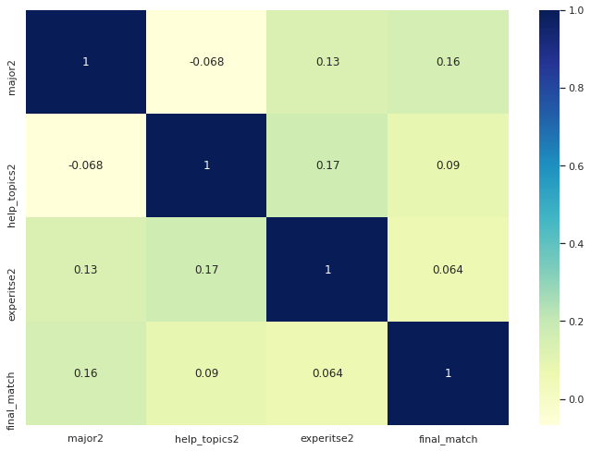
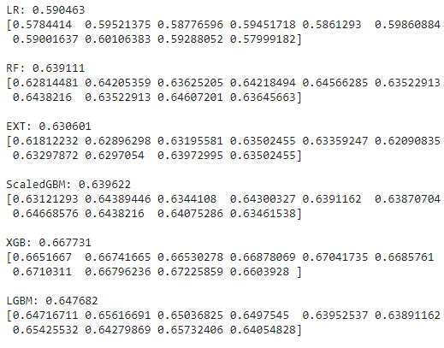
Method_1: Using Word Mover’s Distance
Pre_processing: Removing Stop words, Square brackets single quotes and Converting into lowercase
Creating Vocabulary from given dataset and adding it to Word2vec models
Feature Engineering: Getting the similarity Score between mentee & mentor using Word Mover’s Distance
Handling the Infinity values
Multicollinearity check
Model selection via cross validation: Best performing models using this methods are XGBClassifier -> CV_score = 0.667731 LGBMClassifier -> CV_score = 0.647682

Slide 4
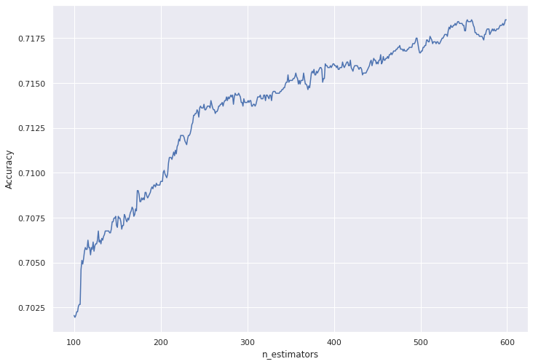
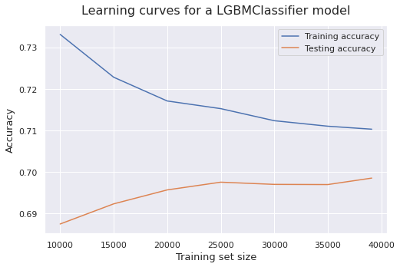
Method 2: Using pre_trained models(Hugging Face)
Pre_processing: Removing Stop words, Square brackets, single quotes, Converting into lowercase
Loading the pre_trained model
Feature Engineering: Embedding & Cosine similarity
Handling the Infinity values
Multicollinearity check
Model selection via cross validation: Best performing models using this methods are XGBClassifier -> cv_score = 0.687615 LGBMClassifier -> cv_score = 0.701751 RandomForestClassifier -> cv_score = 0.694693
Hyperparameter Tuning: After this step XGBClassifier -> score = 0.7194 LGBMClassifier -> score = 0.7190
Learning curve for Overfitting and Under fitting: -> As training set size increases testing accuracy increases. Therefore adding more data will increase the performance Training accuracy is high, so our model has low bias -> Gap between the two curve indicates variance. Generally, the more narrow the gap, the lower the variance. The opposite is also true, the wider the gap, the greater the variance. here we have high variance -> This high variance problem can be solve by adding more data, as we can see that, in the graph slope of test accuracy is more then train accuracy -> Generally in low bias and high variance, XGboost perform well

Slide 5
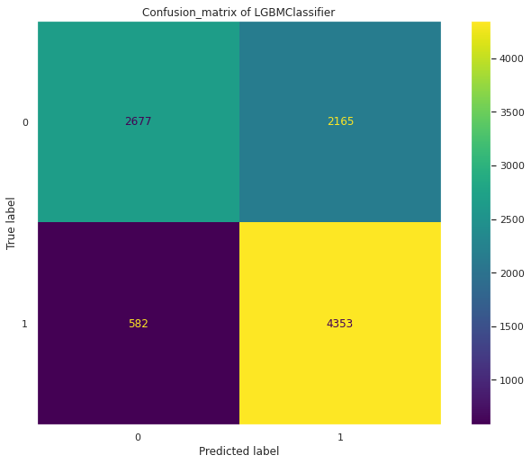

Confusion matrix
Accuracy = 71.90%
Accuracy = 71.94%

Slide 6
Thank you…

