Slide 1
GULLY_DEVS R19 Team Leader- Saumitra Shukla ph_no: 9140444258 email: saumitrawork@gmail.com
Ministry Name - Central Ministry
Organisation Name-Ministry of Railways

Slide 2
PROBLEM STATEMENT :
Advertisement Rates Calculation- THE work of choosing newspapers for every advertisement to be released is done manually .The rate/circulation of newspaper is checked manually from DAVP website, which is laborious and also is prone to error in noting down advertisement rate.
. Fetching Railway News in Real Time- It is not feasible to monitor the release of news concerning Ministry of Railways whether positive or negative due to lack of resource or staff. Using digital technology, a system to be devised to inform or give notification in real time or within 12 hours.

Slide 3
Description of the Website
The Website can only be accessed by the Registered users.
Login is provided by RUID, registered email and password.
Forgot Password can be retained by SMTP Service.
A dashboard profile of every user is also present.
There is an option which gives the real time status of delayed trains.
It has an inbuilt Advertisement Rate Calculator.

Slide 4
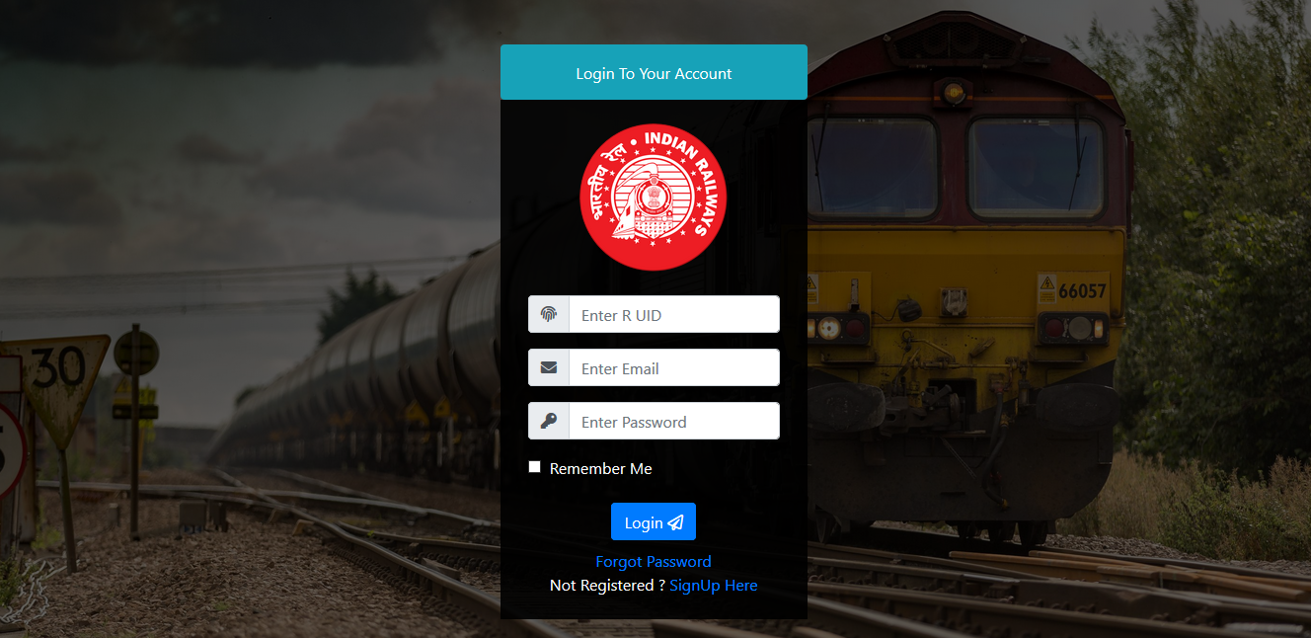
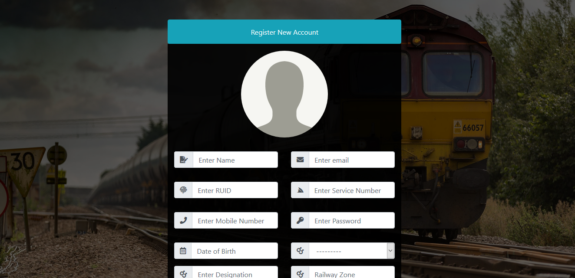

Slide 5
ADVERTISEMENT RATES OF DIFFERENT NEWSPAPERS :
The rates are being scrapped {by Cronjob(automated)} on the basis of :-
1. Citywise circulation
2. Particular newspaper
Advertisement Rates consist of following segments :-
Front page (B/w or Color)
Inner page (B/w or Color)
Back page (B/w or Color)

Slide 6
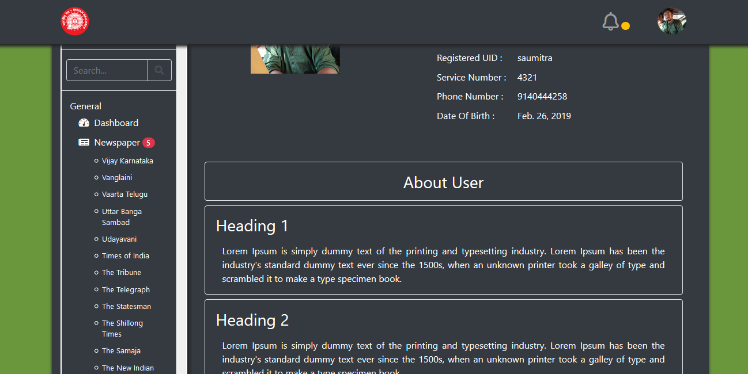
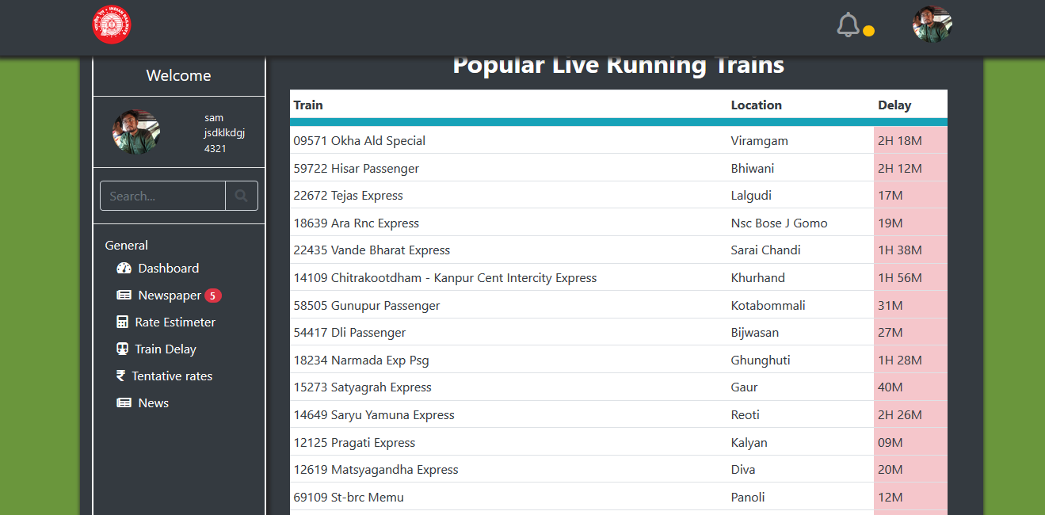
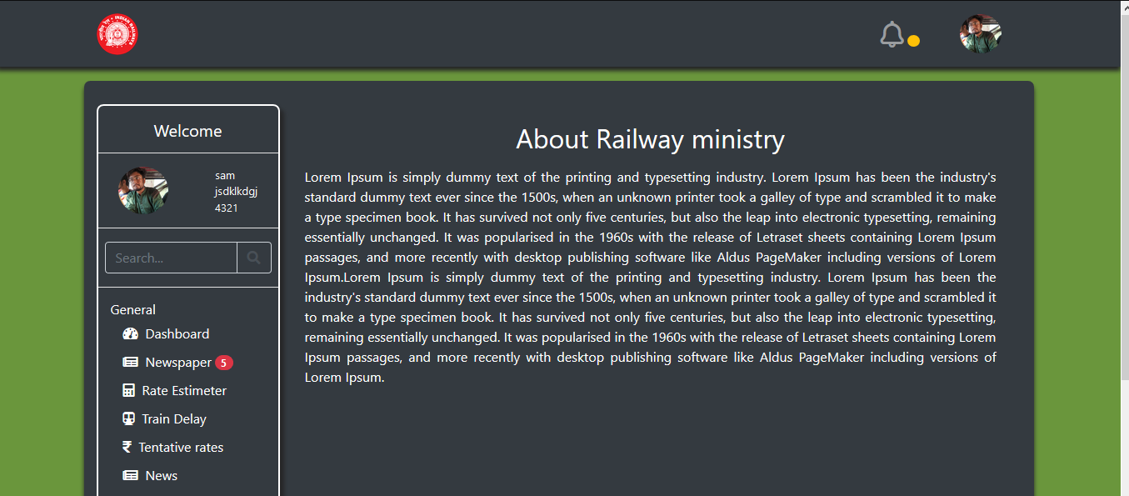
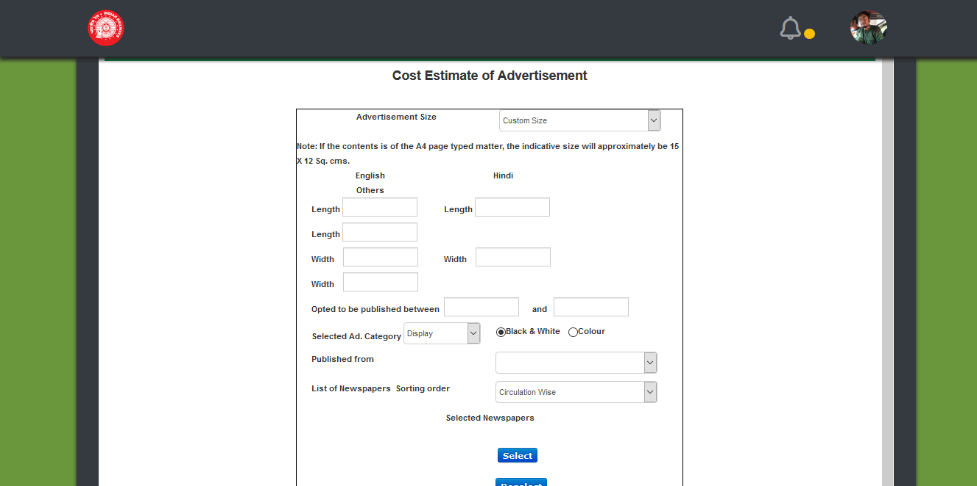

Slide 7
Calculation of rates using calculator:
A calculator from the DAVP website is also integrated for the real time calculation of advertisement rate.
The calculation is done on the basis of following criteria :-
Dimensions of advertisement
Coloured or B/w
Publish Duration
English/Hindi/Regional Languages
Selected Ad Category (Display , Classified Display , UPSC)
City to be Published from
List of Newspapers (Sorting order :- Circulation Wise , Newspaper Name)

Slide 8
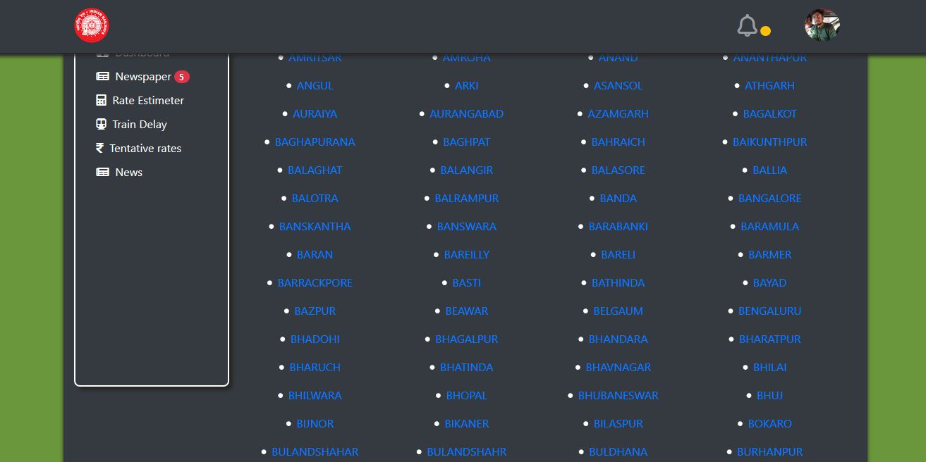
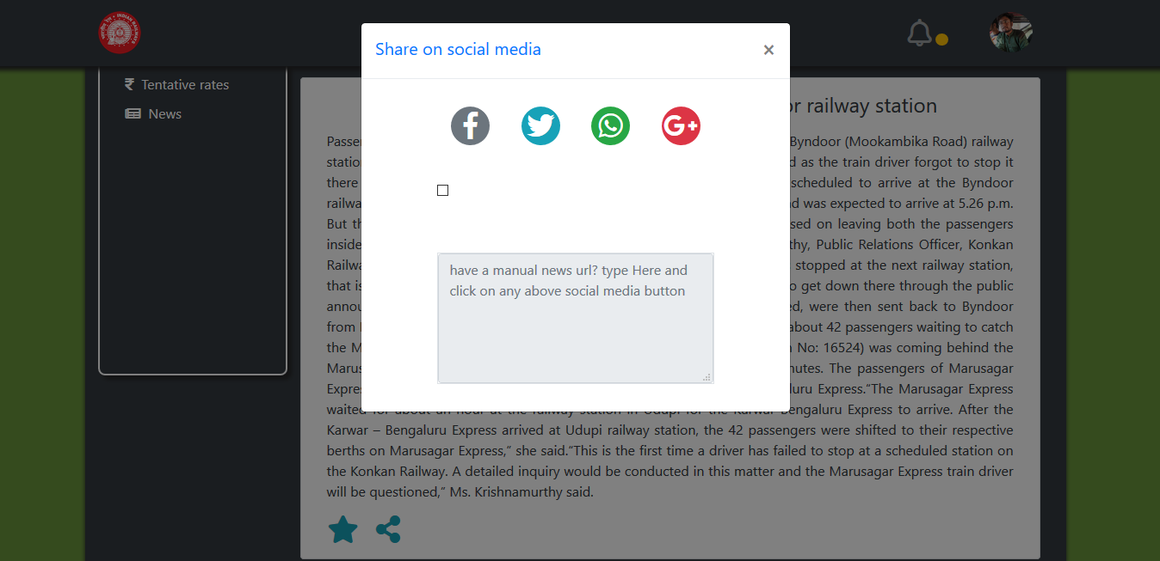
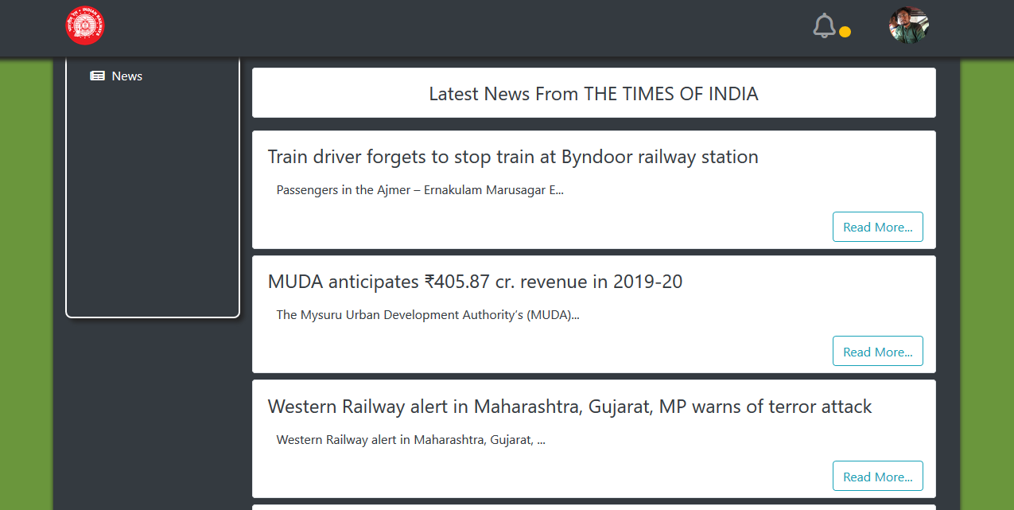
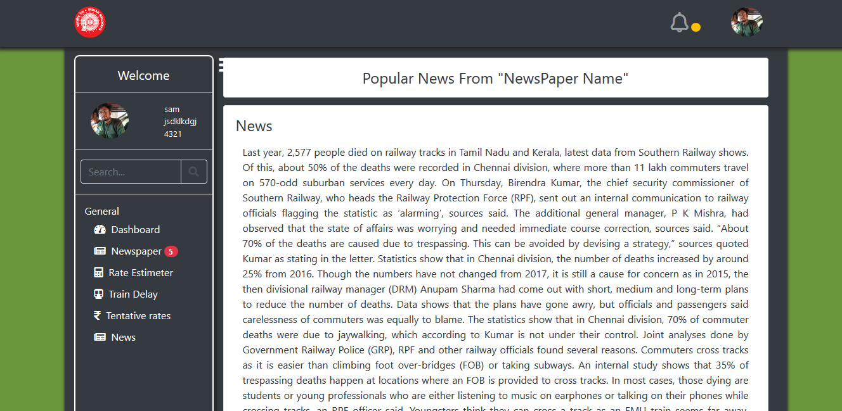

Slide 9
Fetching news in real time and providing notification
News under the tags Railways ,Trains, rail ,Ministry of Railways etc are being scrapped automatically from different newspapers and are updated on our website.
News are being fetched every 12 hours .
Notification bar present on the website gives notification after every 12 hrs & will notify on our email address.
News are fetched in 2 segments Prioritywise Manner & latest news .
Options like sharing news via WhatsApp, fb, twitter, YouTube and a Bookmark option is also available.

Slide 10
News Fetching
News will be updated in real time according to Sentiment Analysis which consist of 5 segments in a Priority wise Manner :-
1. Most negative News ( compound value less than -0.50 (i.e. 50 %)) at the top.
2. Most Positive News (compound value greater than +0.50)
3. Medium Negative News ( compound value b/w -0.50 & 0 )
4. Medium Positive News (compound value b/w 0 and 0.50 )
5. Neutral News (compound value equals to 0.0 )
NOTE :- We`ll be having a big data set in the database , so sorting will be acc. to compound (i.e. overall negative [towards left of 0] & positive [towards right of 0])

Slide 11
Future Possible Enhancements
We will highlight news according to their sentiment priority
Convert backend to Django - Rest-Framework, which more sophisticated for mobile apps
Users can share their own news via social media and any officer may send mail via smtp server to all or specific users.
News can be dispatched directly to the officer responsible in their department.
Colliding news can be tackeled via dandelion API, with text similarity algorithms.
Upvotes can be added which will later be used to verify FAKE NEWS and only real many upvoted will be displayed.
Cities can be Sorted and displayed statewise.

