Slide 1
VowCart
AI-Powered Universal Wedding Registry
Any product from any Shopify merchant - curated by AI, powered by Shopify's Universal Commerce Protocol.
Monetizable B2C + B2B
Aurora PostgreSQL + DynamoDB
Next.js on Vercel
Notes:
Hi, we're VowCart - an AI-powered universal wedding registry. Today registries are walled gardens; we open up the entire universe of products using Shopify's UCP, and we built it on Vercel with Aurora PostgreSQL and DynamoDB.

Slide 2
The problem - and why now
PROBLEM
• Today's “universal” registries aren't universal - catalogs are gated by merchant partnerships and one-off integrations.
• Couples juggle 3-4 registries; big-ticket gifts go unbought because no single guest will cover them.
• Brands never see the purchase-intent demand sitting inside registries.
MARKET
• ~2.0M US weddings / year · ~$63-70B US wedding industry
• 91% of couples create a registry - online has overtaken in-store
• ~$150 average guest gift · ~$33k average wedding
• Digital registry market ~$16B (2025) → ~$50B by 2033
Why now: Shopify's UCP opens the entire product universe - no per-merchant deals required.
Notes:
Incumbents like Zola or Amazon are limited to brands they've struck deals with. Meanwhile this is a huge, resilient market - 2 million US weddings a year, 91% register. What changed is Shopify's Universal Commerce Protocol: programmatic, keyless access to entire catalogs, so the whole product universe is suddenly addressable.

Slide 3
Our solution: VowCart
One universal registry. A two-sided business.
FOR COUPLES & GUESTS
• AI builds your registry from a few lifestyle questions
• Add any product from any Shopify merchant (UCP)
• AI Copilot to shape it by chat
• Group gifting & cash funds with live progress
• Reservations + real checkout, AI thank-you notes
FOR BRANDS (B2B / revenue)
• Separate merchant portal with its own auth
• Anonymized, aggregated demand analytics
• Which products & categories convert, network-wide
• Clearly-labeled sponsored placements
• Privacy by design - no individual user data exposed
Built on Vercel + Aurora PostgreSQL + DynamoDB, with AI via Vercel AI Gateway.
Notes:
VowCart is two products on one commerce graph. Couples get an AI-built, genuinely universal registry. Brands get privacy-safe demand analytics and sponsored placements - that's the monetization. It all runs on Vercel with Aurora and DynamoDB.

Slide 4
Live demo
▶
Demo video
In Canva: drag your .mp4 onto this slide, or paste the YouTube link to embed.
Live app: vowcart-ai-powered-wedding-registry.vercel.app
Notes:
Here's VowCart in action. [Play your 60-90s demo: onboarding -> AI builds the registry -> add a Shopify product -> group gift / cash fund -> public page + reserve -> merchant analytics.]

Slide 5
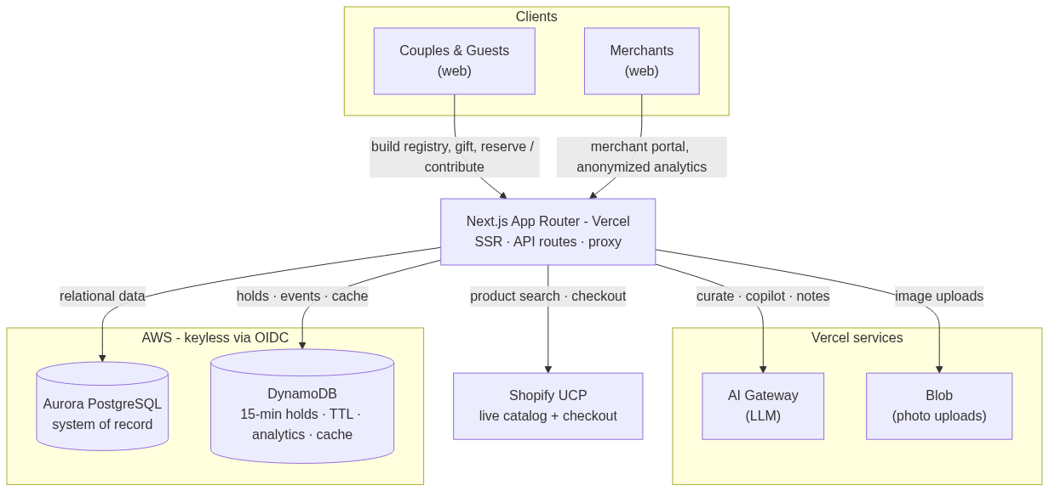
Architecture
Couples & Merchants → Next.js on Vercel → Aurora PostgreSQL (system of record) + DynamoDB (TTL holds, analytics, AI cache). Shopify UCP for live catalog + checkout. Keyless via OIDC.
Notes:
Architecture: a Next.js app on Vercel serves both the couple app and the merchant portal. Aurora PostgreSQL is our relational system of record; DynamoDB handles the 15-minute reservation locks with native TTL, analytics events, and an AI cache. Shopify UCP gives us the universal catalog and checkout. AWS access is keyless via OIDC.

Slide 6
Thank you
VowCart - AI-Powered Universal Wedding Registry
Live app: vowcart-ai-powered-wedding-registry.vercel.app
Built on Vercel + Aurora PostgreSQL + DynamoDB · powered by Shopify UCP
Notes:
Thank you! Happy to take questions. The app is live at the link on screen.

