Slide 1

UNIVERSITY OF ASIA PASIFIC
Department of Computer Science & Engineering
Mini Compiler Design Project
Course Title: Compiler Design Lab
Course code: CSE 430
Submitted By
Jannatun Saumoon
Id: 21201066
Section: B₂

Slide 2
A Mini C Compiler built using Lex, Yacc, , GCC, and Python.It processes Mini-C programs through all major compiler phases — from tokenization to assembly generation. Also reads Mini-C programs step by step,checks for errors,and analyzes the code. Finally, it generates intermediate code as the output.
Introduction
Main Phases:
Lexical Analysis
Syntax Analysis
Semantic Analysis
Intermediate Code Generation
Code Optimization
Assembly Code Generation

Slide 3
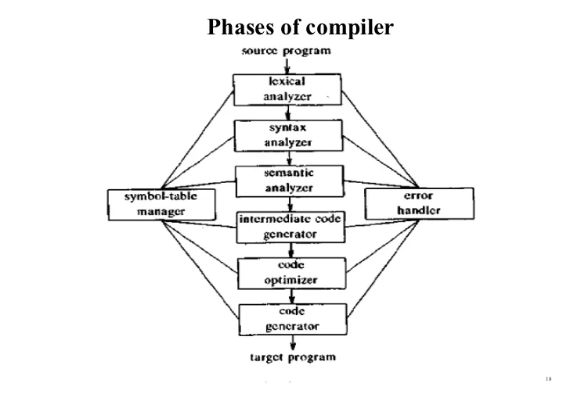

Slide 4
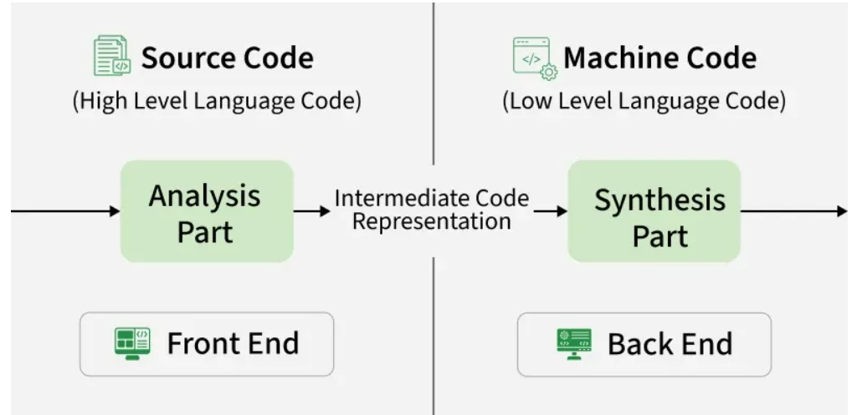
Design Overview
A compiler mainly works in two phases:
Analysis Phase (Front-End)
Lexical
Syntax
Semantic
Intermediate Code Generation
Synthesis Phase (Back-End)
Code Optimization
Code Generation

Slide 5
Lexical Analysis
Role:
Acts as the first phase of the compiler.
Converts raw source code into a stream of tokens.
Serves as a bridge between the source code and syntax analysis.
Functions:
Scans the code and removes spaces/comments.
Breaks the program into tokens.
Detects invalid tokens and passes valid ones to the next phase.
Tools: Lex, GCC
Command:
cd ‘1.Lexical Analysis’
lex lexer.l
cc lex.yy.c
./a.out

Slide 6
Syntax Analysis
Role:
Acts as the second phase of the compiler.
Checks whether the token sequence follows the grammar rules.
Verifies the structure of the program and builds a parse tree.
Functions:
Ensures syntactic correctness of the code.
Detects and reports syntax errors.
Passes the parse tree to the next phase.
Tools: Lex, Yacc, GCC
Command:
cd ‘2.Syntax Analysis’
lex parser.l
yacc parser.y
gcc y.tab.c -ll -w
./a.out test1.c

Slide 7
Semantic Analysis
Role:
Acts as the third phase of the compiler.
Checks the meaning of the code to ensure it’s logically correct.
Verifies declarations, types, and variable scope.
Functions:
Ensures semantic correctness of the program.
Maintains and updates the symbol table.
Detects type mismatches and undeclared variables.
Tools: Lex, Yacc, GCC
Command:
cd '3.Semantic Analysis’
lex parser.l
yacc parser.y
gcc y.tab.c -ll -w
./a.out test1.c

Slide 8
Intermediate Code Generation(ICG)
Role:
Acts as the fourth phase of the compiler.
Converts the verified syntax tree into intermediate, machine-independent code.
Serves as a bridge between high-level source code and target machine code.
Functions:
Generates Three-Address Code (TAC) for easier optimization and translation.
Breaks complex expressions into simple operations.
Prepares the program for target code generation.
Helps in detecting logical structure errors before final code generation.
Tools: Lex, Yacc, GCC
Command:
cd 4.ICG
lex parser.l
yacc parser.y
gcc y.tab.c -ll –w
./a.out test1.c

Slide 9
Code Optimization
Role:
Acts as the fifth phase of the compiler.
Improves the efficiency of the intermediate code without changing its output.
Reduces unnecessary instructions and enhances performance.
Functions:
Eliminates redundant operations and dead code.
Simplifies expressions and optimizes variable usage.
Enhances code execution speed and reduces memory usage.
Produces cleaner and more efficient intermediate code for final generation.
Tools: Python
Command: cd '5.Code Optimization’
python3 icg_opt.py input.txt --print

Slide 10
Assembly Code Generation
Role:
Acts as the final phase of the compiler.
Translates optimized intermediate code into target assembly instructions.
Produces low-level code ready for execution on the machine.
Functions:
Converts three-address code (TAC) into equivalent assembly code.
Allocates registers and manages instruction sequencing.
Generates output file representing final machine-level operations.
Ensures correctness and efficiency of the generated assembly.
Tools: Python
Command:
cd '6.Assembly Code Generation’
python3 gen.py icg.txt

Slide 11
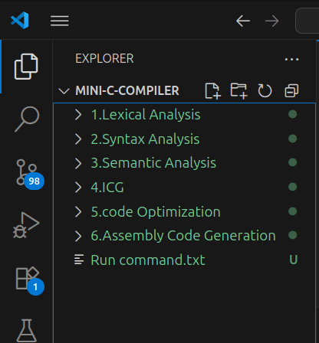
Project File Structure
This structure represents how the Mini C Compiler project is organized in Visual Studio Code.
Each folder represents a specific compiler phase, keeping the project modular and easy to maintain.

Slide 12
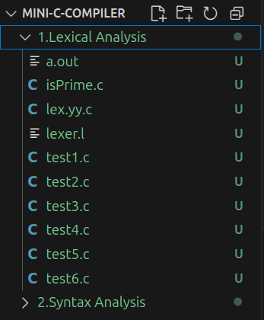
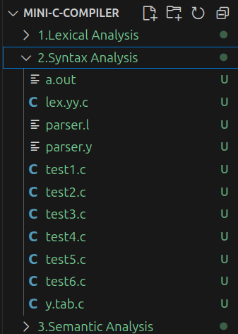
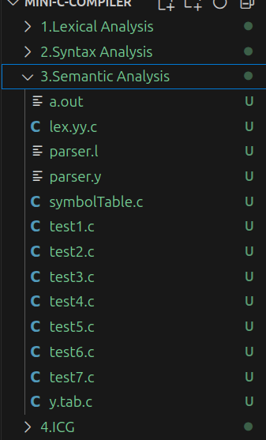
1.
2.
3.
Fig: Lexical Analysis
Fig: Syntax Analysis
Fig: Semantic Analysis

Slide 13
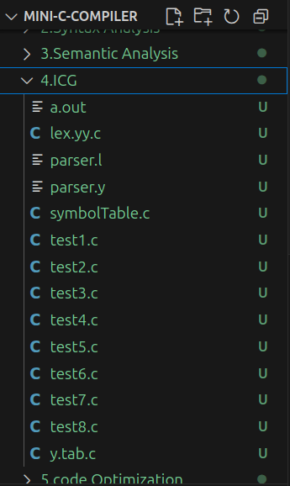
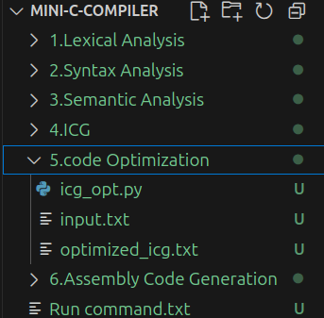
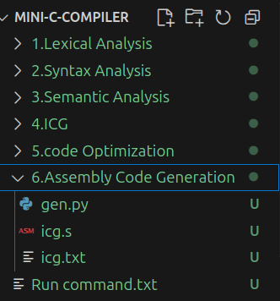
4.
5.
6.
Fig: ICG
Fig: Code Optimization
Fig: Assembly Code Generation

Slide 14
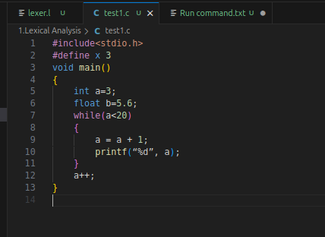
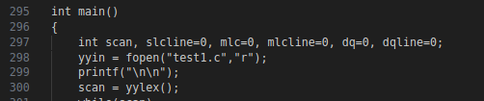
Results
1. Lexical Analysis
Input:

Slide 15
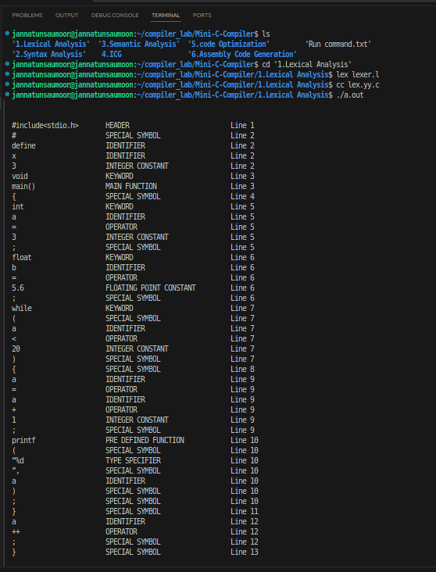
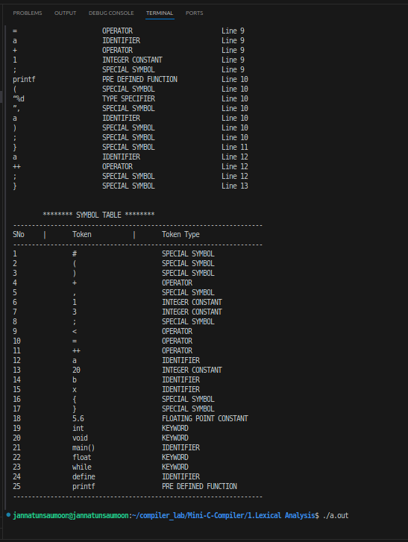
Output:

Slide 16
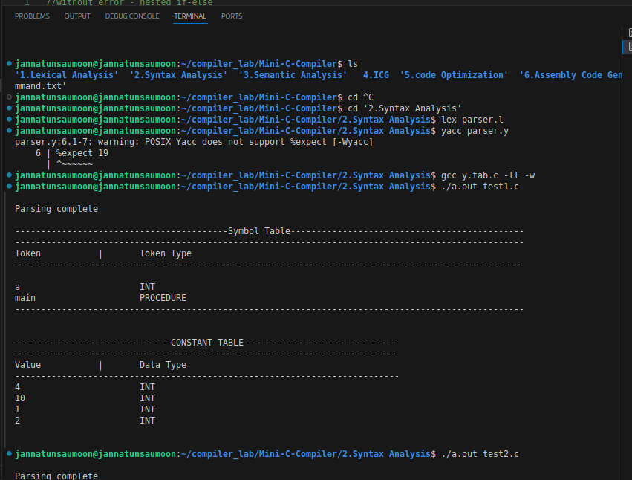
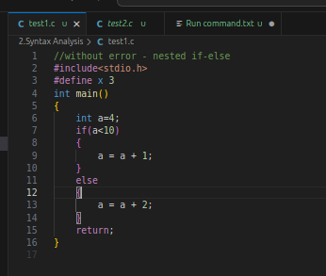
2. Syntax Analysis
Input:
Output:

Slide 17
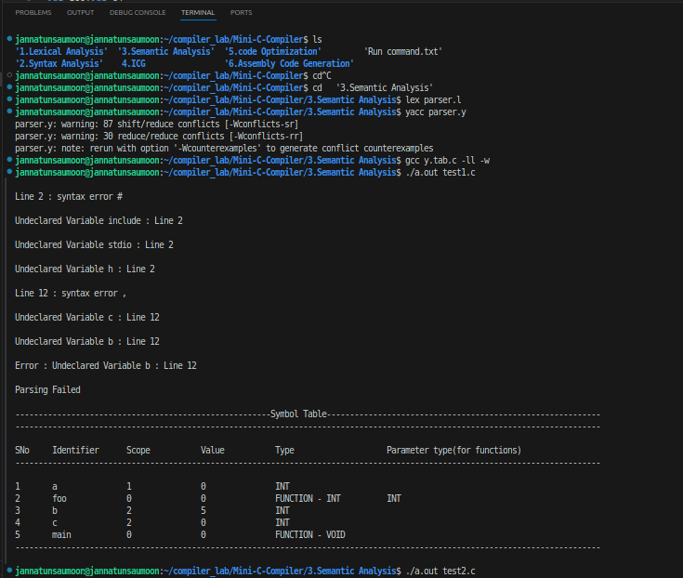
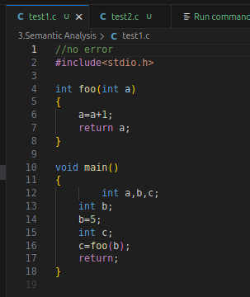
3. Semantic Analysis
Output:
Input:

Slide 18
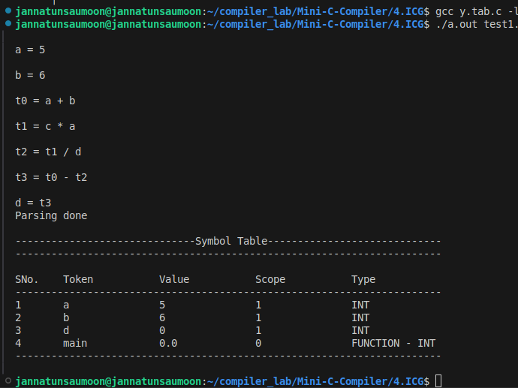
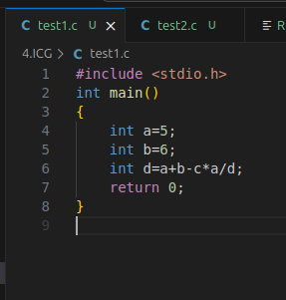
4. Intermediate Code Generation(ICG)
Input:
Output:

Slide 19
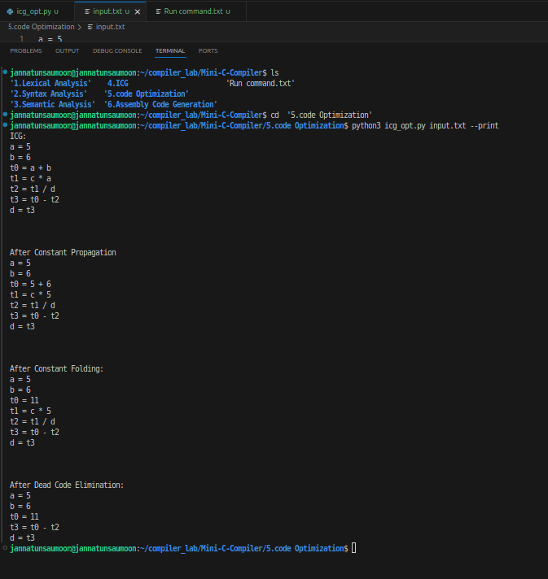
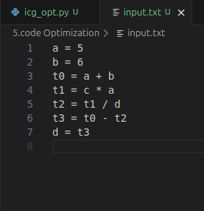
5. Code Optimization
Output:
Input:

Slide 20
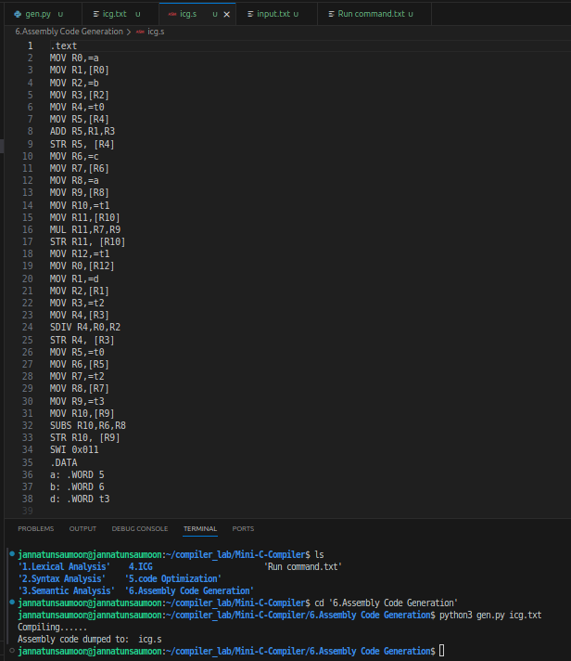
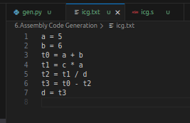
6. Assembly Code Generation
Output:
Input:

Slide 21
Conclusion
The Mini C Compiler covers the main front-end and Back-End phases: Lexical, Syntax, Semantic, Intermediate Code Generation, Code Optimization and Assembly Code Generation.
It shows how source code is analyzed and transformed step by step using Lex, Yacc, C, GCC, and Python.
Future Work: Add full machine code generation and advanced optimizations.

Slide 22


