Slide 1

Coding Masters
LibConnect Pro
AI-Augmented Library Management Platform
Saumya Patel Madhusudhan Poduturu Hakhilesh Neelamegan
Advanced Software Engineering COSC 6370.001

Slide 2






What is a Library Management System?
A Library Management System (LMS) is software that helps libraries organize and automate their day-to-day operations — making it easier for librarians to manage collections and for users to find, borrow, and return materials.
Books in the Library
Who Borrowed What
Due Dates & Late Returns
Fines
Reports & Analytics
•
Catalog of all books & materials
•
Records of every loan transaction
•
Sets return deadlines for each loan
•
Calculates fines for late returns
•
Most borrowed titles & categories
•
Organized by title, author & subject
•
Links each book to the borrower
•
Sends reminders before due date
•
Maintains fine balance per member
•
Active member usage statistics
•
Tracks available vs. checked-out copies
•
Full borrowing history per member
•
Automatically flags overdue items
•
Staff can review and clear fines
•
Inventory & acquisition reports
•
Supports physical & digital collections
•
Separate access for staff vs. members
•
Supports renewals when no holds exist
•
Encourages timely returns of books
•
Helps guide purchasing decisions

Slide 3



WHY THIS PROJECT?
Direct Impact on Islanders
Real-World Engineering Challenge
We chose to upgrade OUR OWN college library portal — a tool every TAMU-CC student relies on. A better portal means less time searching, fewer missed due dates, and stronger research outcomes for thousands of students each semester.
Building for an existing institution means dealing with real constraints: legacy workflows, multi-role access, compliance, and scalability. It's a richer engineering problem than a greenfield app — and our solution proves it.
"Instead of investing our time in a random external app, we decided to focus on our own university library system so that every hour we spend directly improves the tools and services we and our classmates actually use on campus."

Slide 4




EXECUTIVE SUMMARY
LibConnect Pro is a comprehensive, AI-augmented library management platform designed to streamline interactions between university librarians, students, and faculty. It addresses manual tracking, late returns, poor discovery, and lack of research guidance through automation, AI analytics, AR navigation, and semantic search.
Admin Dashboard
Student Portal
AI & AR Layer
Inventory, analytics, fine management & financial oversight
Advanced search, research tools & account management
Demand forecasting, semantic search & AR navigation

Slide 5







FEATURE GAP ANALYSIS
= Exists in TAMUCC library
= Gap / New Feature
Feature
Description
TAMUCC Library
LibConnect Pro
Priority
Real-Time Stock Alerts
Notify users when out-of-stock books return
High
Automated Fine Blocking
Hard-block borrowing when fines exceed limit
High
Smart Loan Periods
Dynamic loan durations based on demand
High
Due-Date Reminders
Auto alerts at 60% & 100% of loan period
High
Demand Predictor (AI)
Forecast high-demand books by season/course
High
AR Shelf Navigator
Mobile AR to locate books on shelves
Medium
Semantic / NLP Search
Topic-cluster based book discovery
High
AI Research Helper
AI chatbot for research guidance & strategy
High
Research Tracker
Milestone-based research progress tracker
Medium
Usage Analytics Dashboard
Visual insights on trends & popular resources
Medium
Fine Clearance Module
Librarian tool to verify & override fines
Partial
Medium
Basic Book Catalog Search
Search books by title/author/keyword
—
LibConnect Pro introduces 10 new features + enhances 1 existing feature compared to the current Bell Library portal.

Slide 6

APPLICATION GOALS
01
02
03
04
Automate Inventory Control
Enforce Academic Accountability
Enhance User Experience
Intelligent Demand Forecasting
Real-time tools for librarians to manage stock, updates, and removals efficiently.
Automated fine system ensuring on-time returns and maintaining resource availability.
Reduce out-of-stock frustration via automated notifications and proactive alerts.
Predict high-demand books for exam seasons to optimize acquisition decisions.
05
06
07
08
Improve In-Library Navigation
Enable Advanced Discovery
Expose Actionable Analytics
Scaffold Research Activities
AR-guided shelf navigation to help students locate books faster.
Semantic topic-cluster search for related materials and refined research queries.
Usage and trending topic dashboards for strategic decisions by librarians and faculty.
Progress tracking, milestones, and AI-powered research assistance.

Slide 7







CORE FEATURES — AI & SMART CAPABILITIES
AI
Analytics
AR
Demand Predictor
Usage Analytics
AR Navigator
Analyzes historical borrowing and course data to forecast high-demand books for acquisition planning.
Visual dashboard showing most viewed resources, active user segments, and hot research topics.
Mobile AR guidance helping students locate books on shelves, reducing physical search time.
NLP
Productivity
AI
Semantic Search
Research Tracker
AI Research Helper
NLP-based search grouping results by topics and related themes for effective discovery.
Organizes research into phases, sets milestones, and tracks progress with suggested next steps.
AI-powered chatbot assisting with research formulation, source discovery, and strategy refinement.

Slide 8





Project Progress & Implementation
Research
Core Dev
AI Integration
Evaluation
TAMU-CC workflow analysis, feature gap identification, and system architecture design.
Backend microservices, dual-panel UI development, and inventory management module.
Demand predictor, semantic search implementation, and AR navigation testing.
Performance benchmarking, resilience testing, and final system deployment.
Current Status: Phase 3 — AI & Smart Capabilities Integration

Slide 9
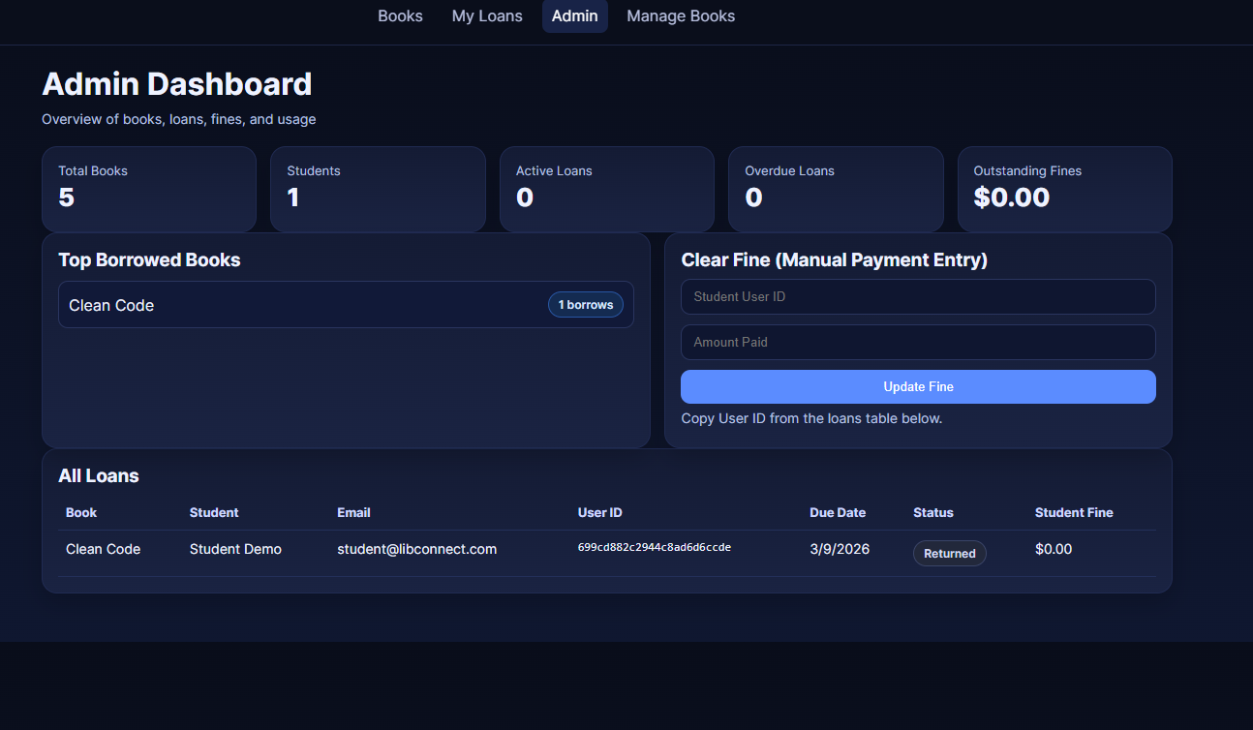

Slide 10
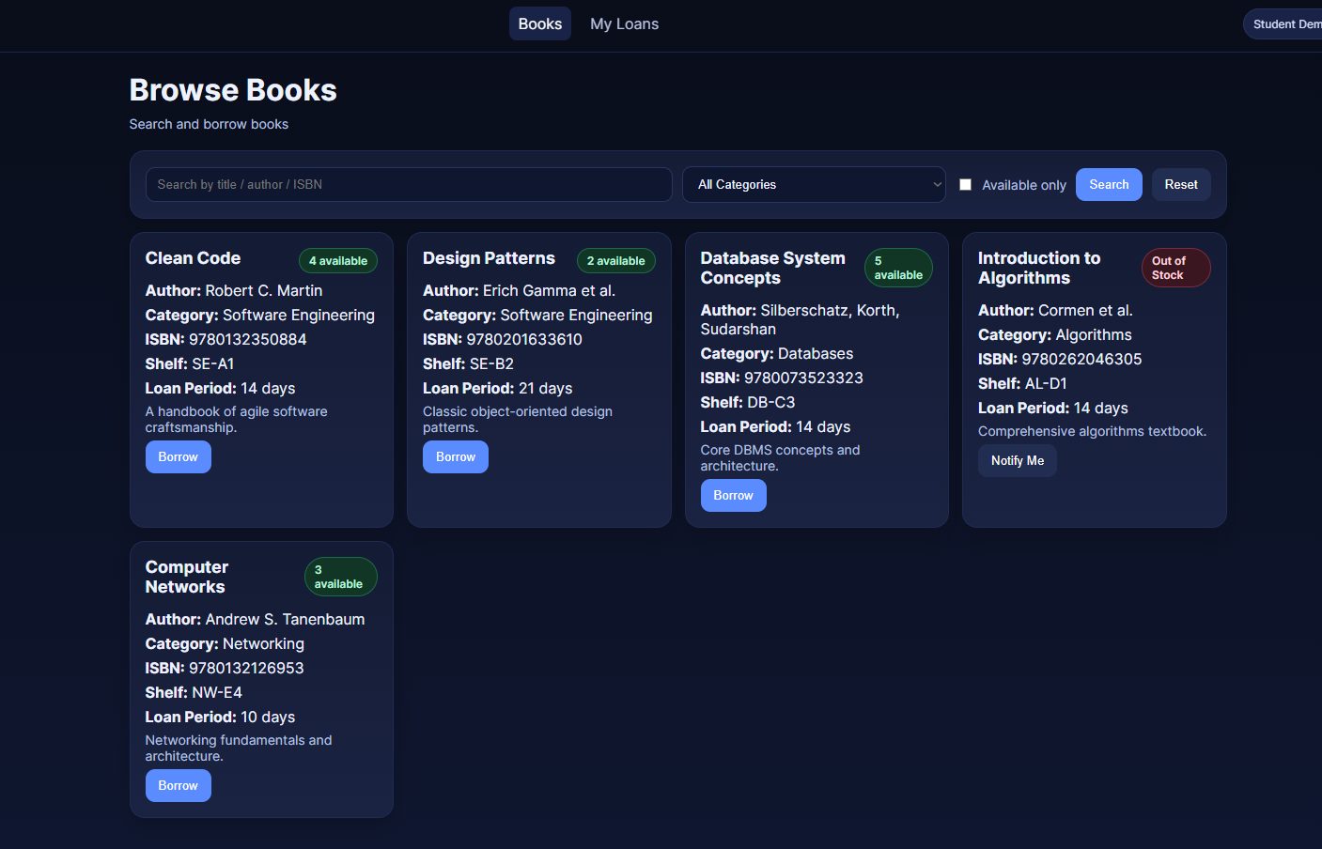

Slide 11

Thank You
LibConnect Pro — Coding Masters
Saumya Patel · Hakhilesh Neelamegan · Madhusudhan Poduturu
COSC 6370.001 · Advanced Software Engineering · Feb 2026

