Slide 1
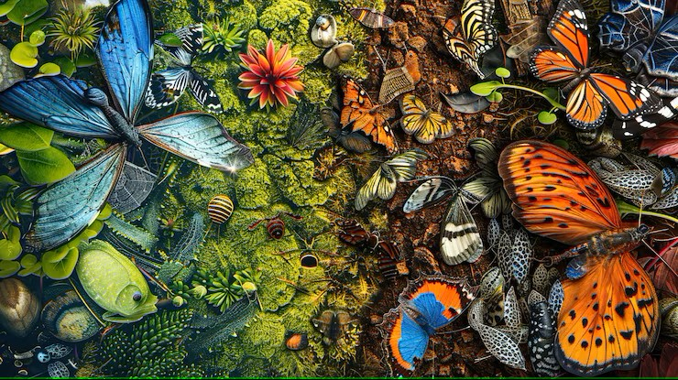
Biodiversity: The Web of Life
By: Saumya Kanti Sarma
FY-BCA-B
Roll: 2570

Slide 2
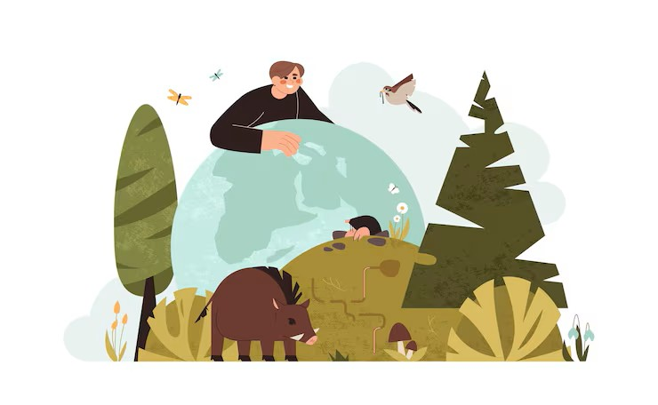
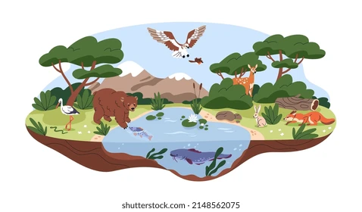

What is Biodiversity?
Biodiversity means the variety of living organisms on Earth. This includes:
plants
animals
Fungi and
microorganisms.
Genetic Diversity
Species Diversity
Ecosystem Diversity

Slide 3
Types of Biodiversity
Genetic diversity
Variation of genes within a species. Every individual of a species carries slightly different versions of genes
Example:
Different breeds of dogs (same species, but different genes).
Rice varieties that resist drought or pests.
Why it matters:
Helps species adapt to changing environments or diseases.
Increases chances of survival and evolution.
Basis for natural selection.
Species diversity
Variety of different species within a particular region or ecosystem.
Example:
A rainforest might have tigers, monkeys, birds, insects, and plants — all different species.
Coral reefs have thousands of species of fish and corals.
Why it matters:
The more species there are, the more stable and resilient an ecosystem becomes.
Each species plays a specific role (for example, bees pollinate, decomposers recycle nutrients).

Slide 4
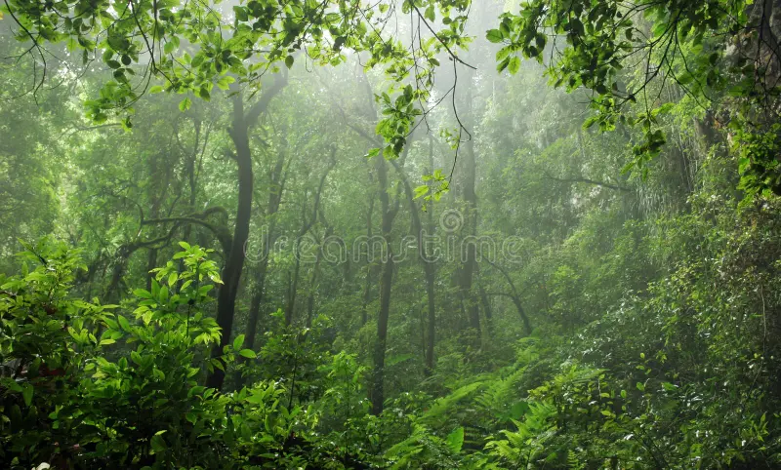
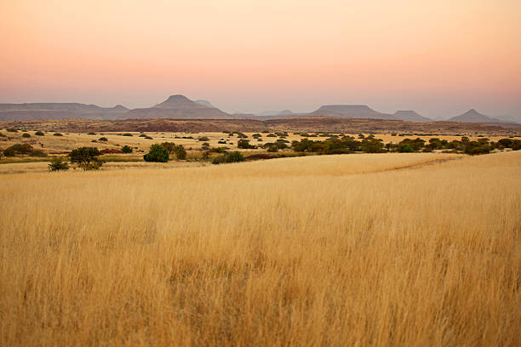
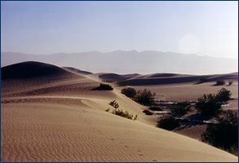
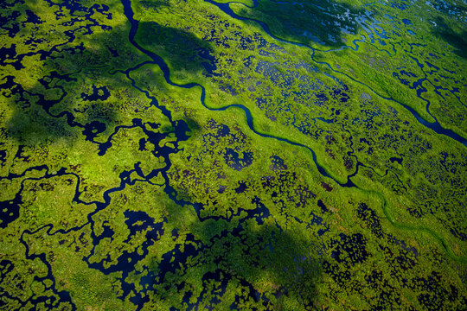
Types of Biodiversity
Ecosystem diversity
Variety of ecosystems within a geographic area or across the planet.
Example:
Forests, grasslands, deserts, wetlands, and coral reefs — all are unique ecosystems.
Each has different climate, soil, and species adapted to it.
Why it matters:
Provides a wide range of habitats and resources.
Supports all forms of life and natural cycles (like the water and carbon cycles).
Ensures the planet’s ecological balance.
Examples of ecosystem diversity:
Forest
Grassland
Desert
Wetlands

Slide 5
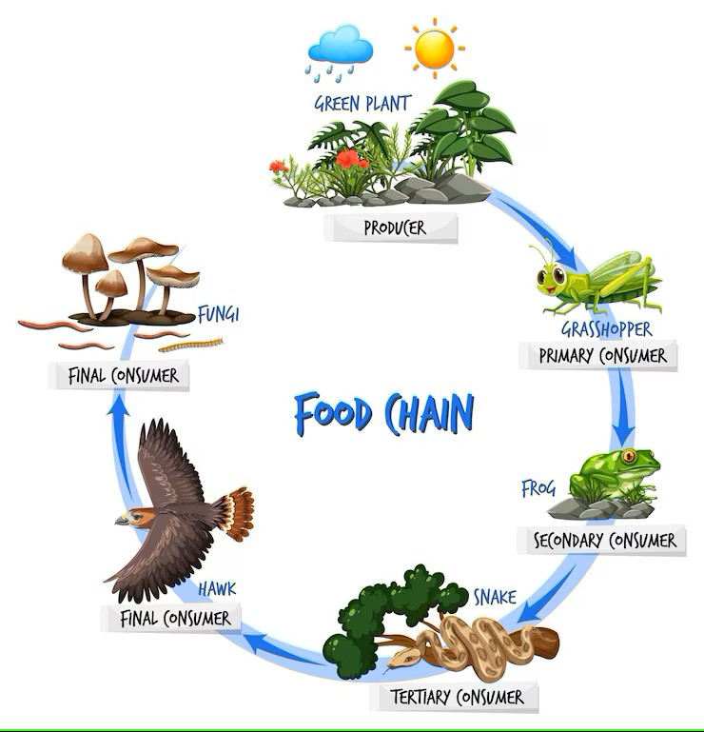
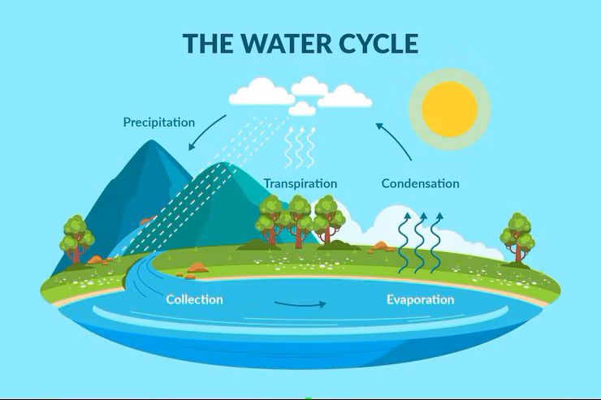
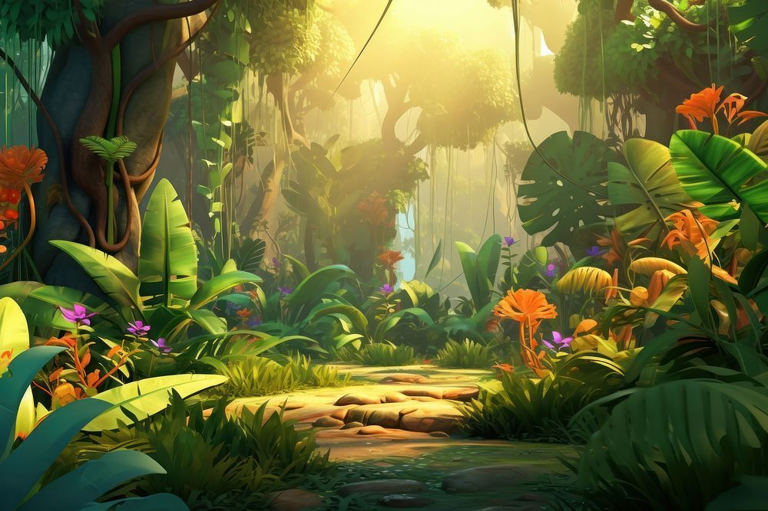
Importance of Biodiversity
Biodiversity is very important to us because:
Provides food, medicine, and raw materials.
Maintains balance in ecosystems (pollination, water cycle, oxygen production).
Supports climate stability and soil fertility.
Source of cultural and recreational value.

Slide 6
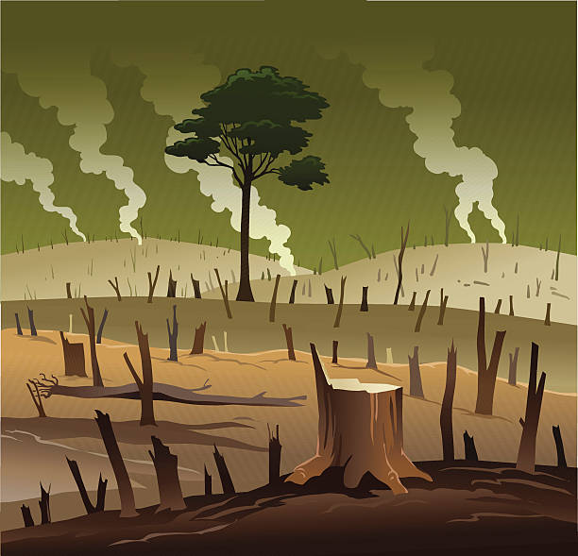
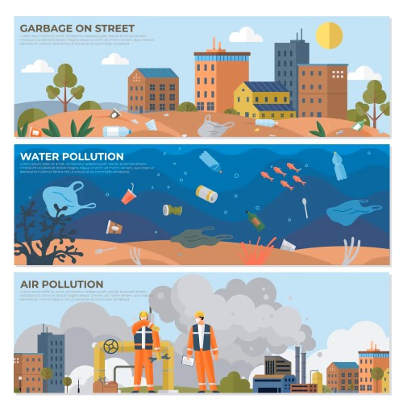

Threads to Biodiversity
Highlight key dangers:
Deforestation
Pollution
Climate change
Overexploitation (hunting, fishing)
Habitat loss due to urbanization

Slide 7

Protecting Biodiversity
Solutions and calls to action:
Wildlife conservation & protected areas
Plant more trees
Reduce pollution & waste
Support sustainable products
Spread awareness and educate others
“The Earth is what we all have in common…” Wendell Berry

Slide 8
Thank You
FY-BCA-B
Roll: 2570

