Slide 1
HackFest
Jabalpur2019
Developing the smart solutions for semi-urban and rural areas

Slide 2

UPKAAR

Slide 3
Social Welfare and Development
A viable solution that impacts the society positively
Sparsh Ahuja | Rakshak | Saumya Mishra

Slide 4
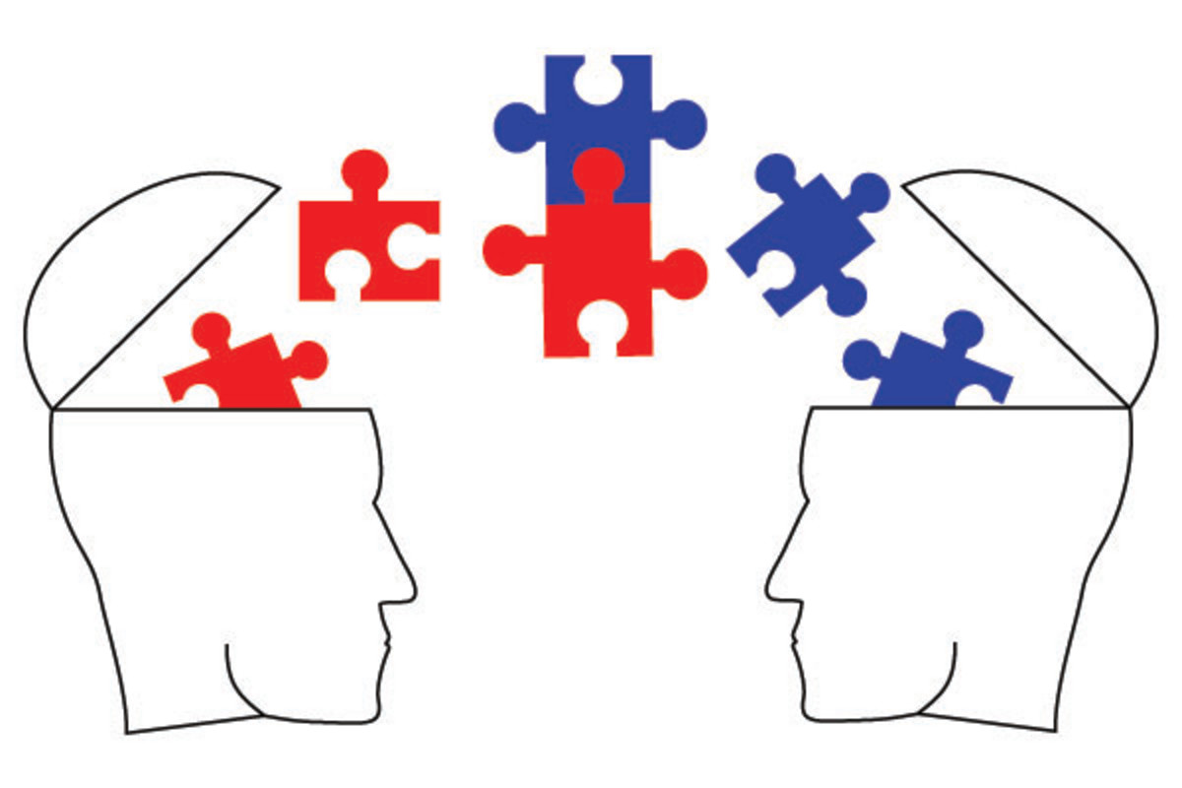
IDEOLOGY

Slide 5

FEATURES

Slide 6

Features
The idea is to build an online donation system for the underprivileged community
A registered user fills in the information about the items he wants to donate along with his comfortable time of pickup on the webapp

Slide 7
Features
The corresponding government department based on travelling logistics designs a pickup schedule every last weekend of a month and the collected items are donated to the poverty-stricken sections on last two days of that month
The user is also awarded donation credits based on his contribution made towards the upliftment of society

Slide 8
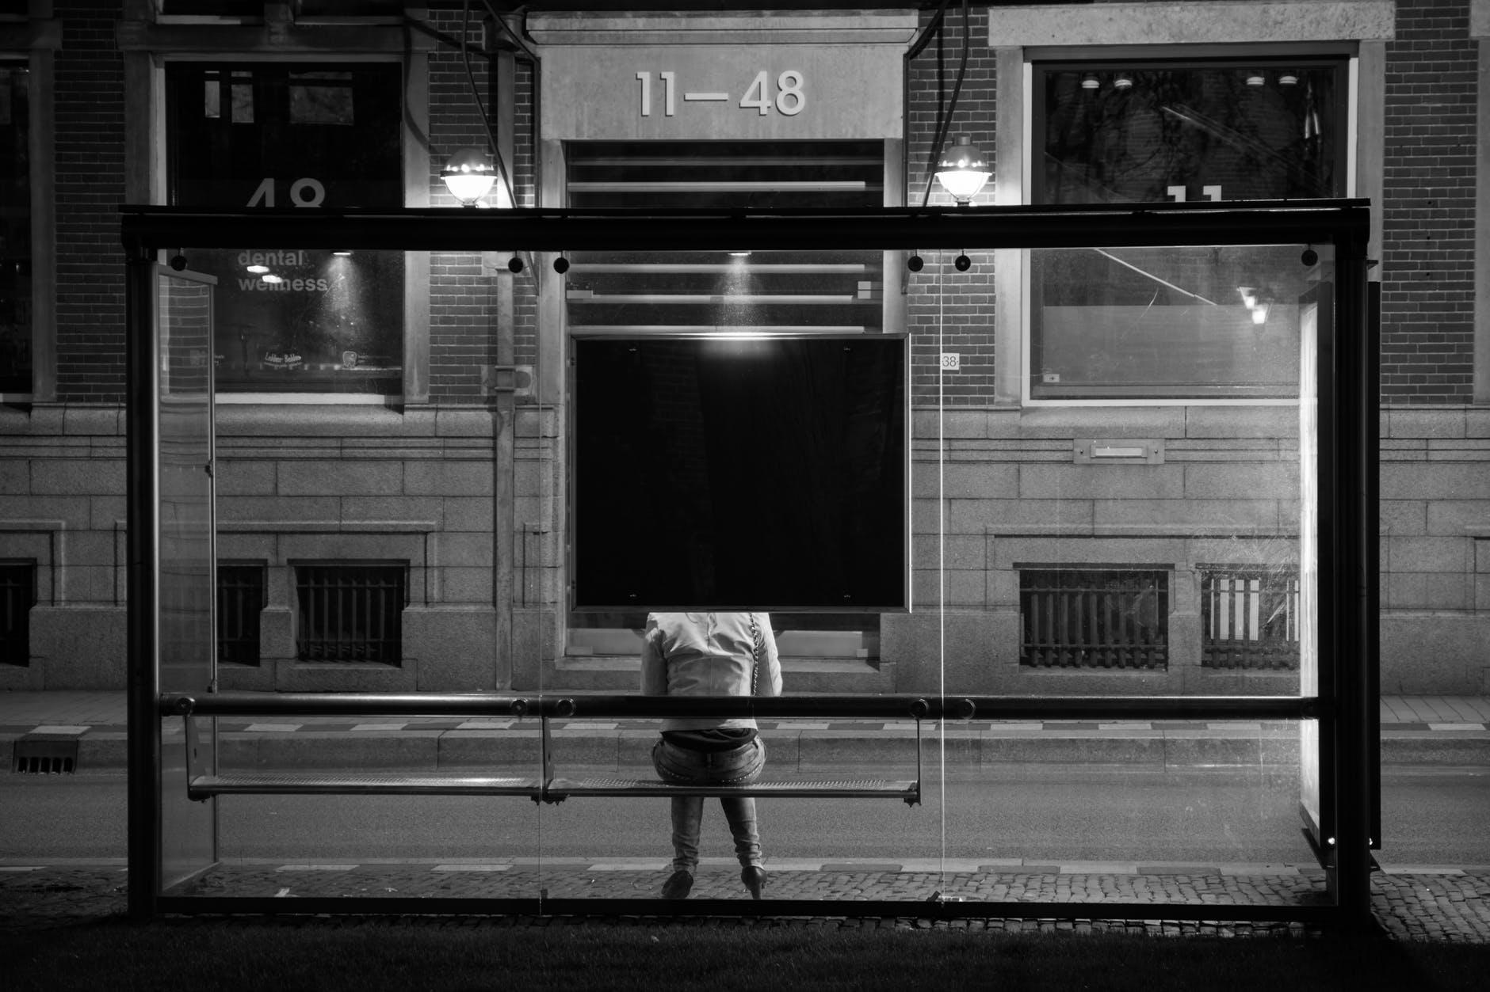
Abstract

Slide 9
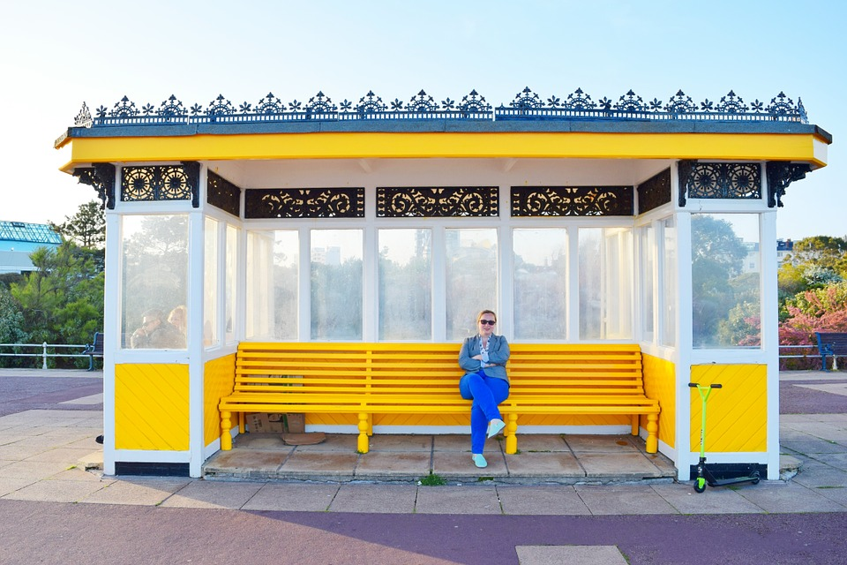
Abstract
In this world full of hustle and bustle today, when each one of us is busy catering our own whims and fancies, do we even care to watch, not for ourselves but others
So just to shatter this confined space we live in, we bring forward this innovation of ours as a radical solution to serve the incessant hardships faced by the underprivileged community

Slide 10
Abstract
Here we introduce you to our web application that serves the purpose of easing out your welfare oppurtunities

Slide 11

Abstract
Now you get to donate your
personal belongings ranging over your clothes, footwear and even your used books
Here we bestow you with a chance to let a smile be a part of that one face that till now craved for that one act of your benevolence

Slide 12

Abstract
Feel Lucky , and make them feel the Same!

Slide 13
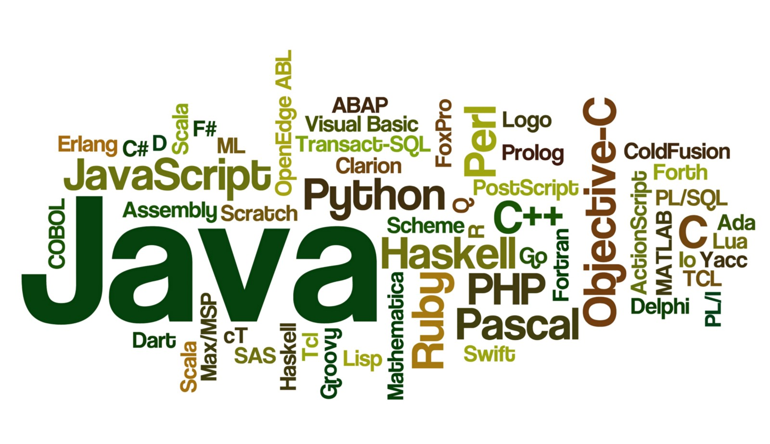
Languages
Used

Slide 14
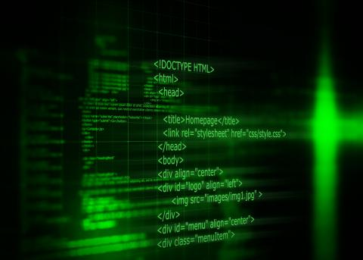
Language
HTML
CSS
JavaScript
PHP
MySQL

Slide 15

FrameWorks
&
Platforms

Slide 16

Frameworks
& Platforms
Bootstrap
PhpMyAdmin
Git Hub

Slide 17

Goals Hereafter
Add more features
User Study
Award credits to contributers
Interface Improvisation

Slide 18
Thank You!
Sparsh Ahuja | Rakshak | Saumya Mishra

