Slide 1
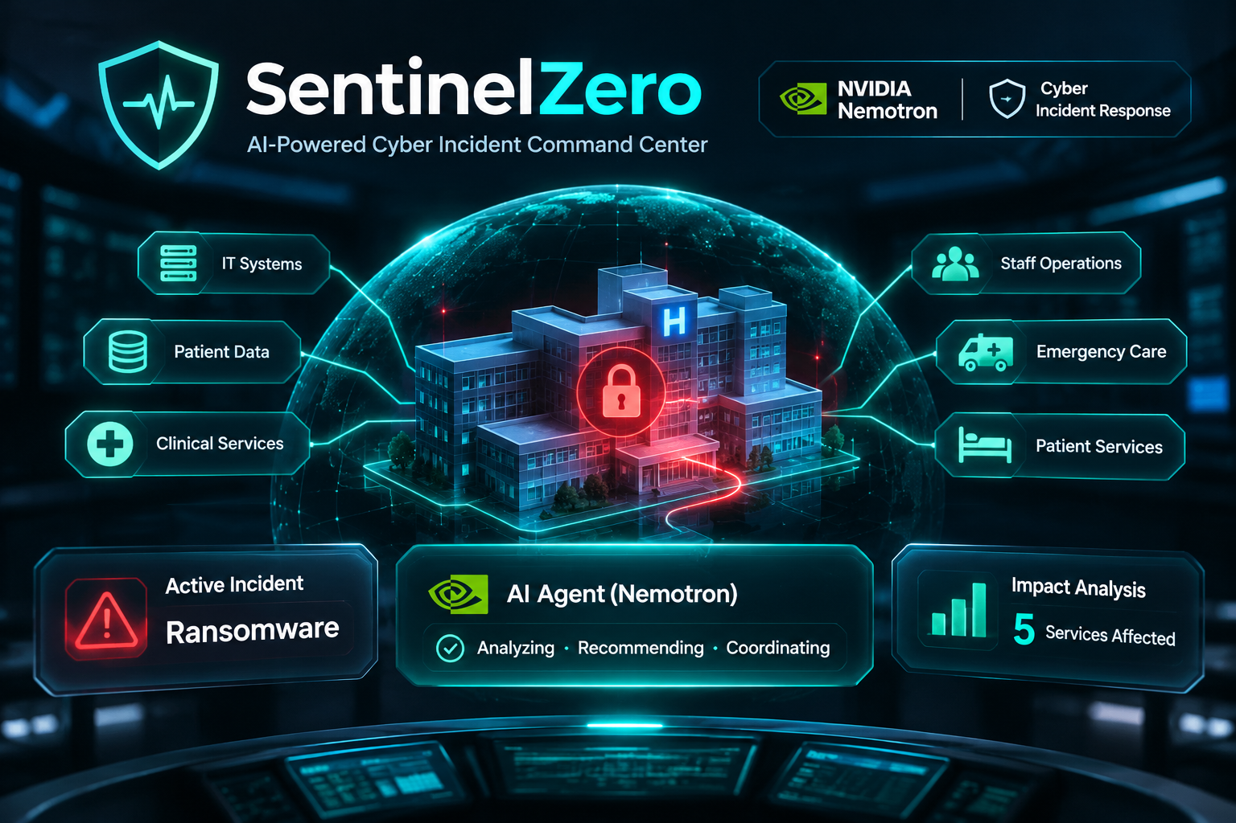
CYBER INCIDENT COMMAND • AGENTIC AI
When systems fail,
command continues.
SentinelZero | HackUTD 2026
Cyber-to-human impact intelligence + human-controlled Nemotron workflows
NVIDIA: tool-using agents
WINSTEAD: independent incident command
Prototype demonstration • synthetic incidents • no production security certification
SENTINELZERO / NVIDIA NEMOTRON + WINSTEAD PC
01
Notes:
Opening (15 sec): Imagine your hospital’s identity, email, and clinical systems all fail together. Your response team still needs a trusted place to coordinate. SentinelZero is designed to be that independent command layer. This presentation distinguishes implemented code from verified deployment. The background is conceptual artwork, not a screenshot of a live app.

Slide 2
THE PROBLEM
The attack is only half the emergency.
What happens after a cyber incident is detected determines how much disruption follows.
$4.99M
56%
1 in 4
AVERAGE BREACH COST
INCREASE IN AI-ENABLED ATTACKS
MALICIOUS BREACHES AI-ENABLED
IBM 2026 global study; market context
IBM 2026; not a SentinelZero result
IBM 2026 findings
The operational failure: the team loses a shared picture.
Compromised email • Fragmented evidence • Unclear service impact • Uncoordinated approvals
Sources: IBM 2026 Cost of a Data Breach Report, Jul 29 2026 (ibm.com / newsroom.ibm.com).
HACKUTD 2026 / SENTINELZERO
02
Notes:
Problem setup (15 sec): IBM reported a $4.99 million global average breach cost in its 2026 study and a 56% increase in AI-enabled attacks. Those are industry-wide figures, never a claim that SentinelZero already reduces cost. The real problem we target is losing situational awareness and command during compromise.

Slide 3
WHY NOW
Your normal tools may be compromised.
Winstead’s threat assumption: act as though an adversary can access internal systems.
EMAIL & IDENTITY
INCIDENT RECORDS
The attacker may see messages or disable sign-in.
Findings scatter across chats, spreadsheets, and tickets.
SERVICE CONTINUITY
DECISION AUTHORITY
A broken server can interrupt critical human workflows.
AI or responders must not execute actions without approval.
SentinelZero is designed as an independent response plane—not a replacement for SIEM, EDR, or forensic tools.
HACKUTD 2026 / SENTINELZERO
03
Notes:
Explain the Winstead challenge: the incident response channel should not depend on compromised corporate AD, mail, DNS, or endpoints. The code implements many server-side safeguards, but a separately hosted production system has not been independently penetration tested.

Slide 4
OUR ANSWER
One command picture. One accountable workflow.
SentinelZero bridges technical findings, operational continuity, human decisions, and evidence.
01
DOCUMENT
Structured incident states and scope
02
UNDERSTAND
Cyber → service → human impact
03
COORDINATE
Tasks, roles, secure team messages
04
RECOMMEND
Nemotron-powered multi-step analysis
05
AUTHORIZE
Commander approves; AI cannot self-execute
HACKUTD 2026 / SENTINELZERO
04
Notes:
Value prop (20 sec): Our command center provides structured documentation, impact mapping, collaboration, agentic investigation, and controlled execution. The correct promise is coordinated, evidence-informed response—not magic prevention or automatic eradication.

Slide 5
THE WEB APP
Eight surfaces. One incident response experience.
The codebase includes these dedicated interfaces; some currently use exercise-mode data.
COMMAND CENTER
DATA SCOPE LEDGER
IMPACT GRAPH
TASKS & APPROVALS
KPIs + incident lifecycle
Locked vs exfiltrated data
Interactive 2D + 3D map
Assigned actions + sign-offs
OUT-OF-BAND COMMS
TEAM & ACCESS
AUDIT & EVIDENCE
NEMOTRON CONSOLE
Incident-specific team messaging
Members + role permissions
Hash chain + evidence records
Four-stage AI investigation
Source: current main branch, apps/web/src/components and apps/web/src/pages (Nov 8, 2026).
HACKUTD 2026 / SENTINELZERO
05
Notes:
Quick feature tour (15 sec): On live app, point to left navigation: dashboard, scope, graph, tasks, communications, team access, audit, and AI. Demo visually clean and animated UI, but do not mistake local role switcher for real authenticated browser sessions.

Slide 6
OUR DIFFERENTIATOR
Cyber-to-Human Impact Graph
Not just “which server is down?” — “which essential service depends on it?”
L0 / CYBER ASSET
→
L1 / SERVICE
→
L2 / HUMAN UNIT
EHR Database • SUSPECTED
Clinical charting • OUTAGE
ER / ICU • AT RISK
Two graph modes, one evidence model
React Flow: accessible 2D / React Three Fiber: exploratory 3D / UNKNOWN ≠ SUSPECTED ≠ CONFIRMED
Illustrative graph relationships; fictional hospital exercise. Dependency does not prove patient harm.
HACKUTD 2026 / SENTINELZERO
06
Notes:
Core story (25 sec): Click Impact Graph; switch 2D/3D; click a node, walk judges from infrastructure to dependent services to potentially affected staff. We are very careful: a graph edge is an operational dependency, not automatic proof of patient harm. The demo data is synthetic.

Slide 7
NVIDIA TRACK
Beyond chat: four focused agent stages
An orchestrator carries one shared execution budget and restricts tools by stage.
01
02
03
04
TRIAGE
IMPACT
CONTAINMENT
COMMS
Find verified facts and open questions
Trace assets → dependencies → services
Propose next tasks, never execute
Draft an operational situation report
CONTROL PLANE: READ-ONLY TOOLS → VALIDATED OUTPUT → HUMAN APPROVAL
Source: services/ai/app/agents/orchestrator.py and subagents.py; default AI_AGENT_MODE=orchestrated.
HACKUTD 2026 / SENTINELZERO
07
Notes:
NVIDIA case (25 sec): Show Subagent Pipeline in AI modal. Triage, impact, containment, and communications are separate bounded stages. Each has a tool allowlist. The communication agent drafts but does not send. Any proposal is pending. The default code config names nvidia/nemotron-3-super-120b-a12b; real live endpoint execution was not verified in the cited test report. Never describe the scripted demo as actual Nemotron inference.

Slide 8
UNDER THE HOOD
Real APIs, explicit trust boundaries
Why each part exists—and what it is allowed to do.
REACT + TYPESCRIPT
SPACETIMEDB 2.14.1
FASTAPI + PYTHON
⇄
⇄
Dashboard / 2D & 3D / Motion
Private views / reducers / subscriptions
Agent API / authorization / validation
SpacetimeDB APIs
NVIDIA NEMOTRON
SDK subscriptions + POST /v1/database/{DB}/call/{name}
OpenAI-compatible chat completions
API routes in docs/INTEGRATION_CONTRACT.md and services/ai/app/routes/analyze.py.
HACKUTD 2026 / SENTINELZERO
08
Notes:
Architecture (20 sec): Web app uses React/TypeScript/Tailwind/Framer Motion, React Flow and Three.js. SpacetimeDB owns incident data and server authorization; API and SDK facilitate real-time state. FastAPI runs the AI orchestrator, checks authorized scope, and makes outbound tool-using Nemotron requests using an OpenAI-compatible chat-completions protocol. Note: frontend still initializes exercise data locally unless live connection is configured. No SIEM, EDR, or threat intelligence third-party API is integrated yet; do not claim it.

Slide 9
WINSTEAD PC REQUIREMENTS
Designed for control when internal systems cannot be trusted.
Five required capabilities; a secure deployment must be independently verified.
1 ISOLATION
Separate host, credentials and identity plane
Design in code; deployed independence not verified
2 ACCESS CONTROL
Owner-managed members + five-role RBAC
Server-side permission tests recorded
3 INCIDENT DOCUMENTATION
Lifecycle, timeline, evidence, real-time state
Backend reducers and views present
4 COMPROMISED DATA SCOPE
Encryption vs exfiltration; UNKNOWN supported
Data Scope Ledger in UI + backend model
5 REAL-TIME COMMS
Incident chat and authorized message views
Backend implemented; live browser test needed
HACKUTD 2026 / SENTINELZERO
09
Notes:
Winstead (20 sec): Address all five requirements precisely. Source code implements RBAC, incident records, scope ledger, and chat. Independence is a deployment property; the repository says no production host/penetration test exists. Clarify that status is a prototype with tested backend controls, not a certified isolated platform.

Slide 10
PROOF, NOT PROMISES
Engineering evidence: 202 recorded passing tests.
Local results reported in repository documentation; not a passing CI badge.
56
27
40
79
FRONTEND TESTS
BACKEND UNIT
BACKEND INTEGRATION
PYTHON AI TESTS
Recorded in repo docs
Recorded in repo docs
Recorded in repo docs
Recorded in repo docs
What we will not claim
Live NVIDIA inference, a fully verified browser-to-backend demo, production readiness or HIPAA compliance.
Source: README.md and docs/testing.md, Nov 8 2026. Live model test skipped; latest GitHub Actions run failed.
HACKUTD 2026 / SENTINELZERO
10
Notes:
Credibility (25 sec): 56 web tests, 27 backend unit, 40 backend integration, 79 Python tests, total 202 in repository docs. These are recorded developer test results, not something we reran today. Current main GitHub Actions workflow failed. Live Nemotron inference is skipped because no NVIDIA_API_KEY. This transparency shows good engineering discipline; do not mislead judges.

Slide 11
DEMO ENVIRONMENT
A hospital ransomware crisis—without a real victim.
Scenario data is entirely synthetic, repeatable, and explicitly labeled EXERCISE.
12
3
4
142k
CYBER ASSETS
DISRUPTED SERVICES
HUMAN TEAMS
SAMPLE ENCRYPTED PHI RECORDS
Fictional exercise
Fictional exercise
Fictional exercise
Fictional exercise
CRITICAL DISTINCTION
Encrypted ≠ exfiltrated. The scenario keeps exfiltration UNKNOWN until supported by evidence.
Sources: README.md Hope Valley fixtures; simulator/scenarios/hospital_ransomware.json (Riverbend scenario differs).
HACKUTD 2026 / SENTINELZERO
11
Notes:
Scenario (15 sec): The web UI has fictional Hope Valley Community Hospital figures: 12 assets, 3 affected services, 4 human groups, 142,000 sample encrypted records. The simulator uses a separate fictional Riverbend hospital; it is not the same dataset. Always show the exercise badge. Do not imply any actual patient compromise, and do not imply encryption proves exfiltration.

Slide 12
LIVE DEMONSTRATION
Three minutes. One story. No disconnected screens.
Follow the same fictional incident from detection through decision and audit.
0:00–0:30
Command Center
Open incident; identify priority and current state.
0:30–1:00
Impact Graph
2D/3D: asset → service → affected operational unit.
1:00–1:55
Nemotron Pipeline
Show stages, permitted tool calls, and evidence.
1:55–2:25
Commander Approval
Review proposal; approve once; verify task.
2:25–3:00
Scope + Chat + Audit
Show uncertainty, coordination, traceability.
HACKUTD 2026 / SENTINELZERO
12
Notes:
This is the presenter live-demo route. Start at a seeded EXERCISE incident. Avoid creating new live data unless it works. Open the graph and show node details, then AI pipeline. Only show real LIVE badge with a genuine NVIDIA response; otherwise call the agent flow scripted. For approval, ensure you are demonstrating actual server reducer, not browser-local task creation. Finish with scope = UNKNOWN, chat, and audit. Have recording ready in case services fail.

Slide 13
THE MARKET
Yes, there are established alternatives.
We compete on a different product thesis—not by pretending security orchestration is new.
Cortex XSOAR
Broad SOAR automations, war room, many integrations
Strong established enterprise platform
ServiceNow SIR
Security-to-IT workflows, case management, AI
Deep enterprise workflow ecosystem
TheHive
Collaborative incident case management
Established response case management
SentinelZero
Out-of-band command vision + cyber-to-human impact graph + proposal-only Nemotron
Focused prototype; narrower integrations
Sources: Palo Alto Networks Cortex XSOAR; ServiceNow Security Incident Response; TheHive/StrangeBee product pages.
HACKUTD 2026 / SENTINELZERO
13
Notes:
Market comparison (25 sec): The market is real, with mature vendors. XSOAR includes 900+ integration packs and war room; ServiceNow connects SIEM/EDR/CMDB and enterprise workflows; TheHive handles collaborative case management. Never say alternatives do not have collaboration or AI. SentinelZero is different in explicit cyber-to-human mapping, out-of-band continuity focus, and Nemotron approval boundaries, but it is a prototype with less coverage.

Slide 14
WHY CHOOSE US
Built for the moment everything else is uncertain.
A focused command layer for response teams who need clarity more than another alert queue.
OPERATIONS FIRST
CONTROL FIRST
Trace technical compromise to the services and people who depend on them.
Only authenticated humans authorize consequential actions.
TRANSPARENCY FIRST
CONTINUITY FIRST
Separate evidence-backed facts from suspected impact and unknown exfiltration.
Designed to function outside compromised corporate infrastructure.
HACKUTD 2026 / SENTINELZERO
14
Notes:
Sales argument (25 sec): Position as a focused incident command companion rather than a replacement for enterprise SOAR. A small team facing ransomware does not need another hundred alerts; it needs a trusted operational picture, evidence discipline, and human-owned decisions. Product not yet independently deployed or production certified.

Slide 15
WHO BUYS THE VALUE
The product is for the responders—not for the demo.
What each stakeholder receives when the normal operating picture breaks down.
INCIDENT COMMANDER
See priorities, approve actions, hold teams accountable.
SECURITY ANALYST
Link evidence, uncertainty, assets, and recommended work.
OPERATIONS LEADER
Understand essential service impact without reading raw alerts.
RESPONSE TEAM
Receive clear assignments, communicate, and preserve a timeline.
HACKUTD 2026 / SENTINELZERO
15
Notes:
Buyer map (20 sec): The incident commander is our primary user and buyer sponsor; analysts, responders, and operations leaders are affected stakeholders. The product benefit is faster shared understanding and safer handoffs. Do not assert quantified time savings without field validation.

Slide 16
THE DECISION
When the network is under attack,
who is running the response?
SentinelZero is designed to be the answer.
One secure command view. One evidence trail. One human-owned decision process.
SEE THE LIVE DEMO • REVIEW THE SOURCE • CHALLENGE THE SECURITY MODEL
github.com/Saumya-Patel-10/SentinelZero
HACKUTD 2026 / SENTINELZERO
16
Notes:
Closing (20 sec): Our question to judges is simple: when email, identity and workflows are all under attack, what trusted command layer remains? SentinelZero is purpose-built around that gap. It joins service impact, collaboration, Nemotron-assisted recommendations and controlled approvals. We invite judges to inspect the code and ask about limitations—our design puts safety and accountability ahead of AI theatrics.

Slide 17
APPENDIX / REVIEWER FACTS
What is verified, simulated, and still unfinished.
Use this slide if judges ask about deployment, inference or reliability.
Backend auth, tests
Implemented + recorded integration tests
Four-stage agent
Implemented + scripted evaluation tests
Real Nemotron inference
Not run in repo evaluation (missing NVIDIA_API_KEY)
Frontend SDK end-to-end
Not demonstrated in repo testing docs; exercise fallbacks exist
Independent deployed isolation
Design requirement; no production deployment/pentest
CI on latest main
Latest GitHub Actions workflow failed
Customer outcome metrics
No measured time-savings, breach-reduction, or ROI
HACKUTD 2026 / SENTINELZERO
17
Notes:
Do not project this slide during core demo unless challenged. Facts reflect main as of Nov 8. Clear distinctions protect sponsor trust. Live NVIDIA inference and real browser integration should be tested before submission. CI failing is a current action item.

Slide 18
APPENDIX / SOURCES
Reproducible references
Project claims come from source code; market and breach figures from cited vendors and IBM.
GitHub main
github.com/Saumya-Patel-10/SentinelZero
Integration / security
docs/INTEGRATION_CONTRACT.md, docs/SECURITY_MODEL.md
AI tests / limitations
docs/testing.md, docs/limitations.md, docs/AI_EVALUATION.md
IBM 2026 Cost of Data Breach
newsroom.ibm.com/2026-07-29-ibm-study-one-in-four-malicious-breaches-are-ai-enabled
NVIDIA Nemotron 3 Super
docs.api.nvidia.com/nim/reference/nvidia-nemotron-3-super-120b-a12b
Cortex XSOAR
paloaltonetworks.com/cortex/cortex-xsoar
ServiceNow Security Incident Response
servicenow.com/products/security-incident-response.html
TheHive
github.com/TheHive-Project/TheHive
HACKUTD 2026 / SENTINELZERO
18
Notes:
References as of Nov 8 2026. For judge verification use GitHub and official product pages. IBM research provides market context, not a measured SentinelZero result.

