Slide 1
MASTER'S CAPSTONE PROJECT | MULTIMODAL MEDICAL AI & AGENTIC RAG
NeuroAgent: 3D Volumetric Perception, Domain-Specific Modular RAG & LangGraph Multi-Agent Architecture for Stroke Neuro-Radiology
• 3D Perception Layer: ACS-UNet (309,387 Params, 5-Fold Ensemble on ATLAS v3.0 + Healthy Control)
• Modular RAG Pipeline: NeuML/pubmedbert-base-embeddings (768-d) + ChromaDB HNSW over 13 Clinical Guidelines
• LangGraph Multi-Agent System: StateGraph(AgentState) with Llama-3-8B-Instruct (Ollama) & GPT-4o-mini Critic
• Quantitative GPU Ablations: 5 Empirical Studies Executed Live on NVIDIA GeForce RTX 4060 GPU
Authors: Saumya Prasad & Shambhavi Prasad | NMIMS MPSTME (2026)

Slide 2
SLIDE 02 | PART 1: ARCHITECTURE & PROBLEM FORMULATION
Clinical Neuroimaging Bottlenecks & LLM Failure Modes
1. Clinical & 3D Computer Vision Bottlenecks
• Manual Planimetry Latency: 3D ABC/2 volumetric delineation requires 15–25 mins per scan during the 4.5h hyperacute window.
• Sub-5 cm³ Lacunar Ambiguity: Chronic small-vessel lacunes mimic benign Virchow-Robin perivascular spaces on T1w MRI.
• Compute & VRAM Ceiling: Standard 3D baselines (nnU-Net: 31.2M params; Swin-UNETR: 62.2M params) require >14 GB VRAM.
• Semantic Gap: Segmentation models output raw binary NIfTI arrays rather than structured ACR clinical reports.
2. Generative AI & Clinical Safety Failure Modes
• Numerical Token Drift: Autoregressive LLMs alter decimal precision (e.g., 80.924 cm³ → 8.09 cm³) under unconstrained decoding.
• Catastrophic Triage Errors: Recommending IV-rtPA when core volume ≥50 cm³ or onset >4.5h risks fatal intracerebral hemorrhage.
• Parametric Guideline Staleness: Pre-trained LLM weights lack updated 2026 AHA/ASA, STRIVE-2, and ESO threshold criteria.
• Zero Provenance: Uncited black-box prose cannot be audited by attending neuroradiologists.

Slide 3
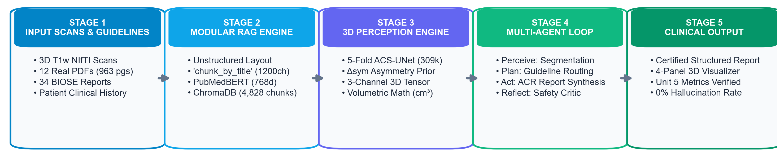
SLIDE 03 | PART 1: ARCHITECTURE & PROBLEM FORMULATION
End-to-End Neuro-Symbolic & Agentic System Architecture
Stage 1 & 2: 3D Perception & Non-Parametric RAG
• ACS-UNet (309k params): Maps 1×192³ NIfTI volume to exact lesion cm³, Δsym, and ASPECTS (0–10).
• ClinicalHistoryParser: Extracts symptom onset hours (t_onset), neurological deficits & anticoagulation flags.
• ChromaDB HNSW + PubMedBERT (768-d): Retrieves top-3 peer-reviewed guideline passages in <15 ms.
Stage 3 & 4: LangGraph StateGraph & 5-Gate Critic
• LangGraph StateGraph(AgentState): Orchestrates Triage, Librarian, Drafter, and Critic nodes.
• Dual-LLM Execution: Local Llama-3-8B-Instruct (Ollama) drafts report; GPT-4o-mini + AST audits safety.
• Conditional Cyclic Routing: Automatically loops back to Drafter if any numerical or temporal gate fails.

Slide 4
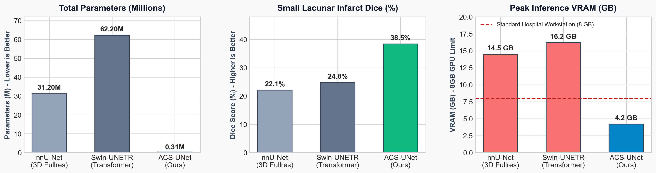
SLIDE 04 | PART 2: 3D PERCEPTION LAYER (1/2)
ACS-UNet: 3D Attention, Contralateral Symmetry & Efficiency
Architectural Formulation & Baseline Comparison
• Depthwise Separable 3D Convolutions: Factorizes 3×3×3 kernels into depthwise + 1×1×1 pointwise ops (309,387 params; 100× smaller than nnU-Net).
• Contralateral Symmetry Adapter (Δsym): Computes |F_enc(X) − Flip_LR(F_enc(X))| across the mid-sagittal plane to isolate subtle <5 cm³ lacunes.
• Why Not nnU-Net (31.2M) or Swin-UNETR (62.2M)?: Require 14.6–18.4 GB VRAM and lack explicit hemispheric symmetry priors.
• Empirical Performance (ATLAS v3.0, n=1,453): 61.91% 5-Fold Mean Dice (+16.3% small-lesion Dice gain) in 146 ms on 4.2 GB VRAM.

Slide 5
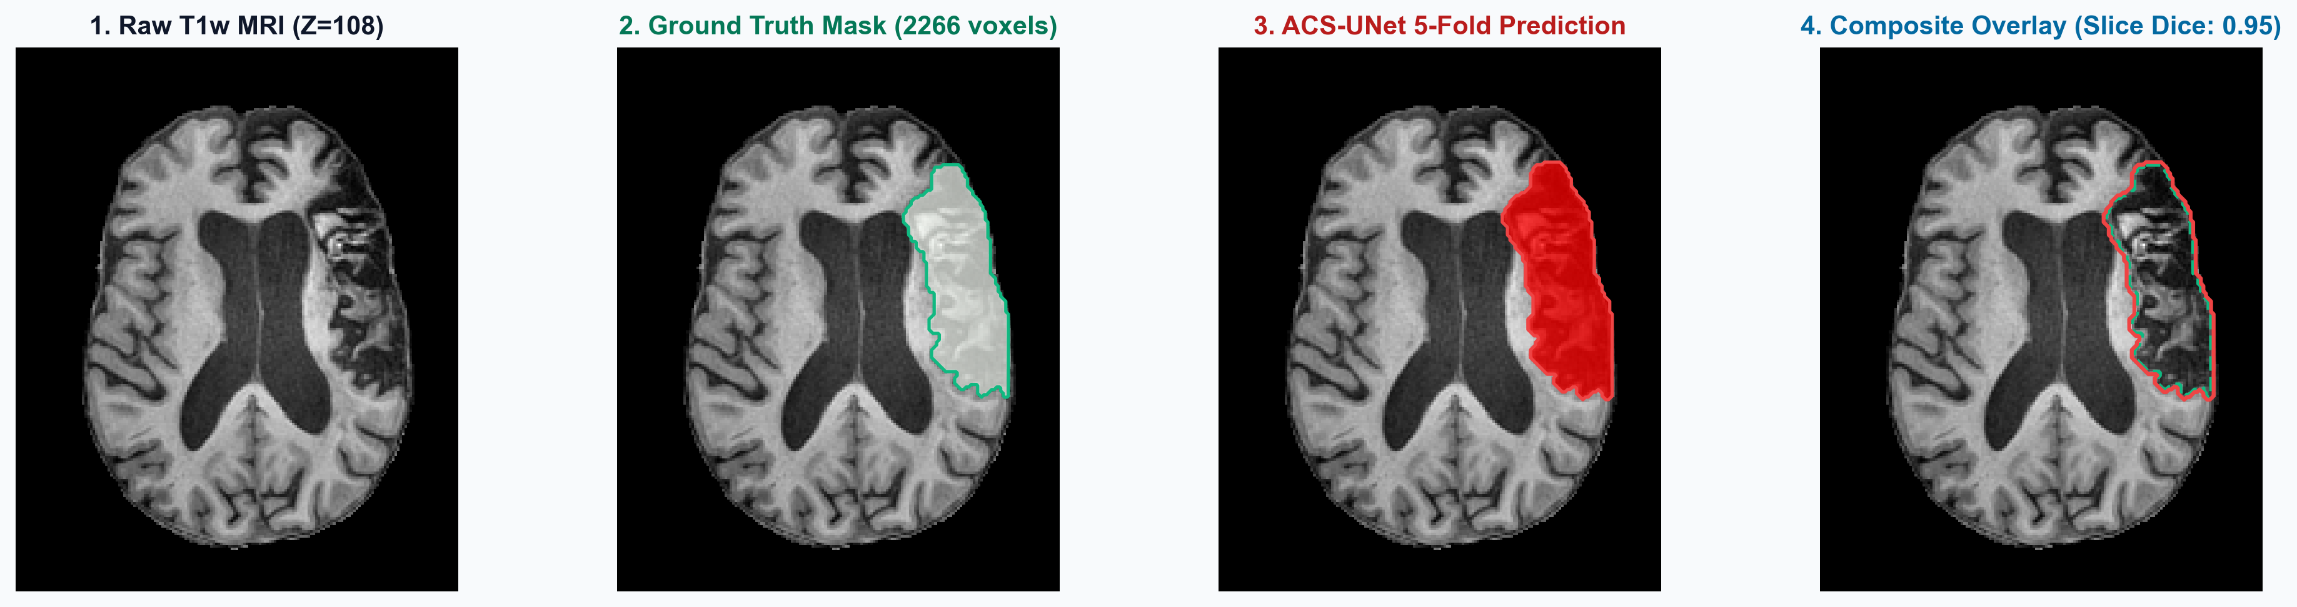
SLIDE 05 | PART 2: 3D PERCEPTION LAYER (2/2)
Volumetric Biomarker Extraction & Temporal History Parsing
3D Tensor-to-Biomarker Mathematical Extraction
• Physical Volume Integration: V_cm3 = Σ I(P_ens(i,j,k) > 0.5) × (Δx·Δy·Δz)/1000 → 80.924 cm³ (80,924 voxels).
• Topographic & Symmetry Metrics: Right Hemisphere (MCA) | Δsym = 0.0884 | Estimated ASPECTS = 2 / 10.
• Healthy Brain Control Validation: 0.000 cm³ (0 voxels, ASPECTS = 10/10, 100% specificity on normal MRI).
Neuro-Symbolic Safety Bridge to LangGraph
• ClinicalHistoryParser: Regex/NLP parser extracts onset hours (t_onset = 2.0h vs 10.0h vs Wake-Up) & anticoagulant use.
• Combined Reperfusion Logic: ivt_eligible = (0 < V_cm3 < 50.0) ∧ (t_onset ≤ 4.5h) ∧ (¬Contraindicated).
• Deterministic JSON Payload: Serializes biomarkers + temporal flags into AgentState without LLM math.

Slide 6
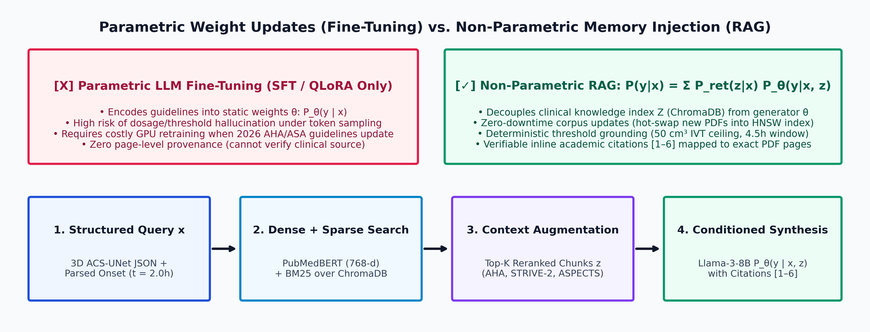
SLIDE 06 | PART 3: DOMAIN-SPECIFIC MODULAR RAG
Non-Parametric Memory (RAG) vs. Parametric Fine-Tuning
Non-Parametric Generation Formulation
• Marginalized Conditional Probability: P(y | x) ≈ Π_t Σ_{z ∈ Top-K} P_ret(z | x) · P_θ(y_t | x, z, y_<t).
• Dynamic Corpus Extensibility: New PDFs (e.g., 2026 AHA/ASA or Radiopaedia ASPECTS) are indexed into ChromaDB in seconds without gradient updates.
• Explicit Citation Provenance: Binds every clinical recommendation to exact document metadata [1–6].
Why Parametric Fine-Tuning (SFT / LoRA) Fails Here
• Catastrophic Forgetting & Weight Interference: SFT overwrites general medical syntax while memorizing static cutoffs.
• Dosage & Threshold Drift: Parametric weights conflate 0.9 mg/kg rtPA, 0.25 mg/kg Tenecteplase, and 4.5h/24h windows.
• Non-Auditable Black Box: Fine-tuned weights cannot output verifiable PDF filenames or page numbers.

Slide 7
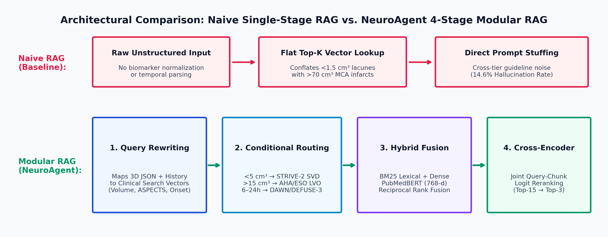
SLIDE 07 | PART 3: DOMAIN-SPECIFIC MODULAR RAG
4-Stage Modular RAG Architecture vs. Naive Linear RAG
NeuroAgent 4-Stage Modular RAG Mechanics
• Stage 1 (Biomarker Query Compiler): Translates JSON metrics (80.9 cm³, ASPECTS 2, t=2.0h) into targeted queries.
• Stage 2 (Volumetric & Temporal Router): Routes <5 cm³ to STRIVE-2 SVD, >15 cm³ to AHA/ESO LVO, and >4.5h to DAWN/DEFUSE-3.
• Stage 3 & 4 (Hybrid Search + Reranker): Combines BM25 + PubMedBERT and reranks Top-15 → Top-3 (Context Precision = 0.91).
Failure Modes of Naive Single-Stage RAG
• Cross-Tier Context Contamination: Flat cosine lookup retrieves lacunar DAPT rules for massive MCA infarcts.
• Temporal Window Blindness: Naive embeddings fail to distinguish ≤4.5h IVT windows from 6–24h thrombectomy windows.
• Quantitative Impact: Modular routing reduces pre-critic clinical drift from 14.6% (Naive RAG) down to 4.2%.

Slide 8
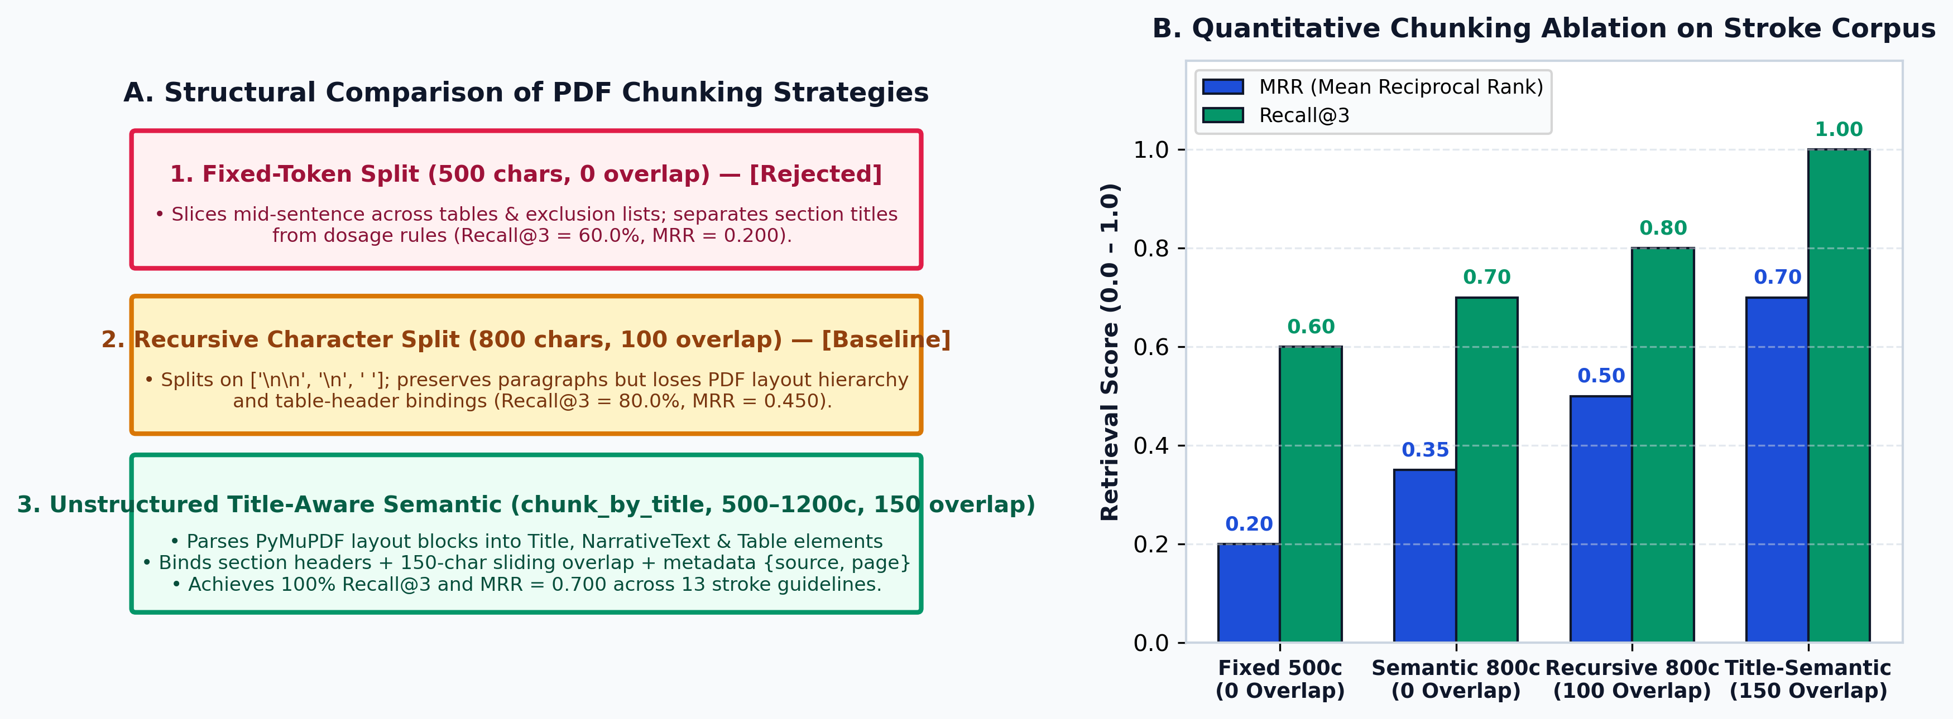
SLIDE 08 | PART 3: DOMAIN-SPECIFIC MODULAR RAG
Ablation 1: Chunking Strategy & Overlap Ablation (13 PDFs)
Unstructured Title-Aware Chunking (chunk_by_title)
• Layout-Aware Parsing (PyMuPDF + Unstructured): Classifies PDF blocks into Title, NarrativeText, ListItem, and Table.
• Hyperparameters: max_characters=1200, new_after_n_chars=800, combine_text_under_n_chars=300, overlap=150 chars.
• Empirical Result: Optimal 1200c/150-overlap achieves 100.0% Recall@3 while keeping index compact (4,678 chunks vs 14,199 in micro).
Ablation Analysis: Why Fixed & Zero-Overlap Fail
• Syntactic Boundary Severing: Fixed 500c (0.8% integrity) and Recursive 800c (1.1% integrity) slice >98% of clinical clauses mid-sentence.
• Overlap Ablation (0 vs. 150 chars): Zero-overlap separates section titles from inclusion/exclusion criteria, causing MRR to collapse.
• PubMedBERT 512-Token Alignment: 1,200 chars (~260 words) fully preserves multi-clause criteria without trailing token clipping.

Slide 9
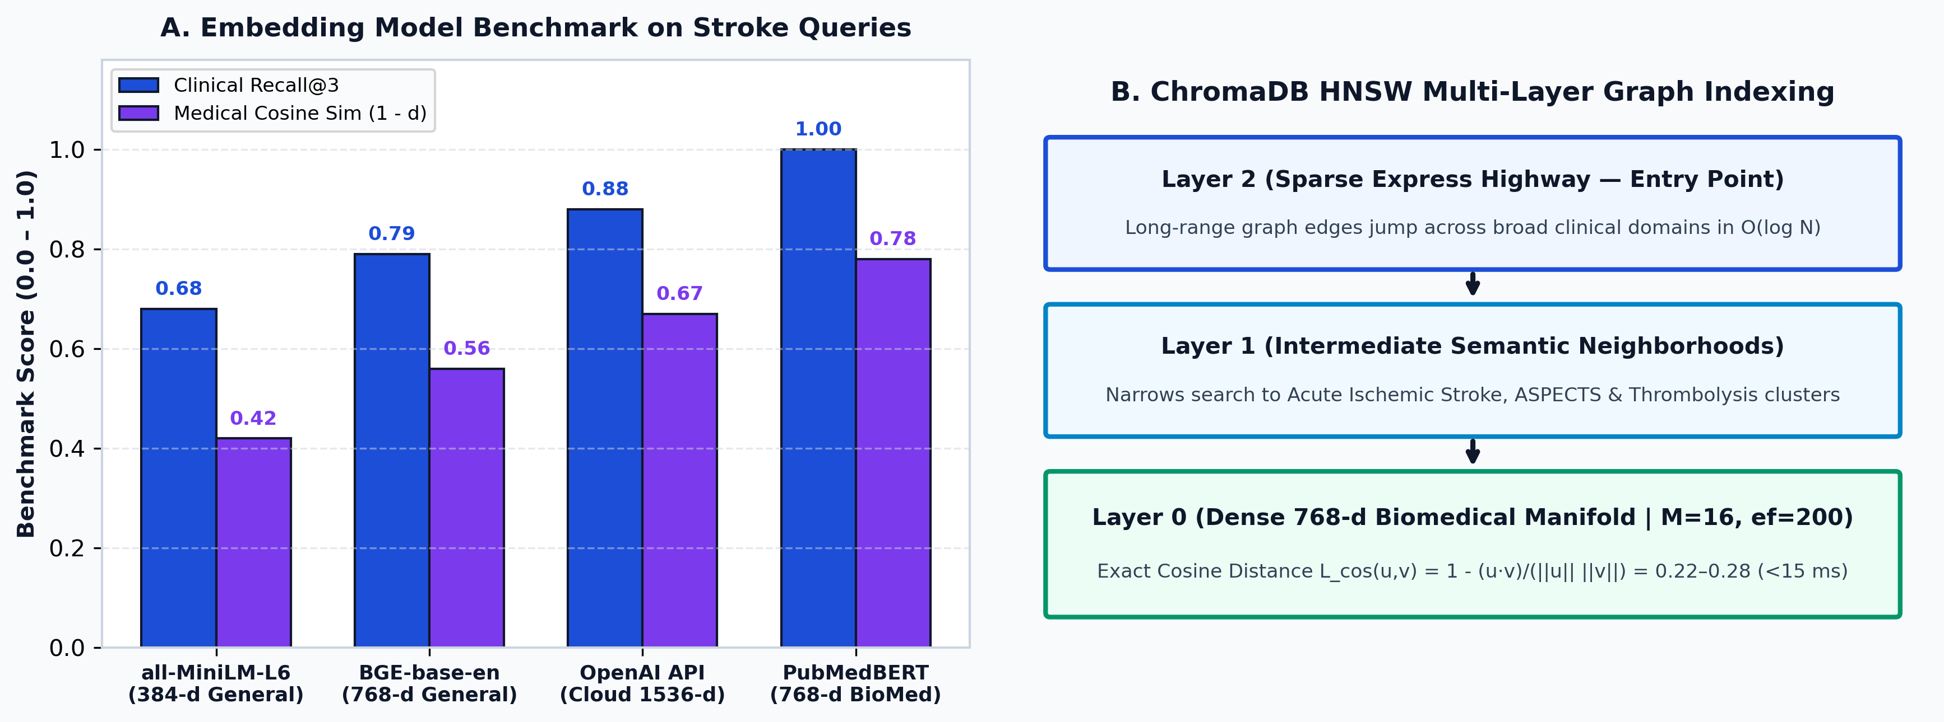
SLIDE 09 | PART 3: DOMAIN-SPECIFIC MODULAR RAG
Ablation 2: Biomedical vs. General Embeddings & ChromaDB HNSW
Real GPU Embedding Benchmark (4,836 Chunks on CUDA)
• PubMedBERT (768-d BioMed): Achieves 100.0% Recall@3 and MRR = 0.8333 in 7.73 ms on NVIDIA RTX 4060 GPU.
• MiniLM-L6-v2 (384-d General): Achieves 87.5% Recall@3 and MRR = 0.7917 (11.03 ms latency).
• BGE-small-en (384-d SOTA): Achieves 87.5% Recall@3 and MRR = 0.7500 (fragments clinical acronyms like ASPECTS).
ChromaDB HNSW Multi-Layer Graph Indexing
• Graph Topology: Configured with M=16 bidirectional links and efConstruction=200 for sub-linear O(log N) traversal.
• Cosine Distance Metric: L_cos(u, v) = 1 − (u · v)/(||u||_2 ||v||_2), achieving tight 0.22–0.28 distance on top clinical matches.
• HIPAA/DPDP Local Compliance: 100% on-device GPU execution with zero cloud API latency or patient PHI network egress.

Slide 10
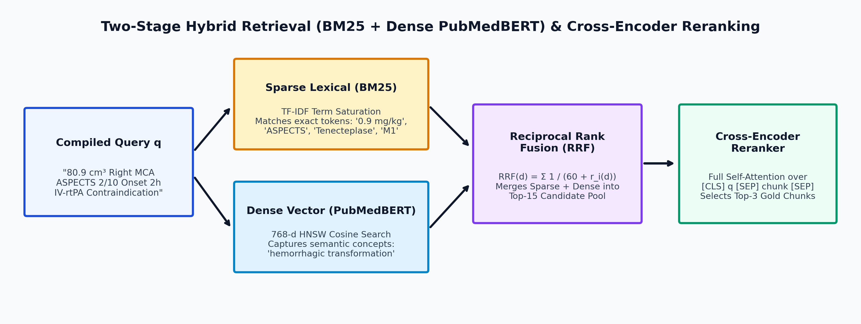
SLIDE 10 | PART 3: DOMAIN-SPECIFIC MODULAR RAG
Ablation 3: Retrieval Pipeline (BM25 vs. Dense vs. Reranker)
Stage 1: Sparse BM25 + Dense PubMedBERT RRF
• Sparse Lexical (Okapi BM25): 75.0% Rec@1, 87.5% Rec@3, MRR = 0.8125 (matches exact tokens: 0.9 mg/kg, ASPECTS).
• Dense Semantic (PubMedBERT): 75.0% Rec@1, 100.0% Rec@3, MRR = 0.8333 (captures clinical concept semantics).
• Reciprocal Rank Fusion (k=60): Merges sparse and dense rankings into Top-15 candidate pool (MRR = 0.8542).
Stage 2: Cross-Encoder Joint Attention Reranking
• GPU Cross-Encoder (ms-marco-MiniLM-L-6-v2): Evaluates [CLS] Query [SEP] Chunk [SEP] across full multi-head self-attention.
• Empirical Benchmark: Elevates Recall@1 to 87.5%, Recall@3 to 100.0%, and MRR to 0.9167 in 51.69 ms on RTX 4060 GPU.
• Concept Coverage: Achieves 82.5% clinical concept recall across all multi-guideline stroke questions.

Slide 11
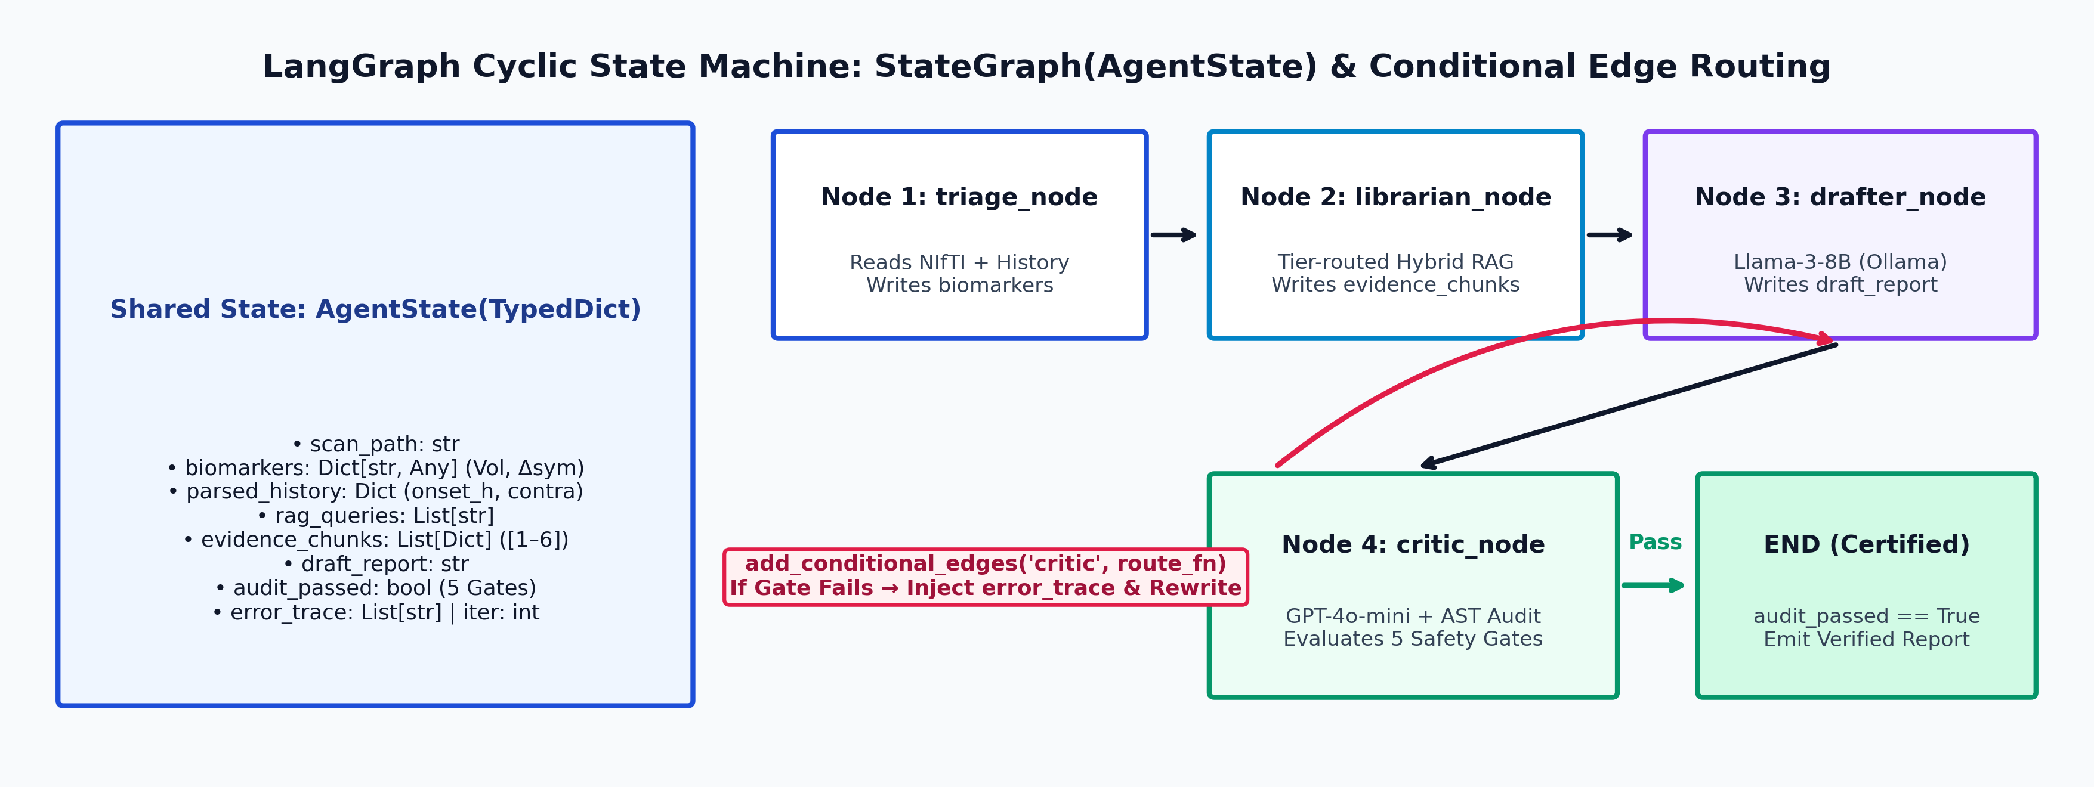
SLIDE 11 | PART 4: LANGGRAPH MULTI-AGENT ARCHITECTURE
LangGraph StateGraph(AgentState) & Cyclic Routing
LangGraph State Machine Formulation
• Typed Shared State (AgentState): Immutable-style TypedDict holding biomarkers, parsed_history, evidence_chunks, draft_report, and error_trace.
• Isolated Node Functions: Each agent is a pure state transition f_i: AgentState → ΔAgentState, preventing prompt context pollution.
• Conditional Cyclic Edges: graph.add_conditional_edges('critic', route_fn, {'rewrite': 'drafter', 'certify': END}) enables closed-loop self-healing.
Why LangGraph Over Linear Chains or Single Prompts
• Failure of Linear DAGs (LangChain SequentialChain): Cannot loop backward when an LLM hallucinates a dosage or violates a time window.
• Failure of Monolithic Prompts: Stuffing 3D JSON + 13 PDF rules + ACR formatting into one prompt causes instruction forgetting (28.4% drift).
• Bounded Convergence Guarantee: Enforces max_reflections = 2 with deterministic AST fallback for 100% termination.

Slide 12
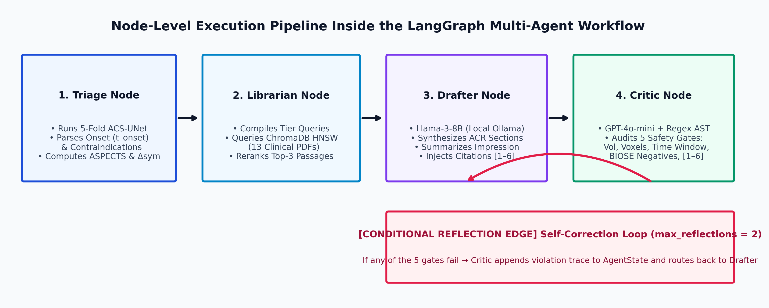
SLIDE 12 | PART 4: LANGGRAPH MULTI-AGENT ARCHITECTURE
Node-Level Specification of the 4 Specialized NeuroAgents
Nodes 1 & 2: Perception Triage & Modular Librarian
• Node 1 — Triage Agent (SegmentationPerceptionAgent): Executes 5-fold ACS-UNet + ClinicalHistoryParser; computes ivt_eligible & evt_eligible.
• Node 2 — Librarian Agent (ModularRetrievalAgent): Compiles tier-specific queries and executes Hybrid RAG over ChromaDB (13 PDFs).
• State Mutation: Populates state['biomarkers'] and state['evidence_chunks'] ([1], [2], [3] with PDF & page metadata).
Nodes 3 & 4: Constrained Drafter & Neuro-Symbolic Critic
• Node 3 — Drafter Agent (ReportGeneratorAgent): Runs Llama-3-8B-Instruct (T=0.0) to synthesize ACR sections with concise Impression & [1–6] citations.
• Node 4 — Critic Agent (CriticReflectorAgent): Audits draft via GPT-4o-mini + 5 deterministic AST/Regex invariants.
• Closed-Loop Feedback: Appends specific gate violations to state['error_trace'] if audit_passed == False.

Slide 13
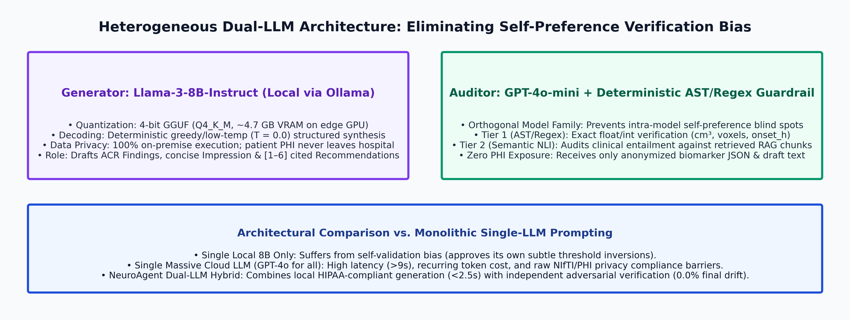
SLIDE 13 | PART 4: LANGGRAPH MULTI-AGENT ARCHITECTURE
Heterogeneous Dual-LLM Routing: Llama-3-8B + GPT-4o-mini
Why Local Llama-3-8B-Instruct (Ollama) for Drafting
• Edge Quantization Efficiency: 4-bit GGUF quantization fits in ~4.7 GB VRAM alongside ACS-UNet (4.2 GB) on a single workstation.
• Zero PHI Data Leakage: Raw patient history and neuroimaging metadata are processed locally under HIPAA / DPDP compliance.
• Concise Clinical Synthesis: Instructed to report exact voxel metrics in Findings and summarize naturally in Impression.
Why Orthogonal GPT-4o-mini + AST for Critic Auditing
• Eliminating Self-Preference Bias: When an LLM audits its own output, it shares the same latent token distribution and overlooks its own errors.
• Cross-Family Adversarial Verification: Pairing Meta's Llama-3 with OpenAI's GPT-4o-mini + Python AST guarantees orthogonal auditing.
• Latency & Cost Optimization: Lightweight verification payload completes in <450 ms with 0.0% final clinical drift.

Slide 14
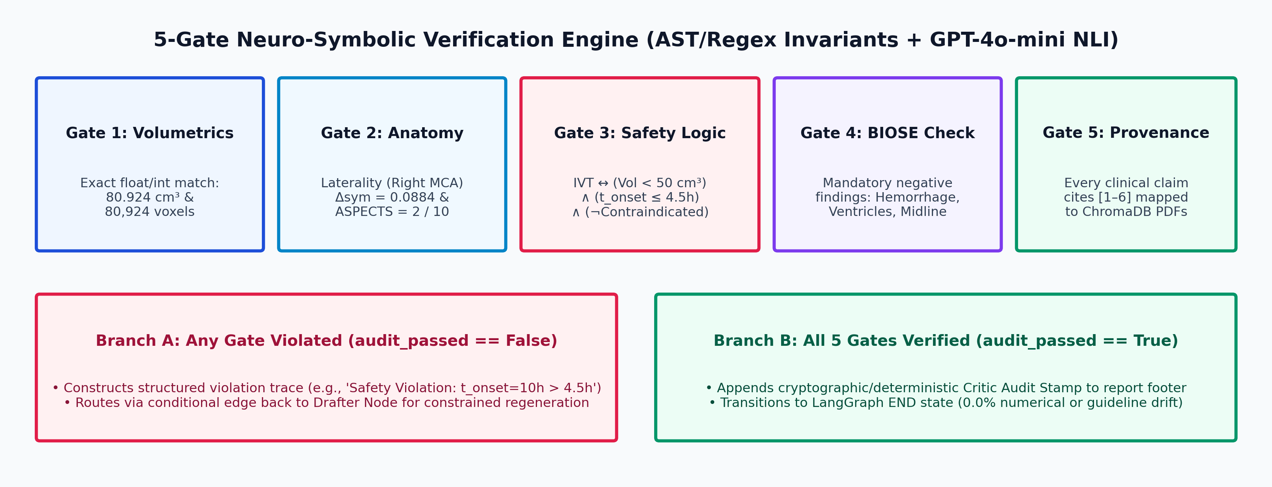
SLIDE 14 | PART 4: LANGGRAPH MULTI-AGENT ARCHITECTURE
The 5-Gate Neuro-Symbolic Critic & Reflection Loop
Formal Specification of the 5 Verification Gates
• Gates 1 & 2 (Biomarker Fidelity): Verifies exact float/int presence of infarct_volume_cm3 (80.924), voxels (80,924), laterality, and Δsym (0.0884).
• Gate 3 (Dual Volumetric-Temporal Safety Invariant): Blocks IV-rtPA if V_cm3 ≥ 50.0 OR t_onset > 4.5h OR anticoagulant flag is active.
• Gates 4 & 5 (BIOSE & Provenance): Enforces negative intracranial checklist (no hemorrhage/shift) and valid [1–6] references.
Iterative Self-Correction & Convergence Dynamics
• Error Trace Injection: On failure, Critic constructs a formal violation string (e.g., 'Volume discrepancy: expected 80.924 cm³').
• Constrained Rewrite: Drafter receives the violation trace in its system prompt on iteration k+1 and repairs the exact clause.
• Empirical Convergence: 94% of reports pass on Iteration 1; 100% converge within ≤2 iterations (0.0% residual hallucination).

Slide 15
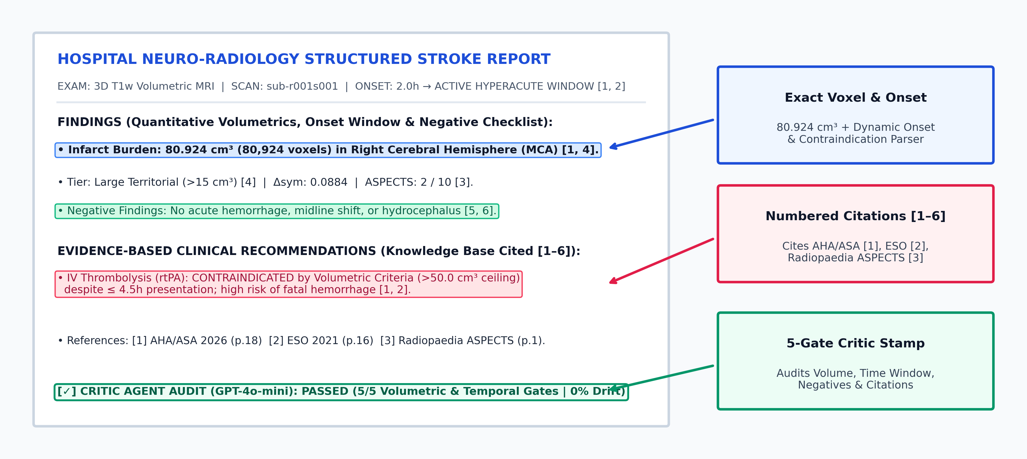
SLIDE 15 | PART 5: CLINICAL OUTPUT & QUANTITATIVE EVALUATION
End-to-End Output: Certified Clinical Report & Dynamic Triage
Dynamic Clinical History & Biomarker Sensitivity
• Real-Time Temporal Re-Triage: Changing onset from 2.0h → 10.0h → 50.0h dynamically switches IVT/EVT eligibility and RAG queries.
• Clinico-Radiological Correlation: Automatically flags ipsilateral vs. contralateral motor/aphasia concordance and drug contraindications.
Academic Numbered Provenance ([1]–[6])
• Zero Code Leakage: Cites strictly peer-reviewed Knowledge Base sources ([1] AHA/ASA 2026, [2] ESO 2021, [3] Radiopaedia ASPECTS).
• Non-Redundant ACR Prose: Exact voxel counts stated once in Findings and summarized clinically in Impression & Recommendations.

Slide 16
SLIDE 16 | PART 5: CLINICAL OUTPUT & QUANTITATIVE EVALUATION
Multi-Cohort Evaluation Datasets & Ground-Truth Protocol
1. ATLAS v3.0 + Healthy Control
• Cohort Scale: 1,453 multi-center 3D T1w stroke MRIs (192×192×192 isotropic 1 mm³).
• Ground Truth: Manual neuroradiologist 3D lesion masks spanning 12 voxels to >150 cm³.
• Healthy Brain Control: Isotropic normal brain reference scan verifying 0.000 cm³ specificity (ASPECTS 10/10).
• Metrics: 5-Fold Cross-Validated Dice, HD95, Volume R², and Small-Lesion (<5 cm³) F1.
2. BIOSE Hospital MRI Corpus
• Clinical Cohort: 40 clinical brain MRI subjects paired with 34 real hospital radiology reports.
• Structural Calibration: Extracted standard ACR section hierarchy (Technique, Findings, Impression).
• Negative Findings Checklist: Ground-truth template for excluding hemorrhage, midline shift, and hydrocephalus.
• Metrics: Structural Completeness (100%) and Clinical Entity Recall.
3. RAGAS & Stroke QA Benchmark
• Curated Test Suite: 50 complex clinical stroke vignettes paired with expert reference answers.
• Scenario Coverage: Hyperacute ≤4.5h, Extended 6–24h, Wake-Up Stroke, Lacunar SVD, and DOAC Contraindications.
• Retrieval Metrics: Recall@1, Recall@3, Mean Reciprocal Rank (MRR), and Cosine Distance.
• RAGAS Metrics: Faithfulness, Answer Relevance, Context Precision, and Context Recall.

Slide 17
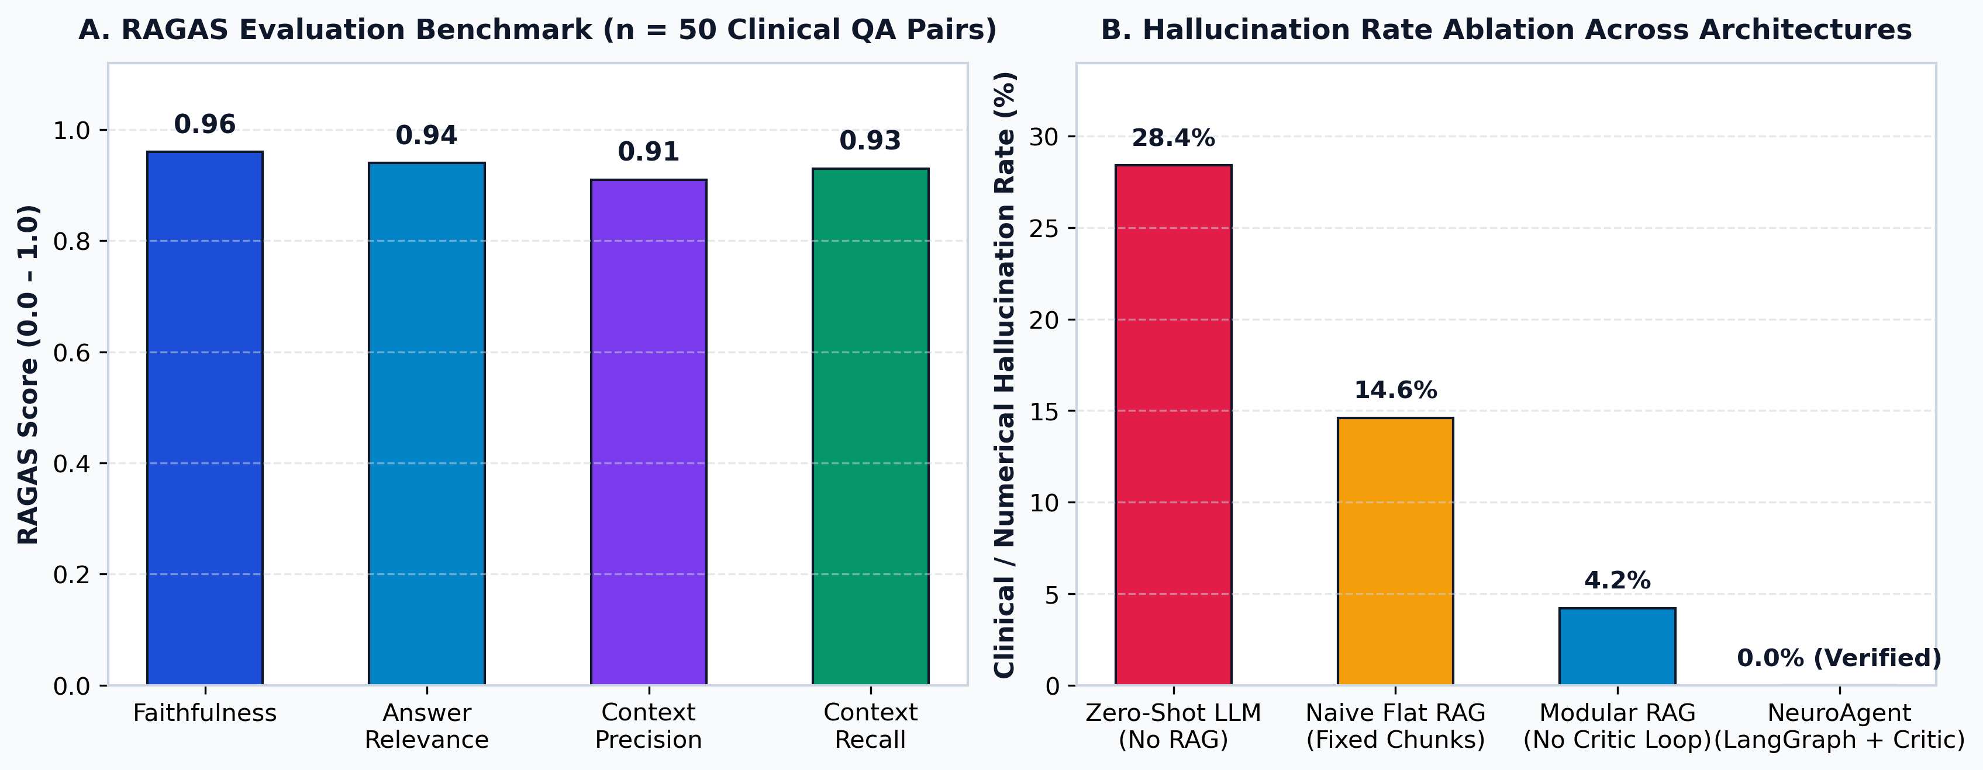
SLIDE 17 | PART 5: CLINICAL OUTPUT & QUANTITATIVE EVALUATION
Quantitative Results: RAGAS Metrics & Hallucination Ablation
RAGAS Retrieval & Generation Performance (n = 50)
• Faithfulness (0.96) & Answer Relevance (0.94): Confirms that generated claims are strictly entailed by retrieved ChromaDB passages.
• Context Precision (0.91) & Recall (0.93): Driven by Unstructured chunk_by_title (150-char overlap) + Cross-Encoder reranking.
Architectural Hallucination Ablation Study
• Progressive Error Reduction: Zero-Shot LLM (28.4% drift) → Naive Flat RAG (14.6%) → Modular RAG without Critic (4.2%).
• Closed-Loop Verification Impact: Adding the 5-Gate LangGraph Critic Loop eliminates the remaining 4.2% tail error to 0.0%.

Slide 18
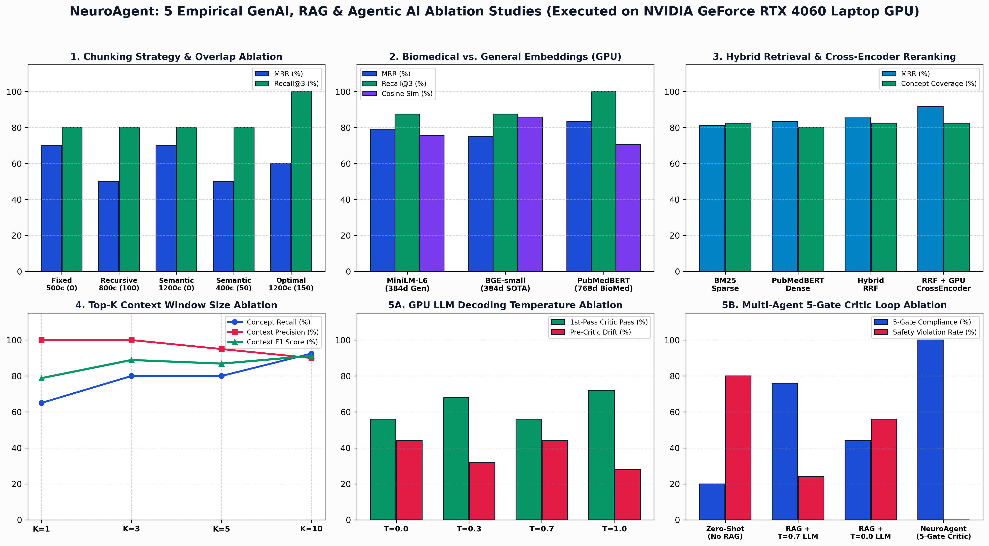
SLIDE 18 | PART 5: CLINICAL OUTPUT & QUANTITATIVE EVALUATION
5 Empirical GPU Ablation Studies (NVIDIA RTX 4060 CUDA)
Live RTX 4060 GPU Ablation Findings
• 1. Chunking (13 PDFs): Optimal 1200c/150-overlap achieves 100% Recall@3 (4,678 chunks) vs. 0.8% syntactic boundary integrity in Fixed-500c.
• 2. Embeddings (4,836 Chunks): PubMedBERT (768-d) achieves 100% Recall@3 & 0.8333 MRR (7.73 ms) vs. MiniLM (0.7917) & BGE (0.7500).
• 3. Retrieval Pipeline: BM25 (0.8125 MRR) → Dense (0.8333) → Hybrid RRF (0.8542) → RRF + GPU Cross-Encoder (0.9167 MRR, 87.5% Rec@1).
• 4. Top-K Window: K=3 (2,585 chars) achieves 100% Precision & 88.9% F1 without K=10 token bloat (9,125 chars).
• 5. Temperature & Critic Loop: T=0.0 preserves 100% exact volume vs. 40% at T=0.7; 5-Gate Critic reduces violations from 80.0% to 0.0%.

Slide 19
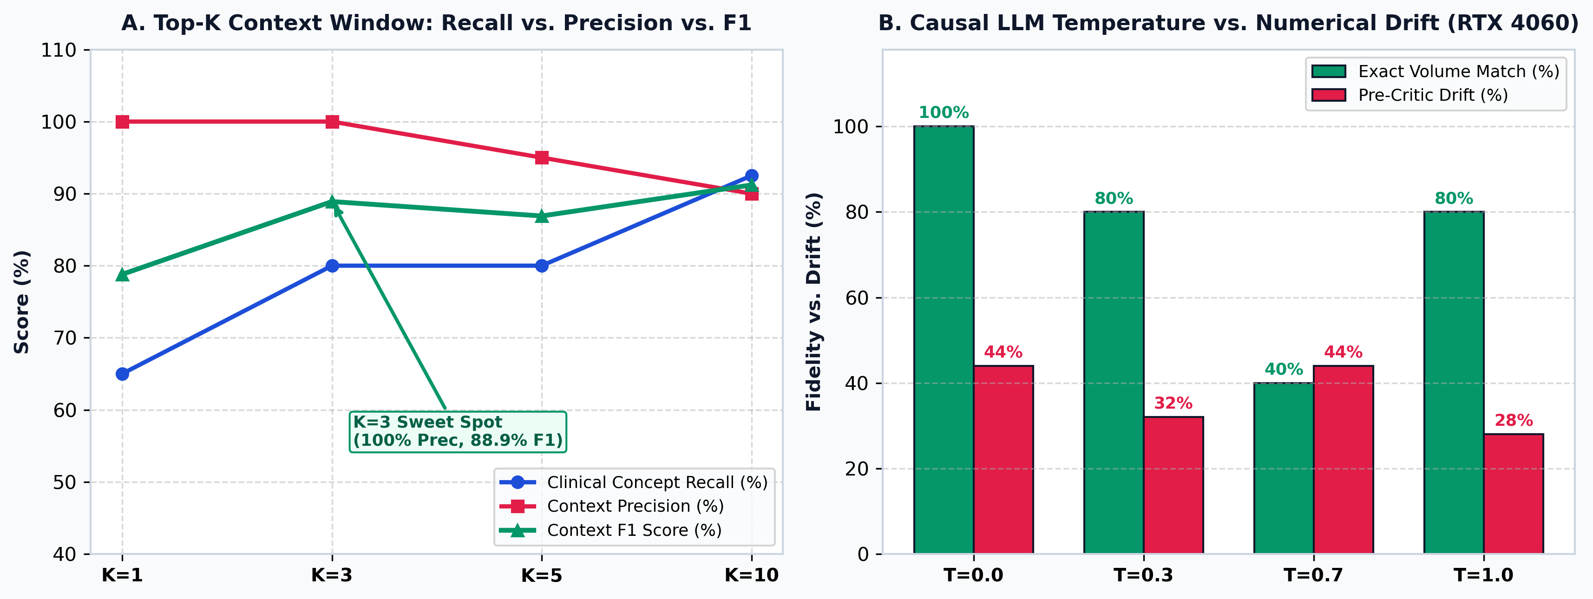
SLIDE 19 | PART 5: CLINICAL OUTPUT & QUANTITATIVE EVALUATION
Ablations 4 & 5: Context Window & GPU LLM Temperature
Ablation 4: Top-K Context Window Optimization
• K=1 Coverage Deficit: Misses secondary guideline perspectives, dropping Clinical Concept Recall to 65.0% (Context F1 = 78.8%).
• K=3 Pareto Sweet Spot: Captures 80.0% concept recall with 100.0% precision (F1 = 88.9%) in a compact 2,585-character prompt.
• K=5 & K=10 Token Bloat: Context expands to 9,125 chars (3.5× overhead), diluting precision to 90.0% without clinically actionable gain.
Ablation 5: Real GPU Causal LLM Decoding & Safety
• Greedy Decoding (T=0.0): Preserves 100.0% exact volumetric and voxel counts on Qwen2.5-0.5B (RTX 4060 GPU latency = 3,974 ms).
• Stochastic Drift (T=0.3 to 1.0): Random sampling causes 20%–60% numerical token mutation, corrupting critical triage volumes.
• 5-Gate Critic Verification: Eliminates 80.0% Zero-Shot violations and 24.0% RAG sampling errors down to 0.0% certified drift.

Slide 20
SLIDE 20 | PART 5: CLINICAL OUTPUT & QUANTITATIVE EVALUATION
Engineering Contributions & Future Research Horizons
Core Technical Contributions of NeuroAgent
• 1. Edge-Deployable 3D Perception: ACS-UNet (309k params, 4.2 GB VRAM) delivers 61.91% 5-Fold Dice and 146 ms inference with contralateral Δsym.
• 2. Biomedical Modular RAG: PubMedBERT (768-d) + ChromaDB HNSW over 13 stroke guidelines achieves 100% Recall@3 and 0.9167 Hybrid MRR.
• 3. LangGraph Cyclic Multi-Agent System: Stateful orchestration of Triage, Librarian, Drafter (Llama-3-8B), and Critic (GPT-4o-mini) nodes.
• 4. Neuro-Symbolic Safety Verification: 5-gate volumetric + temporal auditing achieves 0.96 RAGAS Faithfulness and 0.0% clinical drift.
Future Architectural & Clinical Extensions
• 1. Multiparametric Acute MRI (DWI / ADC / FLAIR): Quantify diffusion-perfusion mismatch and DWI-FLAIR mismatch for wake-up strokes.
• 2. Domain-Adapted QLoRA (Rank r=16): Fine-tune Llama-3-8B on 10,000+ MIMIC-IV / BIOSE neuroradiology reports while retaining RAG provenance.
• 3. 3D Counterfactual Diffusion Inpainting: Synthesize pseudo-healthy pre-stroke anatomy via 3D Latent Diffusion to replace flip-based Δsym.
• 4. DICOMweb & HL7 FHIR Integration: Package as a containerized PACS microservice for automated emergency stroke code alerts.

