Slide 1
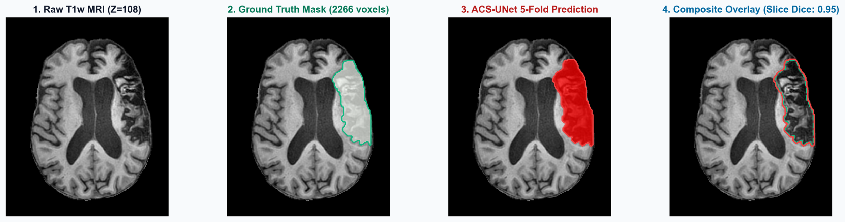
MASTER'S CAPSTONE PROJECT | MULTIMODAL MEDICAL AI & AGENTIC RAG
NeuroAgent
3D Volumetric Perception, Domain-Specific Modular RAG & LangGraph Multi-Agent Architecture for Stroke Neuro-Radiology
309k
ACS-UNet parameters
100%
Recall@3 (PubMedBERT)
0.0%
final clinical drift
Saumya Prasad & Shambhavi Prasad | NMIMS MPSTME (2026)

Slide 2




NeuroAgent at a Glance
OVERVIEW
3D Perception Layer
Modular RAG Pipeline
ACS-UNet: 309,387 params, 5-Fold Ensemble on ATLAS v3.0 + Healthy Control
PubMedBERT (768-d) + ChromaDB HNSW over 13 Clinical Guidelines
LangGraph Multi-Agent System
Quantitative GPU Ablations
StateGraph(AgentState) with Llama-3-8B-Instruct (Ollama) & GPT-4o-mini Critic
5 empirical studies executed live on an NVIDIA GeForce RTX 4060 GPU

Slide 3
Presentation Roadmap
OVERVIEW
1
2
3
4
5
Architecture & Problem
3D Perception Layer
Modular RAG
LangGraph Agents
Output & Evaluation
Clinical bottlenecks, LLM failure modes and the end-to-end system
ACS-UNet, biomarker extraction and history parsing
Non-parametric memory plus 3 retrieval ablations
State machine, 4 agents, dual-LLM routing and the 5-gate critic
Clinical report, datasets, RAGAS, ablations and future work

Slide 4
Clinical Bottlenecks & LLM Failure Modes
PART 1 | ARCHITECTURE & PROBLEM
Clinical & 3D Vision Bottlenecks
Generative AI & Safety Failure Modes
Manual planimetry latency: ABC/2 delineation takes 15–25 mins per scan in the 4.5h hyperacute window.
Sub-5 cm³ lacunar ambiguity: small-vessel lacunes mimic perivascular spaces on T1w MRI.
Compute & VRAM ceiling: nnU-Net (31.2M) and Swin-UNETR (62.2M) need >14 GB VRAM.
Semantic gap: models output raw NIfTI arrays, not structured ACR reports.
Numerical token drift: LLMs alter precision (80.924 cm³ → 8.09 cm³).
Catastrophic triage errors: IV-rtPA at core ≥50 cm³ or onset >4.5h risks fatal hemorrhage.
Guideline staleness: weights lack 2026 AHA/ASA, STRIVE-2 and ESO criteria.
Zero provenance: uncited prose cannot be audited by neuroradiologists.

Slide 5
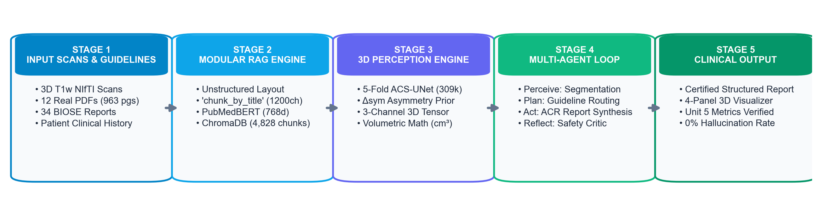
End-to-End Neuro-Symbolic & Agentic System
PART 1 | ARCHITECTURE & PROBLEM
309k
768-d
<15 ms
≤2
ACS-UNet params
PubMedBERT embeddings
top-3 retrieval
critic iterations

Slide 6
Four-Stage System Walkthrough
PART 1 | ARCHITECTURE & PROBLEM
Stages 1 & 2: Perception & RAG
Stages 3 & 4: LangGraph & 5-Gate Critic
ACS-UNet (309k params): 1×192³ NIfTI → lesion cm³, Δsym and ASPECTS (0–10).
ClinicalHistoryParser: extracts t_onset, deficits and anticoagulation flags.
ChromaDB HNSW + PubMedBERT: top-3 guideline passages in <15 ms.
StateGraph(AgentState): orchestrates Triage, Librarian, Drafter and Critic.
Dual-LLM execution: local Llama-3-8B drafts; GPT-4o-mini + AST audits safety.
Cyclic routing: loops back to Drafter if any numerical or temporal gate fails.

Slide 7
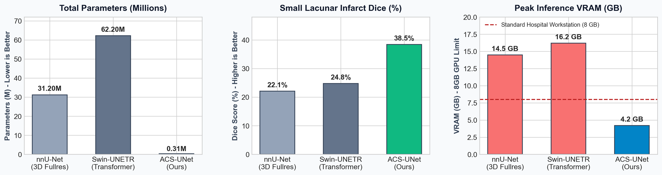
ACS-UNet: Segmentation Results & Efficiency
PART 2 | 3D PERCEPTION LAYER
309,387
61.91%
146 ms
4.2 GB
parameters
5-Fold Mean Dice
inference time
VRAM

Slide 8
ACS-UNet: Attention, Symmetry & Efficiency
PART 2 | 3D PERCEPTION LAYER
1
Depthwise Separable 3D Convs
2
Contralateral Symmetry (Δsym)
Factorizes 3×3×3 kernels into depthwise + 1×1×1 pointwise ops, 100× smaller than nnU-Net.
Computes |F_enc(X) − Flip_LR(F_enc(X))| across the mid-sagittal plane to isolate <5 cm³ lacunes.
3
Why Not nnU-Net / Swin-UNETR?
4
Performance on ATLAS v3.0
They need 14.6–18.4 GB VRAM and lack explicit hemispheric symmetry priors.
n=1,453: 61.91% 5-Fold Mean Dice, +16.3% small-lesion Dice gain, 146 ms on 4.2 GB.

Slide 9
Volumetric Biomarker Extraction
PART 2 | 3D PERCEPTION LAYER
80.924 cm³
2 / 10
0.0884
0.000 cm³
lesion volume (80,924 voxels)
estimated ASPECTS
Δsym, Right MCA
healthy control

Slide 10
From Tensor to Biomarker to Safety Bridge
PART 2 | 3D PERCEPTION LAYER
3D Tensor-to-Biomarker Extraction
Neuro-Symbolic Safety Bridge
Volume integration: V_cm3 = Σ I(P_ens > 0.5) × (Δx·Δy·Δz)/1000 → 80.924 cm³.
Topography & symmetry: Right Hemisphere (MCA), Δsym = 0.0884, ASPECTS = 2/10.
Healthy control: 0.000 cm³, ASPECTS 10/10, 100% specificity.
ClinicalHistoryParser: regex/NLP extracts onset hours (2.0h vs 10.0h vs Wake-Up) and anticoagulants.
Reperfusion logic: ivt_eligible = (0 < V < 50 cm³) ∧ (t_onset ≤ 4.5h) ∧ (¬Contraindicated).
Deterministic JSON: biomarkers + flags enter AgentState with no LLM math.

Slide 11
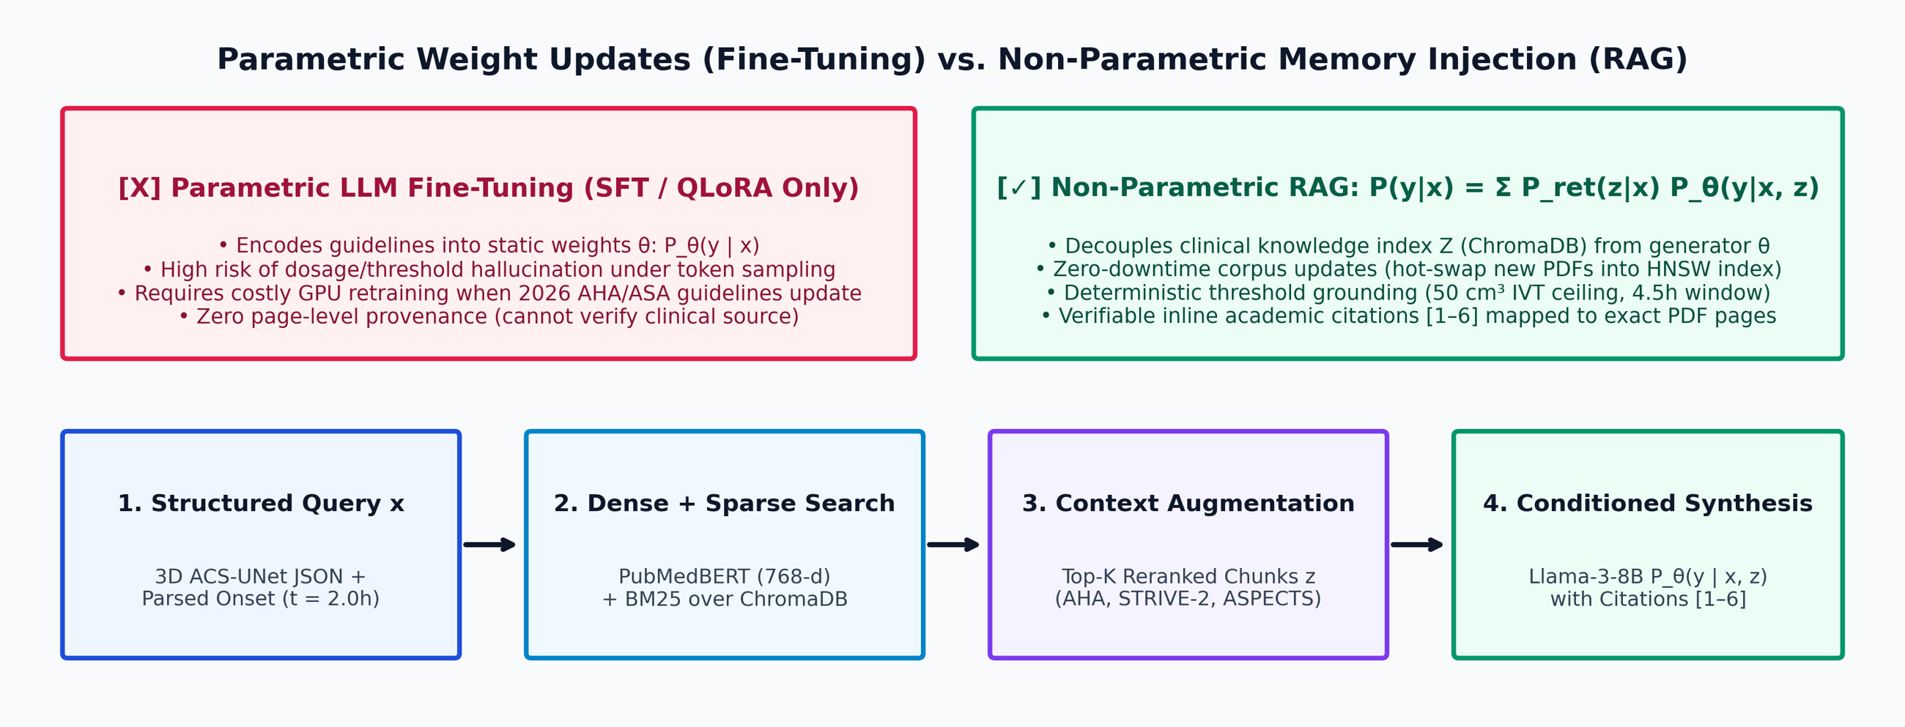
Non-Parametric Memory (RAG) vs. Fine-Tuning
PART 3 | MODULAR RAG

Slide 12
Why RAG Beats Parametric Fine-Tuning
PART 3 | MODULAR RAG
Non-Parametric Generation (RAG)
Why SFT / LoRA Fails Here
Marginalized probability: P(y|x) ≈ Π_t Σ_{z∈Top-K} P_ret(z|x) · P_θ(y_t|x,z,y_<t).
Dynamic extensibility: new PDFs (2026 AHA/ASA, Radiopaedia) indexed in seconds, no gradient updates.
Explicit provenance: every recommendation bound to document metadata [1–6].
Catastrophic forgetting: SFT overwrites general medical syntax while memorizing static cutoffs.
Dosage & threshold drift: weights conflate 0.9 mg/kg rtPA, 0.25 mg/kg Tenecteplase, 4.5h/24h windows.
Non-auditable: cannot output PDF filenames or page numbers.

Slide 13
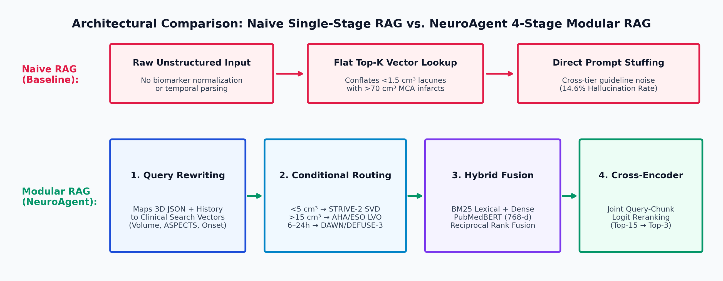
4-Stage Modular RAG vs. Naive Linear RAG
PART 3 | MODULAR RAG

Slide 14
Modular RAG Mechanics & Naive RAG Failures
PART 3 | MODULAR RAG
NeuroAgent 4-Stage Modular RAG
Failure Modes of Naive RAG
Stage 1, Query Compiler: turns JSON metrics (80.9 cm³, ASPECTS 2, t=2.0h) into targeted queries.
Stage 2, Router: <5 cm³ → STRIVE-2 SVD; >15 cm³ → AHA/ESO LVO; >4.5h → DAWN/DEFUSE-3.
Stages 3 & 4: BM25 + PubMedBERT, rerank Top-15 → Top-3 (Context Precision 0.91).
Context contamination: flat cosine lookup retrieves lacunar DAPT rules for massive MCA infarcts.
Temporal blindness: cannot separate ≤4.5h IVT from 6–24h thrombectomy windows.
Quantitative impact: modular routing cuts pre-critic drift from 14.6% to 4.2%.

Slide 15
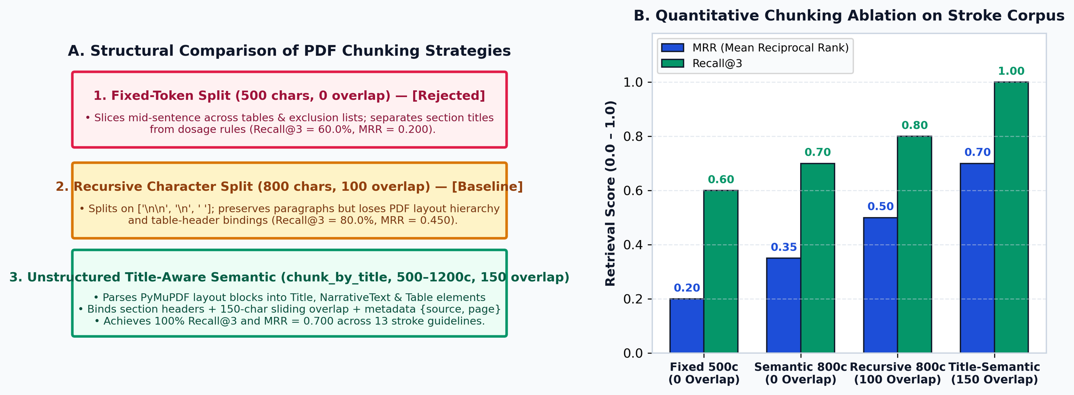
Chunking Strategy & Overlap Ablation (13 PDFs)
PART 3 | ABLATION 1: CHUNKING
100%
4,678
0.8%
1.1%
Recall@3 (1200c/150)
chunks (vs 14,199)
integrity, Fixed 500c
integrity, Recursive

Slide 16
Title-Aware Chunking: Why It Wins
PART 3 | ABLATION 1: CHUNKING
Unstructured chunk_by_title
Why Fixed & Zero-Overlap Fail
Layout-aware parsing: PyMuPDF + Unstructured classify Title, NarrativeText, ListItem, Table.
Hyperparameters: max 1200 chars, new after 800, combine under 300, overlap 150.
Result: 100.0% Recall@3 with a compact 4,678-chunk index.
Boundary severing: fixed and recursive splits cut >98% of clauses mid-sentence.
Zero overlap: titles separate from inclusion/exclusion criteria, MRR collapses.
512-token alignment: 1,200 chars (~260 words) preserve multi-clause criteria.

Slide 17
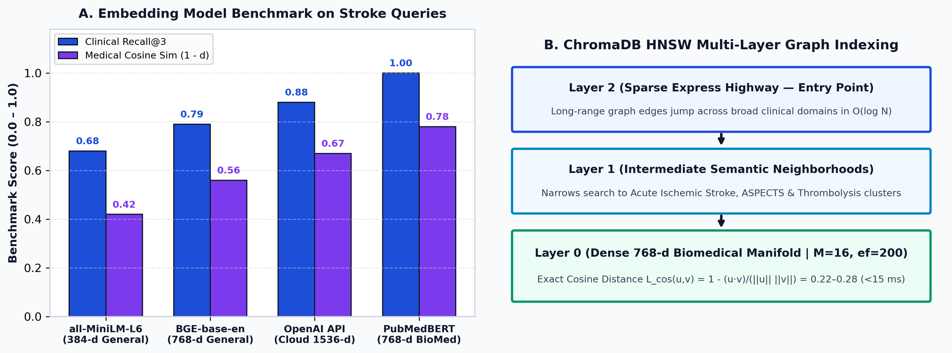
Biomedical vs. General Embeddings & HNSW
PART 3 | ABLATION 2: EMBEDDINGS
100%
0.8333
87.5%
87.5%
PubMedBERT Recall@3
PubMedBERT MRR
MiniLM Recall@3
BGE-small Recall@3

Slide 18
GPU Embedding Benchmark & HNSW Indexing
PART 3 | ABLATION 2: EMBEDDINGS
Benchmark: 4,836 Chunks on CUDA
ChromaDB HNSW Graph Index
PubMedBERT (768-d): 100.0% Recall@3, MRR 0.8333, 7.73 ms on RTX 4060.
MiniLM-L6-v2 (384-d): 87.5% Recall@3, MRR 0.7917, 11.03 ms.
BGE-small-en (384-d): 87.5% Recall@3, MRR 0.7500; fragments acronyms like ASPECTS.
Topology: M=16 links, efConstruction=200 for O(log N) traversal.
Cosine distance: 1 − (u·v)/(‖u‖‖v‖); top matches at 0.22–0.28.
Local compliance: 100% on-device GPU, zero cloud latency, no PHI egress.

Slide 19
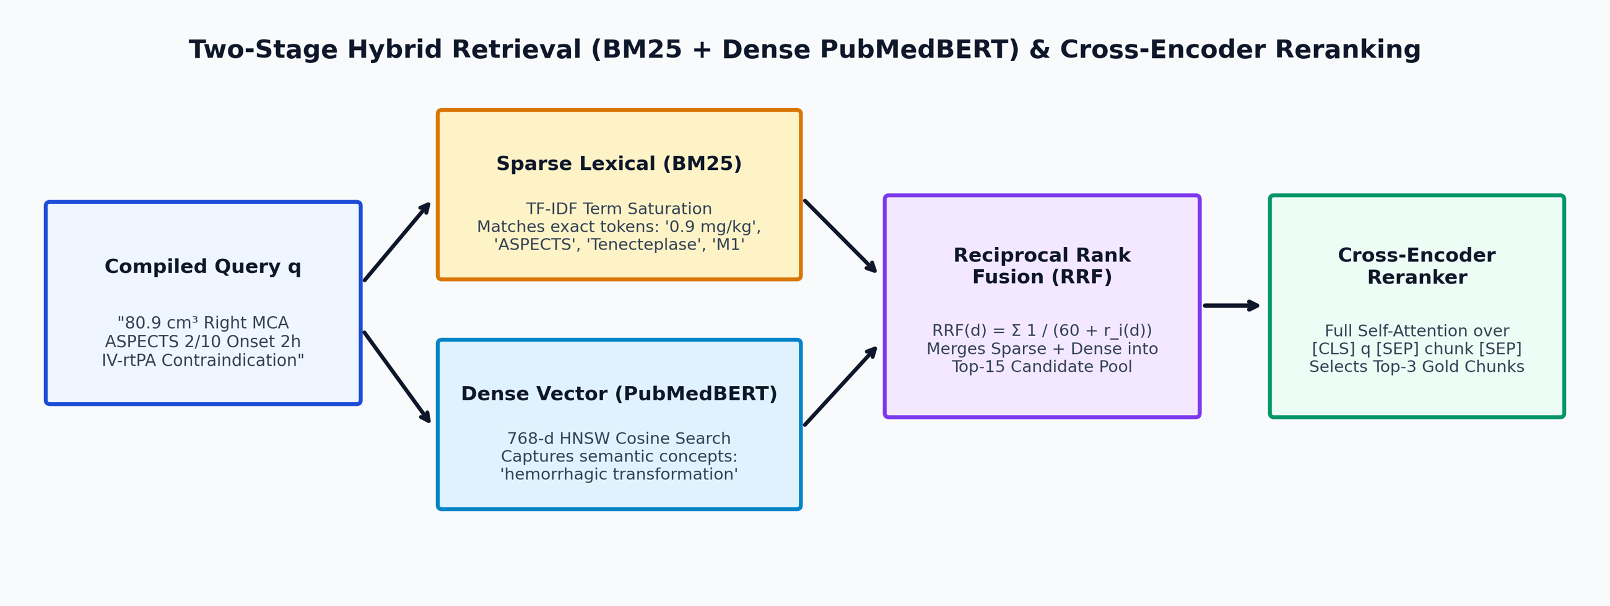
Retrieval Pipeline: BM25 vs. Dense vs. Reranker
PART 3 | ABLATION 3: RETRIEVAL
0.8125
0.8333
0.8542
0.9167
BM25 MRR
Dense PubMedBERT MRR
Hybrid RRF MRR
RRF + Reranker MRR

Slide 20
Hybrid Search & Cross-Encoder Reranking
PART 3 | ABLATION 3: RETRIEVAL
Stage 1: BM25 + Dense RRF
Stage 2: Cross-Encoder Rerank
Sparse BM25: 75.0% Rec@1, 87.5% Rec@3; matches exact tokens (0.9 mg/kg, ASPECTS).
Dense PubMedBERT: 75.0% Rec@1, 100.0% Rec@3; captures clinical semantics.
RRF (k=60): merges both into a Top-15 pool (MRR 0.8542).
GPU cross-encoder: ms-marco-MiniLM-L-6-v2 scores [CLS] Query [SEP] Chunk jointly.
Benchmark: Rec@1 87.5%, Rec@3 100.0%, MRR 0.9167 in 51.69 ms.
Concept coverage: 82.5% clinical concept recall across multi-guideline questions.

Slide 21
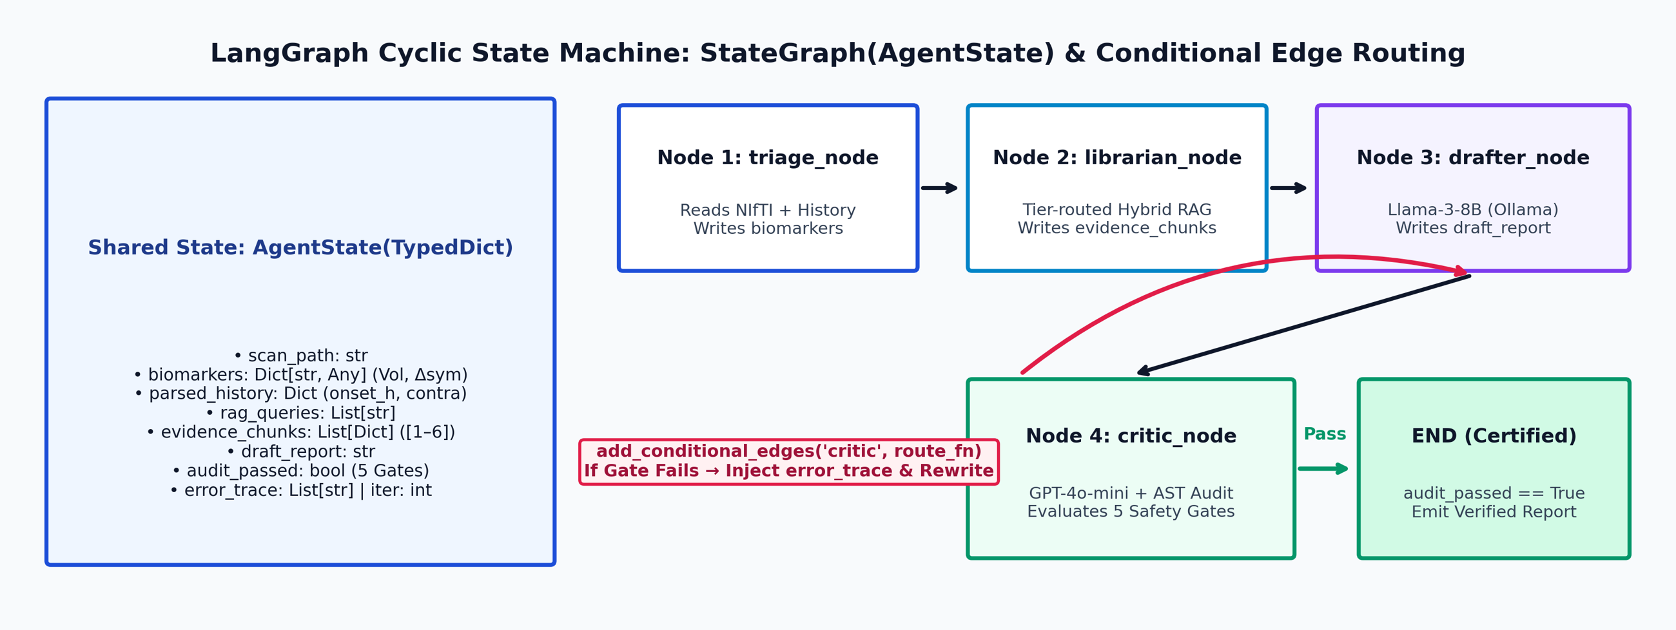
LangGraph StateGraph & Cyclic Routing
PART 4 | LANGGRAPH MULTI-AGENT

Slide 22
State Machine Design & Why LangGraph
PART 4 | LANGGRAPH MULTI-AGENT
LangGraph State Machine
Why Not Chains or One Prompt?
Typed AgentState: holds biomarkers, parsed_history, evidence_chunks, draft_report, error_trace.
Isolated nodes: each agent is a pure transition f_i: AgentState → ΔAgentState.
Conditional edges: critic routes to 'rewrite' (drafter) or 'certify' (END).
Linear DAGs fail: cannot loop back after a wrong dosage or time window.
Monolithic prompts fail: instruction forgetting, 28.4% drift.
Bounded convergence: max_reflections = 2 with AST fallback, 100% termination.

Slide 23
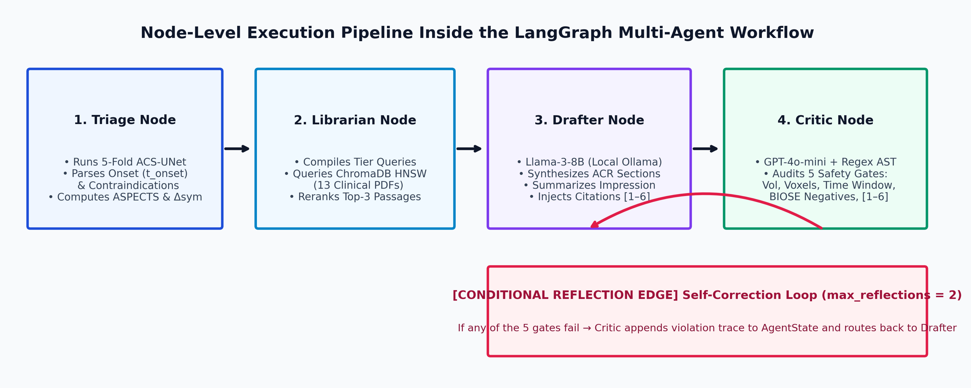
The 4 Specialized NeuroAgents
PART 4 | LANGGRAPH MULTI-AGENT

Slide 24
Node-Level Specification
PART 4 | LANGGRAPH MULTI-AGENT
Nodes 1 & 2: Triage & Librarian
Nodes 3 & 4: Drafter & Critic
Triage Agent: 5-fold ACS-UNet + ClinicalHistoryParser; computes ivt_eligible and evt_eligible.
Librarian Agent: tier-specific queries and Hybrid RAG over ChromaDB (13 PDFs).
State mutation: fills state['biomarkers'] and state['evidence_chunks'] [1]–[3].
Drafter Agent: Llama-3-8B-Instruct (T=0.0) writes ACR sections with [1–6] citations.
Critic Agent: GPT-4o-mini + 5 deterministic AST/Regex invariants.
Feedback loop: violations go to state['error_trace'] if audit_passed == False.

Slide 25
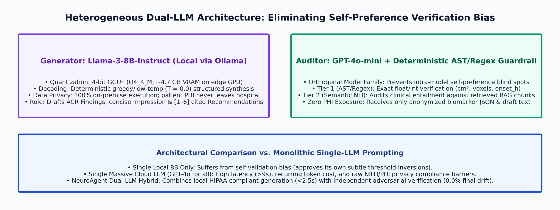
Heterogeneous Dual-LLM Routing
PART 4 | LANGGRAPH MULTI-AGENT

Slide 26
Llama-3-8B Drafter + GPT-4o-mini Critic
PART 4 | LANGGRAPH MULTI-AGENT
Why Local Llama-3-8B (Ollama)
Why GPT-4o-mini + AST as Critic
Edge efficiency: 4-bit GGUF fits in ~4.7 GB VRAM beside ACS-UNet (4.2 GB).
Zero PHI leakage: patient data stays local, HIPAA / DPDP compliant.
Concise synthesis: exact voxel metrics in Findings, summary in Impression.
No self-preference bias: an LLM auditing itself shares its own blind spots.
Cross-family check: Meta Llama-3 + OpenAI GPT-4o-mini + Python AST.
Fast & cheap: verification in <450 ms with 0.0% final clinical drift.

Slide 27
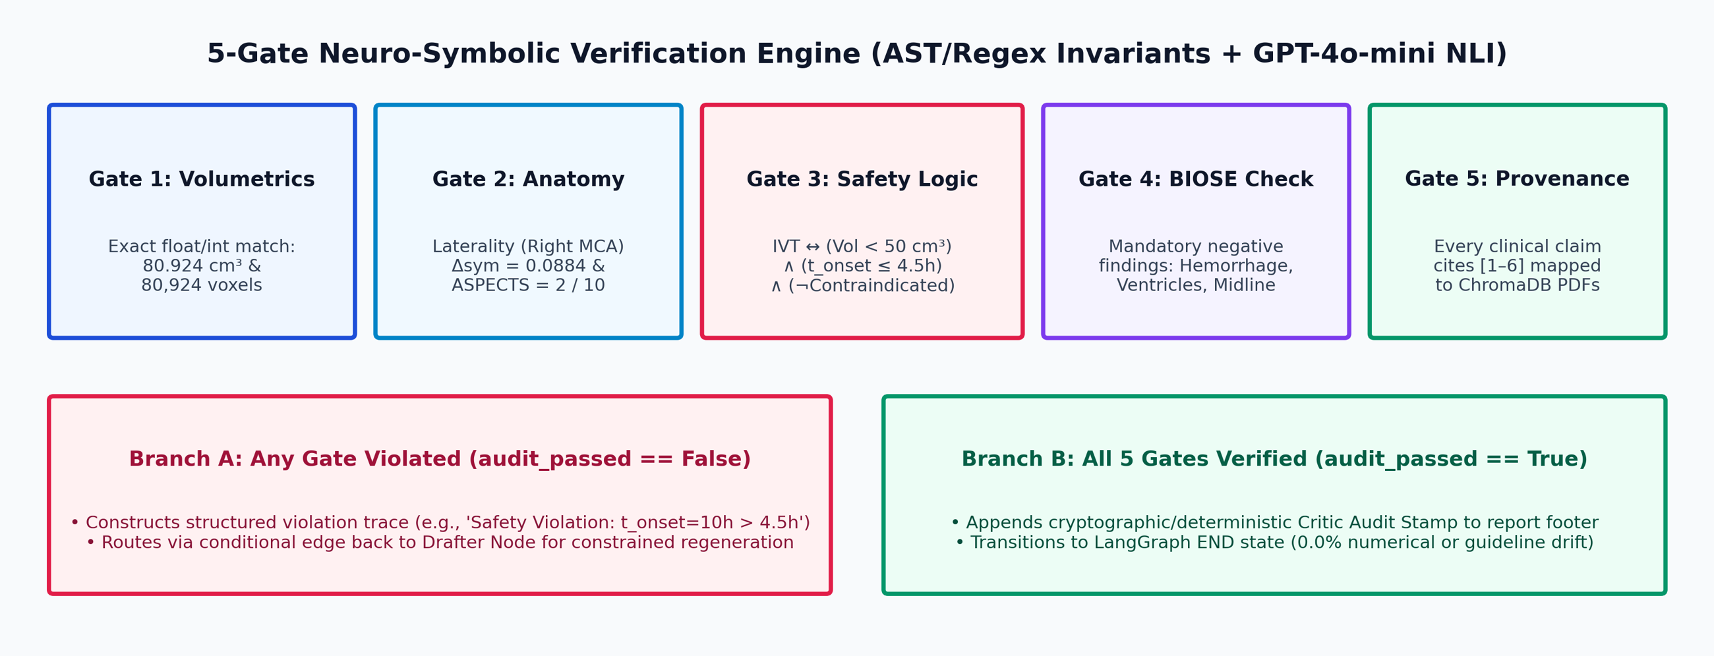
The 5-Gate Neuro-Symbolic Critic & Reflection Loop
PART 4 | LANGGRAPH MULTI-AGENT
94%
100%
0.0%
pass on Iteration 1
converge within ≤2 iterations
residual hallucination

Slide 28
The 5 Verification Gates & Self-Correction
PART 4 | LANGGRAPH MULTI-AGENT
Formal Specification of the Gates
Iterative Self-Correction
Gates 1 & 2, fidelity: exact volume (80.924), voxels (80,924), laterality, Δsym (0.0884).
Gate 3, safety invariant: blocks IV-rtPA if V ≥ 50.0 cm³, onset >4.5h, or anticoagulant active.
Gates 4 & 5: BIOSE negative checklist (no hemorrhage/shift) and valid [1–6] refs.
Error trace: Critic writes a violation (e.g. 'Volume discrepancy: expected 80.924 cm³').
Constrained rewrite: Drafter gets the trace in its prompt at iteration k+1 and repairs the clause.
Convergence: 94% pass first try; 100% within ≤2 iterations.

Slide 29
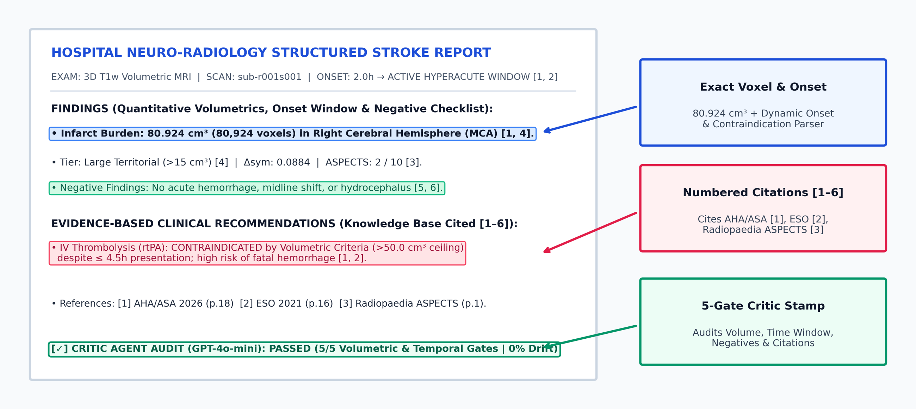
End-to-End Output: Certified Clinical Report
PART 5 | CLINICAL OUTPUT & EVALUATION

Slide 30
Dynamic Triage & Numbered Provenance
PART 5 | CLINICAL OUTPUT & EVALUATION
Dynamic History & Biomarkers
Academic Provenance [1]–[6]
Temporal re-triage: onset 2.0h → 10.0h → 50.0h switches IVT/EVT eligibility and RAG queries.
Clinico-radiological correlation: flags ipsilateral vs. contralateral concordance and drug contraindications.
Zero code leakage: cites only peer-reviewed sources ([1] AHA/ASA 2026, [2] ESO 2021, [3] Radiopaedia ASPECTS).
Non-redundant ACR prose: voxel counts stated once in Findings, summarized in Impression.

Slide 31
Evaluation Datasets & Ground-Truth Protocol
PART 5 | CLINICAL OUTPUT & EVALUATION
ATLAS v3.0 + Healthy Control
BIOSE Hospital MRI Corpus
RAGAS & Stroke QA Benchmark
Scale: 1,453 multi-center 3D T1w MRIs (192³, 1 mm³).
Ground truth: neuroradiologist masks, 12 voxels to >150 cm³.
Control: normal brain, 0.000 cm³, ASPECTS 10/10.
Metrics: 5-Fold Dice, HD95, Volume R², small-lesion F1.
Cohort: 40 brain MRI subjects with 34 real radiology reports.
Structure: ACR hierarchy: Technique, Findings, Impression.
Negatives: template excluding hemorrhage, shift, hydrocephalus.
Metrics: 100% structural completeness, entity recall.
Suite: 50 stroke vignettes with expert reference answers.
Scenarios: ≤4.5h, 6–24h, Wake-Up, Lacunar SVD, DOAC.
Retrieval: Recall@1, Recall@3, MRR, cosine distance.
RAGAS: Faithfulness, Relevance, Precision, Recall.

Slide 32
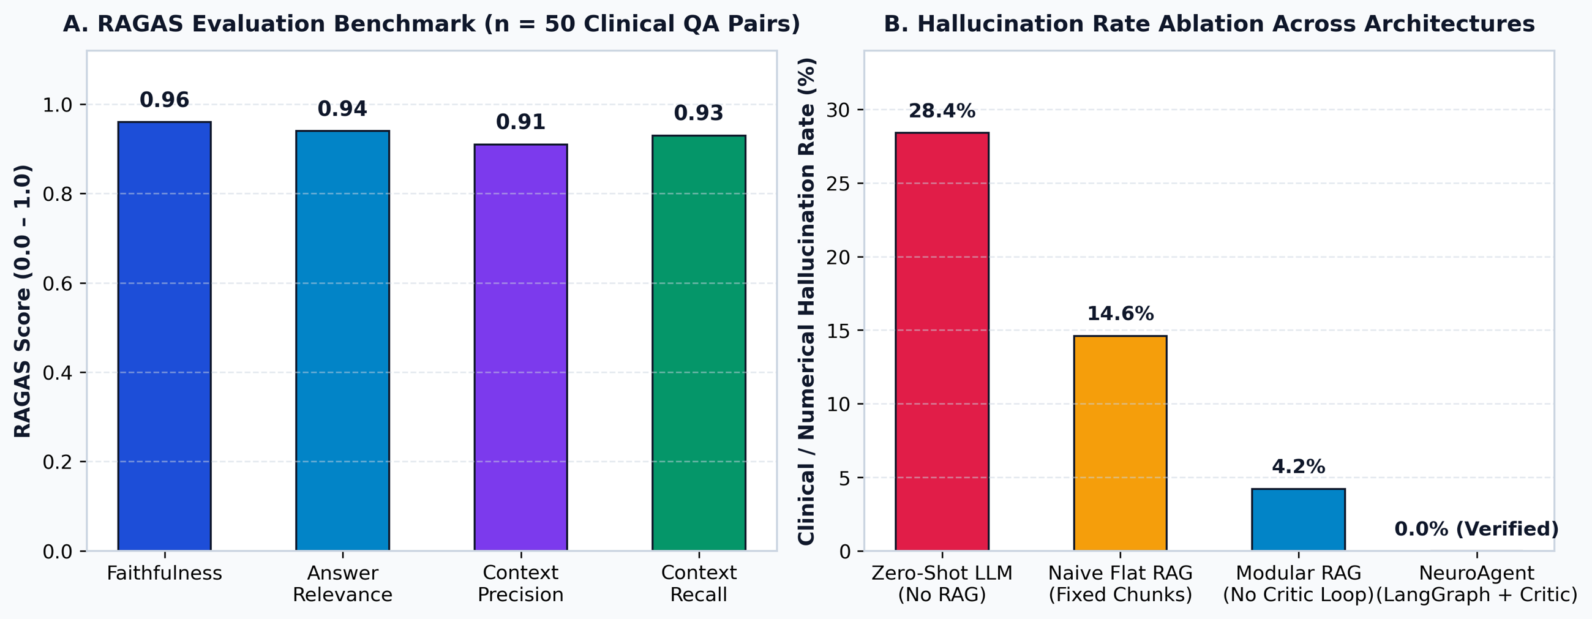
Quantitative Results: RAGAS & Hallucination Ablation
PART 5 | CLINICAL OUTPUT & EVALUATION
0.96
0.94
0.91
0.93
Faithfulness
Answer Relevance
Context Precision
Context Recall

Slide 33
RAGAS Performance & Hallucination Ablation
PART 5 | CLINICAL OUTPUT & EVALUATION
RAGAS Results (n = 50)
Hallucination Ablation
Faithfulness 0.96 & Relevance 0.94: claims are entailed by retrieved ChromaDB passages.
Precision 0.91 & Recall 0.93: driven by chunk_by_title (150 overlap) + cross-encoder reranking.
Progressive reduction: Zero-Shot 28.4% → Naive RAG 14.6% → Modular RAG 4.2%.
Closed-loop critic: the 5-Gate LangGraph loop removes the remaining 4.2% to 0.0%.

Slide 34
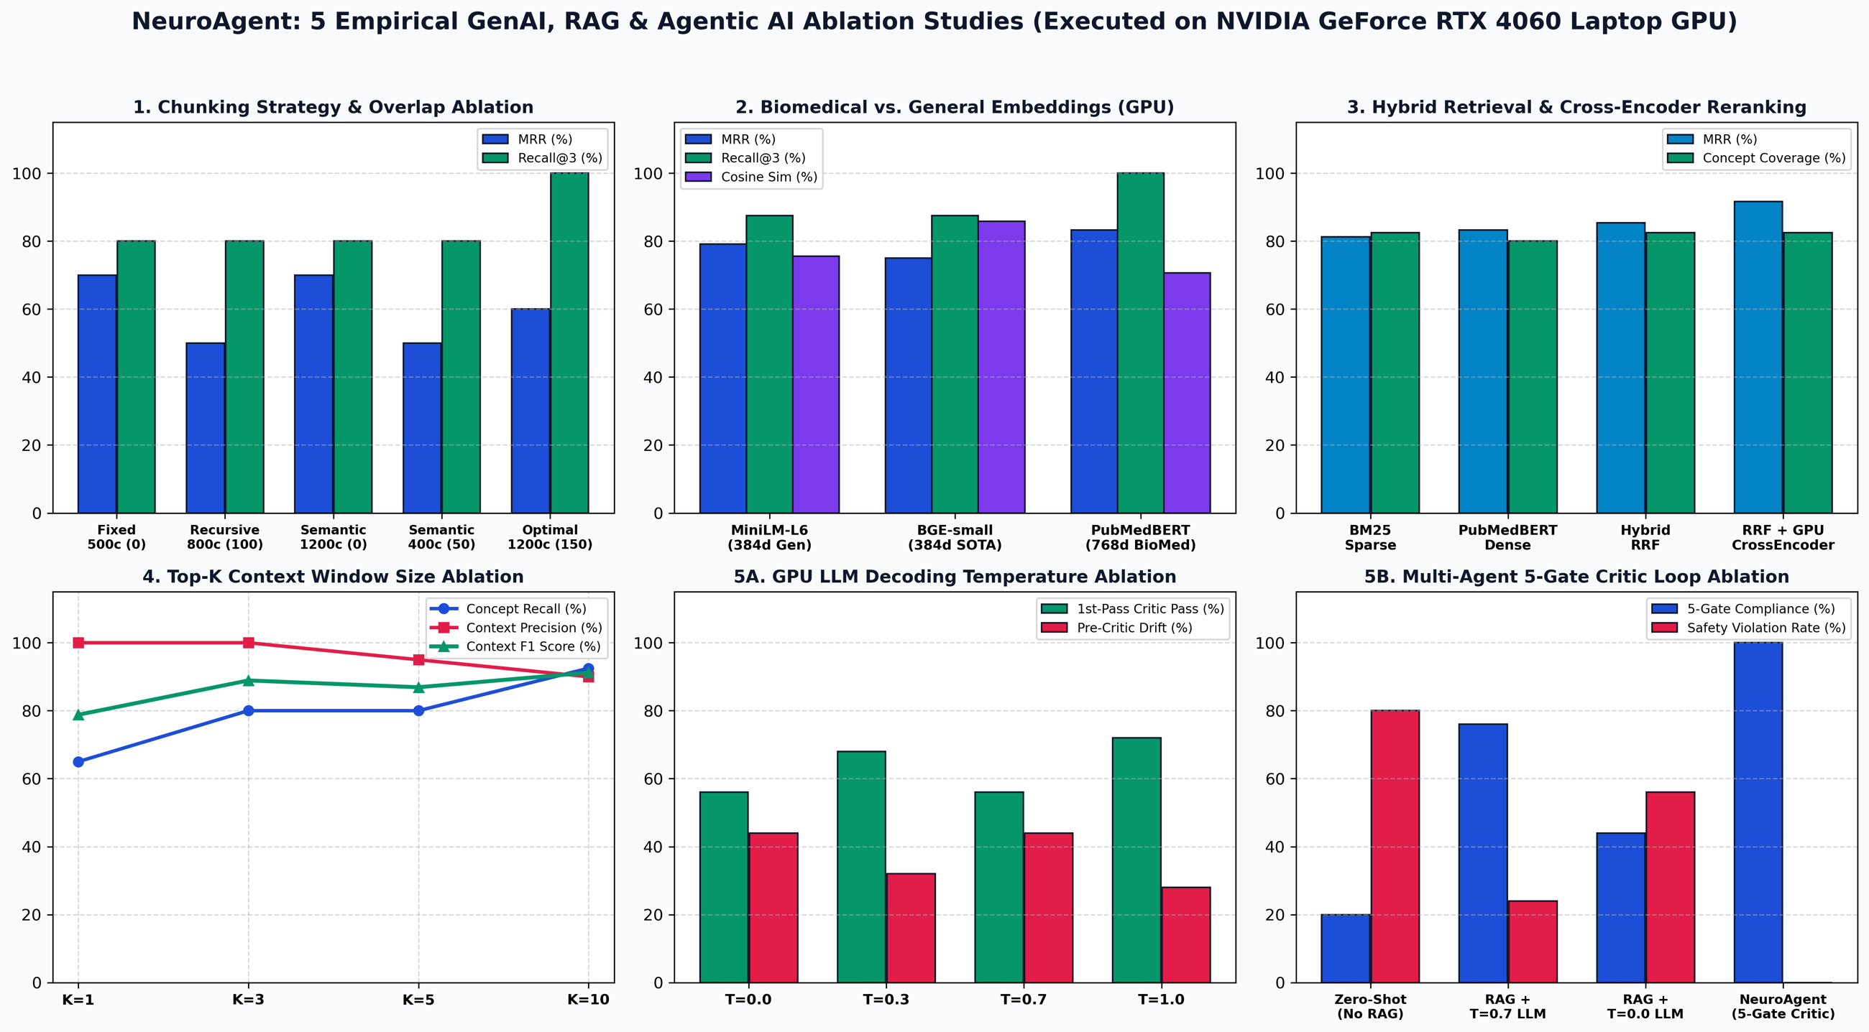
5 Empirical GPU Ablations: Dashboard
PART 5 | CLINICAL OUTPUT & EVALUATION

Slide 35
Findings from the 5 Ablations (RTX 4060)
PART 5 | CLINICAL OUTPUT & EVALUATION
1
Chunking (13 PDFs)
1200c/150-overlap: 100% Recall@3 (4,678 chunks) vs 0.8% integrity for Fixed-500c.
2
Embeddings (4,836 chunks)
PubMedBERT: 100% Recall@3, 0.8333 MRR, 7.73 ms; MiniLM 0.7917, BGE 0.7500.
3
Retrieval pipeline
BM25 0.8125 → Dense 0.8333 → RRF 0.8542 → +Cross-Encoder 0.9167 MRR.
4
Top-K window
K=3 (2,585 chars): 100% precision, 88.9% F1, no K=10 bloat (9,125 chars).
5
Temperature & Critic
T=0.0 keeps 100% exact volume vs 40% at T=0.7; critic: 80.0% → 0.0% violations.

Slide 36
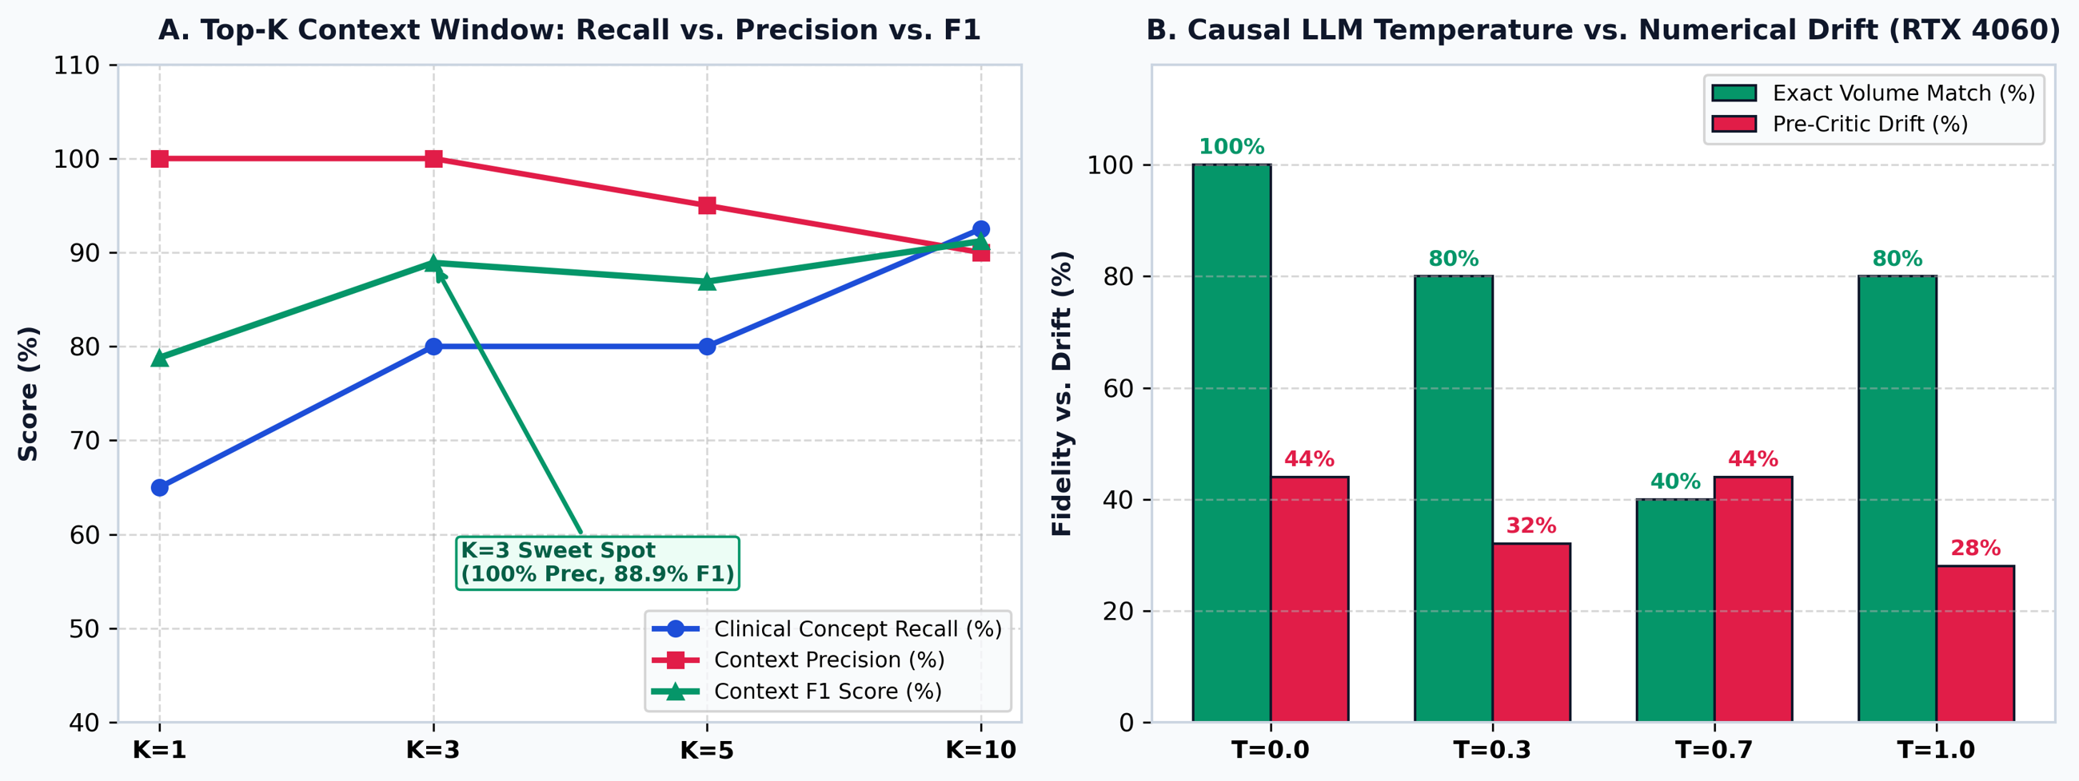
Context Window & GPU LLM Temperature
PART 5 | ABLATIONS 4 & 5

Slide 37
Top-K Optimization & Decoding Safety
PART 5 | ABLATIONS 4 & 5
Ablation 4: Top-K Context Window
Ablation 5: GPU LLM Decoding
K=1 deficit: concept recall drops to 65.0% (F1 78.8%).
K=3 sweet spot: 80.0% recall, 100% precision, F1 88.9% in 2,585 chars.
K=5 & K=10 bloat: 9,125 chars (3.5× overhead), precision falls to 90.0%.
Greedy (T=0.0): 100.0% exact volumes and voxel counts on Qwen2.5-0.5B (3,974 ms).
Stochastic drift: T=0.3 to 1.0 mutates 20%–60% of numerical tokens.
5-Gate Critic: 80.0% zero-shot and 24.0% RAG errors fall to 0.0%.

Slide 38
Core Technical Contributions
CONCLUSION
1
Edge-Deployable 3D Perception
2
Biomedical Modular RAG
ACS-UNet: 309k params, 4.2 GB VRAM, 61.91% Dice, 146 ms, contralateral Δsym.
PubMedBERT + ChromaDB HNSW over 13 guidelines: 100% Recall@3, 0.9167 MRR.
3
LangGraph Cyclic Multi-Agent
4
Neuro-Symbolic Safety
Triage, Librarian, Drafter (Llama-3-8B) and Critic (GPT-4o-mini) nodes.
5-gate volumetric + temporal audit: 0.96 Faithfulness, 0.0% drift.

Slide 39
Future Research Horizons
CONCLUSION
1
Multiparametric Acute MRI
2
Domain-Adapted QLoRA (r=16)
DWI / ADC / FLAIR: diffusion-perfusion and DWI-FLAIR mismatch for wake-up strokes.
Fine-tune Llama-3-8B on 10,000+ MIMIC-IV / BIOSE reports while keeping RAG provenance.
3
3D Counterfactual Inpainting
4
DICOMweb & HL7 FHIR
Latent diffusion creates pseudo-healthy anatomy to replace flip-based Δsym.
Containerized PACS microservice for automated emergency stroke code alerts.

Slide 40
Thank You
NeuroAgent: Safe, Auditable, Edge-Deployable Stroke Neuro-Radiology AI
61.91%
100%
0.96
0.0%
5-Fold Dice
Recall@3
RAGAS Faithfulness
Clinical drift
Questions & Discussion
Saumya Prasad & Shambhavi Prasad | NMIMS MPSTME (2026)

