Slide 1
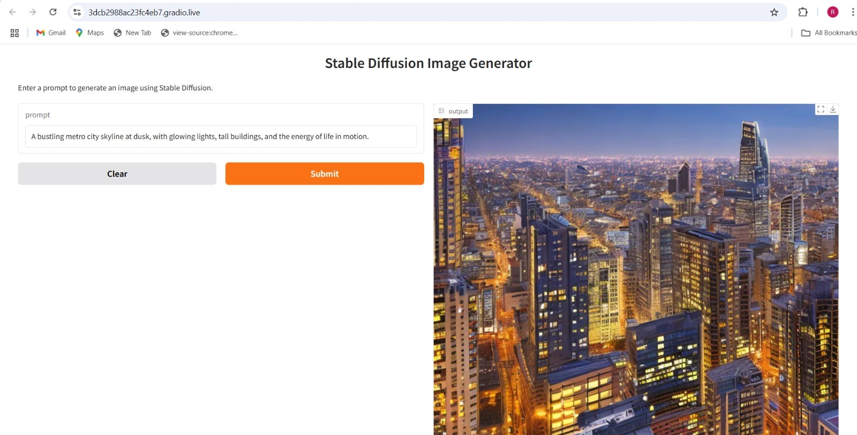
Title: Text-to-Image Generation Using Stable Diffusion (via Diffusers)

Slide 2
Introduction to Text-to-Image with Stable Diffusion
Objective: Generate images from textual descriptions using Stable Diffusion.
Technology Stack:
Stable Diffusion (latent diffusion model)
Hugging Face diffusers library
Supporting libraries: transformers, torch, PIL
Use Cases:
Creative design, game development, product visualization

Slide 3
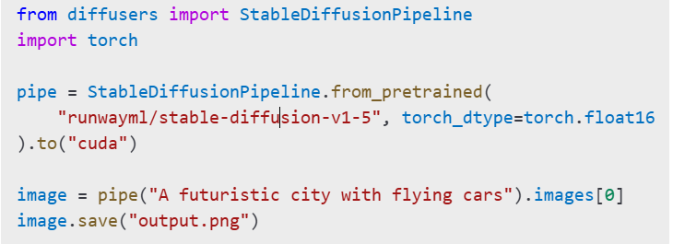
Tools and Architecture
Key Libraries:
diffusers: for running diffusion pipelines
torch: for GPU-accelerated operations
transformers, PIL: for text encoding and image processing
Code Snippet:

Slide 4
Parameters and Output Generation
Main Parameters:
prompt: the input text
guidance_scale: adjusts prompt adherence (e.g., 7.5–12)
num_inference_steps: controls detail (e.g., 25–50)
height, width: resolution of the image
Output:
Returns a PIL image
Can be visualized, saved, or integrated in applications

Slide 5

Optional UI and Extensions
Simple Gradio Interface:
Possible Enhancements:
Add style presets
Integrate with LORA or Dreambooth for personalization
Batch prompt support and automated post-processing

Slide 6
Student Name-Saumya yede
College Name- Sagar institute of research and technology bhopal
Contact-7693812554
Email-saumyayede05@gmail.com

