Slide 1

MANIPAL
UNIVERSITY
School of Computer Science and Engineering
Department of Computer Science and Engineering
MediTrack: An Intelligent Patient Health Monitoring and Symptom Analysis System using NLP and ML
Submitted By:
Saumya Tandon
Supervised By: Mr. Abhay Singh Bisht
Reg No.: 2427030368

Slide 2
Outline
Introduction
Literature Review
Problem Statement
Proposed Solution
Objectives
References

Slide 3
Introduction
Modern healthcare faces challenges in continuous patient monitoring and accurate symptom reporting.
Patients struggle to describe symptoms clearly, while doctors face fragmented historical data.
Manual tracking is inefficient and lacks intelligent trend analysis.
MediTrack leverages NLP and ML to understand patient symptoms and predict health risks.

Slide 4
Introduction (continued)
MediTrack bridges communication gaps between patients and healthcare providers.
Understands natural language symptom descriptions.
Learns health patterns to predict risks and trends.
Provides real-time insights via a dashboard.
Impact: Preventive healthcare through explainable AI.

Slide 5
Literature Review
Existing Symptom Checkers:
WebMD: Rule-based, limited personalization.
Ada Health: Context-aware but lacks historical learning.
Gap: No systems adapt to individual longitudinal data.
Patient History Systems:
EHRs store data but lack predictive analysis.
Traditional ML models are disease-specific and non-adaptive.

Slide 6
Literature Review (continued)
NLP in Medical Domain:
ClinicalBERT enables contextual medical understanding.
NER extracts symptoms and entities.
Challenge: Translating layman terms to medical terminology.
Contribution: Integrates NLP and ML for personalized trend prediction.

Slide 7
Problem Statement
Patients and healthcare providers lack an integrated system that can understand natural language symptom descriptions while learning from patient history to provide personalized health insights and early risk detection.

Slide 8
Proposed Solution
Step 1: Data Collection – Gather symptom and history data.
Step 2: NLP Module – Extract and classify symptoms (spaCy/ClinicalBERT).
Step 3: ML Module – Predict trends and risks.
Step 4: Output Layer – Dashboards with insights and alerts.
Step 5: Continuous Learning – Refine using feedback.

Slide 9
Prototype Design & Planned Implementation
Prototype Design (Current Phase):
• Conceptual system architecture finalized
• Data flow between NLP, ML, and database defined
• Patient symptom input → analysis → insight pipeline planned
• Longitudinal patient history storage designed
• Dashboard interaction flow conceptualized
Planned Implementation:
• NLP using spaCy and ClinicalBERT
• ML models for health trend and risk analysis
• Backend APIs using FastAPI
• Web-based dashboard for visualization

Slide 10
Current Implementation (Prototype)
• Implemented a Machine Learning model using Logistic Regression
• Dataset: Symptom-based structured dataset
• Symptoms converted into binary feature representation
• Train-test split used (70% training, 30% testing)
• Model trained using Scikit-learn
• This forms the core prediction engine of the system

Slide 11
Machine Learning Pipeline
1. Load dataset (data.csv)
2. Data preprocessing (handle missing values)
3. Feature extraction (symptoms → numerical format)
4. Train-test split
5. Train Logistic Regression model
6. Make predictions
7. Evaluate using:
• Accuracy
• Confusion Matrix

Slide 12
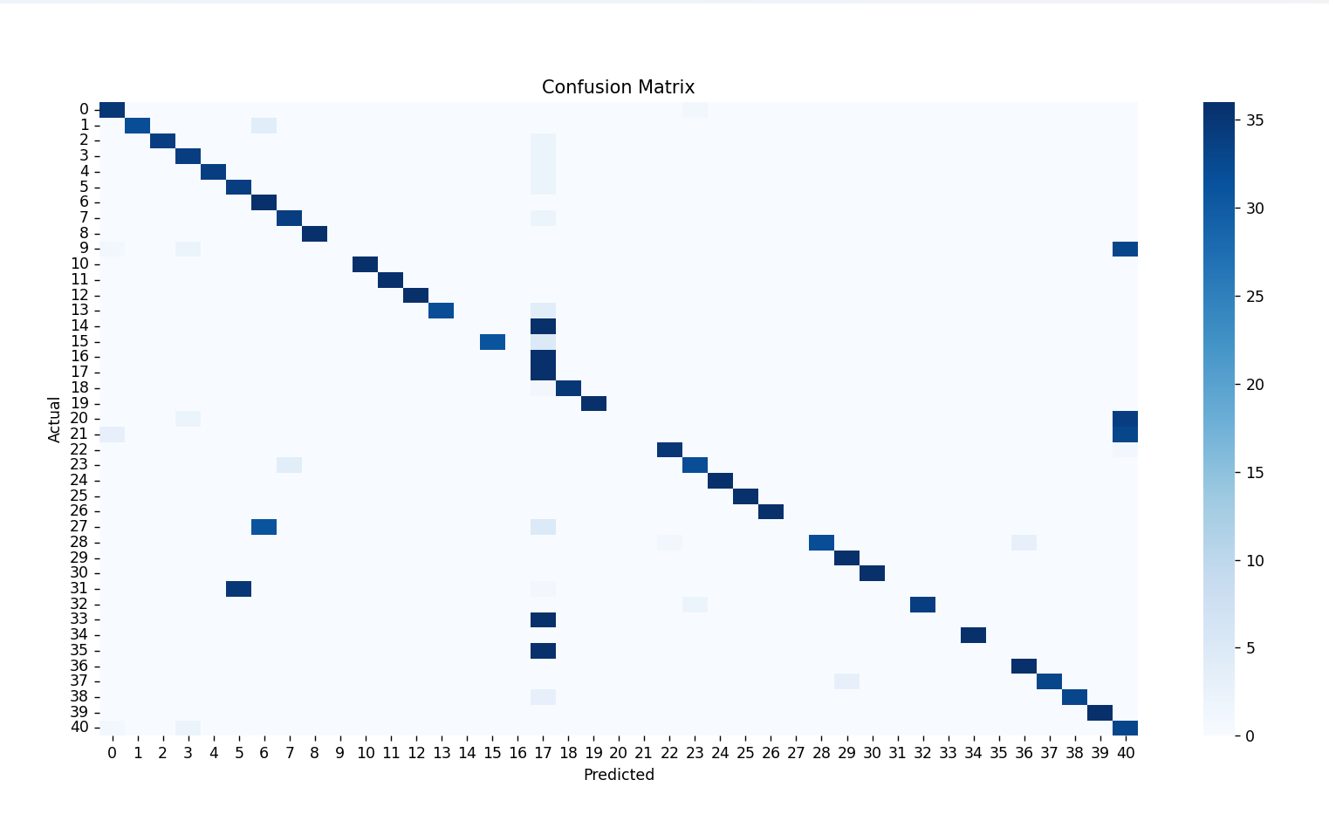
CONFUSION MATRIX

Slide 13
Technologies Used
• Python
• Pandas
• Scikit-learn
• Matplotlib / Seaborn
• NLP (Future Work):
• spaCy
• ClinicalBERT

Slide 14
Results
• Model Accuracy: ~62%
• Confusion Matrix used for performance evaluation
• Shows actual vs predicted classifications
• Model performs reasonably well for prototype-level implementation
• Can be improved with larger dataset and advanced models

Slide 15
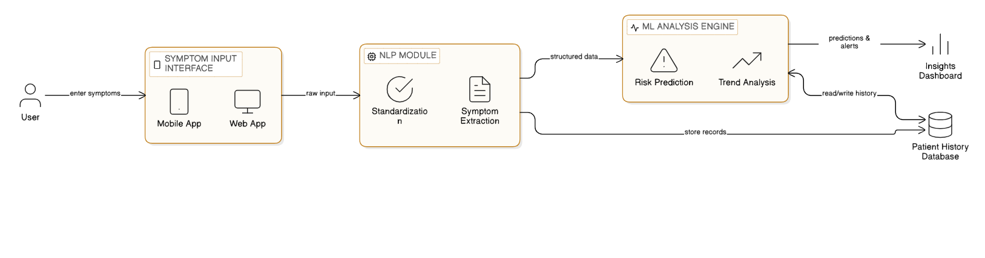
Proposed System Architecture : Input and Processing

Slide 16
Proposed System Architecture: Analysis and Storage

Slide 17
Objectives
Develop an NLP pipeline for symptom understanding.
Build ML models to detect anomalies and predict health risks.
Correlate real-time and historical data for personalized insights.
Design dashboards for patients and healthcare providers.

Slide 18
References
1. ClinicalBERT: Modeling Clinical Notes and Predicting Hospital Readmission - Huang et al.
https://arxiv.org/abs/1904.05342
2. A Review of NLP in Medical Applications – Journal of Biomedical Informatics.
https://www.nature.com/articles/s41746-022-00730-6
3. Machine Learning for Patient Risk Stratification – Nature Medicine.
https://pmc.ncbi.nlm.nih.gov/articles/PMC3540429/
4. SNOMED CT Terminology Standards.
https://www.snomed.org/
5. MIMIC-III Clinical Database Papers.
https://pmc.ncbi.nlm.nih.gov/articles/PMC4878278/

Slide 19
Thank You

